Slide 1

SHORT-TERM INDOOR PARTICULATE MATTER vs. OUTDOOR ATMOSPHERIC CONDITIONS
Zvjezdana Bencetić Klaić and Sarah Ollier
Department of Geophysics, Faculty of Science, University of Zagreb, Zagreb, Croatia
zklaic@gfz.hr, Sarah.Ollier@clearltd.com
3rd International Conference on
Biodiversity & Sustainable Energy Development
June 24-26, 2014 Valencia Conference Centre, Spain

Slide 2
OUTLINE
WHAT IS ATMOSPHERIC PM AND WHY IT IS IMPORTANT?
SOURCES OF PM
INDOOR PM EXPERIMENT
CONCLUSIONS
3rd International Conference on
Biodiversity & Sustainable Energy Development
June 24-26, 2014 Valencia Conference Centre, Spain

Slide 3
WHAT IS PM?
Airborne particulate matter (PM) - dust, dirt, soot, smoke, and liquid droplets suspended in the atmosphere
Particles
Formation processes
&
Subsequent reactions in the atmosphere
Sizes
Other physical properties
Chemical properties
3rd International Conference on
Biodiversity & Sustainable Energy Development
June 24-26, 2014 Valencia Conference Centre, Spain

Slide 4
WHAT IS PM?
Particles
Formation processes
&
Subsequent reactions in the atmosphere
Sizes
~ few nm - ≈ 100 μm
(the size of (small
molecular) enough)
clusters)
3rd International Conference on
Biodiversity & Sustainable Energy Development
June 24-26, 2014 Valencia Conference Centre, Spain

Slide 5
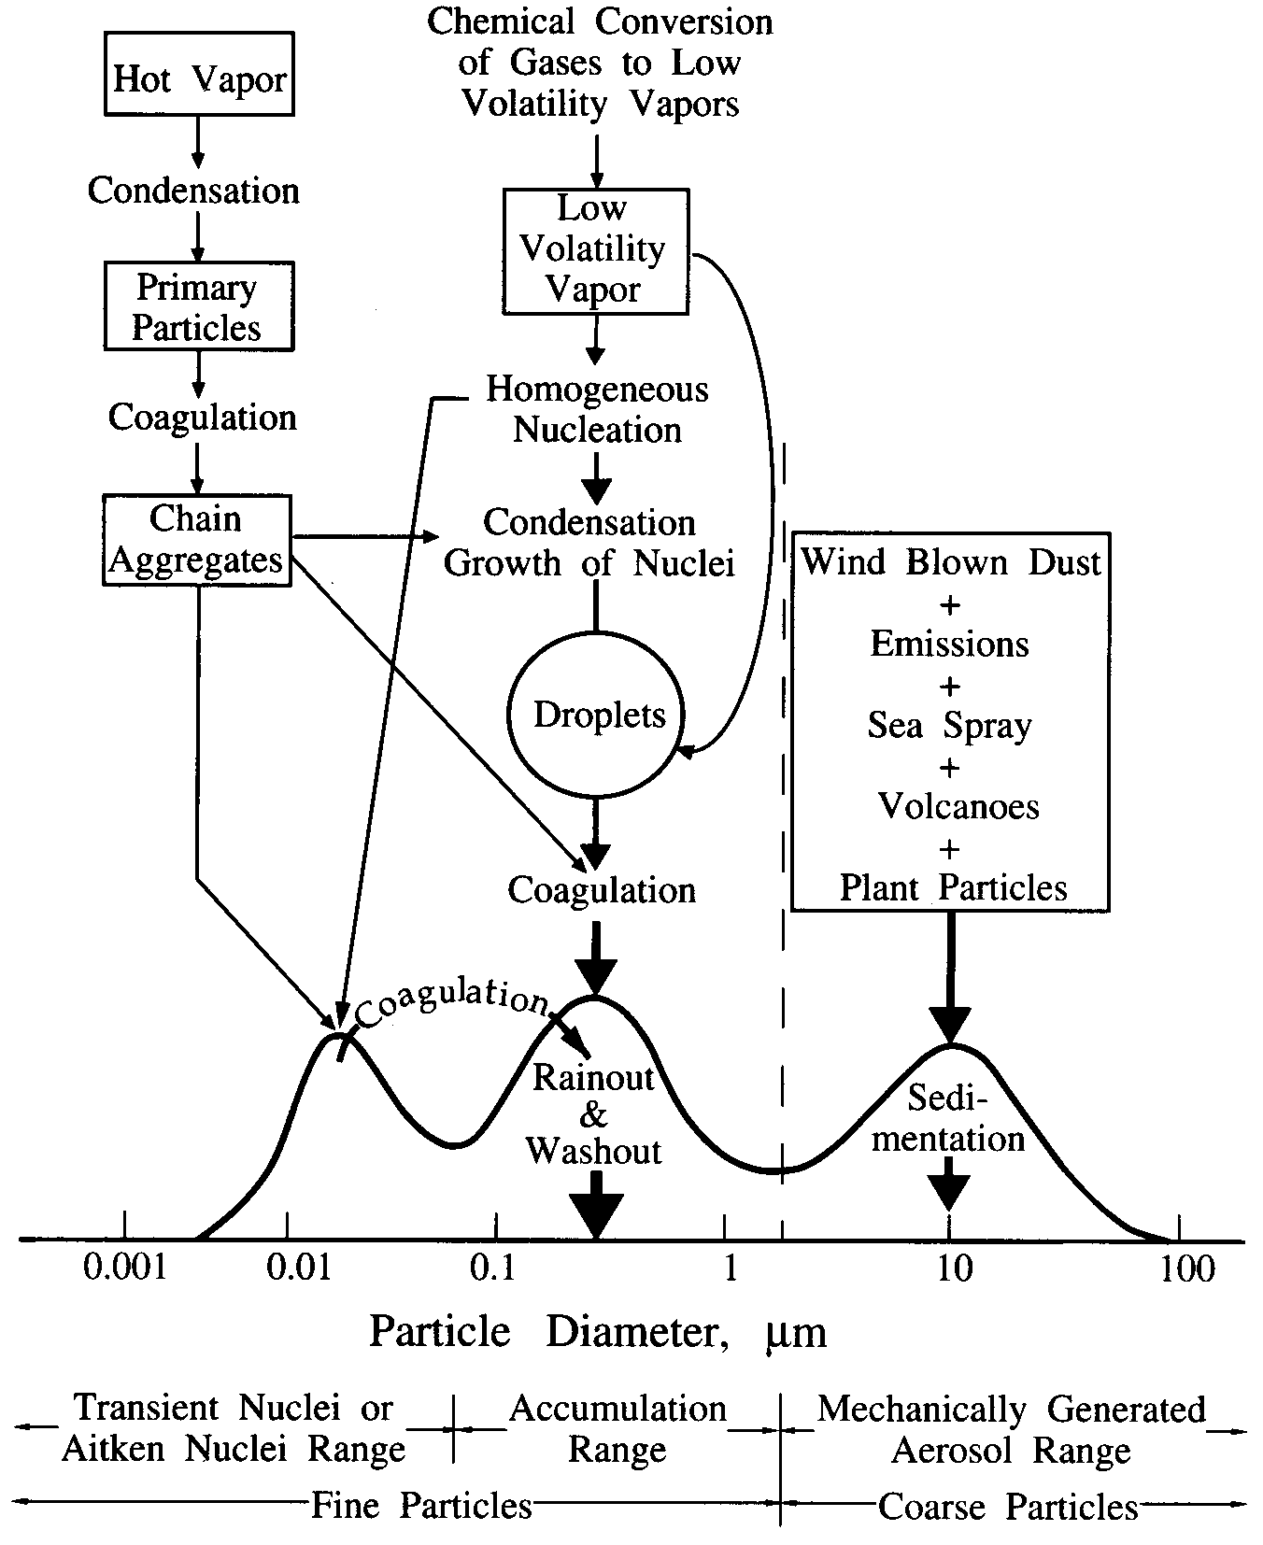
Mass distribution
(Whitby, 1978)
3rd International Conference on
Biodiversity & Sustainable Energy Development
June 24-26, 2014 Valencia Conference Centre, Spain

Slide 6
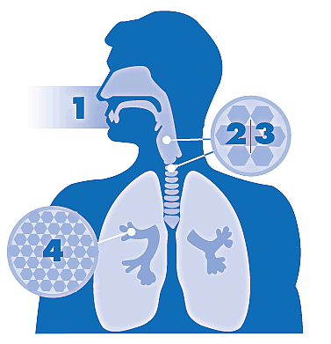
WHY IT IS IMPORTANT?
PM enters respiratory system through the nose and throat.
The larger PM (> PM₁₀) is eliminated thorugh coughing, sneezing and swallowing
HUMAN HEALTH
PM₁₀ - PM_{2.5} remain in the upper parts of respiratory system
http://www.env.gov.bc.ca/epd/bcairquality/health/air-quality-and-health.html
PM_{2.5} can penetrate deep into the lungs. It can enter alveoli, causing lung and heart problems, an delivering harmful chemicals to the blood system.

Slide 7
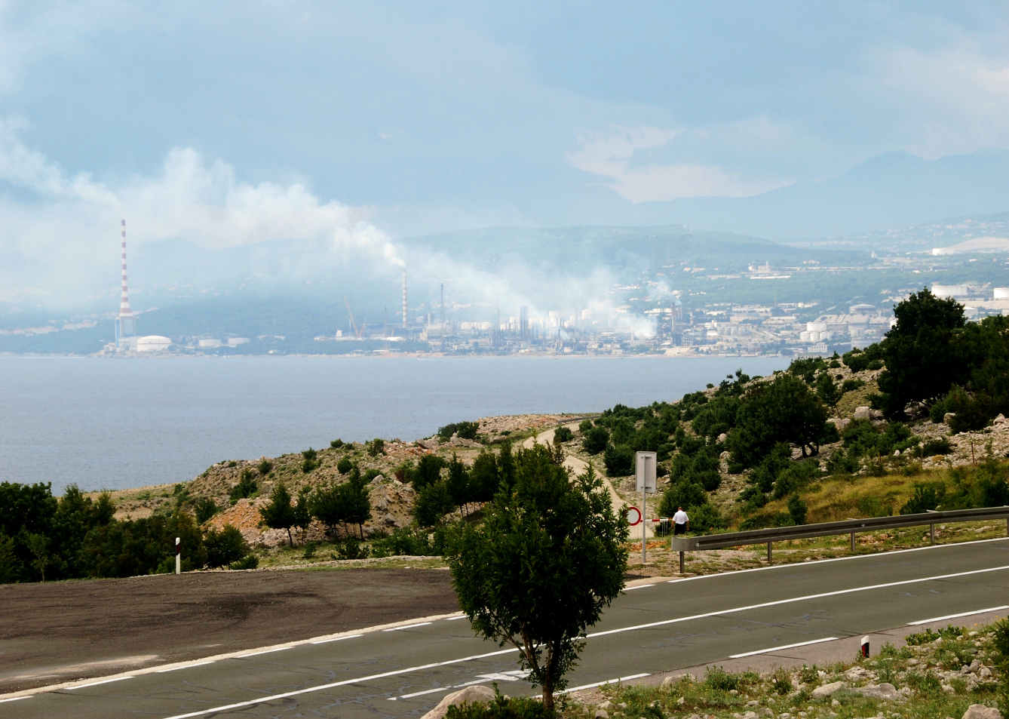
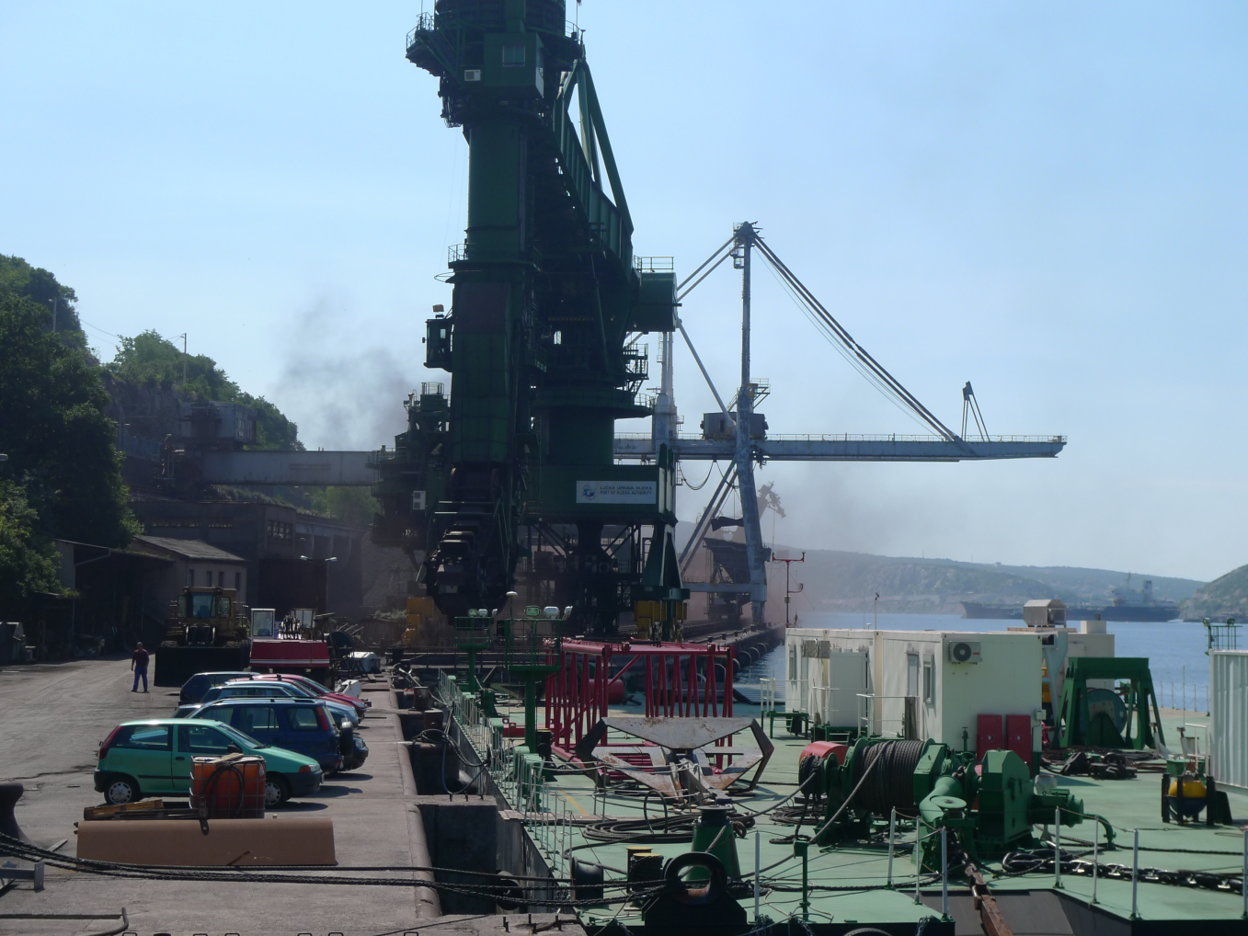
WHY IT IS IMPORTANT?
VISIBILITY
Industrial zone of Rijeka, Croatia, 2 May 2011
Bakar, Croatia, 27 May 2011
3rd International Conference on
Biodiversity & Sustainable Energy Development
June 24-26, 2014 Valencia Conference Centre, Spain

Slide 8
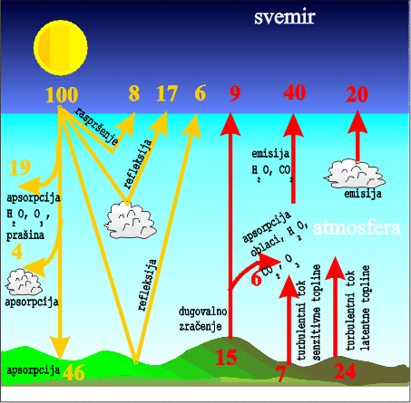
WHY IT IS IMPORTANT?
Mean global energy balance
Radiation & absorption
CLIMATE
3rd International Conference on
Biodiversity & Sustainable Energy Development
June 24-26, 2014 Valencia Conference Centre, Spain

Slide 9
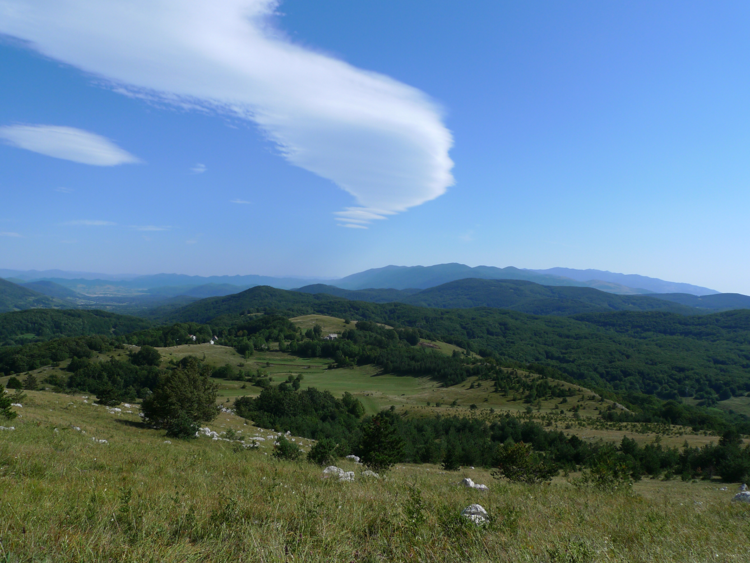

WHY IT IS IMPORTANT?
Cloud formation
CLIMATE
3rd International Conference on
Biodiversity & Sustainable Energy Development
June 24-26, 2014 Valencia Conference Centre, Spain

Slide 10
SOURCES OF PM
Natural
Anthropogenic
3rd International Conference on
Biodiversity & Sustainable Energy Development
June 24-26, 2014 Valencia Conference Centre, Spain

Slide 11
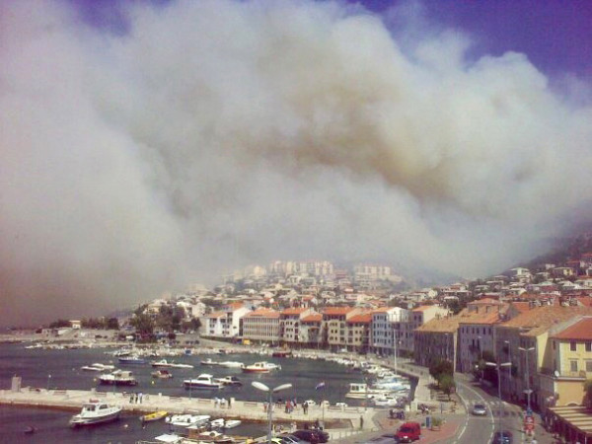
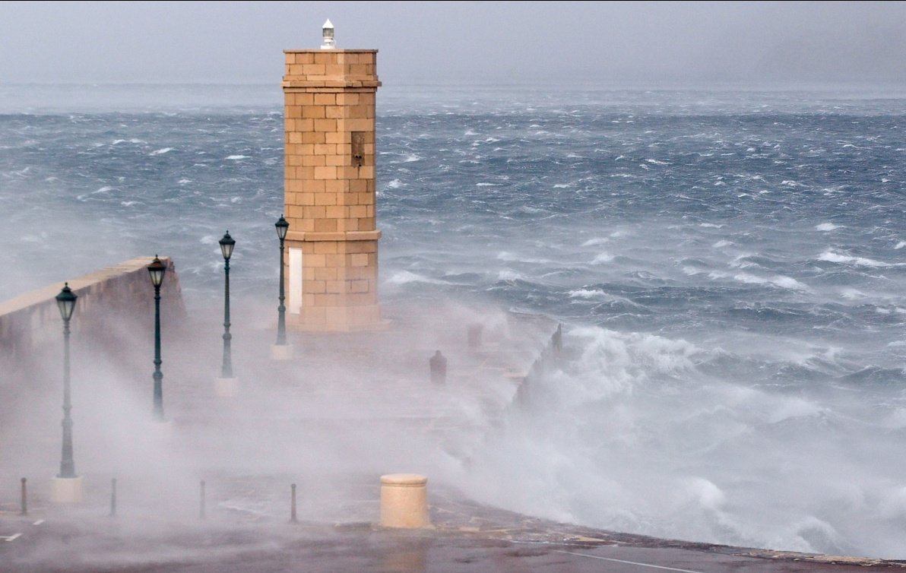
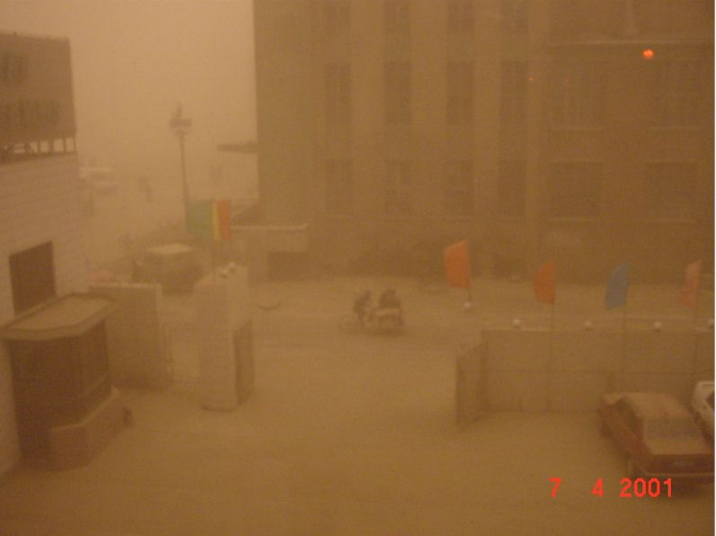
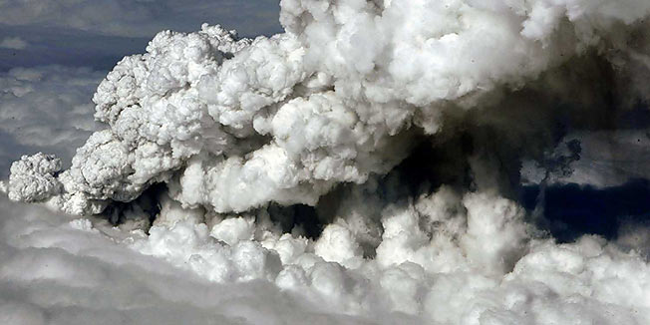

SOURCES OF PM
Forest fires
(e.g., Senj, Croatia, 30 August 2009)
Sea spray
(e.g., bora wind in Senj
17 November 2007)
Dust storms
(e.g., Beijing)
Vegetation
Natural
Volcanoes
(e.g., Eyjafjallajokull 14 April 2010)
3rd International Conference on
Biodiversity & Sustainable Energy Development
June 24-26, 2014 Valencia Conference Centre, Spain

Slide 12
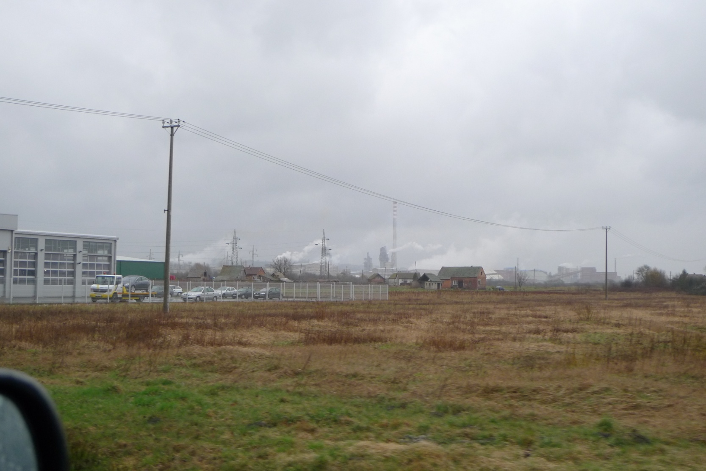
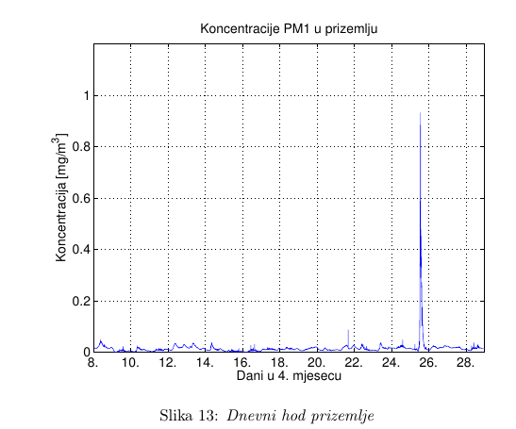
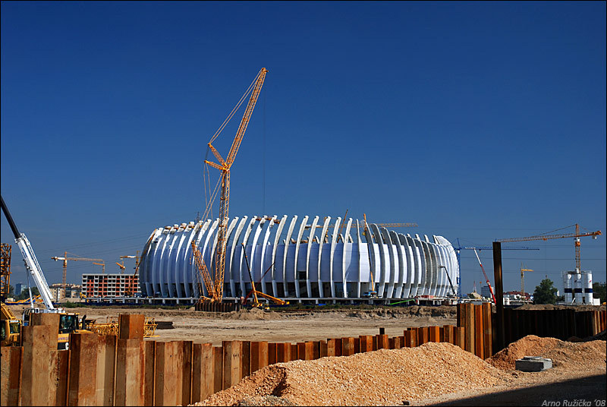
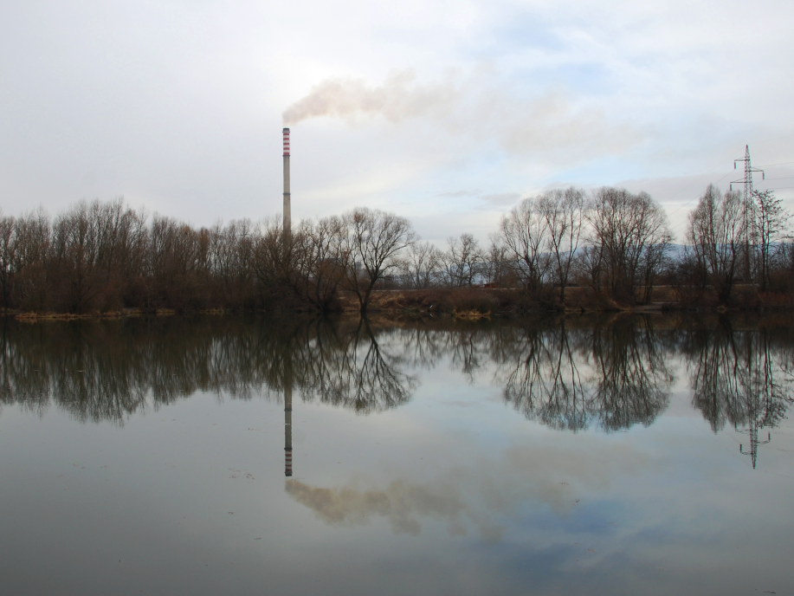
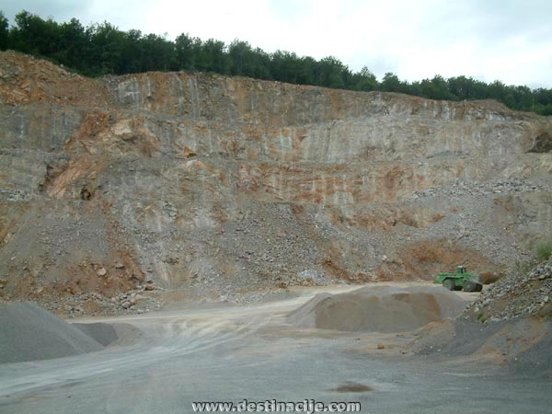
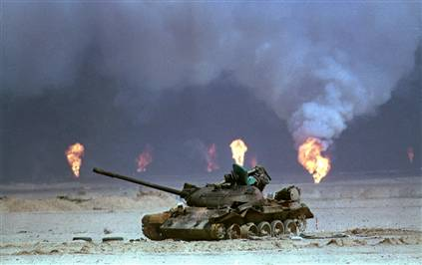
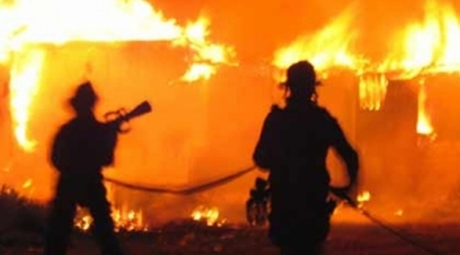
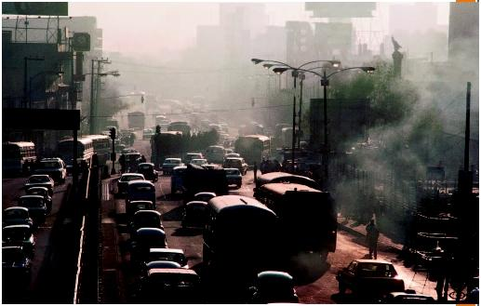
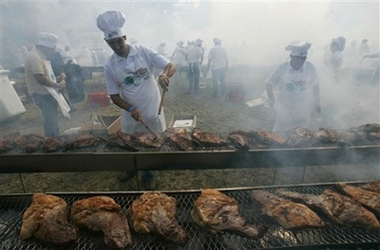
SOURCES OF PM
Industry
(Petrochemical industry, Kutina, Croatia)
Construction works
(Arena, Zagreb, Croatia)
Indoor PM1 mass concentration
Power plants
(e.g., Savica, Zagreb, Croatia)
Stonepits, surface mines (e.g., Tounj, Croatia)
Traffic (land, air & sea)
(Mexico City)
Various accidents
(e.g., fire in the Solaris Yacht Marina, Croatia, 3. April 2010)
War activities
(Gulf War)
Barbeque in front of the building
Anthropogenic
PM1
gradnja
(izgradnja Arene)
3rd International Conference on
Biodiversity & Sustainable Energy Development
June 24-26, 2014 Valencia Conference Centre, Spain
Cooking, particularly frying and barbeque
Day, April 2014

Slide 13
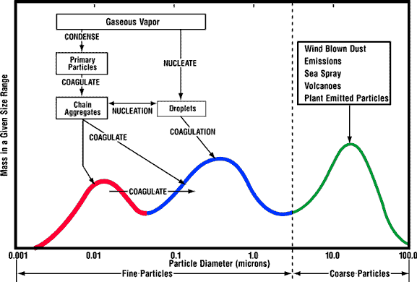
Numerous sources
Chemical & physical complexity
Coarse mode (mainly natural) – crustal materials, sea salt, plant emitted particles)
Fe, Ca, Si, Na, Cl
Al
Accumulation mode (mainly anthropogenic)
SO₄²⁻, NH₄⁺ , NO₃⁻ ,
Pb, C
Nuclei mode
(mainly anthropogenic
– traffic emissions)
3rd International Conference on
Biodiversity & Sustainable Energy Development
June 24-26, 2014 Valencia Conference Centre, Spain

Slide 14
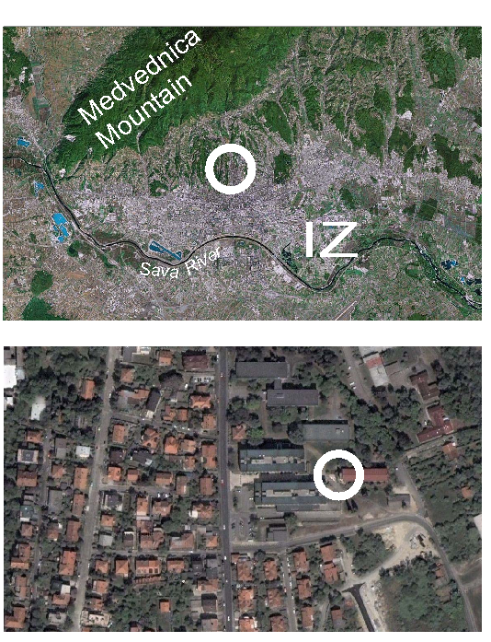
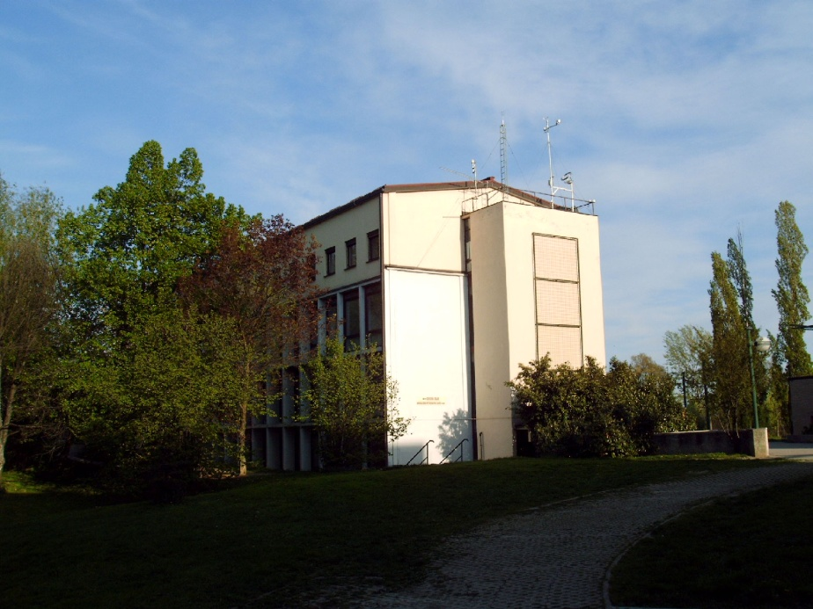
INDOOR PM EXPERIMENT
12 November 2012 – 26 April 2013
Total of 229586 1-min mean data per each measured variable
8 – 9 km
1.5 km
Meteorological data
3rd International Conference on
Biodiversity & Sustainable Energy Development
June 24-26, 2014 Valencia Conference Centre, Spain
Climate Change, Human Health and National Security
NATO Advanced Research Workshop, 28 - 30 April 2011, Dubrovnik, Croatia

Slide 15
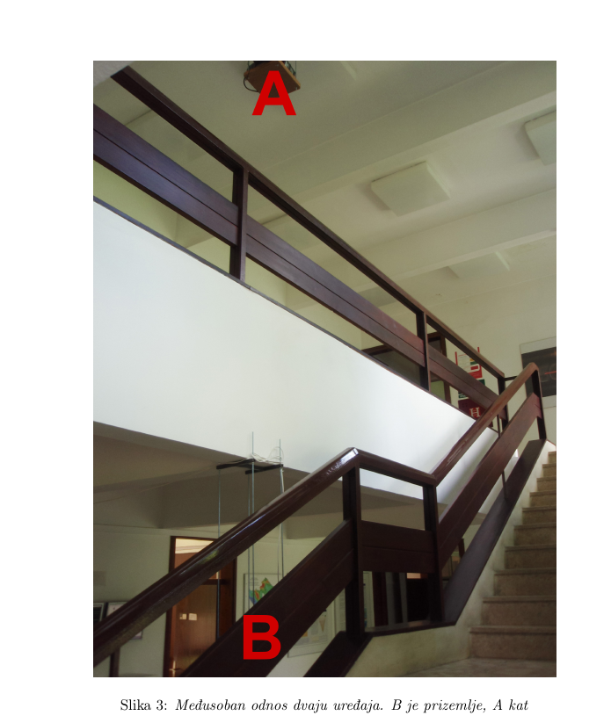
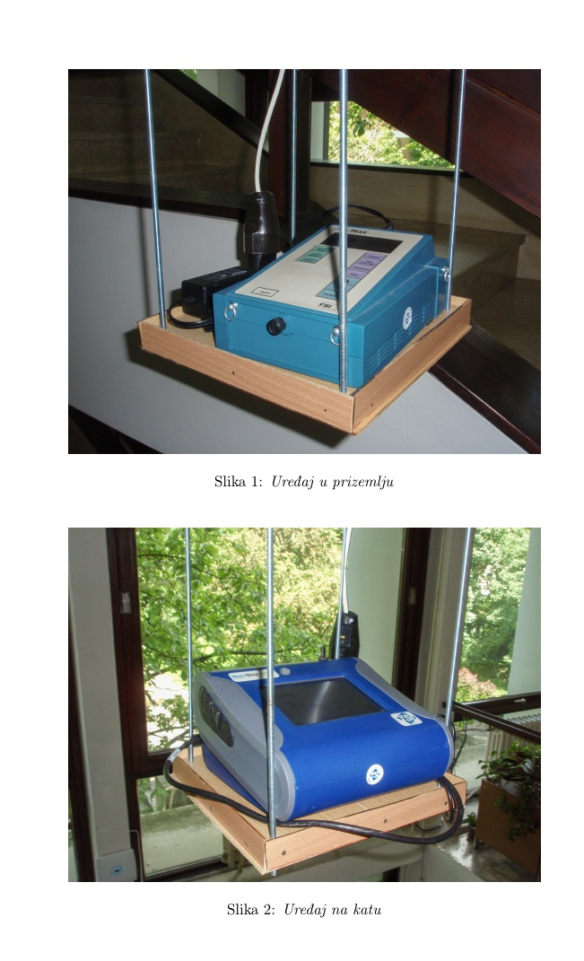
DustTrakTM Aerosol Monitor TSI, Inc., Shoreview, MN, USA
1-min mean mass concentrations at 1.7 m AGL
A - Model 8533:
PM1, PM2.5, PM4, PM10, TSP
B - Model 8520:
PM1

Slide 16
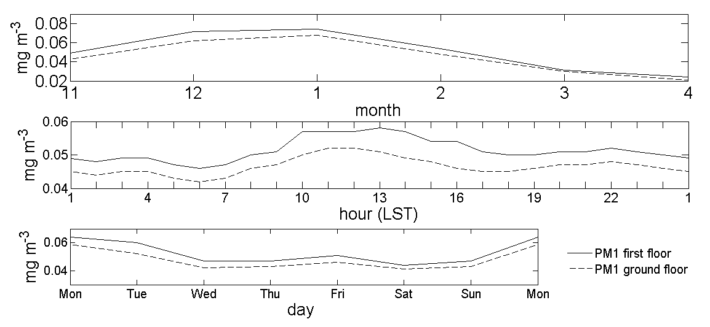
RESULTS (PM1)
Temporal variations

Slide 17
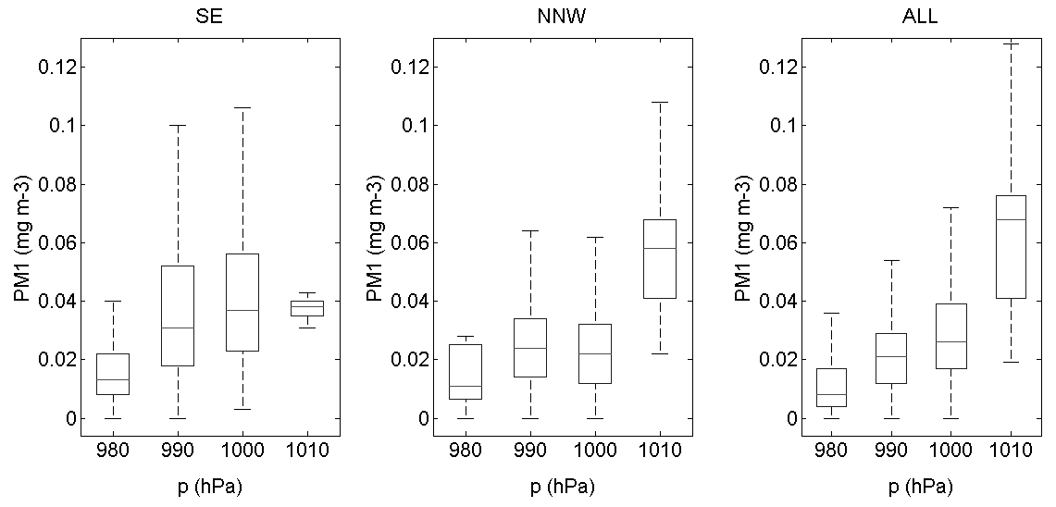
PM1 vs. meteorology
Box-plot
≤ P75 +1.5 * IR
75th percentile (P75)
Interquartile range (IR)
Median (M)
25th percentile (P25)
≥ P25 -1.5 * IR

Slide 18
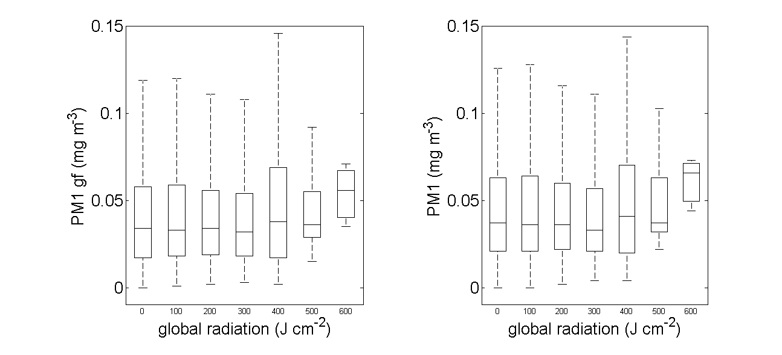
Global radiation
Ground floor
First floor
3rd International Conference on
Biodiversity & Sustainable Energy Development
June 24-26, 2014 Valencia Conference Centre, Spain

Slide 19
Precipitation
Ground floor
First floor
3rd International Conference on
Biodiversity & Sustainable Energy Development
June 24-26, 2014 Valencia Conference Centre, Spain

Slide 20
Air pressure
Ground floor
First floor
3rd International Conference on
Biodiversity & Sustainable Energy Development
June 24-26, 2014 Valencia Conference Centre, Spain

Slide 21
Relative humidity
Ground floor
First floor
3rd International Conference on
Biodiversity & Sustainable Energy Development
June 24-26, 2014 Valencia Conference Centre, Spain

Slide 22
Air temperature
Ground floor
First floor
3rd International Conference on
Biodiversity & Sustainable Energy Development
June 24-26, 2014 Valencia Conference Centre, Spain

Slide 23
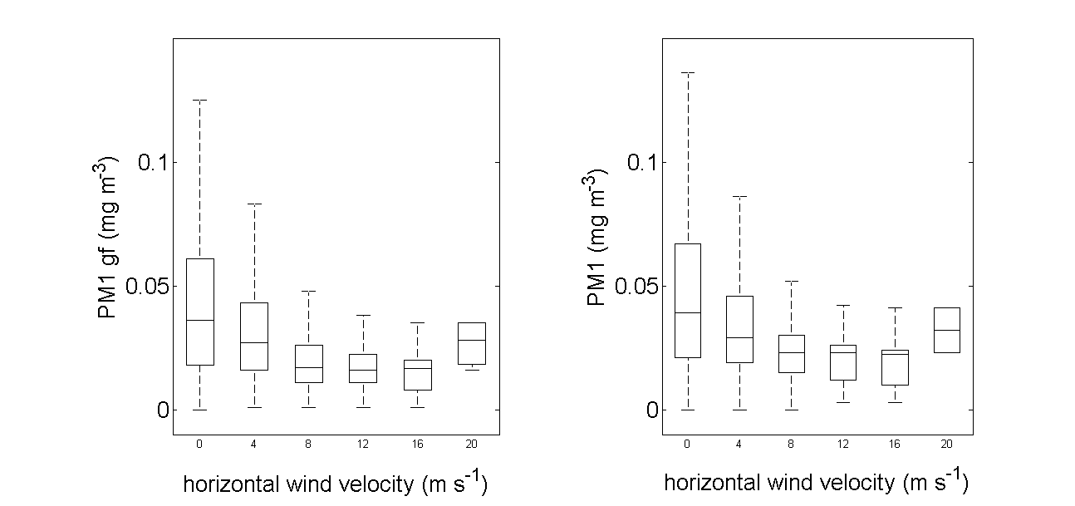
Only 6 out of the total 229586 wind data were associated with horizontal wind speeds above 16 m s⁻¹
Horizontal wind velocity
Ground floor
First floor
3rd International Conference on
Biodiversity & Sustainable Energy Development
June 24-26, 2014 Valencia Conference Centre, Spain

Slide 24
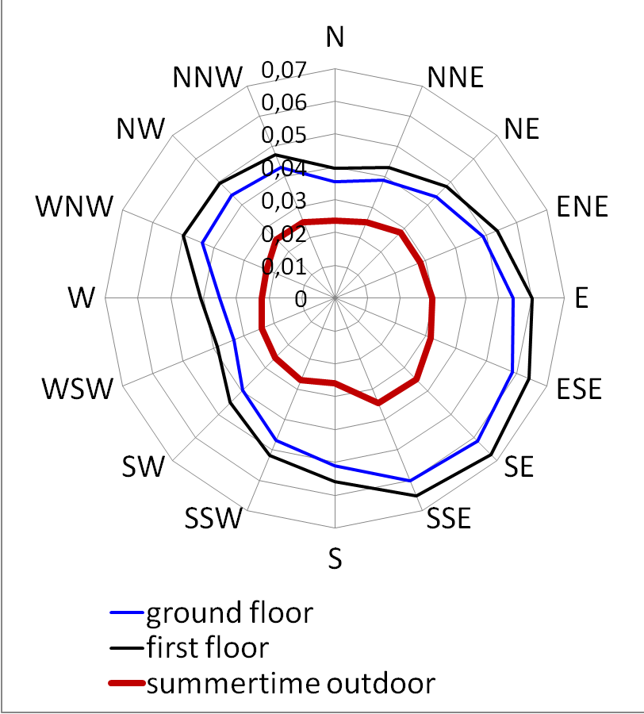
Wind direction
3rd International Conference on
Biodiversity & Sustainable Energy Development
June 24-26, 2014 Valencia Conference Centre, Spain

Slide 25
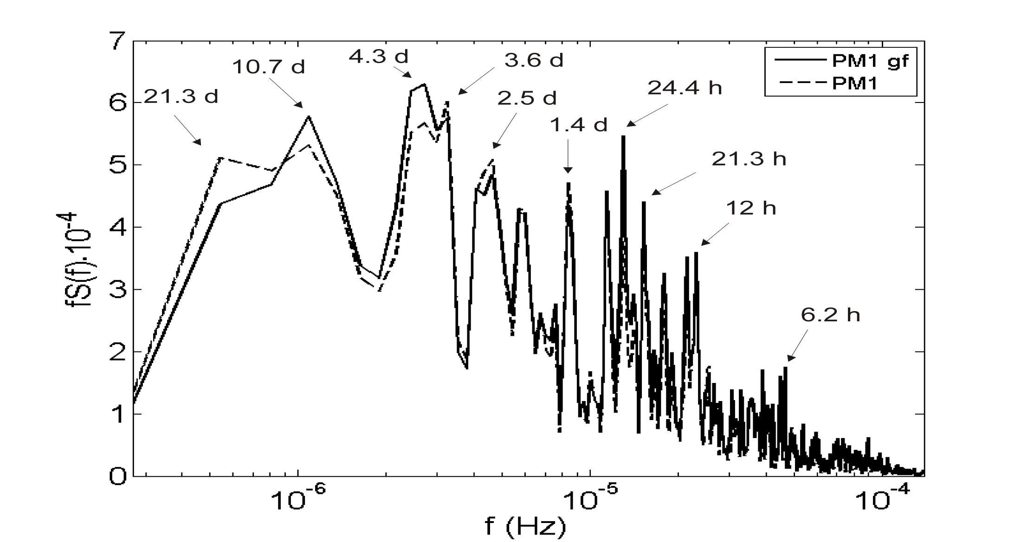
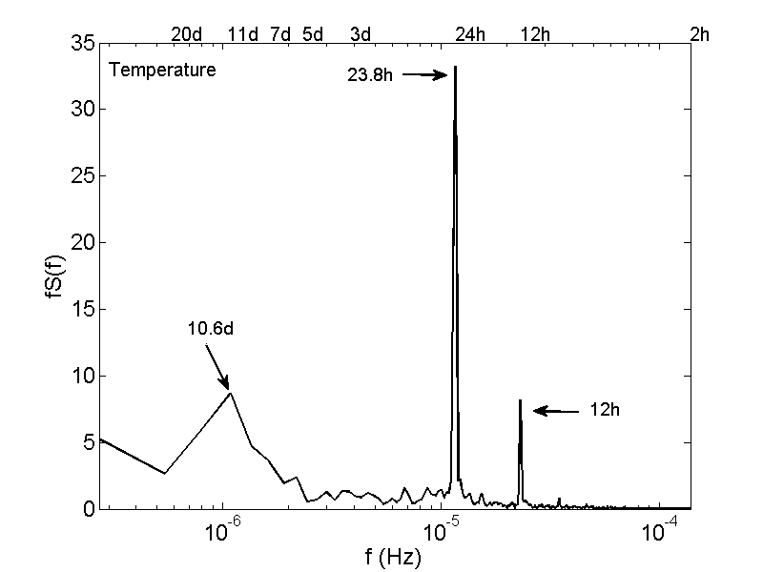
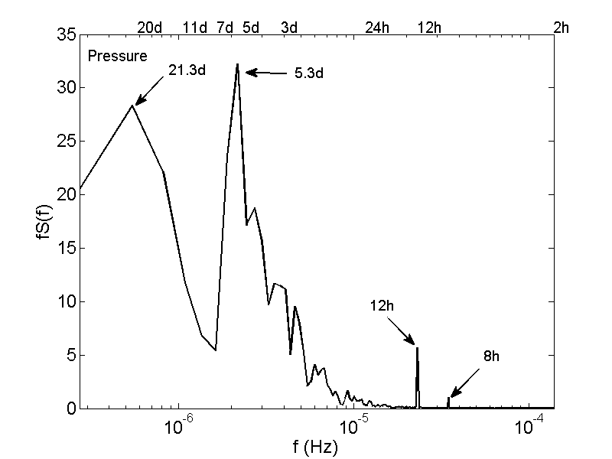
Spectra
cyclones
long-term periodicity
≈ diurnal
semidiurnal

Slide 26
CONCLUSIONS
Wintertime indoor PM levels depend on the outdoor meteorological conditions
[PM] increases with relative humidity, global radiation, and air pressure
[PM] decreases with outdoor temperature, precipitation amount, and horizontal wind velocity
⇒ Indoor [PM] depends on the wind direction → signature of 8 – 9 km distant industrial zone
3rd International Conference on
Biodiversity & Sustainable Energy Development
June 24-26, 2014 Valencia Conference Centre, Spain

Slide 27
CONCLUSIONS
ground floor ≠ 1st floor
(outdoor air vs. resuspension)
⇒ Expected 7-day periodicity (Mon & Sat) seen in simple statistics, but not confirmed by spectra
⇒ Periodicity of [PM] and meteorological variables: semidiurnal, diurnal, and long-term (≈ 11 and 21 days)
⇒ Long-term periodicity & Rossby waves?
⇒ PM spectra more complex than meteorological spectra
3rd International Conference on
Biodiversity & Sustainable Energy Development
June 24-26, 2014 Valencia Conference Centre, Spain

Slide 28
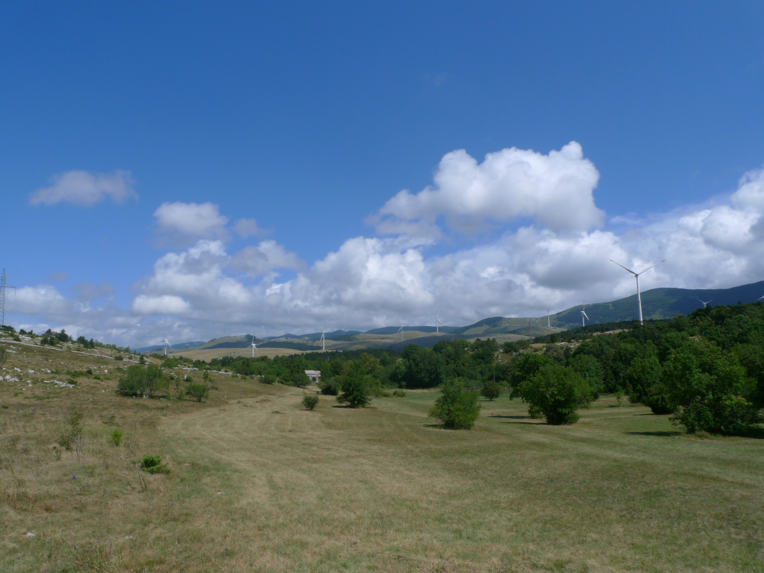
GRACIAS
3rd International Conference on
Biodiversity & Sustainable Energy Development
June 24-26, 2014 Valencia Conference Centre, Spain

