Slide 1
About OMICS Group
OMICS Group is an amalgamation of Open Access publications and worldwide international science conferences and events. Established in the year 2007 with the sole aim of making the information on Sciences and technology ‘Open Access’, OMICS Group publishes 500 online open access scholarly journals in all aspects of Science, Engineering, Management and Technology journals. OMICS Group has been instrumental in taking the knowledge on Science & technology to the doorsteps of ordinary men and women. Research Scholars, Students, Libraries, Educational Institutions, Research centers and the industry are main stakeholders that benefitted greatly from this knowledge dissemination. OMICS Group also organizes 500 International conferences annually across the globe, where knowledge transfer takes place through debates, round table discussions, poster presentations, workshops, symposia and exhibitions.

Slide 2
About OMICS International Conferences
OMICS International is a pioneer and leading science event organizer, which publishes around 500 open access journals and conducts over 500 Medical, Clinical, Engineering, Life Sciences, Pharma scientific conferences all over the globe annually with the support of more than 1000 scientific associations and 30,000 editorial board members and 3.5 million followers to its credit.
OMICS Group has organized 500 conferences, workshops and national symposiums across the major cities including San Francisco, Las Vegas, San Antonio, Omaha, Orlando, Raleigh, Santa Clara, Chicago, Philadelphia, Baltimore, United Kingdom, Valencia, Dubai, Beijing, Hyderabad, Bengaluru and Mumbai.
.

Slide 3
Transcriptional Interference Networks
examined by single-molecule long-read sequencing
Zsolt Boldogkői, University of Szeged TAMOP-4.1.1.C-13/1/KONV-2014-0001

Slide 4
1.
The TIN hypothesis
Adjacent genes interact with each other through collision of their transcriptional machineries at the transcriptionally overlapping regions.
These interactions form a system-level self-regulatory network and result in a strictly-controlled succession of the ON/OFF states of genes.
► A herpesvirus model for the investigation of TIN

Slide 5
2.
Types of interactions
1.
WATERFALL MODEL
– unidirectional interaction
Dislocation of the transcription initiation complex
5’ 3’
5’ 3’
2.
SEESAW MODEL
– bidirectional interaction
Collision of RNA pol molecules
5’ 3’
3’ 5’
3.
PROMOTER COMPETITION MODEL
Competition between transcriptional machineries
Instead: joint coordination of genes
5’ 3’
3’ 5’

Slide 6
Types of transcriptional interference
3.
1.
PARALLEL OVERLAP
4.
CONVERGENT ‚HARD’ OVERLAP
5’ 3’
5’ 3’
5’ 3’
3’ 5’
2.
MULTIPLE PARALLEL OVERLAPS
5.
CONVERGENT ‚SOFT’ OVERLAP
5’ 3’
5’ 3’
5’ 3’
5’ 3’
3’ 5’
3.
BIDIRECTIONAL PROMOTER
6.
DIVERGENT OVERLAP
(overlap of transcribed regions)
5’ 3’
5’ 3’
5’ 3’
3’ 5’
7.
8.
CONVERGENT OVERLAP
between coding – and non-coding genes
DIVERGENT OVERLAP
(overlap of promoters)
5’ 3’
5’ 3’
3’ 5’
3’ 5’

Slide 7
4.
Evidences for transcriptional
interference between gene pairs
VIRUSES:
Cullen BR, Lomedico PT, Ju G. Transcriptional interference in avian retroviruses--implications for the promoter insertion model of leukaemogenesis. Nature. 1984;307(5948):241-5.
-----
BACTERIA:
Crampton N, Bonass WA, Kirkham J, Rivetti C, Thomson NH. Collision events between RNA polymerases in convergent transcription studied by atomic force microscopy. Nucleic Acids Res. 2006; 34(19):5416-25.
-----
FUNGI:
Peterson JA, Myers AM. Functional analysis of mRNA 3' end formation signals in the convergent and overlapping transcription units of the S. cerevisiae genes RHO1 and MRP2. Nucleic Acids Res. 1993; 21(23):5500-8.
Prescott EM, Proudfoot NJ. Transcriptional collision between convergent genes in budding yeast. Proc Natl Acad Sci USA. 2002; 99(13):8796-801.
------
INSECTS:
Petruk S, Sedkov Y, Riley KM, Hodgson J, Schweisguth F, Hirose S, Jaynes JB, Brock HW, Mazo A. Transcription of bxd noncoding RNAs promoted by trithorax represses Ubx in cis by transcriptional interference. Cell. 2006;127(6):1209-21.
----
MAMMALS:
Hu X, Eszterhas S, Pallazzi N, Bouhassira EE, Fields J, Tanabe O, Gerber SA, Bulger M, Engel JD, Groudine M, Fiering S. Transcriptional interference among the murine beta-like globin genes. Blood. 2007;109(5):2210-6.

Slide 8
5.
Pseudorabies virus (PRV)
PRV virion
Alpha-herpesvirus
Natural host: pig
Enveloped virus
Large double-stranded DNA
PRV is widely used as a
model organism for the investigation of molecular pathogenesis of herpesviruses
trans-neuronal tract-tracing tool
gene delivery vector

Slide 9
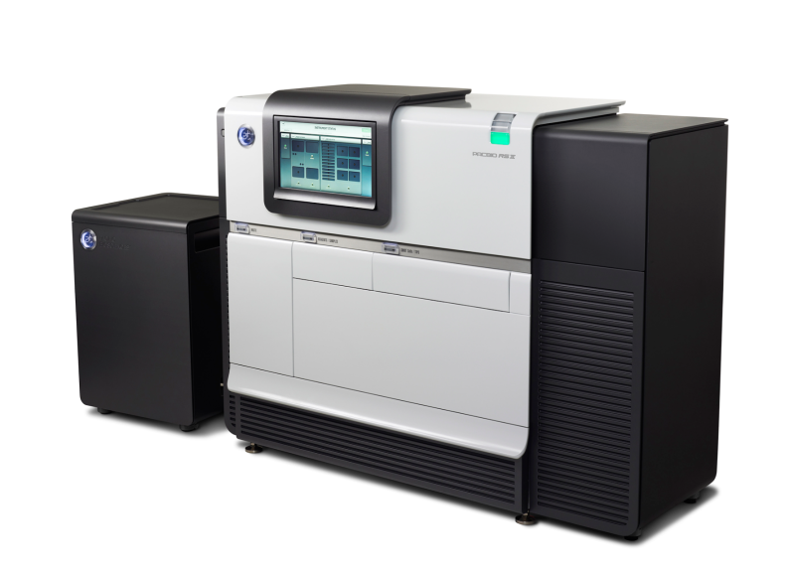
6.
The PRV genome
UL IR US TR
UL: unique long region
US: unique short region
IR: internal repeat
TR: terminal repeat
PacBio RS II platform

Slide 10
7.
Modular organization of PRV genome
The genome of herpesviruses exhibits a special architecture:
it is composed of an array of module-like structures
← Genetic Module →
Divergently- oriented
cluster of genes
Divergently- oriented
cluster of genes
Convergently-oriented clusters of genes

Slide 11
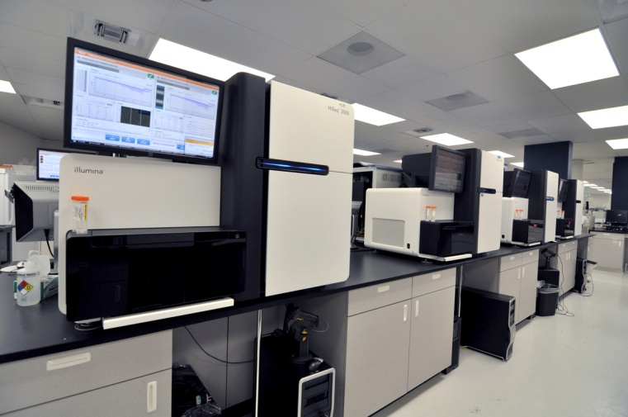
Transcriptome of PRV
8.
Illumina HiSeq platform:
transcriptome with mixed
transcriptional kinetics
PacBio RS II platform:
transcriptome at various phases of
viral infection (1h, 2h, 4h, 6h, 8h, 12h)

Slide 12
Transcriptional overlap of
tandem genes
9.
PARALEL OVERLAP
MULTIPLE PARALLEL OVERLAPS
5’ 3’
5’ 3’
5’ 3’
5’ 3’
5’ 3’
← Genetic Module →
genes
transcripts
Two forms of parallel transcriptional overlaps:
Most of the tandem genes overlaps at their 5’ – 3’ termini
Transcripts encoded by tandem genes share 3’ co-terminals producing polycistronic transcripts

Slide 13
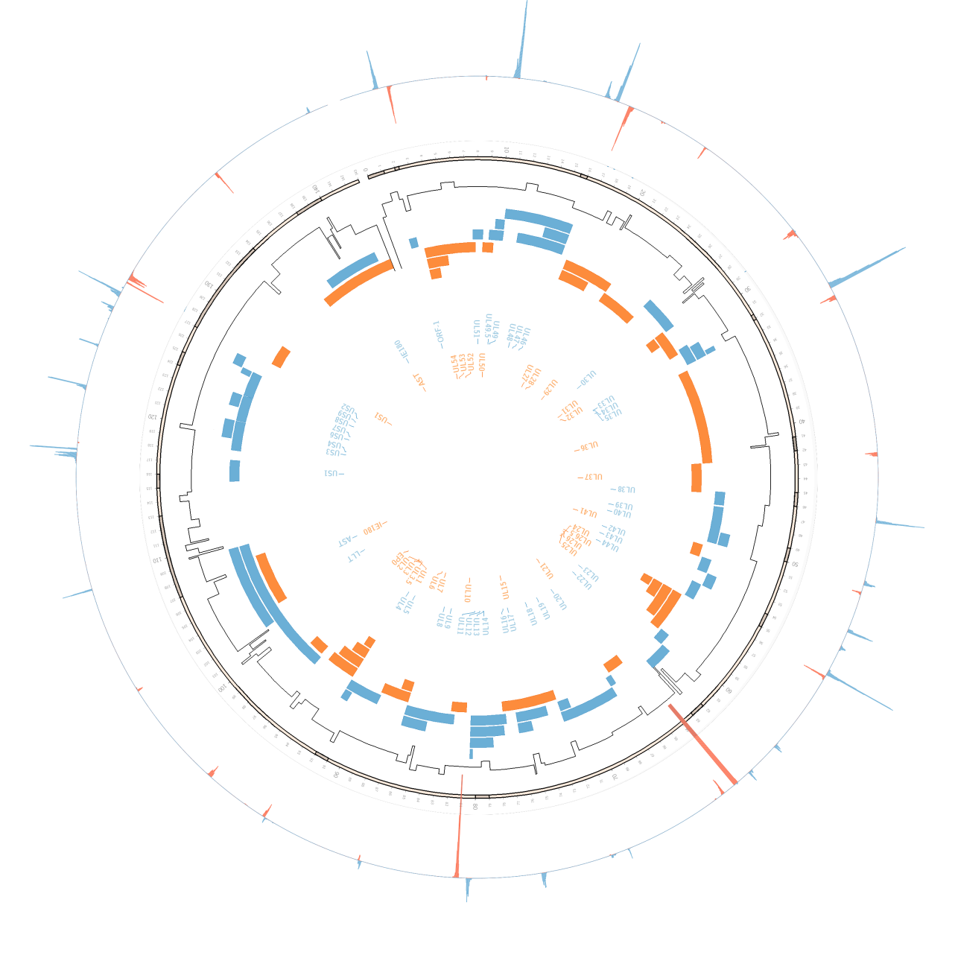
9b.
Circos plot of the PRV transcripts
Dept. of Medical Biology
The most common poly(A) transcripts
share 3’-co-terminals (polycistronic RNAs)
Illumina HiScanSQ platform – anchored oligo(dT) priming [poly(A)-seq]

Slide 14
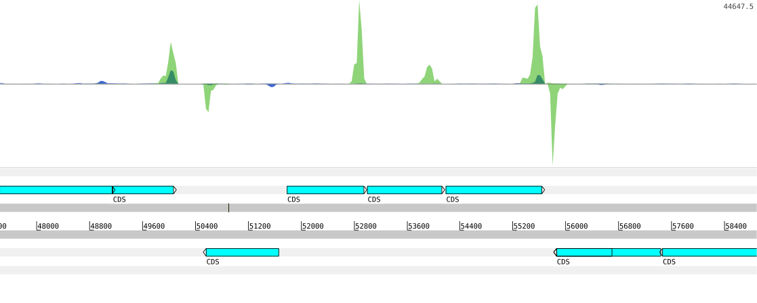
9c.
Transcription terminations of tandem genes
3’ co-terminal poly(A)s
Internal poly(A)s
UL39
UL40
UL42
UL43
UL44
UL41
UL26 .5
UL26
UL25
Anchored oligo(dT) priming
Random hexamer priming
Illumina HiScanSQ platform

Slide 15
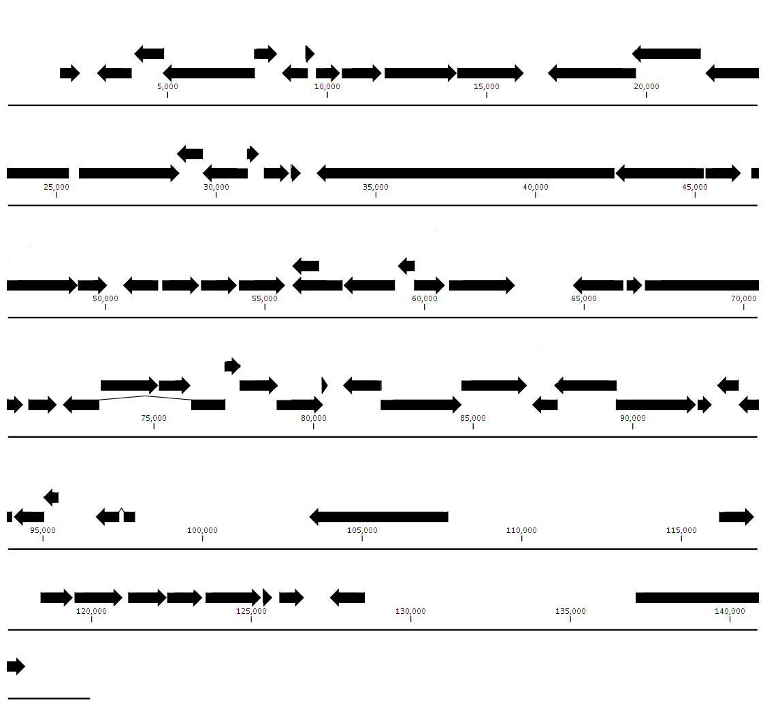
9d.
Poly(A) signals of the upstream genes
UL51
UL49.5
2768
8478
21775
ORF-1
2768
UL53
UL49
16868
UL28
UL54
UL53
UL52
UL48
UL47
UL46
UL27
UL50
2286
8514
10415
16236
28692
UL31
UL33
UL34
UL35
42494
46528
UL29
UL30
UL32
33127
UL36
UL37
UL38
28897
32348
32684
33140
UL24
49061
50138
54127
55795
UL26.5
66643
UL20
52956
54127
54127
UL39
UL40
UL41
UL42
UL43
UL44
UL26
UL25
UL23
UL22
UL21
UL19
50547
55686
55797
60768
62855
OriL
UL14
UL7
UL3.5
UL3
76164
UL11
80906
80695
92610
72044
UL17
L16
UL13
UL10
UL8
UL6
UL4
UL18
UL15
UL12
80470
UL9
UL5
71025
72442
76154
86712
92106
92606
UL2
UL1
93795
96423
EP0
102865
IE180
US1
117408
US9
US2
127332
US3
US4
US6
US7
US8
US1
IE180
121045
123483
125800
126721
Coding region Major poly(A) signal, plus strand Major poly(A) signal, minus strand Weak poly(A) signal in tandem genes
Notes:
Sárga téglalap: Alapvetően nincs átfedés, de van 1-1 pacbio read mindkét oldalról, ami beleír a másik génbe, egyik oldalról polya-s a másikról nem. Egyik 4 óránál, másik 12-nél. A polya-st beírtam, így végülis jócskán átfednek
* ul 30-31 közt pár nukleotiddal nagyobb is lehet az átfedés, mert vannak alternatív végződések

Slide 16
Dynamic transcriptome of PRV
9e.
1h
2h
4h
6h
8h
12h
us8 us9 us2
Transcriptional cascade:
us8-us9 (only the us8 is translated)
us9 + us2 (both are translated)
us9-us2 (only the us9 is translated)
us8-us9-us2 (only the us8 is translated)
Pacific Biosciences RSII platform –
combined anchored oligo(dT) and random hexamer priming
Notes:
Láthatóak a readek amik átmennek us2-be, sok közülük polyAs.

Slide 17
9f.
Changes of expression kinetics of the translated genes across the viral life cycle
R∆ = R_{t} – R_{(t-1)}
R∆ values

Slide 18
10.
Convergent transcriptional overlaps
- 1. ‘hard’ overlaps
Convergent ‘hard’ overlap
5’ 3’
3’ 5’
← Genetic Module →
Divergent gene cluster
Divergent gene cluster

Slide 19
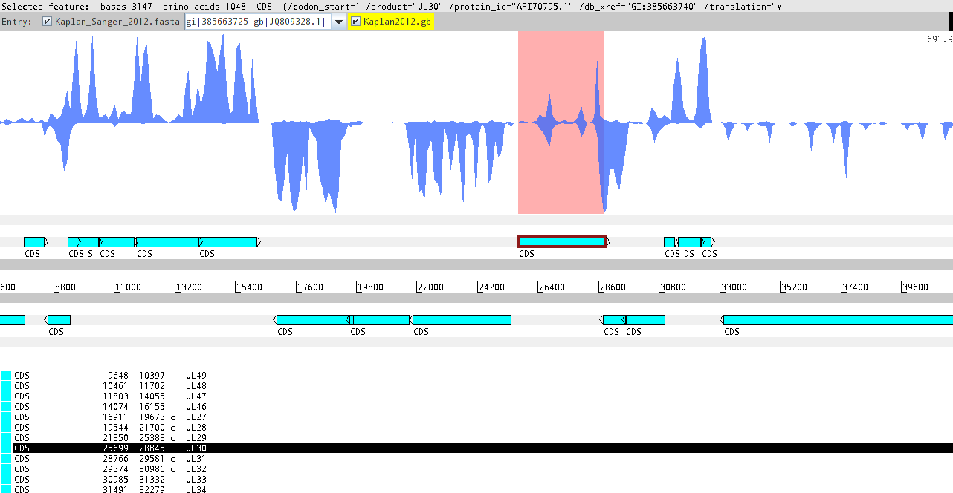
10b.
Convergent transcriptional overlaps
- 1. ‘hard’ overlaps: ul30-31 gene pairs
UL51
UL49.5 49 Ul48 Ul47 Ul46
UL30
UL33, 34, 35
UL50
UL27 ul28 ul29
UL31 Ul 32
UL36
Illumina HiScanSQ platform – random-hexamer priming

Slide 20
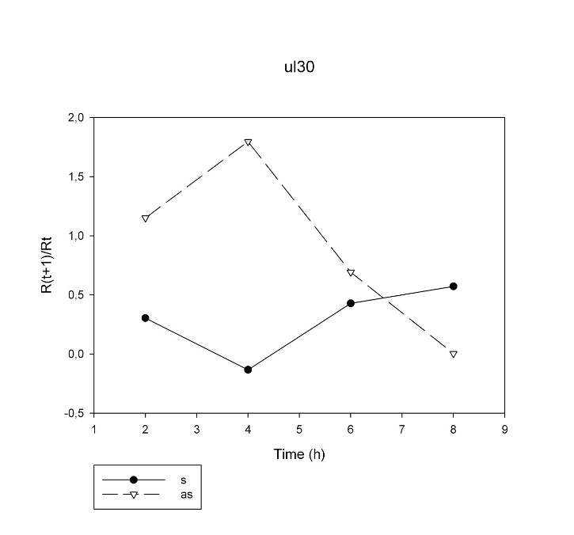
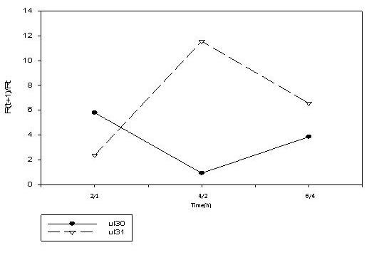
10c.
15d.
ul30 vs. antisense ul30
R: relative expression ratio =
low-titer infection: 0.1 pfu/cell
R∆ = R_{t} – R_{(t-1)}
Convergently-oriented genes
ul32
ul31
ul30
Real-time RT-PCR
1 2-1 4-2 6-4
R_{a} = R_{t}/R_{(t-1)}
ul30 vs. ul30 + ul31-32

Slide 21
15d.
ul30 vs. ul31 + ul31-32
high-titer infection: 10 pfu/cell
Convergently-oriented genes
R∆ = R_{t} – R_{(t-1)}
PacBio RS II
ul32
ul31
ul30
Pearson’s correlation coefficient: - 0.51

Slide 22
15d.
ul31 vs. ul30 + ul31-32
Tandem & convergently-oriented genes
R∆ = R_{t} – R_{(t-1)}
PacBio RS II
ul32
ul31
ul30

Slide 23
15d.
ul30 vs. ul29 + ul29-28-27
Divergently-oriented genes
R∆ = R_{t} – R_{(t-1)}
PacBio RS II
Not promoter competition but joint control!
ul32
ul31
ul30
ul29
ul29

Slide 24
10d.
Convergent transcriptional overlaps
- 1. ‘hard’ overlaps: ul8-ul7 gene pairs
ul10 ul9 ul8 ul7 ul6
Genome
1h
2h
4h
6h
8h
12h
Inverse transcriptional kinetics
PacBio RS II platform:
combined random hexamer-primed and
anchored oligo(dT) primed [poly(A)-seq]
Notes:
24

Slide 25
11.
Convergent transcriptional overlaps
- 2. ‘soft’ overlaps with alternative poly(A) signals
Convergent ‘soft’ overlap
5’ 3’
3’ 5’
← Genetic Module →
Convergent gene cluster
- RNS pol-II : inefficient recognition of major transcription termination signals
- Collision of RNA pol molecules
- Generation of antisense transcripts

Slide 26
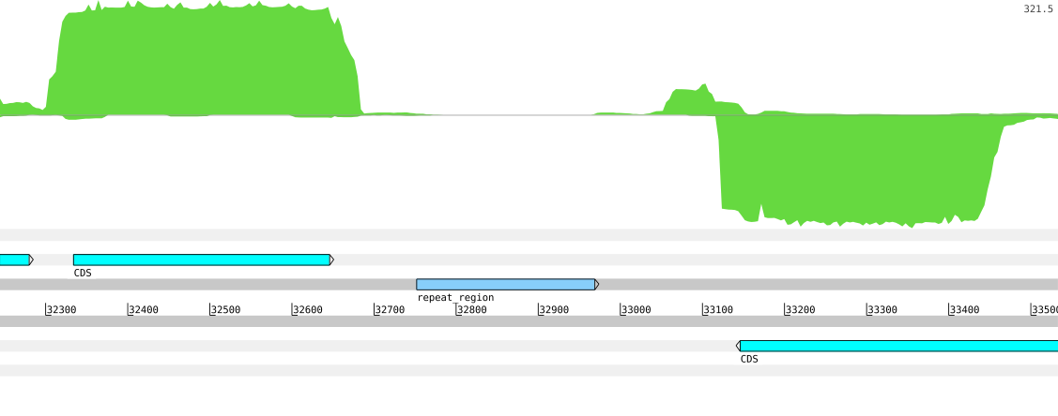
11c.
Convergent transcriptional overlaps
- 2. ‘soft’ overlaps with alternative poly(A) signals
alternative poly(A) signal of ul35 transcript poly(A) signal of ul36 transcript
AATAAACAATTTATT
UL43
UL35
UL36
Anchored oligo(dT) priming
Illumina HiScanSQ platform – anchored oligo(dT) priming [poly(A)-seq]
Notes:
Gének alternatív polyA szignállal: UL35, UL36
-Alternatív polyA csúcs háttér feletti lefedettségű
-Erős polyA szignál (AATAAA) mellett helyezkedik el
-repetitív régión kívül esik
-readek 5' vége a szemközti “major polyA peak”-en kívül helyezkedik el
-3' végen polyA farok található

Slide 27
11d.
Whole-genome convergent overlaps
UL51
UL49.5
2768
8478
21775
ORF-1
2768
UL53
UL49
16868
UL28
UL54
UL53
UL52
UL48
UL47
UL46
UL27
UL50
2286
8514
10415
16236
28692
UL31
UL33
UL34
UL35
42494
46528
UL29
UL30
UL32
33127
UL36
UL37
UL38
28897
32348
32684
33140
UL24
49061
50138
54127
55795
UL26.5
66643
UL20
52956
54127
54127
UL39
UL40
UL41
UL42
UL43
UL44
UL26
UL25
UL23
UL22
UL21
UL19
50547
55686
55797
60768
62855
OriL
UL14
UL7
UL3.5
UL3
76164
UL11
80906
80695
92610
72044
UL17
UL16
UL13
UL10
UL8
UL6
UL4
UL18
UL15
UL12
80470
UL9
UL5
71025
72442
76154
86712
92106
92606
UL2
UL1
93795
96423
EP0
102865
IE180
US1
117408
US9
US2
127332
US3
US4
US6
US7
US8
US1
IE180
121045
123483
125800
126721
Coding region Major poly(A) signal, plus strand Major poly(A) signal, minus strand Weak poly(A) signal in convergent genes
Hard overlaps: ul7-8, ul30-31, ul50-51
Soft overlaps: ul35-36, ul44-26.5
Very close locations: ul15-18, ul15-16, ul3-3.5
Notes:
Sárga téglalap: Alapvetően nincs átfedés, de van 1-1 pacbio read mindkét oldalról, ami beleír a másik génbe, egyik oldalról polya-s a másikról nem. Egyik 4 óránál, másik 12-nél. A polya-st beírtam, így végülis jócskán átfednek
* ul 30-31 közt pár nukleotiddal nagyobb is lehet az átfedés, mert vannak alternatív végződések

Slide 28
12.
Convergent transcriptional overlaps
- 3. ‘soft’ overlaps, no poly(A) signals
Convergent ‘soft’ overlap
5’ 3’
3’ 5’
← Genetic Module →
Convergent gene cluster
- RNA pol II : inefficient recognition of main transcription termination signals
- Collision of transcriptional machineries
- Generation of antisense transcripts

Slide 29
12b.
Convergent transcriptional overlaps
- 3. ‘soft’ overlaps, no poly(A) signals
UL51
UL49.5 49 Ul48 Ul47 Ul46
UL30
UL33, 34, 35
UL50
UL27 ul28 ul29
UL31 Ul 32
UL36
Illumina HiScanSQ platform – random-hexamer priming

Slide 30
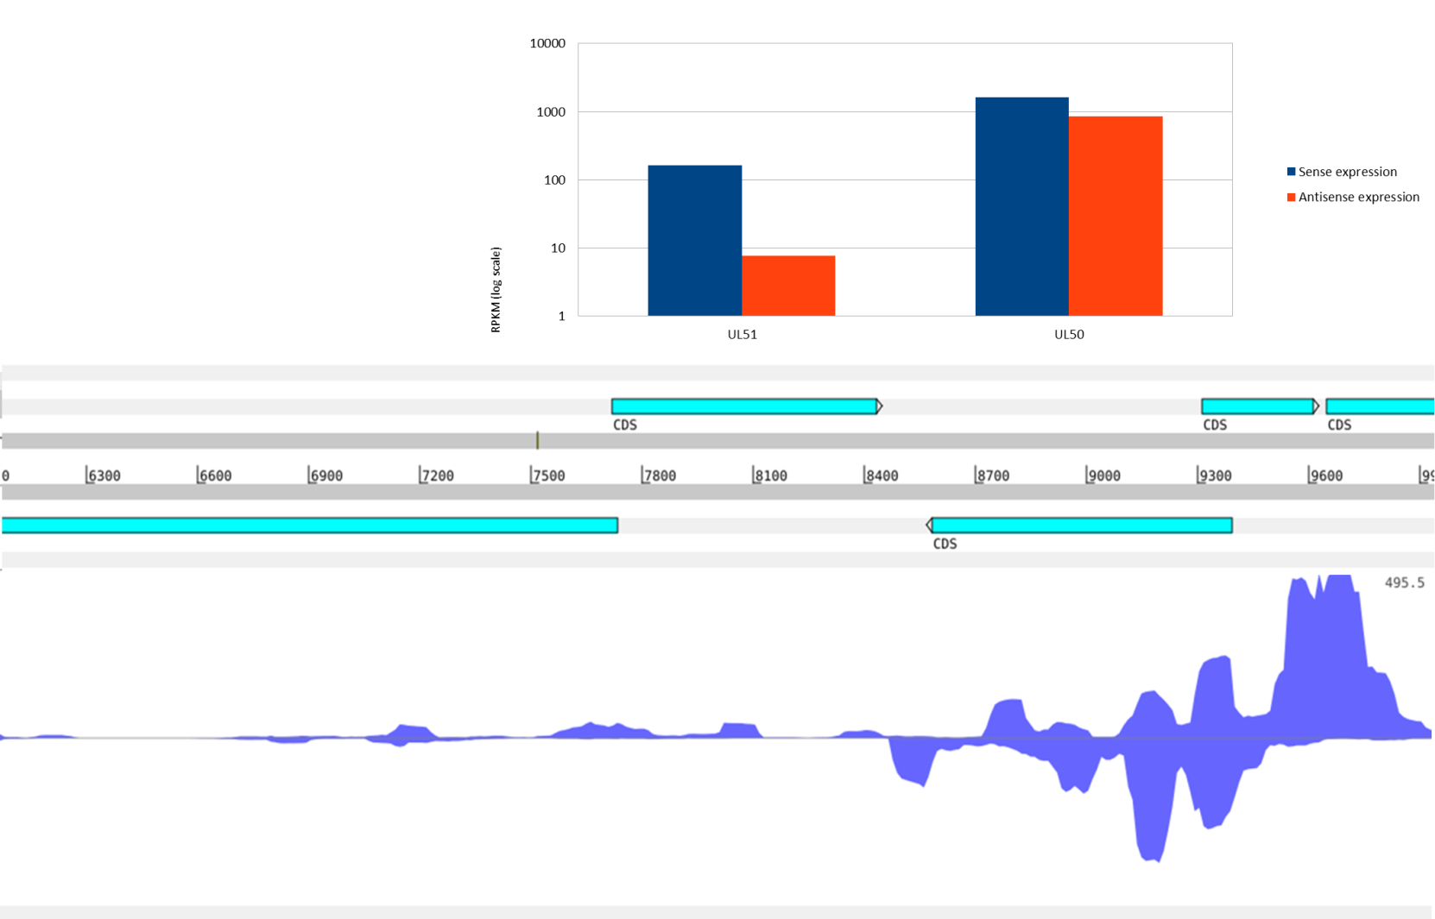
12c.
Convergent transcriptional overlaps
- 3. ‘soft’ overlaps, no poly(A) signals
ul31 ul30
UL31
UL49.5 Ul49
UL32
UL30
Illumina HiScanSQ platform – random hexamer priming

Slide 31
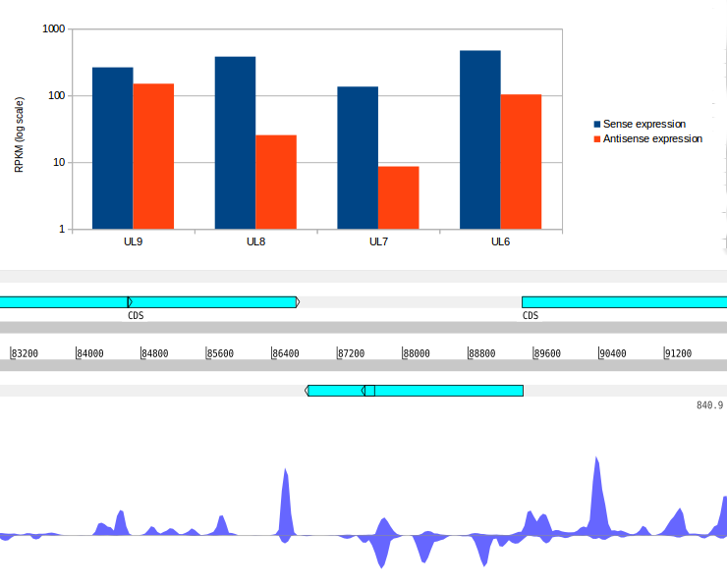
12d.
Convergent transcriptional overlaps
- 3. ‘soft’ overlaps, no poly(A) signals
UL9
UL8
UL5
UL7
UL6

Slide 32
12.e
Overall antisense RNA expression
Illumina HiScanSQ platform

Slide 33
12f.
Inverse expression of mRNAs and their antisense RNA partners
5’ 3’
3’ 5’
ul51
ul50
Real-time RT-PCR
5’ 3’
3’ 5’
ul51
ul50

Slide 34
12g.
Positive correlation between mRNA and antisense RNA expressions
Within the hard overlap
5’ 3’
3’ 5’
ul30
ul31
Time (h)
5’ 3’
3’ 5’
ul51
ul50

Slide 35
15.
Long non-coding RNAs of PRV
CONVERGENT OVERLAP
between coding – and non-coding genes
5’ 3’
3’ 5’
Ul IR Us TR
ep0 ie180
ep0 ie180
LAP ASP
LAT LLT AST

Slide 36
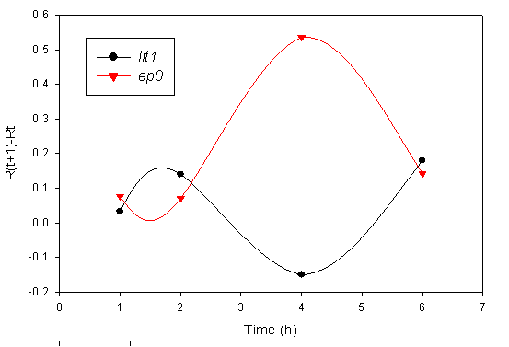
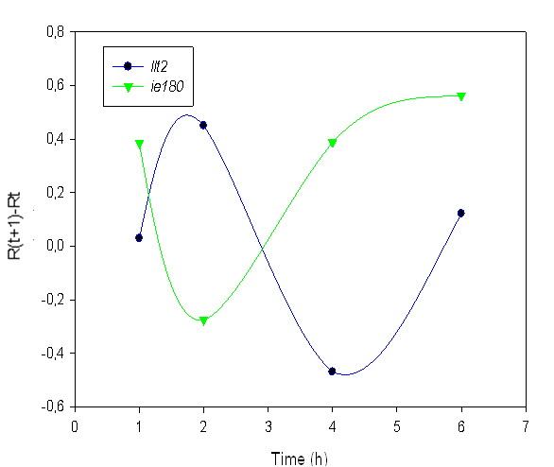
15b.
Inverse expression patterns between mRNA and antisense RNA expressions
Time (h) Time (h)
Transcription factor genes
ep0
ie180
LAT
AST
Non-coding genes

Slide 37
13.
An experimental system for the modification of convergent transcriptional read-through
5’ 3’
3’ 5’
ul38
ul39
ul40
CMVP
Gene | Time | R_{AS}/R_{S} (wt) | R_{AS}/R_{S} (mut) | R_{AS}/R_{S} (mut/wt)
ul38 | 1h | 0,093 | 0,181 | 1.951
 | 2h | 0,032 | 2,025 | 63.257
 | 4h | 0,212 | 0,291 | 1.375
 | 6h | 0,323 | 1,514 | 4.694
 | 8h | 0,146 | 0,624 | 4.258
 | 12h | 0,240 | 0,303 | 1.263
Gene | Time | R_{AS}/R_{S} (wt) | R_{AS}/R_{S} (mut) | R_{AS}/R_{S} (mut/wt)
Gene | Time | R_{AS}/R_{S} (wt) | R_{AS}/R_{S} (mut) | R_{AS}/R_{S} (mut/wt)
ul40 | 1h | 0,023 | 0,036 | 1.554
 | 2h | 0,015 | 0,021 | 1.366
 | 4h | 0,085 | 0,407 | 4.761
 | 6h | 0,152 | 0,854 | 5.604
 | 8h | 0,180 | 0,746 | 4.136
 | 12h | 0,155 | 0,358 | 2.311
ul39 | 1h | 0,044 | 0,072 | 1.638
 | 2h | 0,062 | 0,048 | 0.781
 | 4h | 0,137 | 0,654 | 4.783
 | 6h | 0,141 | 0,972 | 6.896
 | 8h | 0,197 | 0,870 | 4.420
 | 12h | 0,153 | 0,676 | 4.425

Slide 38
16.
Transcriptional overlap in divergently-oriented genes
DIVERGENT OVERLAP
(overlap of transcribed regions)
DIVERGENT OVERLAP
(overlap of promoters)
5’ 3’
5’ 3’
3’ 5’
3’ 5’
← Genetic Module →
Divergent gene cluster
Divergent gene cluster
Convergent gene cluster

Slide 39
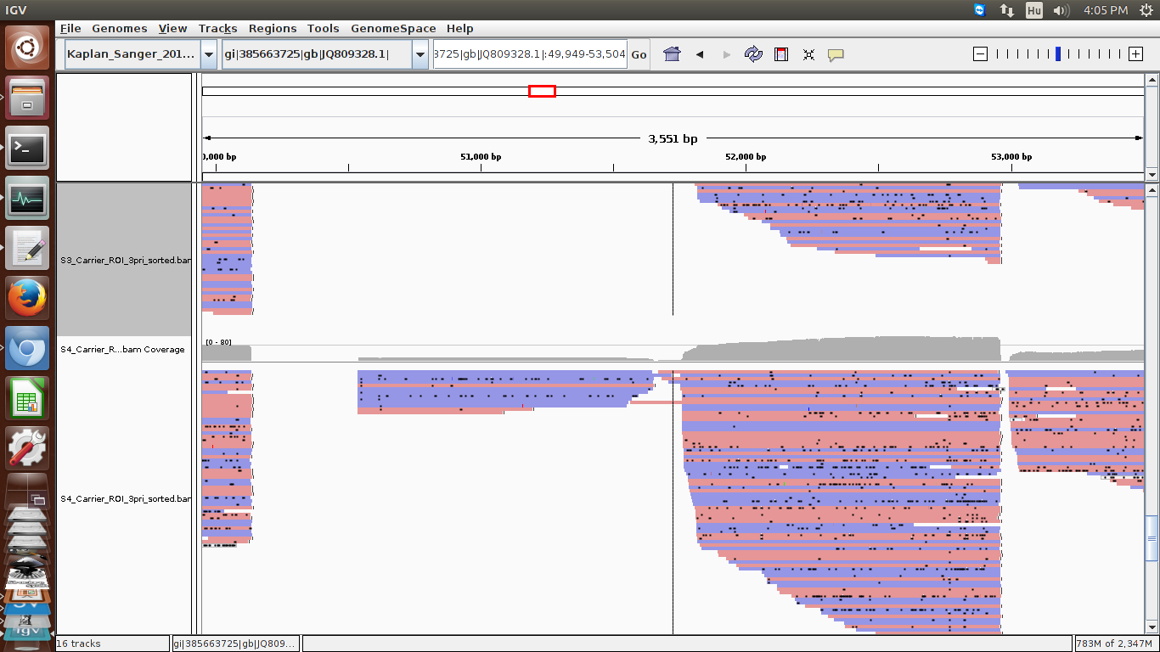
16b.
Transcriptional overlap of divergently-oriented genes
PacBio RS II platform:
combined random hexamer-primed and
anchored oligo(dT) primed [poly(A)-seq]
ul41 ul42
All of the divergent
genes overlaps

Slide 40
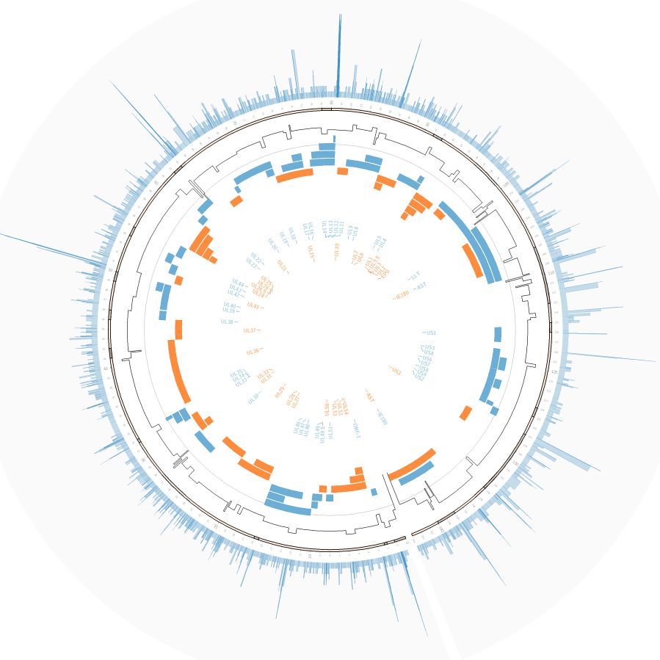
14.
Methylation of genome of PRV virion
The highest density of DNA methylation occur
between the convergent genes
Dept. of Medical Biology
Pacific Biosciences RSII platform

Slide 41
1.
The putative functions of TINs
(1) Automatism in the alteration of transcriptional activity of gene clusters
(2) Synchronization and negative synchronization of gene activities ➢ well-defined temporal patterns of gene expressions
(3) Reduction of transcriptional noise
TINs are assumed to be especially important in biological processes following a definite time course of gene expressions, such as embryonic development, tissue regeneration, response to external stimuli, metabolism, viral replication, etc.

Slide 42
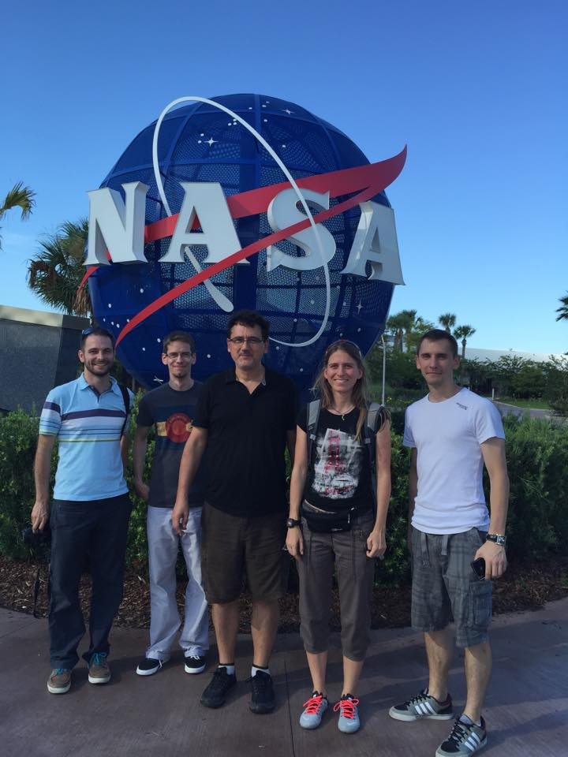
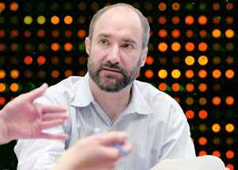
Acknowledgements:
Mike Snyder
Director, Stanford Center for Genomics and Personalized Genetics

Slide 43
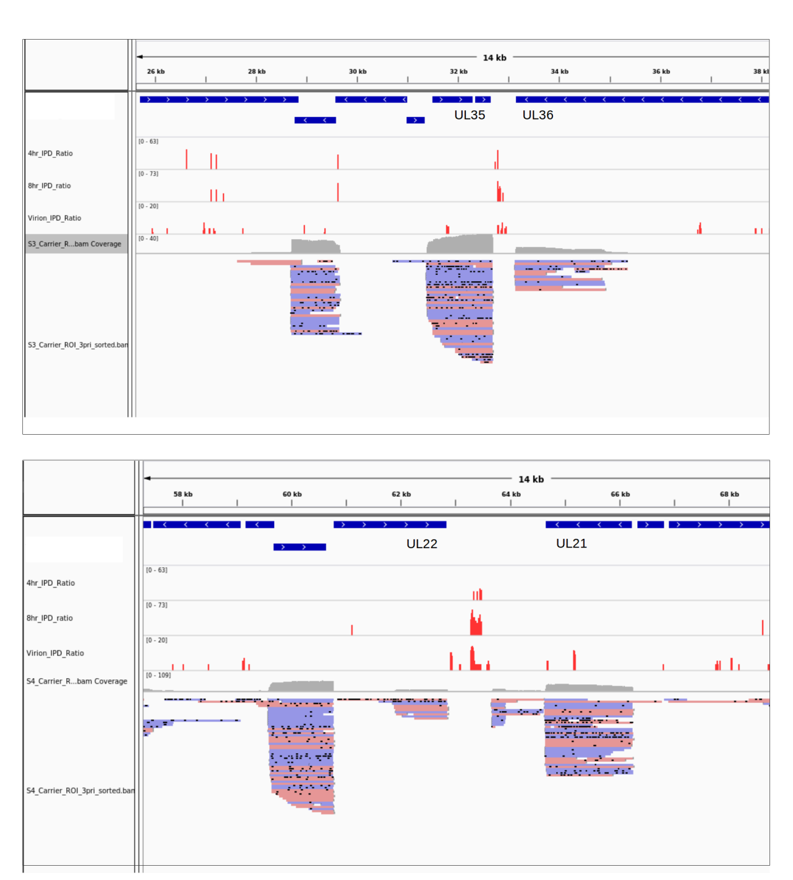
14b.
Dynamics of DNA methylation throughout the viral replication
4h
8h
virion
4h
8h
virion
PacBio RS II platform

Slide 44
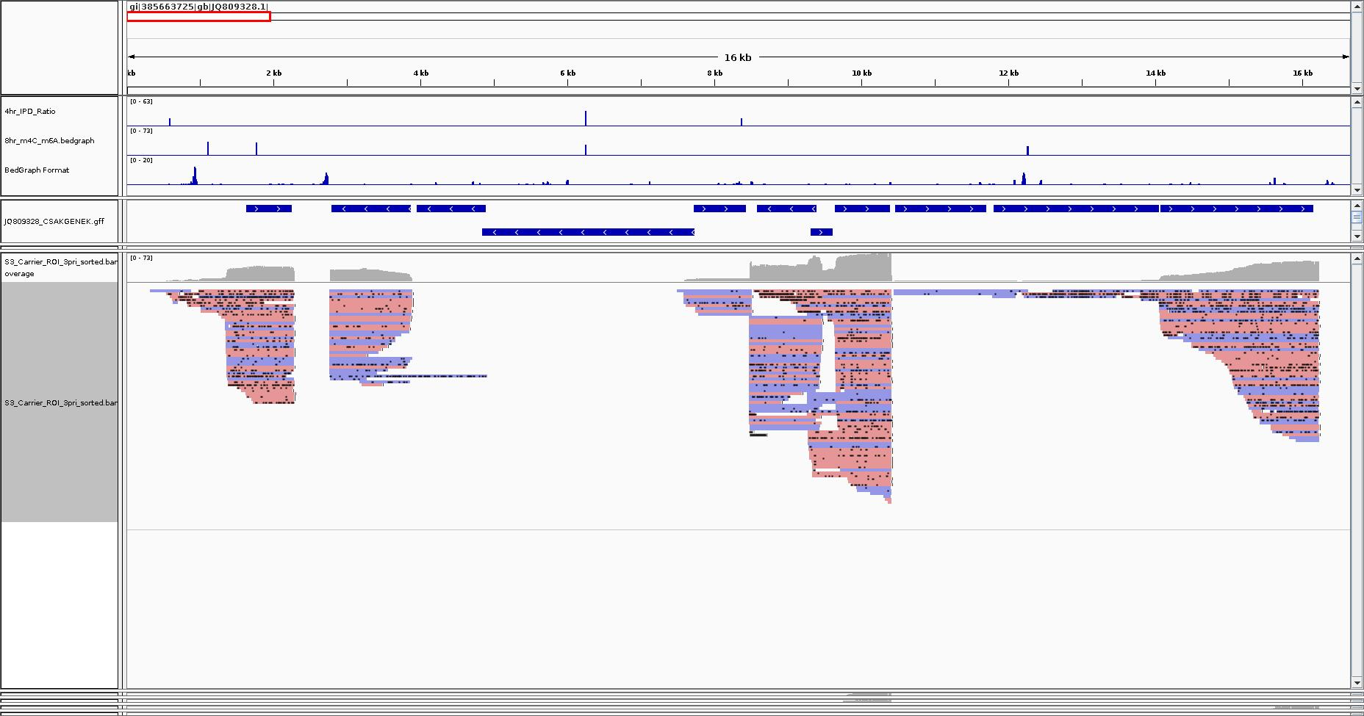
14c.
Dynamics of DNA methylation throughout the viral replication
ORF-1 ul54 ul53 ul52 ul51 ul50 ul49.5 ul49 ul48 ul47 ul46
4h
8h
virion
PacBio RS II platform

Slide 45
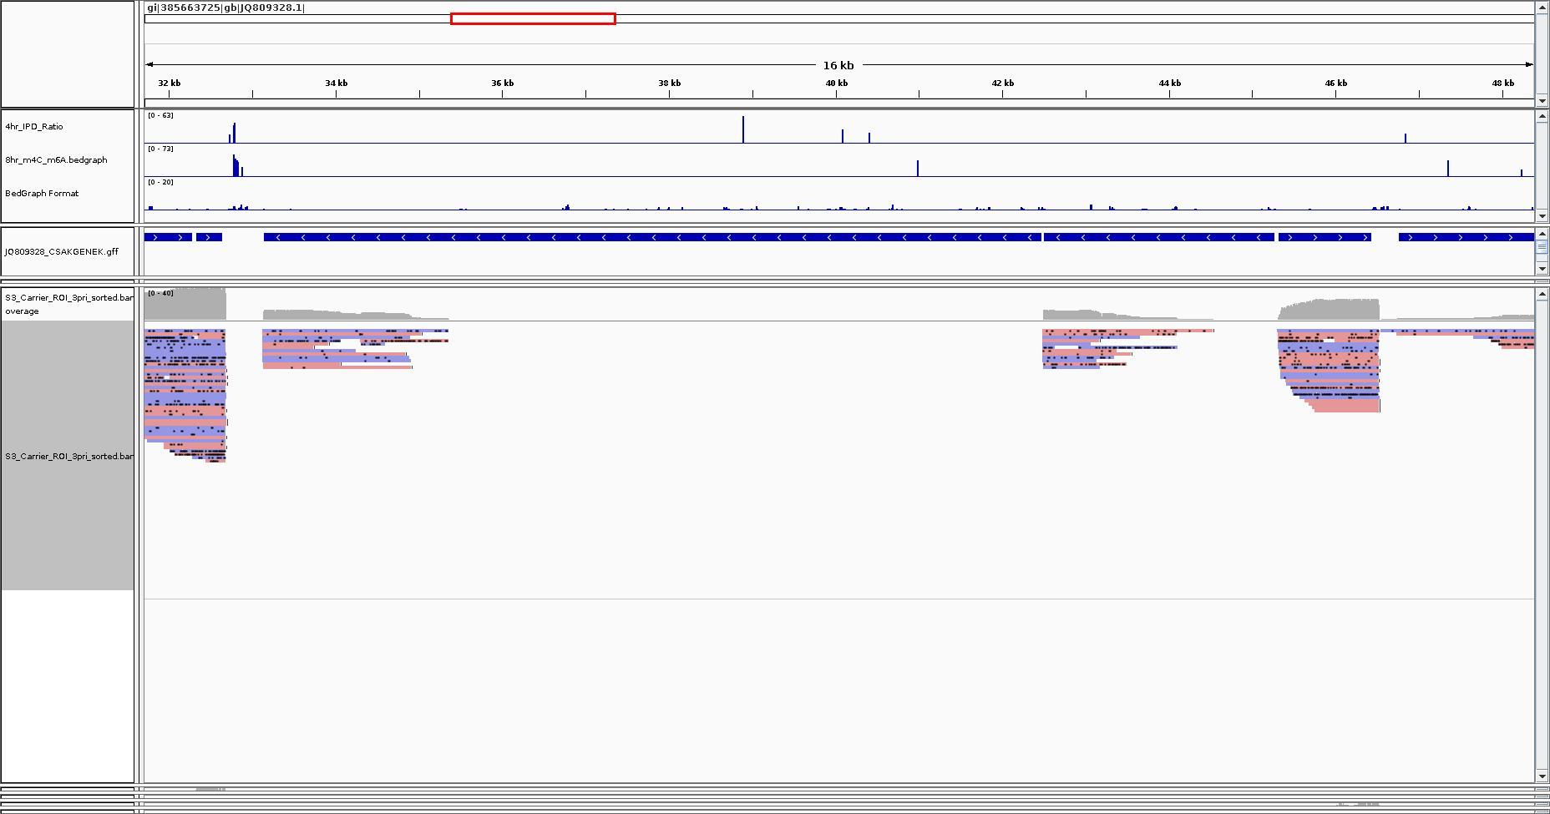
14d.
Dynamics of DNA methylation throughout the viral replication
ul34 ul35 ul36 ul37 ul38 ul39
4h
8h
virion
PacBio RS II platform

Slide 46
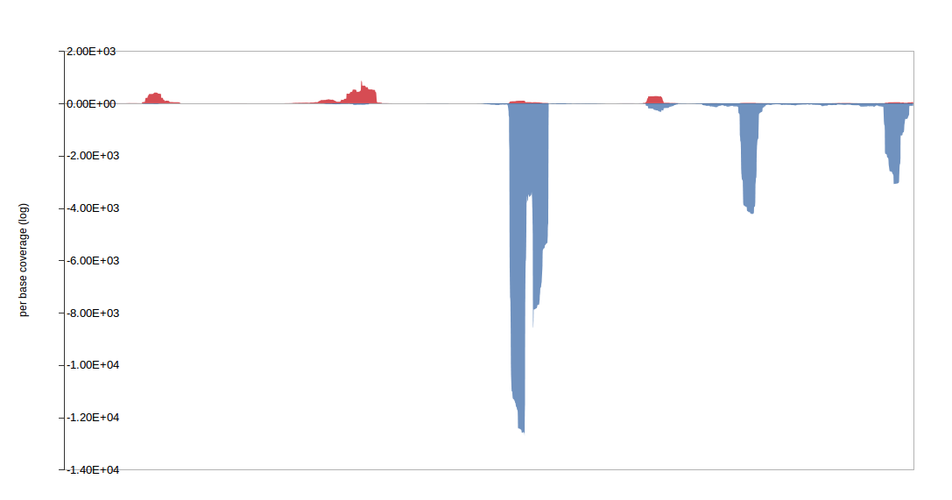
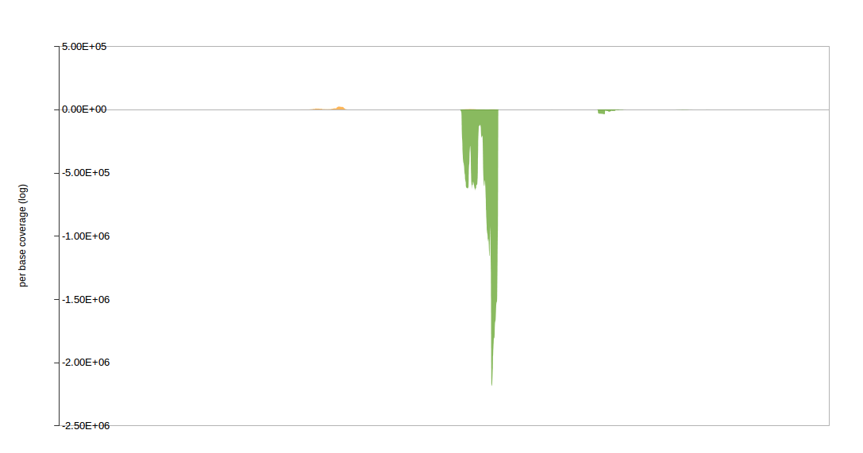
17.
CTO - a novel lnc-RNA
UL22
OriL
60800
61600
62800
63200
67200
CTO-S
UL21
Random hexamer priming
OriL
UL22
OriL
60800
61600
62800
63200
67200
CTO-S
UL21
Anchored oligo(dT) priming
Illumina HiScanSQ platform
mRNA sequence
polyadenylation signal

Slide 47
18b.
Transcriptional kinetics of
CTO length variants
Clash between the transcription and DNA replication machineries?
UL20
OriL
60800
61600
62800
63200
UL21
67200
CTO-S
CTO-M
- mRNA sequence
-replication origin
-polyadenylation signal
CTO-L
-4hrs p.i.
-6hrs p.i.
-8hrs p.i.
-12hrs p.i.
PacBio RS II platform – combined random hexamer-primed and anchored oligo(dT) primed [poly(A)-seq]
Notes:
Sequencing of the CTO polyadenylated non-coding transcript using single- molecule and
PCR-based technologies.
A: Illumina high-throughput sequencing coverage of the replication
origin OriL area of the PrV genome, using conventional random-hexamer primed (top) and
anchored oligo(dT) primed (bottom) libraries. The short isoform of CTO was sequenced to a
depth of ~11e3 (random hexamer) and 2.2e6 (oligo(dT)) reads, respectively.
B: Less abundant isoforms of CTO discovered using Pacific Biosciences Single- Molecule
Real-Time sequencing: molecules which proved to be of intermediate length, and are suspected
to be incomplete fragments, are marked with dotted lines. (single molecules corresponding to
the CTO short isoform are not shown).

Slide 48
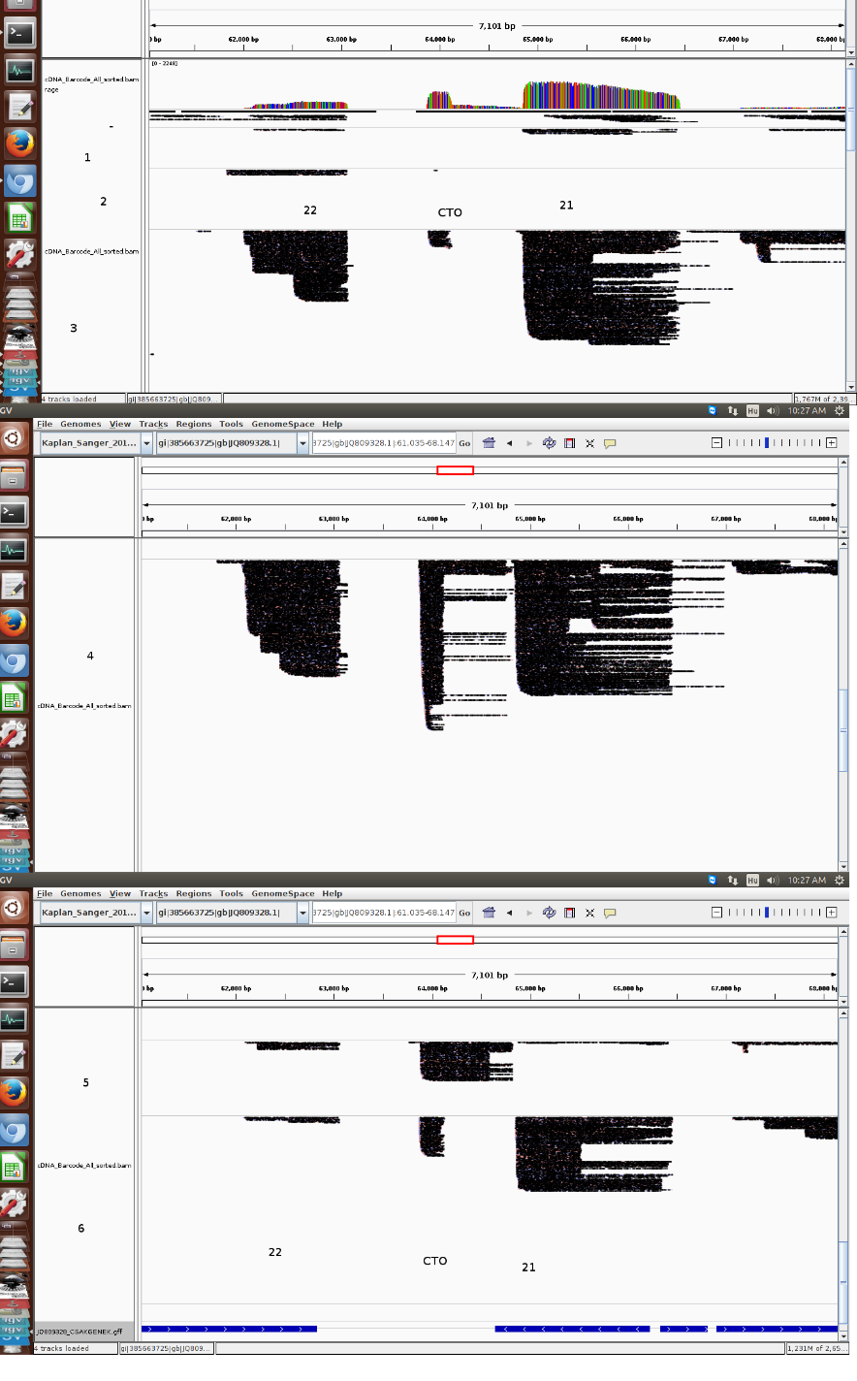
17b.
Transcriptional kinetics of
CTO length variants
OriL
1h
2h
4h
Confrontation of transcription
and DNA replication machinery?
6h
CTO-S
CTO-M
CTO-L
PacBio RS II platform:
combined random hexamer-primed and
anchored oligo(dT) primed [poly(A)-seq]
8h
12 h
CTO-S OriL

Slide 49
17b.
Confrontation between transcription and replication machineries?

Slide 50
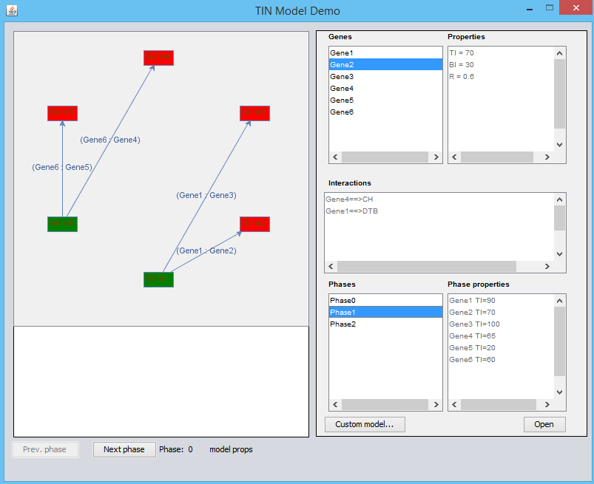
18.
Graph-based modeling of TIN
Java SDK 1.7
NetBeans 7.4 IDE
jgrapht – 0.9
Platform-independent
XML based storage of data

Slide 51
Let Us Meet Again
We welcome you all to our future conferences of OMICS International
Please Visit: http://transcriptomics.conferenceseries.com/
http://conferenceseries.com/
http://www.conferenceseries.com/genetics-and-molecular-biology-conferences.php

