Slide 1
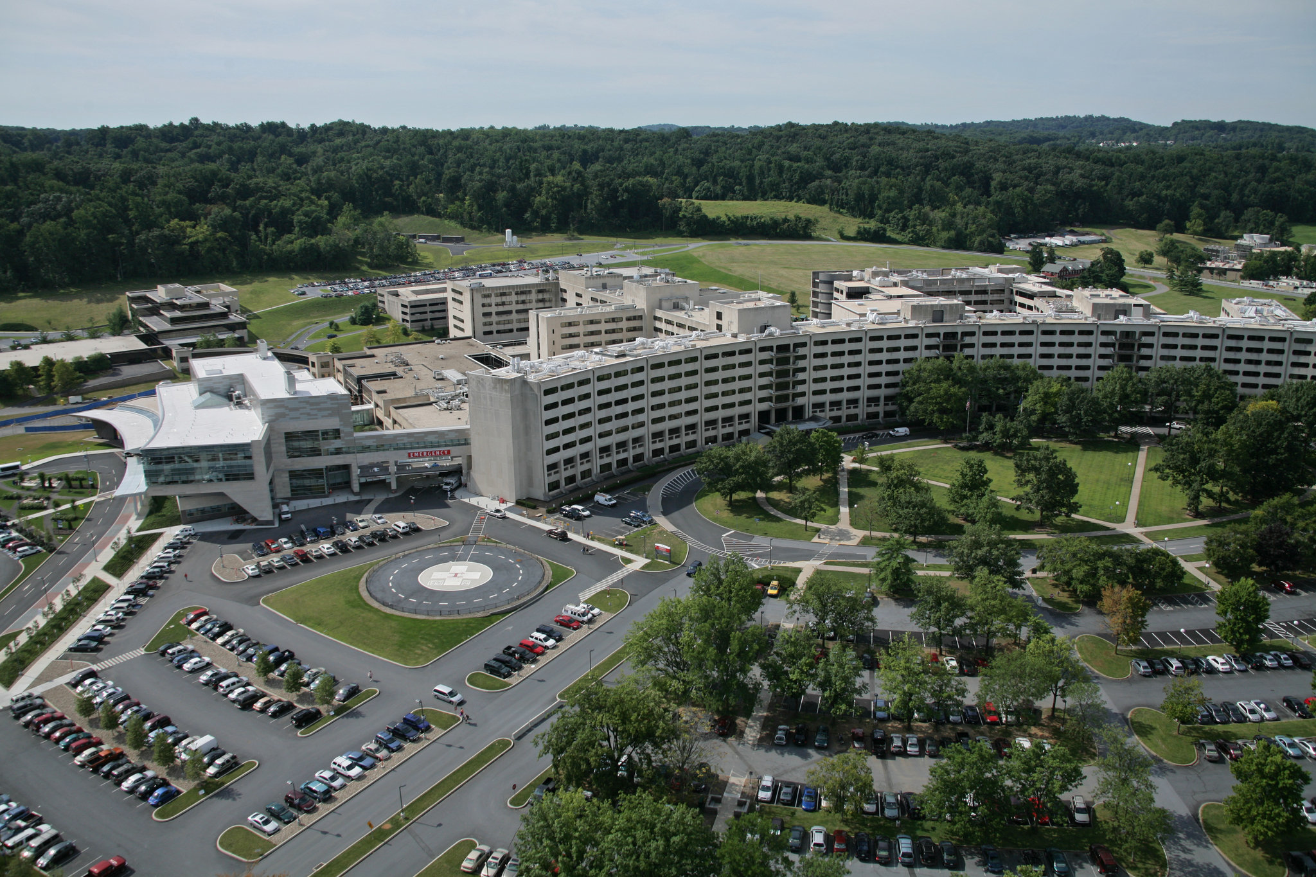
Toll-like receptors in the development of germinal centers and autoimmunity
Zia Rahman
Department of Microbiology and Immunology
Penn State College of Medicine

Slide 2
Long-lived plasma cells
High affinity
DC
T cell
B cell
ICs
Memory B cells
T cell zone
T cell
T cell
B cell
T_{FH} cell
T cell
T cell
B cell
T cell
FDC
T cell
ICs
B cell
T cell
B cell follicle
T_{FH} cell
Tingible body macrophages
B cell tolerance in Germinal center
Notes:
2

Slide 3
Our goal is to understand the mechanisms by which loss of B cell tolerance in the germinal centers contributes to autoantibody production and subsequent development of an autoimmune disease SLE/lupus disease

Slide 4
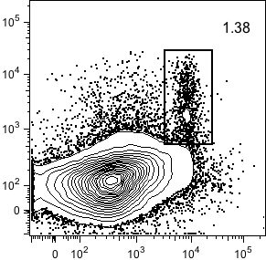
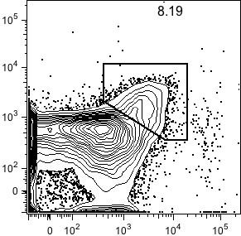
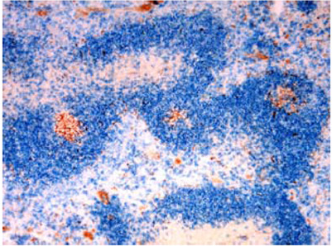
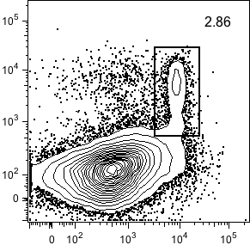
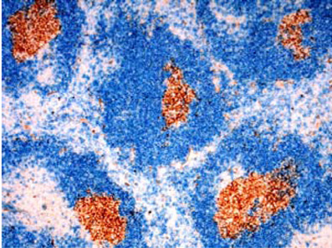
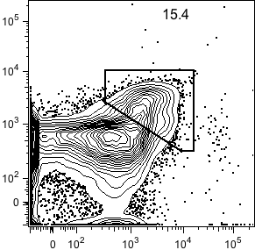
Increased spontaneous GC response in aged B6.Sle1b mice
B220⁺
CD4⁺
B6
B6
1.4
***
B6
***
6.9
% GC B Cells
B6.Sle1b
% T_{FH} Cells
B6.Sle1b
B6.Sle1b
PNA
PD-1
3.2
11.2
IgD PNA
B6
B6
Fas
B6.Sle1b
CXCR5
B6.Sle1b
Wong et al. 2012

Slide 5
% GC B cells correlates with autoantibody titers
R=0.6
Anti- dS DNA
P <3.8X10⁻⁸
R=0.7
Anti-histone
P <1.4X10⁻⁸
R=0.6
Anti-nucleosome
P <1.7X10⁻⁸
% GC B Cells
Wong et al. 2012

Slide 6
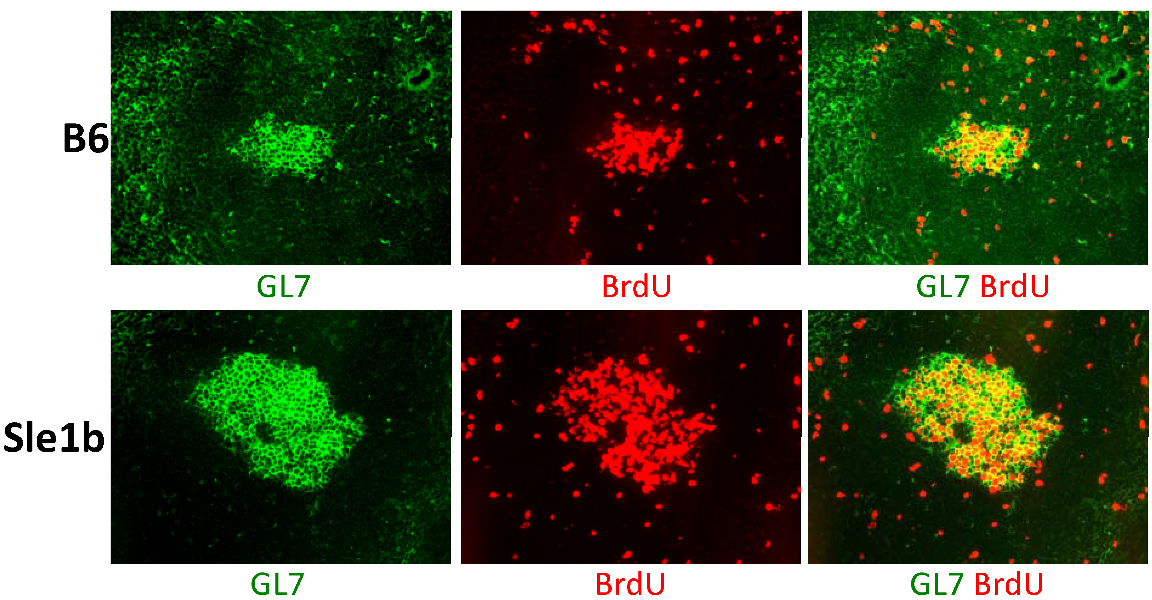
Increased spontaneous GC response in aged B6.Sle1b mice
B220⁺
CD4⁺
B6
B6
1.4
***
B6
***
6.9
% GC B Cells
B6.Sle1b
% T_{FH} Cells
B6.Sle1b
B6.Sle1b
PNA
PD-1
3.2
11.2
IgD PNA
B6
B6
Fas
B6.Sle1b
CXCR5
B6.Sle1b
Wong et al. 2012

Slide 7
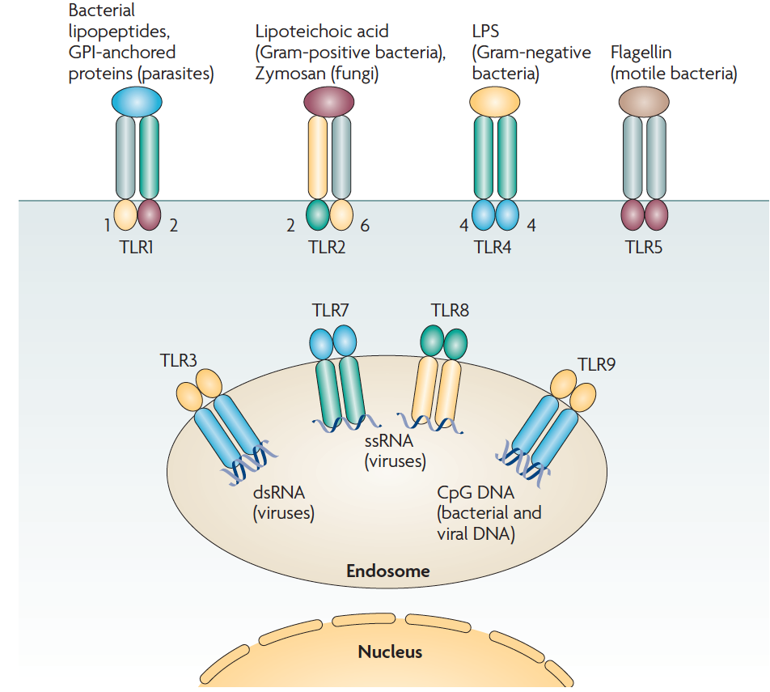
Toll Like receptors (TLRs)
Stimulated by:
exogenous viral and
bacterial components
endogenous viral and
self nucleic acids
(ssRNA, unmethylated CpG) DNA)
Earnest C. Borden et al., Nature Reviews Drug Discovery, 2007

Slide 8

Mouse
Strains GCs (Spontaneously formed)
B6 +
TLR2KO +
TLR3KO +
TLR4KO +
TLR7KO
TLR9KO

Slide 9
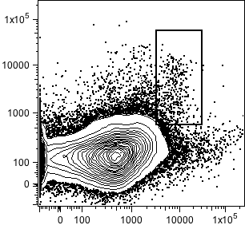
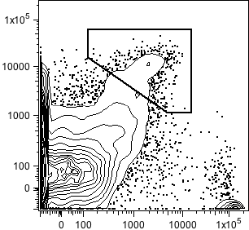
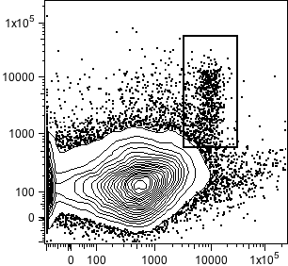
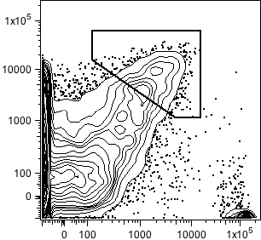
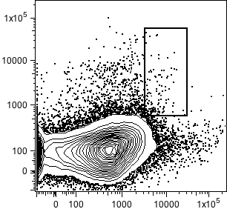
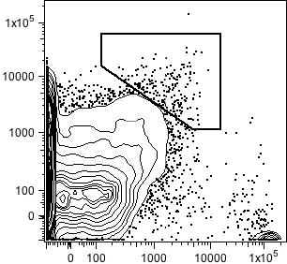
What is the effect of TLR7 and TLR9 on Spt- GC formation ?
B220⁺
CD4⁺
B6
B6
0.6
**
**
***
***
***
***
2.4
TLR9 KO
TLR9 KO
1.2
PNA
PD-1
% B220⁺Fas^{hi}PNA^{hi}GC B Cells
% CD4⁺CXCR5^{hi}PD-1^{hi} T_{FH} Cells
6.1
TLR7 KO
TLR7 KO
0.2
1.1
FAS
B6
CXCR5
B6
TLR9 KO
TLR7 KO
TLR9 KO
TLR7 KO
3 mo

Slide 10
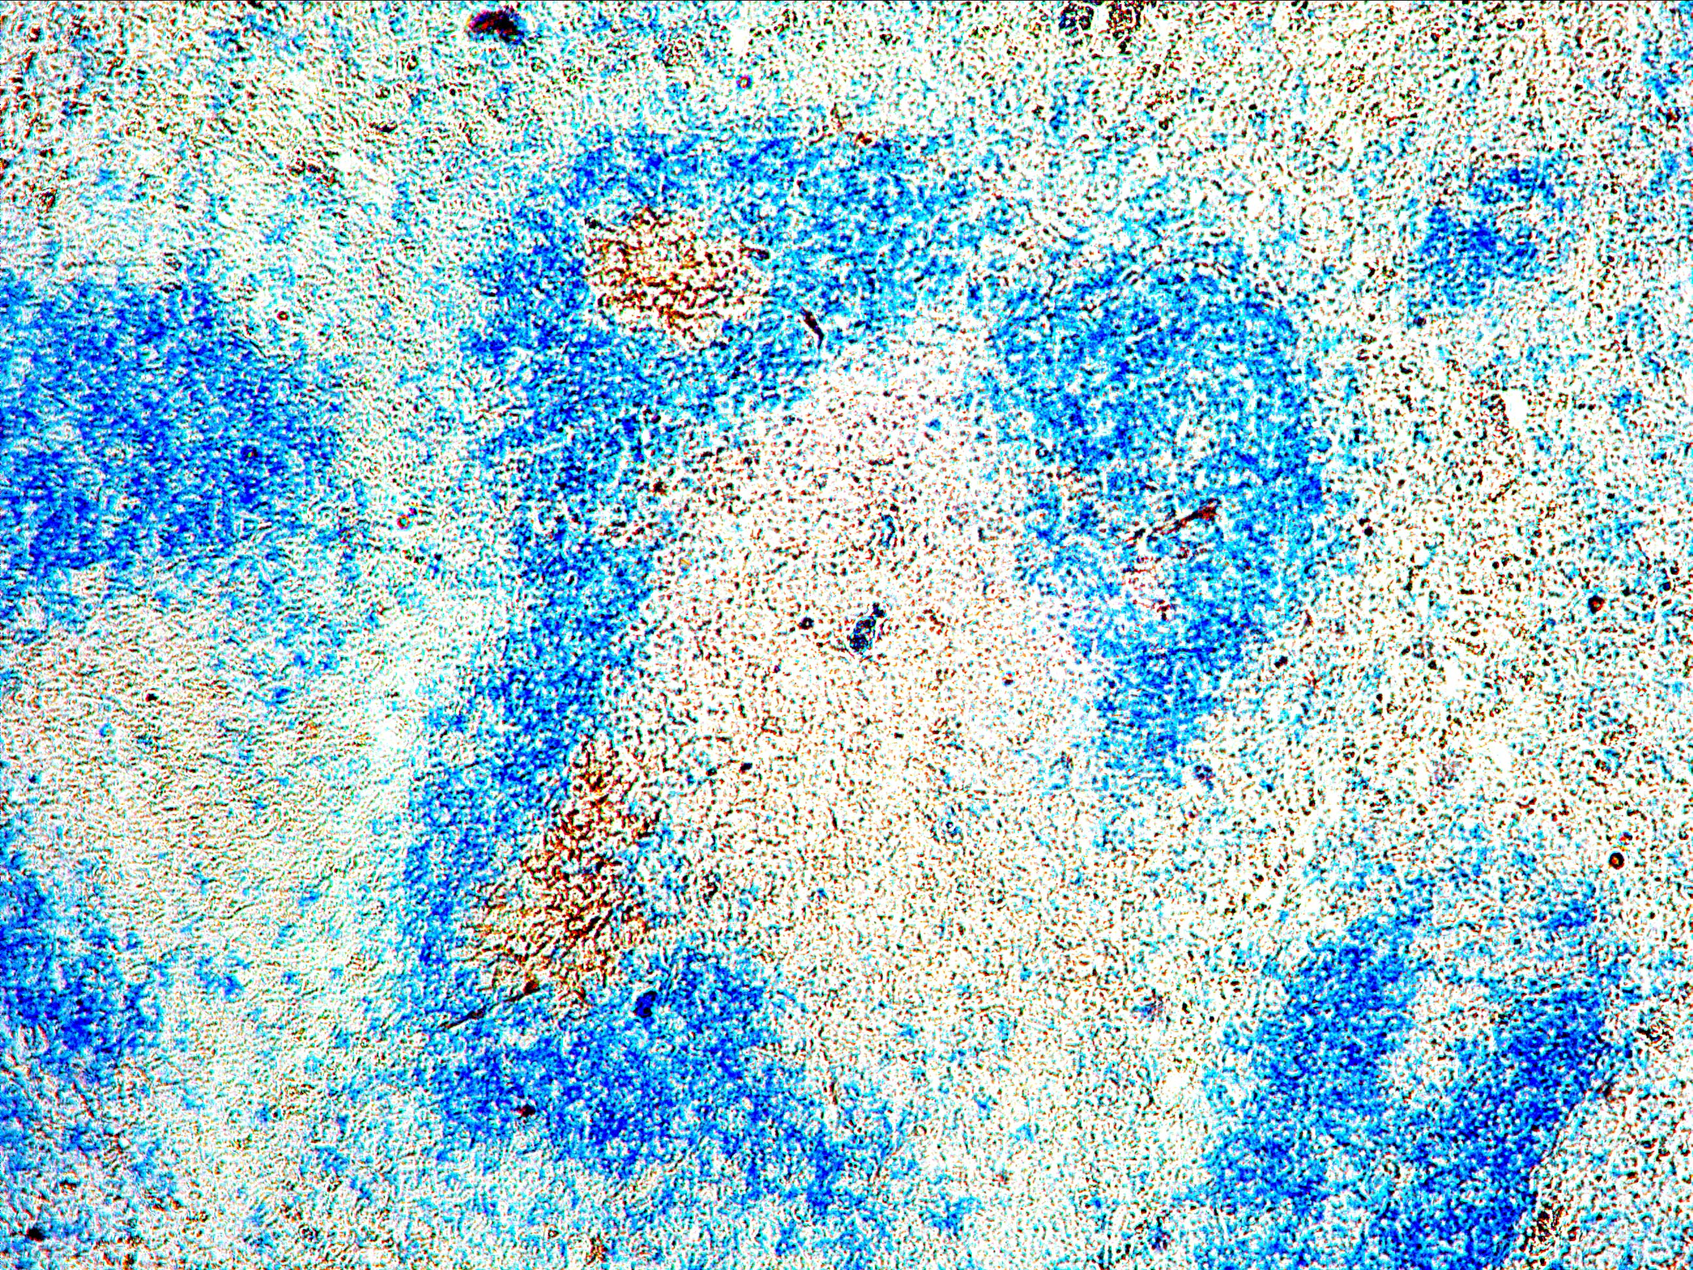
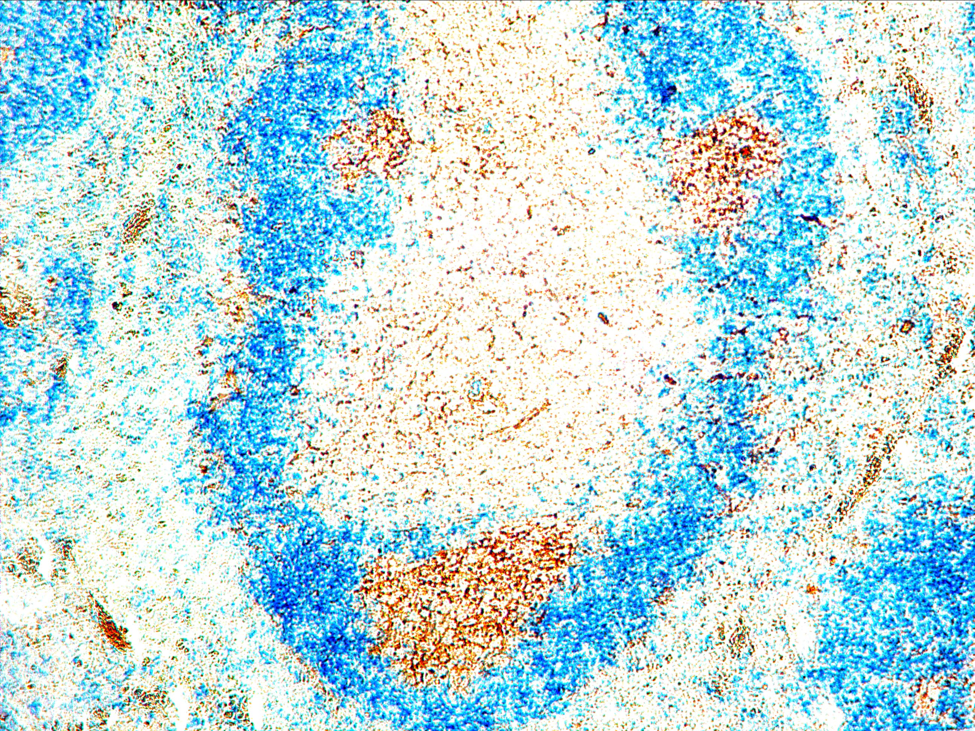
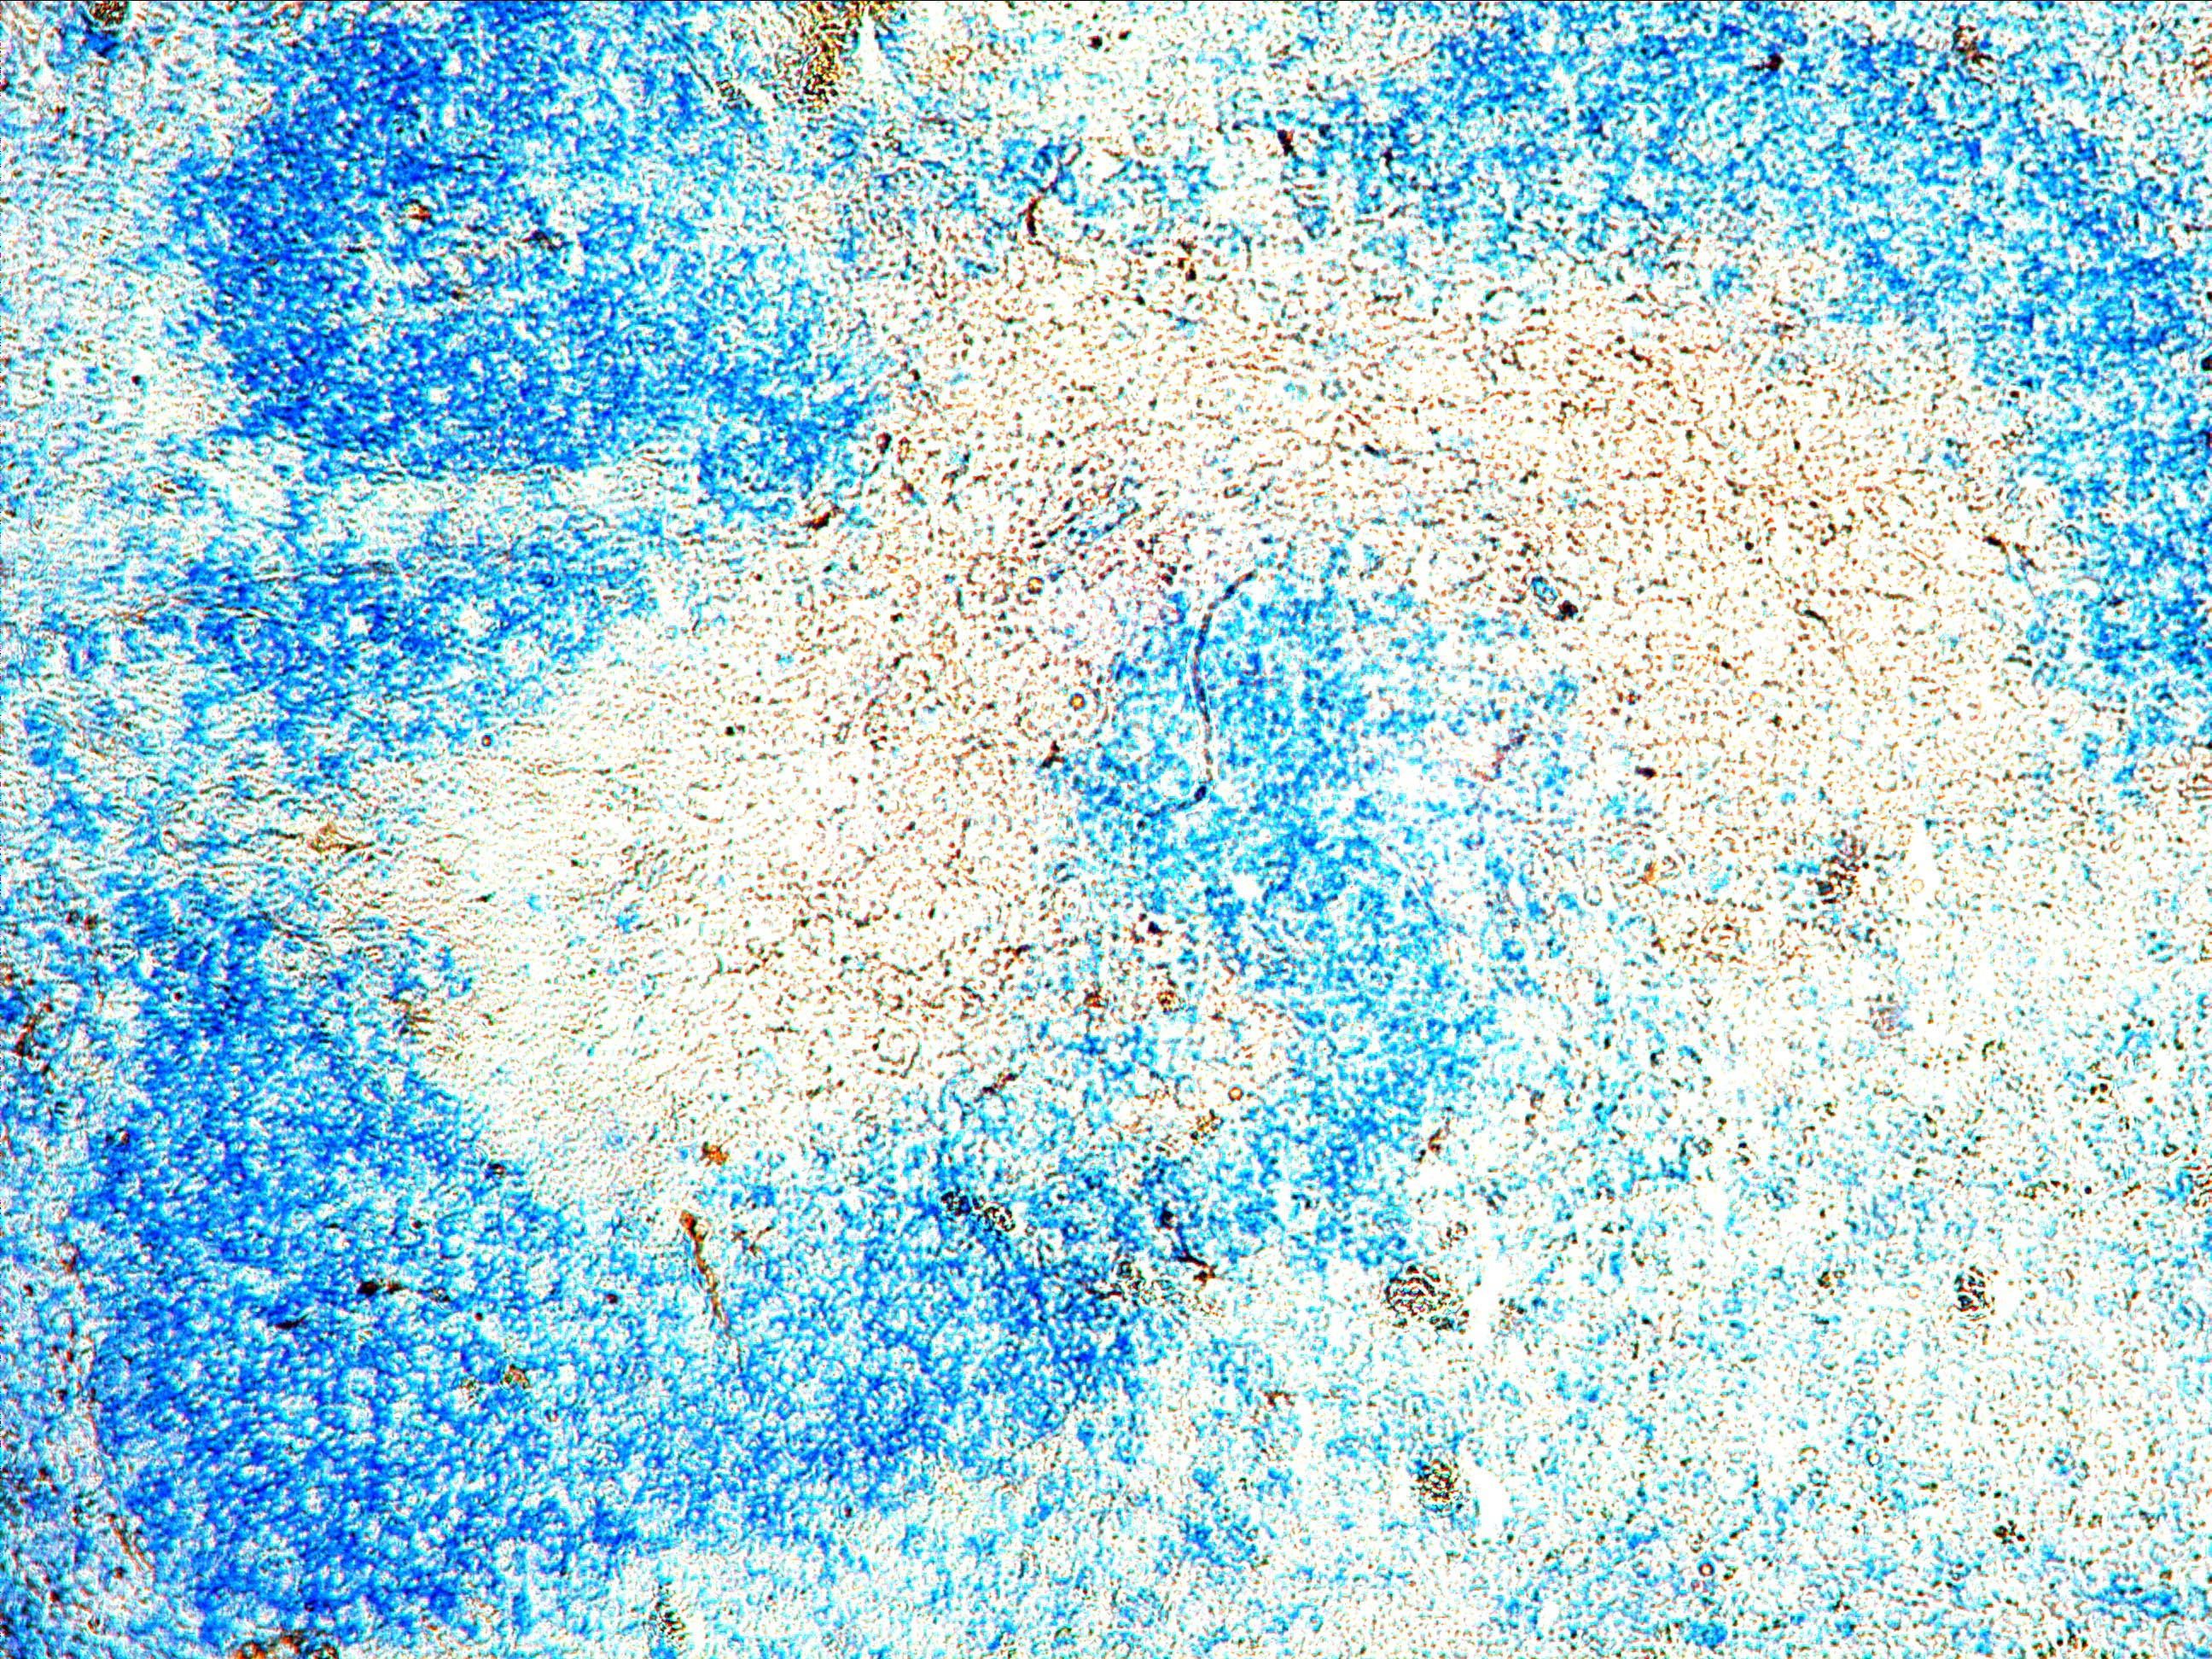
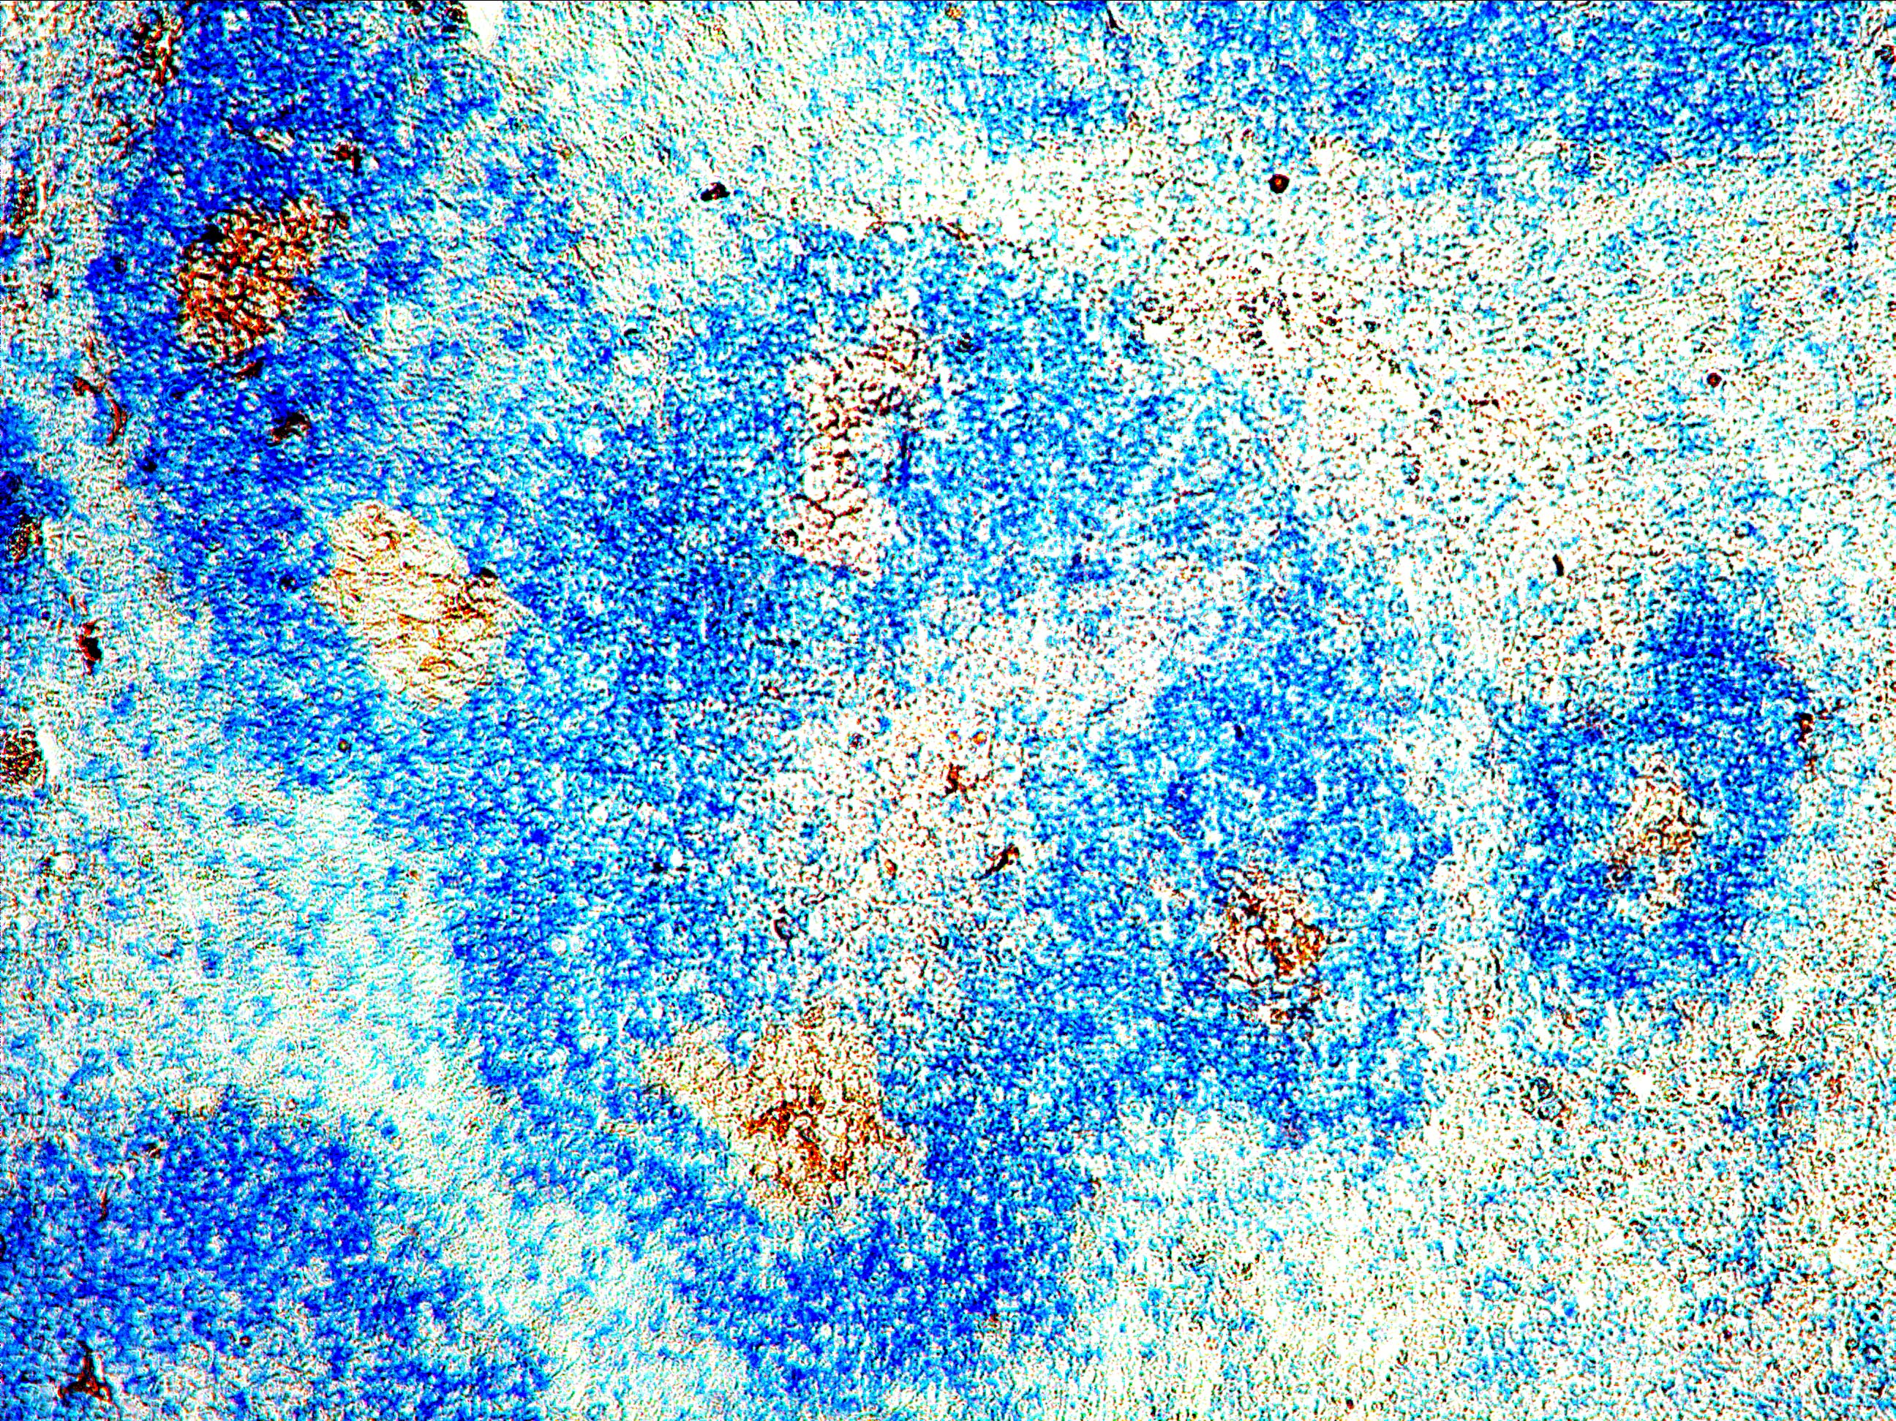
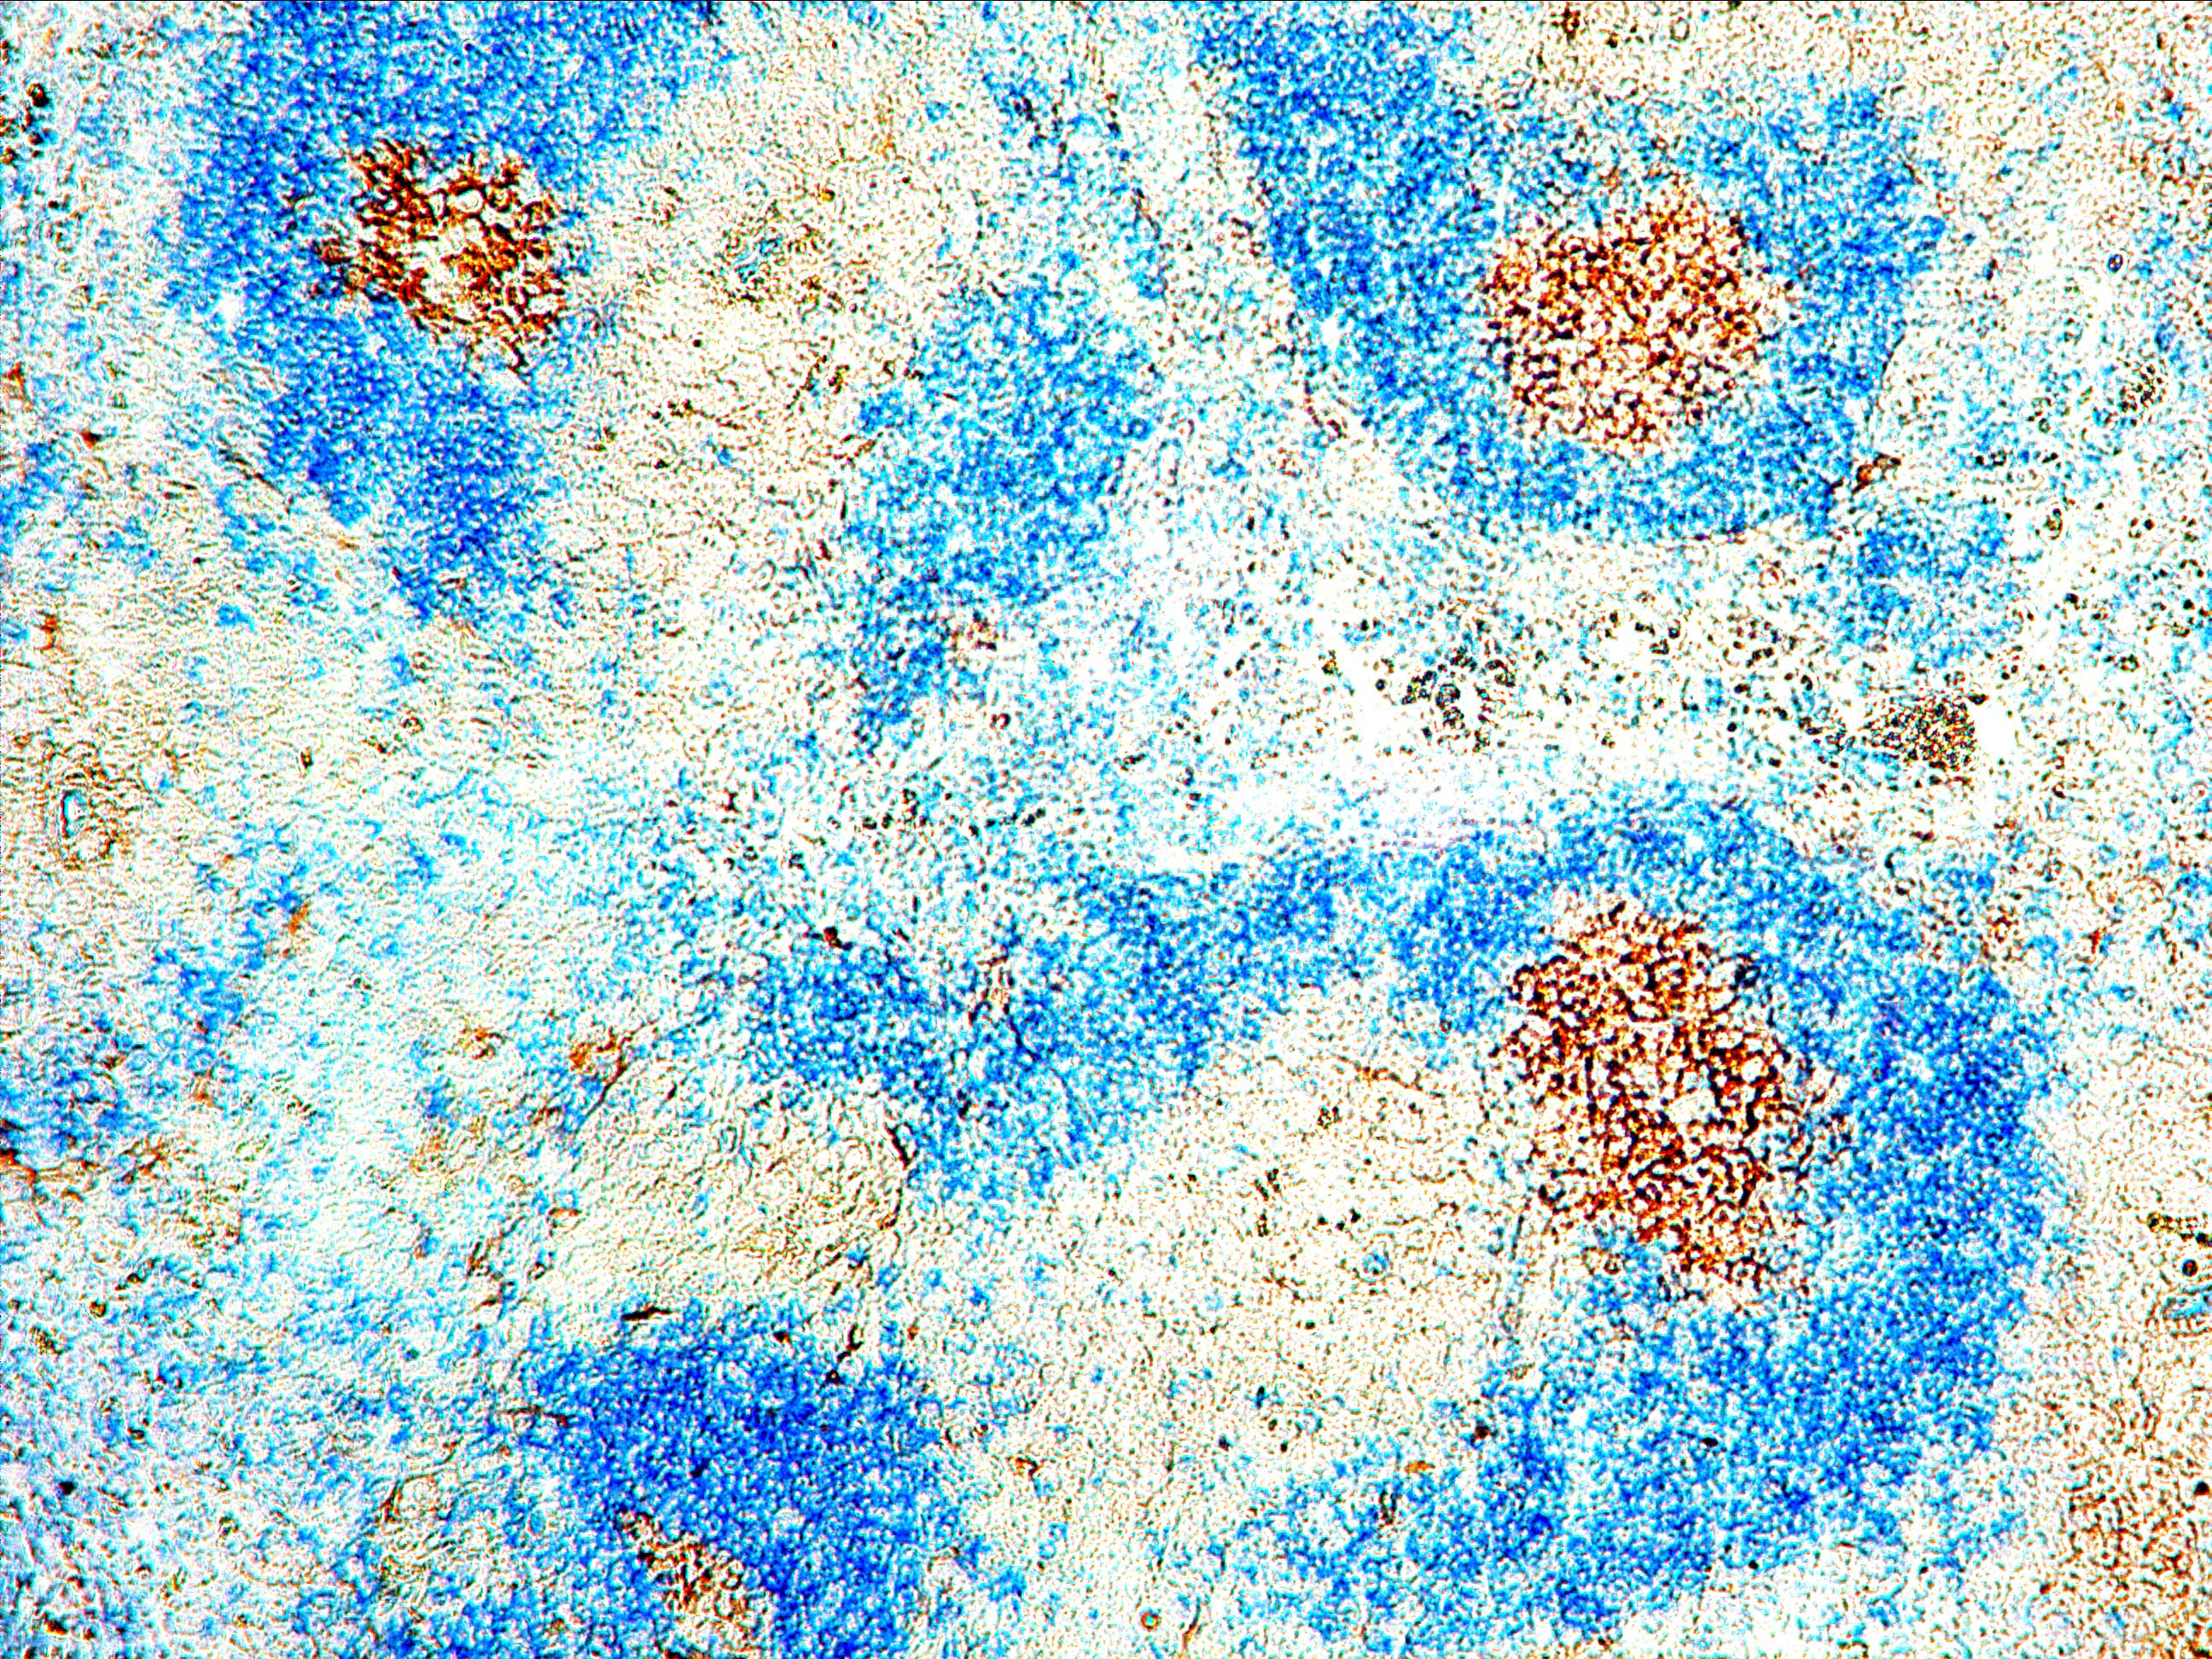
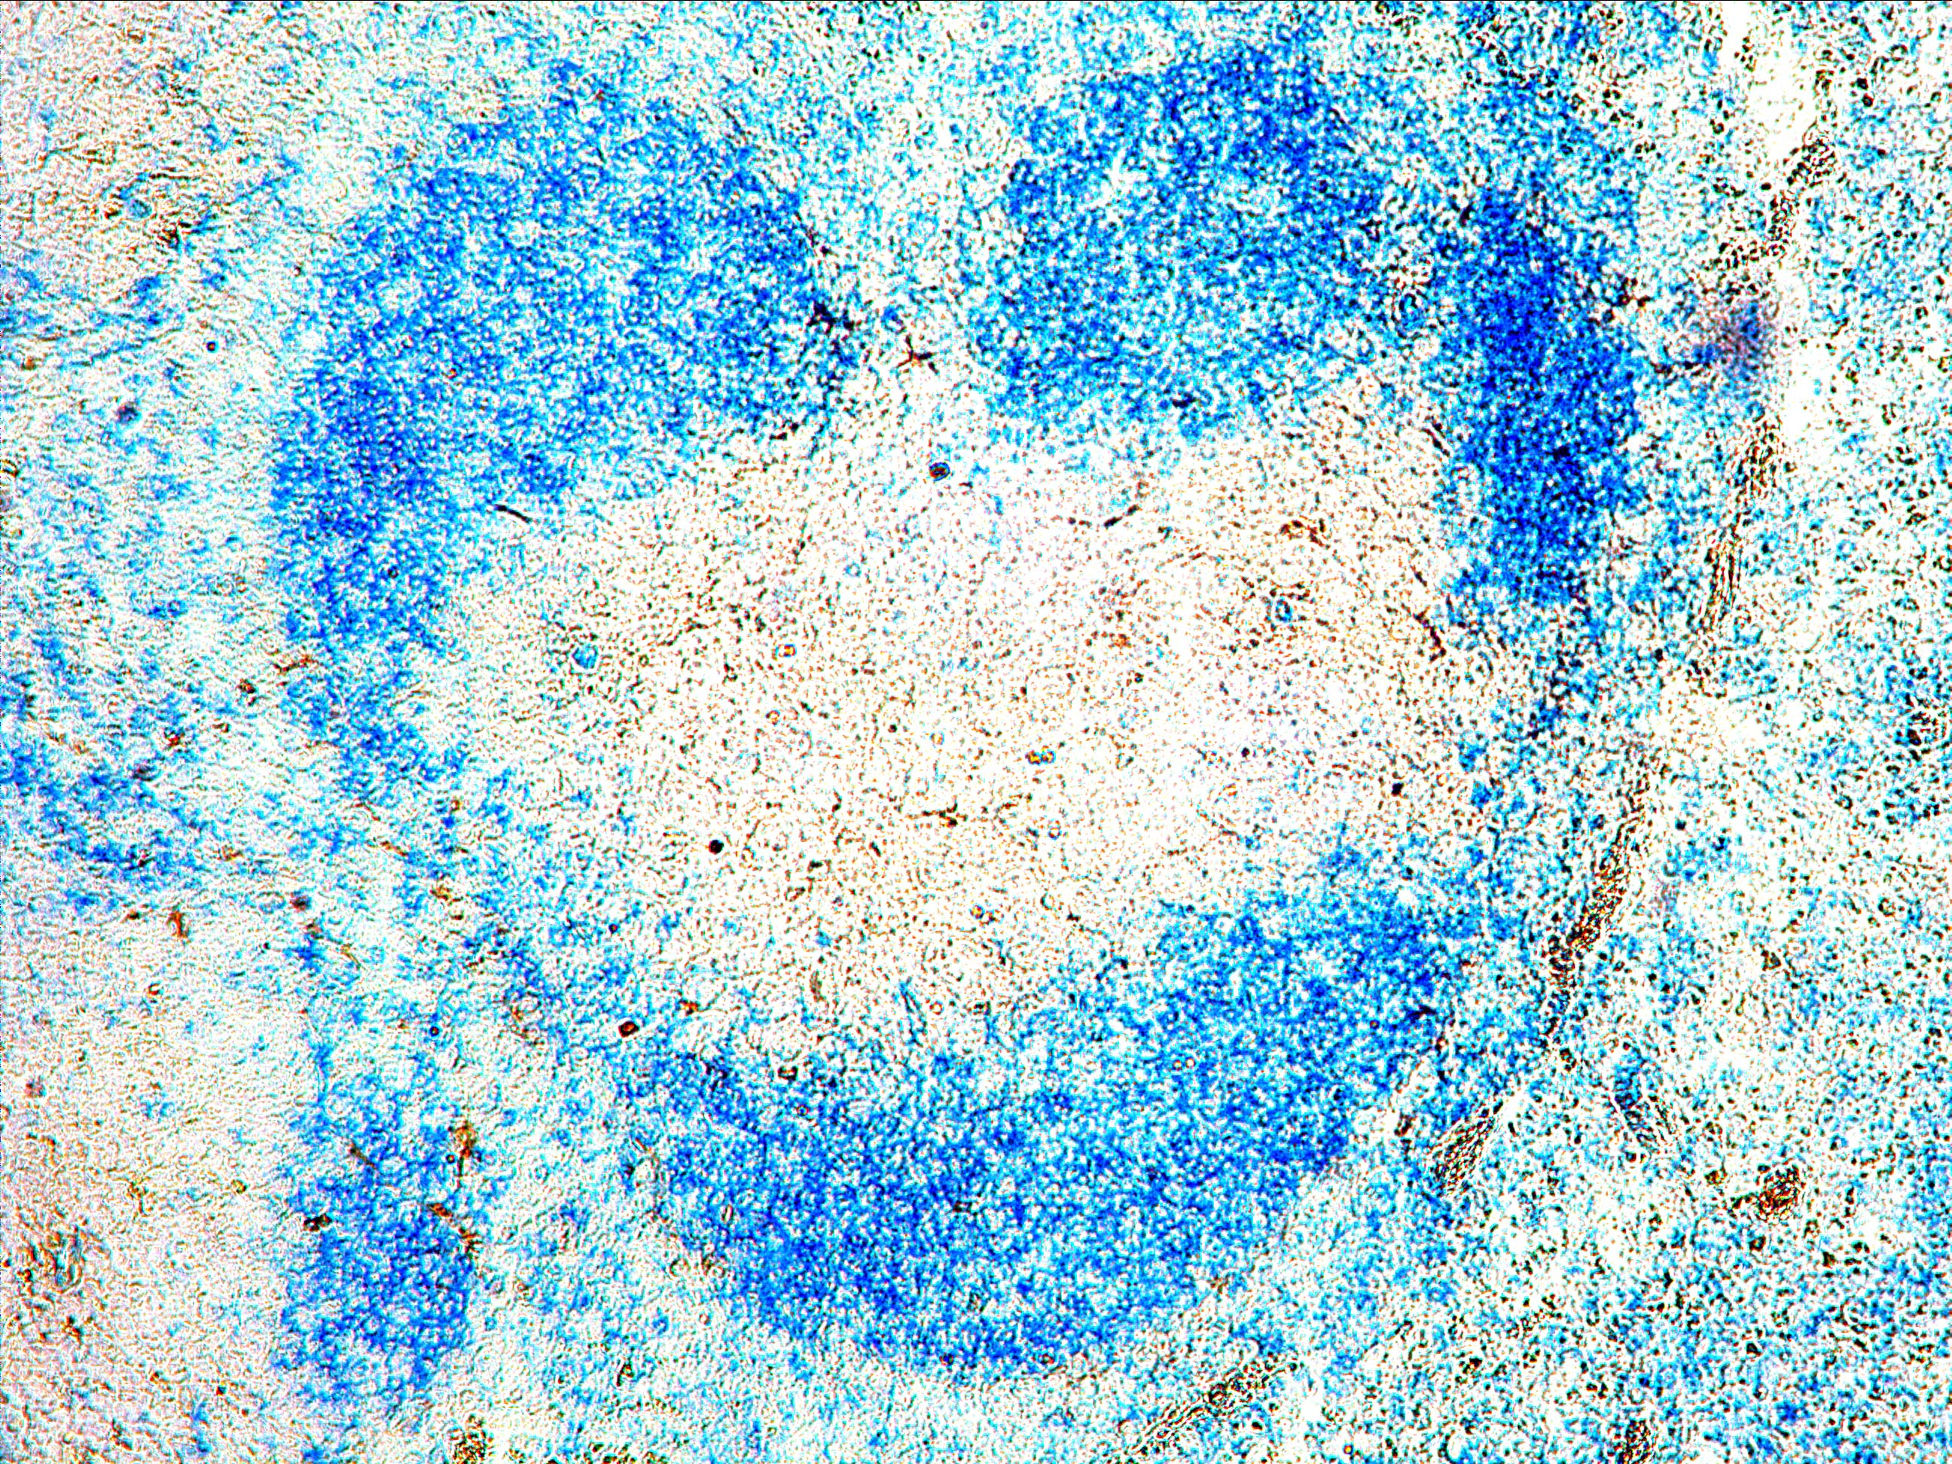
What is the effect of TLR7 and TLR9 on Spt- GC formation ?
***
***
NS
B6
TLR9 KO
TLR7 KO
***
**
***
PNA IgD
3 mo
% B220⁺Fas^{hi}PNA^{hi}GC B Cells
% CD4⁺CXCR5^{hi}PD-1^{hi} T_{FH} Cells
PNA IgD
6 mo
B6
B6
TLR9 KO
TLR9 KO
TLR7 KO
TLR7 KO
Germinal center
6 mo
Absolute requirement of TLR7 in Spt-GC formation

Slide 11
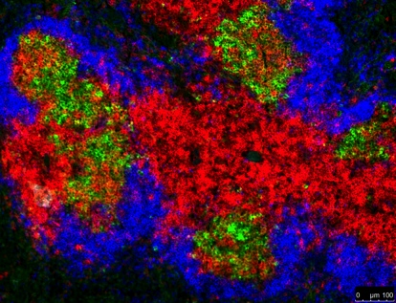
What is the role of TLR7 and TLR9 in Spt-GC response in B6.Sle1b mice?
6 mo old naïve mice
B6
B6.Sle1b
**
**
***
***
***
***
***
***
% B220⁺Fas^{hi}PNA^{hi}GC B Cells
% CD4⁺CXCR5^{hi}PD-1^{hi} T_{FH} Cells
Sle1b/TLR7 KO
Sle1b/TLR9 KO
B6
B6
Sle1b
Sle1b
Sle1b/TLR9 KO
Sle1b/TLR9 KO
100X
Sle1b/TLR7 KO
Sle1b/TLR7 KO
GL7 CD4 IgD
TLR7 promotes while TLR9 downregulates Spt-GCs in B6.Sle1b mice

Slide 12
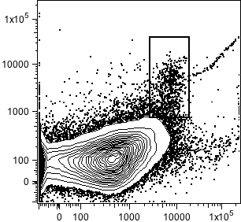
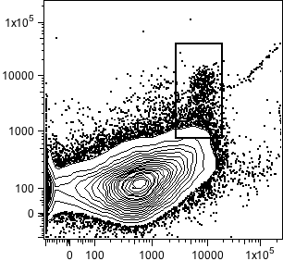
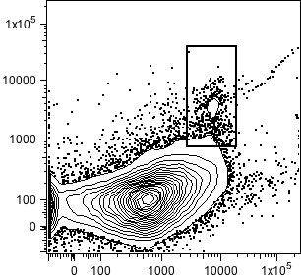
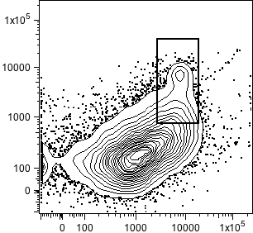
6 mo old naïve mice
***
***
B220⁺
***
B6
B6.yaa
0.9
1.8
% B220⁺Fas^{hi}PNA^{hi} GC B Cells
NS
PNA
B6.Sle1b
B6.Sle1b.yaa
***
1.7
6.9
***
B6
Fas
B6.Sle1b
B6.yaa
B6. Sle1b.yaa

Slide 13
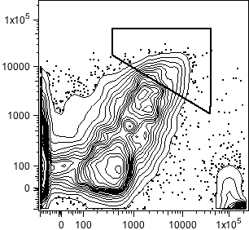
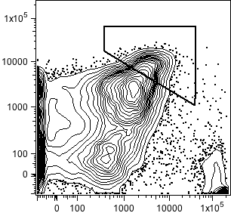
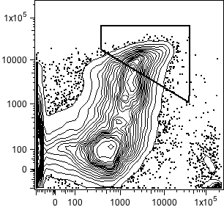
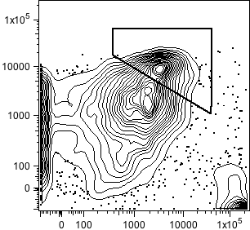
***
***
CD4⁺
***
B6
B6.yaa
5.4
8.6
NS
% CD4⁺CXCR5^{hi}PD-1^{hi} GC T_{FH} Cells
***
PD-1
B6.Sle1b
B6.Sle1b.yaa
***
8.4
21.8
B6
CXCR5
B6.Sle1b
B6.yaa
B6. Sle1b.yaa
Extra copy of TLR7 in B6.yaa and B6.Sle1b.yaa mice enhances
Spt-GC and Tfh cell responses

Slide 14

Does B cell receptor (BCR) and TLR7 stimulation synergize to induce Spt-GCs?
Imiquimod (IMQ) :TLR7 agonist
B6
B6.Sle1b
BCR signaling together with TLR signaling enhances Spt-GC formation in B6.Sle1b mice but not in B6 controls

Slide 15
We also observed that:
TLR7 is essential for the generation of anti-dsDNA, anti-histone, anti-nucleosome, anti-Sm/RNP, and anti-cardiolipin antibodies.
TLR9 is essential for the formation of anti-dsDNA, anti-histone and anti-nucleosome antibodies but NOT anti-Sm/RNP and anti-cardiolipin antibodies
Both TLR7 and TLR9 are essential for Glomerular complement
deposition and progressive kidney pathology

Slide 16
Does TLR7 expression in myeloid cells contribute to Spt-GC formation?
Mouse strain Spt-GC at 3 mo
CD11c-Cre^{+/-}-MyD88^{fl/fl} ✔
LysM-Cre^{+/-}-MyD88^{fl/fl} ✔
TLR7 and 9 in myeloid cells do not play a direct role in Spt-GC formation

Slide 17
Does TLR7 expression in B cells contribute to Spt-GC formation?
Bone Marrow Chimeras
B6.μMT mice (Do not have mature B cells)
B6.μMT
B6
OR
TLR9KO
OR
TLR7KO
BM cells
80%
BM cells
20%
B6.μMT
Spontaneous GC analysis after 3 mo of transfer

Slide 18
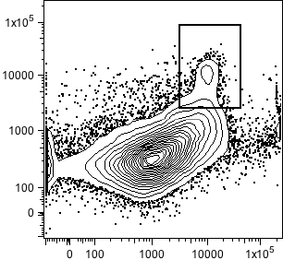
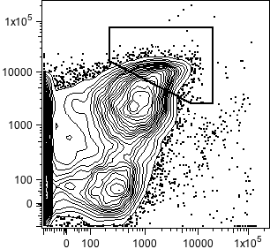
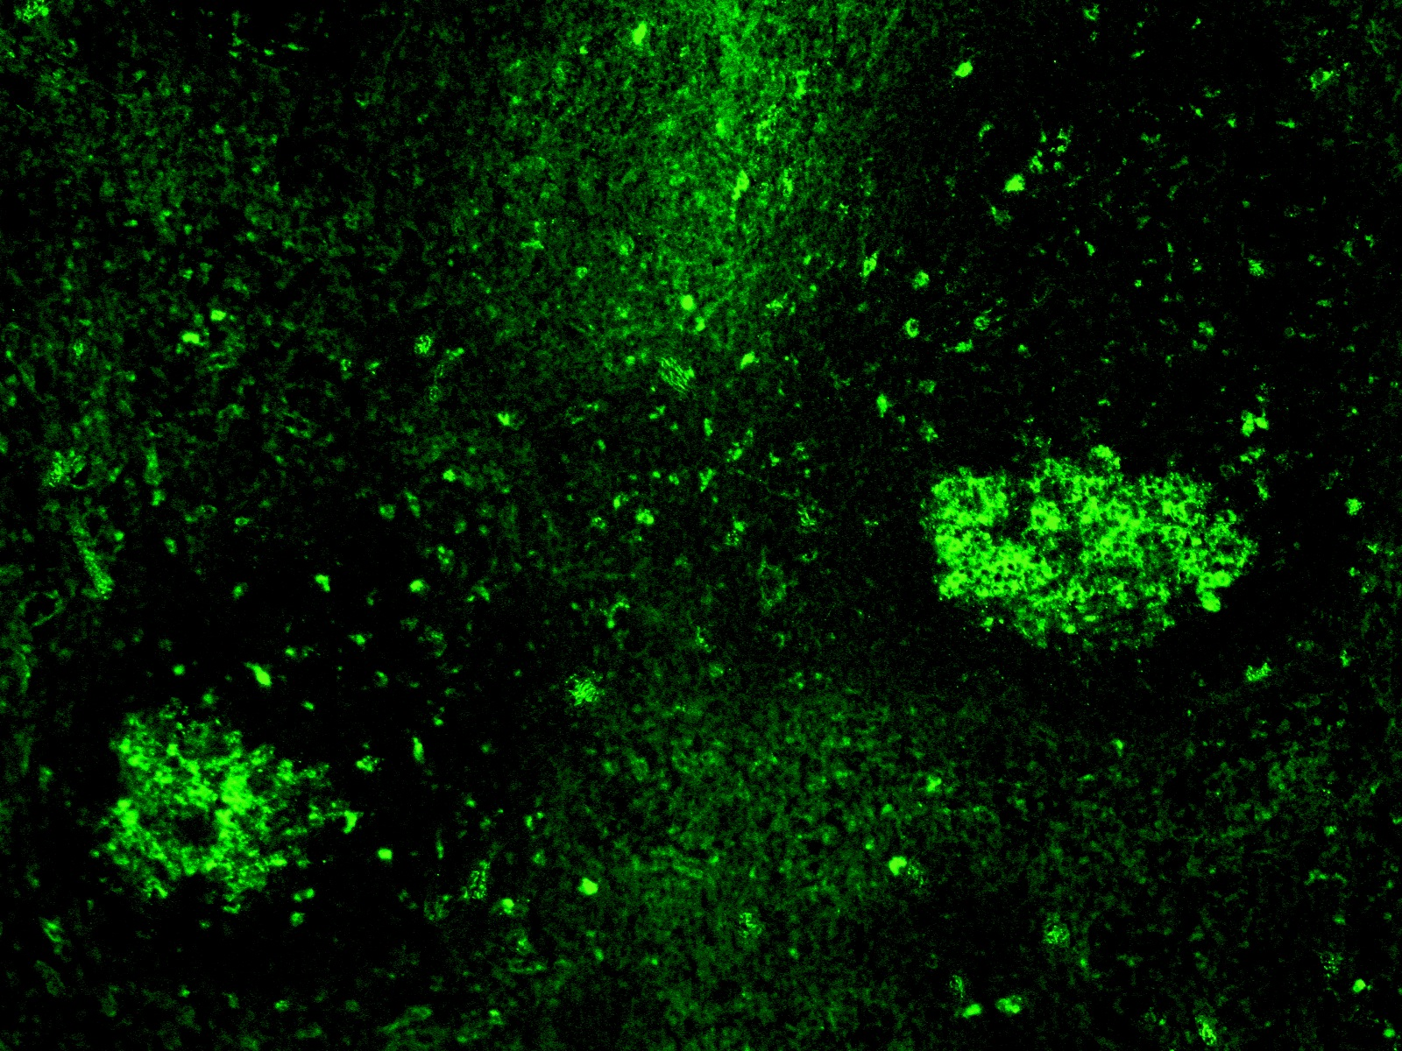
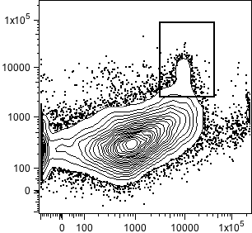
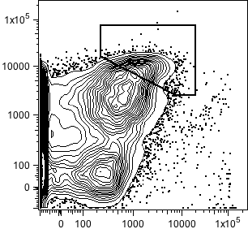
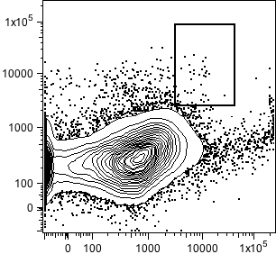
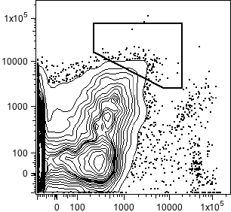
2.5
8.9
B6 + μMT
to μMT
GL-7
1.7
7.8
TLR9 KO + μMT
to μMT
GL-7 CD4 IgD
0.1
1.2
TLR7 KO + μMT
to μMT
PNA
PD-1
B6 + μMT
to μMT
TLR9 KO + μMT
to μMT
TLR7 KO + μMT
to μMT
FAS
CXCR5
TLR7 expression in B-cells is necessary for the induction of Spt-GCs

Slide 19
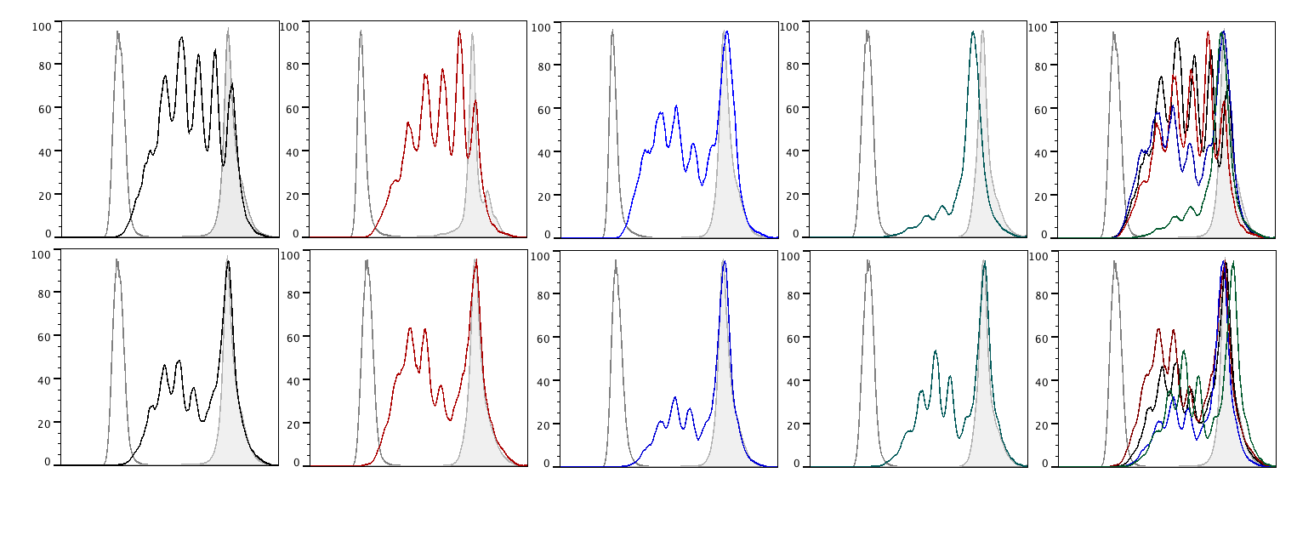
2. What is the effect of TLR7 and 9 on B cell proliferation?
In-vitro Proliferation
B6
TLR9KO
TLR7KO
MyD88KO
overlay
B cells
Anti IgM/
anti CD40
T cells
Anti CD3/
anti CD28
events
CFSE

Slide 20
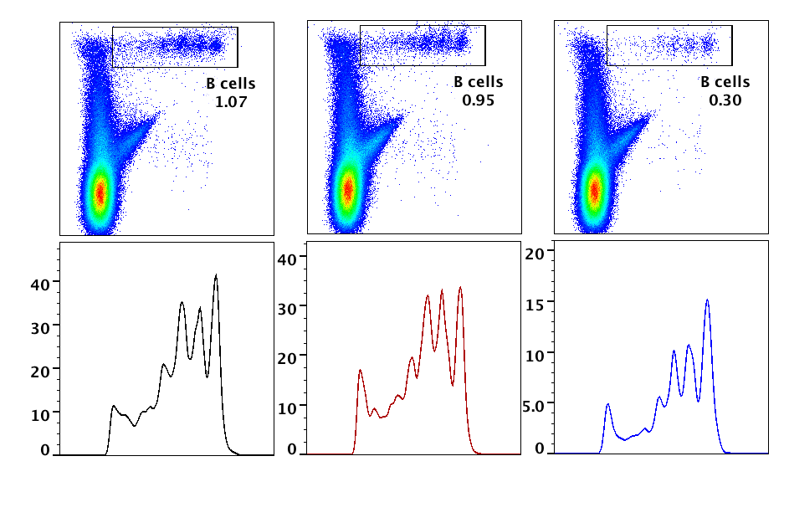
In-vivo Proliferation
B6.μMT
B6
OR
SRBC
TLR9KO
B cells
5 x 10⁶
OR
B6.μMT
TLR7KO
B6.μMT
Immunization cell transfer CFSE dilution
Day 0 Day 2 Day 6
B220
events
B6
TLR9KO
TLR7KO
CFSE

Slide 21
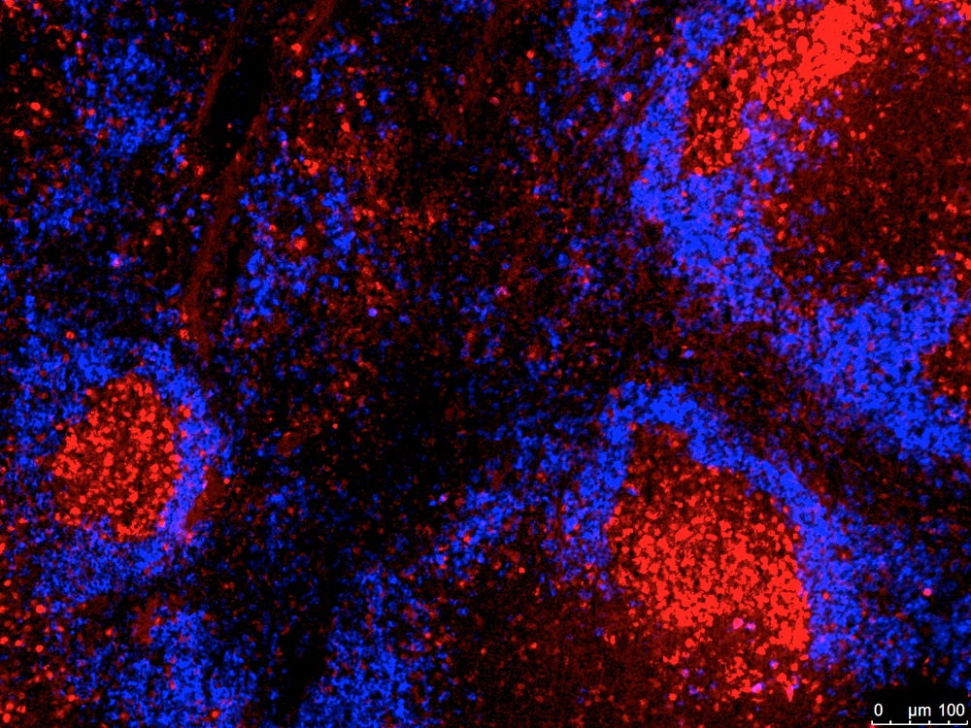
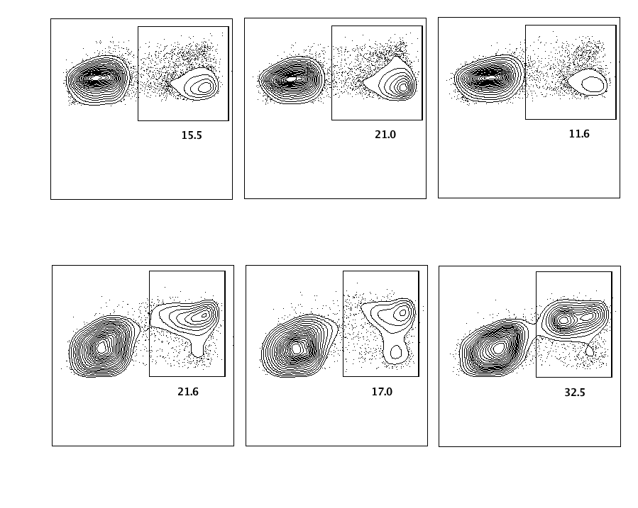
B6
Sle1b
Sle1b/TLR7 KO
Sle1b/TLR9 KO
Ki67 IgD
Anti IgM /anti CD40 stimulation
B220
15.5
21.0
11.5
Ki67
B6
TLR9KO
TLR7KO
TLR7 is required for optimal proliferation of B cells upon BCR stimulation

Slide 22
3. What is the effect of TLR7 and 9 on B cell survival?
Anti IgM /anti-CD40 stimulation

Slide 23
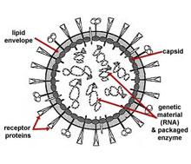
BCR
TCR
MHCII
CD40L
Apoptotic
cells
CD4 T cells
(Tfh cells)
B cells
CD84/Ly108
(Sle1b)
Survival Signals
Proliferative signals
Altered Spt-GC response
GC reaction
Escape negative selection
AutoAb producing plasma cells or memory B cells

Slide 24
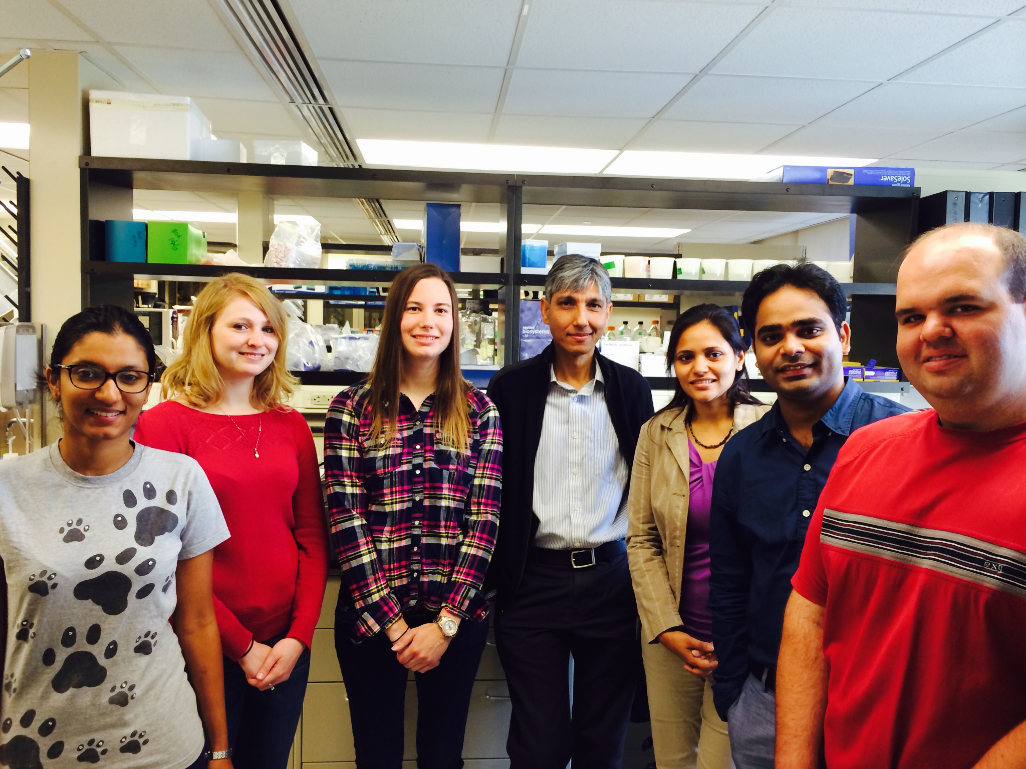



Rahman Lab:
Chetna Soni, PhD
Eric Wong
Phillip Domeier
Melinda Elias
Tahsin Khan
Stephanie Schell
Sathi Babu Chodisetti, PhD
Collaborators:
Ward Wakeland (UT Southwestern)
Dr. Shizuo Akira (Osaka University)
Dr. Milena Bogunovic
Dr. Aron Lukacher
Dr. Chris Norbury

