Slide 1
A Wireless Cognitive Radio Network with a Synchronized Cooperative Relaying
Zaid A. Shafeeq
Mohammed N. Al-Damluji
Al-Ahliyya Amman University
Amman - Jordan
September 2015

Slide 2
Outline
Introduction
System model
Protocol procedure
Simulation results
Conclusion

Slide 3
Outline
Introduction
System model
Protocol procedure
Simulation results
Conclusion

Slide 4
Introduction
This paper attempts to apply cooperative relay in an underlay wireless cognitive radio network
Relay technology is one of these methods that are used to enhance the performance of wireless networks
This technique is based on using relay nodes that are located in the path between the source and the destination
These cooperative nodes receive the signal from the transmitter, then process it, and retransmit it to the destination

Slide 5
Introduction
Cognitive radio is another technique that was suggested in order to improve the performance of the wireless networks
This technique depend on the phenomenon of the spectrum utilization , where it is expected to overcome the shortage on the frequency spectrum and to enhance its utilization
Underlay scheme, cognitive radio gives wireless commun-ication users (the secondary users) the opportunity to use the frequency bands that are not occupied by their licensee users (the primary users)

Slide 6
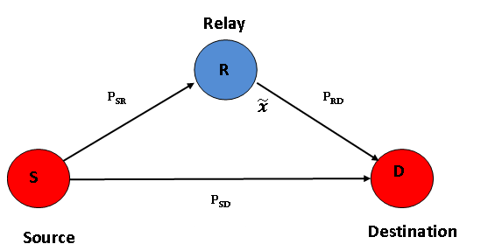
Introduction
We use the relay technology in the sense of cognitive radio
We intend to employ the features of relay in cognitive radio to get the maximum benefits from both techniques

Slide 7
Outline
Introduction
System model
Protocol procedure
Simulation results
Conclusion

Slide 8
System model
We adopted a system that consists of four secondary users in addition to a single primary user
The secondary users SUi are located around the primary user PU, as they adapt their power from the primary user

Slide 9
System model
Each two nodes connect together and form a communication pair while the other two nodes work as relay nodes for this pair
Inversely, those relay nodes form the second communication pair and the nodes in the first pair work as relay nodes for the second pair

Slide 10
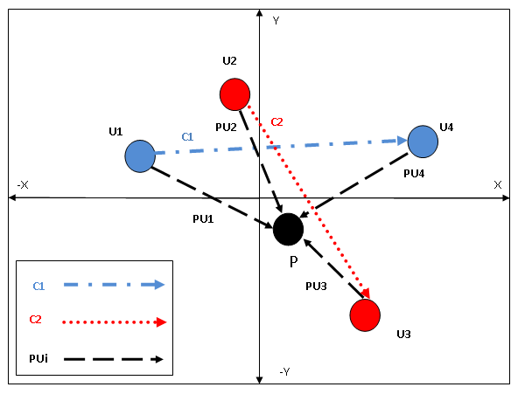
System model

Slide 11
Outline
Introduction
System model
Protocol procedure
Simulation results
Conclusion

Slide 12
Protocol procedure
Each secondary user connects randomly chooses another secondary user to form a pair
Two pairs have been formed. The first pair exchanges data after choosing a best relay node from the other two secondary users
The same process is performed by the second pair

Slide 13
Protocol procedure
Calculating the signal to noise ratio (SNR) for each relay node path in addition to the direct link is necessary for the best path detection process between the source and the destination of a pair
The best relay selection process (choosing the highest SNR) is executed

Slide 14
Protocol procedure
SNR value depends on the channels conditions
The next figure illustrates the connections for the first pair which consists of secondary user U1 and secondary user U4. Secondary users U2 and U3 are relay candidates for pair 1

Slide 15
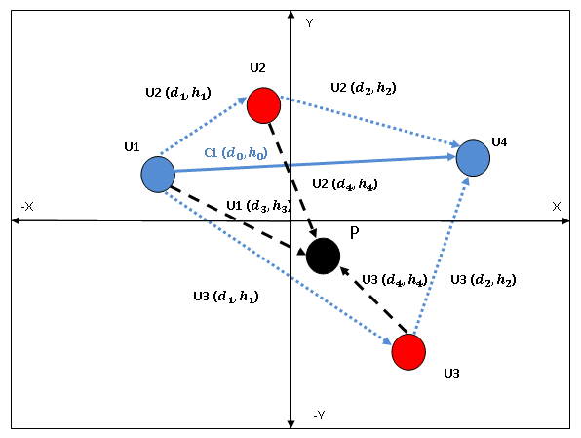
Protocol procedure

Slide 16
Outline
Introduction
System model
Protocol procedure
Simulation results
Conclusion

Slide 17
Simulation results
The outage probability calculation through applying Monte Carlo simulation presents the system’s performance where each two nodes work as source and destination while the other two nodes work as relay ones
The locations of the nodes are distributed randomly, and any two nodes can establish a connection to form a pair

Slide 18
Simulation results
Thus giving the system better flexibility and providing a more realistic behavior
Each node works as a transmitter / receiver and as a relay node simultaneously

Slide 19
Simulation results
For example:
The system model assumed that the distribution of the nodes is U1(1,O.5)U2(0.8,0.5)U3(0.3,0.9) andU4(0.4,0.4)
The first pair is modeled to contain U4,U2and the second pair contains U3,U1
The location of the primary user has been assumed to be (0.5, 0.5)

Slide 20
Simulation results
Figure (1) shows the system procedure when the first pair works as a source and destination and the second pair nodes works as relay nodes
Figure (2) presents the case when the nodes of the first pair work as relay nodes while the nodes of the second pair transmit data

Slide 21
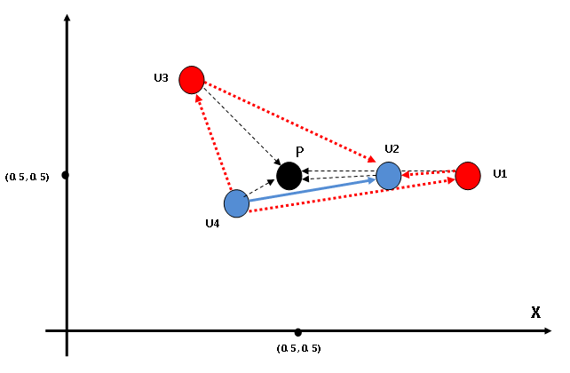
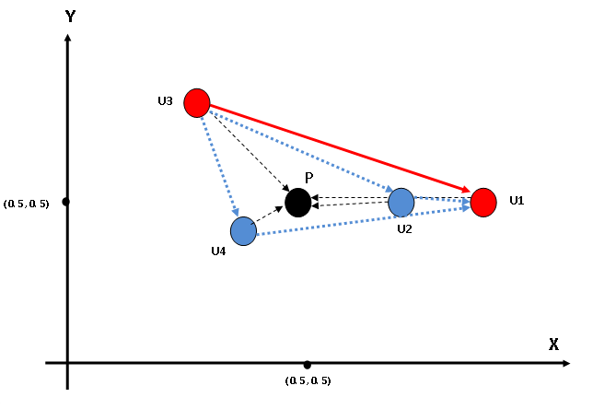
Figure 1
Figure 2

Slide 22
Simulation results
For the outage probability calculations, the system applies (10^5) trials and adopts the average value of the simulation
The next figure presents the outage probability in two cases; the first one is applying cooperative relay and the second one is deactivating it
It can be seen that activating cooperative relay enhances the performance significantly for each pair within the system.

Slide 23
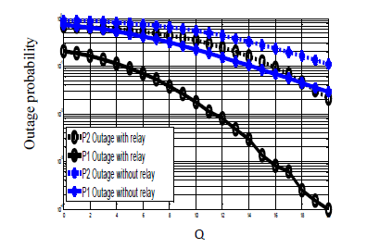
Simulation results

Slide 24
Simulation results
The next figure shows the system performance with different distribution models to the four communication nodes
The outage probability of each system model is considered as a total value of outage for the two communication pairs
The best performance o the system model can be obtained when users and relay nodes are located far away from the primary user

Slide 25
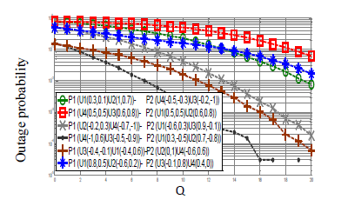
Simulation results

Slide 26
Outline
Introduction
System model
Protocol procedure
Simulation results
Conclusion

Slide 27
Conclusion
This system is suggest a way to employ all the existing nodes to work as a send/receive node or as a relay node
Which enhances the performance of the communication path
Using relay technique between the secondary users make the improvement in the system's performance is noticeable

