Slide 1
IN THE NAME OF GOD
Post Tonsillectomy Pain
Presented by:
Dr.Z.Sarafraz
Otolaryngologist

Slide 2
Post Tonsillectomy Pain

Slide 3
Introduction
Tonsillectomy is a common surgery in children
Post tonsillectomy pain is an important concern.
Duration &severity of pain depend on:
The surgical technique
Antibiotic& corticosteroid use
preemptive and postoperative pain management
patient’s perception of pain

Slide 4
Surgical indication for tonsillectomy

Slide 5
Surgical indication for tonsillectomy

Slide 6
Multiple tonsillectomy techniques
sharp dissection
Electrocauterization
Lasers(KTP,CO2)
Coblation
microdebrider

Slide 7
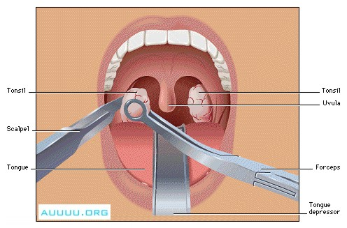
Introduction

Slide 8
Introduction
Sharp dissection slightly less postoperative pain
Electrocautery less in intraoperative blood loss
But more postoperative pain
Sub total tonsillectomy less postoperative pain but more recurrence rate

Slide 9
Tonsillectomy complications
Postoperative Hemorrhage
Airway Obstruction and Pulmonary Edema
Velopharyngeal Insufficiency
Nasopharyngeal Stenosis
Cervical Spine Complications
pain

Slide 10
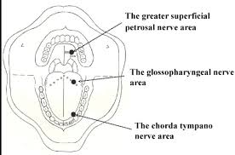
Tonsillar innervation

Slide 12
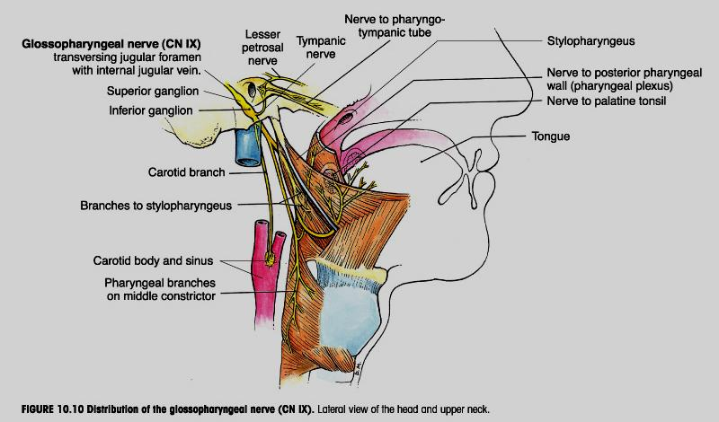

Slide 13
Introduction
There are many studies that investigated the control of post tonsillectomy pain using different drugs:

Slide 14
Pappas AL et al,1998
The effect of preoperative dexamethasone on the immediate and delayed postoperative morbidity in children undergoing adenotonsillectomy.
Compared with placebo, dexamethasone significantly decreased the incidence of PONV in the 24 h after discharge, improved oral intake, decreased the frequency of parental phone calls, and resulted in no hospital returns for the management of PONV and/or poor oral intake.

Slide 15
Samarkandi AH,et al,2004
Use of dexamethasone to reduce postoperative vomiting and pain after pediatric tonsillectomy procedures.
Dexamethasone is considered safe and there was no adverse effects associated with a single dose of dexamethasone. Although the need for rescue antiemetic, time to oral intake and analgesia requirements in both groups were not significant, however, we found that dexamethasone does have antiemetic properties as overall incidence of retching and vomiting was significantly less in dexamethasone group as compared to control group in children who underwent tonsillectomy

Slide 16
Ugur MB,et al,2008
The efficacy of intramuscular injection and peritonsillar infiltration of tramadol to prevent pain in children undergoing tonsillectomy.
Peritonsillar infiltration with tramadol provided good intraoperative analgesia, less postoperative pain on awakening and lower analgesic requirement within the first hour after surgery.

Slide 17
Saeed Khademi et al,2011
Intravenous and Peritonsillar Infiltration
of Ketamine for Postoperative Pain after
Adenotonsillectomy: A Randomized
Placebo-Controlled Clinical Trial
more effective in reducing the postoperative pain severity, need for analgesics and need for antiemetics.

Slide 18
V. Hermans et al.2012
Effect of dexamethasone on nausea, vomiting, and pain in pediatric tonsillectomy
A single I.V. injection of DEX at the induction of anesthesia was effective in reducing the incidence of early and late PONV and the level of pain on the second postoperative day. A 0.15 mg/ kg DEX dose appeared to be as effective as a 0.5 mg /kg dose to reduce the incidence of PONV.

Slide 19
Z.Sarafraz et al 2013
Assessing the effect of peritonsillar infiltration of ketamine and tramadol on post tonsillectomy pain and compare the side effects.
Peritonsillar infiltration of tramadol before
operation decreased post tonsillectomy pain
Without any hemodynamic instability, sedation, or hallucinations.
Decreased analgesic consumption
Decreased time to the beginning of oral liquid diet

Slide 20
Z.Sarafraz et al 2013
Ketamine:
cause hallucinations
does not have the efficacy of tramadol in pain management & hemodynamic stabilization effects.

Slide 21
Introduction (Sarafraz et al 2014)
Aim To assess the effect of peritonsillar infiltration tramadol and parenteral dexamethasone on post tonsillectomy pain, nausea and vomiting in children.

Slide 22
Dexamethasone: anti-emetic and anti-inflammatory
Tramadol:
opium agonist that mostly effects mu receptors
in smaller extent kappa and sigma receptors
Side effects:
nausea, vomiting, dizziness
sweating, anaphylactic reactions
increased intra-cerebral pressure, lower the seizure threshold

Slide 23
Inclusion Criteria
6-12 years old children with elective tonsillectomy
Recurrent tonsilitis
Obstructive symptoms (snoring, open mouth breathing, sleep apnea)

Slide 24
Exclusion Criteria
Cardiovascular disease
History of seizure
Peritonsillar abscess
Long operation time (more than 1 hour)

Slide 25
Material & Methods
A double-blind randomized clinical trial
90 patients aged 6-12 years
sharp dissection without electrical cutter
sedation and pain scores at2, 4, 6, 8, and 12 hours (VAS & PONV scores)
The patients were randomly divided into 3 groups :
Dexamethasone
Tramadol
Placebo

Slide 26
Materials and methods
randomized placebo-controlled clinical trial
3groups:
Group(A) :was injected 0.5 mg/kg Dexamethasone
Group( B): 2 mg tramadol
Group (C): 2 cc NaCl
injection site: bed and anterior fold of each tonsil (1 cc for each tonsil)blind by an anesthesiologist and ENT surgeon

Slide 27
Results
variable | Dexamethasone | Tramadol | placebo | p
Age Mean (age) | 8.05 + 2.67 | 7.06 + 2.21 | 7.40 + 1.38 | 0.103
Sex (male percent) | 57.10 | 66.70 | 40.02 | 0.061
Duration of anesthesia | 54.29+ 10.96 | 51.67 + 10.37 | 53.00 + 14.6 | 0.553
Duration of Surgery (min) | 42.14 +10.43 | 40.56 + 9.35 | 41.0 + 12.62 | 0.761

Slide 28
Discussion
tramadol had significantly lower pain scores
than other groups at all time points
The time to first dose of analgesic request was
longer in tramadol group than in the other two groups
In our study, tramadol group had significantly shorter
time to the first liquid uptake than dexa &placebo
groups.

Slide 29
Discussion
Dexamethasone group had significantly lower nausea and vomiting (P=0.001)

Slide 30
Discussion
Pain following tonsillectomy is one of the most important complaints
pain consequences :
as excessive use of analgesics
longer period of hospitalization
intolerance to diet, which can lead to nutritional problem
poorer quality of life

Slide 31
Conclusion
Peritonsillar infiltration of tramadol before
operation can decrease post tonsillectomy pain
Without any hemodynamic instability, sedation, or hallucinations.
Decrease analgesic consumption
Decrease time to the beginning of oral liquid diet

Slide 32
Conclusion
Therefore, we recommend the use of tramadol for management of post tonsillectomy

Slide 33
References
gur MB, Yilmaz M, Altunkaya H, Cinar F, Ozer Y, Beder L. Effect of Intramuscular and peritonsillar injection of tramadol before tonsillectomy: a double blind randomized, placebo-controlled clinical trial. Int J Pediatr Otorhinolaryngol. 2008;72:241-8.
ngelhardt T, Steel E, Johnston G, Veitch DY. Tramadol for pain relief in children undergoing tonsillectomy; a comparison with morphin.Paediatr Anaesth. 2003;13:249-52.
al D, Celebi N, Elvan EG, Celiker V, Aypar U. The efficacy of intravenous or peritonsillar infiltration of ketamin for postoperative in children following adenotonsillectomy. Paediatr Anaesth. 2007;17:263-9.
Honarmand A, Safavi MR, Jamshidi M. The preventative analgesic effect of preincisional peritonsillar infiltration of two low doses of ketamin for postoperative pain relief in children following adenotonsillectomy. A randomized, double-blind, placebo-controlled study. Paediatr Anaesth. 2008;18:508-14.

Slide 34
Thanks for Attention

