Slide 1
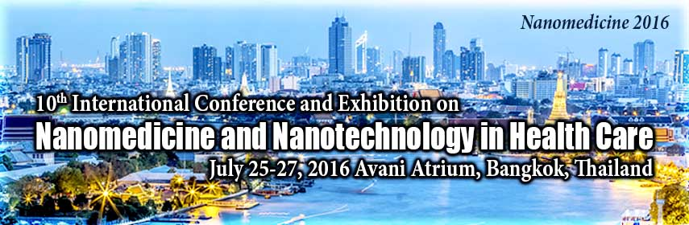


Formulation of Nanocomposite drug containing fine ZnO Q-dots, and consideration of invitro cytotoxicity evaluation of mouth KB44, breast MCF7, colon HT29, and HeLa Cancer Cell Lines, and invivo mouse ear swelling tests
Zahra Fakhroueian*, Alireza Mozafari Dehshiri, Peyman Keyhanvar

Slide 2


1- I am PhD and Adjunct Assistant Professor in organometallic chemistry in Nanotechnology Science and Postdoc in Nanofluids from University of Tehran, Iran.
I am expert in Nanotechnology of chemistry, and Nanobiotechnology Science.
School of Chemical Engineering, College of Engineering, IPE, University of Tehran, Iran.
fakhroueian@ut.ac.ir
2- Department of Traditional Pharmacy, Faculty of Traditional Medicine, Shahid Beheshti University of Medical Sciences, and Barij Essence Pharmaceutical Company. Tehran, Iran.
( pharmacist, PhD in traditional pharmacy)
3- Nano-ophthalmology Lab, Stem Cell Preparation Unit, Eye Research Center, Farabi hospital, Tehran University of Medical Sciences, Tehran, Iran.
(M.D. , PhD in Nanotechnology)

Slide 3
Interesting points and targets
in cancer nanomedicine research
1-Abstract.
2-Short Introduction and history of application of nanotechnology in Nanomedicine Science.
3- Experimental works and preparation of ZnO Nanoparticles and Formulation of Nanofluid as cancer nanomedicine.
Cytotoxicity effects of ZnO nanofluid product against four cancer cell lines and two normal cells.
Characterization of ZnO QD NPs and nanofluid.
Invivo mouse ear swelling tests.
Our achievement.
Conclusion

Slide 4
** Recently, the scientists are going to find a proper way to replace old and traditional cancer medicine by novel materials such as effective Nanoparticles and special Nanofluids as new drugs.
**Nanotechnology-based therapeutics will revolutionize cancer treatment.
** We believe to fight with cancer by using nanomedicine as fine nanofluids.
**Nanomedicine tries to be modified, and have targeting efficiency, retention
and fewer patient side effects.
**Nanoparticles have beneficial properties that can be used to improve drug delivery such as ZnO NPs. Semiconductor Zinc oxide NPs, are very smart for attacking to only tumor cells, while some of the normal cells can be unaffected.
**it is very important for ZnO NPs, which their surfaces can be modified to hydrophilic and hydrophobic materials , in order to solubilize in water as stable solution.
*** Highly diffusion, Drug targeting, good distribution, hydrogen bonding towards cell membrane and into cell cytoplasm are significant mechanism for Performance of ZnO NPs.
Abstract for cancer nanomedicine

Slide 5
Introduction of ZnO NPs as interesting nanomedicines
Nanoparticles have high surface area to volume ratio. This allows for many functional groups to be attached to nanoparticles, and so to bind to certain tumor cells.
Nanotechnology is beginning to allow the scientists, engineers, chemists, and physicians to work at the molecular and cellular levels, to produce important advances in the life sciences and healthcare.
ZnO NPs have biocompatibility, safety and activity properties against broad spectrum of microorganisms such as antibacterial and their excellent untifungi activity, which have been well- investigated.
Limitations to conventional cancer chemotherapy include, drug resistance, lack of selectivity, and lack of water solubility was observed, but Nanoparticles have the potential to overcome these problems.
ZnO Nanoparticles, have been proved to be more efficient than micron ZnO particle, because they have more surface defects and high surface area which facilitate higher contact between nano materials and microbes or tumor cells.

Slide 6
Investigation of application of ZnO QD NPs, and formulation of nanofluids,
as new Amazing and wonderful
antitumor and antimicrobial and
untifungi for nanomedicine as ng /ml
concentrations and water solution stability.
These findings showed that ZnO QDs have low toxicity in normal cells HFF2 and can display potential application in cancer chemotherapy in the near future.

Slide 7
**The most studied Nanoparticles are carbon nanotubes (CNT), gold nanoparticles, silica, ZnO, TiO₂, Al₂O₃, Fe₃O₄, MgO, CuO, CeO₂ , Ag NPs, CdTe and cadmium selenide quantum dots, as promising novel agents for cancer therapy.
**In the present research, we focused on the cellular toxicity of fine ZnO QD NPs containing particular blue fluorescence for invitro targeted delivery of breast MCF7, colon HT29, mouth KB44, human cervical (HeLa) cancer cell lines.
**ZnO Nanoproduct has the wide band gap energy ( 5.32 eV) and demonstrates very high surface energy and undergoes a significant UV-Vis absorption spectroscopy,
large number of defects (oxygen vacancies) on modified surfaces.
*** Also it is able to trap bacteria and major functional groups of plasma membrane proteins in cancerous cells. It also shows less toxicity, greater selectivity and heat resistance.

Slide 8

Experimental works and preparation of ZnO Nanoparticles and novel Nanofluid
1-ZnO NPs were synthesized by chemical hydrolysis (sol-gel, wet-chemical) and hydrothermal procedures, using various surfactant templates, due to obtain polar surface area and very fine nanoscales ( ˂ 3-4 nm) for biological in vivo applications and medical fields.
2-In second step, we needed to prepare polar and hydrophilic surfaces, which can dissolve in water, and used green soya fatty acids eco-friendly material, by fast cold quenching methods. Certainly, we have prepared very highly reactive and energetic surfaces.
3- The obtained ZnO NPs, was formulated in water based solution, applying suitable pH reagent, surfactant as emulsifier o/w, solubilizing material, binding and wetting agents in stable nanofluid.
4- Bottom-up processes to manipulate the growth of dimensional NPs need to use engineering techniques to obtain novel activity surfaces for creation defect levels on them.

Slide 9
Zinc oxide QD NPs as nanofluid induced in vitro cytotoxicity effects against four cancer cell lines (MTT assay) after 72 h.
Table 1: IC50 measurement cell lines for nanogram / ml concentrations
Cell lines | Name | Cancer cells categorized which to be treated via ZnO nanofluid | IC50 (ng/mL)
Cancer | KB 44 | Epidermal carcinoma of the mouth | 6.5
 | MCF-7 | Breast cancer | 7
 | HT-29 | Human colorectal adenocarcinoma ( colon) | 12.5
 | HeLa | Cervical cancer | 15

Slide 10

IC50 for HFF2 normal cell line (Human foreskin fibroblasts) (28.88 ng/mL) is exactly:
4.44, 4.12, 2.31 and 2 fold higher than others.
KB= 6.5 ng /ml
0.0065 µg/ml
HeLa (15 ng/ml)
0.015µg/ml
HT-29 (12.5 ng/ml)
0.0125 µg/ml
MCF7=7 ng/ml
0.007 µg/ml

Slide 11
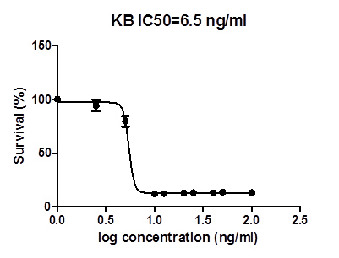
1000, 500, 400, 250, 200,125, 100, 50, 25 ng/ml the concentrations of KB cell lines.
IC50 measurement of mouth cancer cell lines KB 44 ( is 6.5 ng/ml)
Figure 1.
represents survival % of ZnO QD NPs as nanofluid cytotoxicity against cancer cell lines KB 144.

Slide 12
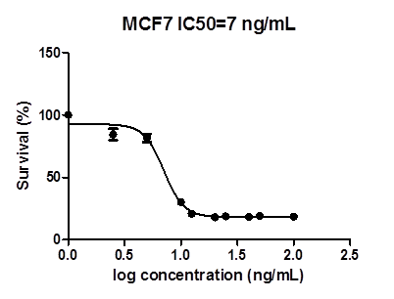
50000, 25000, 1000, 500, 250, 100, 50 ng/ml, concentrations and incubated at
37 ᵒC after 72 h incubation.
Cytotoxicity effect of ZnO QD NPs as nanofluid induced growth inhibition in breast cancer cells MCF-7

Slide 13
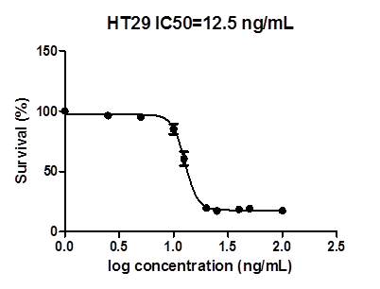

50000, 25000, 1000, 500, 250, 100, 50 ng/ml concentrations used for treatment after 72 h in MTT assay.
It was found that ZnO QD NPs as nanofluid demonstrated stronger cytotoxicity against breast cancer cell lines MCF7 than colon HT-29 cancer cells
Survival % curve for HT29 colon cancer cell lines

Slide 14
NCBI, Code 115 Hela
500, 400, 250, 200, 125, 100, 50, 25 ng/ml concentrations in MTT assay.
Hela cancer
Cell survival rate (%) of Cervical cancer cell line, after 72 hours of incubation in the face of ZnO nano-medicine.

Slide 15
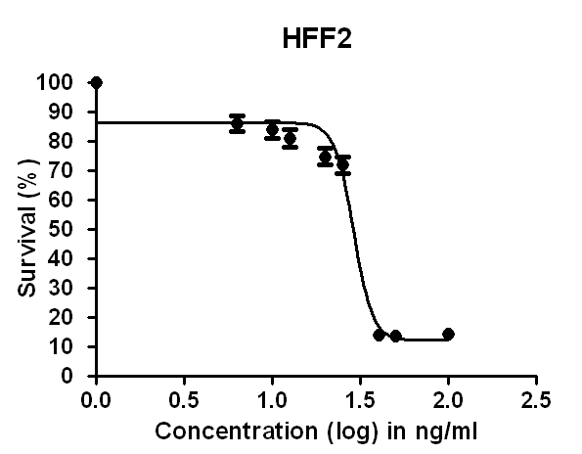
The concentrations used in this test include:
25, 20, 15, 12.5, 10, 6.25, 5.5, 3.12, 2.5 ng/ml
These tests showed that this nano medicine has a high ability and potentiality for mouth, breast, Hela and colon cancer cell lines compared to the others that are used in hospitals today. It is low cost and soluble in water and very stable nanofluid.
Survival % curve for normal human
cell line HFF2
(Human foreskin fibroblasts)
IC50 = 28.88 ng / ml

Slide 16
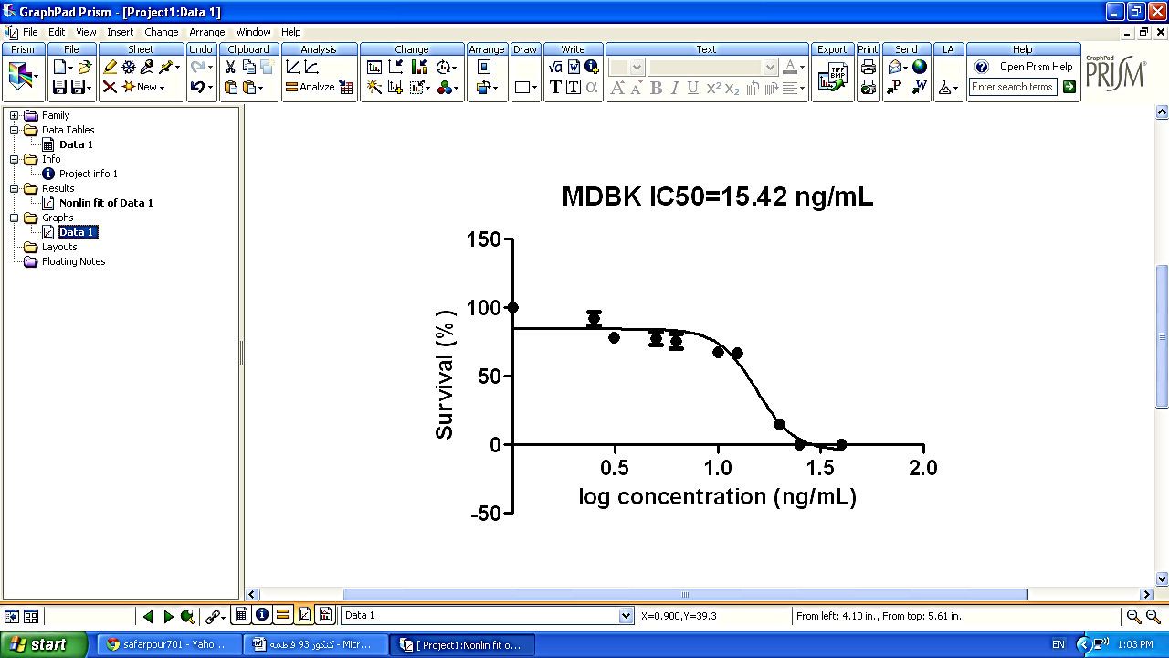
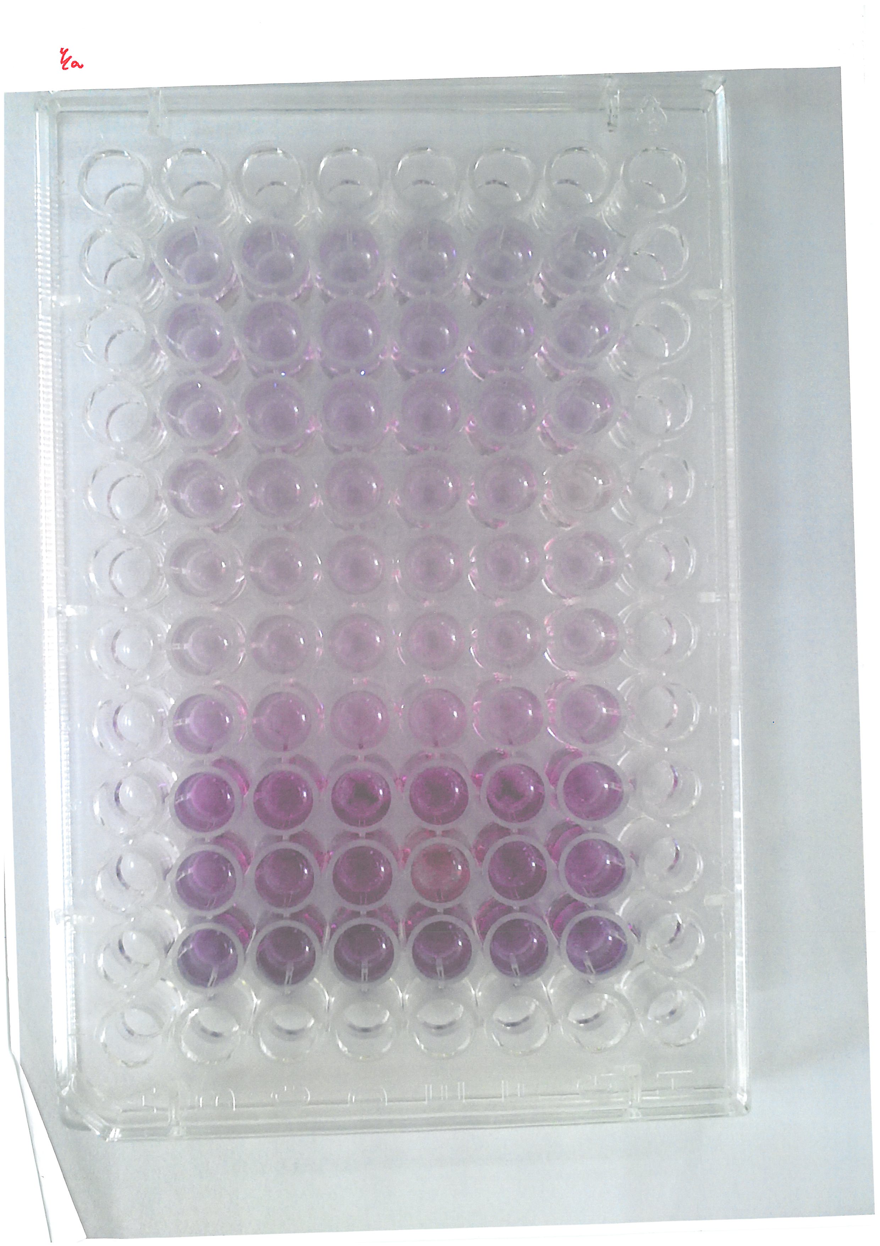
The effect of ZnO nanofluid of MDBK normal Bovine kidney cell lines
(Madin-Darby Bovine Kidney. (MDBK)
IC50 is 15.42 ng/ml for MDBK control cell lines. Our experiment results, show that ZnO nanofluid can disturb normal MDBK cell lines.
50, 25, 20, 15, 12.5, 10, 6.25, 5.5, 3.12, 2.5
ng / ml, the concentrations which used in test.
MDBK were obtained from the national center for cell science, Pasteur institute of Iran (Tehran).

Slide 17
Therefore, it can be concluded that ZnO QD NPs as nanofluid can be used as an strong anti-cancer drug similar to the cis-platinum medicine. But in-vivo tests and clinical study should be applied for this new synthesized nanomedicine
Statistical curve
IC50 measurement of normal HFF2 and 4cancer cell lines.

Slide 18

MEST (Mouse Ear Swelling Test)
to measure the sensitivity of ZnO nanofluid as nanoproduct.
Our goal is to consider the impact and response to ZnO nanofluid in medical on the body.
To specify nanoproduct interaction and allergic reactions with the body, we carried out laboratory animal test , such as
mouse ear swelling test (MEST) with 12 Wistar rat.

Slide 19




Results of MEST sensitivity
We worked with 12 Wistar rats that was checked for any kind of skin disease (Mouse Ear Swelling Test)
On the first and third days two Wistar rats died with no specific reason.
On the twelfth day, there was two rats with allergic symptoms, and 8 rats with no symptoms neither on the ear nor abdominal area.
We could observe, less than of 10 percent changes on Wistar rats, therefore we have reported very promising invivo results.
by Dr. Peyman Keyhanvar

Slide 20

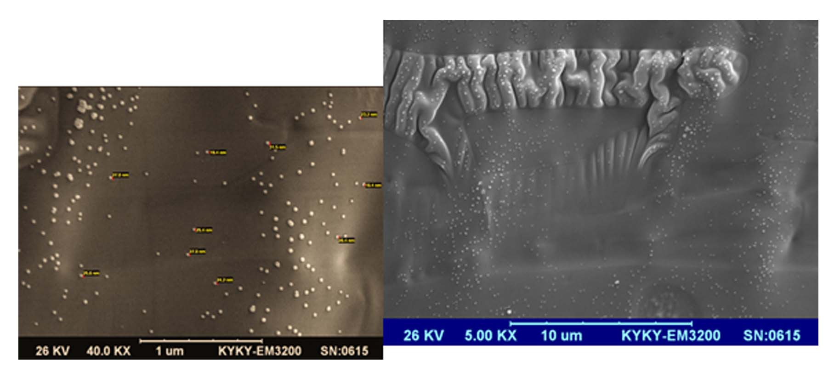
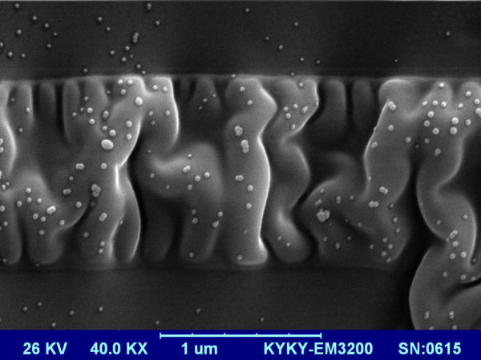
Characterization of ZnO QD NPs , and its nanofluid
1- SEM images of ZnO QD NPs in nanofluid as very fine spherical structure.
SEM morphology of ZnO nanofluid
SEM images of morphology of nanofluid with water based

Slide 21
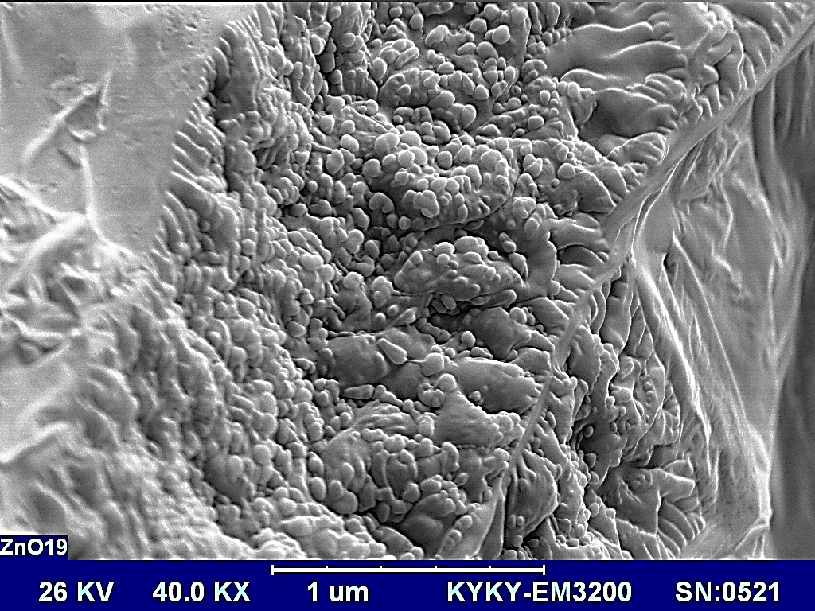
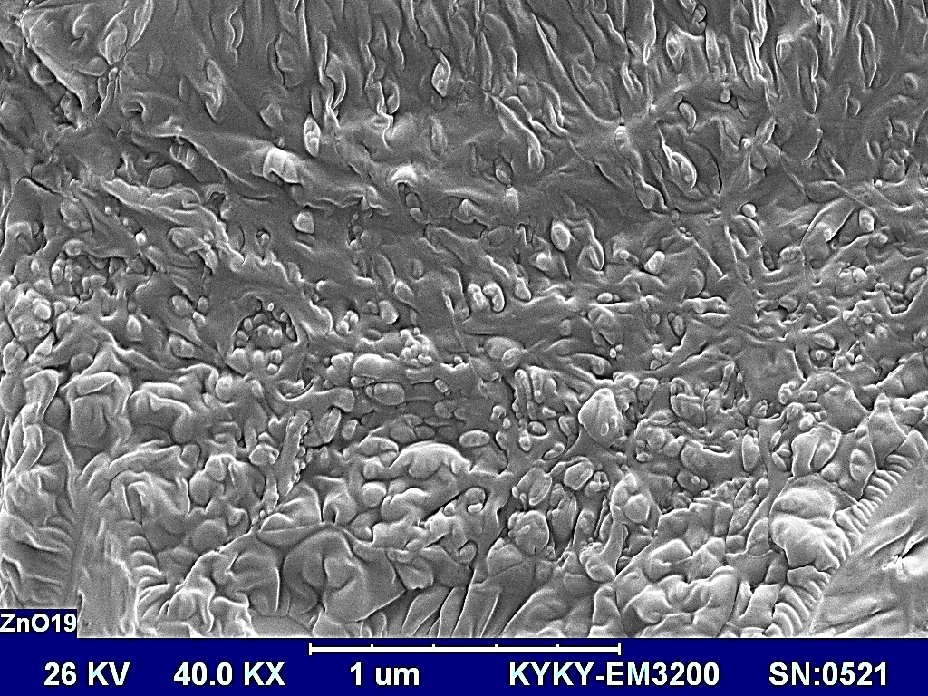
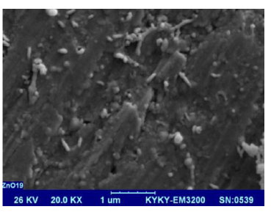

Hydrophilic Nanoparticles and soluble in water, without any polymer and substrate carrier with it
SEM images of only ZnO QD NPs which were immersed into the
green fatty acid layer matrix.
It is wonderful advantages in synthesis, regarding to producing strong diffusion properties for ZnO NPs.

Slide 22
DLS curve for second concentration of ZnO nanofluid, and hydrodynamic diameter size is lower than first sample. Average particle size is
9-11 nm
DLS (dynamic light scattering) curve for average particle size, distribution is 19.7 nm and Zetz potential value (charged particles in a dispersion ) is positive (+ 11, + 15 mV).

Slide 23
My Suggestion
Zeta- potential for ZnO QD NPs was measured to remarkably
+ 50 mV, and cancerous cell membrane is highly electronegative (-)
Then, they can create interesting attraction and absorption forces
between opposites charges,
by strongly electrostatic interaction and electro valance bonding,
So, ZnO QD NPs are able to produce greater ROS ( active free radicals)
production in this phenomena.

Slide 24
UV–Vis absorption spectrum of ZnO nanofluid, that has shifted to broad strong peak at 194.3 nm (blue emission) due to oxygen vacancies on the surface, and the mean particle size is around 1–3 nm.
1-3 nm particle size

Slide 25

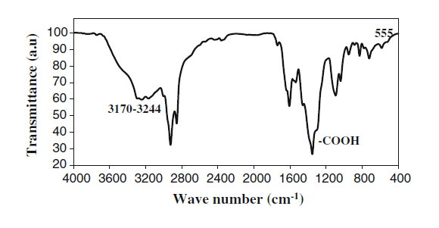
Zn-O bonding
FTIR spectrum of hexagonal of ZnO QD NPs functionalized with green soya fatty acids

Slide 26
Zn-O
-COOH , COO⁻
-C=O
-OH, H₂O,
-N-H
-C-H
FTIR of ZnO nanofluid, nanomedicine

Slide 27
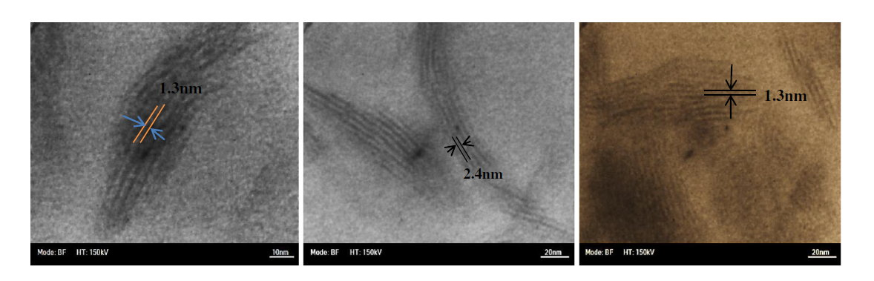
Typical high-resolution TEM images of the ZnO QD NPs
(as nanoparticles and nanorods mixture). The lattice fringe
between two adjacent planes was about 1–3 nm or less.

Slide 28
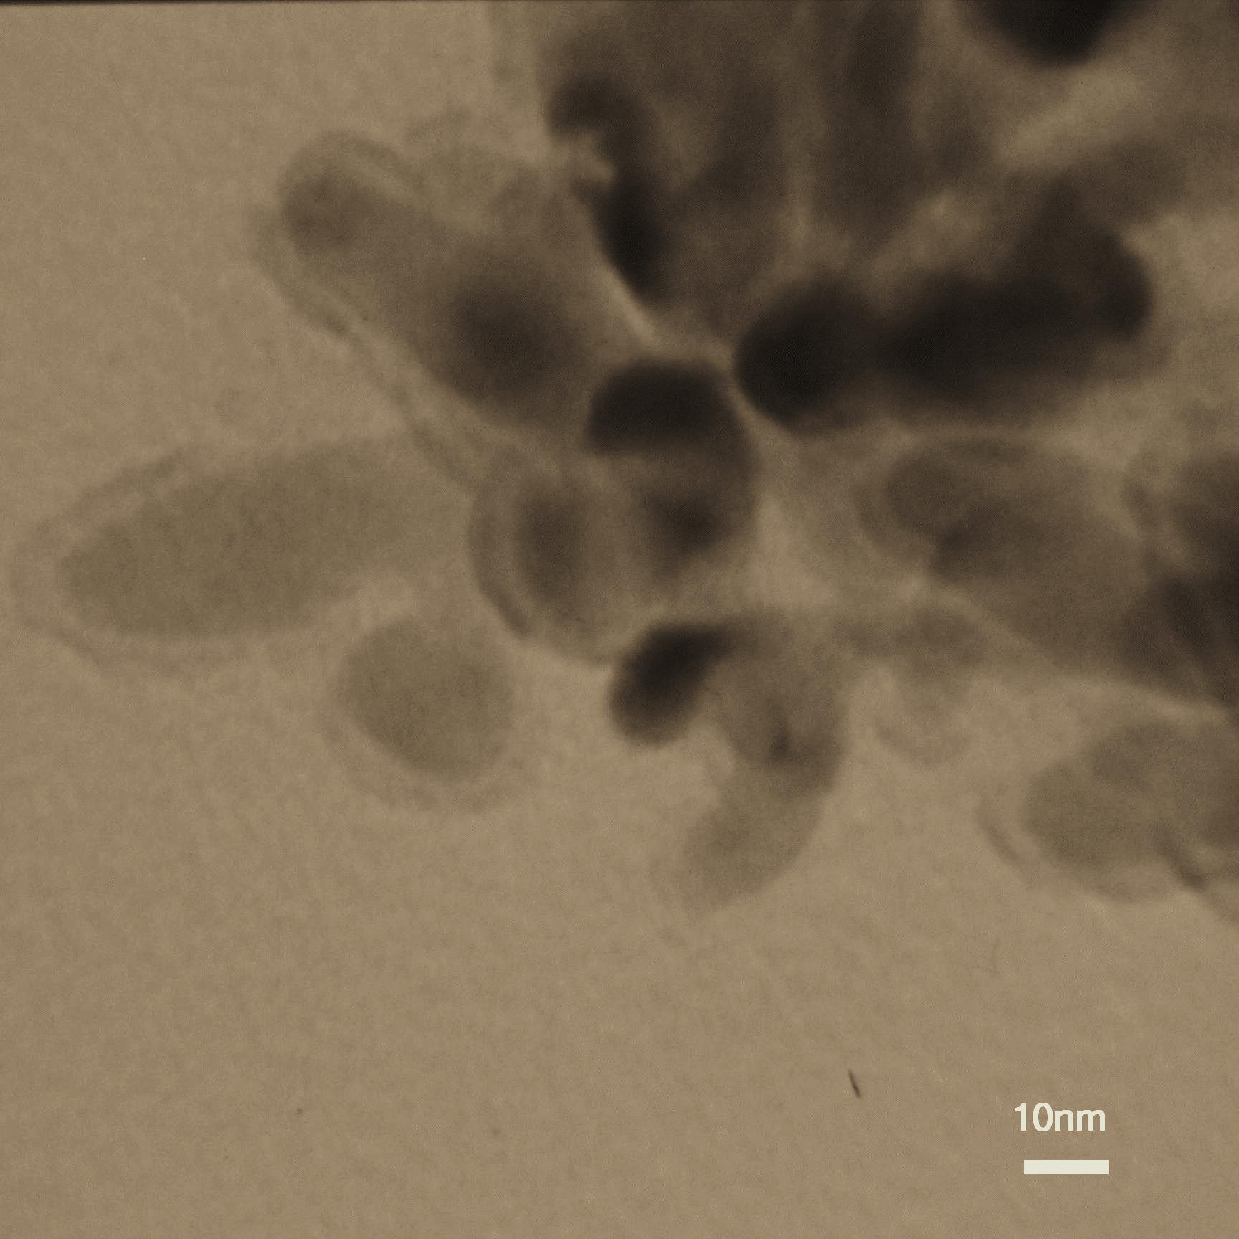
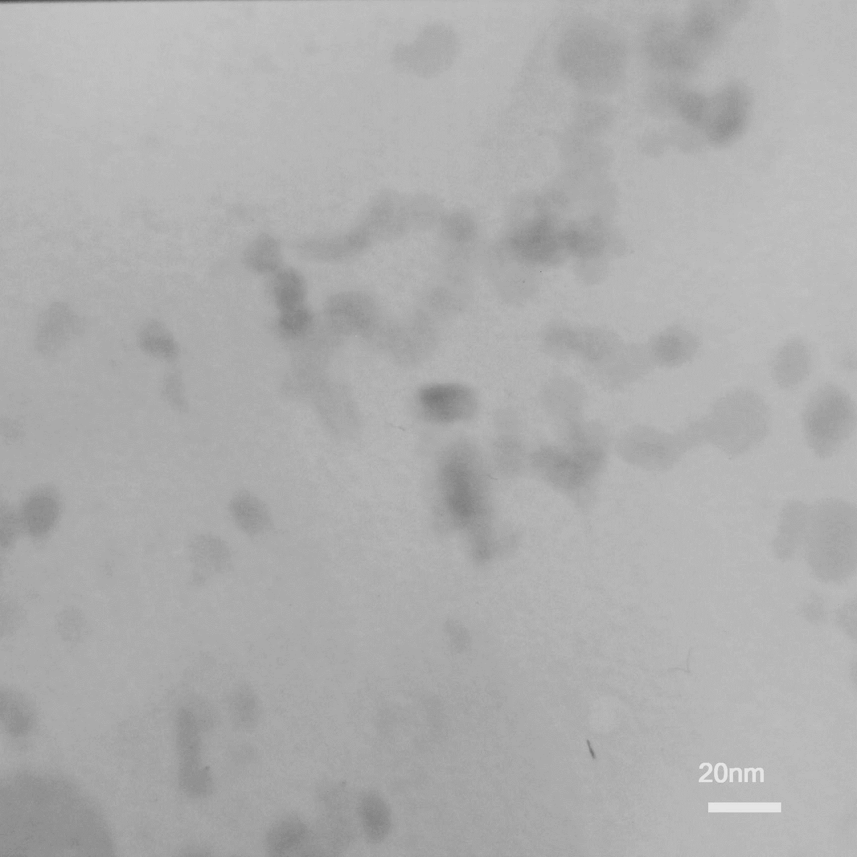
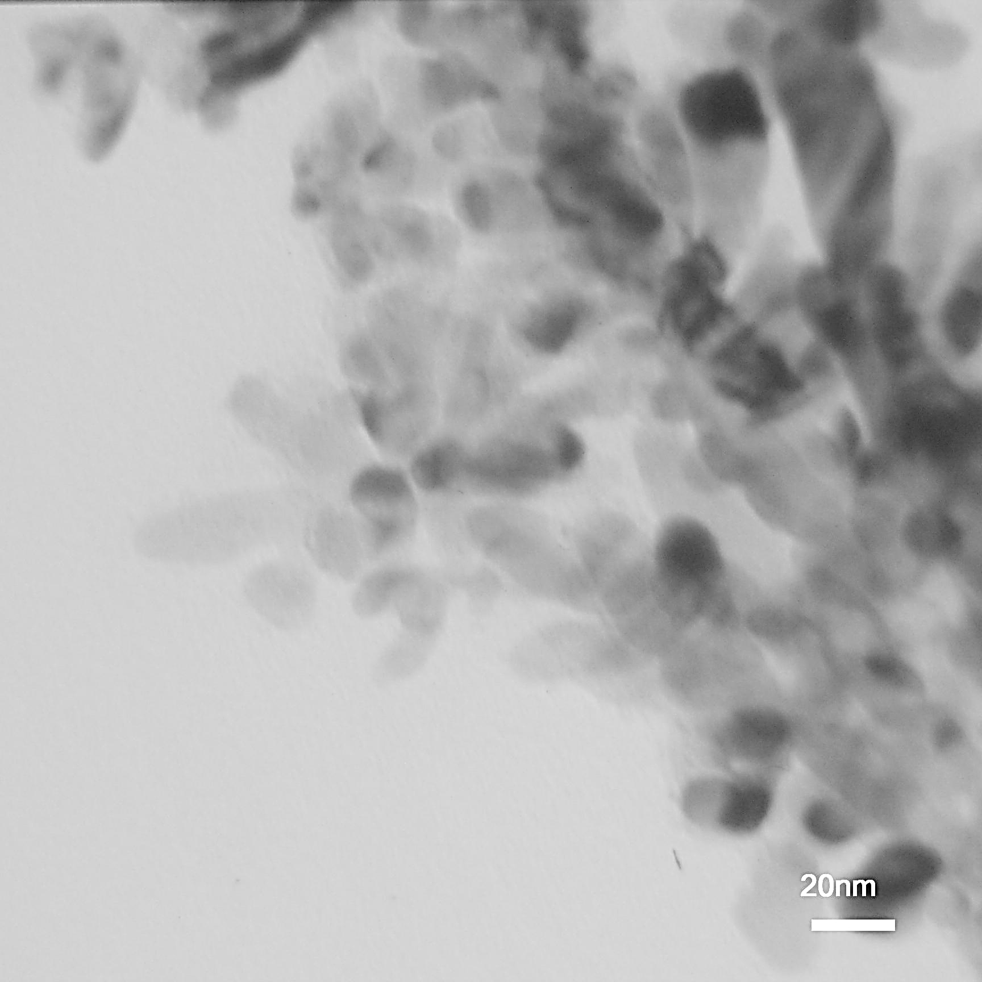
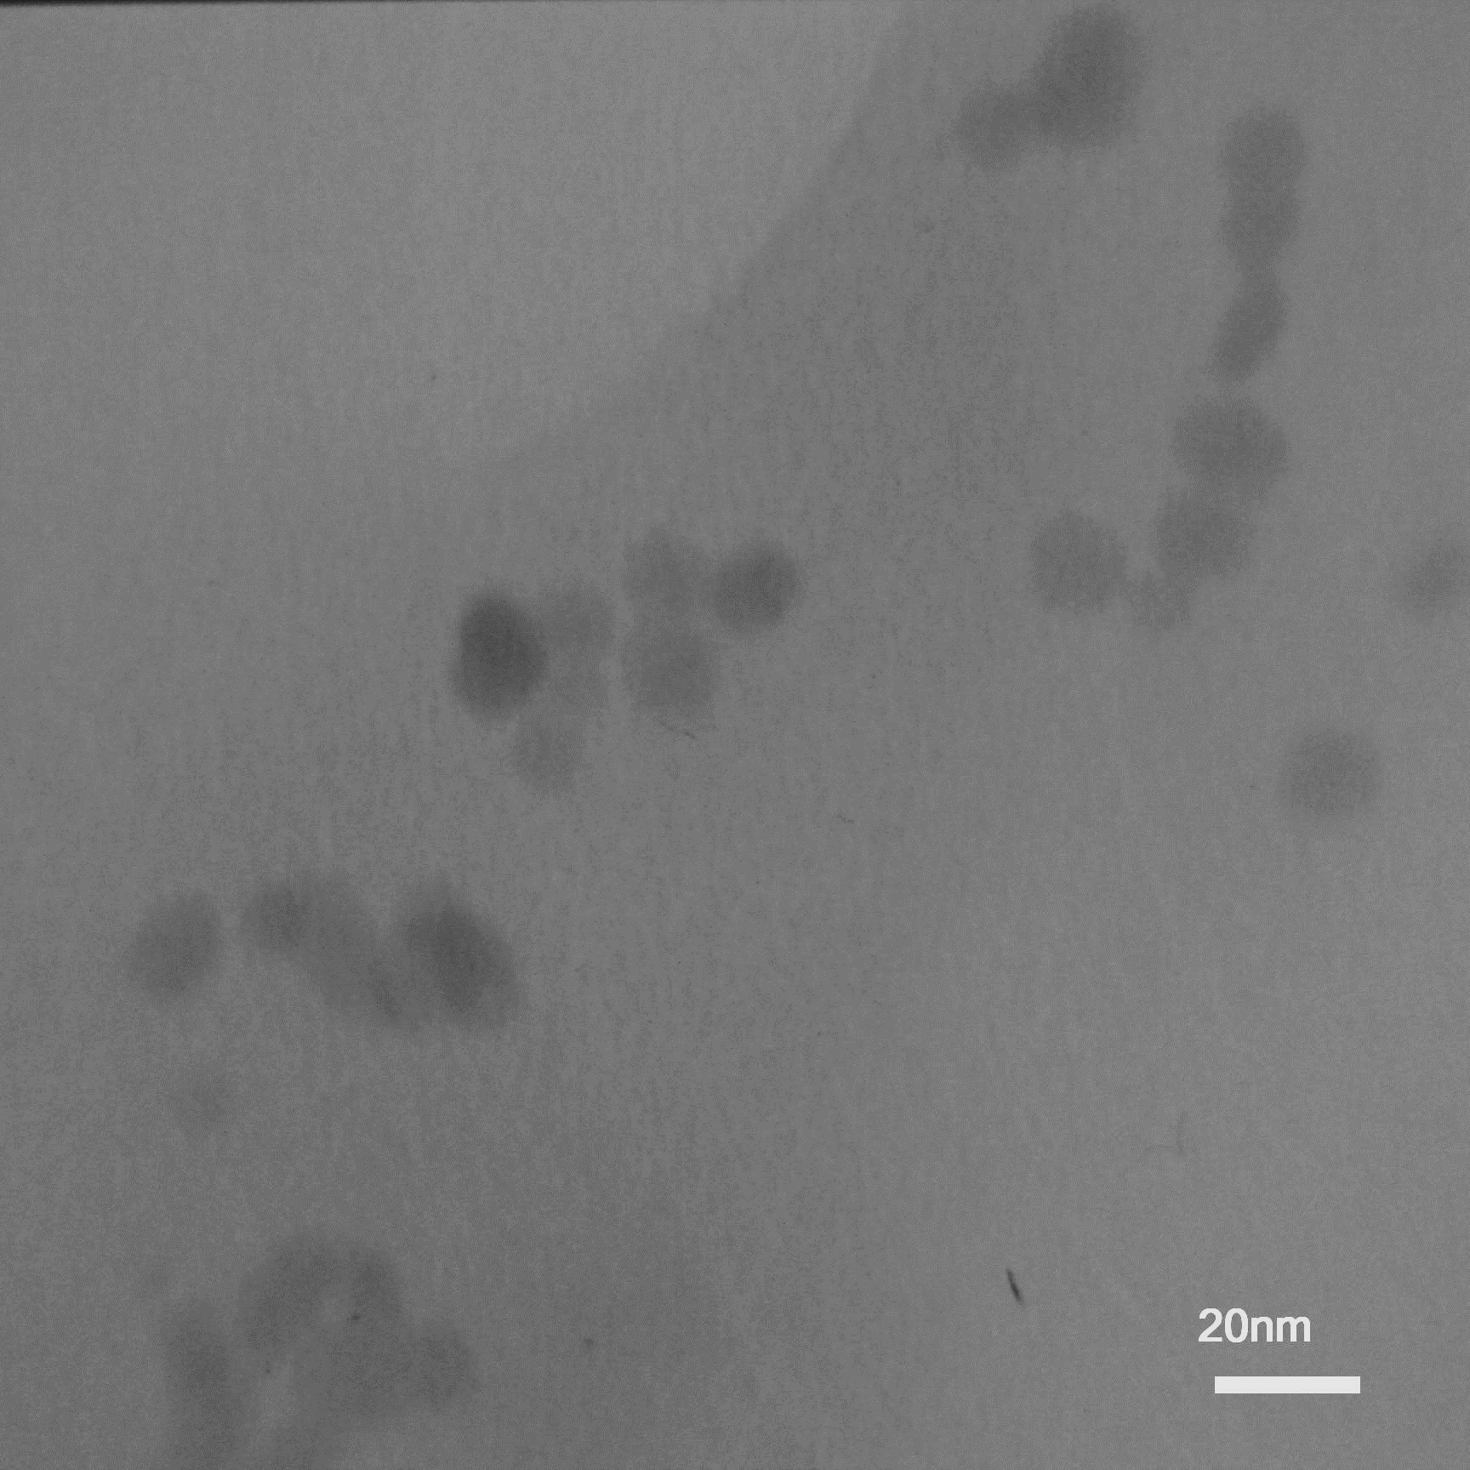
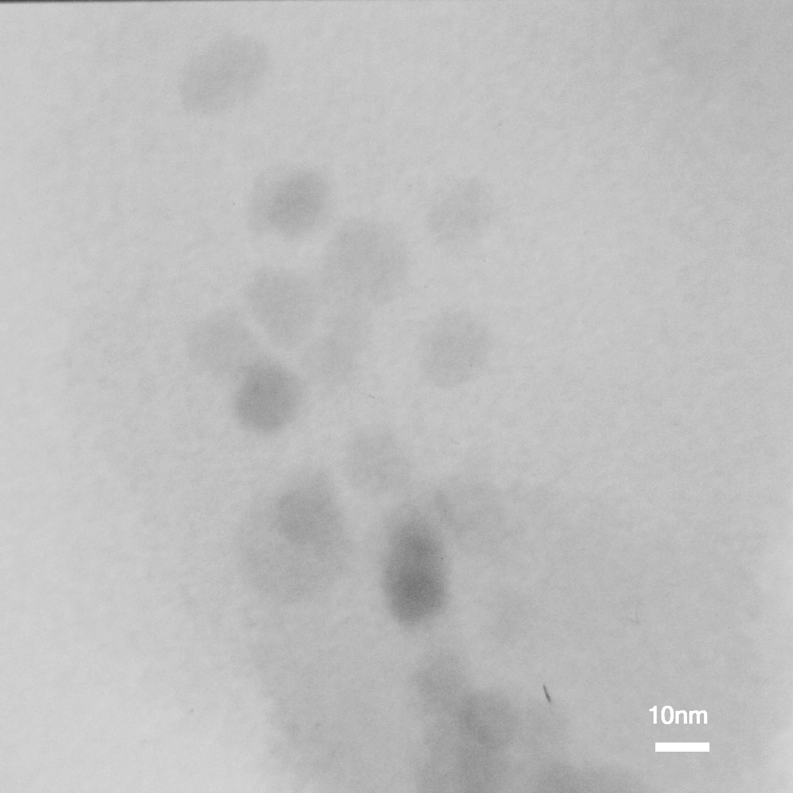

High-resolution TEM images of the ZnO nanofluid, as nanomedicine
Important point
We try to avoid of ZnO NPs from agglomeration during the formulation of nanofluid product, because it helps to improve the activity of ZnO NPs in attacking and diffusing towards cell membrane.

Slide 29

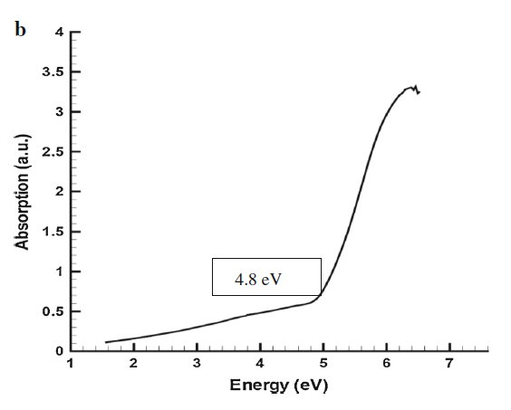
nanoparticles
nanofluid
5.32 eV
Band gap energy is 4.8 eV for ZnO QD NPs surrounded by green soya fatty acid.
Band gap energy is 5.32 eV for ZnO formulation of nanofluid as nanomedicine

Slide 30

Photoluminescence (PL) spectrum of ZnO nanofluid
252 nm is the wavelength of light
emitted to the nanofluid
Trapping states
A maximum absorption in the
ultraviolet light shows 297.7 nm.
These are the main characteristics
of very fine nano-particles
and nanofluids.

Slide 31
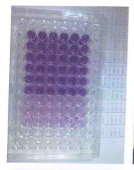
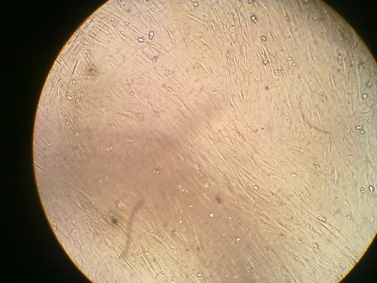
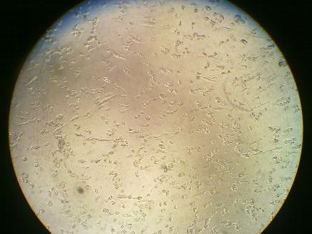
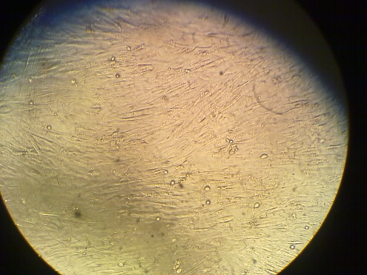
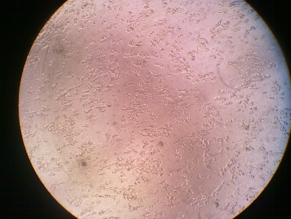
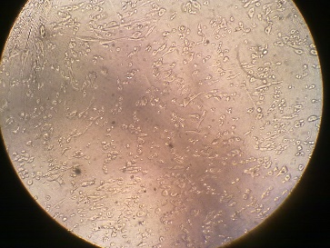
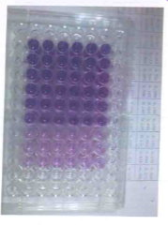
Alive cells for HFF2 normal
Dead cells, for HFF2
HFF2 Cells , before (a) and after employing ZnO nanofluid, nanomedicine. (a) alive cells (b) dead cells.
deformation and agglomeration of cells

Slide 32
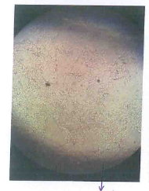
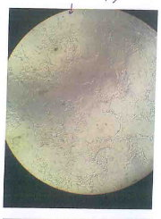
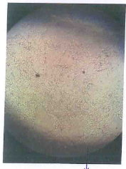
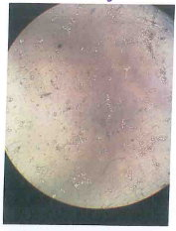
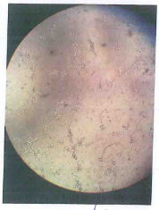

Alive MDBK normal cells
MDBK Cell Lines were exposed to the ZnO nanofluid medicine, and were damaged by it.
Alive cells
Dead cells
Dead Lines MDBK
culture plates of MTT assay

Slide 33
Toxicity mechanism of performance of ZnO QD NPs in cancer treatment, based on our experiences and proposal
ZnO nanofluid synthesized product, have shown major behaviors as:
1- Antitumor and major role in destroy of cancer therapy.
2- We could not measure cytotoxicity effect on normal human cells (HHF2 Human foreskin fibroblasts).
3- ZnO NPs our product, is semiconductor nanocrystals, with very small size, containing: Large surface area, and high surface energy (UV absorption), wider band gap energy (4.8 eV), defect structures, oxygen vacancies producer on modified surface, and generation of free radicals after interaction of NPs with tumor membrane cells.
4- Their surfaces can be modified with various chemical functions.
5- They indicated very strong penetration and diffusion power into the membrane of cancer cells, by strong electrostatic interaction and generating of stable hydrogen bonding towards amino acids of proteins

Slide 34
6- Surface trapping states, effective nanoporous and modified surface defects are the best major characteristics of ZnO QD NPs for biological applications.
7** One of the significant evidence in this formulation of nanofluid is,
to prevent agglomeration of nanoparticles processing in solution. It is very unsuitable phenomena in biological activity.
8** In here, ZnO QD NPs have the critical role in diffusing and killing tumor cells, without using polymer, co-activator, or other nano metal as mixture and chitosan, starch or CNT as matrix or substrates.
9**We think some of the polymers cannot dissolve in water and so cannot disperse completely and finally agglomerate and precipitate in fluid, therefore they lose their potential diffusing into cancer membrane cells.
Another proposal is suggested

Slide 35
but other studies suggest that:
** The literature from 1997 to 2014 has discussed about oxidative stress as a potential mechanism of ZnO NPs toxicity.
Scientists believe that:
** The Nanoparticles get attached to the cell membrane and also penetrate inside the cancerous cells and form highly reactive oxygen species (ROS). The plasma membrane contains sulfur-containing proteins and the nanoparticles interact with these proteins in the cell as well as with the phosphorus containing compounds such as DNA.
Apoptosis and cytotoxicity were possibly correlated to ROS generation and oxidative stress.
Also, some of the changes, took place in their membrane morphology, such as, induce collapse of membrane, cell decomposition and death eventually.

Slide 36

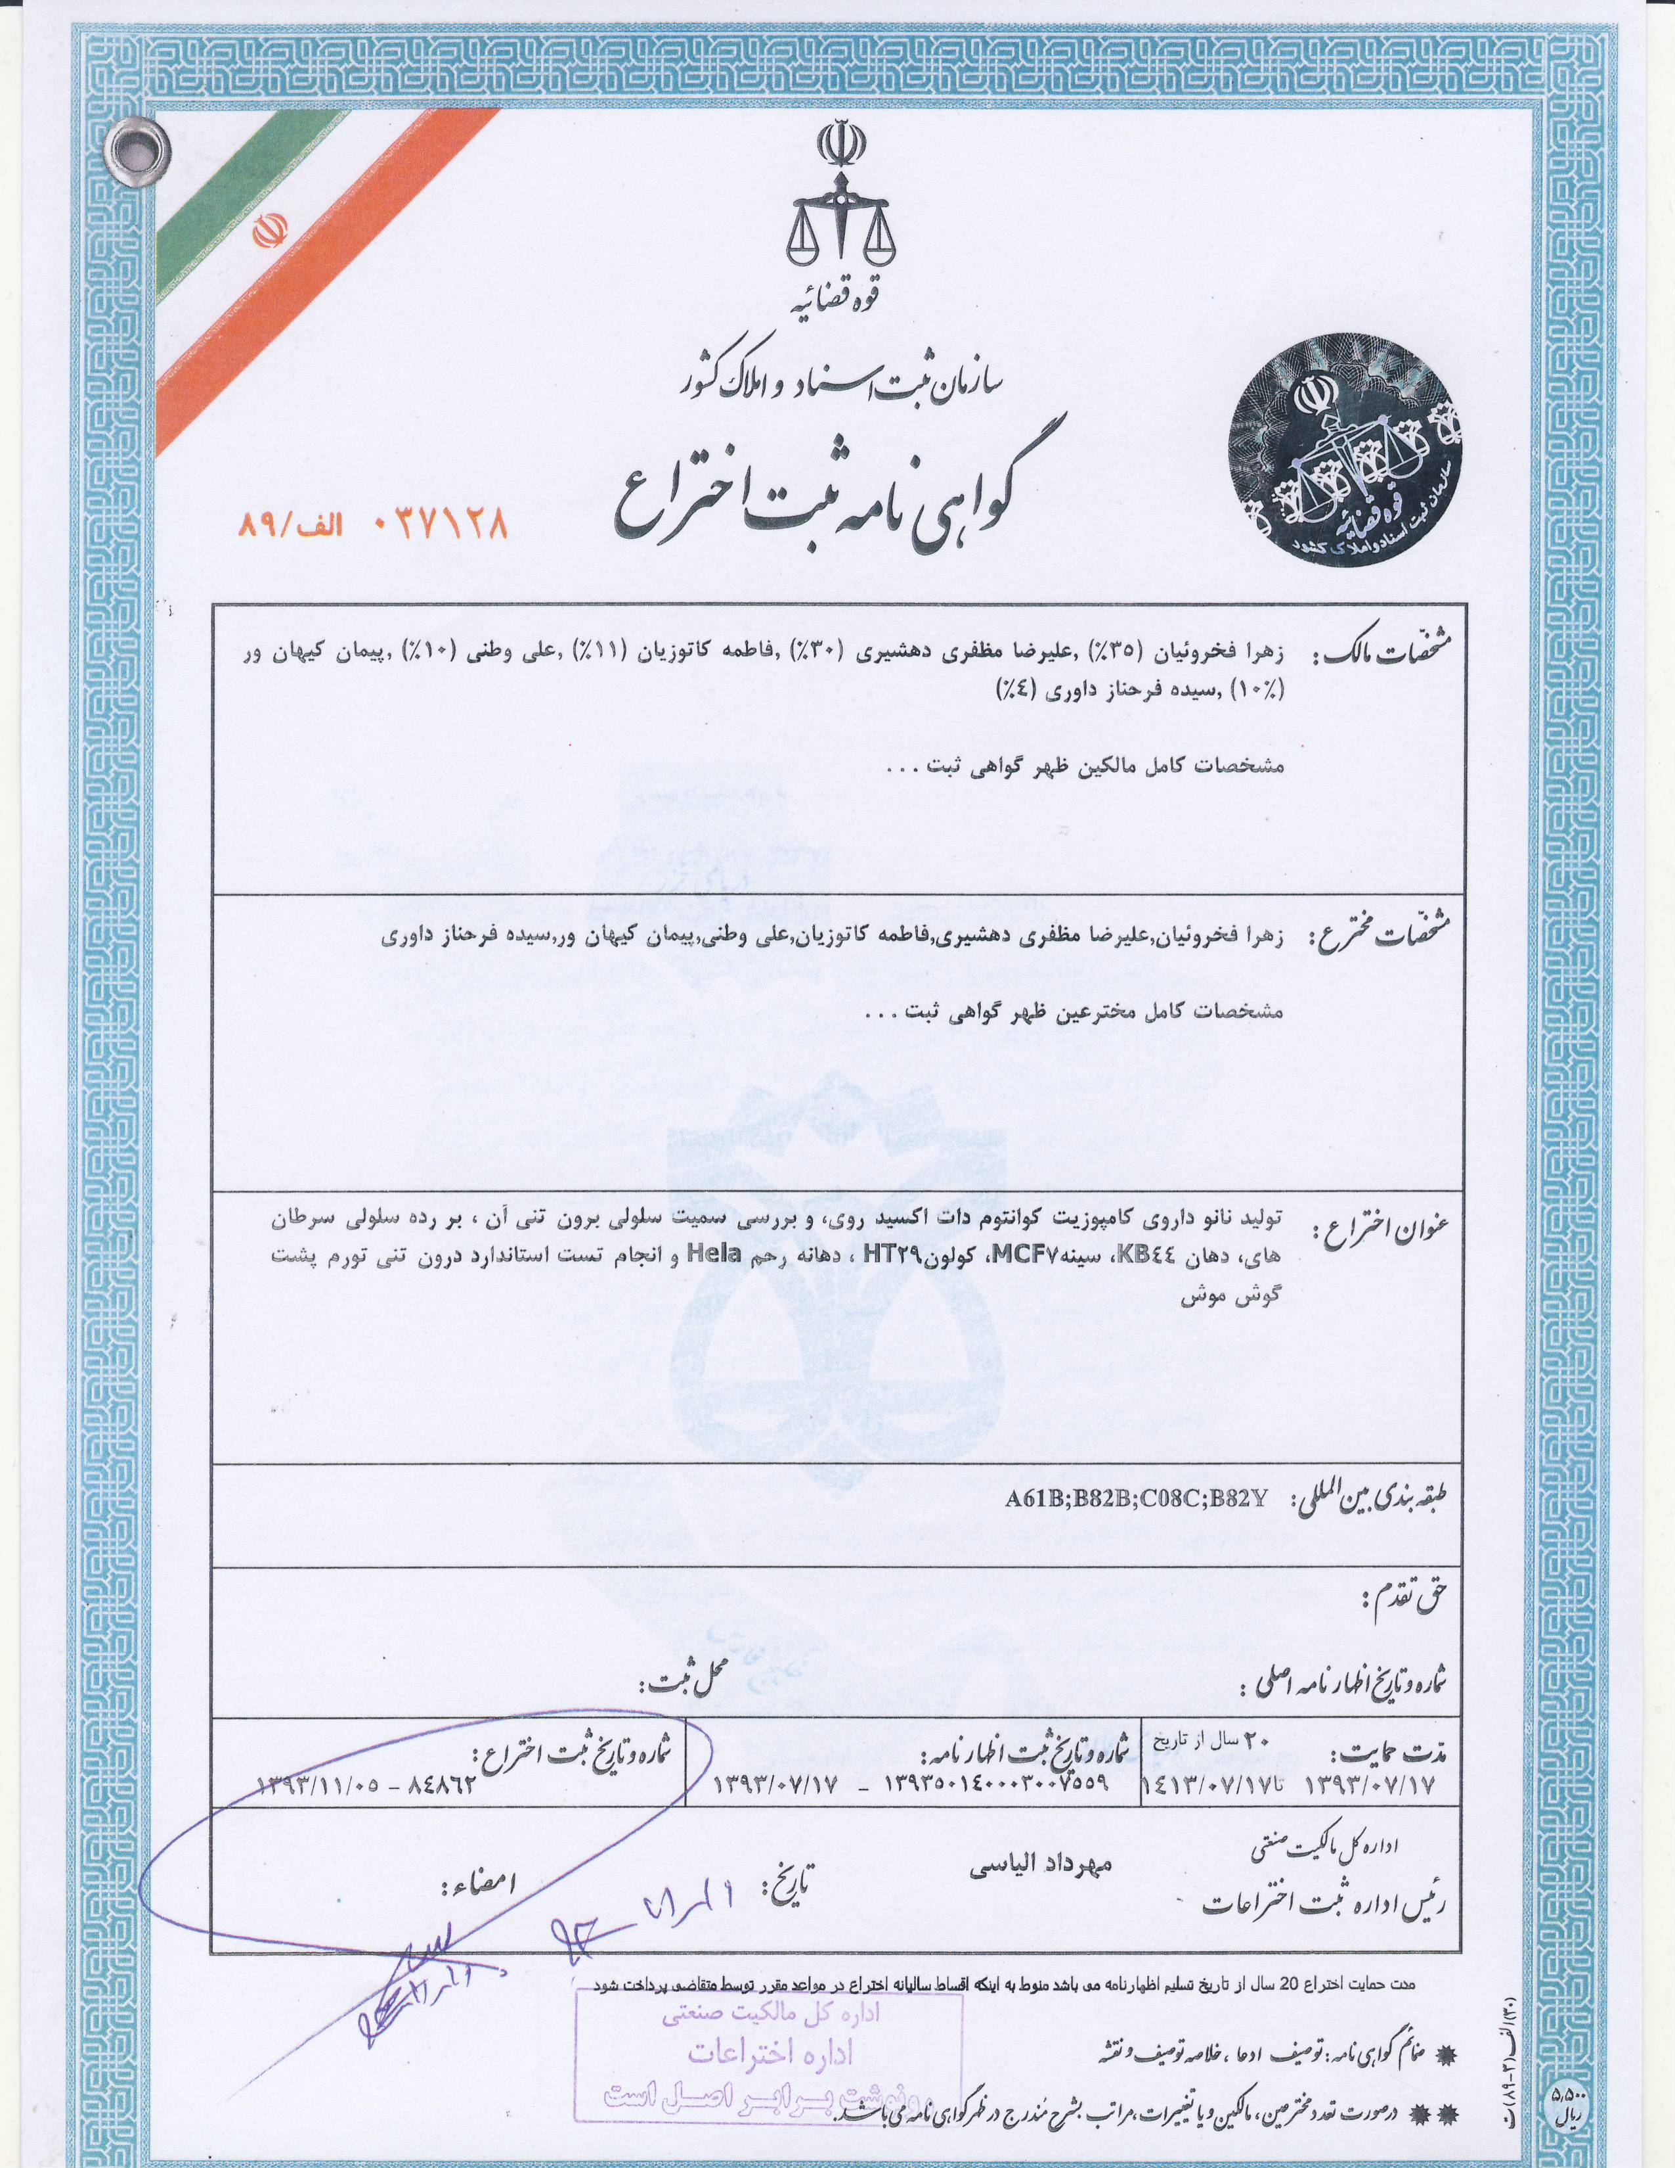
A certification of Iranian patent from ZnO nanofluid product as cancer treatment.
We have owned this formulation for 20 years

Slide 37



Thank you in advance for your kind and Patiently attention to cancer points
I am appreciated to believe to produce this Nanomedicine product for clinical process and cell death pathways.

