Slide 1
Conference Series LLC Conferences
Conference Series LLC is a pioneer and leading science event organizer, which publishes around 500 open access journals and conducts over 500 Medical, Clinical, Engineering, Life Sciences, Pharma scientific conferences all over the globe annually with the support of more than 1000 scientific associations and 30,000 editorial board members and 3.5 million followers to its credit.
Conference Series LLC has organized 500 conferences, workshops and national symposiums across the major cities including San Francisco, Las Vegas, San Antonio, Omaha, Orlando, Raleigh, Santa Clara, Chicago, Philadelphia, Baltimore, United Kingdom, Valencia, Dubai, Beijing, Hyderabad, Bengaluru and Mumbai.

Slide 2
OVERVIEW OF BIOAVAILABILITY/BIOEQUIVALENCE TRIALS IN A PHASE 1 CLINIC IN TURKEY
Assist.Prof.Dr.Zafer SEZER
7th World Congress onBioavailability & Bioequivalence: BA/BE Studies
2016 Atlanta, Georgia, USA

Slide 3

Contents:
Definitions
Our clinic
Overwiev BA/ BE trials
Conclusion

Slide 4
Bioavailability (BA)
The rate and extent to which the active drug substance or therapeutic moiety is absorbed from a pharmaceutical form and becomes available at the site of action

Slide 5
Bioequivalence (BE)
The absence of a significant difference in the rate and extent to which the active ingredient or active moiety in pharmaceutical equivalents or pharmaceutical alternatives becomes available at the site of drug action when administered at the same molar dose under similar conditions in an appropriately designed study

Slide 6
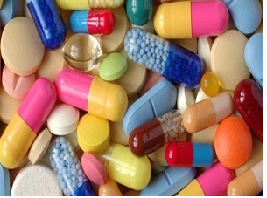
The concept of bioavailability and bioequivalance have gained considerable importance during last decades because of their application to new brand name drugs, as well as generic drugs.

Slide 7
Bioavailability/Bioequivalency(BA/BE) trials have been conducting in our clinic since 1999.
The number of trials which were performed was 1200 until now.
There are 5 clinical centers approved for BA/BE trials in Turkey. Our clinic is the first one.

Slide 8
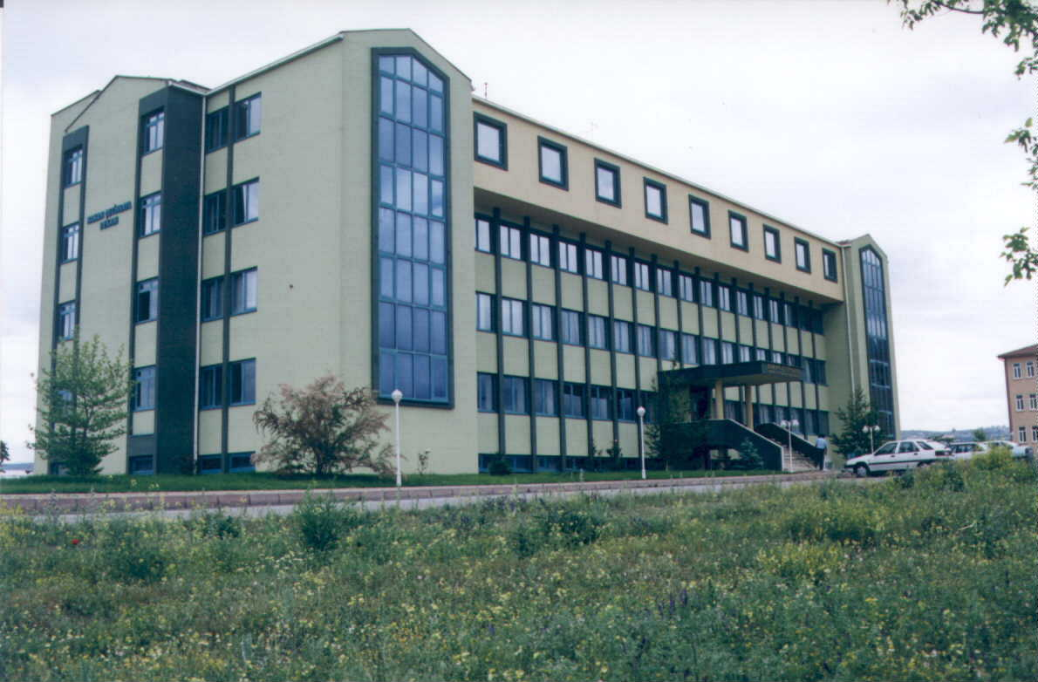
Hakan Cetinsaya Good Clinical Practice and Research Center
(Phase - I Unit)

Slide 9
We have 5 hospitals and 1 special unit
General Hospital
Dialysis and Transplantation Hospital
Oncology and Hematology Hospital
Cardiology and Cardiovascular Surgery Hospital
Phase-I Unit
Pediatrics Hospital

Slide 10
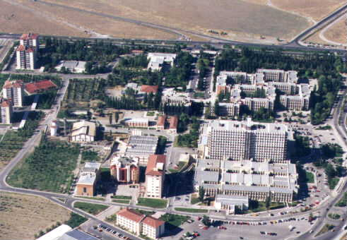
ERCIYES UNIVERSITY HOSPITAL COMPLEX

Slide 11
We want to evaluate the trials which were carried in our clinic between the years 2005 and 2015
The total number of the trials 947

Slide 12
Number of trials | 151 | 118 | 123 | 120 | 88 | 84 | 68 | 51 | 54 | 36 | 54
Year | 2005 | 2006 | 2007 | 2008 | 2009 | 2010 | 2011 | 2012 | 2013 | 2014 | 2015

Slide 13
Medicine Groups

Slide 14
CNS Medicine Groups
1.Antidepressants
2.Antipsychotics
3.Antiparkinson
4.Alzheimer
5.Antiepileptics
6.Antiemetics
7.Other

Slide 15
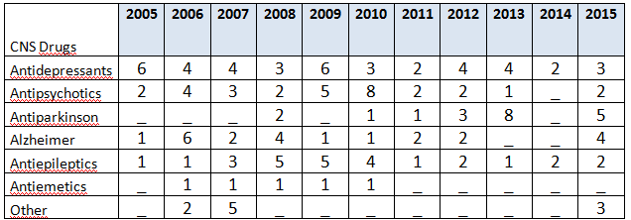
CNS medicine groups and years

Slide 16
Both the number of trials and medicine groups which were studied in our clinic change according to years
The number of BA/BE trials releated antibiotics are less than previous years.
CNS and anticancer medicines trials are increasing at the last years.

Slide 17
List of the inspected authorities
Germany (2 times)
EMA
Spain
Austria
South Africa
Swedish
Turkey (8 times)

Slide 18
Erciyes University Medical Faculty Phase -I-Unit
“ 3 flats, 1300 m² total area, 30 rooms and other daily use places”

Slide 19
Erciyes University Medical Faculty
Phase -I-Unit
Staff
Pharmacologist 3
Family Medicine 1
Quality 2
Nurse 8
Laboratory 4
Secretary 1
Pharmacist 1
Cleaner 4
TOTAL Staff 24

Slide 20
Erciyes University Medical Faculty
Phase -I-Unit
DUTY DISTRIBUTION
Head Investigator → Pharmacology
CO-Investigators → Family Medicine, Pharmacology
Laboratory → Biochemistry, Biology

Slide 21
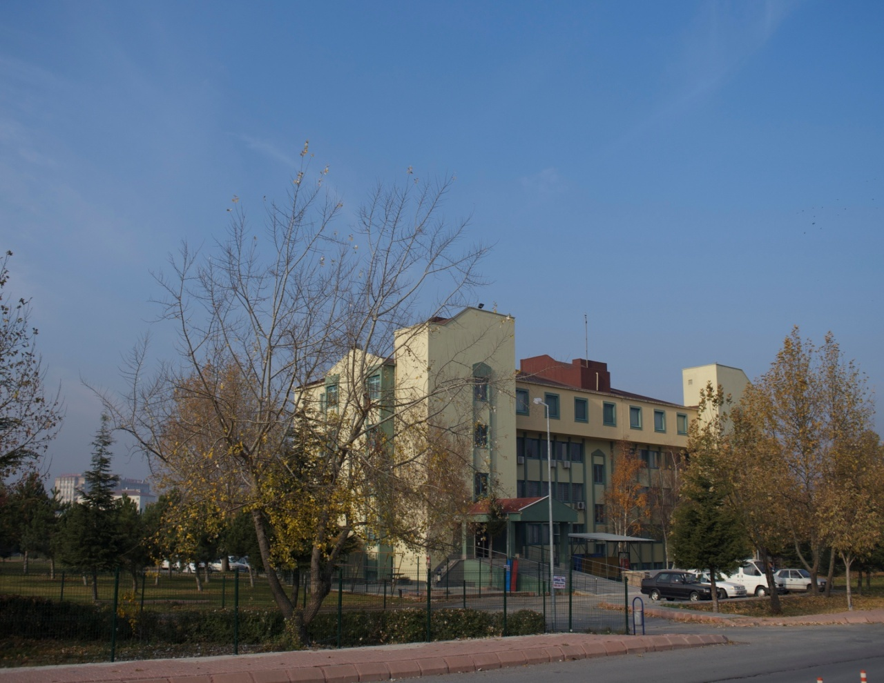

Slide 22
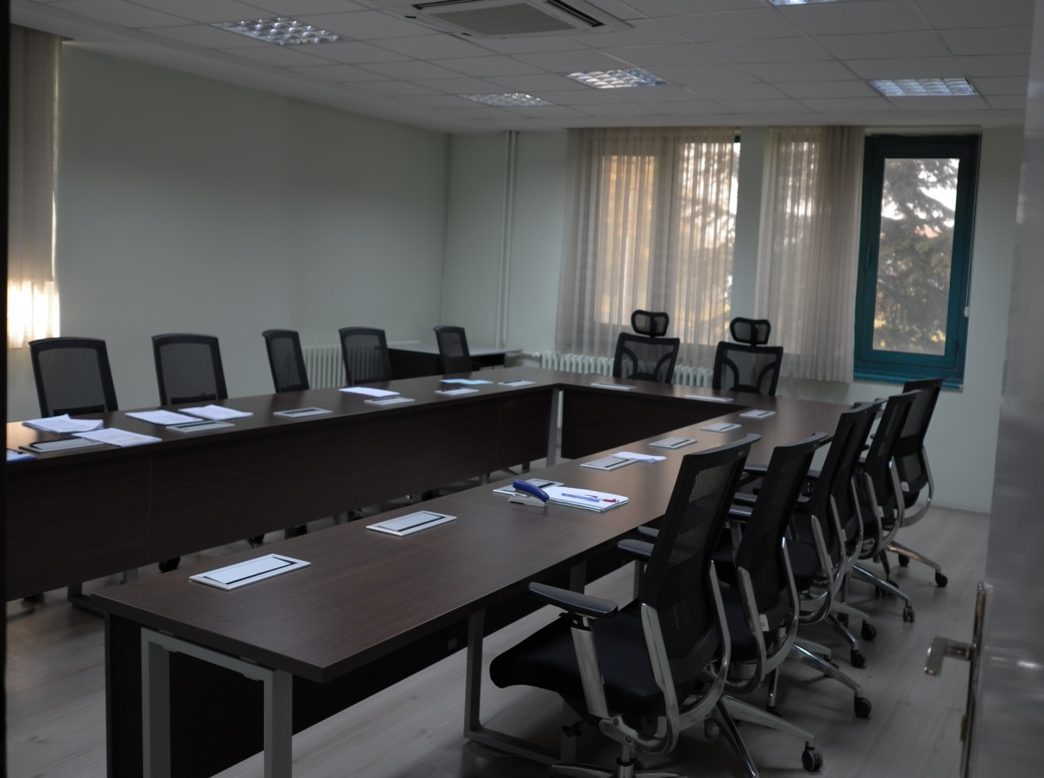

Slide 23
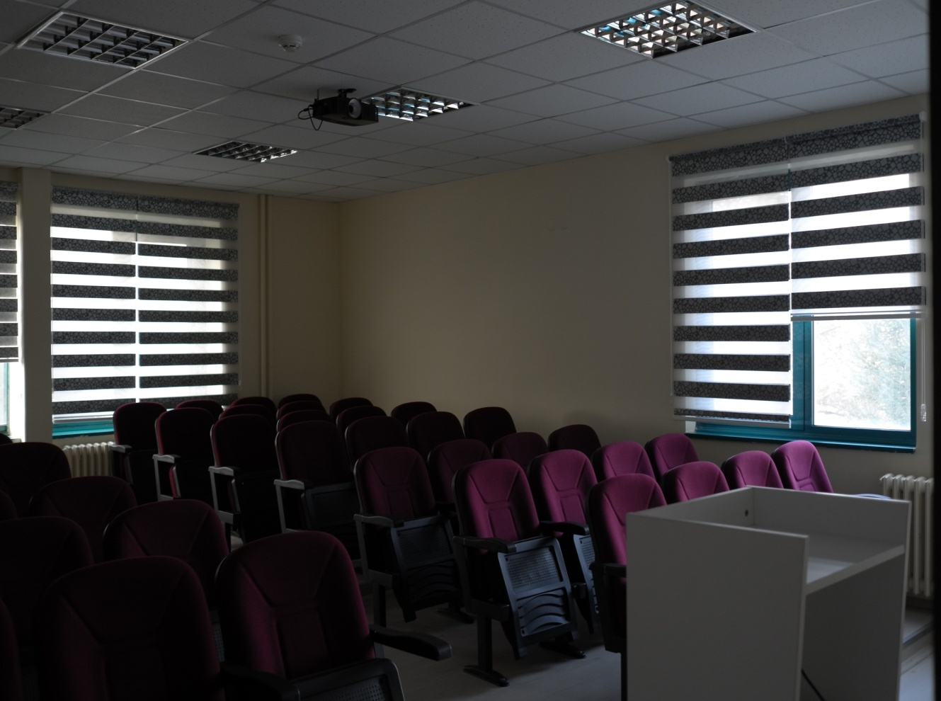

Slide 24
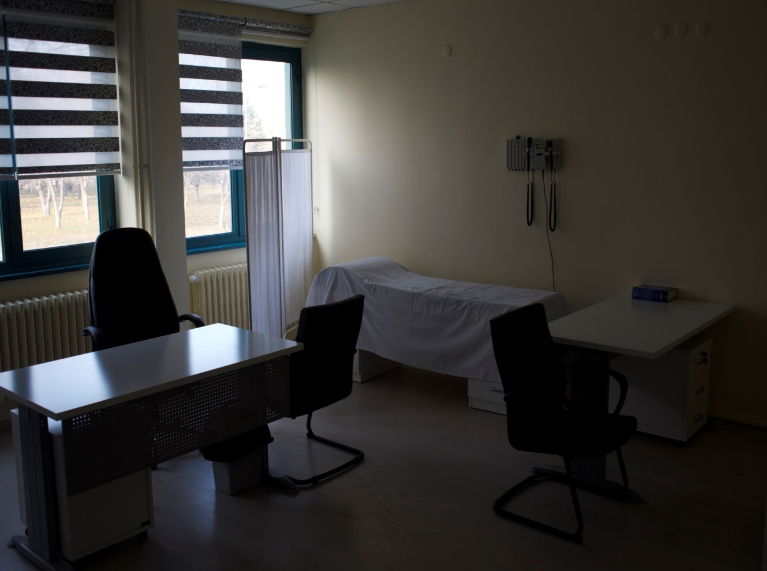

Slide 25
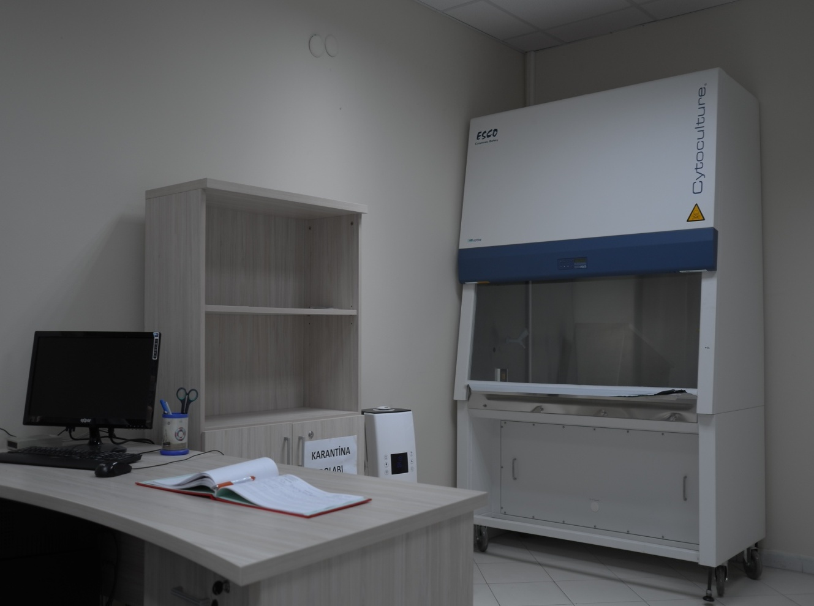

Slide 26
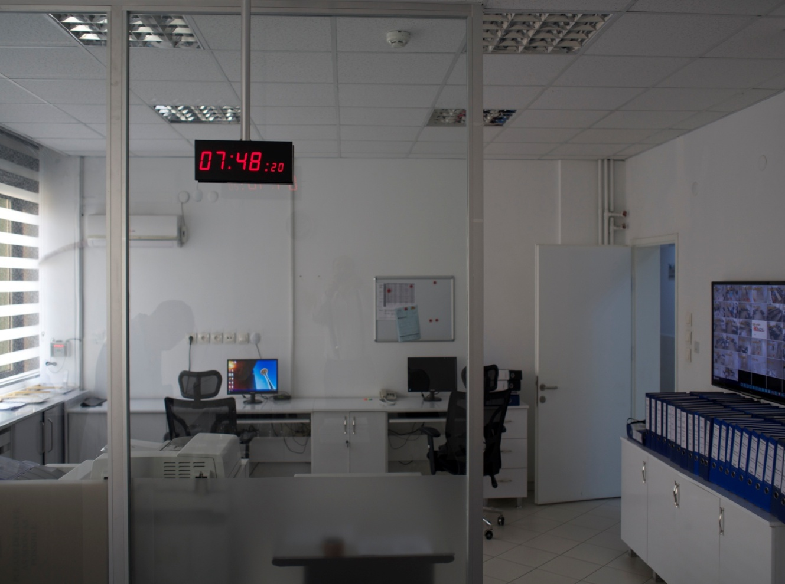

Slide 27
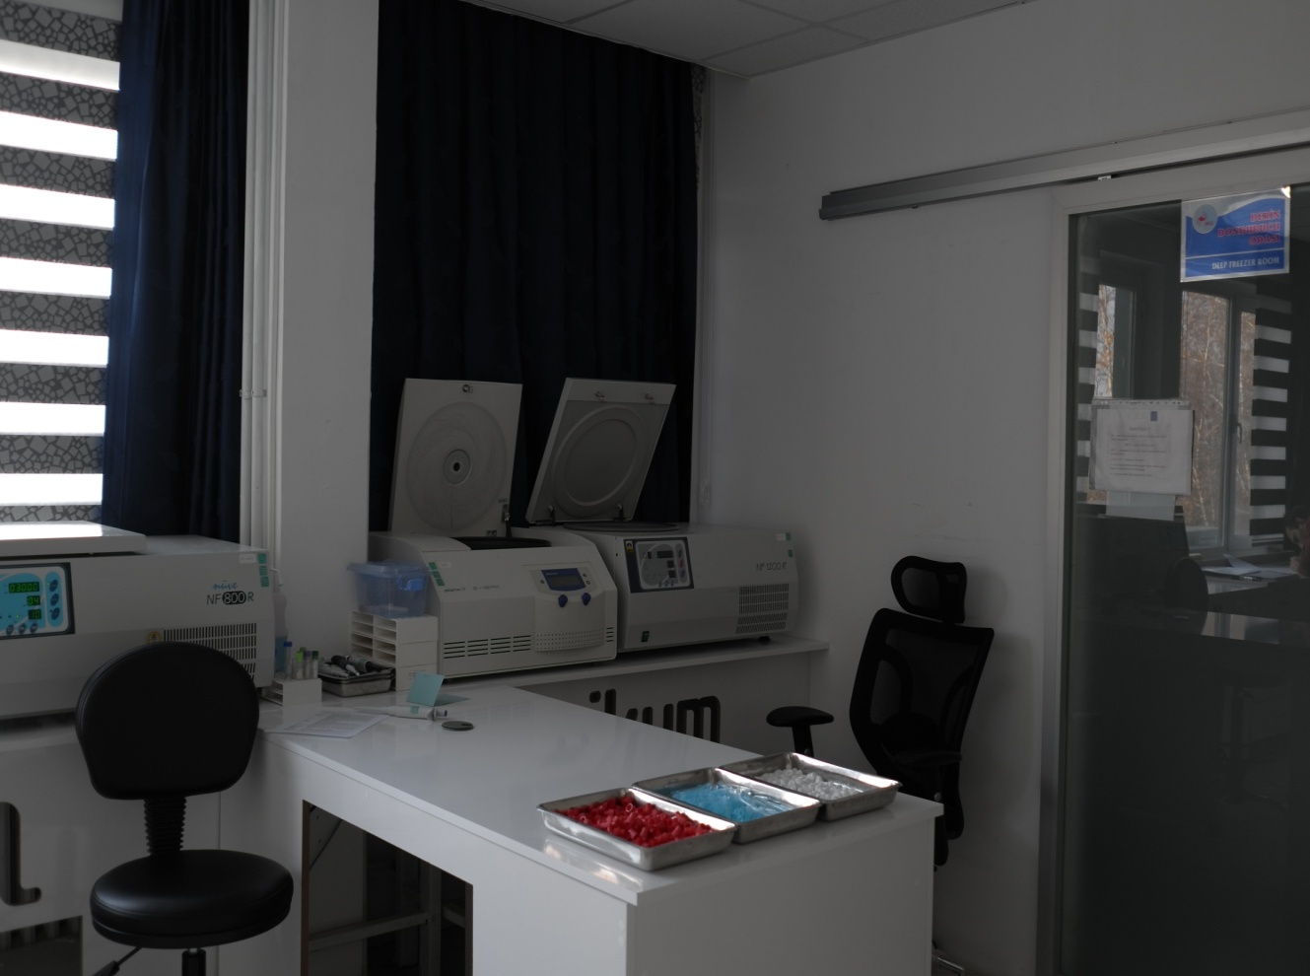

Slide 28
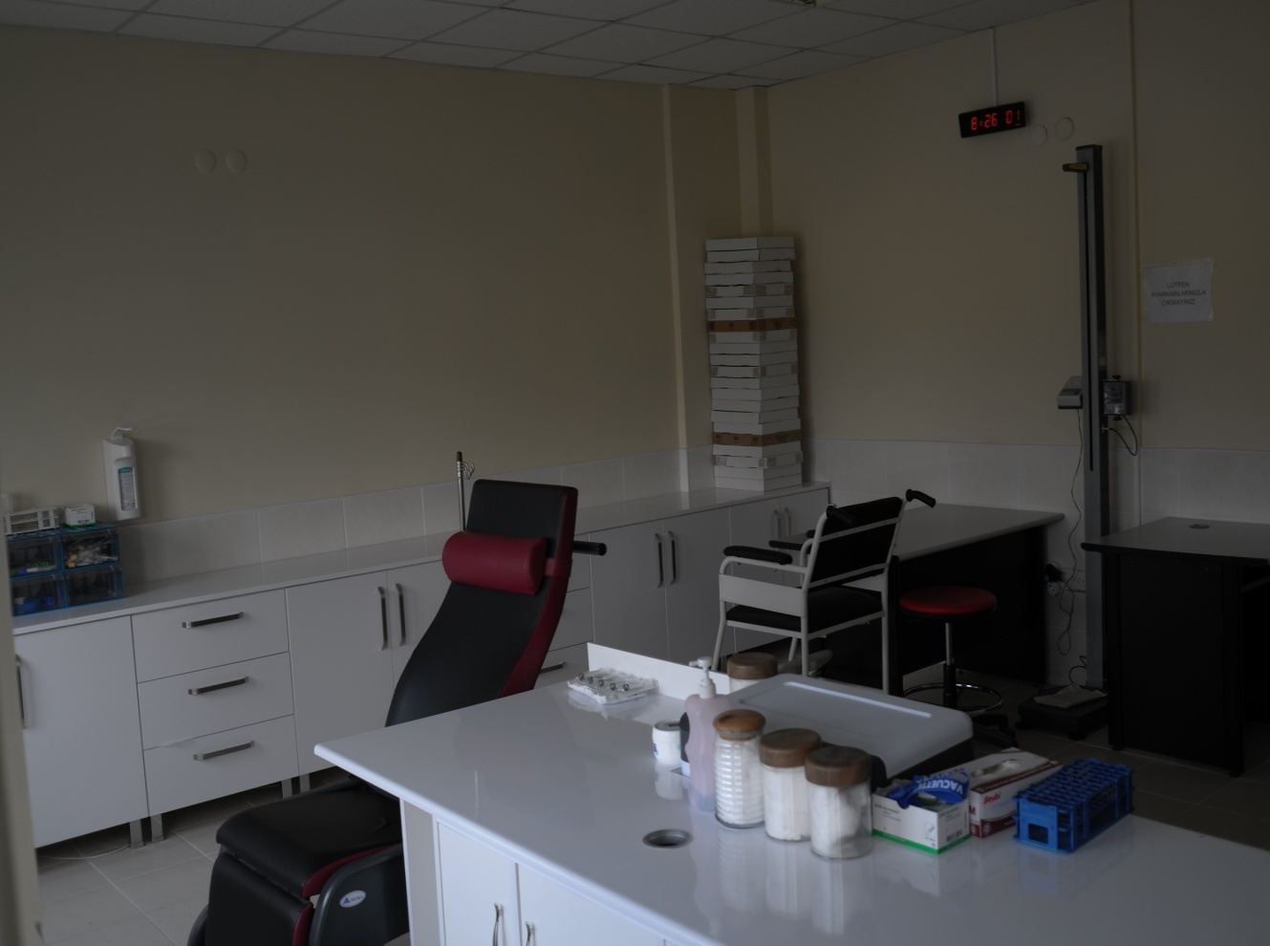

Slide 29
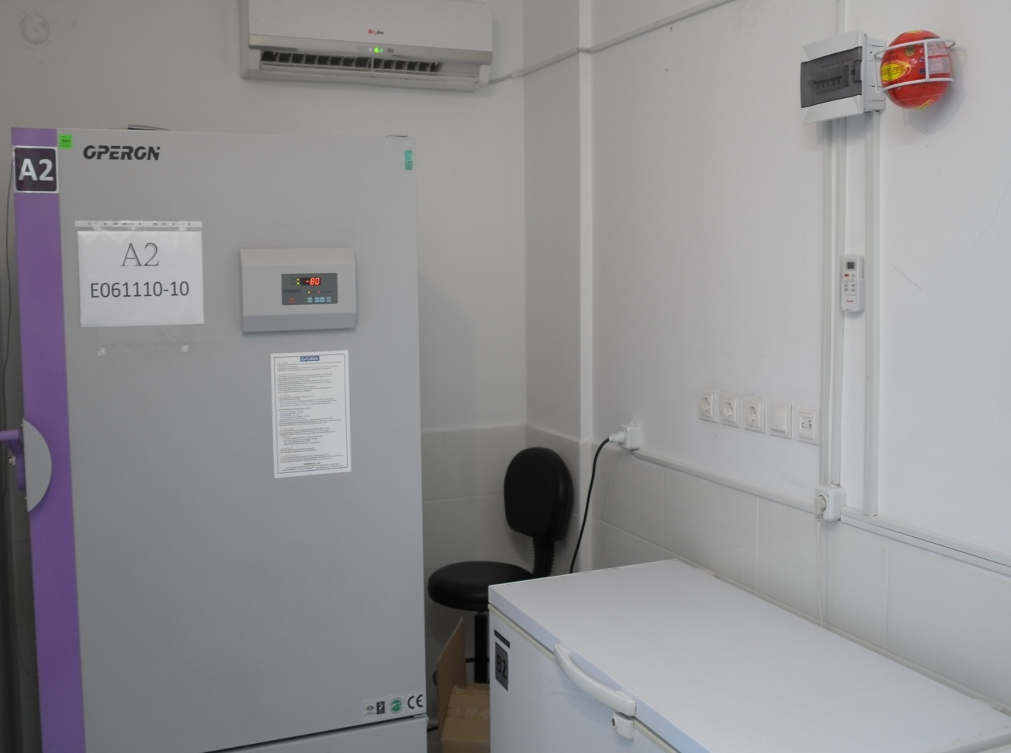

Slide 30
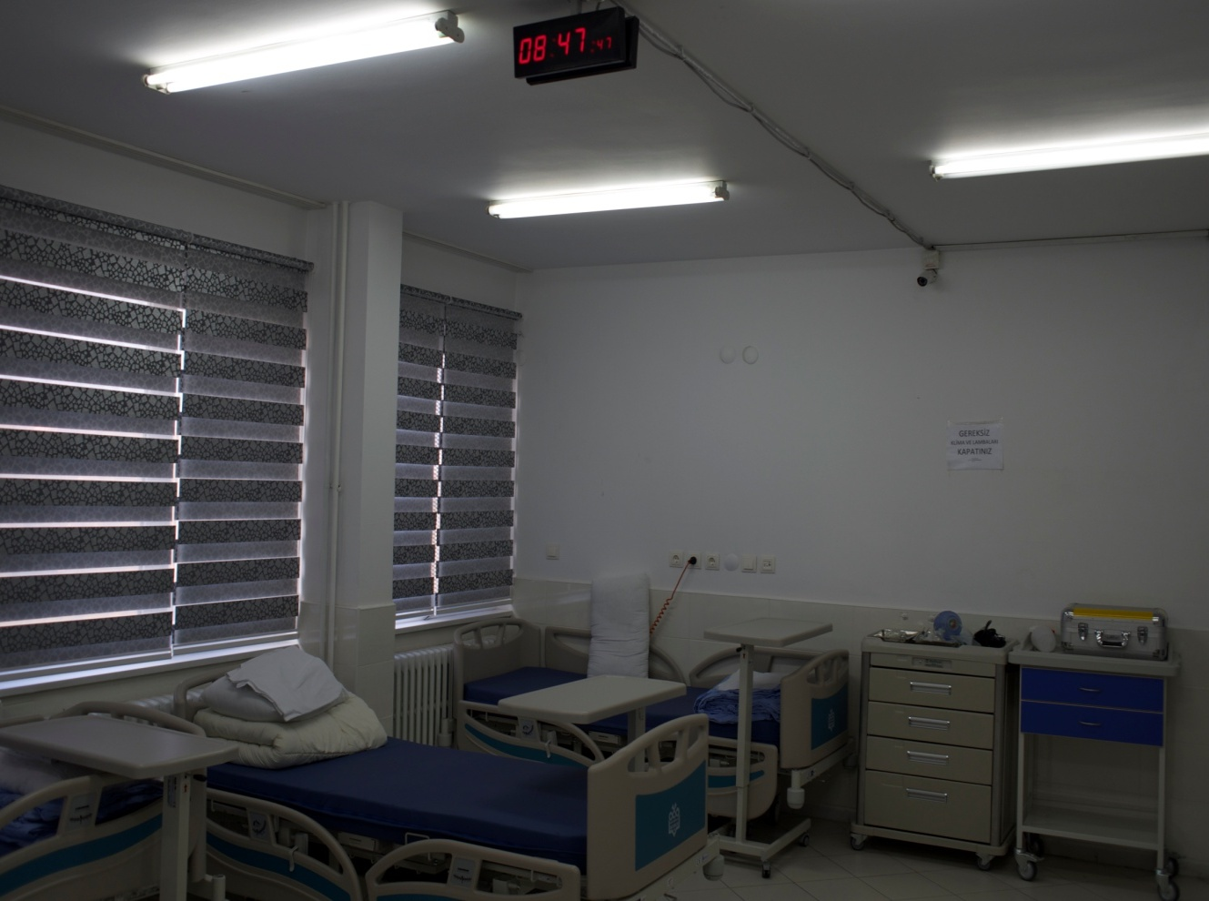

Slide 31
A major strategy for lowering the cost of medication, and thereby reducing its contribution to total healthcare costs has been the introduction in global markets of generic equivalents of brand name drugs (innovator drugs)
Thousands of generic drugs bioequivalance trials are necessary to conform to the same standards of quality, efficacy and safety as required of the originator’s drugs

Slide 32



As a result BA/BE trials are improving in Turkey. They are conducting according to Turkish Regulations Regarding Clinical Trials of Drugs and Biologics

Slide 33



Slide 34
Let us meet again..
We welcome you to our future conferences of Conference Series LLC
through
8th World Congress on Bioavailability & Bioequivalence: BA/BE Studies Summit
June 26-29, 2017 at San Diego, USA
http://bioavailability-bioequivalence.pharmaceuticalconferences.com/

