Slide 1
About OMICS Group
OMICS Group International is an amalgamation of Open Access publications and worldwide international science conferences and events. Established in the year 2007 with the sole aim of making the information on Sciences and technology ‘Open Access’, OMICS Group publishes 400 online open access scholarly journals in all aspects of Science, Engineering, Management and Technology journals. OMICS Group has been instrumental in taking the knowledge on Science & technology to the doorsteps of ordinary men and women. Research Scholars, Students, Libraries, Educational Institutions, Research centers and the industry are main stakeholders that benefitted greatly from this knowledge dissemination. OMICS Group also organizes 300 International conferences annually across the globe, where knowledge transfer takes place through debates, round table discussions, poster presentations, workshops, symposia and exhibitions.

Slide 2
About OMICS Group Conferences
OMICS Group International is a pioneer and leading science event organizer, which publishes around 400 open access journals and conducts over 300 Medical, Clinical, Engineering, Life Sciences, Pharma scientific conferences all over the globe annually with the support of more than 1000 scientific associations and 30,000 editorial board members and 3.5 million followers to its credit.
OMICS Group has organized 500 conferences, workshops and national symposiums across the major cities including San Francisco, Las Vegas, San Antonio, Omaha, Orlando, Raleigh, Santa Clara, Chicago, Philadelphia, Baltimore, United Kingdom, Valencia, Dubai, Beijing, Hyderabad, Bengaluru and Mumbai.

Slide 3
Consecutive vortex ring formation from a pulsed jet
Zachary Garcia
zagarcia@alaska.edu
Jifeng Peng
Notes:
My presentation:
Studying the consecutive ring formation from a pulsed jet, and the subsequent ring interaction behavior.

Slide 4
What is a vortex ring?
A vortex ring is a ring-shaped mass of moving fluid which has rotational motion around an axis disposed in circular form
Streamlines on the symmetry plane
Notes:
So, what is a vortex ring?
A vortex is a mass of fluid which has rotational momentum about an axis. If the axis is disposed into a circular form, the vortex becomes a vortex ring.
The image you can see is a cross-sectional diagram of a vortex ring with streamlines showing.
In the subject of propulsion, the most relevant aspect of vortex ring dynamics is it’s formation. During the formation, momentum is transferred into the surrounding fluid. The more efficient the momentum transfer, the more efficient the thurst generation.

Slide 5
Experimental Setup
Actuator controlled piston
Laser sheet
Notes:
In order to study vortex ring formation we constructed an experimental apparatus.
We used a large clear acrylic tank filled with water.
Added computer controled linearly actuated piston to provide the pulse to the smaller piston.
Using the actuator, we can control the frequency and size of the vortex rings.
A laser sheet is then shone through the tank to bisect the vortex rings allowing the cross section to be seen.

Slide 6
Piston velocity
U_{p}
U_{p}
D
time
t_{p}
t_{G}
Notes:
As I mentioned, by controlling the pulse length we can control the ring size. Similarly, the gap between pulses controls the frequency.
As the pulse of fluid exits the piston, the shear layer between the moving fluid and the stationary fluid causes a rotation about an axis that is curved circular from the edge of the piston tube.
When the piston stops, the ring separates and propogates through the fluid.

Slide 7
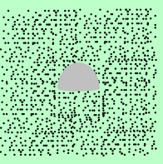
Quantitative flow measurements Use digital particle image velocimetry (DPIV) to measure velocity field
Neutrally buoyant glass beads
(mean size: 14 micron )
Laser
Particle movement
between frames
Camera
Notes:
The fluid is seeded with millions of neutrally buoyant glass bead particles. Average particle diameter is 14 microns.
The laser sheet bisects the rings and illuminates the particles in the fluid.
Using digital partical image velocimetry we are able to evaluate the fluid motion and in turn the circulation of the vortex rings.
Since the circulation is proportional to the momentum we can then quantify the momentum transfer to the surrounding fluid.

Slide 8
Notes:
Visually, DPIV allows us to generate a fluid flow field.
This is a cross-sectional view of the rings exiting the piston tube.
Here you can see the longer arrows indicate areas of higher velocity. If you look closely, you can see the first ring, a gap, then a trailing ring.
From this velocity data we are able to compute the circulation.

Slide 9
Notes:
Circulation is defined as the line integral of velocity or area integral of vorticity, so the velocity data is then converted into circulation which can then be plotted.
The primary and trialing vortices are more clearly seen here.
The red/blue color depicts the direction of the circulation within this cross-section. The blue representing clockwise and the red counterclockwise.

Slide 10
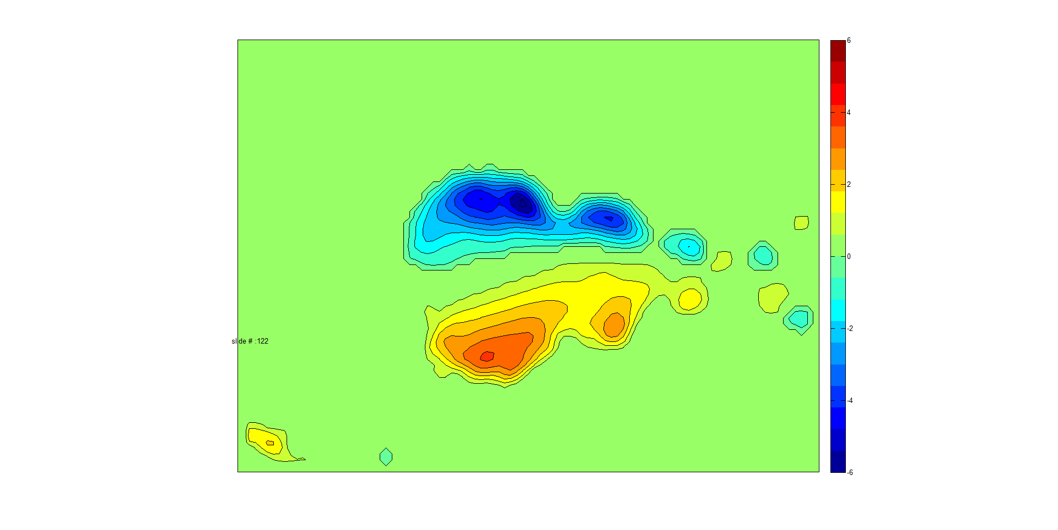
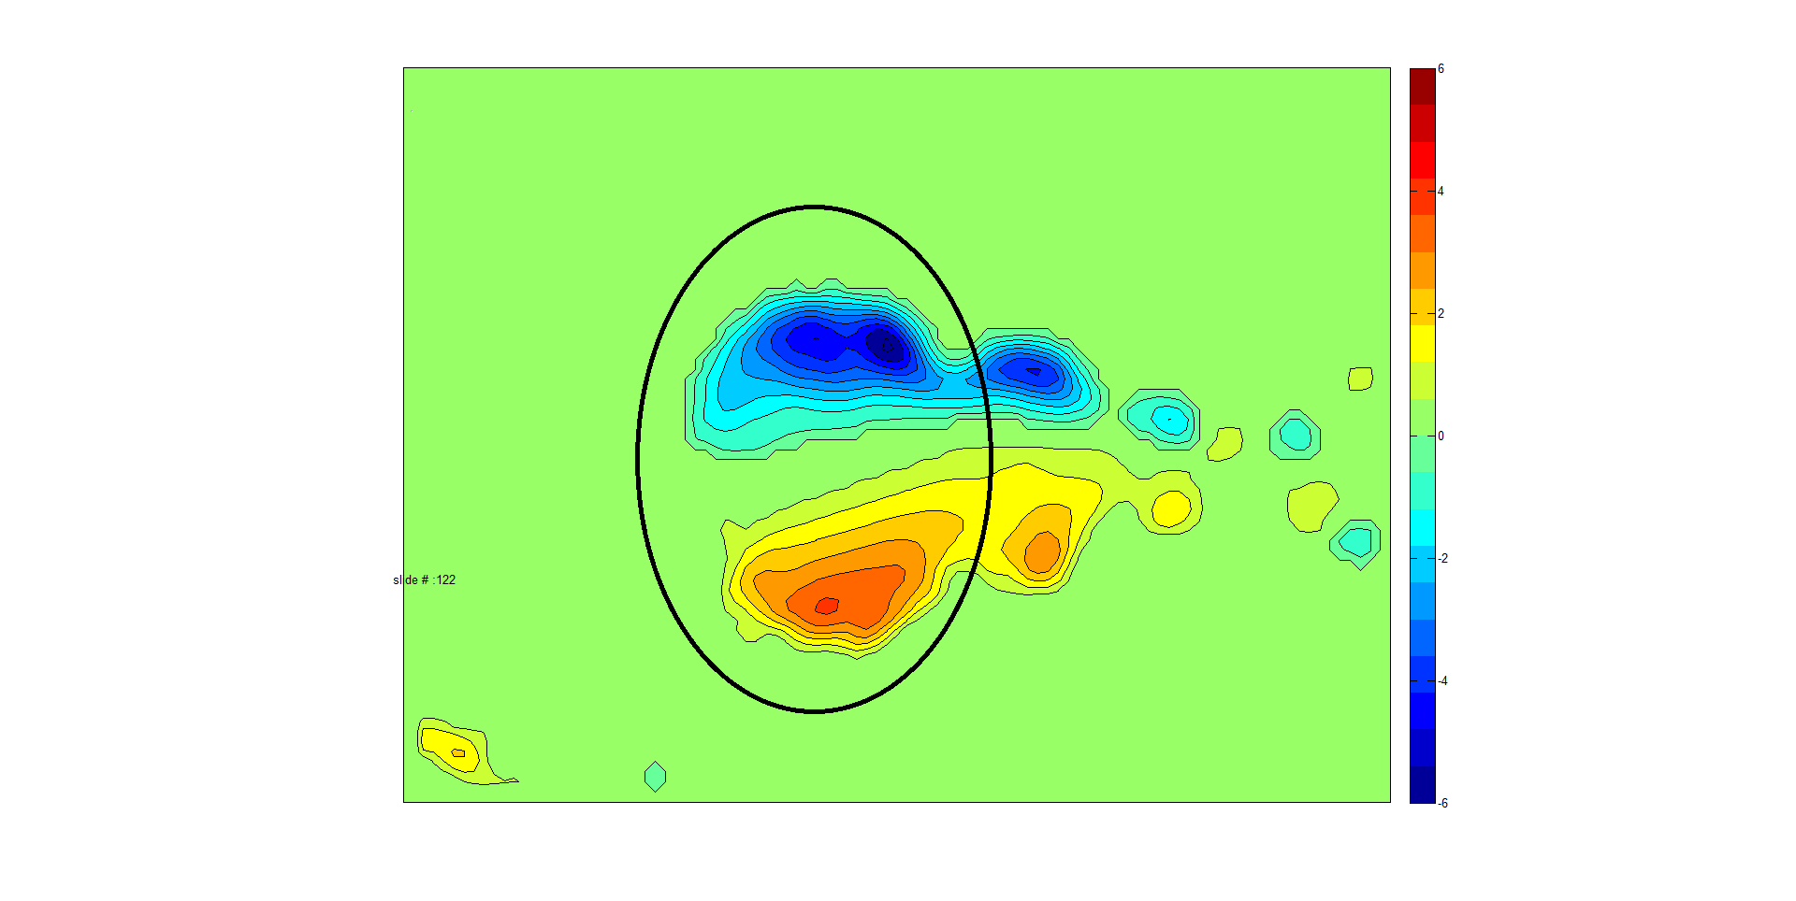
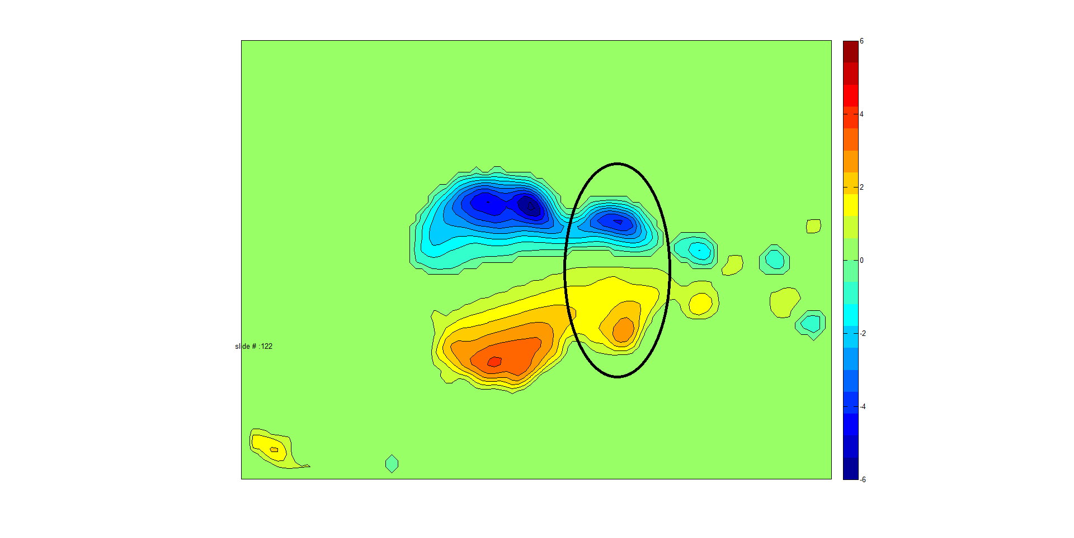
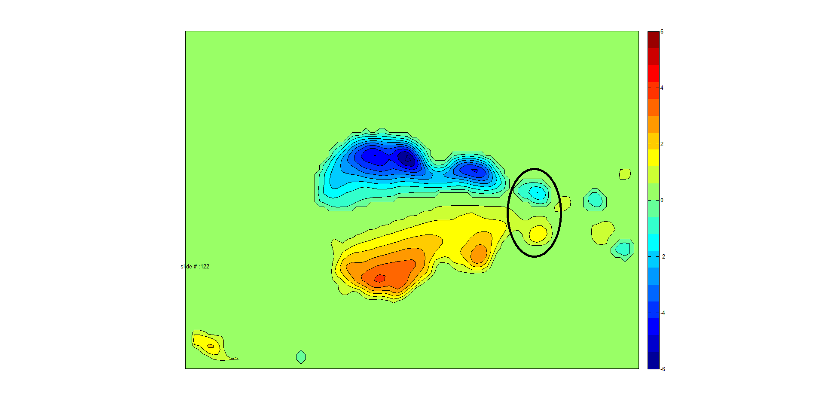
Notes:
Each frame is then analyized.
In this frame you can clearly see the leading vortex… trailing vortex… and then the shedding.
Shedding occurs off the trailing vortex during formation when more energy is transferred to the ring than can be accepted.
You can see that trailing vortex size maxed out much less than that of the leading. This is due to how closely the trailing vortex was generated behind the leading ring; due to the flow induced by the leading ring, the interaction between the two rings cause the trailing ring to accelerate and to contract in size (smaller radius) , which limits the entrainment of the shear layer. Therefore, the trailing ring is smaller in size and shedding occurs when it reaches its limit.

Slide 11
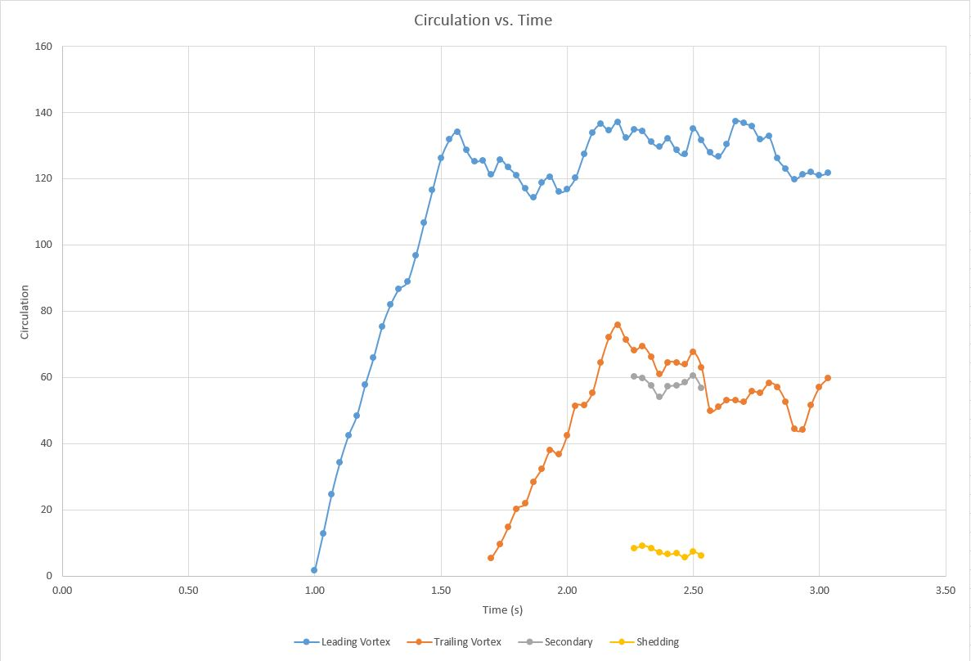
Circulation vs. Time
Δt
Circulation
Leading Vortex
Total trailing Vortex
Trailing vortex after
Shedding
Shedding
Notes:
The circulation of each frame for the given parameters of pulse size and gap are recorded.
Here you can see the formation of the leading vortex, and then where it departs-
And the formation of the trailing vortex, and where it too departs.
During the formation of the trialing vortex ring, when it cannot accept any more shear layer towards it’s growth, it begins shedding. The trailing ring size is then related back to the formation of the trailing ring in order to determine the point at which growth stopped.
This relationship is measured by determining the delta-t, or the time between beginning formation of the trailing ring, and the maximum size when shedding occurs.

Slide 12
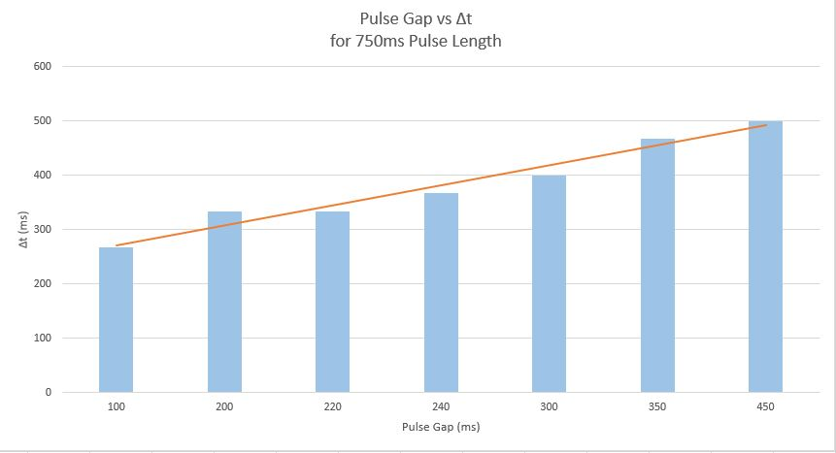
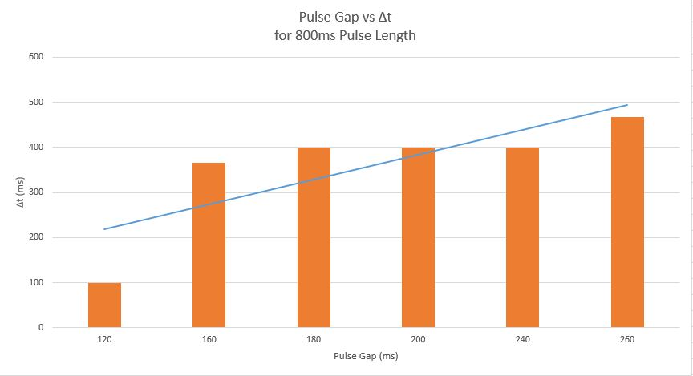
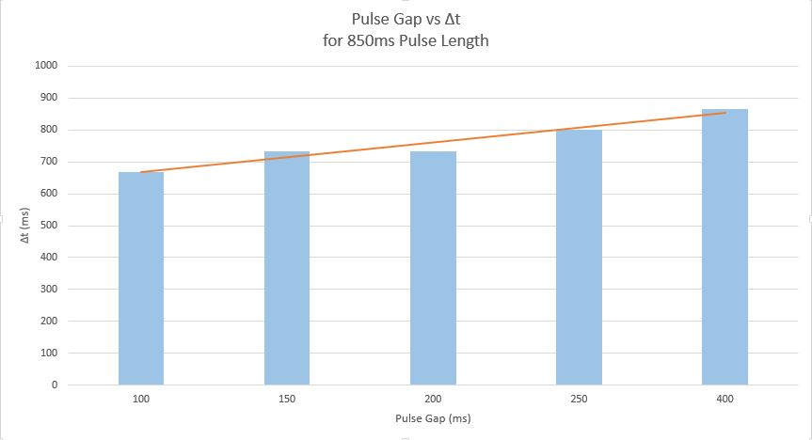
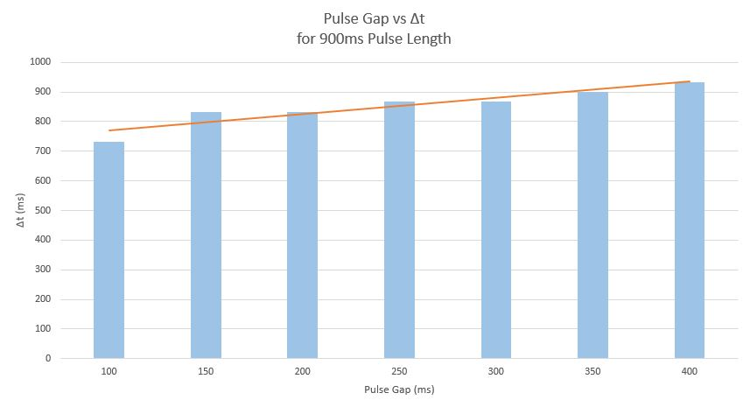
Notes:
That data is collected for each iteration of pulse size and pulse gap with delta-t data recorded.
Here is some example data with pulse sizes ranging from 750 to 900ms. The y-axis designates the recorded delta-t, and the x-axis designates the respective gap time between pulses from approximately 100 to 500ms.
As you can see, as the gap between consecutive vortex rings gets larger, so too does the delta-t value.
The purpose here is to determine the max size that the trailing ring can grow to before shedding occurs for varying gap lengths between vortices.
In terms of momentum transfer, vortex shedding is less efficient, so minimizing it based on pulse frequency is interesting.

Slide 13
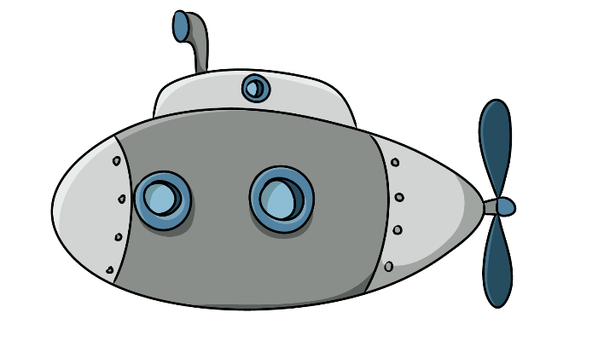
Conclusion
Examines the formation of consecutive vortex rings with varying size and frequency
Quantifies the momentum transfer by evaluating the fluid circulation within the rings using DPIV
Relates the time to maximum formation, Δt, to the time gap between rings
Zachary Garcia
zagarcia@alaska.edu
Notes:
In conclusion, our research examines the formation of consecutive vortex rings while varying their size and frequency.
Quantifies the momentum transfer to the surrounding fluid by evaluating the fluid circulation within the rings using digital partical image velocimetry.
Relates the time it takes for the trailing ring to reach maximum formation size, delta-t, to the time gap between consecutive rings.
If we would like to look at vortex rings as a method of propulsion, we first need to be able to quantify their behavior and understand them. Once they are more understood, we can evaluate potential uses.

