Slide 1
About OMICS Group
OMICS Group is an amalgamation of Open Access Publications and worldwide international science conferences and events. Established in the year 2007 with the sole aim of making the information on Sciences and technology ‘Open Access’, OMICS Group publishes 500 online open access scholarly journals in all aspects of Science, Engineering, Management and Technology journals. OMICS Group has been instrumental in taking the knowledge on Science & technology to the doorsteps of ordinary men and women. Research Scholars, Students, Libraries, Educational Institutions, Research centers and the industry are main stakeholders that benefitted greatly from this knowledge dissemination. OMICS Group also organizes 500 International conferences annually across the globe, where knowledge transfer takes place through debates, round table discussions, poster presentations, workshops, symposia and exhibitions.

Slide 2
OMICS International Conferences
OMICS International is a pioneer and leading science event organizer, which publishes around 500 open access journals and conducts over 500 Medical, Clinical, Engineering, Life Sciences, Pharma scientific conferences all over the globe annually with the support of more than 1000 scientific associations and 30,000 editorial board members and 3.5 million followers to its credit.
OMICS Group has organized 500 conferences, workshops and national symposiums across the major cities including San Francisco, Las Vegas, San Antonio, Omaha, Orlando, Raleigh, Santa Clara, Chicago, Philadelphia, Baltimore, United Kingdom, Valencia, Dubai, Beijing, Hyderabad, Bengaluru and Mumbai.

Slide 3
Targeting delivery of etoposide to inhibit the growth of human glioblastoma multiforme using lactoferrin- and folic acid-grafted poly(lactide-co-glycolide) nanoparticles
Department of Chemical Engineering, National Chung Cheng University, Chia-Yi, Taiwan 62102, Republic of China

Slide 4
Introduction
Glioblastoma multiforme (GBM)
Antiangiogenic therapy
Chemotherapy
Resection
Radioative therapy
Supportive care
Notes:
●Glioblastoma multiforme is a kind of gliomas in primary brain tumors.
●The mainly therapy is resection by surgery, and then treating with radioative therapy, antiangiogenic therapy, chemotherapy, and supportive care, the recurrence of GBM in clinical practice is still high with average survival of 12-18 months.

Slide 5
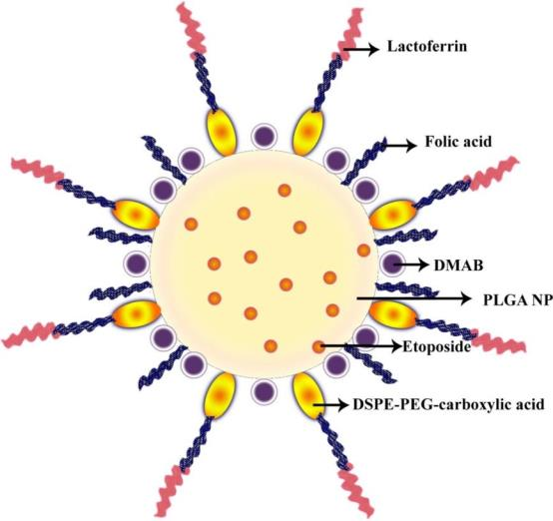
Lactoferrin (Lf)
Folic acid (FA)
Folic acid (FA)
Didodeyldimethylammonium bromide (DMAB)
Folic acid (FA)
Poly(lactide-co-glycolide) (PLGA)
Etoposide (ETP)
DSPE-PEG(2000)-carboxylic acid
Figure 1. An schematic structure of an Lf-FA-ETP-PLGA nanoparitcle (NP).
Notes:
●The hydrophobic ETP with low solubility in plasma and low permeability across BBB was entrapped in biodegradable PLGA that can enhance the bioavailibility of ETP and reduce the toxicity of ETP to normal cell.
●The surfactant Didodeyldimethylammonium bromide (DMAB) with positive charge can inhibit the aggregation of PLGA by increasing in the absolute zeta potential, and enhance the attachment of PLGA NP to BBB cell by electrostatic interaction.
●In this study, PLGA with surface modification of FA can target folate receptor which is generally overexpressed in human tumors, and grafting with Lf can enhance the permeability of ETP cross BBB for brain cancer treatment, and demonstrate the ability of ETP-encapsulated PLGA NP to inhibit GBM proliferation.

Slide 6
Produce ETP encapsulated PLGA formulations with FA and Lf grafting
In-Vitro test
Physicochemical property
TEER and permeability for BBB model
Morphology
Average diameter and zeta potential
Viability of BBB cells with PLGA NPs stimulation
Grafting efficacy of FA and Lf
Viability of U87MG cells with PLGA NPs stimulation
Entrapment efficacy of ETP
Immunochemical staining of HBMECs
Dissolution of ETP
Immunochemical staining of U87MG cells
Notes:
●In the experiment section, we prepare PLGA NPs by emulsification-diffusion method, and then grafting with FA, and Lf subsequently.
●After surface modification, the physicochemical property will be identified.
●We employ TEM and SEM to observe morphology, average diameter measurement can make sure PLGA NPs were small enough for cell uptake.
●Zeta potential is an stability index for the suspension system.
●The quantity of FA and Lf after grafting will be measure by ELISA, and then determine the grafting efficacy of FA and Lf.
●HPLC will determine the dissolution of ETP release from PLGA NPs.
●In the section of in-vitro test, we set a BBB model by co-culture HBMECs and HAs and measure TEER to make sure BBB model is satisfactory and reasonable to use.
●The viability test for BBB cells can make sure the biocompatibility of PLGA NPs is satisfactory for drug delivery system, and the viability of U87MG cells with PLGA formulation stimulation can demonstrate the potential of antitumor drugs.
● The consistent Immunochemical staining images can proof the uptake of PLGA formulation by HBMECs and U87MGs.

Slide 7
Result and discussion
At a high level of PLGA, probability of polymeric collision increased during emulsification and the enhanced viscosity of organic phase reduced fluidic mobility.
Figure 2. Effect of DMAB weight percentage on average diameter. (○) P_{PLGA} = 0.02% (w/v); (◇) P_{PLGA} = 0.04% (w/v); (□) P_{PLGA} = 0.06% (w/v); (△) P_{PLGA} = 0.08%. n = 3.
Notes:
●In this figure, an increase in DMAB weight percentage can decrease the average diameter because DMAB can reduce the interfacial tension and decrease the curvature of PLGA NPs.
●An increase in PLGA weight percentage can enlarge the particles at the same level of DMAB weight percentage, because the probability of polymer molecules collision increased during emulsification.
●Otherwise, the enhanced viscosity of organic phase can reduce the fluidic mobility, hinder the diffusion of PLGA to aqueous phase and produce larger cluster.
●The range of particle size is from 83.3 nm to 181.9 nm, this kind of size is suitable for cell uptake.

Slide 8
(a)
(b)
C_{FA}↑
PLGA ↑ D (nm) ↑
Figure 3. Effect of DMAB weight percentage on zeta potential. (a): (○) P_{PLGA} = 0.02% (w/v); (◇) P_{PLGA} = 0.04% (w/v); (□) P_{PLGA} = 0.06% (w/v); (△) P_{PLGA} = 0.08%; (b): P_{PLGA} = 0.02% (w/v). (△) C_{FA} = 0.01 % (w/v); (□) C_{FA} = 0.05% (w/v); (○) C_{FA} = 0.1% (w/v). n = 3.
Notes:
●In figure A, an increase in DMAB can enhance the absolute zeta potential, because DMAB with positive charge incorporated on PLGA.
●In figure B, an increase in FA concentration decrease the absolute zeta potential, because FA with negative charge neutralized the positive charge on NPs, and a higher positive charge on NP can attract more FA to surface.
●Otherwise, an increase in PLGA weight percentage enhanced the particles size and decreased in specific surface area which lead to decrease in electrical density on the surface.

Slide 9
Saturation of grafting site for free FA.
Table 1. The concentration of Lf versus zeta potential and grafting efficiency of Lf.
P_{Lf} (%) (w/v) | ζ (mV) | GE_{Lf} (%)
0 | 30.841 ± 3.253 | -
0.02 | 32.147 ± 2.035 | 94.965 ± 2.215
0.04 | 34.595 ± 4.938 | 77.278 ± 4.548
0.06 | 39.192 ± 3.193 | 56.412 ± 2.889
0.08 | 40.212 ± 2.844 | 40.070 ± 3.416
Figure 4. Effect of DMAB weight percentage on FA grafting efficiency. P_{PLGA} = 0.02% (w/v). (△) C_{FA} = 0.01 % (w/v); (□) C_{FA} = 0.05% (w/v); (○) C_{FA} = 0.1% (w/v). n = 3.
Notes:
●In this figure, an increase in DMAB weight percentage enhanced the grafting efficiency of FA, because the electrostatic interaction between negatively charged FA and positively charged DMAB on PLGA NPs.
● An increase in the FA weight percentage reduced the grafting efficiency, because more FA molecules in the grafting medium caused a stronger competition among FA for the crosslinking sites on PLGA NPs.
●But the enhancement of FA grafting efficiency was inhibited when the DMAB weight percentage increased from 0.06% to 0.08%, suggesting the saturation of grafting site for free FA on NPs surface.
●This table list an increase in Lf concentration can enhance zeta potential because Lf with positive charge in grafting medium.
●Otherwise, an increase in Lf concentration reduced the grafting efficiency, because the strong competition among Lf molecules for grafting site on FA-modified PLGA NPs.
●In general, when the zeta potential was over 30 mV, the suspension system would be quite stable, and this result indicate PLGA NPs with FA and Lf grafting would be stability for drug delivery system.

Slide 10
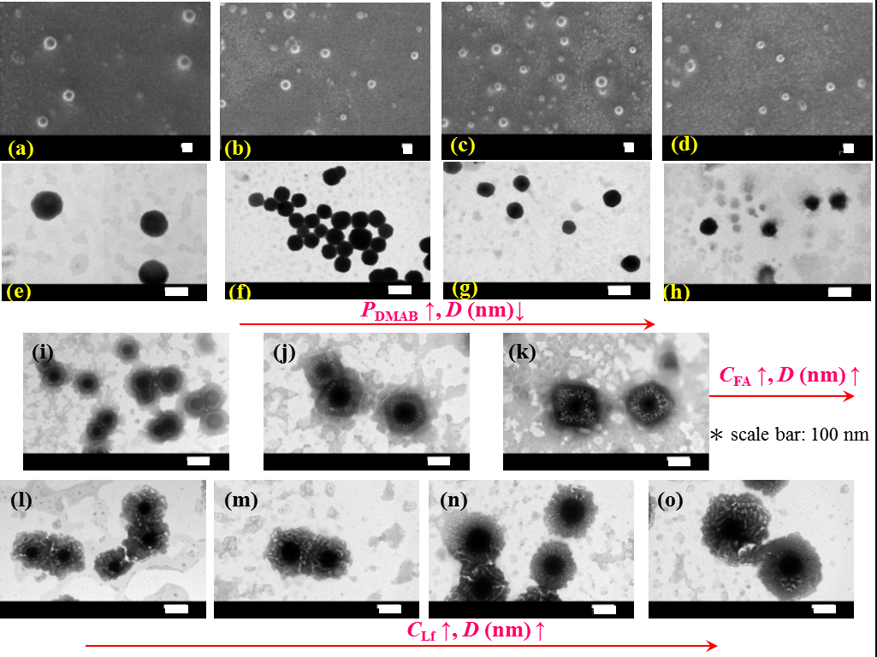
Notes:
●Image a to d are SEM image, and image e to o are TEM images.
●In image a to d, we can observe the reduced particle size when increases in DMAB weight percentage, and this results are consistent with the data show before.
●In image e to h, dark PLGA NPs with smooth boundaries appeared, and a thin layer of DMAB covered on the particle surface.
●Grafting with FA yielded bright exterior and slight deviations from spherical periphery, which were similar to distorted rhomb-shape with right angles, moreover an increase in FA weight percentage enlarged the particle size.
●In image l to o, PLGA with FA and Lf grafting show the irregular shape with few voids in the surface layer, because the distribution of modified Lf and FA on PLGA NPs was not completely uniform.
●All of those image demonstrate PLGA formulation produced step by step coating with different ingredient of DMAB, FA and Lf.

Slide 11
C_{ETP} = 0.5 mg/mL
Sufficient space for drug occupation.
C_{ETP} = 1 mg/mL
Drug competition.
C_{ETP} = 2 mg/mL
Figure 5. Effect of DMAB weight percentage on ETP entrapment efficiency. P_{PLGA} = 0.02% (w/v). (△) C_{ETP} = 0.5 mg/mL; (□) C_{ETP} = 1 mg/mL; (○) C_{ETP} = 2 mg/mL. n = 3.
Notes:
●In this figure, an increase in DMAB weight percentage enhance the entrapment efficiency of etoposide.
●Because the hydrophobic interaction between DMAB two hydrocarbon tails and etoposide, inhibit the loss of etoposide during emulsification.
●Otherwise, the competition of ETP leaded the decrease in entrapment efficiency, but when concentration of ETP was less than 0.5 mg/mL, the entrapment efficiency was independent on competition interaction, instead of dependent on the sufficient space for drug occupation.

Slide 12
Figure 6. Dissolution profile for ETP from PLGA NP formulation. P_{PLGA} = 0.02%, P_{DMAB} = 0.08%, C_{ETP} = 2 mg/mL. (○) PLGA NPs; (□) FA-ETP-PLGA NPs, P_{FA} = 0.1%; (△) Lf-FA-ETP-PLGA NPs, P_{Lf} = 0.08%, P_{FA} = 0.1%. n=3.
Notes:
●In this figure, there is no initial burst release in first 5 days.
●ETP release from PLGA NPs by the degradation of PLGA to lactic and glycolic acid and a stable ETP release was observed in the subsequent period of 9 days.
●The ETP release rate was in the order of PLGA NPs > PLGA NPs with FA grafting > PLGA NPs with FA and Lf grafting.
●Two reasons to explain this order dissolution:
●First, surface modification of FA and Lf like the sponge that can inhibit the diffusion of ETP from PLGA.
●Second, surface modification of FA and Lf can enlarge the particle size, prolong the diffusion distance of ETP from PLGA NPs.
●In fact, the migration path for releasing ETP from PLGA NPs with Lf and FA grafting was longer than that from PLGA with FA grafting.

Slide 13
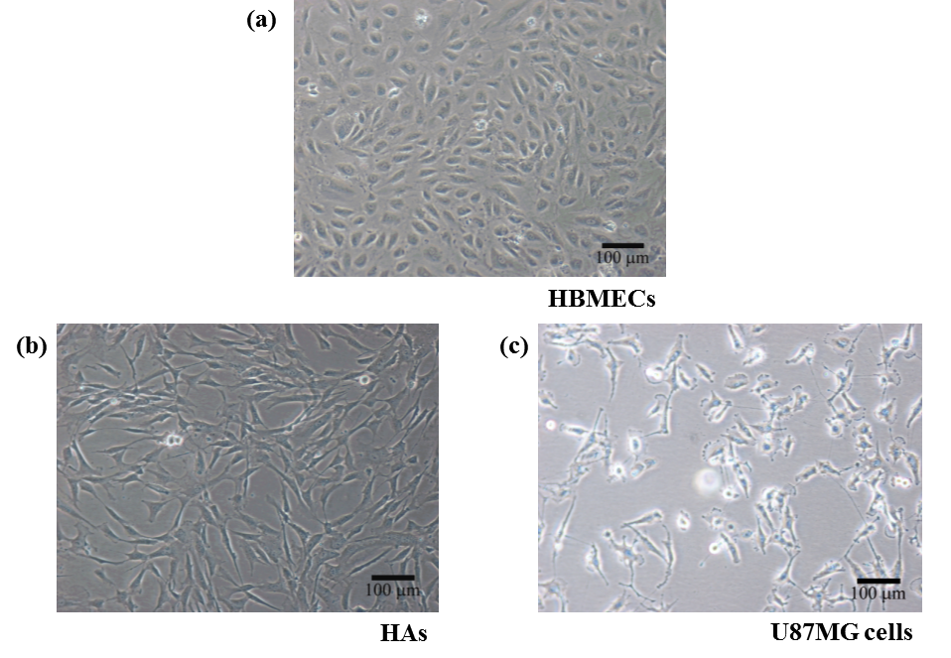
Figure 7. Morphology of HBMECs, HAs and U87MG cells. (a) HBMECs cultured at day 6; (b) HAs cultured at day 6; (c) U87MG cells cultured at day 4.
Notes:
●These figures show the morphology of HBMECs, HAs and U87MG cells.
●In figure A, the proliferation of HBMECs were close to each other and growth in certain directions.
●HAs displayed slim exteriors with extended branches and minor overlap in figure b.
●U87MG cells displayed dendrite-like appearance of typical malignant glioblastoma cells.

Slide 14
Y₁
Y₂
The blood-brain barrier (BBB) model was satisfactory and reasonable when TEER was over 120 Ω×cm².
Figure 8. TEER and permeability of ETP across the monolayer of HBMECs/HAs using PLGA formulation. P_{PLGA} = 0.02%; P_{DMAB} = 0.08%; P_{FA} = 0.1%; P_{Lf} = 0.08%, C_{ETP} = 2 mg/mL. White bar: TEER, Y₁; black bar: permeability, Y₂. n = 3.
Notes:
●TEER is an index for satisfactory and reasonable BBB model, and high TEER can make sure drug permeate via endocytosis not intercellular tight junction.
●In this figure, TEER of three PLGA formulation were over 120 omh*cm2, this result was satisfactory to assess the permeation of PLGA NPs across the BBB.
●The permeability of ETP was in the order of PLGA NPs with Lf and FA grafting > PLGA NPs with FA grafting > PLGA NPs coating with DMAB.
●PLGA NPs incorporated DMAB with positive charge can slightly promote the permeability via adsorptive-mediated transcytosis.
●The permeability of PLGA with Lf grafting was higher than PLGA with FA grafting, because the wide expressing of Lf receptor on HBMECs surface, and both two PLGA formulation across the BBB were via receptor-mediated transcytosis.

Slide 15
(a)
(b)
Figure 9. (a) Viability of HBMECs, HAs after treatment with PLGA NP formulation; (b) viability of U87MG cells by treatment with PLGA NP formulation over 48 hours. n = 3.
Notes:
●In figure A show the viability of BBB cells.
●The three PLGA formulations could slightly decrease in the viability of BBB cells, and the viability of BBB cells was in the order of PLGA NPs > PLGA NPs with FA grafting > PLGA NPs with Lf and FA grafting, two reason can be explain.
●First, because the ETP is damage to mammalian cells, and surface modification of Lf can increase the probability of PLGA NPs internalization.
●Second, PLGA NPs with positive charged could trigger the electrical intervention in the negatively charged cells system.
●However, PLGA formulations with low cytotoxicity was satisfactory for drug delivery system.
●In figure B, after treating with three PLGA formulation, the viability of U87MG cell decrease with targeting time, and the viability of U87MG cells was in the order of free ETP solution > PLGA NPs > PLGA NPs with FA grafting > PLGA NPs with Lf and FA grafting, two reasons can be explain.
●First, FA can target FR expressed U87MG cells and favor specific delivery of ETP. Moreover, grafting with Lf could benefit the uptake of PLGA formulation by U87MG cells via binding to low-density lipoprotein receptor, and increase in the internalization of PLGA formulations by U87MG cells.
●Second, the etoposide release rate was PLGA NPs > FA/PLGA NPs > Lf/FA/PLGA NPs . Thus, Lf/FA/PLGA NPs demonstrated a stronger feature of sustained release during the treatment than PLGA NPs with FA grafting.

Slide 16
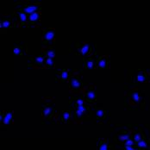
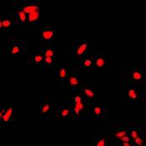
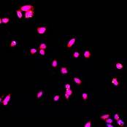
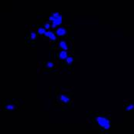
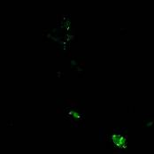
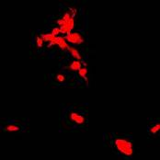
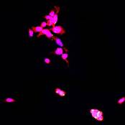
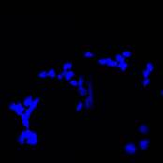
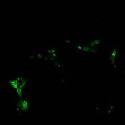
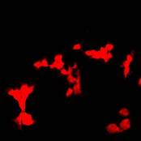
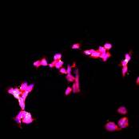
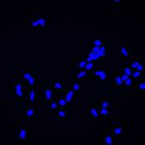
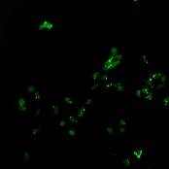
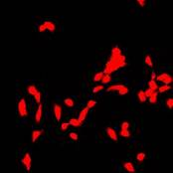
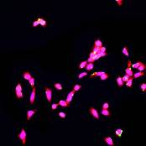
(a-1)
(a-2)
(a-3)
(a-4)
(b-1)
(b-2)
(b-3)
(b-4)
(c-1)
(c-2)
(c-3)
(c-4)
(d-1)
(d-2)
(d-3)
(d-4)
C_{Lf} ↑
Figure 10. Immunochemical staining images of Lf-FA-ETP-PLGA NPs interacting with HBMECs. P_{PLGA} = 0.02%, P_{DMAB} = 0.08%, C_{ETP} = 2 mg/mL. (a-#) C_{Lf} = 0.02%; (b-#) C_{Lf} = 0.04%; (c-#) C_{Lf} = 0.06%; (d-#) C_{Lf} = 0.08%; (*-1): nuclei for blue; (*-2): Lf-FA-ETP-PLGA NPs for green; (*-3): Lf receptor for red; (*-4): merged image. * is 1, 2, 3, or 4; * is a, b, c, or d.
Notes:
●These figure show the uptake of PLGA formulation by HBMECs.
●As figure displayed, an increase in Lf concentration can enhance the uptake of PLGA NPs by HBMECs, and this result was consistent with TEER data.
●Base on these images, we made the following two conclusions.
●First, Lf can be a potential protein to intensify the interaction between Lf/FA/PLGA NPs to HBMECs. Surface modification of Lf can recognize Lf receptor on HMBECs and trigger the RMT pathway to accelerate the transport of PLGA NPs with FA and Lf grafting to HBMECs.
●Second, PLGA NPs modified with cationic DMAB could be an efficient colloidal system for delivering etoposide across the BBB.
●Thus, the application of Lf ligand to anchor the BBB can play a crucial role in the brain-targeted delivery and can be an important strategy for nanomedication in clinical practice.

Slide 17
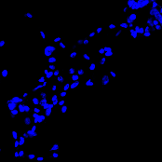
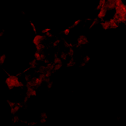
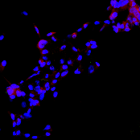
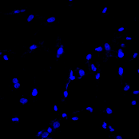
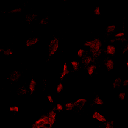
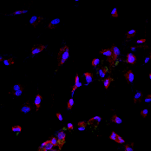
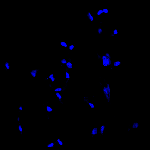
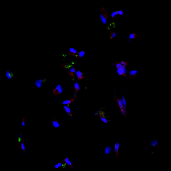
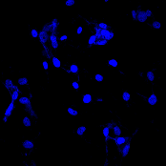
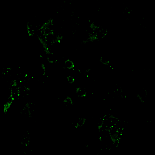
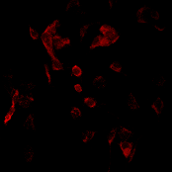
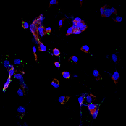
(a-1)
(a-2)
(a-3)
(a-4)
(b-1)
(b-2)
(b-3)
(b-4)
(c-1)
(c-2)
(c-3)
(c-4)
(d-1)
(d-2)
(d-3)
(d-4)
C_{FA} ↑
Figure 11. Immunochemical staining images of Lf-FA-ETP-PLGA NPs interacting with U87MG cells. P_{PLGA} = 0.02%, P_{DMAB} = 0.08%, C_{ETP} = 2 mg/mL. (a-#) C_{FA} = 0%; (b-#) C_{FA} = 0.01%; (c-#) C_{FA} = 0.05%; (d-#) C_{FA} = 0.01%; (*-1): nuclei for blue; (*-2): Lf-FA-ETP-PLGA NPs for green; (*-3): folate receptor for red; (*-4): merged image. * is 1, 2, 3, or 4; * is a, b, c, or d.
Notes:
●In these images, the uptake of PLGA NPs by U87MG cells enhanced when increased in FA concentration, and this result was consistent with viability data show before.
●This demonstrated that the uptake of Lf/FA/PLGA NPs by U87MG cells could be attributed to the regulatory mechanisms of FR-mediated pathways. Thus, the targeting efficiency in delivering antitumor etoposide to brain cancer cells was strongly related to the modified FA on PLGA formulation.

Slide 18
Conclusions
PLGA NPs incorporated with DMAB can increase the physical stability via enhancing zeta potential.
The biocompatibility of PLGA formulation to the BBB cells was quite high and suitable for drug delivery system.
PLGA NPs grafted with Lf and FA could enhance the permeability across the BBB and the internalization of PLGA NPs for inhibiting the proliferation of malignant glioblastoma cells.
Notes:
●The conclusions are:
●First, PLGA NPs incorporated with DMAB can increase the physical stability via enhancing zeta potential.
● Second, the biocompatibility of PLGA formulation to the BBB cells was quite high and suitable for drug delivery system.
● Third, PLGA NPs grafted with Lf and FA could enhance the permeability across the BBB and the internalization of PLGA NPs for inhibiting the proliferation of malignant glioblastoma cells.
● Moreover, Lf and FA on Lf/FA/PLGA NPs could appreciably reduce the administered dosage of cytotoxic etoposide.
● In addition to the delivery of etoposide to glioblastomas cells, examples of medical therapy with Lf/FA/PLGA NPs can include the treatment for Alzheimer’s disease, Parkinson’s disease, Huntington’s disease, epilepsy, cerebral ischemia, intracerebral hemorrhage, stroke, and acquired immunodeficiency syndrome.

Slide 19
Thank you for attention!

Slide 20
Let us meet again..
We welcome you to our future conferences of OMICS International
2nd International Conference and Expo on
Drug Discovery & Designing
On
October -31 November-02, 2016 at Istanbul, Turkey
http://drug-discovery.pharmaceuticalconferences.com/

