Slide 1
Dark Energy in General Relativity
Yukio Tomozawa
Physics Department
University of Michigan

Slide 2
Contents
Acceleration of Universe expansion, dark energy
Experimental test of General Relativity (GR)
The Physical Metric (PM)
Nature of black hole (BH), extended horizon
Masses of BH merger in GW150914
Coordinate transformation from PM to FRW (Friedmann-Robertson-Walker) metric
Inside-acceleration, Outside-deceleration
The end of the universe expansion

Slide 3
Acceleration of Universe expansion
The universe expansion is accelerated. Physics Nobel Prizes are given in 2011.

Slide 4
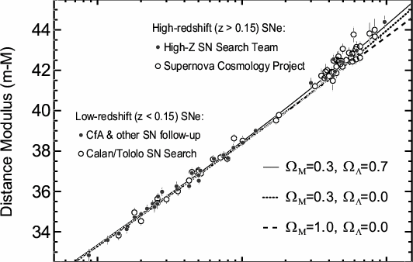
Acceleration

Slide 5
Cosmological constant, Λ
Acceleration always.
a(τ): expansion factor
[(da(τ)/dτ)/a(τ)]^2=8πGρ/3 + Λ/3, Λ=constant
For ρ=0, a(τ) = A exp ((Λ/3)^1/2 * τ)
Accelerating expansion!! a”(τ) > 0

Slide 6
Experimental test of GR Time delay experiment of Solar system
I. Shapiro et al, Bertotti et al.
Δt = (r_s /c) ln (r/b) fits the data well (1/10^5 accuracy), where b is the impact parameter and r_s is the Schwarzschild radius (SR hereafter).
r_s = 2Gm/c^2
The Schwarzschild metric of GR gives the prediction (See Weinberg’s Gravitation, p.202)
Δt = (r_s /c) [ln (r/b) + ½*((r-b)/(r+b))^1/2]
This does not fit the data.

Slide 7
Lesson in GR
The Schwarzschild metric is the exact solution of the Einstein equation, but it does not fit the experimental data.
ds^2=exp(a(r))*dt^2 – exp(b(r))*dr^2 – r^2*exp(c(r)*dΩ
If exp(a(r)=exp(c(r)), one gets the correct formula for time delay experiment, Δt=(r_s/c) * ln (r/b).

Slide 8
The physical metric (PM)
exp(a(r)) = exp(c(r)) = ω
Schwarzschild metric, r’ = r * ω ^1/2
1-r_s/(r* ω ^1/2) = ω
Solving for r_s/r, one gets
r_s/r = ω^1/2 * (1 – ω)
This terminates at
R = (3*3^1/2)/2 r_s = 2.60 r_s
This gives the size of BH, called the extended horizon.
exp(b(r)) = (d(r*ω^1/2)/dr)^2/ω = (2ω/(3ω-1))^2

Slide 9
PM(Inside solution)
Inside the extended horizon, using the internal solution of the Schwarzschild metric one gets
D (r_s/r) = ω^1/2 (Aω – 1)
Connecting the inside and outside solutions at the extended horizon, R, one gets
A = 2D + 3
The choice of D > 0, A > 3
makes all the metric functions positive definite.
exp(b(r)) = A*(2ω/(3Aω-1))^2
The inside solution is repulsive. (See the graph in the next page. This is a new feature!)

Slide 10
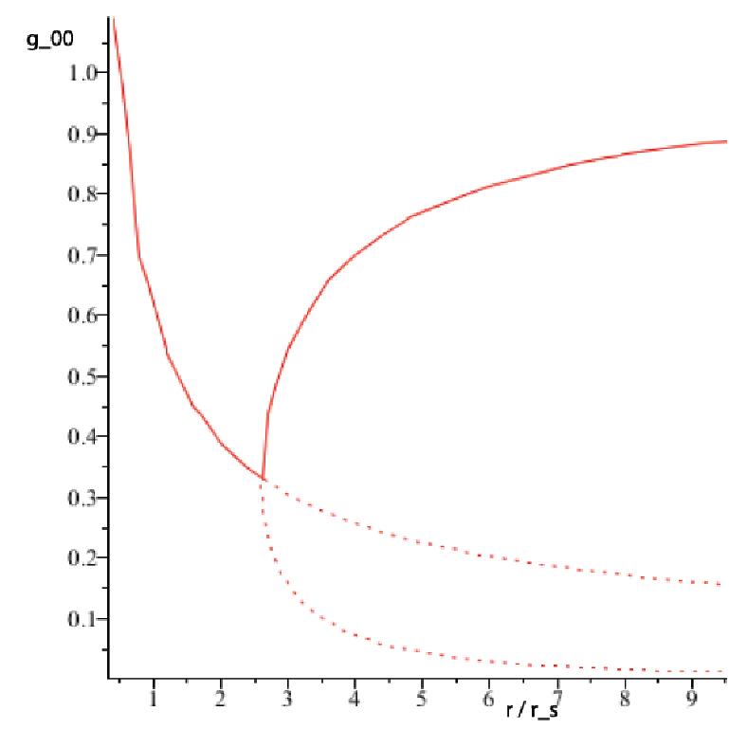
Physical metric (ω=g_00)

Slide 11
Gravitational redshift at R
On the surface of BH, i. e. at r = R,
g_00(R) = 1/3.
Then the gravitational redshift at R is
1 + z = 1/(g_00(R))^1/2 =3^1/2 = 1.732

Slide 12
PM with constant density, ρ [inside]
For r < R = 2.60 r_s,
ω = 1/ (B+(8πGρr^2)/3))
exp(b(r)) = B ω^2
This is a repulsive gravity.
Connecting ω at r = R, one gets
B = 3 – 2/3 *3^1/2 = 2.615

Slide 13
Nature of BH and Neutron Stars
The radius is 2.60 times SR. This is a surprise!
The gravitational red shift at R is
1+z = 1/ω^1/2 = 3^1/2 = 1.732
The temperature of BH and NS is very high.
T ≈ dω/dr
outside of R positive temperature
at R infinity
inside of R negative temperature
(higher than any positive temperature)
Boltzman Probability ≈ exp(-E/kT)
For T<0, high E state is more probable.

Slide 14
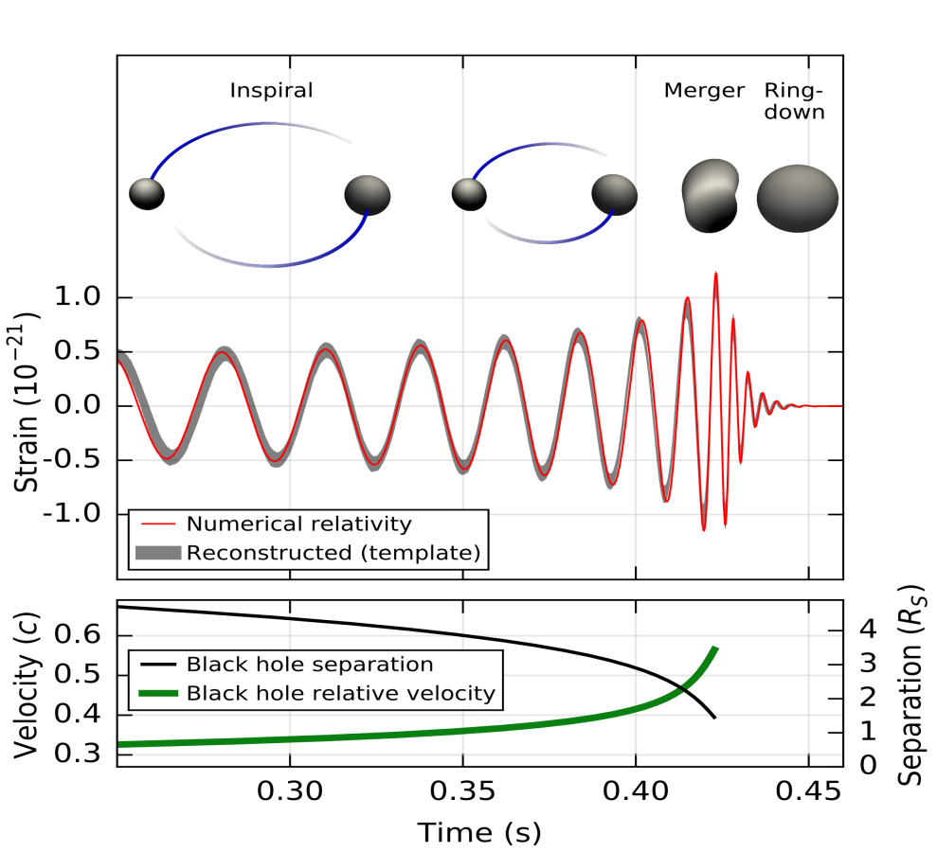
Black hole merger in GW150914

Slide 15
Black hole masses in GW150914
The numerical simulation indicates the masses of black hole merger to be
M_1 = 29 (+4, -4) M_ʘ
M_2 = 36 (+5, -4) M_ʘ➔M_f = 62 (+4, -4)M_ʘ
These must be changed to (divided by 2.60), since the size of black hole is increased by 2.60
M_1 = 11.2 M_ʘ
M_2 = 13.8 M_ʘ ➔ M_f = 23.8 M_ʘ

Slide 16
Away from the Merger Contact
The change of energy by GW emission,
-dE/dt = F (32G/5c^5)*(m1 m2 /(m1+m2))^2 *
r^4 *ω^6,
where F= (2.60)^2 * (1+z)^2
is the enhancement factor by the size of BH and the gravitational red shift, 1+z = $\sqrt{3}$ =1.732.
This factor F is good enough to fit the data by smaller masses, m1 = 13.8 and m2 = 11.2 SM.

Slide 17
Coordinate transformation from PM to FRW (Friedman- Robertson- Walker)
FRW
ds^2=dτ^2 – a(τ)^2*(dξ^2/(1-kξ^2) + ξ^2*dΩ),
where k =0, ± 1.
PM
ds^2 = ω*dt^2 – exp(b(r))*dr^2 –r^2*ω*dΩ
r < R, ω = 1/(B + (8πGρr^2)/3)
exp(b(r)) = B ω^2, B=2.615
r > R, r_s/r = ω^1/2 * (1 – ω)
exp(b(r)) = (2ω/(3ω-1))^2

Slide 18
Coordinate transformation [1]
t = t(τ,ξ), r = r(τ,ξ)
dt = (∂t/∂τ)dτ + (∂t/∂ξ)dξ
dr = (∂r/∂τ)dτ + (∂r/∂ξ)dξ
a(τ)*ξ = r*ω^1/2
ω(∂t/∂τ)^2 – exp(b(r))*(∂r/∂τ)^2 = 1
exp(b(r))*(∂r/∂ξ)^2 – ω*(∂t/∂ξ)^2 = a(τ)^2/(1-kξ^2)
ω*(∂t/∂τ) (∂t/∂ξ) – exp(b(r))(∂r/∂τ) (∂r/∂ξ) = 0

Slide 19
Coordinate transformation [2]
Eliminating ∂t/∂τ and ∂t/∂ξ, and using the explicit formulae for ω and exp(b(r)), one gets
(a’(τ)ξ)^2 = 1- kξ^2 –B/(B + (8πGρr^2)/3)
for r < R, and
(a’(τ)ξ)^2 = 1 – ω - kξ^2 for r > R
The right hand sides of the both equations are positive definite for k < 0 or k=0 or for small value of ξ.

Slide 20
Coordinate transformation [3]
Differentiating the equations in the previous page wrt τ, one gets
a”(τ) = (8πGρr/3)/(B + (8πGρr^2)/3)^1/2 (1)
for r < R, and
a” (τ) = - (1 – ω)/(2*r*ξ*ω^1/2) (2)
for r > R
a”(τ) in Eq. (1) is positive and that in Eq. (2) is negative. These are the results from dω/dr < 0
for r < R (repulsive) and dω/dr > 0 for r > R (attractive).

Slide 21
Dark energy by PM
By coordinate transformation from PM to FRW metric, the author has shown that the universe expansion is accelerated inside the extended horizon (R) and decelerated outside R.
This is the result from the nature of the gravity being repulsive/attractive for inside/outside of R in PM.
The difference from Cosmological Constant is clear, since the latter gives acceleration everywhere.

Slide 22
The end of the universe expansion [1]
For simplicity, let us assume k = 0. (The observation is consistent with this assumption.) Then,
a’(τ)*ξ = (1 – ω)^1/2 for r>R.
Since (1 – ω)^1/2 = (r_s/rω^1/2)^1/2
= ( r_s/a(τ)ξ)^1/2, one gets
a(τ)^1/2 * a’(τ) = (r_s/ξ^3)^1/2 and it’s solution is
a(τ) = (H(ξ)* τ + K(ξ))^2/3, where
H(ξ) = (3/2)*(r_s/ξ^3)^1/2, and K(ξ) is an integration constant.

Slide 23
The end of the universe expansion [2]
For r > R,
a(τ) = (H(ξ)* τ + K(ξ))^2/3
This means that although outside the extended horizon the universe expansion is decelerated, the expansion reaches at the infinite distance.

Slide 24
The most important comment
The property of BH in PM is entirely different from that in the Schwarzschild metric. Almost everything based on the latter is wrong.
One has to review all the observable properties of BH and Neutron Stars (Compact Objects) based on the new metric (PM).

