Slide 1
Salt sales survey: a simplified method to evaluate population salt reduction programs
Yuan Ma, Feng J He, Nicole Li, Jesse Hao, Jing Zhang, Lijing L. Yan, Yangfeng Wu
The George Institute for Global Health at Peking University Health Science Centre
School of Public Health, Peking University
5th August 2015, Valencia, Spain

Slide 2
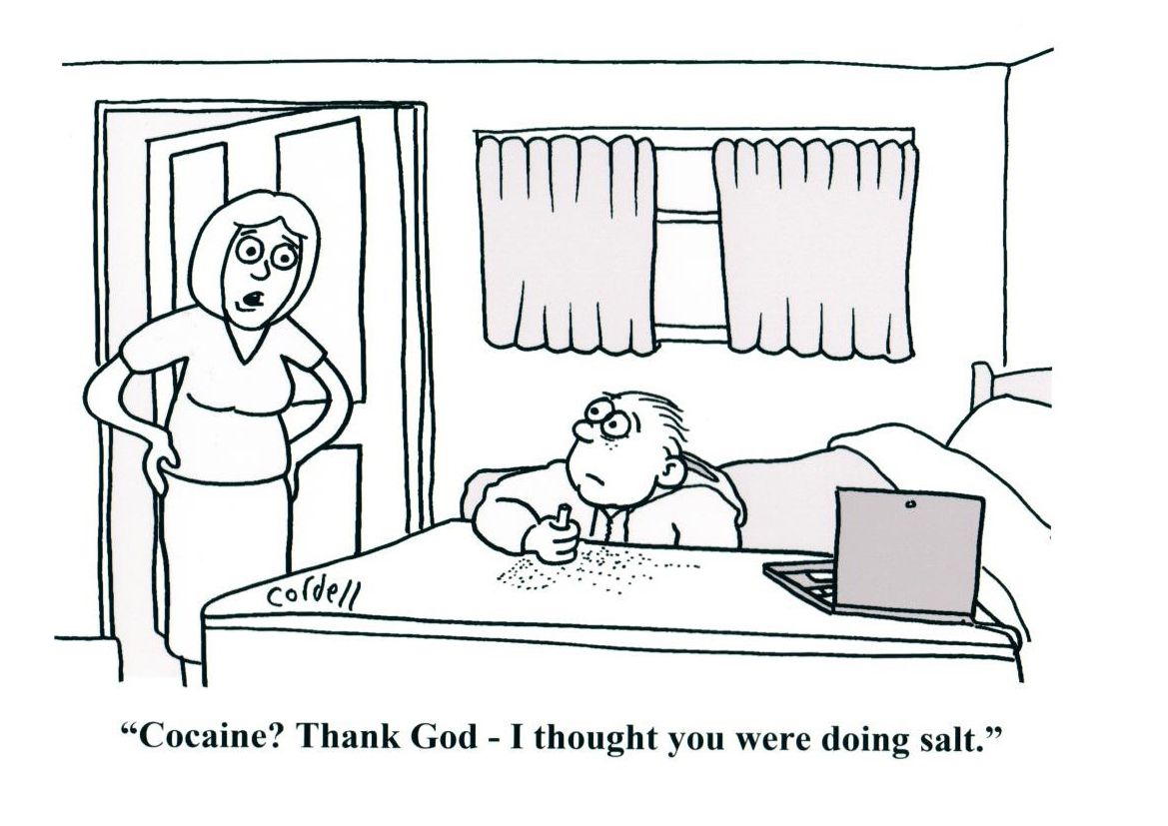
www.actiononsalt.org.uk
Notes:
The silent killer

Slide 3
Background
？
Salt intake
High blood pressure
TOP risk factor of global disease burden in 2010
Cardiovascular disease (62% strokes ,49% CHD)
Lim et al. Lancet 2012;380:2224
Notes:
3

Slide 4
Background
Salt intake in China
one of the highest in the world (≈12-14g/d)
≈80% added by consumers
More than 1 in 4 adults have hypertension
24h urine collection
√: accurate
×:High participant burden; costly;
×: Completeness?

Slide 5
Aim
To determine whether a salt sales survey could serve as a simplified method to evaluate community-based salt reduction programs

Slide 6
CRHI-SRS main study design
120 villages
in 10 counties from 5 provinces
Randomization
Control(60villages)
No intervention
Intervention
(60 villages)
Randomization
HE+PS (30 villages)
Health Education
Delivery of salt substitute
Price Subsidy
HE (30 villages)
Health Education
Delivery of salt substitute
≈2400 individuals collected one 24h urine collection at the end of the trial

Slide 7
Salt sales Survey
PS+HE
(30 villages)
HE
(30 villages)
Control
(60 villages)
Random sampling
PS+HE
10 villages
HE
10 villages
Control
10 villages
166 Shops invited
50 shops
56 shops
60 shops
1 had no telephone
3 closed down 1 merged by another shop
5 could not be reached
1 refused to participate
1 did not sell salt
1 closed down
8 could not be reached
2 refused to participate
2 closed down
12 could not be reached
129 shops recruited
40 shops
45 shops
44 shops
An independent researcher called the shopkeepers monthly to collect salt sales data

Slide 8
Regular salt vs Salt Substitute
1 g
1 g
0.25g Nacl (salt)
0.25g Kcl
↓Blood pressure

Slide 9
Results
The last HE
intervention
The last PS
intervention
Salt substitute sales trend by group

Slide 10
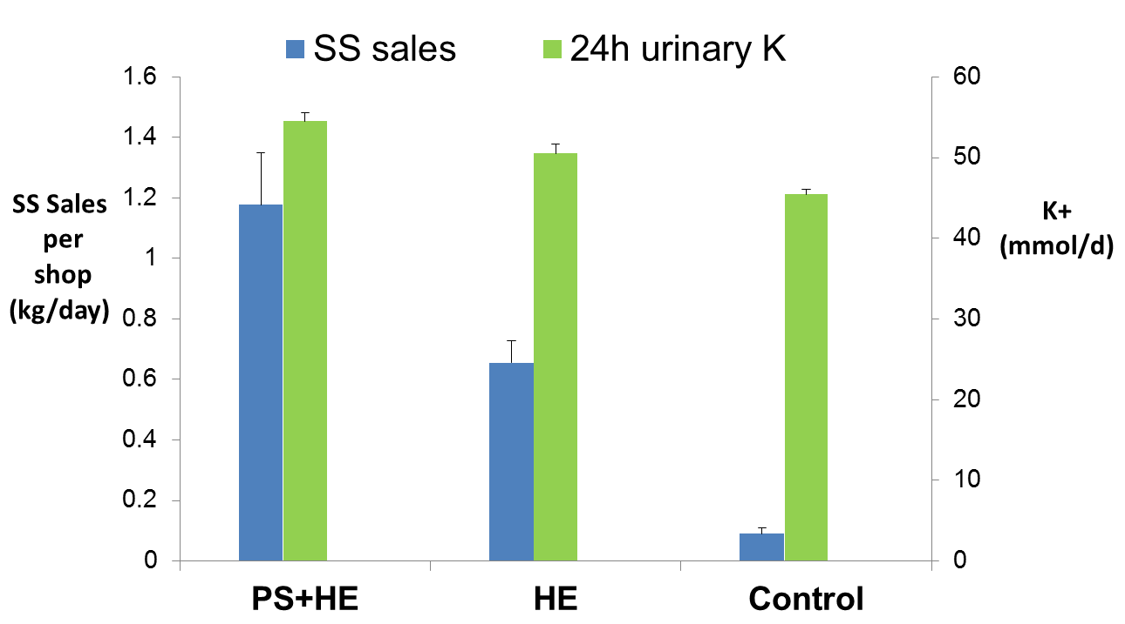
Results
Salt substitute sales vs 24h urinary K

Slide 11
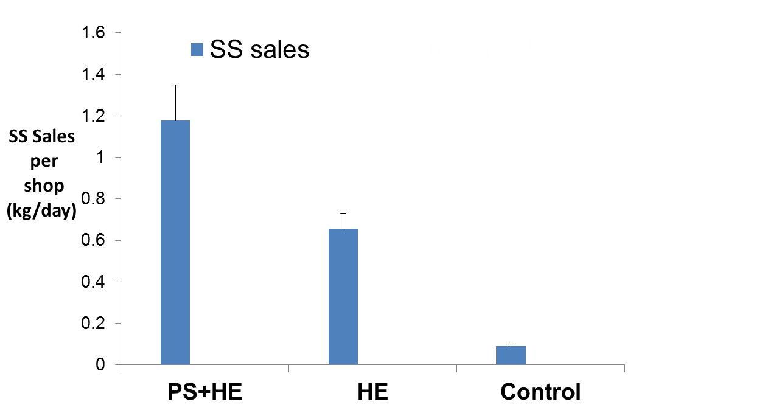
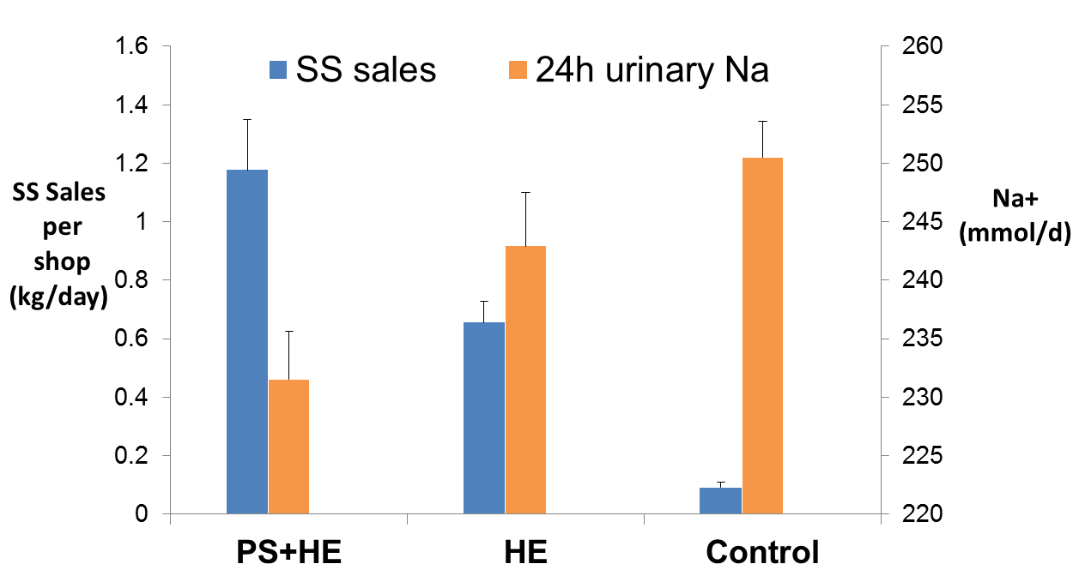
Results
Salt substitute sales vs 24h urinary Na

Slide 12
Results
Effect size (Intervention vs control) | Assessed by 24-hour Urine | Estimated from SS sales
difference in sodium intake | -7.0 mmol/d | -8.0 mmol/d
difference in potassium intake | 14.1 mmol/d | 14.2 mmol/d
114%
101%

Slide 13
Results
Salt sales survey: ¥RMB 57,000 (≈ $10,000 )
Cost
24h Urine collection : RMB 420,000 (≈ $70,000 )

Slide 14
Summary- Salt sales survey
SS sales: PS+HE>HE>control
24h urinary K:PS+HE>HE>control
24h urinary Na:PS+HE<HE<control
Intervention effect estimated from SS sales
Potassium: 114% of that from 24h urine.
Sodium: 110% of that from 24h urine
Larger statistical power
Lower cost

Slide 15
Limitations
? Salt intake level
Suitable situation:
Salt added by consumers is major source
Population should be stable
Community-based

Slide 16
Conclusion
A salt sales survey could serve as a simple, sensitive and cost-effective method to evaluate community-based salt reduction programs where salt is mainly added by the consumers.

Slide 17
Acknowledgement
Sponsors
The US NIH NHLBI
The US CDC DHDSP
United Health Group
Partners
US CDC
The Duke University
The George Institute for Global Health, Australia
China Medical University
Jiaotong University Medical College
Hebei Provincial CDC
Ningxia Medical University
Changzhi Medical University
Participants

Slide 18
Thank you!
Any Questions?

Slide 19
Timeline
Price subsidy
Intervention
Delivery of Salt substitute
Health education
24h urine
collection
Survey
Monthly salt sales survey
May 2011
July 2011
Sep 2012
Dec 2012
June 2013

