Slide 1
About OMICS Group
OMICS Group is an amalgamation of Open Access Publications and worldwide international science conferences and events. Established in the year 2007 with the sole aim of making the information on Sciences and technology ‘Open Access’, OMICS Group publishes 500 online open access scholarly journals in all aspects of Science, Engineering, Management and Technology journals. OMICS Group has been instrumental in taking the knowledge on Science & technology to the doorsteps of ordinary men and women. Research Scholars, Students, Libraries, Educational Institutions, Research centers and the industry are main stakeholders that benefitted greatly from this knowledge dissemination. OMICS Group also organizes 500 International conferences annually across the globe, where knowledge transfer takes place through debates, round table discussions, poster presentations, workshops, symposia and exhibitions.

Slide 2
OMICS International Conferences
OMICS International is a pioneer and leading science event organizer, which publishes around 500 open access journals and conducts over 500 Medical, Clinical, Engineering, Life Sciences, Pharma scientific conferences all over the globe annually with the support of more than 1000 scientific associations and 30,000 editorial board members and 3.5 million followers to its credit.
OMICS Group has organized 500 conferences, workshops and national symposiums across the major cities including San Francisco, Las Vegas, San Antonio, Omaha, Orlando, Raleigh, Santa Clara, Chicago, Philadelphia, Baltimore, United Kingdom, Valencia, Dubai, Beijing, Hyderabad, Bengaluru and Mumbai.

Slide 3
Metabolic control of the TCA cycle by the YdcI transcriptional regulator in
Escherichia coli
Yousuke Nishio
Institute for Innovation
AJINOMOTO Co., Inc.

Slide 4
Agenda
Background
  Why is TCA cycle important?
Bioinformatics approach for network finding
  DNA motif finding process
Functional validation of YdcI in E. coli
  L-Glu fermentation

Slide 5
Key messages
Network analysis will provide attractive hypothesis which is worthy of the experimental validation.
Basic idea in fermentation study will provide metabolism based understanding in bacteriology.

Slide 6
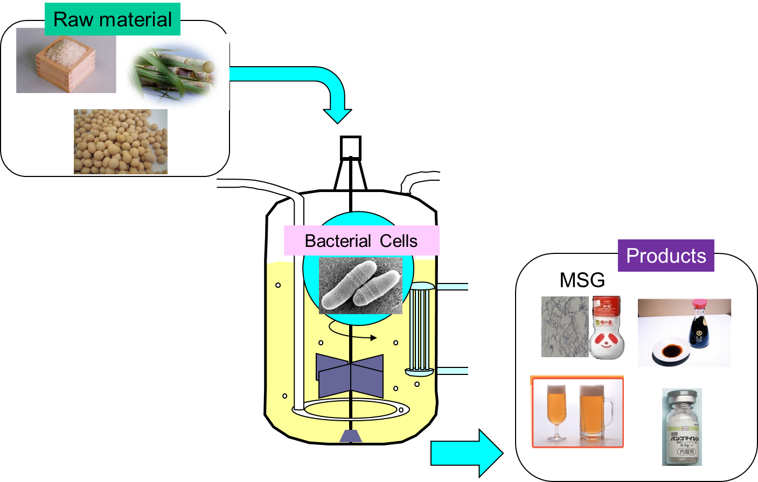
Background : fermentation technology
Scale up
Bacterial cell number will be increased to more than 7,500,000 times from test tube.
By controlling bacterial cell growth and material production, we have developed industrial fermentation technology.
Notes:
Here, I explain fermentation technology. We used several kinds of cereals as feed stock. Bacterial cells converted them into useful products like amino acid, soy source, beer or medicines. For industrial fermentation, we used several kilo litters volume fermentation tank. You may easily understand we should increase the number of bacterial cells from seed culture in test tube. As I show here, we should control both bacterial cell growth and material production for efficient fermentation.

Slide 7
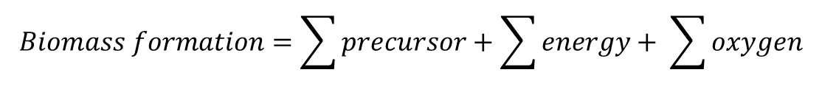
Formulation of metabolism in fermentation
General concept of metabolism in fermentation
Product
Substrate
(ex. Glucose)
By-product
Cells
Stoichiometry for cells in aerobic fermentation condition
$$Biomass formation=\sum{precursor}+\sum{energy}+ \sum{oxygen}$$
Protein, DNA, RNA, lipid, murein and glycogen are necessary for biomass formation. These molecules are provided through metabolic reactions.
Energy molecule (ATP, NAD(P)H) are provided through metabolic reactions and respiration.
Notes:
In usual, we formalize metabolism and cell production. Here, I showed our general concept of metabolism. Cells utilize carbon source. According to its metabolic pathway, it will converted into fermentation product, by-product and cells. For cells, we can apply stoichiometry system. Biomass formation is consisted from many precursors, energy for polymerization and maintenance, and oxygen. As a precursor, Protein, DNA, RNA lipid murein and glycogen are necessary. Moreover, energy production through metabolism and respiration, and energy consumption are considered in this equation.

Slide 8
Amino acid fermentation by E. coli
Glucose
ArcA (E. coli)
Val, Leu, Ile
Pyruvate
Acetyl-CoA
Asp, Asn, Thr, Lys
Ser, Gly, Cys
Oxaloacetate
Citrate
Malate
Isocitrate
Fumarate
2-ketoglutarate
Glu, Gln, Arg, Pro
Succinate
Succiny-lCoA
Stoichiometry for complete oxidation of pyruvate in TCA cycle
Pyruvate + 3 H₂O + GDP + 2~P + 4 NAD⁺ + FAD = 3 CO₂ + GTP + 4 NADH + FADH + 4 H⁺
Combine with respiration, complete oxidation of pyruvate generates 15 ATP molecules.
Regulation of carbon flux into TCA cycle is important for cell growth control and amino acid fermentation.
Notes:
Here, I showed a metabolic pathway in E. coli with amino acid production. From pyruvate, branched amino acid are synthesized. These amino acids are synthesized from 2-ketoglutarate, and these amino acids are synthesized from oxaloacetate. TCA cycle is used for energy production. When one molecule of pyruvate are completely oxidized, 15 ATP molecules are provided. Thus, regulation of carbon flux into TCA cycle is important for cell growth control and amino acid fermentation. In E. coli, as a global regulator of TCA cycle, ArcA has been known.

Slide 9
ArcAB two-component system in E. coli
Changes of O₂ concentration
ArcB
ArcB
Sensor kinase
ATP
P
P
ArcA
ArcA
Response regulator
Promote gene expression
Repress gene expression
cydAB
ndh, etc
TCA cycle genes
cyoABCDE , etc
Gene disruption of arcA has been shown to enhance expression of TCA cycle genes. As a result, carbon flux into TCA cycle will be increased.
Gene amplification of arcA may not repress expression of TCA cycle genes.
Main purpose of this study
Finding out regulatory factor which represses carbon flux into TCA cycle
Notes:
Here, I explain ArcAB two-component system in E. coli. When oxygen concentration is changed, ArcB sensor kinase catch it and it is in phosphorylated status. Phosphorylation modification is transferred into ArcA response regulator. Phosphorylated ArcA molecule will bind to DNA and modify several gene expressions as shown in here. Until now, gene disruption of arcA has been shown to enhance expression of genes on TCA cycle. As a result, carbon flux into TCA cycle will be increased. So, carbon flux control into TCA cycle is important for fermentation. On the other hand, gene amplification of arcA may not repress gene expression of genes on TCA cycle, because for DNA binding, phosphorylation is required. Simple increase of ArcA molecule may not lead phosphorylation. So, in this study, I tried to find out regulatory factor for repressing carbon flux into TCA cycle.

Slide 10
DNA array data analysis
【DNA array data analysis result】
By data analysis of ΔarcA and ΔarcB gene in E. coli¹⁾, we extracted
genes whose expression are negatively regulated by ArcA.
control
arcA⁻
arcB⁻
【Result】
Among 21 genes whose expression levels were increased, only 9 genes (lpdA, acnB, gltA, sdhCB,sucCD, icdA, and glcB) have been known as ArcA regulon. We observed the increase of expression levels due to unknown regulation system.
【Working hypothesis】
Through gene network analysis of these 21 genes, we may find out new regulation system involved in TCA cycle regulation.
1) Oshima, T. et al., Mol Microbiol, 46, 281-291, 2002
Notes:
At the beginning of this study, I reanalyzed previous DNA array data in ΔarcA and DarcB strains. And I tried to confirm the agreement and disagreement in previous knowledge. We extracted 21 genes whose expression levels are increased in both DarcA and DarcB strains. Comparing this result with literature, only 9 genes have been known as ArcA regulon. That suggests unknown regulatory system will exist in E. coli.

Slide 11
Gene network analysis
Upstream of initial codon (500bp)
Similar expression pattern
gene 1
gene 2
gene 3
gene 4
gene 5
Locally conserved sequence
(DNA motif)
Network 1
Network 2
Network 3
・Key concept is finding out all of DNA motifs
・Network formation is defined per DNA motif
Notes:
Here, I explain Gene network in this study. We tried to combine DNA expression data with sequence data. From upstream region of similar expression pattern genes, we found locally conserved sequence as shown in here. Genes with the same motif are to form network. This idea is very common. However, to find locally conserved sequence is not a easy task.

Slide 12
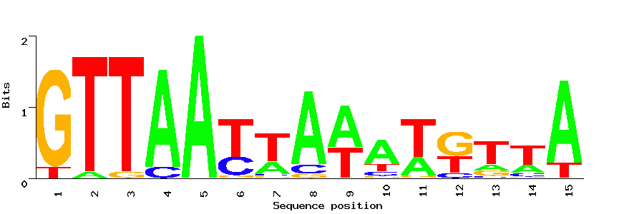
DNA motif detection
Step 1 : input sequence
Step 2 : breakdown to elements
１
20mer or 25mer or 30mer by wordcount(EMBOSS)
２
３
･ ･ ･
Ｎ
Step 3 : finding similar sequence
Step 4 : aligning elements
Step 5 : weak similarity
Input sequence
DNA motif
１
２
３
･ ･ ･
Ｎ
Multiple Alignment by
MEME
Finding similar sequence by
HMMalign (MATLAB)
20mer, 25mer or 30mer elements will have similar sequence in input sequence.
fuzznuc (EMBOSS)
Belonging to the same gene network
Notes:
For finding out DNA motif, I used procedure shown in here. Input sequences are breakdown to elements whose length were from 20mer to 30mer. For each elements, similar sequence were exhaustively explored from input sequences. Found similar sequence were aligned by MEME. Weak similarity of DNA motif were detected by hidden markov model method.

Slide 13
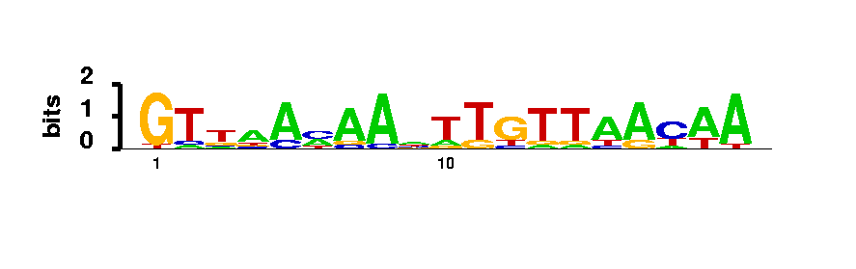
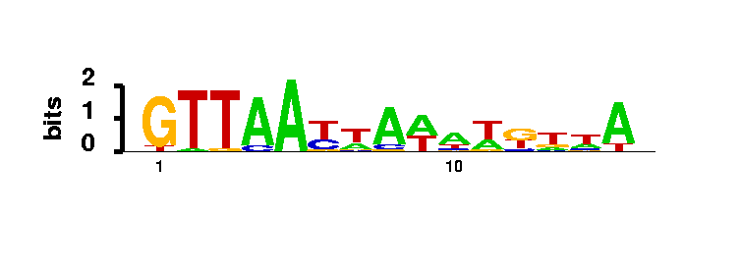
DNA motif comparison
Motif A
Motif B
Information content matrix for Motif A
Information content matrix for Motif B
[ Information content calculation ]
f_{b} is the appearance frequency of A, G, C and T in a residue position of the DNA motif, and P_{b} is the A, G, C, and T frequencies in the E. coli genome, which were each set to 25%.
Notes:
In this procedure, we found many similar DNA motif. So, we need to measure the similarity of similar DNA motif. For this purpose, we used shanon entropy. This is an example of DNA motif comparison for calculating similarity. Aligned DNA sequence was converted into matrix by using information content calculation. Motif A and Motif B are shown in matrix as shown in here..

Slide 14
DNA motif comparison
Motif A
Similarity score = 19.58
Motif B
Residue of Motif B
Residue of Motif A
DNA motifs were classified into two groups based on their similarities.
Notes:
For calculation of similarity score, we used semi-global alignment with no penalty for end gaps. Here is an example. And we obtained similarity score as 19.58. By using this method, we can classify many DNA motif by measuring distances based on similarity score.

Slide 15
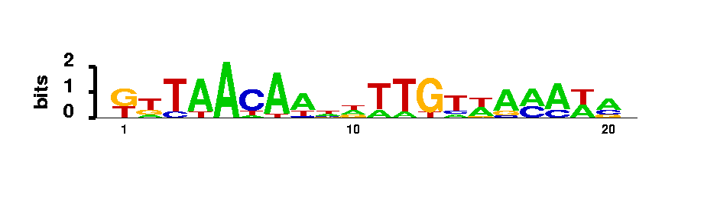
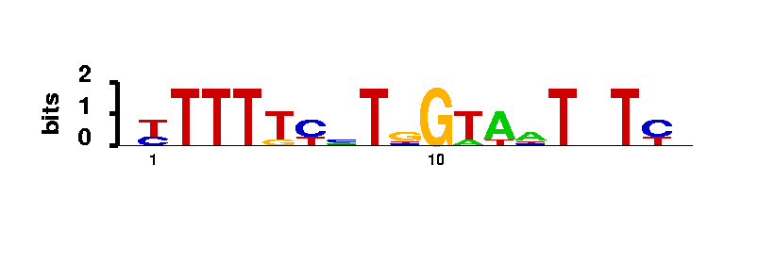
Predicted gene network
－
ArcA
lpd
acnB
fepA
gltA
sdhCB,sucCD
ydcI
yejG
mqo
b1163
osmB
glcB
acs
New knowledge
YdcI
Networking by DNA motif
Weak similarity
icdA
yhhX
hdeA
purEK
bglJ
Disagreement with previous knowledge
YdcI is a LysR family predicted HTH transcriptional regulator
YdcI is suggested to regulate gene expression on TCA cycle.
Attractive hypothesis is proposed by DNA motif based gene network.
Notes:
Here, I showed the result of gene network analysis. I found two network. Line arrow shows network with consisting DNA motif. Dot arrow shows network with weak similarity detected by hidden markov model. One is from ArcA oriented DNA motif shown in here. These relations are agree with previous knowledge. These three genes has not known in a member of arcA regulon. The icdA gene has been known as arcA regulated gene. In my analysis, direct relation was not connected. This is an only exception in my analysis or arcA regulated gene network. So, from the view point of gene network prediction, I can use our analysis method for finding new as a useful method. In addition to ArcA-binding site related motif, I found different motif. Among up-regulated genes, YdcI protein is a transcriptional regulator. So, we hypothesized that YdcI may play an important role of this new network. As a result, we hypothesized that YdcI may regulate gene expression on these genes and this is an attractive hypothesis for us. So, we tried to validate this hypothesis through experiment.

Slide 16
Model for experimental validation
Glucose
IHF
ArcA
YdcI
p1
p2
gltA
Pyruvate
Acetyl-CoA
Citrate synthase activity has been known to show high sensitivity for L-Glu fermentation in E. coli ⁽¹⁾.
②
YdcI
Oxaloacetate
Citrate
Malate
Isocitrate
①
Fumarate
2-ketoglutarate
L-Glu
Succinate
Succinyl-CoA
①Confirm the effect of ydcI gene amplification or deletion on L-Glu fermentation
②Confirm the effect of ydcI gene amplification or deletion on citrate synthase activity
(1) Nishio Y et al., Analysis of l-glutamic acid fermentation by using a dynamic metabolic simulation model of Escherichia coli, BMC Systems Biology 2013, 7:92
Notes:
Here, I explain our experimental model for experiment. We have a model strain and cultivation system for glutamate fermentation in E. coli. For glutamate production, citrate synthase activity has been known to show high sensitivity. Based on our prediction, YdcI may regulate gltA gene expression. So, at first, we tried to confirm the effect to glutamate fermentation by ydcI gene amplification and deletion. And then, we confirmed citrate synthase activity in ydcI gene amplification and deletion strain.

Slide 17
L-Glu fermentation result
ΔsucA
ΔsucA
ΔydcI
ΔsucA /
pMW218
ΔsucA /
pMW218-ydcI
(Test for ydcI gene deletion)
(Test for ydcI gene amplification)
Condition: glucose 40g/L, MS medium, 24h & 37ºC cultivation
Cell growth (OD600) should not be different in this condition because of ΔsucA genotype.
L-Glu accumulation is increased by ydcI gene deletion &
decreased by ydcI gene amplification
→ YdcI may control carbon flux into TCA cycle.
Notes:
Here, I showed glutamate fermentation result. Vertical axis shows OD and glutamate concentration. Blue bar shows OD and red bar shows glutamate concentration. In ydcI gene deletion, slightly increase of glutamate accumulation was observed. On the other hand, in ydcI gene amplifaction, decrease of glutamate accumulation was observed. This result suggested to support our hypothesis, YdcI may control carbon flux into TCA cycle.

Slide 18
Relative activity of citrate synthase
Oxaloacetate + Acetyl-CoA → Citrate + CoA
CoA + DTNB → TNB + CoA-derivative
Increase of 412nm absorbance
*
**
* : p<0.05
** : p<0.01
Expression level of citrate synthase is increased by ydcI gene deletion and
decreased by ydcI gene amplification
YdcI may control citrate synthase expression levels by regulating gltA gene expression.
Notes:
Next, I measured citrate synthase activity from crude extract of E. coli. In citrate synthase reaction, free CoA is produced, and by using DTNB molecule, we can measure CoA production. Vertical axis showed the relative activity of citrate synthase. In each condition, control condition was set to one. In ydcI gene deletion condition, citrate synthase activity was increased and ydcI gene amplification condition, citrate synthase activity was decreased. This result was agree with glutamate fermentation result. So, it was suggested that YdcI may control citrate synthase expression levels by regulate gltA gene expression.

Slide 19
Proposed TCA cycle regulation in E. coli
Glucose
ArcA
Val, Leu, Ile
Pyruvate
YdcI
Acetyl-CoA
Asp, Asn, Thr, Lys
Ser, Gly, Cys
Oxaloacetate
Citrate
Malate
Isocitrate
Fumarate
2-ketoglutarate
Glu, Gln, Arg, Pro
Succinate
Succiny-lCoA
Protein-DNA interaction at promoter region of gltA gene should be verified.
Cell growth control by YdcI should be verified.
Notes:
Here, I summarize our result. In E. coli, in addition to ArcA, YdcI may regulate carbon flux into TCA cycle through control of gltA gene expression. In future, Protein-DNA interaction at promoter region of gltA gene should be verified more precisely. And cell growth control by YdcI should be also verified.

Slide 20
Summary
Combination of DNA array and DNA motif analysis is useful for understanding gene network.
  Similarity scores between DNA motifs were calculated using the information content of the DNA motif and semi-global alignment with no penalty for end gaps.
Biological function of YdcI in E. coli was proposed as a transcriptional regulator repressing gltA gene.
Nishio Y, Suzuki T, Matsui K, Usuda Y (2013) Metabolic Control of the TCA cycle by the YdcI Transcriptional Regulator in Escherichia coli.
J Microb Biochem Technol 5: 059-067. doi:10.4172/1948-5948.1000101

Slide 21
Acknowldgement
Dr. Yoshihiro Usuda
Mr. Yohei Yamada
Ms. Tomoko Suzuki

Slide 22
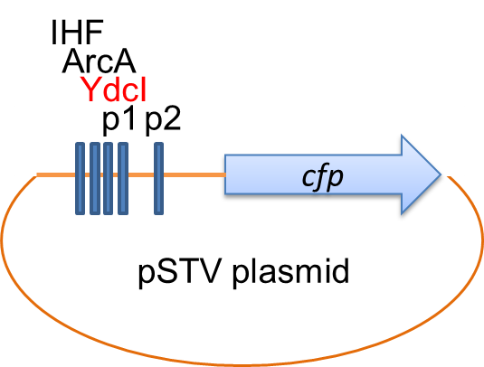
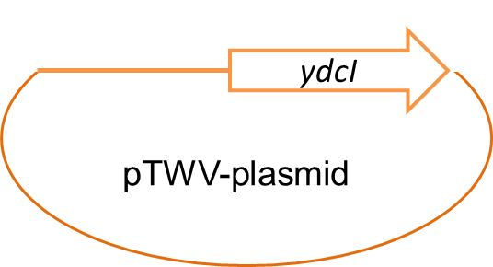
YdcI binding test on gltA promoter region
[Experimental condition]
P<0.01
YdcI protein
Excitation wavelength : 433 nm
Fluorescence : 475 nm
Specific Fluorescence
P_{gltA}
E. coli BW25113 was used as a host.
There was statistically significant difference in specific fluorescence, although observed difference was not large.
YdcI may bind to promoter region of gltA gene.
Notes:
Next, we tried to measure gltA promoter activity by cyan fluorescent protein. In my experiment, two vector expression system was used. In front of cfp gene, gltA promoter was cloned. YdcI gene was clone into different plasmid with its own promoter. The result was shown in here. When we co-expressed cfp and YdcI, specific fluorescence level was slightly decreased. In honest, this experiment should be improved. But it also suggest gltA gene expression regulation by YdcI.

Slide 23
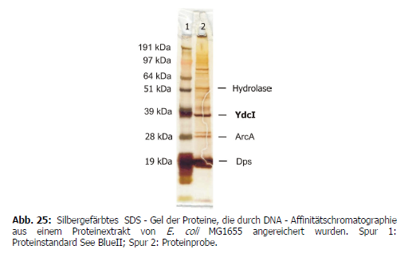
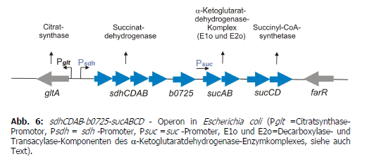
Discussion (1) YdcI-DNA interaction
Dr. Andrea Veit found YdcI-Psdh interaction in her PhD thesis.
Another regulator of the sdhCDAB-b0725-sucABCD-operon in E. coli MG1655 could be identified by DNA-affinity chromatography: YdcI. This regulator which belongs to the lysR family was isolated from cells grown in glucose minimal medium. YdcI is supposed to take part in the regulation of aerobic acetate formation.
708bp
Andrea Veit, Untersuchungen zum Überflussmetabolismus in Escherichia coli, Band 4199 von Berichte des Forschungszentrums Jülich, Forschungszentrum Jülich, ISSN 0944-2952 Forschungszentrum, Zentralbibliothek, 2006

Slide 24
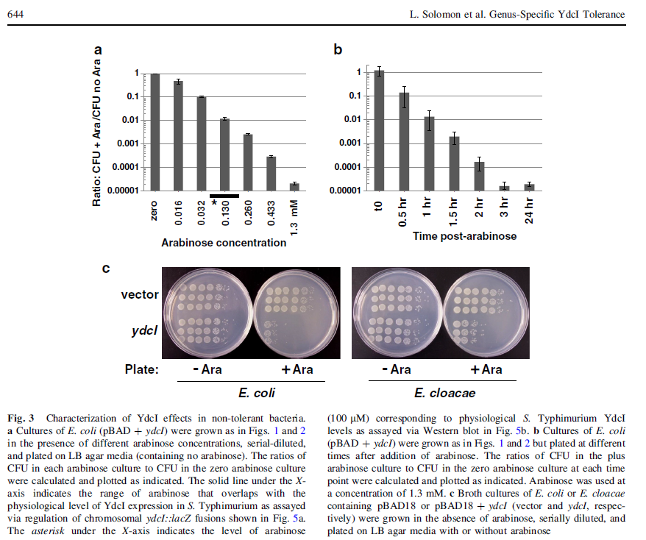
Discussion (2) Cell growth control by YdcI
Dr. J. W. Wilson has shown the effect of YdcI overexpression to cell growth in E. coli.
L. Solomon et al., Bacterial Genus-Specific Tolerance for YdcI Expression, Curr. Microbiol. 69, 640-648, 2014

Slide 25
Let us meet again..
We welcome you all to our future conferences of OMICS International
4th Annual Conference on European Pharma Congress
June 18-20,2016, Berlin, Germany.
http://europe.pharmaceuticalconferences.com/

