Slide 1


TSG-6 induces liver regeneration by enhancing autophagy in mice with chronic liver damage
Pusan National University, Korea
Youngmi Jung
Notes:
Thank you for introducing me.

Slide 2


From Greek myth
Notes:
Ancient Greek recognized LR in the myth of Prometheus. Having stolen the secret of fire from the gods of Olymous, Prometheus was condemned to have a portion of liver eaten daily by an eagle. To make matter worse, the liver grow back O/N, thus providing the eagle with eternal food and prometheus with eternal torture.
Ancient Greek already knew the biological aspect of the liver, today we are validating their discovery through experimental evidence.
2

Slide 3
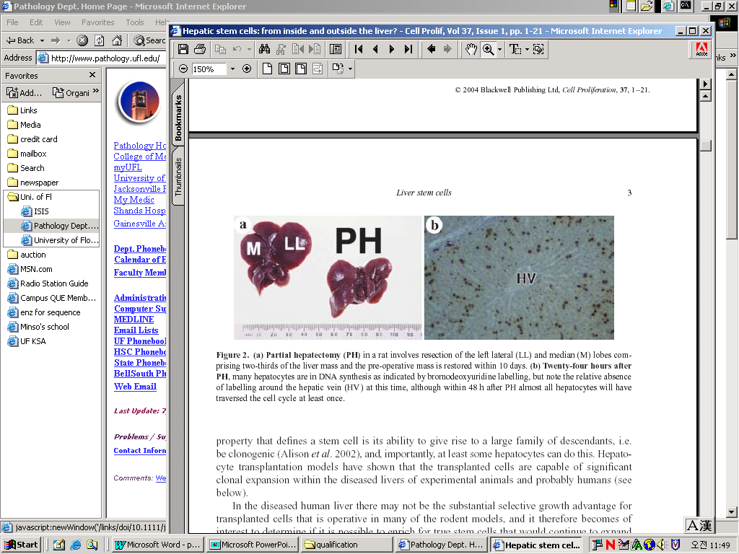
Liver Regeneration
Alison MR et al Cell Proliferation 2004, 37:1-21
Notes:
LR is well known capacity of liver. PHx in rodent involved the 70% resection of liver. LR occur in remaining lobules by HEP proliferation. The whole process lasts 5 to 7 days. Although HEP are normally quiescent, these cells rapidly re-enter the cell cycles. Figure B show DNA synthesis in HEP by BRDU staining.
3

Slide 4

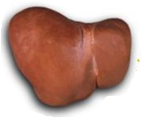
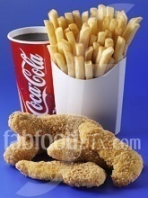
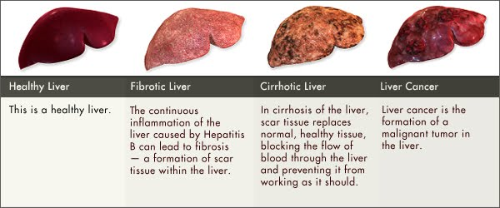
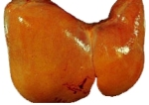
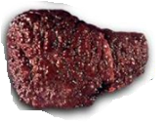
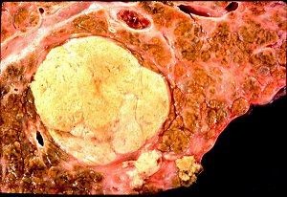
Stages of liver damage
Healthy
Severe exposure
Chronic
Mild
repeated attacks
repeated attacks
Cirrhosis
Cancer
Notes:
In human adult liver, high fat diets, such as fast food and alcohol induce fatty liver and this type of injury is reversible and repaired by hepatocyte replication. However, severe and chronic injury, such as habitual alcohol consumption, virus and toxin impair liver permantly. This severe injury block liver repair process by hepatocyte proliferation and accompany fibrous matix accumulation, eventually inducing cirrhosis. Cirrhosis is end stage of liver dX, like liver cancer.

Slide 5
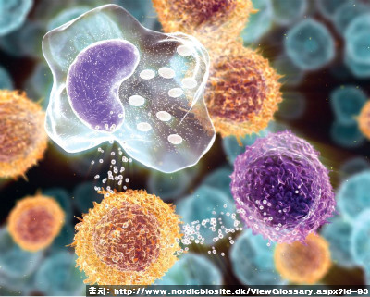

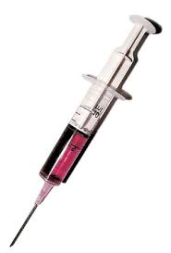
Effect of MSCs on tissue repair: Help regeneration of damaged tissue
creating a favorable micro-environment for liver regeneration by secreting something good
What kinds of molecules contribute to and how they work on liver regeneration?
Notes:
stem cell based therapy has been suggested as an alternative treatment strategy for patients who suffer from hepatic diseases.
Mesenchymal stem cells (MSCs) are found in most adult and postnatal organs and capable of self-renewing and differentiating into several lineages of cells, including hepatocytes. This differentiation potential of MSCs into hepatocytes provides new and promising therapeutics for patients with liver disease.
MSCs were shown to contribute to liver regeneration by secreting tropic and immunomodulatory molecules, which creats a favorable XXXX
Hence, it is necessary to identify and characterize such biologically active soluble factors

Slide 6
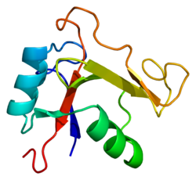
TSG-6 in liver
Tumor necrosis factor-inducible gene 6 protein, TNF-stimulated gene 6 protein, TNF-α-induced protein 6
Anti inflammation effect in several organs
Cytokine secreted from MSCs
Unknown in liver
Mol Ther 2012 ;20(11):2143-2152
Stem Cell Res Ther 2011;2(3):27
Notes:
Tumor necrosis factor-inducible gene 6 protein (TSG-6), is a 35 kDa glycoprotein and identified as anti- inflammatory factor.
Recent studies demonstrate that TSG-6 is a key immune modulator released from hMSCs and shown to be responsible for hMSCs’ therapeutic effects, such as improvement of cardiac function, peritonitis and wound healing.
However, expression and function of TSG-6 are unknown in liver.

Slide 7
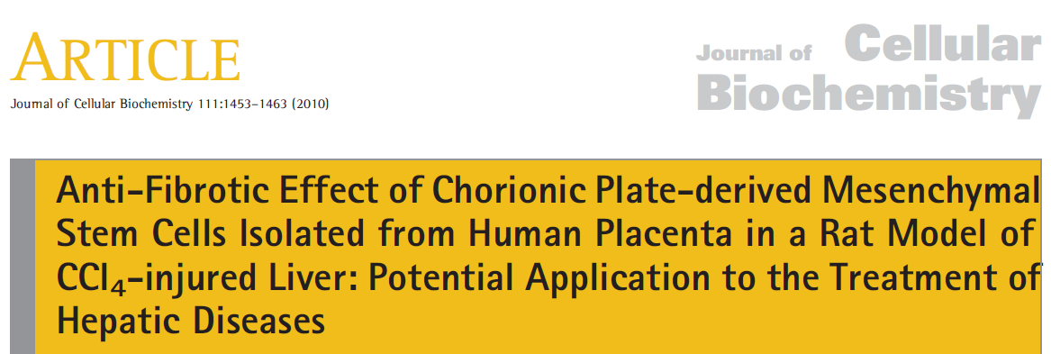
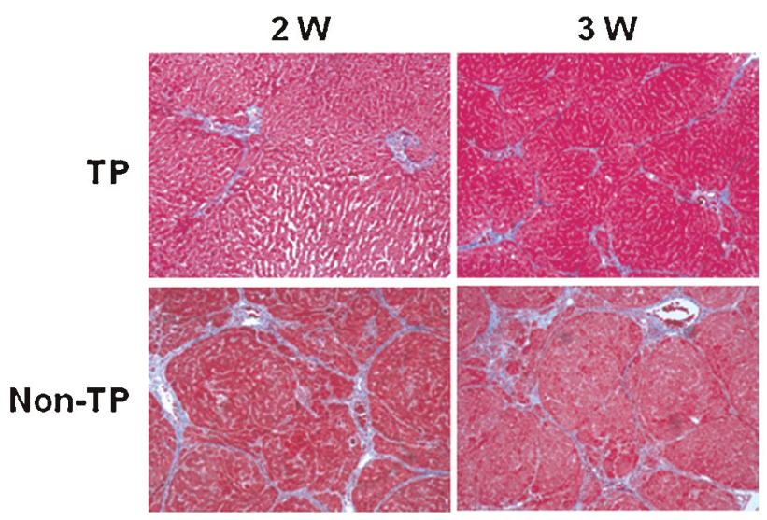
Human placenta-derived mesenchymal stem cells promote liver regeneration
Saline injection
Non-Tx
group
CCl₄ injection
(1.6 g/kg, twice a week by IP)
9 wk
2 wk
3 wk
Tx
group
hCP-MSCs transplantation (2×10⁶)
Notes:
CP-MSCs are shown to promote liver regeneration. As you see, CP-MSCs-tranasplated liver shows the improved morphology. However, it is poorly understood how CP-MSCs promote liver regeneration.

Slide 8
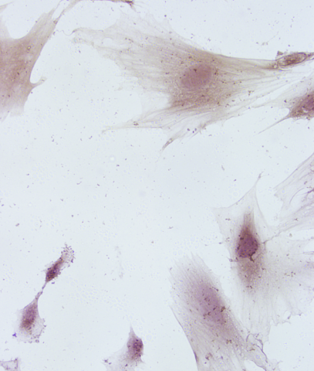
miRNA-125b released by CP-MSCs contributes to liver regeneration by suppressing fibrosis
LX2
miR-125b
Normal
Exosomes
Cell lysate
*
*
LX2/miR-125b
CD9
24kDa
22kDa
GAPDH
CP-MSC/miR-125b
CP-MSC/NC
Normal
Cell lysate
LX2
Exosomes
20μm
Notes:
There are several possible mechanism explaining for action of CP-MSCs in liver regeneration. One of these mechanism is miRNAs released by CP-MSCS. CP-MSCs secrets exosome, which contained a higher level of miRNA125b. miRNA125b is demonstrated to involved in liver regeneration.
Like that, CK, GF, even miRNAs are the possible candidates for mediating therapeutic effects of MSCs

Slide 9
Hypothesis
TSG-6 level (qRT-PCR)
CP-MSCs
CP-MSCs transplanted rat liver
***
##
#
**
*
Normal
CCl₄
Transplantation
Fold Increase
Fold Increase
#
*
*: vs Normal
#: vs Own CCl₄ Group
Normal
CP-MSCs
Normal
1W
2W
3W
CP-MSCs contained a higher level of TSG-6
TSG-6 is rich in CP-MSCs-transplanted liver
TSG-6 released by MSCs promotes liver regeneration
Notes:
Hence, we examined whether CP-MSCs contained TSG-6 and found that TSG-6 is rich in CP-MSCs and these cells-transplanted liver.
Therefore, we hypothesized that

Slide 10
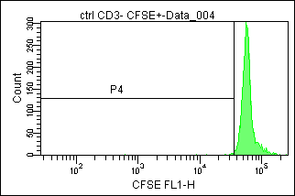
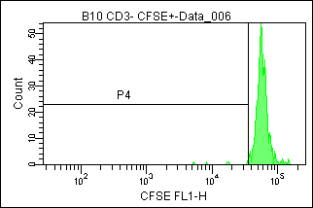
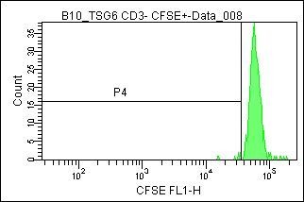


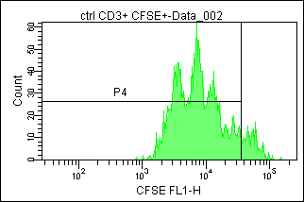
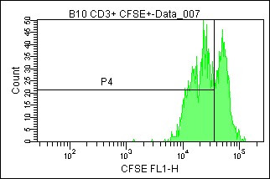
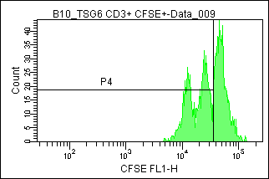


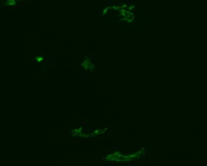
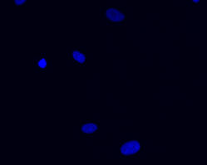
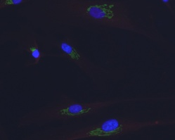
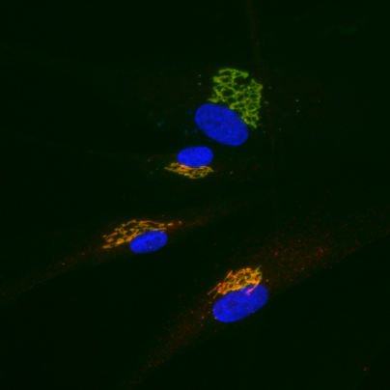
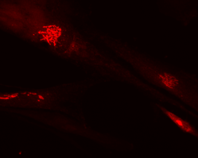
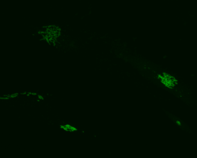
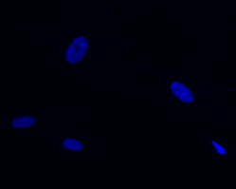
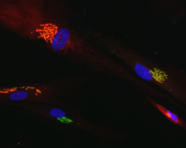
Generation of TSG-6-overrexpressing MSCs
Immunoblotting
Immune-modulatory activity
Control medium
B10(MSC) CM
TSG-6 B10(MSC) CM
0.5%
1.0%
1.2%
Mock
TSG-6
-αCD3
Fold Increase
TSG-6
TCL
α-tubulin
90.7%
61.0%
53.6%
CM
TSG-6
+αCD3
NT
TSG-6
Immunofluorescence
TSG-6
GM130
DAPI
MERGE
TSG-6 / GM130 / DAPI
TSG6
DAPI
MERGE
Mock
TSG-6
Notes:
To investigate the effect of TSG-6 in liver injury, we generate hMSCs stably expressing TSG-6 based on immortalized fetal bone marrow hMSCs (B10), using a lentivirus delivery system.
The stable expression of TSG-6 was confirmed by a higher level of TSG-6 mRNA, protein, and even in CM from TSG-6-overexpressing MSCs.
Because TSG-6 is glycoprotein and processed in the Golgi complex, we conducted double IF with TSG-6 and GM130, a marker of Golgi. TSG-6-positive signals are co-localized with GM130.
Also, we confirmed the immune-modulatory activity of TSG-6 released from TSG-6-overexpressing MSCs in mouse splenocytes.
(To examine the immune-modulatory activity of TSG-6 secreted from TSG-6-overexpressing MSCs, splenocytes freshly isolated from the mouse spleen were treated with CM from MSCs or TSG-6- MSCs . While activated CD4+ T cells by CD3 antibody underwent active proliferation, proliferation of CD4+ T cells was markedly reduced following treatment with CM from either hMSC or TSG-6-hMSCs. Of interest, CM from TSG-6-hMSCs appeared to be more effective in suppressing T cell proliferation)

Slide 11
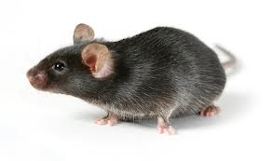
Design of mouse experimental model
CCl₄
CCl₄
CM or NC injection
Sacrificed
7 weeks of age
3 day
5 day
8 day
11 day
CM: 0.5 ml conditioned medium (CM) from TSG-6 overexpressing MSCs
(TSG-6 group)
NC: 0.5ml CM from empty plasmid-carrying MSCs (NC group)
Wang et al. (Stem Cell Res Ther. 2015 Mar 11;6:20)
Notes:
To examine whether TSG-6 influenced liver regeneration, mice were treated with CCl4 to induce acute liver injury and i.p. injected with CM from TSG-6-overexpressing MSCs (named as TSG-6 group) or control MSCs (named as NC group).

Slide 12
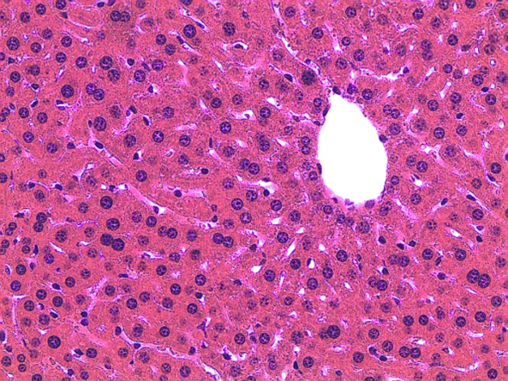
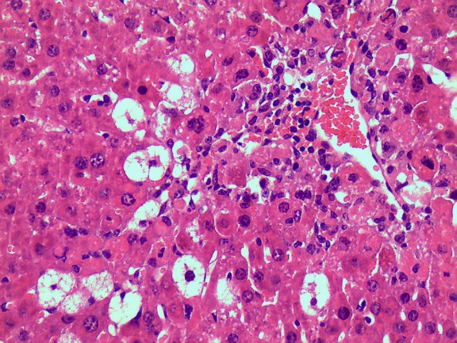
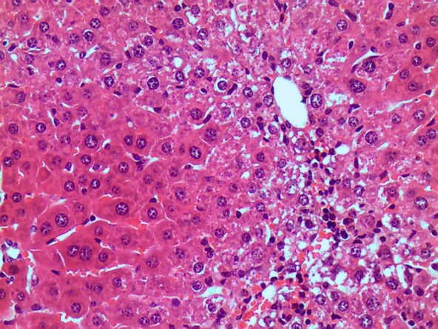
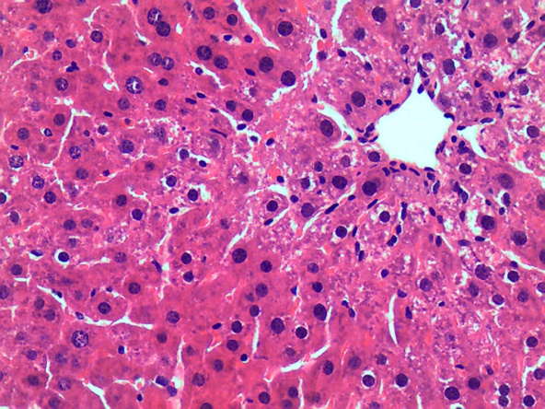
Effects of TSG-6 on liver histomorphology and function in CCl₄-treated mice
H&E Staining
Liver Function Test
CTRL
CCl₄
$
g6pc
*
*
#
$
*: vs CTRL
#: vs CCl₄
$: vs CCl₄+NC
*
#
LW / BW
Fold Increase
*
CCl₄
CCl₄
CTRL
CCl₄+NC
CTRL
CCl₄+NC
20μm
20μm
CCl₄+TSG-6
CCl₄+TSG-6
CCl₄+NC
CCl₄+TSG-6
*
$
*
*
#
*
$
*
#
ALT (IU/L)
AST (IU/L)
*
CCl₄
CCl₄
20μm
20μm
CTRL
CCl₄+NC
CTRL
CCl₄+NC
CCl₄+TSG-6
CCl₄+TSG-6
Wang et al. (Stem Cell Res Ther. 2015 Mar 11;6:20)
Notes:
CCl4-treated mice showed severely damaged morphology. However those abnormal morphological changes were remarkably reduced and restored to almost normal morphology in the TSG-6 group, compare to the NC and CCl4 groups.
The ratio of liver versus body weight declined in mice in the CCl4 and NC group whereas it was not significantly changed in the control and TSG-6 groups. In addition, CCl4-treated mice with or without NC-CM had elevated serum AST and ALT, while TSG-6-CM-treated groups showed the decreased level of AST and ALT. Furthermore, the RNA level of glucose-6-phosphatase, an essential enzyme for glycolysis, was similar between the control and TSG-6 groups.

Slide 13
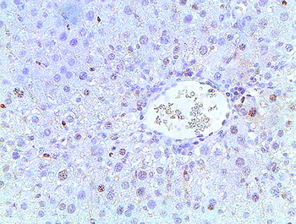
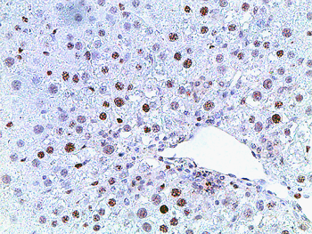
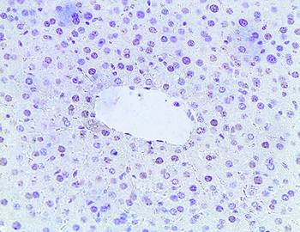
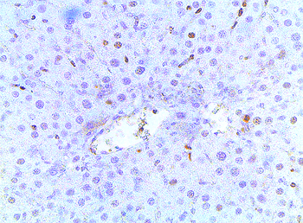
Expansion of Ki67-positive hepatocytic cells in liver of mice with CCl₄ +TSG-6 treatment
Ki67 Staining
Cell counting
CTRL
CCl₄
*: vs CTRL
#: vs CCl₄
$: vs CCl₄+NC
$
#
*
20μm
# of Ki67 positive cells
/ total # of hepatocyte
20μm
CCl₄+NC
CCl₄+TSG-6
CCl₄
CTRL
CCl₄+NC
CCl₄+TSG-6
20μm
20μm
Wang et al. (Stem Cell Res Ther. 2015 Mar 11;6:20)
Notes:
To determine if these changes in the liver repair process were associated with the hepatocyte proliferation, we stained liver sections with Ki67, a marker of S phase. We observed a greater accumulation of Ki67-positive hepatocytic cell in TSG-6 group.

Slide 14
TSG-6 decreases the inflammation in the damaged liver with CCl₄
qRT-PCR for Inflammatory Marker
tnf-α
Il-1β
cxcl1
cxcl2
*
*
*
*
*
*
$
*
*
$
$
#
Fold Increase
Fold Increase
#
Fold Increase
#
Fold Increase
*
$
*
#
CCl₄
CCl₄
CCl₄
CCl₄
CTRL
CCl₄+NC
CTRL
CCl₄+NC
CTRL
CCl₄+NC
CTRL
CCl₄+NC
CCl₄+TSG-6
CCl₄+TSG-6
CCl₄+TSG-6
CCl₄+TSG-6
*: vs CTRL
#: vs CCl₄
$: vs CCl₄+NC
Wang et al. (Stem Cell Res Ther. 2015 Mar 11;6:20)
Notes:
Because CCl4 is a well-known chemical that induces hepatocyte injury and inflammation, we examined whether TSG-6 have an anti-inflammatory effect, thereby decreasing fibrogenesis in this animal model. The expression of inflammation markers, such as tnfα, il-1β, cxcl1 and cxcl2, was significantly reduced in the TSG-6 group

Slide 15
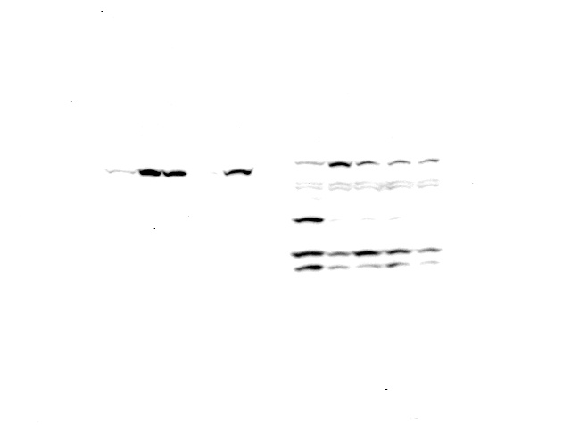
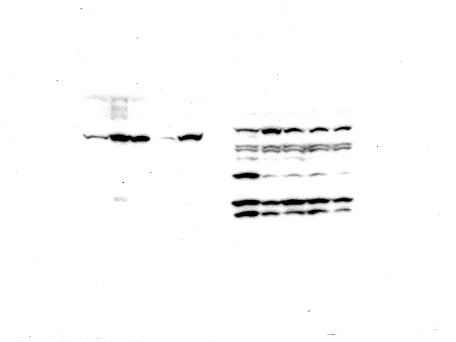
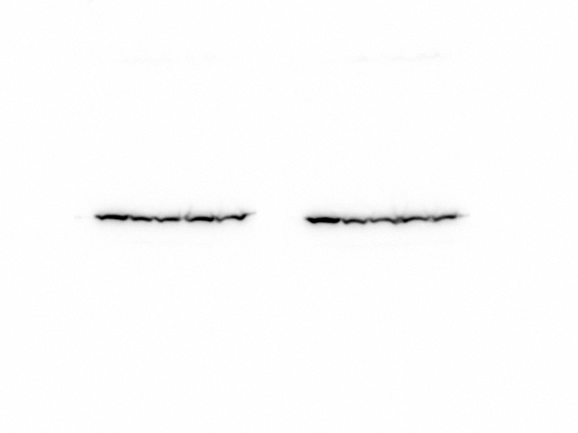
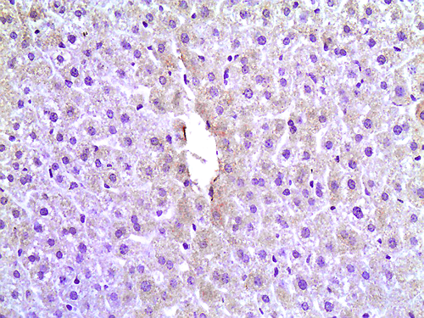
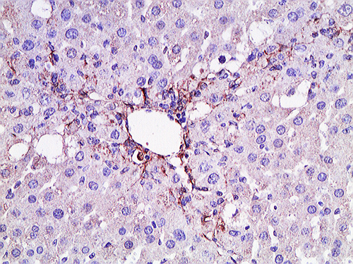
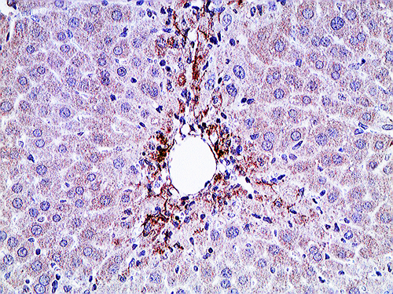
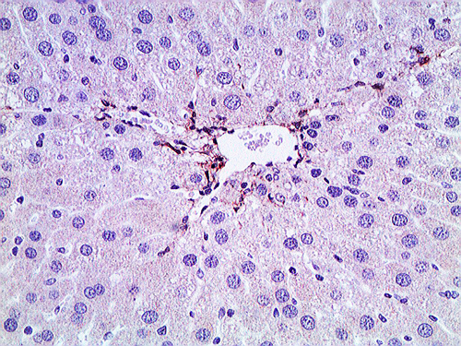
Reduced fibrosis in the TSG-6 treated liver
Expression of Fibrotic Marker
tgf-β
α-sma
collagen α1
CCl4+TSG-6
CTRL
CCl4
CCl4+NC
*
*
$
*
*
#
*
$
*
$
TGF-β
Fold Increase
Fold Increase
#
Fold Increase
#
*
*
α-sma
GAPDH
CCl₄
CCl₄
CCl₄
CTRL
CCl₄+NC
CTRL
CCl₄+NC
CTRL
CCl₄+NC
CCl₄+TSG-6
CCl₄+TSG-6
CCl₄+TSG-6
*: vs CTRL
#: vs CCl₄
$: vs CCl₄+NC
CTRL
CCl₄
20μm
20μm
IHC for α-Sma
CCl₄+NC
CCl₄+TSG-6
Wang et al. (Stem Cell Res Ther. 2015 Mar 11;6:20)
20μm
20μm
Notes:
The RNA expression of the fibrotic markers, tgf-β, α-sma and collagen α1, was greatly upregulated in the CCl4 and NC group, whereas those genes were downregulated in TSG-6 group. In line with mRNA expression, the protein level of TGF-β and α-SMA decreased in the TSG-6 treated group. In addition, IHC staining for α-SMA clearly showed a reduction of activated hepatic stellate cells in TSG-6 group.
(Therefore, these results demonstrated that the TSG-6 attenuated both inflammation and the expansion of activated HSCs in liver.)

Slide 16
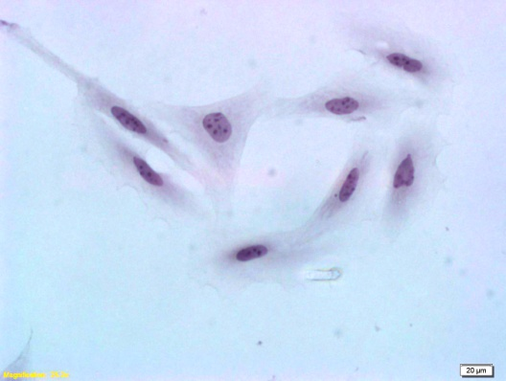
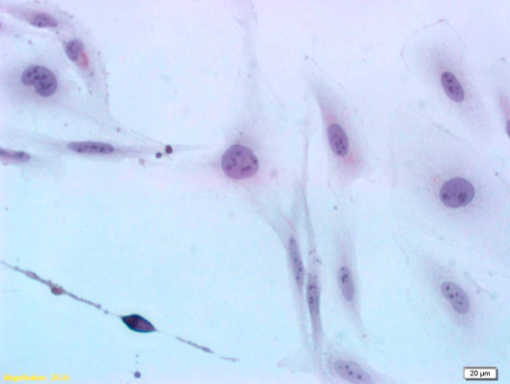
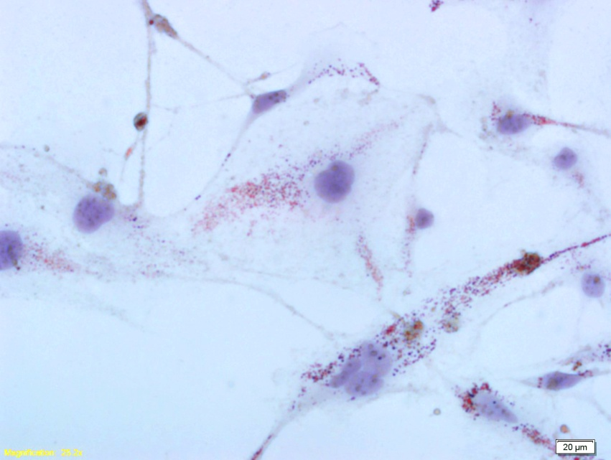
TSG-6 blocks activation of hepatic stellate cells
qRT-PCR
LX2
LX2+NC
tgf-β1
vimentin
collagen α1
LX2+TSG-6
$
LX2+TSG-6+Ab
#
#
$
Fold Increase
*
*
Fold Increase
Fold Increase
#
LX2+TSG-6+IgG control
$
#
$
$
#
*
$
#
#
*
#
#
*
#
#
*
*
*
#
*
*
*
*
D1
D2
D1
D2
D1
D2
*: vs LX2
#: vs NC
$: vs TSG-6+Ab
ORO stainning
LX2
LX2+NC
LX2+TSG-6
**
Positive cells
/ total LX2 cells (%)
LX2
LX2+NC
LX2+TSG-6
20μm
20μm
20μm
Wang et al. (Stem Cell Res Ther. 2015 Mar 11;6:20)
Notes:
Activated hepatic stellate cells are primary sources promoting fibrosis. Hence, we investigated whether TSG-6 was involved in the activation of hepatic stellate cells.
LX2 cells, activated HSC line originated from human, cultured in TSG-6-CM showed the decreased expression of markers for the activated hepatic stellate
cells, (such as tgf-β, vimentin and collagen α1, )compared with cells cultured in NC-CM or LX2 cell medium. In addition, neutralization of TSG-6 by the TSG-6 antibody effectively induced the expression of those markers in LX2 cells .
Oil Red O staining showed cytoplasmic lipid droplets, the morphologic hallmark of inactivated hepatic stellate cells, in the LX2 cells cultured in TSG-6-
CM, whereas those lipid droplets were not seen in cells cultured in NC-CM or LX2 cell medium.

Slide 17
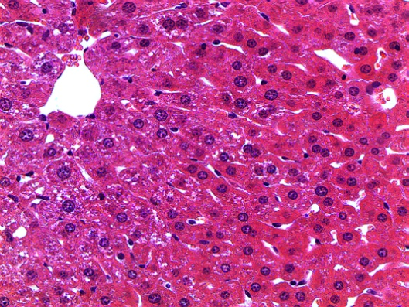
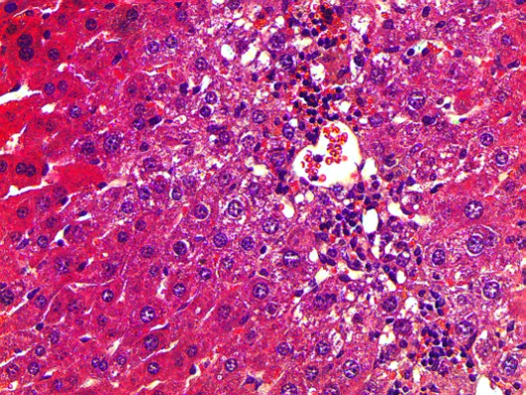
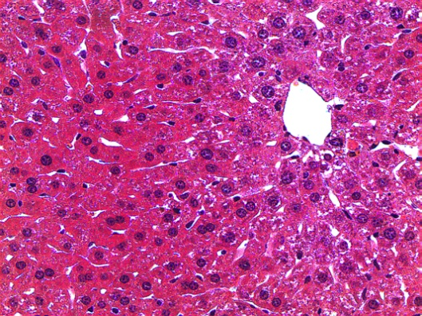
Neutralization of TSG-6 by TSG-6 antibody attenuates restoration effect of TSG-6 in liver of CCl₄+TSG-6-treated mice
CCl₄
CCl₄
CM+Ab or CM+ IgG injection
Sacrificed
7 weeks of age
3 day
5 day
8 day
11 day
CCl4+TSG-6
CCl4+TSG-6+Ab
CCl4+TSG-6+IgG
The ratio of LW/BW
*
#
Fold increase
20μm
20μm
20μm
Wang et al. (Stem Cell Res Ther. 2015 Mar 11;6:20)
Notes:
To assess whether TSG-6 directly influenced liver restoration in mice with CCl4 damage, TSG-6-CM neutralized with TSG-6 antibody was injected in CCl4-treated mice.
The livers of the TSG-6 + Ab group had severe hepatic injuries, whereas the livers from the TSG-6 or TSG-6 + IgG groups showed almost normal morphology without distinct morphological differences between the two groups. Also, The ratio of liver weight/ body weight (LW/BW) decreased in these group.

Slide 18
Neutralization of TSG-6 by TSG-6 antibody attenuates restoration effect of TSG-6 in liver of CCl₄+TSG-6-treated mice
Liver function test
ALT (IU/L)
AST (IU/L)
g6pc
*
*
#
CCl₄+TSG-6
#
Fold Increase
#
CCl₄+TSG-6+Ab
*
CCl₄+TSG-6+IgG
tgf-β
α-sma
collagen α1
qRT-PCR
*
*
*
#
*: vs CCl₄+TSG-6
#: vs CCl₄+TSG-6+Ab
Fold Increase
Fold Increase
Fold Increase
#
#
tnf-α
Il-1β
cxcl1
cxcl2
*
*
*
#
*
Fold Increase
Fold Increase
Fold Increase
Fold Increase
#
#
#
Wang et al. (Stem Cell Res Ther. 2015 Mar 11;6:20)
Notes:
serum AST and ALT increased and RNA expression of g6pc decreased in the TSG-6 + Ab group, compared with the TSG-6 or TSG-6 + IgG group.
In addition, the inhibition of TSG-6 by TSG-6 antibody led to an increase in the fibrotic and inflammatory markers.
(Taken together, these data suggested that TSG-6 induced the inactivation of hepatic stellate cells, contributing to the ameliorated fibrosis in mice.)

Slide 19
Summary
TSG-6 attenuates liver injury
Hepatic fibrosis decreases in TSG-6 treated mice
TSG-6 induces inactivation of hepatic stellate cells
TSG-6 contributed to the liver regeneration by suppressing the activation of hepatic stellate cells in CCl₄-treated mice, suggesting the therapeutic potential of TSG-6 for acute liver failure.
Notes:
Taken together, these results show that

Slide 20

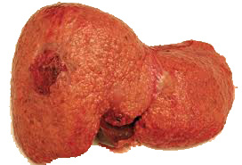


How did TSG-6 effect of liver regeneration?
TSG-6
?
Healthy Liver
Damaged Liver
Autophagy
Notes:
In the first step, we reported that TSG-6-containing CM promoted liver regeneration. In the next step, we aims to demonstrate how TSG-6 peptide, not TSG-6-CM, mediates liver recovery from chronic liver dx.
In previous studies, we found that TSG-6 led to hepatocyte prolifertation. Emerging evidence shows that autophagy is a survival pathway for hepatocytes. Hence, we hypothesize that TSG-6 induce autophagy formation in hepatocytes, eventually contributing to liver regeneration.

Slide 21
Autophagy
Autophagy = Auto ‘Self ‘+ phagein ‘to eat’ (from Greek)
Natural, destructive mechanism that disassembles unnecessary or dysfunctional cellular components through a regulated process.
Autohphagy plays an important role in regulating liver homeostasis under physiological condition;
Elimination of aggregated-prone protein ad damaged mitochondria
Regulation of metabolic pathway during fasting
Protecting hepatocytes from senescence
Autophagy is associated with life span, ageing or various diseases, including Cancer, Type II Diabates, Neuro-degenerative Dx and Fatty Liver.
Notes:
Autophagy or cellular self-digestion is a catabolic process that disassembles XXX

Slide 22

Autophagy Pathway
RAB7
LAMP2
ProLC3
Autolysosome
Lysosome
Atg4
LC3-I
Autophagic cargo
LC3-II
Atg7
LC3-II
Atg3
Preautophagosomal structures
Autophagosome
Notes:
I briefly introduce autophagy pathway.
LC3, soluble protein is cleaved into LC3-I, which is then conjugated to lipid, phosphatidylethanolamine(PE), via Atg7 and 3.
This lipid conjugation forms the LC3-II protein, which allows the closure of the autophagic vacuole, forming autophagosome.
Autophagosome subsequently fuses with the endosome and then the lysosome, and the internal material is degraded.
Lamp2 is lysosomal marker. Rab7 is required for maturation of late autophagic vacuoles and fusion with lysosome
LC3-II:autophagic double-membrane-associated

Slide 23
Design of mouse experimental model
TSG-6 or Vehicle injection
Sacrificed
MCDE Diet
10 weeks of age
2 weeks
4 weeks
Methionine choline-deficient supplemented with ethionine (MCDE)
MCD diets induce NAFLD (Nonalcholic Fatty Liver Disease) in rodents
The addition of ethionine exacerbates liver injury by inhibiting survival of mature hepatocytes
Notes:
To induce chronic liver injury, NASH, we treated mice with MCDE (Methionine choline-deficient supplemented with 0.1 % ethionine) for 4 weeks.
MCD diets induce lipid accumulation in liver, leading to NAFL (Nonalcholic Fatty Liver) in rodents. The addition of ethionine exacerbates the liver injury by inhibiting replication and survival of the mature hepatocytes.
After 2 weeks of MCDE feeding, TSG-6 protein (50ng) or vehicle was injected to mice every other days for 2weeks. During TSG-6 treatment, MCDE was kept feeding to mice.

Slide 24

Effects of TSG-6 on histomorphology and function of liver with chronical damage
H&E Staining
Liver Function Test
NORMAL
MCDE
*
*
*
*
ALT (IU/L)
AST (IU/L)
20μm
20μm
MCDE+Vehicle
MCDE+TSG-6
MCDE
-
+
+
+
MCDE
-
+
+
+
Vehicle
-
-
+
+
Vehicle
-
-
+
+
TSG-6
-
-
-
+
TSG-6
-
-
-
+
20μm
20μm
Unpublished
Notes:
From now on, the data I present are not published and ongoing.
As you can see this figures, TSG-6-treated group shows the improved morphology compared with MCDE or MCDE and vehicle-treated group. In addition, the level of ALT and AST is lower in TSG-6-treated group than other two groups.

Slide 25








TSG-6 decreases apoptosis but increases proliferation of hepatocytes
Caspase-3 Staining
Ki67 Staining
Normal
MCDE
Normal
MCDE
20μm
20μm
20μm
20μm
MCDE+Vehicle
MCDE+TSG-6
MCDE+Vehicle
MCDE+TSG-6
20μm
20μm
20μm
20μm
Unpublished
Notes:
To determine if these changes were associated with the hepatocyte survival, we stained liver sections with active caspases 3, apoptosis marker, and Ki67, proliferation marker. Compared with the injured livers of these two groups, liver of TSG-6 group shows a decreased apoptosis but increase proliferation of hepatocytic cells.

Slide 26











Up-regulation of autophagic marker in TSG-6-treated mice with MCDE diet
Autophagic Marker(mRNA & Protein)
*: vs MCDE $: vs Vehicle
MCDE
-
+
+
+
atg3
atg7
lc3
lamp2
Vehicle
-
-
+
+
$
TSG-6
-
-
-
+
Fold Increase
*
$
$
$
*
*
*
LC3
GAPDH
LAMP2
MCDE:
-
+
+
+
GAPDH
-
+
+
+
-
+
+
+
-
+
+
+
Rab7
Vehicle:
-
-
+
+
-
-
+
+
-
-
+
+
-
-
+
+
TSG-6:
-
-
-
+
-
-
-
+
-
-
-
+
-
-
-
+
GAPDH
Normal
MCDE
LC3 IHC
20μm
20μm
MCDE+Vehicle
MCDE+TSG-6
20μm
20μm
Unpublished
Notes:
We examined whether autophagy formation was up-regulated in regenerating liver by TSG-6. The RNA level of autophagic marker, XXXX, and protein level of LC3-II, LAMP2, and Rab7 were upregulated in TSG-6-treated mice fed with MCDE. IHC for LC3 clearly shows accumulation of LC3-positive cells in these regenerating liver.

Slide 27
Accumulation of autolysosome in damaged liver treated with TSG-6
Rab7 IF staining
DAPI
Rab7
Merge
Normal
MCDE
MCDE+
Vehicle
MCDE+
TSG-6
Unpublished
Notes:
In addition, Rab7-positive signals were observed in cytoplasm in these livers

Slide 28

TSG-6 promotes survival of hepatocytes
Tunicamycin (TM)
TSG-6 or Vehicle (10ng/ml)
AML12
0 day
1 days
2 days
Withdrawal of TM
No drug
TM 2.5ug/ml + TSG-6
*
TM 5ug/ml + TSG-6
Cell Viability (%)
&
*
TM 2.5ug/ml
TM 5ug/ml
: vs 2.5ug/ml without TSG-6 group
& : vs 5ug/ml without TSG-6 group
0 day
1 day
2 days
Withdrawal of TM
Unpublished
Unpublished
Notes:
To assess whether TSG-6 contributes to the survival of hepatocytes by promoting autophagy formation, we treated AML12, normal hepatocyte cell line orginated from mouse, with tunicamycin to induce cell death for 24 hours, and then withdraw tunicamycin and add TSG-6 or vehicle for 24 or 48 hours.
Tumicamycin effectively induces cell death, even one day after withdrawal of TM. However, TSG-6 suppress this sharp drop of cell viability and causes the improved cell viability.
At now we are keeping investigate whether TSG-6 promotes autophagy formation which results in cell survival in this in vitro system.

Slide 29
Summary
TSG-6 attenuates morphological and functional damages in liver with chronical injury
TSG-6 promotes the autophagy formation in MCDE-treated liver of mice
TSG-6 induces the decrease of apoptotic hepatocytes but increases of hepatocyte proliferation
Notes:
Based on the results so far achieved, we summarize that

Slide 30



Conclusion
TSG-6
autophagy
TSG-6 contributes to liver regeneration by promoting autophagy formation
Notes:
In conclusion, TSG-6 XXX

Slide 31


Thank YOU
Notes:
This picture shows my lab members, 2 PhD candidate, 1 PhD, and 1 Master degree student. MR. Wang, PhD candidate, contributes to most works presented today.
Thank you for listening my talk. Thank you.

Slide 32
Thank YOU

Slide 33


Different severities of liver damage(DELETE?
Mild Dx (NAFL)
(Chronic dx (NASH)
Hepatocyte Fat
Hepatocyte Death
Cirrhosis
HCC
Notes:
This figures show the morphology of liver with mild or chronic damages. These white bubbles are fat accumulated in hepatocytes. In mild dx, rate of hepatocyte proliferation is higher than death rate of hepatocytes. However, in chronic liver dx. Death rate of hepatocytes is higher than proliferation rata. Hence, NASH, one of chronic liver disease, can be severe and can lead to cirrhosis, in which the liver is permanently damaged and scarred.

