Slide 1
About OMICS Group
OMICS Group is an amalgamation of Open Access Publications and worldwide international science conferences and events. Established in the year 2007 with the sole aim of making the information on Sciences and technology ‘Open Access’, OMICS Group publishes 500 online open access scholarly journals in all aspects of Science, Engineering, Management and Technology journals. OMICS Group has been instrumental in taking the knowledge on Science & technology to the doorsteps of ordinary men and women. Research Scholars, Students, Libraries, Educational Institutions, Research centers and the industry are main stakeholders that benefitted greatly from this knowledge dissemination. OMICS Group also organizes 500 International conferences annually across the globe, where knowledge transfer takes place through debates, round table discussions, poster presentations, workshops, symposia and exhibitions.

Slide 2
OMICS International Conferences
OMICS International is a pioneer and leading science event organizer, which publishes around 500 open access journals and conducts over 500 Medical, Clinical, Engineering, Life Sciences, Pharma scientific conferences all over the globe annually with the support of more than 1000 scientific associations and 30,000 editorial board members and 3.5 million followers to its credit.
OMICS Group has organized 500 conferences, workshops and national symposiums across the major cities including San Francisco, Las Vegas, San Antonio, Omaha, Orlando, Raleigh, Santa Clara, Chicago, Philadelphia, Baltimore, United Kingdom, Valencia, Dubai, Beijing, Hyderabad, Bengaluru and Mumbai.

Slide 3
Hepatoprotective activity of silymarin against acetaminophen involves an enhancement of the glutathione-dependent detoxification capacity
Young Chul Kim
College of Pharmacy
Seoul National University
Notes:
I would like to present recent finding made in our lab regarding the mechanism of antioxidative action provided by silymarin.

Slide 4

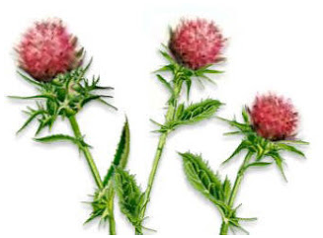
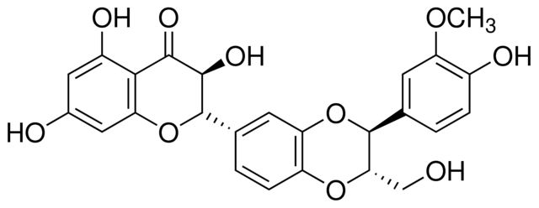
Enhancement of GSH Detoxicifcation Capacity by Silymarin
Silymarin:
Extract from seeds of milk thistle
(silybum marianum).
Mixture of flavonolignans mostly consisting of silybin, silychristin, silydianin, and isosilybin.
Notes:
Silymarin is a mixture of several flavonolignans extracted from milk thistle. Silybin is the major component, comprising more than a half of the total flavonoids.

Slide 5
Enhancement of GSH Detoxicifcation Capacity by Silymarin
Has been used as a remedy for the treatment of chronic liver diseases in traditional medicine (ALD, viral hepatitis, liver cirrhosis, etc.).
Experimental evidence showed that silymarin protects the liver against various toxicants including CCl₄, ethanol, acetaminophen and galactosamine.
The mechanism of hepatoprotective action provided by silymarin is frequently attributed to its antioxidant effect.
Silymarin prevents GSH depletion induced by those toxicants, which seems to be a secondary effect resulting from GSH conservation due to its direct radical scavenging activity.
Notes:
Because the liver toxicity of these substances involves oxidative stress, and also silymarin is known to directly interact hydroxyl radical and hyfrogen peroxide, the hepatoprotective action of silymarin is frequently attributed to its antioxidant effect.
In fact silymarin prevents the reduction of hepatic GSH; this effect seems to be a secondary effect resulting from conservation of GSH due to direct ROS scavenging activity of silymarin.

Slide 6
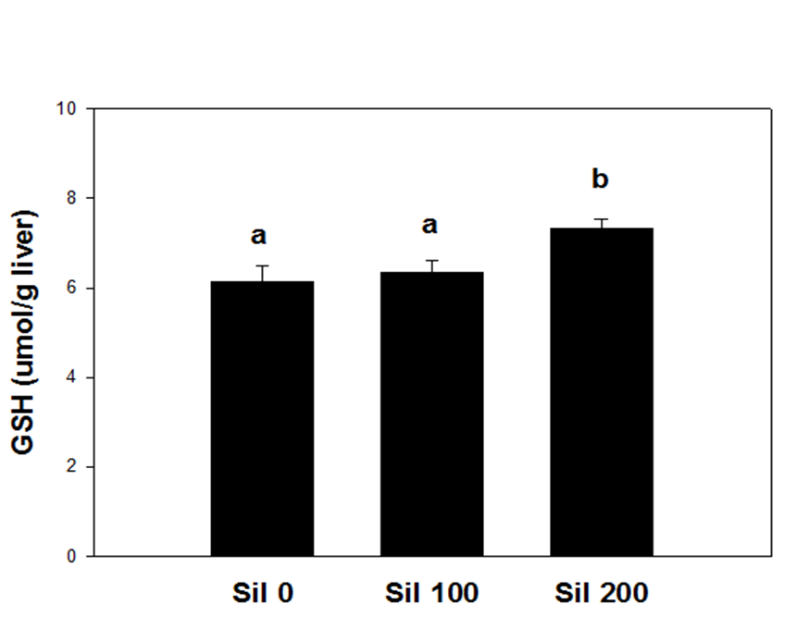
Enhancement of GSH Detoxicifcation Capacity by Silymarin
GSH levels in liver of mice treated with silymarin (100 mg/kg or 200 mg/kg) every 12 hr for 3 times. (Kwon et al., BK21 Report to Bukwang Pharmaceuticals, 2008, SNU)
Notes:
In our earlier study, however, acute administration of silymarin to naïve mice was shown to elevate hepatic GSH content. Which suggests that silymarin may directly increase GSH synthesis.
Therefore, we determined the effects of silymarin treatment on the GSH biosynthesis in liver.

Slide 7
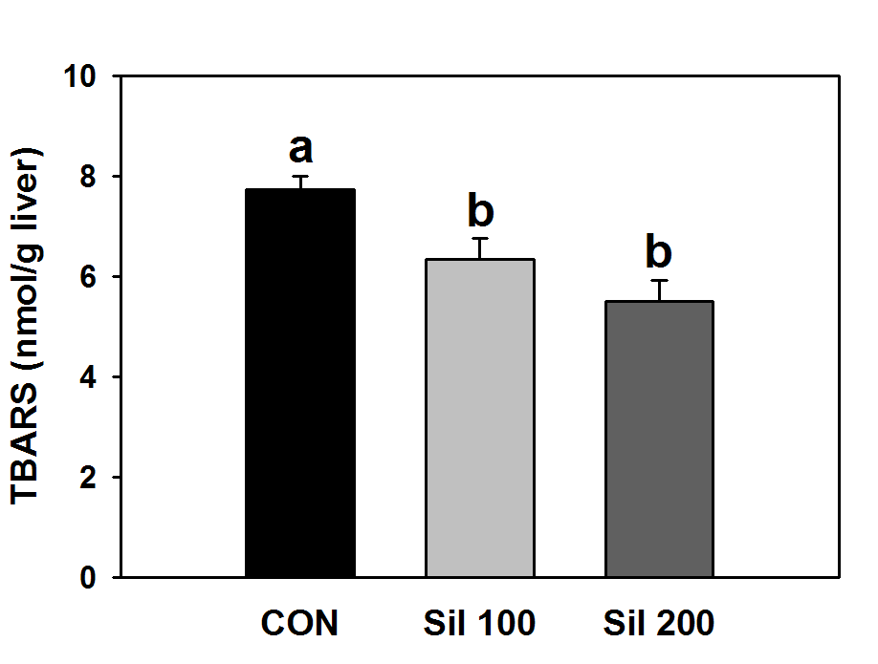
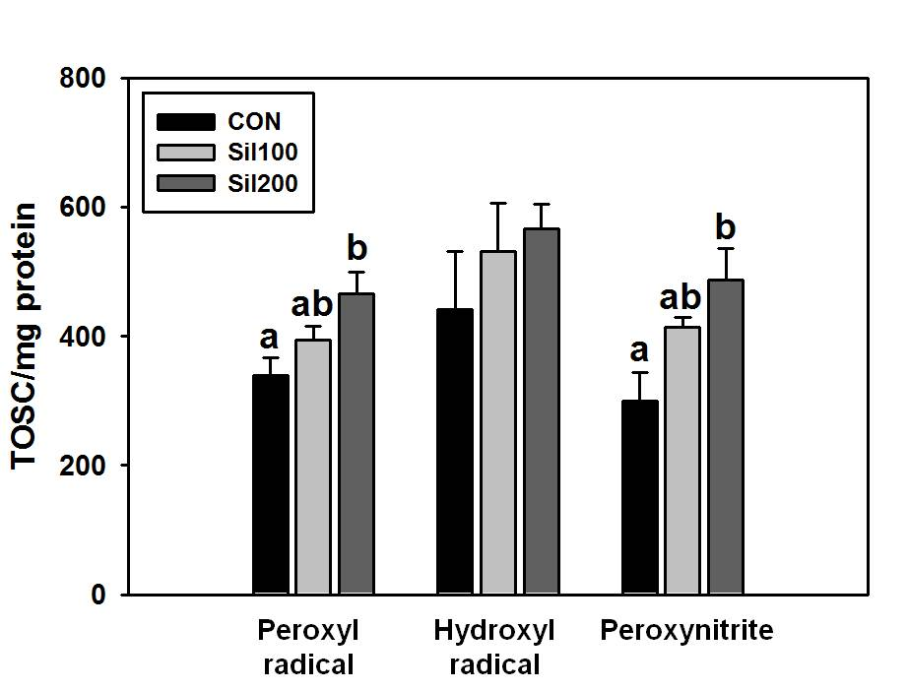
Enhancement of GSH Detoxicifcation Capacity by Silymarin
Lipid peroxidation and total oxyradical scavenging capacity (TOSC)
Notes:
We determined the physiological significance of silymarin-induced glutathione elevation in the liver.
Lipid peroxidation Dec / Total oxyradical scavenging capacity or TOSC against peroxyl radical and peroxinitrite Inc

Slide 8
Enhancement of GSH Detoxicifcation Capacity by Silymarin
Part I :
Alterations in hepatic transsulfuration reactions in mice treated with silymarin

Slide 9
ATP
MAT
Methionine
SAM
Ornithine
THF
SAMDC
ODC
N,N-Dimethylglycine
MS
SAH
Putrescine
BHMT
DC-SAM
N-⁵Methyl-THF
Betaine
MeSAdo
Homocysteine
Spermidine
Serine
CβS
DC-SAM
Cystathionine
MeSAdo
CγL
Spermine
Cysteine
Glutamate
CDO
GCS
Cysteine sulfinate
γ-Glutamylcysteine
CDC
Glycine
GS
Hypotaurine
GSH
Taurine
Metabolic pathway for sulfur amino acids
(Adapted from Kim and Kim, J. Hepatol. 2005)
Notes:
This is a scheme of overall metabolic reactions for sulfur amino acids in liver. (introduction to terminology –Met cycle, cystathionine pathway, transsulfuration pathway)
Methionine is first converted to S-adenosylmethionine or SAM by MAT, methionine adenosyltransferase. SAM IS ESPECIALLY INTERESTING.
SAM is a methyl donor for various biological methylation reactions, and also provides the sulfur source for cysteine and glutathione. And SAM is decarboxylated to dcSAM and serves as a aminopropyl group for synthesis of polyamines, which has an important role for cell regeneration.
SAH is hydolyzed to homocysteine, which is either remethylated to methionine or leaves the met cycle to be condensed with serine to produce Cystathionine and Cysteine. Cysteine is the essential substrate for synthesis of both taurine and glutathione. CDO and GCS are the rate determining enzymes for the synthesis of taurine and glutathione. Therefore, cysteine availability and GCS are the two most important factors determining the GSH synthesis in liver.

Slide 10
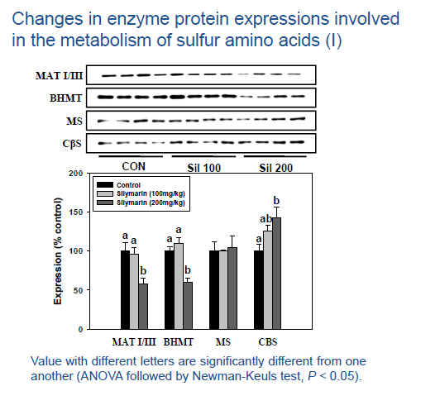
Enhancement of GSH Detoxicifcation Capacity by Silymarin
Changes in major sulfur-containing metabolites (I)
 | Control | Silymarin (100 mg/kg) | Silymarin (200 mg/kg)
Methionine (nmol/g liver) | 38.2 ± 1.4a | 46.7 ± 2.5a,b | 51.1 ± 6.2b
SAM (nmol/g liver) | 99.3 ± 5.2 | 95.5 ± 4.4 | 108.8 ± 8.6
SAH (nmol/g liver) | 46.0 ± 2.4 | 49.1 ± 4.4 | 53.1 ± 4.6
Homocysteine (nmol/g liver) | 6.8 ± 0.5 | 6.8 ± 0.2 | 6.4 ± 0.3
Cystathionine (nmol/g liver) | 9.9 ± 1.4a | 13.5 ± 1.6a,b | 16.7 ± 1.2b
Cysteine (nmol/g liver) | 89.3 ± 9.3a | 84.4 ± 3.2a | 149.1 ± 10.3b
Changes in enzyme activities involved in the metabolism of sulfur amino acids (I)
 | Control | Silymarin (100 mg/kg) | Silymarin (200 mg/kg)
MAT (pmol/mg/min) | 41.3 ± 3.2a | 38.5 ± 1.4a,b | 32.5 ± 1.8b
BHMT (nmol/mg/min) | 1.55 ± 0.14a | 1.34 ± 0.10a,b | 1.14 ± 0.10b
CβS (nmol/mg/min) | 7.1± 0.6a | 8.7 ± 0.8a,b | 10.1 ± 0.8b
CγL (nmol/mg/min) | 10.1 ± 0.1 | 10.4 ± 0.4 | 10.7 ± 0.5
Notes:
Mice were treated with silymarin at 100 or 200 mg/kg every 12 hr for 3 does, and sacrifice 6 hr after the final treatment.
Met Inc, however, no change in SAM, SAH, Homocysteine
Cyst Inc / Cys Inc
MAT activity Dec / BHMT activity Dec / But CBS activity Inc /
MAT I and III (liver form) Dec / BHMT Dec / CBS Inc

Slide 11
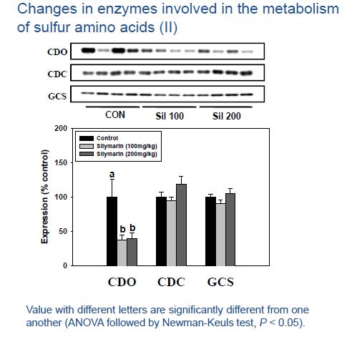
Enhancement of GSH Detoxicifcation Capacity by Silymarin
Changes in major sulfur-containing metabolites (II)
 | Control | Silymarin (100 mg/kg) | Silymarin (200 mg/kg)
Cysteine (nmol/g liver) | 89.3 ± 9.3a | 84.4 ± 3.2a | 149.1 ± 10.3b
Hypotaurine (μmol/g liver) | 0.13 ± 0.02 | 0.14 ± 0.03 | 0.16 ± 0.02
Taurine (μmol/g liver) | 13.0 ± 0.7 | 13.4 ± 0.7 | 14.7 ± 0.4
GSH (μmol/g liver) | 5.7 ± 0.3a | 5.9 ± 0.3a | 6.9 ± 0.2b
GSSG (μmol/g liver) | 0.22 ± 0.01 | 0.20 ± 0.01 | 0.22 ± 0.01
GSH/GSSG ratio | 25.4 ± 0.6a | 29.9 ± 0.9b | 31.7 ± 1.2b
Changes in enzyme activities involved in the metabolism of sulfur amino acids (II)
 | Control | Silymarin (100 mg/kg) | Silymarin (200 mg/kg)
CDO (nmol/mg/min) | 0.62 ± 0.07a | 0.40 ± 0.02b | 0.32± 0.02b
CDC (nmol/mg/min) | 16.3 ± 0.8 | 16.1 ± 0.3 | 17.3 ± 1.1
GCS (nmol/mg/min) | 3.8 ± 0.4 | 3.3 ± 0.1 | 3.2 ± 0.5
Notes:
Cysteine Inc / GSH Inc / GSH/GSSG ratio Inc / No changes in HT and Tau
The rate limit enzyme for taurine synthesis, CDO activity Dec / GCS no changes
CDO expression Dec / GCS no changes again

Slide 12
Alterations in the metabolism for sulfur amino acids in mice treated with silymarin
ATP
MAT
Methionine
SAM
Ornithine
THF
SAMDC
ODC
N,N-Dimethylglycine
MS
SAH
Putrescine
BHMT
DC-SAM
N-⁵Methyl-THF
Betaine
MeSAdo
Homocysteine
Spermidine
Serine
CβS
DC-SAM
Cystathionine
MeSAdo
CγL
Spermine
Cysteine
CDO
Glutamate
GCS
Cysteine sulfinate
γ-Glutamylcysteine
CDC
Glycine
GS
Hypotaurine
GSH
Taurine
Notes:
Met Inc, MAT InHB, offset each other, no changes in SAM
BHMT InHB, but no changes in Hcy, instead CBS Inc, also cyst and cys Inc
CDO Dep, GSH Inc

Slide 13
Enhancement of GSH Detoxicifcation Capacity by Silymarin
SUMMARY – 1ST PART
Acute silymarin treatment increases hepatic methionine level which is accompanied with inhibition of MAT without a significant change in SAM or SAH.
BHMT is inhibited, but homocysteine is not accumulated. Instead, the generation of cystathionine is enhanced, probably due to induction of CβS.
Also cysteine catabolism to taurine is depressed significantly by silymarin as evidenced by down-regulation of CDO.
The increase in cysteine generation and the inhibition of its catabolism to taurine lead to an elevation of cysteine availability which accounts for the enhancement of GSH synthesis in liver.

Slide 14
Enhancement of GSH Detoxicifcation Capacity by Silymarin
Part II :
Significance of the enhancement of GSH synthesis by silymarin on acetaminophen hepatotoxicity
Notes:
Because GSH has an essential role in detoxication of electrophilic reactive substances, we wanted to see the changes in the toxicity of such substnaces by slymarin treatment. So we selected acetaminophen for this study.

Slide 15
Metabolic fate of acetaminophen
UGT
SULT
APAP-GLUC
APAP
APAP-SULF
CYP450
(2E1, 1A2, 3A4)
NAPQI
GSH
GST
APAP-GSH
GSH depletion
Binding to macromolecules
APAP-CYS
APAP-NAC
Oxidative stress
Cell death !!
Notes:
Explain the metabolic pathways involved in induction of the APAP toxicity.
CYP activity and GSH availability two most important determinants for APAP toxicity.

Slide 16
Enhancement of GSH Detoxicifcation Capacity by Silymarin
Elevation of enzyme activities in plasma of mice treated with APAP
Lipid peroxidation and GSH content in liver
Notes:
Elevation of ALT, SDH was prevented by SIL
Lipid peroxide formation increased by APAP was moderated by SIL / GSH depletion was less & recovered rapidly in SIL-treated mice.

Slide 17
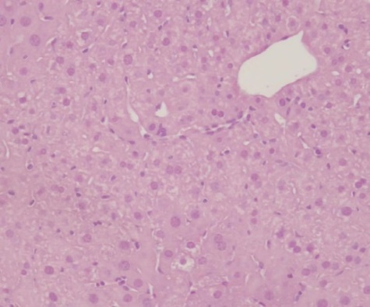
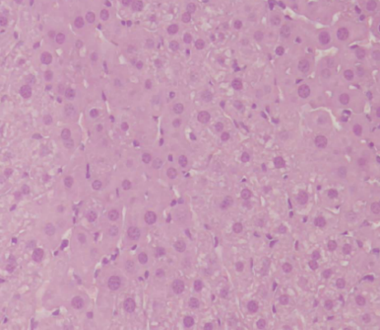
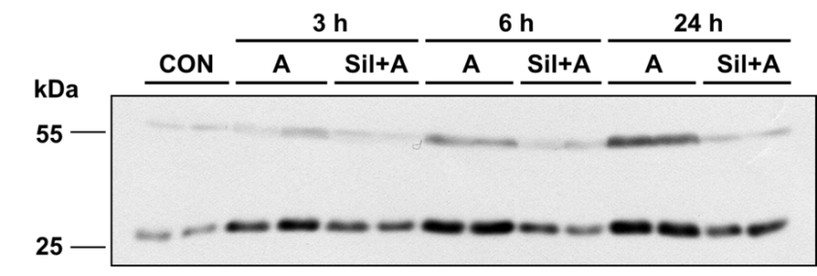
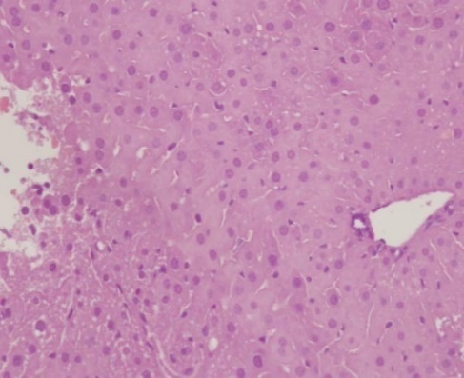
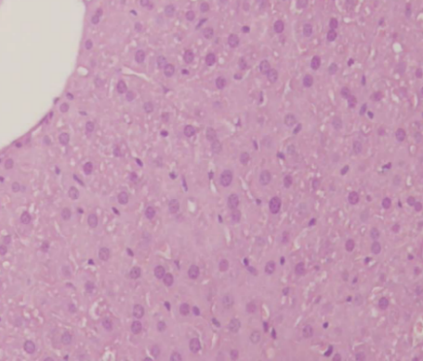
Enhancement of GSH Detoxicifcation Capacity by Silymarin
control
silymarin
APAP
silymarin + APAP
Formation of nitrotyrosine protein adducts in liver
H & E staining
Notes:
Not a big change prob due to low acute dose of APAP.
But vacuole degeneration in APAP rats.

Slide 18
Enhancement of GSH Detoxicifcation Capacity by Silymarin
APAP metabolites in plasma
APAP
APAP-GLUC
APAP-SULF
APAP-GSH
APAP-CYS
APAP-NAC
Notes:
There were no differences in APAP or major non-toxic products (glucuronide or sulfate conjugate) between APAP only and APAP+SIL groups
However, GSH conjugate & its metabolites were all elevated.

Slide 19




Enhancement of GSH Detoxicifcation Capacity by Silymarin
Changes in CYP enzymes in liver of mice treated with silymarin only
Cyp2e1
Cyp1a1/2
Cyp3a
GAPDH
Control
Silymarin
(200 mg/kg)
Notes:
GSH conjugation with APAP increased, but this could be induced by greater activation of APAP to the reactive metabolite.
Therefore, CYP activities were determined. 2E1 & 1A2 did not change, 3A was depressed, suggesting the CYP induction did not contribute to the increase in GSH conjugation.

Slide 20
Enhancement of GSH Detoxicifcation Capacity by Silymarin
SUMMARY – 2nd PART
Silymarin pretreatment inhibits the hepatotoxicity and lipid peroxidation induced by an acute dose of APAP. GSH depletion is also alleviated.
Plasma levels of thiol conjugates of APAP are elevated while APAP, APAP-glucuronide and APAP-sulfate are unchanged, indicating GSH conjugation with NAPQI is enhanced.
Hepatic CYP activity responsible for the metabolic activation of APAP is not induced by silymarin. Therefore, the increased detoxification of APAP via GSH conjugation should be attributed to the elevation of GSH availability in liver.

Slide 21
Enhancement of GSH Detoxicifcation Capacity by Silymarin
conclusions
The antioxidant activity of silymarin should be, at least in part, attributed to the increase in GSH biosynthesis.
The induction of GSH synthesis by silymarin has a physiological significance as shown by the reduction of lipid peroxidation and the improvement of antioxidant defense in the naïve mice.
The elevation of hepatic GSH by silymarin may increase the detoxification potential of liver against various toxicants and their electrophilic metabolites.
Notes:
GSH synthesis or metabolism is tightly regulated, and its content is very difficult to modulate. As a matter of fact silymarin seems to the first substance known to alter the GSH content by increasing the availability of cysteine for synthesis of GSH.

Slide 22
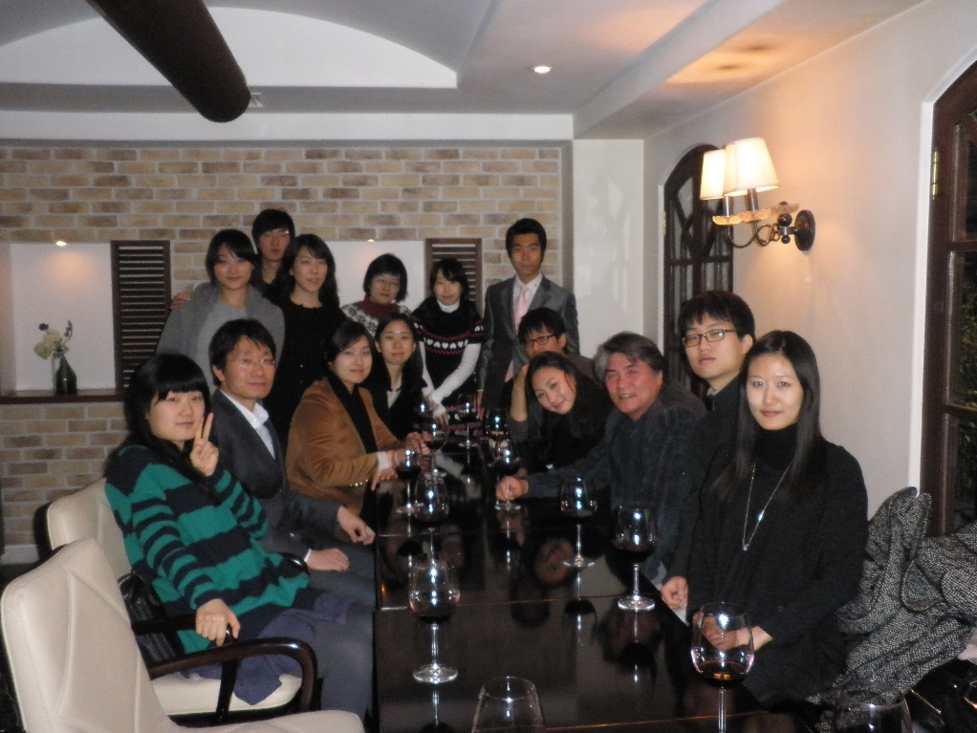
Thank You !
Contributors:
Do Young Kwon, Ph.D.
Sun Ju Kim, Ph.D.
Mr. Chul Won Ahn
Jae Hak Park, D.V.M., Ph.D.
Ms. Ji Hyun Kim
Fundings:
National Research Foundation (NRF) grants (No. 2011-0016781 and No. 2009-
0083533), Ministry of Education, Science and Technology, Korea.

Slide 23
Let us meet again..
We welcome you to our future conferences of OMICS International
2nd International Conference and Expo
on
Drug Discovery & Designing
On
October -31 November-02, 2016 at Istanbul, Turkey
http://drug-discovery.pharmaceuticalconferences.com/

