Slide 1
About OMICS Group
OMICS Group is an amalgamation of Open Access publications and worldwide international science conferences and events. Established in the year 2007 with the sole aim of making the information on Sciences and technology ‘Open Access’, OMICS Group publishes 500 online open access scholarly journals in all aspects of Science, Engineering, Management and Technology journals. OMICS Group has been instrumental in taking the knowledge on Science & technology to the doorsteps of ordinary men and women. Research Scholars, Students, Libraries, Educational Institutions, Research centers and the industry are main stakeholders that benefitted greatly from this knowledge dissemination. OMICS Group also organizes 500 International conferences annually across the globe, where knowledge transfer takes place through debates, round table discussions, poster presentations, workshops, symposia and exhibitions.

Slide 2
About OMICS International Conferences
OMICS International is a pioneer and leading science event organizer, which publishes around 500 open access journals and conducts over 500 Medical, Clinical, Engineering, Life Sciences, Pharma scientific conferences all over the globe annually with the support of more than 1000 scientific associations and 30,000 editorial board members and 3.5 million followers to its credit.
OMICS Group has organized 500 conferences, workshops and national symposiums across the major cities including San Francisco, Las Vegas, San Antonio, Omaha, Orlando, Raleigh, Santa Clara, Chicago, Philadelphia, Baltimore, United Kingdom, Valencia, Dubai, Beijing, Hyderabad, Bengaluru and Mumbai.
.

Slide 3

Transcription-based Chronobiology of Receptor Tyrosine Kinases: Relevance to Cancer Progression
Yosef Yarden, PhD
Department of Biological Regulation
The Weizmann Institute of Science
Rehovot, Israel
International Conference on Transcriptomics
Orlando; July 27, 2015

Slide 4
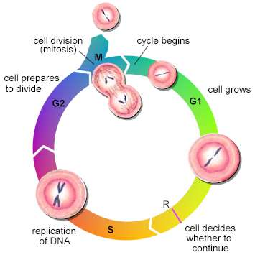
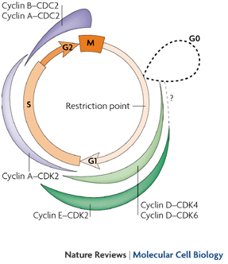
Part 1: EGF-induced proliferation of mammary cells (HMEC cells)
1st pulse (1-hour )
2nd pulse (1-hour)
R point
R Point: cell decides
Whether to continue
R crossing requires continuous (>6 hours) presence of growth factors, but might be replaced by 2 pulses of 1 hour each.

Slide 5
IGF1 may replace EGF in the 1st, not in the 2nd pulse
H
o
u
r
s
0
1
2
3
4
5
6
7
8
9
1
0
1
1
1
2
BrdU incorporation
1.0 ± 0.09
1.66 ± 0.18
1.62± 0.18
1.01 ± 0.2

Slide 6
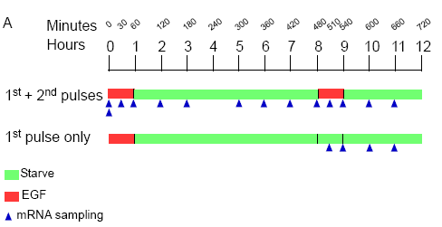
RPPA and Transcriptomic Analyses of the Two-Pulses

Slide 7
10 expression profiles are induced by EGF
(two pulses)

Slide 8
The module includes well-established p53 target genes
The module “Down-regulated by 2nd Pulse” comprises
several p53 regulated genes
And
p53 associates with chromatin upon the 1st pulse, remains active during the interval and dissociates on the 2nd pulse

Slide 9
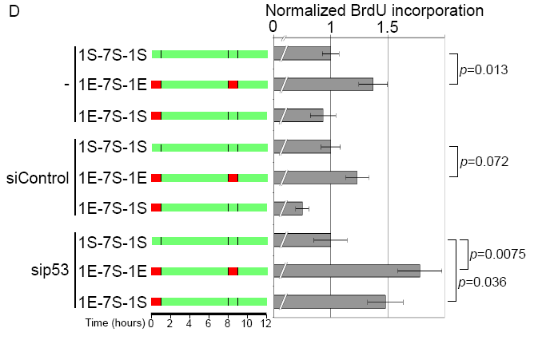
Knockdown of p53 enables R-crossing in the absence of a second pulse

Slide 10
The Paradigm of “Consistency Test”
The 2-pulse mode of commitment might filter the "noise" of growth factor bursts, which are often short and inconsistent
In the absence of p53 (e.g., cancer cells), this filtering mechanism is defective

Slide 11
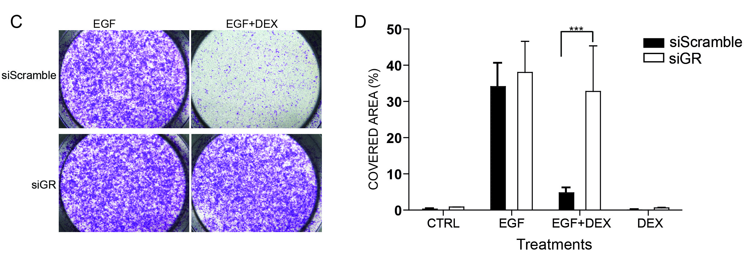
Part 2: EGF-induced migration of mammary cells (MCF10A cells)
GR Mediates the Inhibitory Effect of DEX on Cell Migration

Slide 12
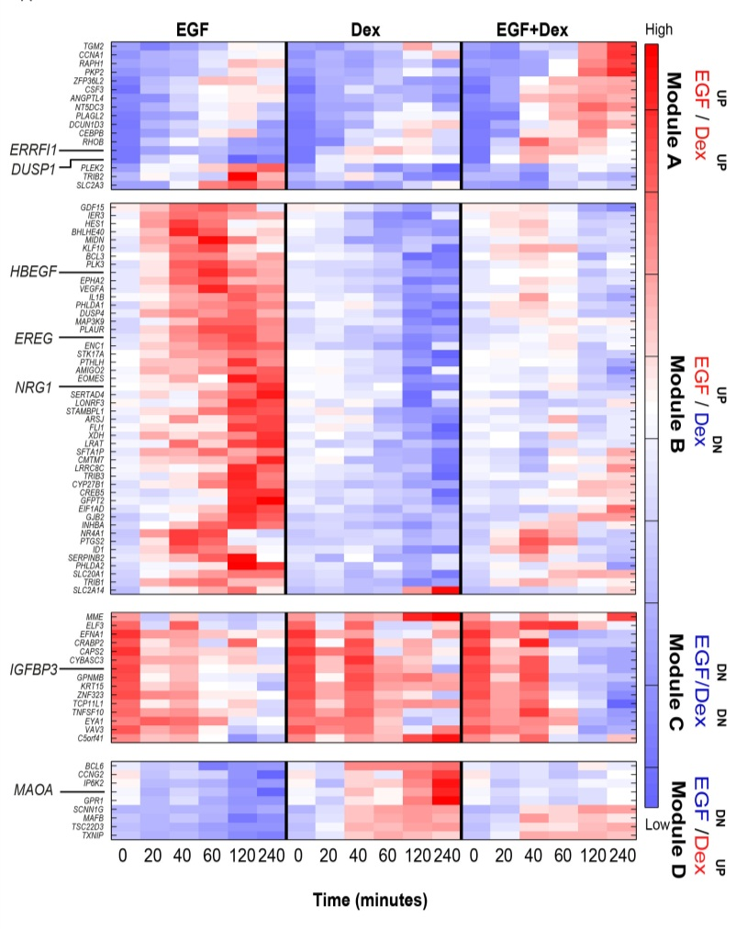
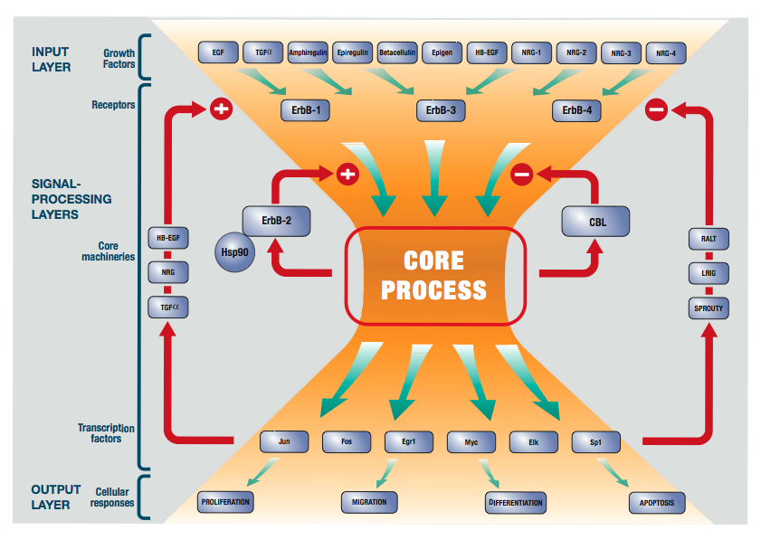
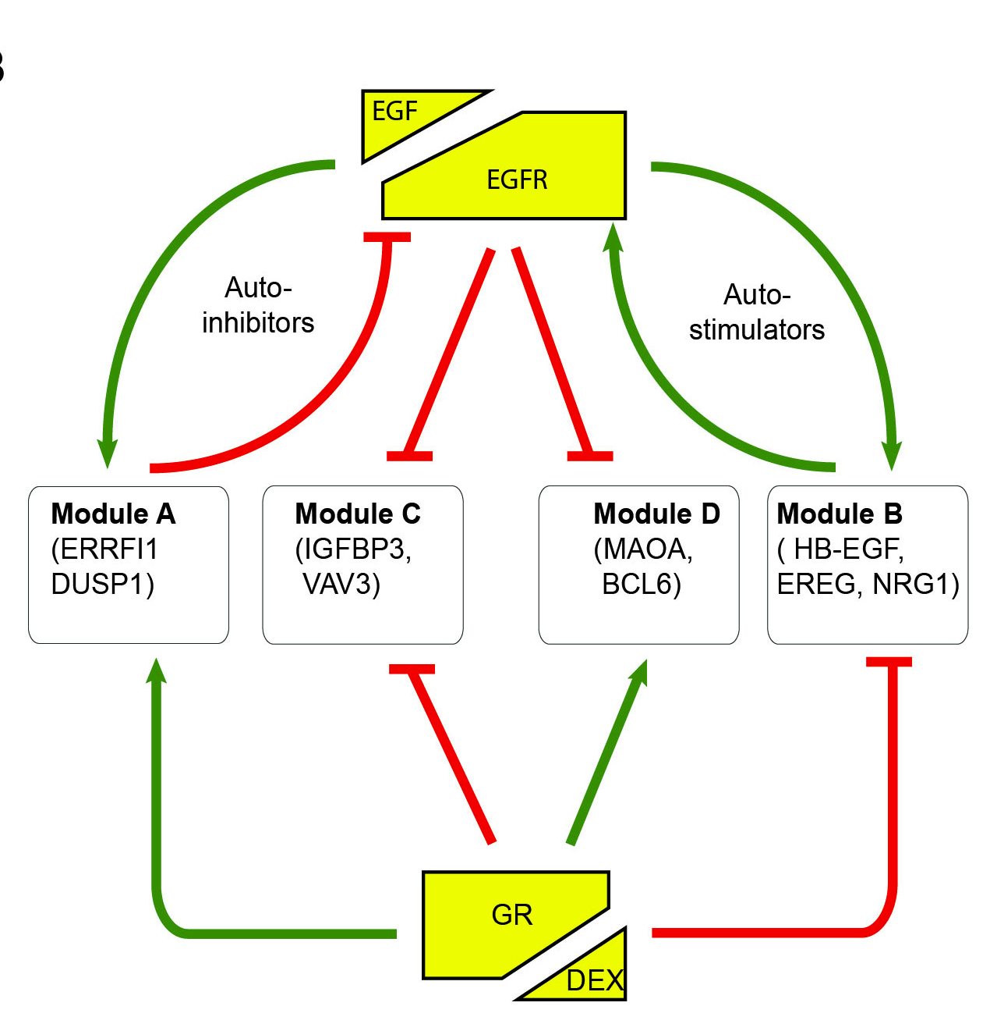
GR exploits the EGFR gene program by inhibiting the feedback activators and activating the feedback inhibitors

Slide 13
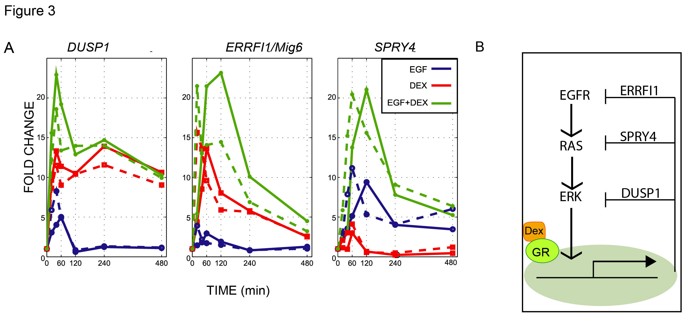
Module A: GR enhances the expression of a set of negative regulators of EGFR signaling

Slide 14
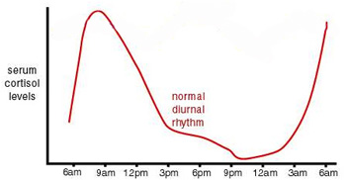
Circadian Oscillations of Serum Cortisol Levels in Human
TIME (AM/PM)

Slide 15
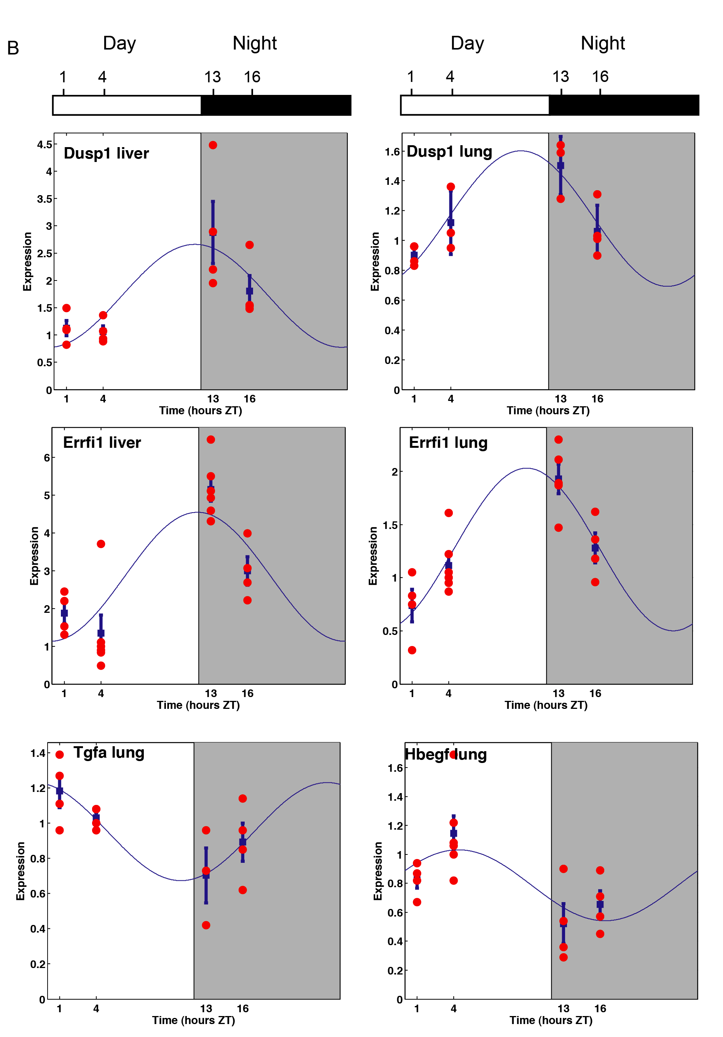
Circadian regulation of EGFR feedback genes (liver and lung; WT mice)
Module A genes
Module B genes

Slide 16
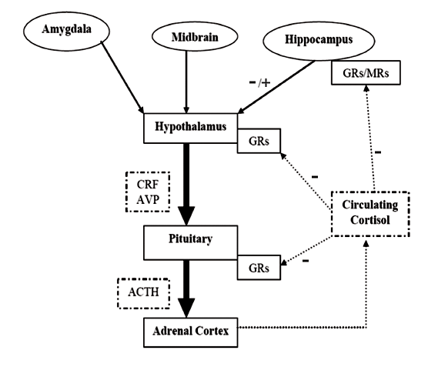
The Hypothalamus-Pituitary-Adrenal (HPA) Axis

Slide 17
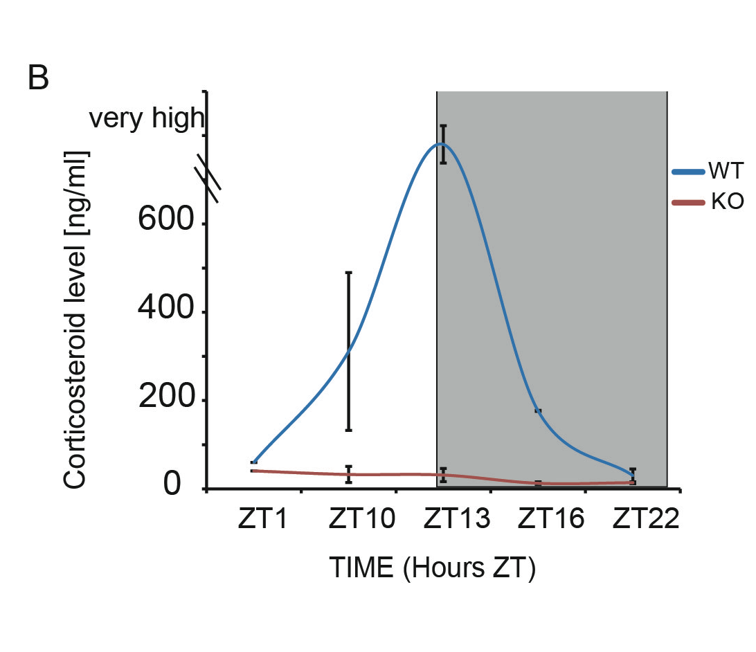
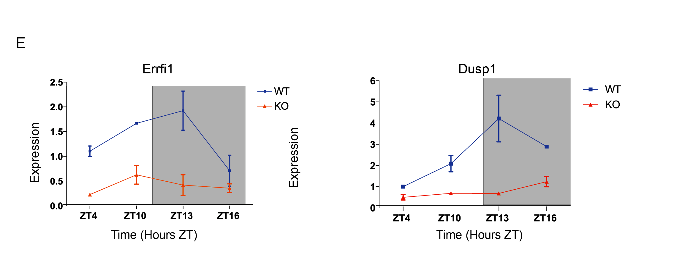
Circadian regulation of EGFR negative regulators is defective in CRFR1-KO mice
In Red: CRFR1-depleted mice (CRFR1^{-/-})

Slide 18
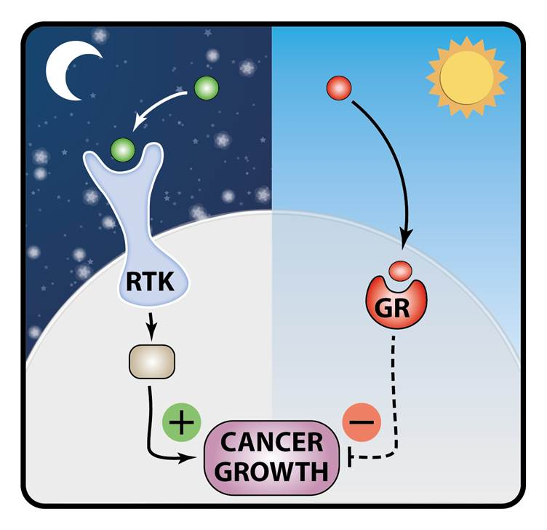
Take-home Messages #3: Circadian Regulation of EGFR Signaling
Take-home Message #3: Circadian Regulation of EGFR
Glucocorticoid block EGF-induced migration of mammary cells by suppressing the activators and activating the inhibitors of EGFR.
Our model predicts that EGFR is suppressed during daytime.
If correct, EGFR’s contribution to tumor progression might occur at night.
Hence, inhibiting EGFR at night might be more beneficial than daytime treatments.

Slide 19
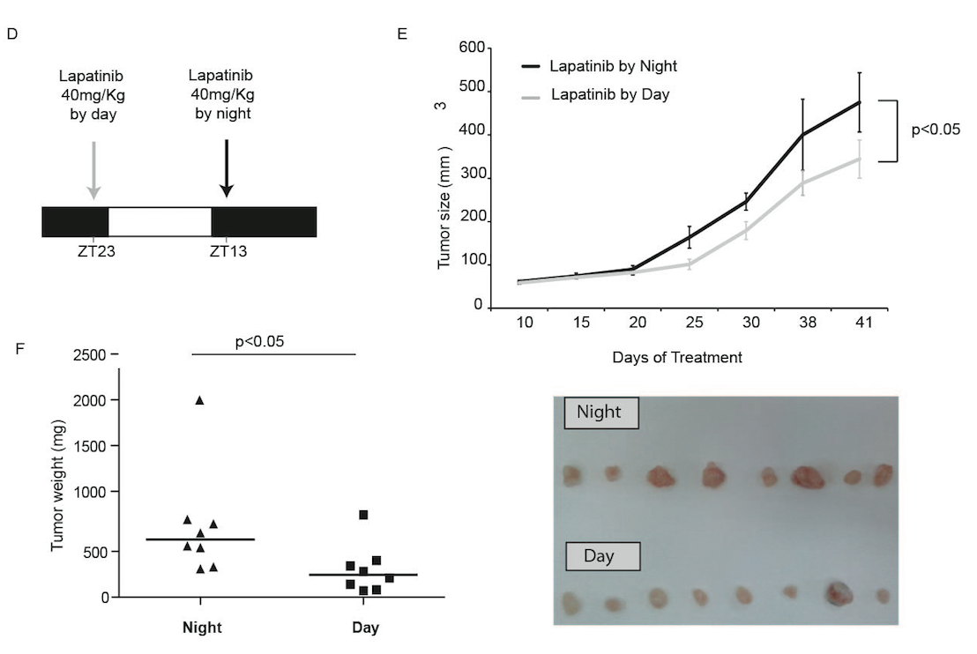
HER2-overexpressing Gastric Cancer Xenografts: Superiority of Resting Phase Treatment with Lapatinib

Slide 20
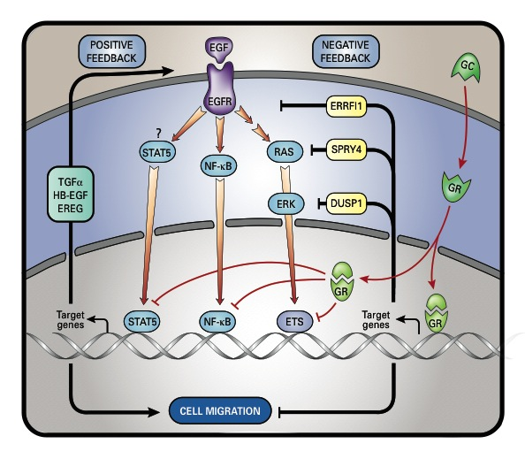
GR Inhibits the EGFR Gene Program by Stimulating EGFR Negative Feedback and Suppressing Essential TFs

Slide 21
Chronobiology of RTKs: Messages
1. Pulsatility of RTK signaling depends on wt-p53; it might be lost in tumors, leading to unregulated cellular proliferation.
2. Growth factor signaling is strongly suppressed by the glucocorticoid receptor, implying that some tumors might progress at the resting phase (night, in human).
3. Better understanding of the chronobiology of RTKs might improve cancer therapy.

Slide 22
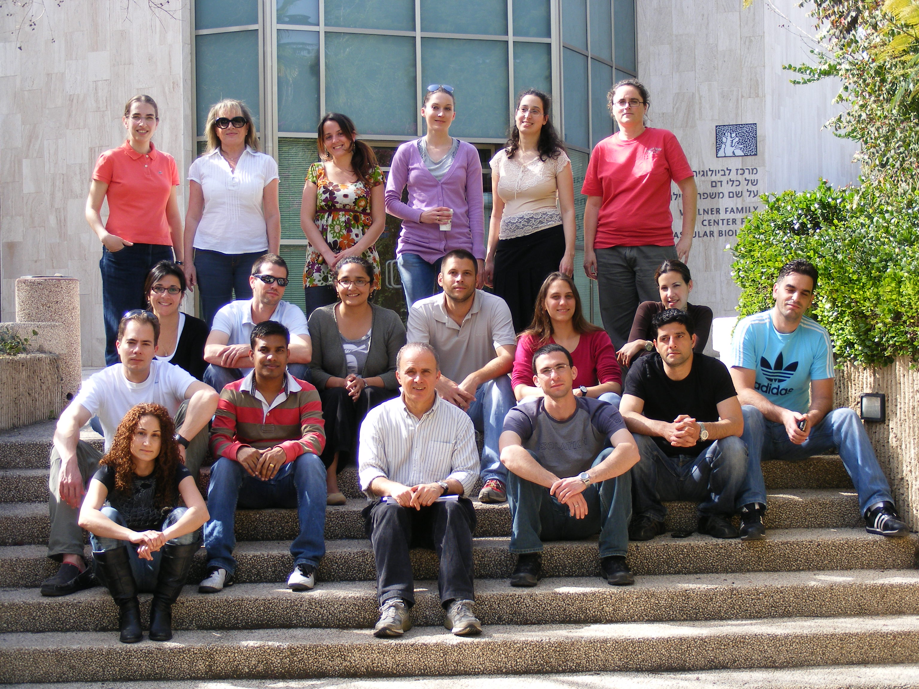

Acknowledgements
My Group | My Collaborators
Dr. Moshit Lindzen Sara Lavi Gur Pines Gabi Tarcic Dr. Esther Witsch Yaron Mosseson Roi Avraham Dr. Anna Emde Yaara Zwang Dr. Fresia Gilda Pareja Zea Dr. Pradeep chaluvally Raghavan Lilach Friedman Dr. Wolfgang Koestler Dr. Tsipi Ben-Kasus Dr. Erez Bublil Nir Ben-Chetrit Hadas Cohen Sivan Abramovitch Jean Wakim | Carlos Caldas (Cambridge, UK) Eytan Domany (WIS) Michael Sela (WIS) Moshe Oren (WIS) Stefan Wiemann (Heidelberg) Gideon Rechavi (Tel Hashomer) Roslin Russell (Cambridge, UK) Christine Desmedt (Jules Bordet) Eran Segal (WIS)) Gordon B. Mills (MDACC) Fernando Schmitt (Porto) Martine Piccart (Jules Bordet) Christos Sotiriou (Jules Bordet) Noa Bossel (WIS) Amit Zeisel (WIS) Marc Symons (Mahasset)
Past fellows
Hadassa Waterman Menachem Katz Gil Levkowitz Daniel Harari Leah Klaper Gal Gur-Shachar Mina Marmor Ariel Rinon Bose Kochupurakkal Judith Gan | Ami Citri Ido Amit Keren Shtiegman Shlomit Boguslavsky Shlomo Oved Edit Kario
Notes:
22
22

Slide 23
Let Us Meet Again
We welcome you all to our future conferences of OMICS International
Please Visit:
http://transcriptomics.conferenceseries.com/
http://conferenceseries.com/
http://www.conferenceseries.com/genetics-and-molecular-biology-conferences.php

