Slide 1
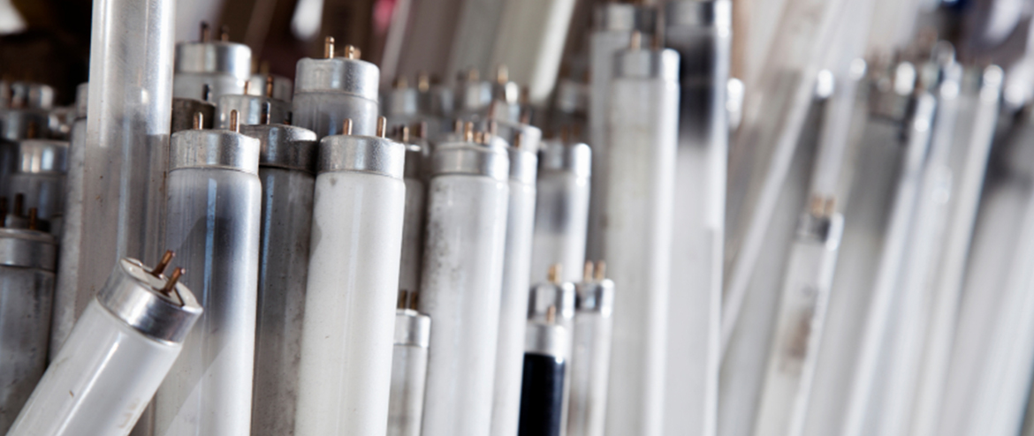
Recycling practices and material flow analysis of mercury-containing fluorescent lamps in Korea
Yong-Chul Jang
Chungnam National University, Daejeon, Korea

Slide 2

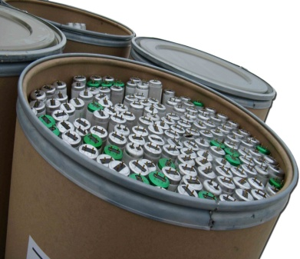
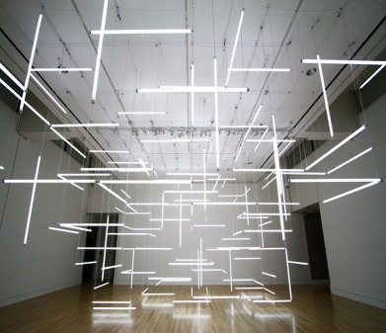
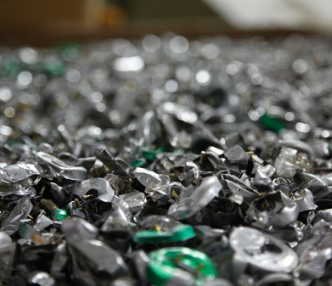
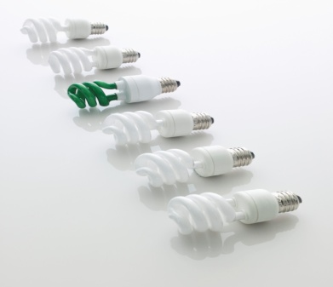
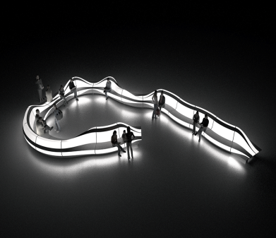
CONTENTS
4. Current issues of Spent Fluorescent Lamps management
2. EPR System of Fluorescent Lamps
1. Intro
3. MFA of Fluorescent Lamps
5. Future direction

Slide 3
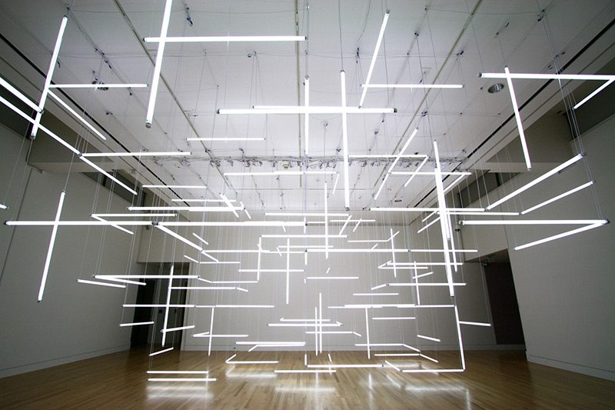
1.
Introduction

Slide 4
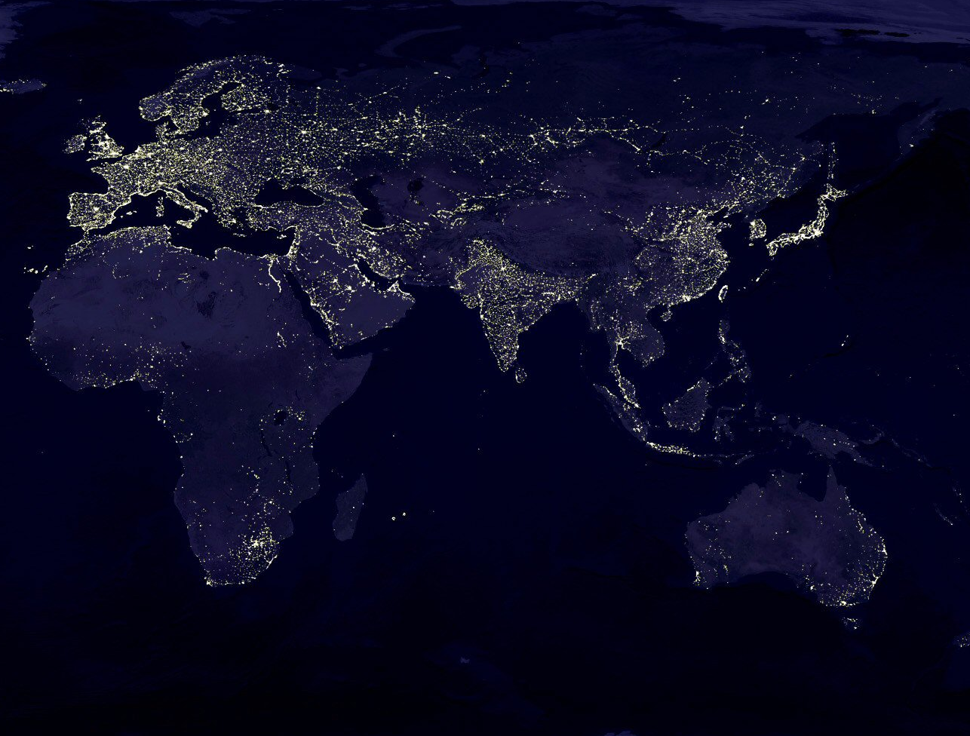

Intro.
Intro.
World General Lighting Market
4 billion pcs/ year
(Unit : million pcs)
Source : McKinsey, 2012
(Compact Flourescent lamp)
(Linear Flourescent lamp)

Slide 5
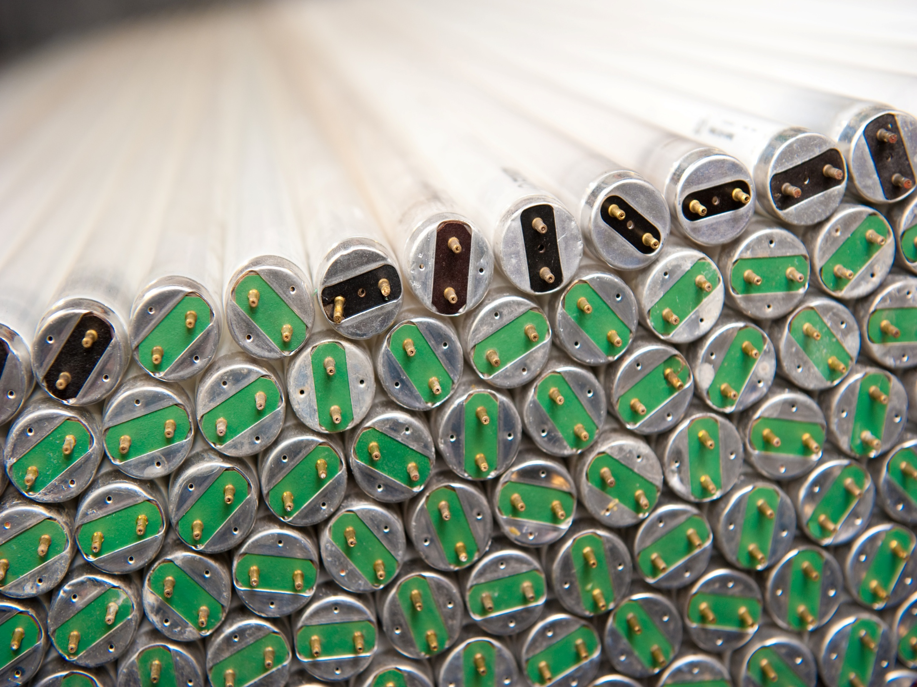
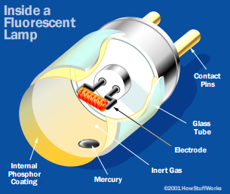
Intro.
Fluorescent lamps
Quantities of Mercury in Lamps
Type of Lamps | Avg. Amount
CFL (Compact Fluorescent Lamps) | 1-25 mg
U-Tubes FL | 3-12 mg
Fluomeric Lamps | 2 mg
LFL (Linear Flourescent Lamps) | 10-50 mg
Mercury Reduced LFL | 3-12 mg
Mercury Vapour Lamps | 25-225 mg
Metal Halide Lamps | 25-225 mg
Sodium Vapour Lamps | 20-145 mg
Source : Guide to Recycling Mercury- Containg Lamps, Northewest Territories Environment and Natural Resource

Slide 6
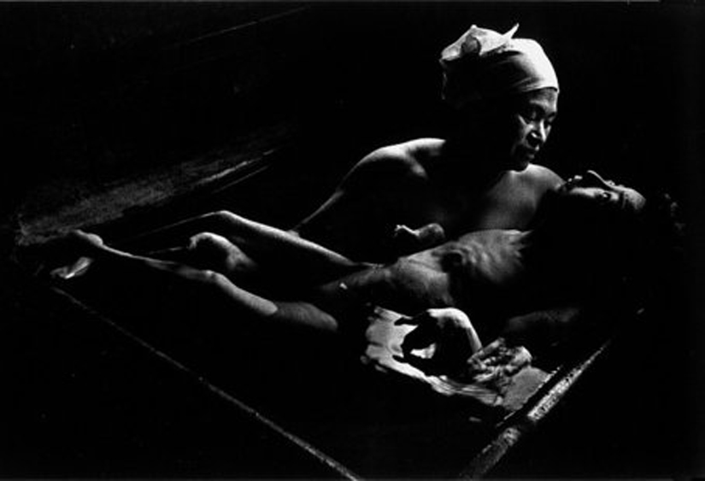

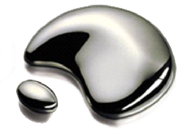
Intro.
Mercury and Minamata Convention
Elemental and inorganic
: Exposed directly through occupation
Hg
Organic (e.g., Methylmercury)
: Exposed indirectly through diet
(Bioaccumulation)
Mercury is a chemical of global concern owing to its long-range atmospheric transport, its persistence in the environment, its ability to bioaccumulate in ecosystem and its significant negative effects on human health and the environment
Recently, Minamata Convention was agreed to ban on new mercury mines, the phase-out of existing ones, control measure on air emissions in 2013.
Notes:
Mercury exists in various forms: elemental and inorganic (to which people may be exposed through their occupation); and organic (e.g., methylmercury, to which people may be exposed through their diet). These forms of mercury differ in their degree of toxicity and in their effects on the nervous, digestive and immune systems, and on lungs, kidneys, skin and eyes.

Slide 7
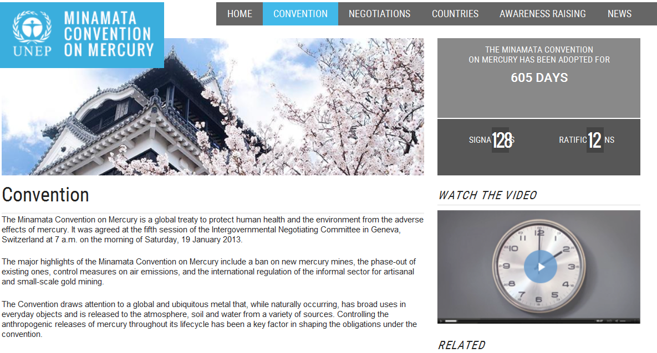
MINAMATA CONVENTION ON MERCURY
* Controlling the anthropogenic releases of mercury throughout its lifecycle has been a key factor in shaping the obligations under the convention

Slide 8
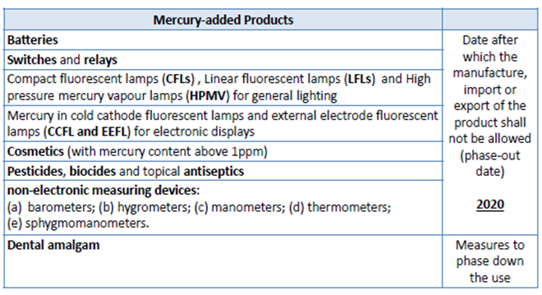
MINAMATA CONVENTION ON MERCURY

Slide 9

2.
EPR System of FL in Korea

Slide 10






EPR : Extended Producer Responsibility
EPR system is an environmental protection strategy
to decrease total environmental impact of a product,
by making the producer of the product responsible
for the entire life-cycle of the product and especially for the take-back, recycling and final disposal.
Responsibility
Production
Sale
Cosumption
Discard
Recycling
Past
Present
Notes:
Came into force

Slide 11
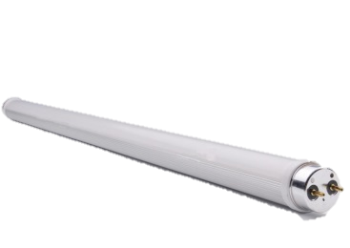
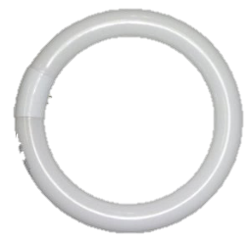
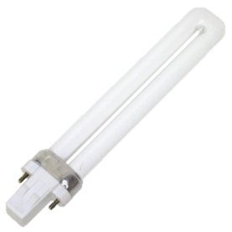
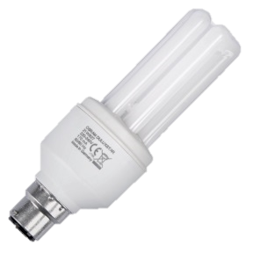
1
Recycling targets of fluorescent lamp in Korea EPR system
Linear shape (LFL) | Round shape (FCL) | U-tube shape (FPL) | Contains inverter (CFL)
In Korea, there are 4 recycling targets of FL in EPR system .
Each year, recycling target rate of used lamps is set and should be achived.

Slide 12
1w
EPR system of fluorescent lamp in Korea
Flow of product
MOE
(Ministery of Environment)
Flow of waste
Financial Flow
(Report result)
(Target rate)
Report System
Korea Environment Corperation
(Monitoring)
(Report recycling responsibility and statistics)
(Guidance)
Producers
Korea Light Recycling Cooperative
(Fund support)
Recyclers
(Share of expenses)
(Entrust)
Retailers
(Recylcing)
(Collection & Disposal Fee)
(Collection & Recycling)
Consumers
(Households)
Consumers
(Industiral)
Municipalities (Collectors)
(Source : MOE, EPR 시행 10년 성과평가 및 발전방향 연구, 2010)

Slide 13

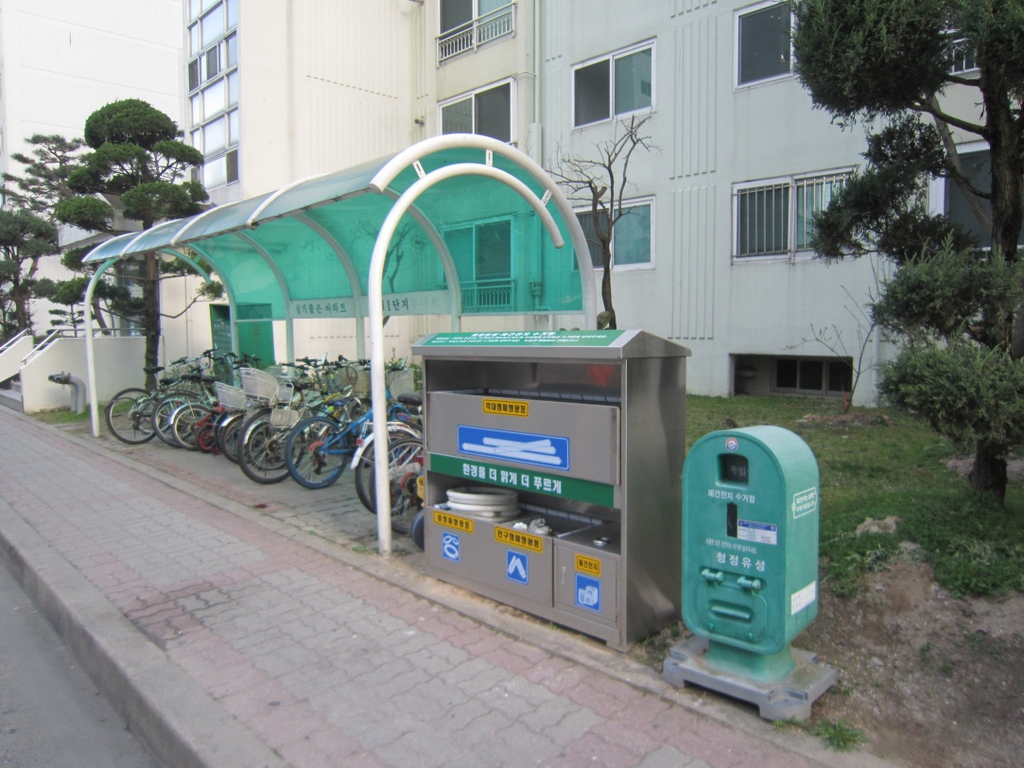
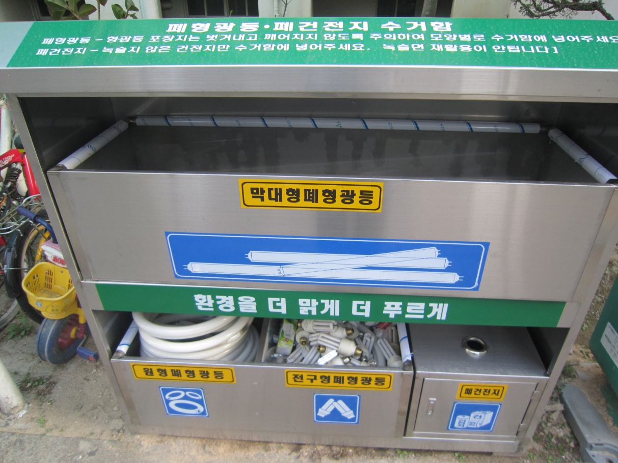

Collection points of fluorescent lamp in Korea

Slide 14
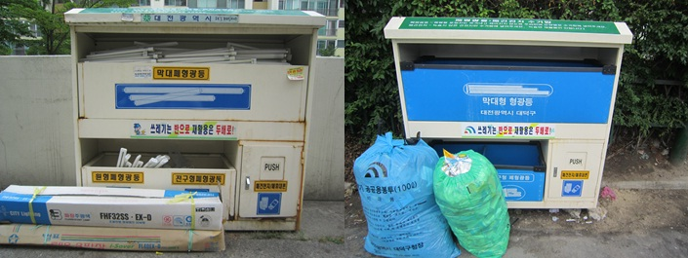
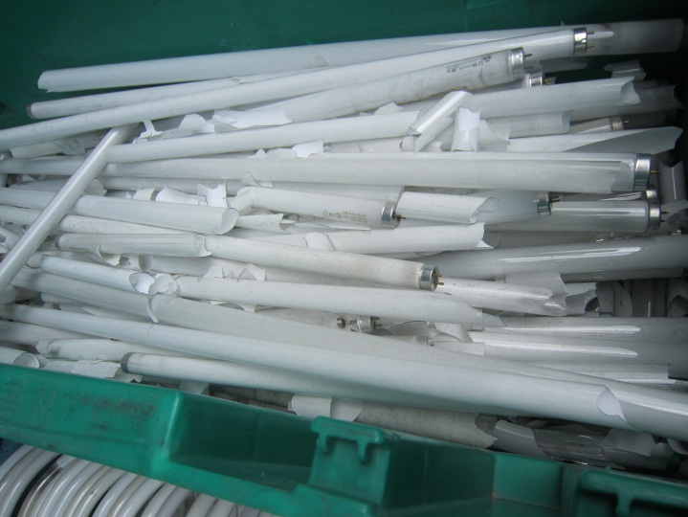
Collection points of fluorescent lamp in Korea

Slide 15
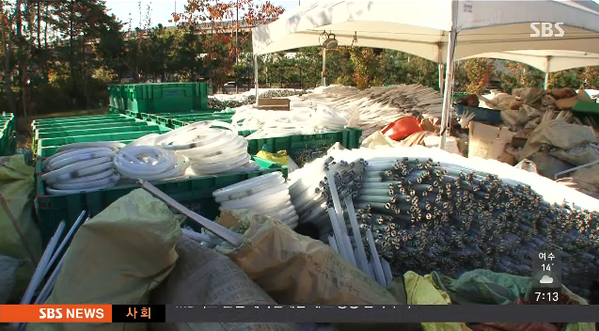
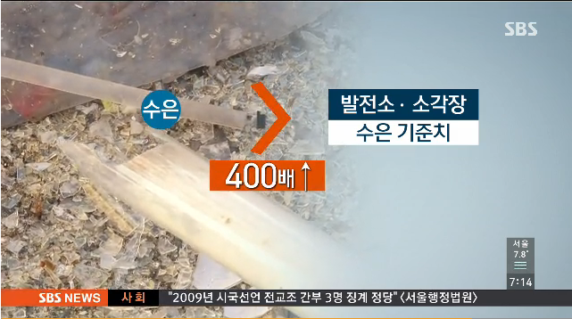
Transfer station of fluorescent lamp in local government
Mercury lamps waiting for disposal at collection site in Korea
(Source : SBS News 2014. 10. 30)
Improper disposal of mercury lamps causes a concern in community by media in 2014

Slide 16
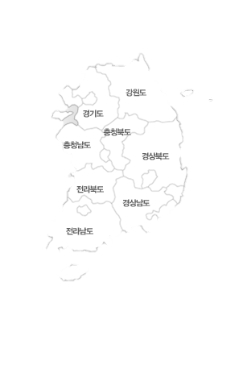
FL recycling facilities in Korea
 | Facility A | Facility B | Facility C
Equipment | Straight type 1 line other type 3 line HID type 1 line | Straight& other type 1 line | Straight& other type 1 line
Treatment Capacity | Straight type : 5,000 unit/h HID type : 2,500 unit/h | Straight & other type : 5,000 unit/h | Straight&other type : 5,000 unit/h
Treatment Technology | Modified MRT (Sweden) | Modified Herbon (Germany) | Modified Herbon (Germany)
A
B
C
Current recycling facility
Future recycling facility
There are 3 FL recycling facilities operated in Korea
3 more FL recycling facilities are planned to operate in 2015

Slide 17
General SFL recycling process in Korea
Linear Lamp Input
Other type Lamp Input
Cutting base
Shredder
Drum sorting
Drum sorter
Base outlet
Glass sorting
Mixed metal sorting
Glass heating
Powder heating
Glass cooling
Powder cooling
Mercury distillator
Fine metal sorting
Powder outlet
Mercury recovery
Source : Korea Lighting Recycling Corporation

Slide 18
Statistic Data of FL Management in Korea
(Unit : 1,000 unit)
  SFL Recycling target has been continuously increasing since 2004
  SFL recycling rate is still low compared to the amount in the market.

Slide 19

3.
MFA of lamps in Korea

Slide 20

MFA
MFA (Material Flow Analysis) is an analytical method
of quantifying flows and stocks of materials or substances
in a well-defined system.
It is based on the law of mass conservation.
MFA Definition
Defining system boundary
Selection of target material & Setting system boundary
Quantifying flow and stocks
Investigation of general material flow in each life-cycle stage
Setting data range & collection of data
Calculation & Verification of data
Result analysis
Drawing material flow diagram
<MFA Process >

Slide 21
MFA
FL
Filament lamp
High pressure
discharge lamp
Target of
MFA subject of
Fluorescent lamps
Discharging lamp
Low pressure
discharge lamp
Special FL
System boundary : Household sector
Time boundary :
1 year (2013)
Resource
Extraction
Product Manufacture
Product Use
Defining system
boundary
Waste Disposal
Waste Recycling
Waste Collection

Slide 22
MFA
Data collection & Sources for MFA of FL
Data collection : Field & Literature survey
Life cycle | Data | Data collection method
 |  | Statistics | Literature survey | Field survey & advice
Import | FL Import | ○
Production | Shipment | ○
 | FL Production·Domestic market·Export | ○
 | LED market |  | ○
Use | Household use |  | ○
 | Industrial use |  | ○
 | Stock |  |  | ○
Collection | Municipality collection | ○
 | Collection by entrustment | ○
 | Dumping |  |  | ○
Recycling | Input of RC | ○
 | Output of RC | ○
Disposal | Incineration |  | ○
 | Landfill |  | ○
▶ Data of disposal stage was not sufficent
whereas data of production stage
and recycling stage is avalilable to collect
▶ Stages difficult to collect data were estimated
through field survey, literature investigation,
expert adivce
▶ When data estimated through mass balance
had uncertainty, they were modified and
complemented with consideration of
material flow interrelationship

Slide 23

MFA
Output data
collection
Unit : 1,000 unit
 | Total Output | Import | Production | Shipment | Stock | Domestic Market | Export
2013 | 149,453 | 107,521 | 45,958 | 45,572 | 4,129 | 41,932 | 3,640
*Source : Statistics Korea, Korea Environment Corporation
  Shipment = Domestic Market + Export
  Total Output = Domestic Market + Import

Slide 24



MFA
(Household)
Disposal data
Estimation
Disposal (Unbroken) in MSW bags (7%)
Take-back to store(0.3%)
Source | Product Life time (Years)
Korean Standards & Certification | 2.47
Green Purchasing Network | 2.81
OSRAM | 5.21
Average | 3.5
others(2.7%)
Survey
Result
In Daejeon city
Product
Life Time
Collection box (83.8%)
Disposal (Broken) in MSW bags (3.2%)

Slide 25

MFA
Example-Lifetime
Produce 1000 unit/ year, Product Life time : 4 years
(Household)
Disposal data
Estimation
Disposal
1,000 FL
1,000 FL
1,000 FL
1,000 FL
Unit : 1,000 unit
1,000 FL
 | Disposal in envelope (Not broken) | Disposal in envelope (Broken) | Collection box | Take-back to the store | Etc. | Total
2013 | 3,209 | 1,406 | 36,832 | 132 | 1,187 | 42,766
2011
2012
2013
2014
2015
  The number of SFL by disposal shape was estiamted based on citizen survey
  Stock = The number of disposal × replacement period = around 149 million unit

Slide 26
MFA
(Household)
Recycling Data
collection
SFL componets by product type
Unit : g, %
SFL recycling amount by componets
 | Straight FL | Compact FL | Contains inverter | Average | % Ratio
Glass | 134.60 | 89.60 | 54.90 | 103.43 | 80.2%
Fluorescent material | 2.80 | 0.90 | 0.05 | 1.64 | 1.3%
Metal | 1.45 | 1.20 | 0.60 | 1.18 | 0.9%
Aluminum | 2.25 | - | 3.30 | 1.95 | 1.5%
Glue | 9.10 | 2.90 | 90 | 7.25 | 5.6%
Plastic | - | 9.80 | 18.90 | 7.18 | 5.6%
Inverter | - | - | 25.40 | 6.35 | 4.9%
Sum | 150 | 104 | 111 | 128.96 | 100.0%
Unit : g, %
 | % Ratio | Recycling amount | Actual result*
Glass | 80.2% | 4,447 | 4,015
Plastic | 5.6% | 308 | 372
Aluminum | 2.4% | 134 | 170
Powder | 11.8% | 655 | 469
Sum | 100.0% | 5,545 | 5,025
* Source : Korea Environment Corporation
* Source : Development of valuable material recovery technology of Waste lighting equipment, 2011

Slide 27
MFA
Import
107,521
Unit | 1,000
Time | 2013
Total
Domestic demands
149,453
Generation from home
42,766
Collection box
36,832
Collection by city
36,964
Recycling
36,964
glass
4,447 ton
Production
45,958
Shipment
45,572
Domestic demands
41,932
plastic
308 ton
Use in home
140,226
Al
134 ton
Retailers
132
particulate
665 ton
Storage
386
Disposal bag with broken 1,406
Incineration
3,481
Disposal bag
3,209
landfills
2,321
Others
1,187
Export
3,640
Hidden flow
Sold to industrial sector
106,687
Collectors
5,743
Recycling
5,743
Solid waste
Disopsal

Slide 28

4.
Current issues of lamps
Management in Korea

Slide 29

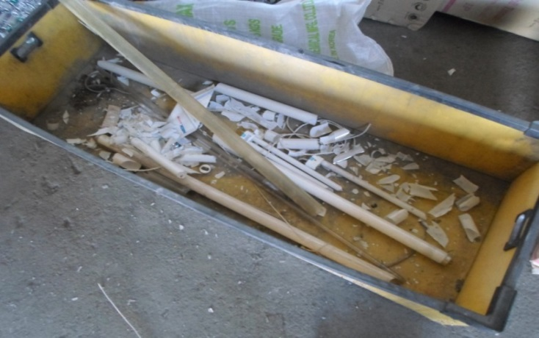
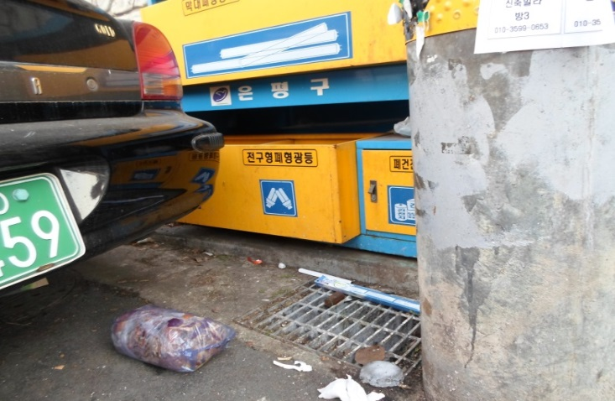
Disposal
Stage
If SFLs are discharged in broken shape, mercury vapor will be exposed to the surrounding environment
Mixed waste in SFL collection box caused additional cost and labor force on segregation and collection stage

Slide 30


Current issues of SFL Management in Korea
Collection
Stage
74% Recycling rate
Unit : 1,000 unit
Household
 | Generation | Recylcing
Household | 50,000 | 36,964
Industrial | 100,000 | 5,793
Industrial
6% Recycling rate
Recycling rate from industrial sectors is relatively low compared to household sectors

Slide 31






Transportation
Stage
Transportation cost is high because of long distance from municipality to recycling facility
Cumulated SFL have been issued in capital region because of high transportation cost and long distance

Slide 32

Recycling
Stage
Mercury concentration in recovery materials was higher than standard level(0.005mg/L)
There is no regulation on mercury concentration in recovery materials of SFL
Mercury concentration in workplace atmosphere was higher than OSHA PEL standard in US (lower than 0.1 mg/m³ every moments)
Management of elemental mercury storage and transportation was incomplete
Introdunced recycling technology from abroad was modified or some facilities are eliminated for convenience

Slide 33
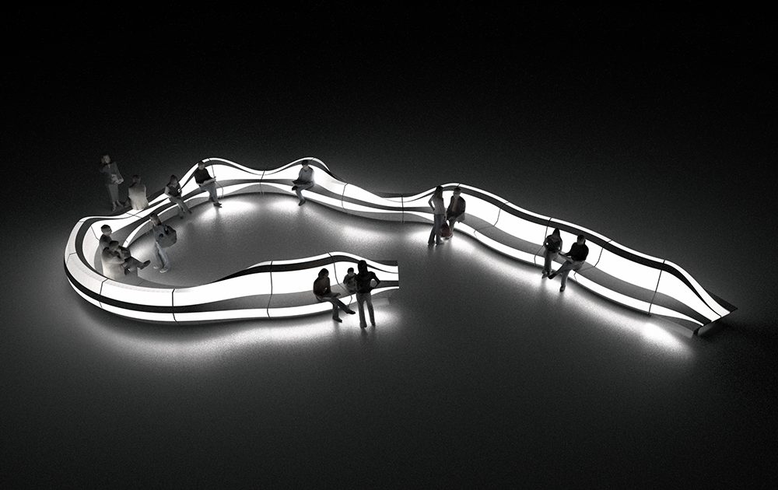
5.
Future Directions
and summary

Slide 34
Future Direction
Remediation direction of SFL management
Short term
Mid term
Long term
Establishment of more effective collection system for SFL of industrial sector
Expension of EPR subjectlamp containing mercury
Addition of LED lamp to the EPR system
Disposal
stage
Installation more collection box for residents availablity
Establishment of take-back system for retailers
Management of SFL of industrial sector to the industrial waste registration system
Collection
stage
More strict recycling guidlines
Establishment of safe recovery and recycling foundation for mercury
Development of recyling technology for LED lamp
Recycling
stage

Slide 35
Future Direction
Current states and anticipation of the world LED industry
(Trillion won)
(%, triilion won)
Replacement
Scale of entire lamp market
75
New installation
Scale of LED lamp market
170
Market share of LED
160
52
42.9
147
34.6
138
143
127
131
134
28
27.4
123
20.3
21
15.5
15
128
9.2
9
4
6
83
2
30
41
2
5
8
12
21
2011
2012
2013
2014
2015
2016
09
10
11
12
13
14
15
18
20
(Year)
(Source : Meritz Investment Bank Research Center)
LED lamp market is anticipated to sharply grow with decreasing LED price and impelmentation of carbon emission trading system
Life-time of LED lamp (30,000-50,000 hours) is 3~4 times longer than that of fluorescent lamp (8,000 hours)

Slide 36
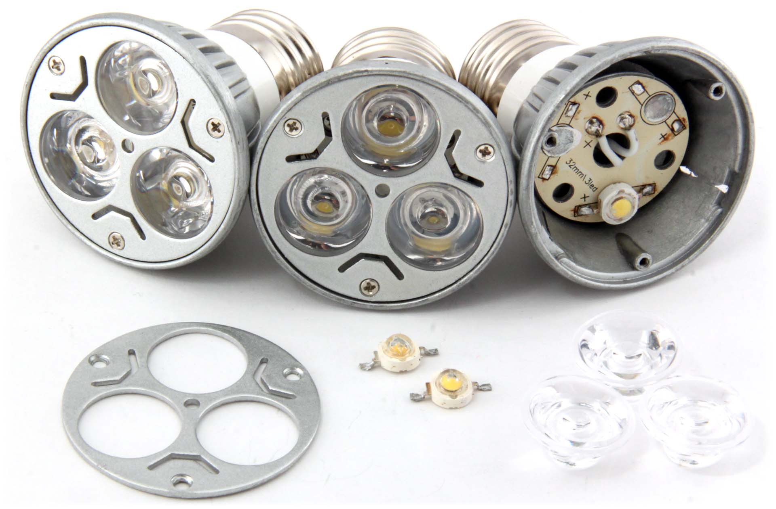
Future Direction
LED lamp
Even though LED lamp doesn’t contain Mercury, it has hazardous and valuable materials such as antimony, copper, lead, nickel, and zinc
In some crushed specimen, leaching test results showed some concerns of leaching due to several hazardous materials found in LED lamp (Lim et al., 2010)
Some EU country have already been implementing LED recycling duty with fluorescent lamp
It may be required to add LED lamp to the EPR system and establish appropriate management directives

Slide 37
Thank you for your attention !

Slide 38
Q&A

