Slide 1

About OMICS Group
OMICS Group International is an amalgamation of Open Access publications and worldwide international science conferences and events. Established in the year 2007 with the sole aim of making the information on Sciences and technology ‘Open Access’, OMICS Group publishes 400 online open access scholarly journals in all aspects of Science, Engineering, Management and Technology journals. OMICS Group has been instrumental in taking the knowledge on Science & technology to the doorsteps of ordinary men and women. Research Scholars, Students, Libraries, Educational Institutions, Research centers and the industry are main stakeholders that benefitted greatly from this knowledge dissemination. OMICS Group also organizes 300 International conferences annually across the globe, where knowledge transfer takes place through debates, round table discussions, poster presentations, workshops, symposia and exhibitions.

Slide 2
About OMICS Group Conferences
OMICS Group International is a pioneer and leading science event organizer, which publishes around 400 open access journals and conducts over 300 Medical, Clinical, Engineering, Life Sciences, Pharma scientific conferences all over the globe annually with the support of more than 1000 scientific associations and 30,000 editorial board members and 3.5 million followers to its credit.
OMICS Group has organized 500 conferences, workshops and national symposiums across the major cities including San Francisco, Las Vegas, San Antonio, Omaha, Orlando, Raleigh, Santa Clara, Chicago, Philadelphia, Baltimore, United Kingdom, Valencia, Dubai, Beijing, Hyderabad, Bengaluru and Mumbai.

Slide 3

Y. ADIGUZEL, 12.08.2014
Progress on the Studies on Visual Detection and Surface Modification Testing of Glass Microfiber Filter Based Biosensor
Yekbun ADIGUZELª, Haluk KULAH^{b,c}
ª Department of Biophysics, School of Medicine, Istanbul Kemerburgaz University, Mahmutbey Dilmenler Caddesi, No:26, 34217 Bagcilar, Istanbul, Turkey; email: yekbun.adiguzel@kemerburgaz.edu.tr
^{b} METU-MEMS Research and Application Center, Middle East Technical University
(METU), Ankara, Turkey; email: kulah@metu.edu.tr
^{c} Electrical and Electronics Engineering Department, Middle East Technical University (METU), Universiteler Mah., Dumlupinar Bulv. No: 1, 06800 Cankaya, Ankara, Turkey

Slide 4
Summary of Previous Work
Y. ADIGUZEL, 12.08.2014
► Surface of glass microfiber paper was modified with 3- aminopropyltriethoxysilane (APTES) and was suggested to be used as a biosensor in this surface-modified form.
► As an application, visual detection of the surface- immobilized yeast cells was achieved by Gram staining and shown to be increasing by modification with APTES. (This’ll not be presented here.)
► DNA detection was performed by using unmodified and APTES-modified surface as well and visualized with YOYO-1 fluorescence upon 200 nM double stranded DNA binding.
► Surface adsorption tendency of YOYO-1 was offered as a testing method of proper surface coverage, for sensors with glass-based active surfaces.

Slide 5
Materials & Methods
Y. ADIGUZEL, 12.08.2014
► Fluorescent microscope images were captured at 200 ISO, with the GFP filter. Brightness of the images was increased 64 %, for clarity.
► Invalid regions were removed from the original images.
► YOYO-1 concentration in the controls were 3 folds more, as a result of experimental procedure. Brightness of the relevant images were reduced 66 %, to equilibrate YOYO-1 intensities.
► RGB profiles were plotted on a descending diagonal line that was drawn on the images, with the plugin tools of the ImageJ 1.47v.
Y. Adiguzel and H. Kulah, (2014) Biosens. Bioel. 54:27.

Slide 6
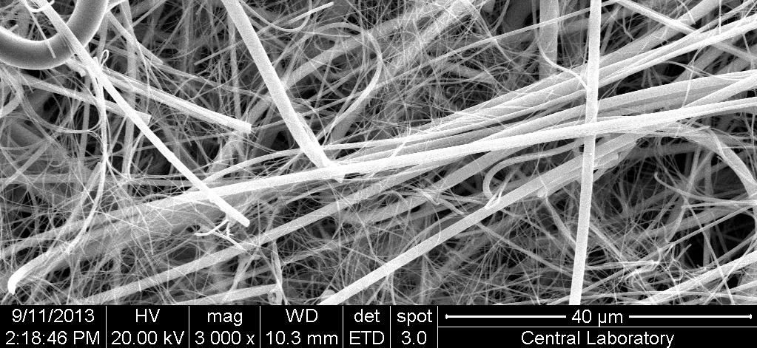
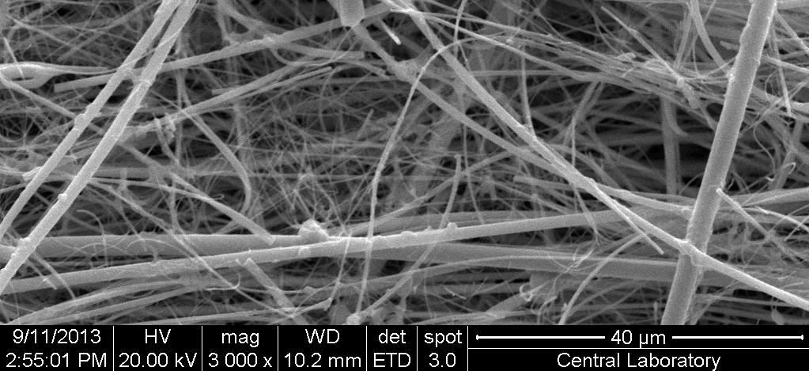



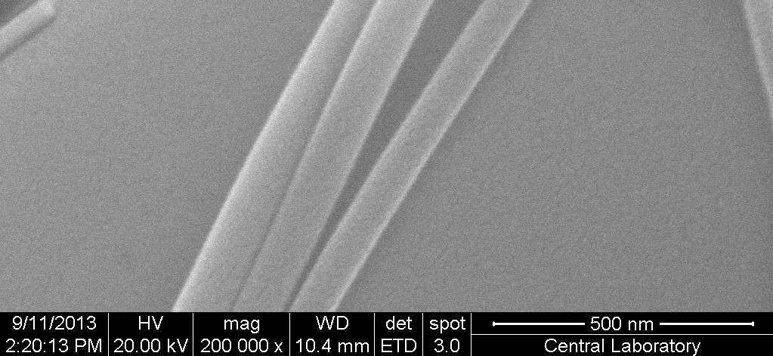
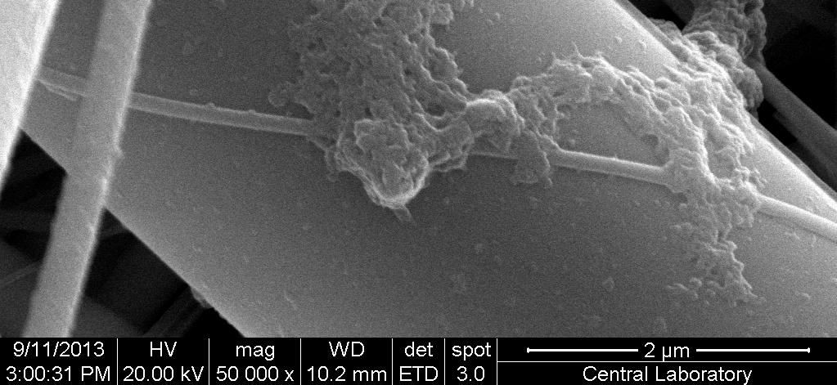



Results
Y. ADIGUZEL, 12.08.2014
APTES Modification of the Surface −
Scanning electron microscopic (SEM) characterization by QUANTA 400F Field Emission SEM of the Middle East Technical University,
Central Lab:
Unmodified surface
40
µm
APTES-modified surface
40
µm
0.5 µm
2
Unmodified surface APTES-modified
SEM images of unmodified and AP^{s}T^{u}E^{rfa}S^{c}-modified glass microfiber paper surfaces. Samples were coated with gold-palladium.

Slide 7

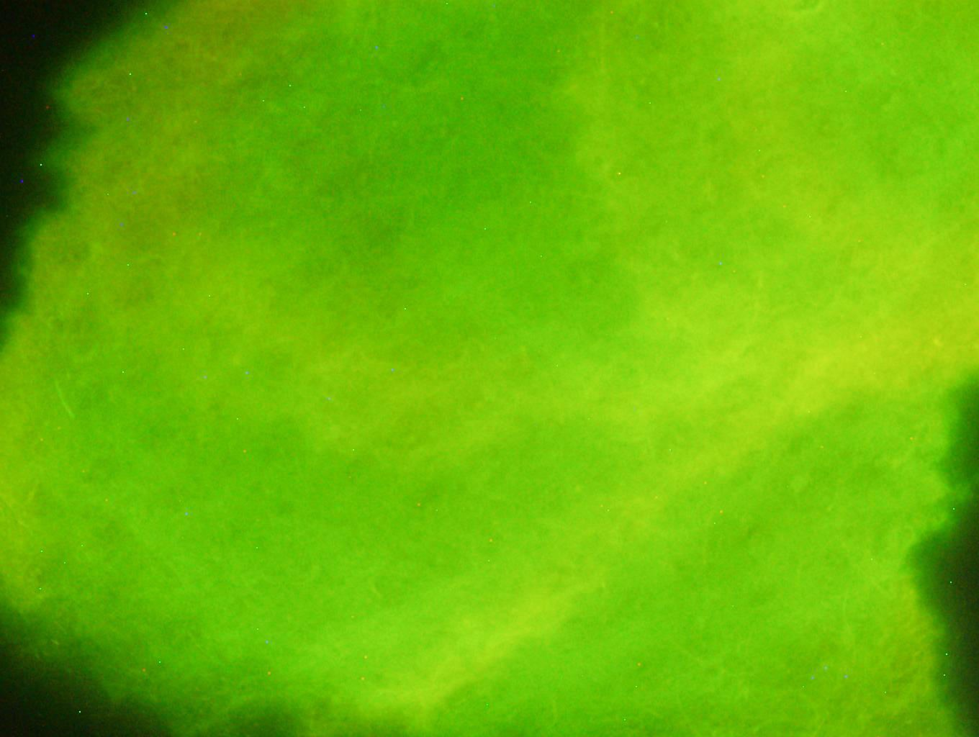

Results
Y. ADIGUZEL, 12.08.2014
*
* “Different treatment” stands for: Presence or absence of APTES- modification; or application of YOYO-1 preliminary to DNA; or changing incubation durations after washing, following treatments.
Background Image: Exemplary image for YOYO-1 interaction with DNA on glass microfiber filter paper.

Slide 8
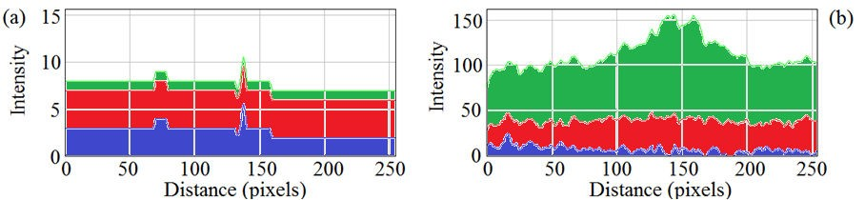
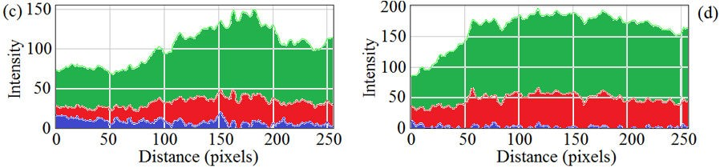
Y. ADIGUZEL, 12.08.2014
(Figure 1)
RGB profile plots of fluorescent microscope images of APTES-modified samples that were treated with YOYO-1 only, or YOYO-1 and DNA, in the given order, followed by washing and incubation.
RGB profile plots of the data, published in Y. Adiguzel and H. Kulah, (2014) Biosens. Bioel. 54:27.

Slide 9
Interpretation of Figure 1
Y. ADIGUZEL, 12.08.2014
► YOYO-1 leads to a characteristic green fluorescence, when intercalated into the double-stranded DNA, as can be seen through the green channel values in (a) compared to the rest.
RGB profile plots of the data, published in Y. Adiguzel and H. Kulah, (2014) Biosens. Bioel. 54:27.

Slide 10
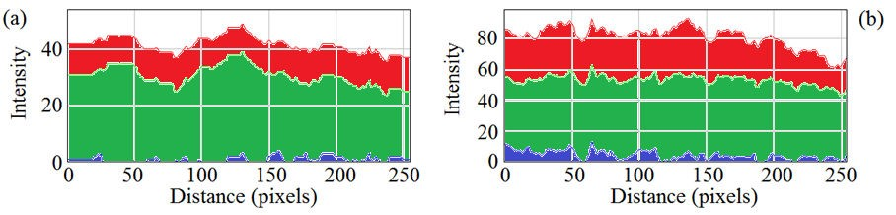


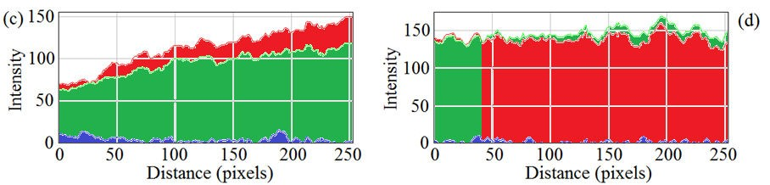
RGB profile plots of fluorescent microscope images of unmodified samples that were treated with YOYO-1 only, or YOYO-1 and DNA, in the given order, followed by washing and incubation.
Y. ADIGUZEL, 12.08.2014
(Figure 2)
RGB profile plots of the data, published in Y. Adiguzel and H. Kulah, (2014) Biosens. Bioel. 54:27.

Slide 11
Interpretation of Figure 2
Y. ADIGUZEL, 12.08.2014
► Green YOYO-1 fluorescence was accompanied and even dominated by red fluorescence, when surface was unmodified. Intensity of these fluorescence signals rose with DNA addition.
RGB profile plots of the data, published in Y. Adiguzel and H. Kulah, (2014) Biosens. Bioel. 54:27.

Slide 12
Y. ADIGUZEL, 12.08.2014
RGB profile plots of fluorescent microscope images of YOYO-1 on APTES-modified versus unmodified samples.
(Figure 3)
Interpretation of Figure 3
► Green YOYO-1 fluorescence was accompanied by red fluorescence, when surface was unmodified, due to adsorption of YOYO-1 directly onto the glass surface.
► Apt coverage of the glass surfaces is important for surface modifications and following interaction kinetics.
► So, YOYO-1 can be used to test proper surface coverage.
RGB profile plots of the data, published in Y. Adiguzel and H. Kulah, (2014) Biosens. Bioel. 54:27.

Slide 13
Conclusions of the Previous Work
Y. ADIGUZEL, 12.08.2014
► YOYO-1 leads to green fluorescence, when intercalated into double-stranded DNA, on APTES-modified glass surface.
► Sensitivity was found to be 2 nM (Data was not presented here.)
► YOYO-1 sourced emission remained with little intensity loss, after sample washing and incubation for 2.5 h more. This loss was remediated till 15 h.
► YOYO-1 fluorescence was accompanied and dominated by red fluoresĐeŶĐe, wheŶ surfaĐe was uŶŵodified. It’s proďaďle that this was sourced by YOYO-1 adsorption on surface.
► YOYO-1 sourced emission did not undergo any intensity
loss, after sample washing and incubation for 2.5 h more.
► Apt coverage of the glass surfaces is important for surface modifications and following interaction kinetics.
► YOYO-1 can be used to test proper surface coverage.
Y. Adiguzel and H. Kulah, (2014) Biosens. Bioel. 54:27.

Slide 14
Y. ADIGUZEL, 12.08.2014
Further Analysis:
Analysis of R/G Mean
Ratios

Slide 15
Further Analysis:
Y. ADIGUZEL, 12.08.2014
Analysis of R/G Mean Ratios
Materials & Methods −
► Fluorescent microscope images were captured at 1600 ISO and 200 ISO, with the GFP filter.
► Invalid regions were removed from the original images.
► YOYO-1 concentration in the controls were 3 folds more, due experimental procedure. Brightness of relevant images were reduced 66 %, to equilibrate YOYO-1 intensities.
► RGB profiles were plotted on a descending diagonal line that was drawn on the images, with the plugin tools of the ImageJ 1.47v.
► R/G mean ratios were calculated from the RGB mean values of the color histogram results, which was obtained by using the color histogram plugin of ImageJ 1.47v.

Slide 16
Y. ADIGUZEL, 12.08.2014
Changes in R/G Mean Ratios by Exposure
YOYO-1 on APTES- modified samples | Change in the R/G mean ratio of images, when measured with 200iso, after the 1600iso measurements
 | 0 min incubation | 1 min incubation | 1 h incubation | 4 h incubation | 12 h incubation
Before washing (1st test) | ⇧ from 1.46 to 1.53 | ⇧ from 1.00 to 1.23 | ⇧ from 1.05 to 1.25 | ⇧ from 1.04 to 1.11 | ⇩ from 0.93 to 0.91
Before washing (2nd test) | ⇧ from 1.02 to 1.54 | ⇧ from 1.00 to 1.23 | ⇧ from 1.04 to 1.23 | ⇧ from 0.99 to 1.02 | ⇩ from 0.93 to 0.92
After washing (1st test) | ⇧ from 1.02 to 1.55 | ⇧ from 1.09 to 1.22 | ⇧ from 1.04 to 1.22 | ⇧ from 0.77 to 0.78 | ⇩ from 0.75 to 0.69
After washing (2nd test) | ⇧ from 1.02 to 1.54 | ⇧ from 1.00 to 1.22 | ⇧ from 1.06 to 1.17 | ⇧ from 0.68 to 0.70 | ⇩ from 0.74 to 0.70

Slide 17
Discussion for Further Analysis
Y. ADIGUZEL, 12.08.2014
► During imaging, changing the ISO from 1600 to 200, decreases the exposure 8 folds. This change is normally not expected to influence R/G mean ratios of the RGB values.
► When imaging YOYO-1 fluorescence on the APTES- modified samples, decreasing the exposure level 8 folds increased the R/G mean ratios, for the measurements including and until the one at 4 h of incubation.
► Conversely, decreasing the exposure level 8 folds lead to diminished R/G mean ratios, in case of 12 h incubation.
► This latter observation could have implications in YOYO-1 interaction with the surfaces and DNA, such as differences in the fluorescent emission gains of molecules, or varying emission gains of the same molecule at diverse wavelengths.

Slide 18
Y. ADIGUZEL, 12.08.2014
Paper-Based Microfluidics
Previous Studies −
► Oyama et al. [(2012) Lab Chip 12:5155)] previously reported electroosmotic lateral flow immunoassay, with glass fiber sheets.
► In relation to this work, they confirmed the linear relationship between the concentration of analyte and the resulting fluorescence intensity from the immunoassay of C-reactive protein and insulin.
► Fang et al. [(2014) Lab Chip 14:911)] reported paper-based microfluidics with high resolution cut on a glass fiber membrane for bioassays.
► Microchannels were produced with a common cutter.
► By this means, they created a star micro-array format
of multiplexed urine tests.

Slide 19


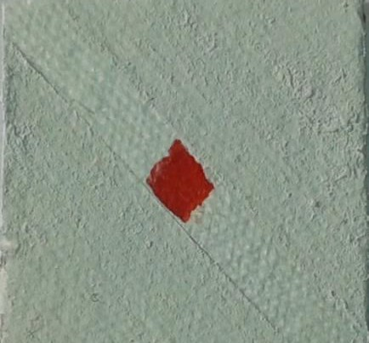


Y. ADIGUZEL, 12.08.2014
Paper-Based Microfluidics
Current Approach −
► It is possible to realize glass microfiber filter paper-based microfluidics approaches, utilizing both sides of the filter paper to built interconnected fluid channels.
► Accordingly, water-based dye, applied form a macro channel on the front side of the glass microfiber paper, is transmitted to the back side, only at the cross-section of another channel, diagonal to the one on the front:
Channel at the back side
Channel on the front side
2.5 cm
► MEMS-based coating is likely to overcome this limitation.

Slide 20
Summary
Y. ADIGUZEL, 12.08.2014
► Progress on the Studies on Visual Detection and Surface Modification Testing of Glass Microfiber Filter Based Biosensor is presented through:
1-) Data of the previous work for DNA detection by YOYO-1 fluorescence on glass microfiber paper [Y. Adiguzel and H. Kulah, (2014) Biosens. Bioel. 54:27], which was presented & discussed through the re-drawn RGB profile plots of the data.
2-) Performing further analysis of the data, by calculating the R/G mean ratios. R/G mean ratios were changing, along with the ISO level that resulted in 8 folds less exposure. This outcome can have relevance to some physical phenomena, and YOYO-1 interaction kinetics with DNA.
3-) Initial and early paper-based microfluidics approaches that
are utilizing glass microfiber papers were presented.

Slide 21
Acknowledgments
Y. ADIGUZEL, 12.08.2014
We would like to thank to the:
► European Union 7th Framework Program, Capacities Special Program - "Research Potentials" area (REGPOT), by the framework of call: FP7-REGPOT- 2009-1 "METU-MEMS Research and Applications Center (METU-MEMS)“, for financial support.
► Istanbul Kemerburgaz University, for financial
support.
► BioMEMS group of METU-MEMS.

Slide 22
Let Us Meet Again
We welcome you all to our future conferences of OMICS Group International
Please Visit:
www.omicsgroup.com
www.conferenceseries.com
www.pharmaceuticalconferences.com

