Slide 1
Cyanidin-3-O-glucoside ameliorates lipid and glucose accumulation in C57BL/6J mice via activation of PPAR-α and AMPK
3rd International Conference and Exhibition on
Nutrition & Food Sciences
September 23-25, 2014 Valencia, Spain
Food Biomedical Science Lab.
Yaoyao Jia
Sep 23th, 2014

Slide 2
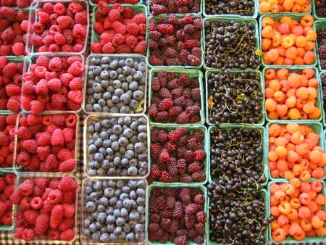
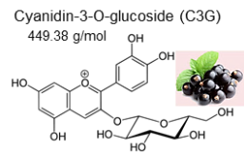
Background
Natural organic pigment
Antioxidant
Anti-inflammatory effects
↓ Cardiovascular Diseases
↓ Cancer
↓ Obesity
↓ Diabetes
characteristics
functions
Grapes
Berries
Cherries
Apples
Plums
Red cabbage
Red onion
?
Molecular target
objectives
To investigate the effects and molecular mechanisms of cyanidin-3-O-glucoside (C3G)

Slide 3
Background
Exercise
(muscle stimulation)
Berries containing C3G regulate lipid and glucose metabolisms
Nucleus
AMP:ATP ratio↑
ligands
Thr172
P
Lipid metabolism
Glucose metabolism
α
β
γ
PPRE
AMPK
Peroxisome proliferator-activated receptors (PPARs):
Nuclear receptors
Containing 3 isoforms: PPARα, PPARγ, PPARδ/β
PPARα:
A major regulator of lipid metabolism in the liver
Fatty acid uptake (fatty acid transport)
Fatty acid utilization (fatty binding and activation)
Fatty acid catabolism (peroxisomal and mitochondrial fatty acid β-oxidation)
Ketogenesis
Triglyceride turnover
Ligands:
Synthetic ligands include the fibrate drugs (hyperlipidemia)
Endogenous ligands include fatty acids and various fatty acid-derived compounds
AMP-activated protein kinase (AMPK):
An enzyme plays a role in cellular energy homeostasis
Consists of three proteins (subunits): α, β, and γ
Three subunits together make a functional enzyme
AMPK:
Stimulate:
Fatty acid oxidation
Ketogenesis
Inhibit:
Lipogenesis
Triglyceride synthesis
Gluconeogenesis
* RXR: retinoid X receptor
PPRE: peroxisome proliferator hormone response elements

Slide 4
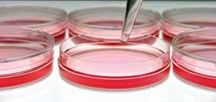
Experimental design
Molecular targets of C3G
BIAcore Surface plasmon resonance (SPR)
Time resolution-fluorescence resonance energy transfer (TR-FRET) coactivator assay
AMPK activity assay
Animal/cell experimental design
Lipid contents
Fatty acit oxidation/synthesis
Autophagy analysis
Gluconeogenesis
Lipid-loading for 24 h
Treatment with C3G for 24 h
HepG2 cells
Sacrifice
Sample (plasma & organs) collection
HFD: High fat diet (45%)
FF: 100 mg/kg body weight of fenofibrate (FF)
C3G: 100 mg/kg body weight of cyanidin-3-O-glucoside (C3G)
Physiological relevance & molecular mechanisms of C3G
Body & organ weight measurement
Plasma lipid, glucose, insulin & hormone measurement
Liver & adipose tissue histology & analysis
Liver lipid concentration measurement
Oral glucose tolerance test (OGTT)
Insulin tolerance test (ITT)
Autophagy pathway analysis
qPCR & immunobloting

Slide 5
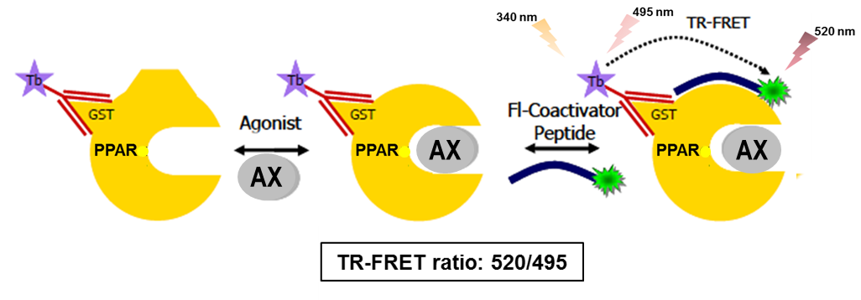
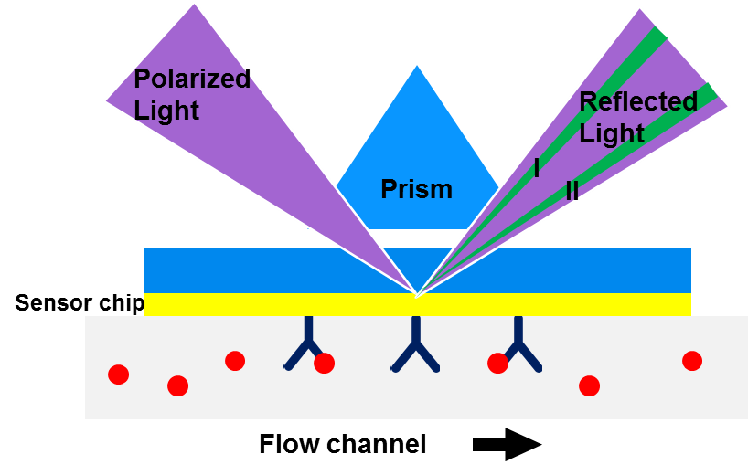
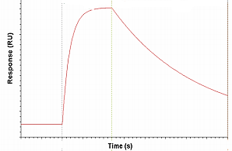
C3G induces PPARα coactivator activity via direct binding to PPARα
A
Time resolution-fluorescence resonance energy transfer (TR-FRET) coactivator assay
Surface Plasmon Resonance (BIAcore SPR)
C3G
C3G
C3G
B
K_{D} values and EC₅₀ values of C3G and positive controls
 | C3G |  |  | Positive controls
 | PPARα | PPARγ | PPARδ | PPARα | PPARγ | PPARδ
 |  |  |  | GW7647 | TT | GW0742
SPR | 456 nM | 1.36 μM | 4.96 μM | 13.2 nM | 377 nM | 102 nM
TR-FRET | 1126 nM | 10.8 µM | 31.05 μM | 26.9 nM | 82.3 nM | 10.25 nM
C
K_{D}, the equilibrium dissociation constant ('binding constant');
EC₅₀, Half maximal effective concentration
D

Slide 6
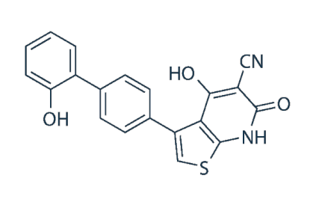
C3G induces AMPKα1 activity via direct interaction with AMPKα1
A
B
AMPK
α
β
γ
A-769662
EC₅₀ (nM) | A1/B1/G1 | A2/B1/G1
A-769662 | 262 | 457
C3G | 599 | 1010
C3G directly activates PPARα and AMPK

Slide 7
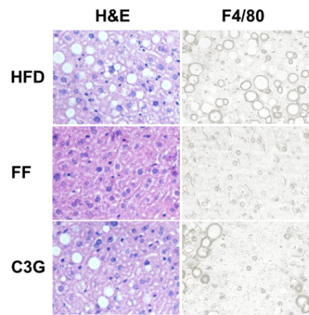
C3G reduces lipid accumulation in mouse livers & hepatocytes
A
B
C
D
AST, Aspartate Aminotransferase;
ALT, Alanine Aminotransferase

Slide 8
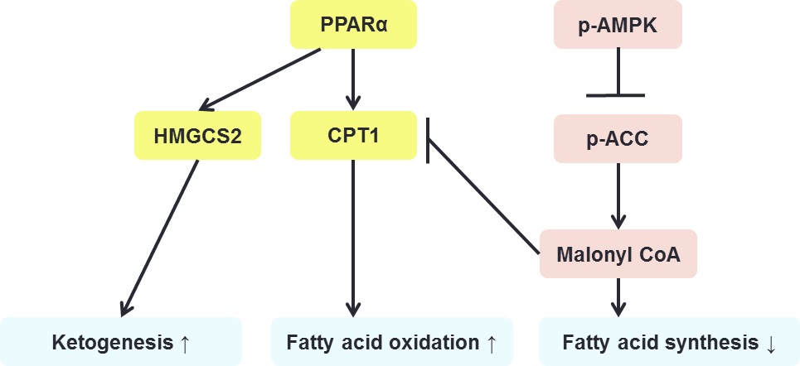
C3G induces hepatic fatty acid oxidation and ketogenesis while decreases fatty acid synthesis via regulation of PPARα & AMPKα1
A
B
C
D
E
C3G reduces lipid accumulation via increases fatty acid oxidation, ketogenesis, whereas inhibits fatty acid synthesis
ACC, acetyl-CoA carboxylase
CPT1, carnitine palmitoyltransferase 1;
LPL, lipoprotein lipase;
HMGCS2, 3-hydroxy-3-methylglutaryl-CoA synthase 2

Slide 9
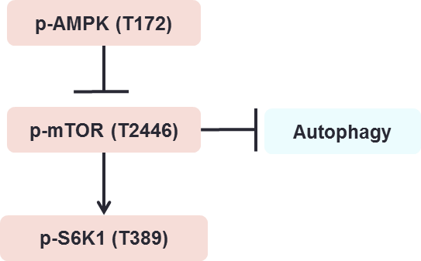
C3G induces phosphorylation of AMPK thus blocks the mTOR-S6K1 axis
HFD
FF
C3G
p-AMPK^{T172}
AMPK
p-mTOR^{T2446}
mTOR
p-S6K1^{T389}
S6K1
β-actin
mTOR, mammalian target of rapamycin; S6K1, P70-S6 Kinase 1

Slide 10
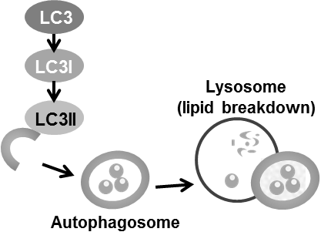
C3G induces hepatic autophagy pathway
A
B
C
GW7647 C3G (µM)
HFD FF C3G
C 1 10 50
LC3I
LC3II
LC3I
LC3II
β-actin
α-tubulin
D
C3G reduces lipid accumulation via activates hepatic autophagy pathway
STF, STF-62247

Slide 11
C3G reduces plasma glucose & insulin concentrations and improves insulin sensitivity
A
B
C
D
HOMA-IR, Homeostatic Model Assessment - Insulin Resistance;
AUC, Area under the curve

Slide 12
C3G reduces gluconeogenesis
A
B
CE-TOF & QqQMS：Selected component analysis

Slide 13
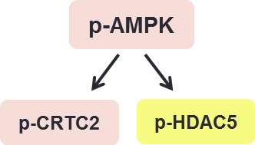
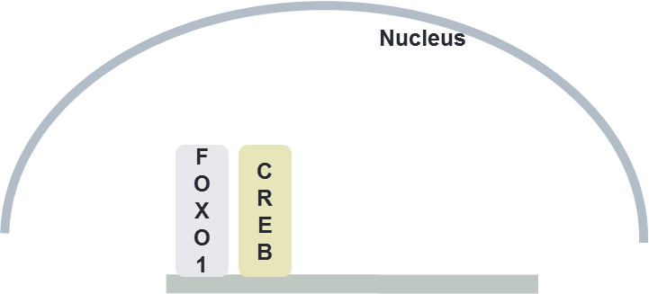
C3G reduces gluconeogenesis via increases plasma adiponectin concentration & inhibits FOXO and CREB activity
A
HFD
FF
C3G
p-AMPK
AMPK
HDAC5
CRTC2
p-CRTC2
CRTC2
X
p-HDAC5
PEPCK
G6Pase
HDAC5
β-actin
B
C
C3G reduces glucose accumulation via inhibits hepatic gluconeogenesis
FOXO1, Forkhead box protein O1; CREB, cAMP response element-binding protein; HDAC5, Histone deacetylase 5; CRTC2, CREB regulated transcription coactivator 2; PEPCK, Phosphoenolpyruvate carboxykinas; G6Pase, Glucose 6-phosphatase

Slide 14
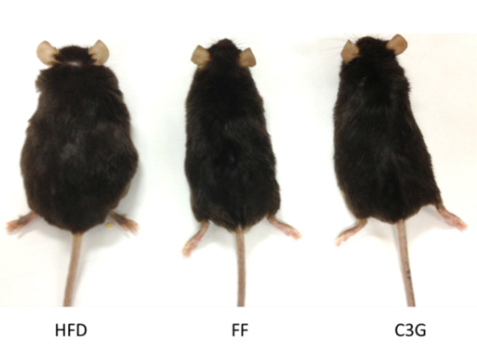
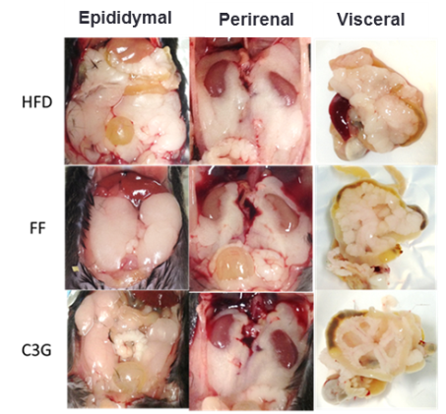
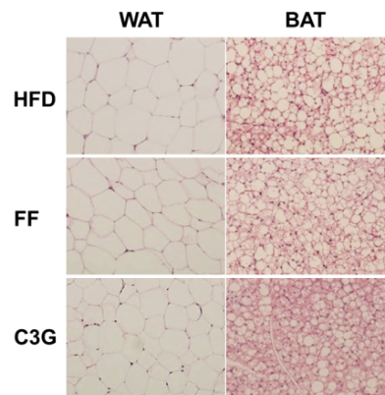
C3G reduces body weight, visceral fat weight & adipocyte size
A
B
C
Organ weight of mice
 |  | HFD |  |  | FF |  |  | C3G
Epididymal Fat (g) | 2.45 | ± | 0.16ª | 2.43 | ± | 0.26ª | 2.41 | ± | 0.19ª
Visceral Fat (g) | 1.67 | ± | 0.11ª | 0.71 | ± | 0.09^{bc} | 0.98 | ± | 0.19^{c}
Perirental Fat (g) | 1.52 | ± | 0.10ª | 1.02 | ± | 0.09^{bc} | 1.19 | ± | 0.15^{ac}
Total White Adipose Tissue (WAT, g) | 5.63 | ± | 0.20ª | 4.16 | ± | 0.42^{bc} | 4.58 | ± | 0.52^{ac}
Brown Adipose Tissue (BAT, g) | 0.29 | ± | 0.03^{ab} | 0.22 | ± | 0.03ª | 0.36 | ± | 0.04^{b}
WAT/BAT | 20.81 | ± | 2.07ª | 19.90 | ± | 1.52ª | 12.90 | ± | 0.87^{b}
Skeletal Muscle (g) | 0.68 | ± | 0.04ª | 0.55 | ± | 0.08ª | 0.76 | ± | 0.06ª
WAT/Skeletal Muscle | 8.43 | ± | 0.49ª | 7.98 | ± | 0.58^{ab} | 5.85 | ± | 0.80^{b}
Liver (g) | 1.59 | ± | 0.13ª | 1.46 | ± | 0.05ª | 1.37 | ± | 0.17ª
Liver/Body weight | 0.036 | ± | 0.002ª | 0.040 | ± | 0.001ª | 0.034 | ± | 0.003ª

Slide 15
C3G increases energy expenditure via induces thermogenesis gene expressions in brown adipose tissue (BAT)
A
B
C3G reduces body weight via increases energy expenditure and thermogenesis in brown adipose tissue
PGC-1α, Peroxisome proliferator-activated receptor gamma coactivator 1-alpha;
UCP1, uncoupling protein 1

Slide 16
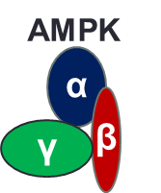
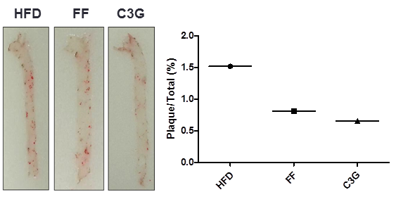
Conclusion
C3G
C3G
Fatty acid synthesis
Fatty acid oxidation
Insulin
sensitivity
Gluconeo-genesis
Energy
expenditure
Autophagy
↓ Body weight, visceral fat weight & adipocyte size
↓ Lipid accumulation in liver
↓ Glucose & insulin concentrations in plasma
Improves insulin sensitivity
↓Atherosclerosis

Slide 17
Acknowledgement
Food Biomedical Science Lab.
Supervisor
Prof. Sung-Joon Lee
FBS lab. Members
Ji Hae Lee
Chunyan Wu
Bobae kim
Ji Ah Kim
Soyoung Kim
Boram Mok
Rural Development Administration of Korea
Ewha Women’s University
Prof. Young-Suk Kim
Minyoung So

Slide 18
Thank you for your attention!

