Slide 1


Role of co-inhibitory pathways during experimental infection by Trypanosoma cruzi Tulahuen strain.
8th European Immunology Conference
01.07.2017
Yanina H. Arana P.

Slide 2
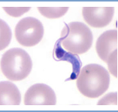
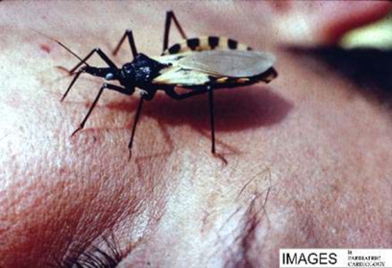
Chagas disease – Human American trypanosomiasis
Chronic infection induced by the protozoan Trypanosoma cruzi
20 million people infected (Mexico, Central and South America)
and 100 million (25% LA population) at risk.
Global incidence: 56,000 new cases/year and 12,000 deaths/year
Main mechanism of transmission:
Vector: haematophagous insect,
Subfamily: Triatominae
Others: Congenital,
blood transfusion,
organ transplantation,
accidental laboratory exposure and
oral (food and drinks contaminated)
Drugs: Benznidazole – Nefurtimox
Vaccines are not available.

Slide 3
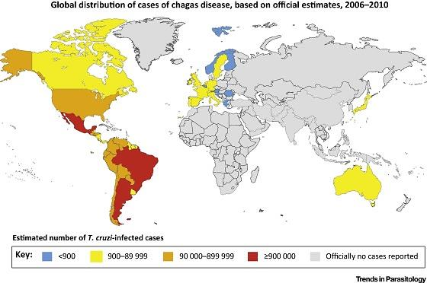
Global distribution of cases of chagas disease, based on official estimates,
2006-2010

Slide 4
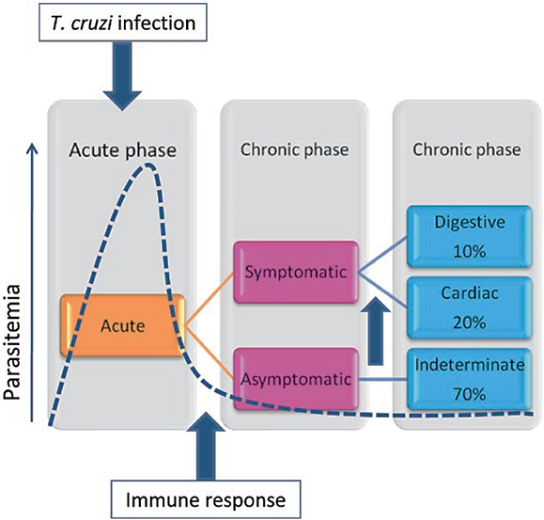
Clinical evolution of Chagas disease
Mem Inst Oswaldo Cruz. 2009

Slide 5
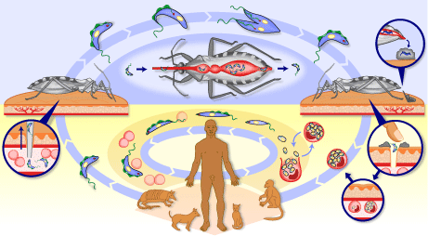

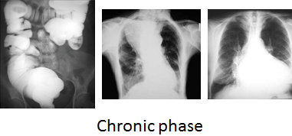
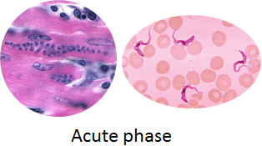
Trypanosoma cruzi – Life cycle
http://www.who.int/tdr/diseases/Chagas/lifecycle.htm.

Slide 6

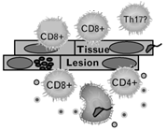


Inflammatory/anti-inflammatory immune response defines the outcome of T. cruzi infection
Acute phase
TNF-α
IFN-γ
TNF-α
IL-12
IL-10
TGF-β
IFN-γ
Co-inhibitory molecules?
Inflammation
Chronic phase

Slide 7
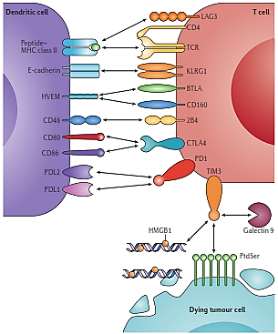
Co-receptors that negatively regulate
T cell function (Co-inhibitory pathways)
-
-
-
-
-
-
-
Nguyen, 2015. NATURE REVIEW|IMMUNOLOGY

Slide 8

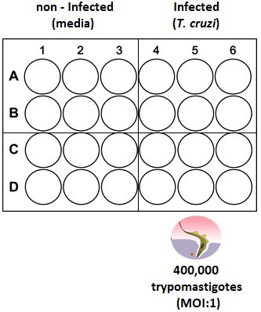
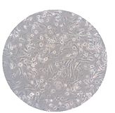
T. cruzi induces expression of co-inhibitory molecules in vitro
C57BL/6J (Bone marrow)
GM-CSF
6 h co-incubation
FACS
staining
Incubation
(until 72h p.i)
wash
Dendritic cells
(DCs)

Slide 9
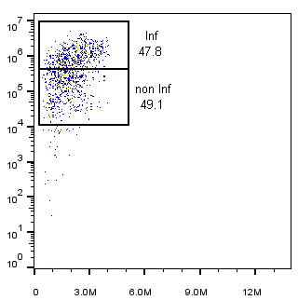
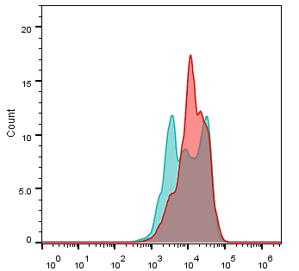
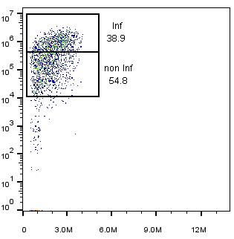
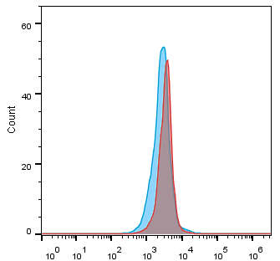
T . cruzi induces the expression of HVEM in infected dendritic cells in vitro
DC’s
Inf
non Inf
T. cruzi - APC
DC’s HVEM KO
FSC-A
HVEM - PE

Slide 10


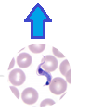
BTLA deficiency does not induce resistance to the T. cruzi infection in vivo
C57BL/6J
(7 weeks)
BTLA KO
(7 weeks)
Parasitemia / Weight
Day 0
2,000
parasites
(T. cruzi T)

Slide 11




Effect of BTLA deficiency in the immune response during T. cruzi infection
C57BL/6J
(7 weeks)
PMA/IONO
(Phenotype)
FACS
staining
BTLA KO
(7 weeks)
Day 0 22
Cytokine
Cytometry beads assay
2,000
parasites
(T. cruzi T)

Slide 12
BTLA deficiency does not affect the frequency of different immune cell populations
...but is accompanied by increased cytokine production

Slide 13
BTLA deficiency does not induce resistance to the T. cruzi infection in vivo
C57BL/6J
(7 weeks)
BTLA KO / HVEM KO
(7 weeks)
Parasitemia / Weight
Day 0
2,000
parasites
(T. cruzi T)

Slide 14
BTLA deficiency does not enhance T cell activation or its effector function

Slide 15
BTLA deficiency does not affect the frequency of different immune cell populations

Slide 16
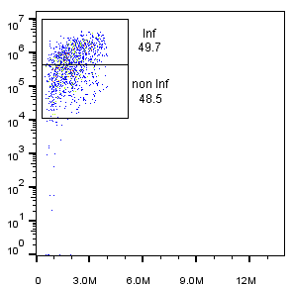
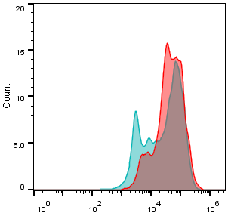
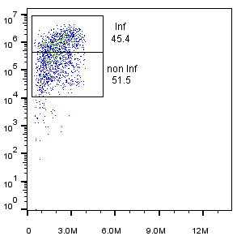
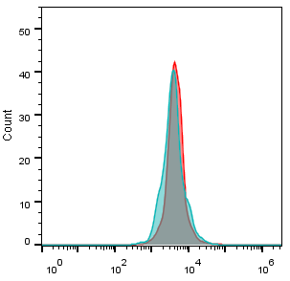
T . cruzi induces the expression of PD-L1
in infected dendritic cells in vitro
DC’s
Inf
non Inf
DC’s PD-L1 KO
T. cruzi - APC
FSC-A
PD-L1 - PE

Slide 17
PD-L1 deficiency does not induce resistance to the T. cruzi infection in vivo
C57BL/6J
(7 weeks)
PD-L1 KO
(7 weeks)
Parasitemia / Weight
Day 0
2,000
parasites
(T. cruzi T)

Slide 18
Effect of PD-L1 deficiency in the immune response during T. cruzi infection
C57BL/6J
(7 weeks)
PMA/IONO
(Phenotype)
FACS
staining
PD-L1 KO
(7 weeks)
Day 0 22
Cytokine
Cytometry beads assay
2,000
parasites
(T. cruzi T)

Slide 19
PD-L1 deficiency does not enhance T cell activation or its effector function but exhibits significate co-inhibitors expression

Slide 20
PD-L1 deficiency does not affect the frequency of different immune cell populations
...and does not improve the cytokine production

Slide 21
Interruption of PD-1:PD-L1 pathway induces TIM-3 upregulation during T. cruzi infection
At 10 dpi
At 22 dpi

Slide 22
Summary
BTLA:HVEM and PD-1:PD-L1 co-inhibitory pathways play an important role in the control of the parasite during the infection by T. cruzi Tulahuen strain.
Interruption of both co-inhibitory pathways do not improve the resistance to infection but would also favor a pronounced exhaustion stage of immune cells.
BTLA and PD-L1 deficiency does not alter the frequencies of immune cell population suggesting the existence the other immunosuppressive mechanisms (inhibitory receptors, suppressor cytokines)
TIM-3 expression is upregulated upon PD-1:PD-L1 pathway disruption suggesting a compensatory mechanism sustaining the exhaustion status of T cells.

Slide 23
Outlooks
Develop a TIM-3 blocking antibody treatment in mice.
Develop dual blockade assays employing antibodies against PD-1 and TIM-3 in mice .
Evaluate other inhibitory molecules (2B4, TIGIT) as potential candidates for infection control.

Slide 24
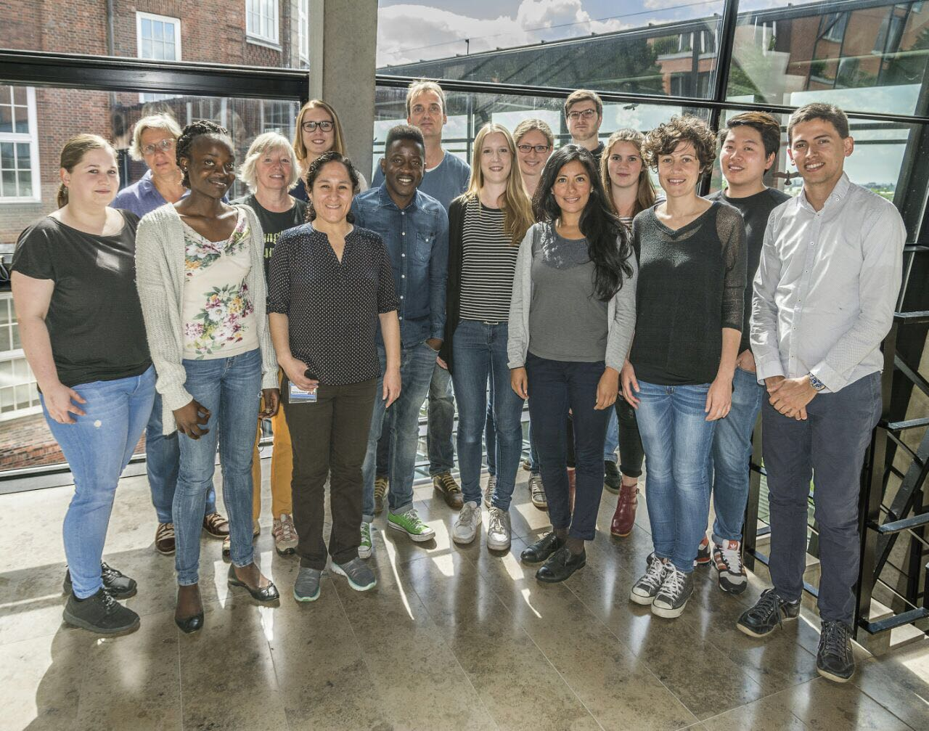




Acknowledgments
Prof. Dr. Bernhard Fleischer
AG Jacobs
PD. Dr. Thomas Jacobs
Christiane Steeg
Rosa Isela Grote-Galvez
Franziska Muscate
Annemieke Abel
PD. Dr. Eva Tolosa

