Slide 1
How does information affect willingness to pay for green power?
Yang Zhou
Fudan University

Slide 2
Background
In 2015, there are more than 80 mild air pollution and above days in Shanghai.
In Northeast China, the air pollution situation is even more serious, especially in winter.
According to the researches, more than half of the air pollution are due to coal-burning.
Among all the coals used in Shanghai, more than half of them are used in fire power plants.

Slide 3
Motivation
Policy change
Electricity market reform and Promote market competition
The survival problem for Green Power
A deeper understanding for the competitiveness of green power
Subsidies are not enough for the high-speed development of green power
Need more support from demand side
WTP for green power is the basement for related policy
Value of Green Power = Direct value + Indirect value
Green power is a impure public goods
The indirect value of green power can not be priced because of its public character
In most researches, the basic assumption is perfect information
Notes:
政策背景：电力市场市场化改革，增强竞争
在这样的市场情况下，绿色电力如何存活。并且补贴不足以满足绿色电力的高速发展
因此需要从市场支付意愿的角度去研究绿色电力存在的意义以及竞争力

Slide 4
Hypothesis
Households have perfect information on green power, and giving them any information will not change their WTP.
Household do not have perfect information.
If we give them the cost information that is higher than we they think it was, their WTP will decrease and vice versa.
If we give them the emission advantage that is higher than we they think it was, their WTP will decrease and vice versa.
If we give them the environment benefit that is higher than we they think it was, their WTP will increase and vice versa.

Slide 5
Research Structure
Background and motivation
Valuation of green power
Supply of green power
Subsidies
Main research method
Market structure
WTP for green power in Shanghai
Contingent Valuation Method
Double-Bounded Survey Method
Utility Theory
Probit Regression
MLE
WTP and influence factor

Slide 6
Literature review
Main factors that will influence WTP for green power
Population character, including gender, age, health situation, education etc.
Resource structure
National fixed character
Knowledge about green power
Notes:
为了研究影响WTP的主要因素，前三个可以通过传统的问卷方式获得，但是国家能源结构、国家特征都需要更高的层次和角度去分析。
直接去各个国家进行问卷研究是不现实的，因此可以通过文献的meta-analysis进行分析。

Slide 7
Literature review
Stated preference method
Contingent valuation
Single-bounded the simplest method
Double-bounded more efficient than single-bounded
Payment card approach more subjective to the question
Opening question limited information
Choice experiment
Virtual contracts sometimes can be confused
Based on the education level and population structure in shanghai, we use the simplest way in contingent valuation method for the research.
Notes:
中国普遍教育水平要低于欧美国家，并且环境意识不强，如果采用复杂的问卷可能会有不理解的问题，因此，我们采用了CVM中比较简单的single和double方法。

Slide 8
Literature review
Contingent Valuation Method (CVM)
Single bounded CVM application for valuation estimation (Bishop and Heberlein, 1979)
Earliest research on green power using CVM in 1996 (Farhar and Houston, 1996)
Weakness of lower efficiency for SBDC method
Double bounded CVM for WTP research (Hanemann ,1991)
Anchoring effect or starting-point bias and modified model on DBDC ( Herriges and Shogren 1996, Alberini et al. 1997)
We use the modified double-bounded CVM for the research
Notes:
对于WTP的研究有很多，条件价值评估是目前最流行的方法，条件价值评估中离散条件价值评估可以分为单边界和双边界，单边界只问一次问题，效率较低 ，需要大量样本。
因此1991年出现了双边界，可以大大提升效率，减少样本量。但是双边界存在一些问题，主要是anchoring effect，这会导致WTP测算不准，可以通过Herriges and Shogren的修正模型去解决这个问题。

Slide 9

Model
WTP
Willingness to pay and the selection of the respondents
$W$= $Xβ+ε$
For people answered to the bid price
$${choice}_{ti}=1 if W_{1}≥b_{ti} or ε≥b_{ti}−Xβ$$
$=0 if W_{1}≤b_{ti} or ε≤b_{ti}−Xβ$
Notes:
首先，被访者先回答是否愿意支付，这里就会形成一个01问题，即是与否。这是本文的第一个模型
其次，在回答是否之后，我们需要调查他的支付意愿，其次被访者面对bid price会有第二个选择。
支付意愿收到各种因素影响，如收入，年龄，家庭构成，教育程度等X。因此如果对方接受报价，说明$ε的$范围可以通过以下式子表示，从而假定$ε服从$正态分布，可以通过极大似然的方法对beta进行估计
t 是第一次问题和第二次问题（1,2）
i 代表第i个被访者面对的问题

Slide 10
Model
For people whose answer to both bid price is yes,
$$P_{i}^{11}=prob\left({choice}_{1}=1,{choice}_{2}=1\right)=1−Φ\left(\frac{b_{2}−Xβ}{σ}\right)$$
$$P_{i}^{10}=prob\left({choice}_{1}=1,{choice}_{2}=0\right)=Φ\left(\frac{b_{2}−Xβ}{σ}\right)−Φ\left(\frac{b_{1}−Xβ}{σ}\right)$$
$$P_{i}^{01}=prob\left({choice}_{1}=0,{choice}_{2}=1\right)=Φ\left(\frac{b_{1}−Xβ}{σ}\right)−Φ\left(\frac{b_{2}−Xβ}{σ}\right)$$
$$P_{i}^{00}=prob\left({choice}_{1}=0,{choice}_{2}=0|y_{i}=1\right)=Φ\left(\frac{b_{2}−Xβ}{σ}\right)$$
Notes:
因此对于不同回答组合，即11,10,01,00几种用户，可以分别求出他们的概率分布。

Slide 11
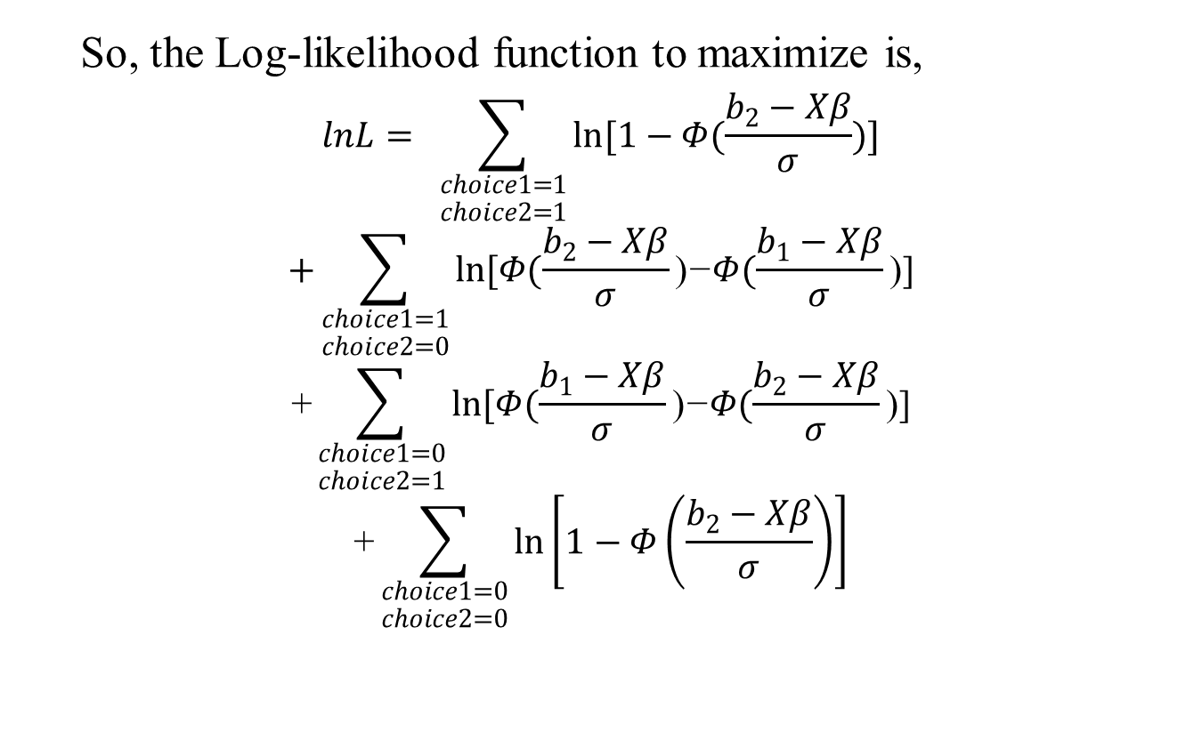
Model
So, the Log-likelihood function to maximize is,
$$lnL= \sum_{\begin{aligned}choice1=1 \\ choice2=1\end{aligned}}{ln[1−Φ(\frac{b_{2}−Xβ}{σ}})]$$
$$+\sum_{\begin{aligned}choice1=1 \\ choice2=0\end{aligned}}{ln[Φ(\frac{b_{2}−Xβ}{σ}}\text{)}\text{−}Φ(\frac{b_{1}−Xβ}{σ}\text{)]}$$
$$\text{+}\sum_{\begin{aligned}choice1=0 \\ choice2=1\end{aligned}}{ln[Φ(\frac{b_{1}−Xβ}{σ}}\text{)}\text{−}Φ(\frac{b_{2}−Xβ}{σ}\text{)]}$$
$$\text{+}\sum_{\begin{aligned}choice1=0 \\ choice2=0\end{aligned}}{\ln\left[1−Φ\left(\frac{b_{2}−Xβ}{σ}\right)\right]}$$
Notes:
因此针对两个问题，四种回答可能性有着这样的对数似然方程。

Slide 12

Anchoring effect and starting-point bias
Anchoring effect (Herriges and Shogren, 1996)
Starting-point bias (Chien et al., 2005)
Using the new $W_{2}$ for the estimation in the log-likelihood function
$W_{2}$= $Xβ+δ_{i}{START}_{i}+ε$
Notes:
但是正如前文所述，双边界模型会存在一些问题，这里主要是anchoring和strating-point bias，二者本质上其实是一样的。
这里认为第一次的报价会对被访者形成参考，因此被访者心里的WTP会想第一次的报价b1倾斜。并且使用gamma表示倾斜程度，其显著性就代表了是否存在anchoring。
而starting-point bias则认为不同的起始值会对用户产生一定的偏差，这样的偏差会导致用户第二次回答出现问题，START代表不同起始值的哑变量
之后可以用上面的对数似然方程进行估计。

Slide 13
Question design of double-bounded CVM
Why would not you want to pay more for green power?
Will you pay (X-0.02) more cents per KW.h for green power？
Will you pay (X+0.02) more cents per KW.h for green power？
Will you pay X cents more per KW.h for green power？
Would you like to pay for green power?
Based on the preliminary research, we set the beginning bid price set as {4, 6, 8, 10, 12, 14, 16 and 18 cents/kw.h} and randomly assign them to respondents.
Totally there are 2751 effective respondents.
Notes:
双边界方法的整体逻辑，X为基础价格，从0.04元至0.18元浮动。

Slide 14
Summary Statistic
 | Sample | Pudong | Shanghai
Gender | 46.55% | 51.66% | 49.62%
Age | 47.63 | 46.54 | 47.62
Education level
junior school | 36.33% | 54.51% | 35.60%
high school | 19.71% | 19.01% | 24.00%
community college | 12.94% | 9.44% | 18.10%
university | 23.70% | 10.36% | 22.30%
graduate | 7.33% | 2.09%
Unemployment | 10.99%
Self-owned | 82.40%
House space | 26.24 | 27.97 | 27.25
Income | 5347.88 |  | 4798.30
Notes:
数据来源：上海第六次人口普查, 2016年上海统计年鉴 Shanghai Statistical Yearbook

Slide 15
Definition of variables
Definition of variables
Variables | Definition
LN(income) | Natural log of average monthly home income (yuan)
Education | Education level
Employment | If the respondents is employed, if not it's 1, if employed it's 0.
Rental | if the house is rental, this variable will be 1
Space | The house square of the respondent
House age | The house year in use of the respondent
Pollution days | The pollution days in respondent's memory during 2016
Pollution level | The pollution level the respondents feel in 2016
Anti -pollution | The anti-pollution devices the respondent bought.
Knowledge | The knowledge level about the electricity price in Shanghai
Cost | If the respondents was given the cost information about green power
Emission | If the respondents was given the emission benefit information about green power
Environment | If the respondents was given the environment benefit information about green power
Notes:
本文进行分析时采用的变量

Slide 16
Basic Results
Variables | Basic model | With information source | Starting-point bias | Anchoring effect
 | Estimate | Estimate | Estimate | Estimate
Gender | 0.65** (0.322) | 0.704** (0.311) | 0.434** (0.206) | 0.886** (0.418)
Age | -0.017 (0.013) | -0.021* (0.012) | -0.007 (0.008) | -0.023 (0.016)
LN(income) | 1.039*** (0.104) | 0.967*** (0.097) | 0.956*** (0.074) | 1.073*** (0.13)
Education | 1.201*** (0.152) | 1.122*** (0.151) | 0.882*** (0.102) | 1.594*** (0.199)
Employment | -0.347 (0.331) | -0.442 (0.342) | -0.27 (0.221) | -0.504 (0.456)
Rental | -4.326*** (0.578) | -4.299*** (0.482) | -2.879*** (0.328) | -5.646*** (0.632)
Space | 0.018*** (0.006) | 0.018*** (0.006) | 0.011*** (0.004) | 0.022*** (0.007)
Knowledge | 0.475*** (0.171) | 0.525*** (0.172) | 0.356*** (0.113) | 0.577*** (0.215)
Houseage | 0.129*** (0.02) | 0.13*** (0.019) | 0.09*** (0.013) | 0.158*** (0.025)
Sigma(σ) | 5.567*** (0.155) | 5.539*** (0.156) | 3.781*** (0.138) | 7.28*** (0.327)
Notes:
这里是第二个模型，时影响支付意愿的参数。
两个模型分别是基础模型和anchoring两个模型中显著的变量，里面是参数值，所有参数都在10%水平以上显著。Anchoring的参数要比basic的大，因为在估计时会有（1-gamma）<1在分母上，从而导致整体估计偏大。
这里如果失业，unemployment为1，如果是出租屋，rental为1，days和levels分别代表被访者印象中去年的污染天数和程度，knowledge代表用户对于阶梯+峰谷电价的了解程度。Sigma是方差

Slide 17
Anchoring and Starting-point bias
Gamma(γ) |  | 0.484*** (0.027)
Starting 0.04 | -2.902*** (0.409)
Starting 0.06 | -1.197*** (0.456)
Starting 0.08 | 0.425 (0.554)
Starting 0.12 | 1.616*** (0.431)
Starting 0.14 | 1.943*** (0.37)
Starting 0.16 | 2.676*** (0.443)
Starting 0.18 | 4.907*** (0.463)
Notes:
这里是关于starting-point bias和anchoring的估计结果，结果表明，两种误差都是显著的。

Slide 18
Environment knowledge
Variables | Basic model | With information source | Starting-point bias | Anchoring effect
 | Estimate | Estimate | Estimate | Estimate
Pollution days | 0.015*** (0.004) | 0.015*** (0.004) | 0.011*** (0.002) | 0.021*** (0.005)
Pollution level | 1.19*** (0.245) | 1.127*** (0.251) | 0.856*** (0.166) | 1.566*** (0.34)
Anti-pollution | 0.573 (0.355) | 0.554 (0.339) | 0.237 (0.22) | 0.569 (0.435)
TV |  | 0.854*** (0.177)
Domestic |  | 1.538*** (0.239)
International |  | 1.63** (0.789)
Monitor |  | 1.345*** (0.383)

Slide 19
Information effect
Variables | Basic model | With information source | Starting-point bias | Anchoring effect
 | Estimate | Estimate | Estimate | Estimate
Cost | -0.935* (0.487) | -0.932** (0.448) | -0.688** (0.306) | -1.259* (0.678)
Emission | 0.591 (0.509) | 0.65 (0.466) | 0.392 (0.335) | 0.748 (0.668)
Environment | -1.363** (0.419) | -1.288*** (0.381) | -0.78*** (0.275) | -1.458** (0.632)

Slide 20
Conclusion and Innovation
We adopted the Double bounded CVM method for WTP research.
The main individual character that will influence household’s WTP for green power are Income, Gender, Age, Education level and knowledge of the resource and pollution.
In the research, there truly exists an anchoring effect and starting-point bias. Based on the modified DB CVM model, we calculated a higher WTP, which also consists with other literatures.
In our sample, the estimated total willing payment for the indirect value of green power in Shanghai is about 3.06 billion Yuan RMB per year.
The government should set up channels to the access of funds from the households for a better development chance of green power.
Notes:
这里，使用居民年用电总量170亿千瓦时*0.18元每度计算得出约30亿人民币。

Slide 21
Conclusion and Innovation
Information may influence households’ willingness to pay for green power.
The more knowledge about the environmental problems, the higher willing payment for green power.
Household did not have perfect information on Green power.
Household think that the cost and benefit of Green power is better than it truly is.
If the advantages of green power do not meet households’ expectation, this kind of information would lower households’ willingness to pay for green power.
It is suggested that the government should improve the relevant information disclosure mechanism, disclose the ecological environment status to residents in a timely and multi way.

Slide 22
Thank you!
yangzhou@fudan.edu.cn

