Slide 1

About OMICS Group
OMICS Group International is an amalgamation of Open Access publications and worldwide international science conferences and events. Established in the year 2007 with the sole aim of making the information on Sciences and technology ‘Open Access’, OMICS Group publishes 400 online open access scholarly journals in all aspects of Science, Engineering, Management and Technology journals. OMICS Group has been instrumental in taking the knowledge on Science & technology to the doorsteps of ordinary men and women. Research Scholars, Students, Libraries, Educational Institutions, Research centers and the industry are main stakeholders that benefitted greatly from this knowledge dissemination. OMICS Group also organizes 300 International conferences annually across the globe, where knowledge transfer takes place through debates, round table discussions, poster presentations, workshops, symposia and exhibitions.

Slide 2
About OMICS Group Conferences
OMICS Group International is a pioneer and leading science event organizer, which publishes around 400 open access journals and conducts over 300 Medical, Clinical, Engineering, Life Sciences, Pharma scientific conferences all over the globe annually with the support of more than 1000 scientific associations and 30,000 editorial board members and 3.5 million followers to its credit.
OMICS Group has organized 500 conferences, workshops and national symposiums across the major cities including San Francisco, Las Vegas, San Antonio, Omaha, Orlando, Raleigh, Santa Clara, Chicago, Philadelphia, Baltimore, United Kingdom, Valencia, Dubai, Beijing, Hyderabad, Bengaluru and Mumbai.

Slide 3
Study on the Penny Platform of Variable Stator Vane in Compressor
3rd International Conference and Exhibition on Mechanical & Aerospace Engineering October 05-07, 2015 San Francisco, USA
Yang Rongfei
Nanjing University of Aeronautic and Astronatuic
2015-10-07

Slide 4
Outline
Background
Experimental and numerical study on 2D cascade
Numerical study on 3D cascade
Conclusion

Slide 5
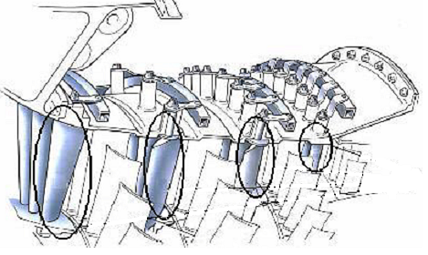
Background
Variable Stator Vane (VSV) is widely used to improve multistage compressor performance at off-design condition.
Engine | VSV/total Stages
CFM56-3 | 4/9
PW4000 | 4/11
V2500 | 4/10
PW2037 | 5/12
JT9D-7R4E | 4/11
CF6-80A | 6/14
АЛ-31Ф | 3/9
F119 | 3/6
M88 | 3/9
EJ200 | 2/5
TECH56 | 3/6
GE90 | /510

Slide 6
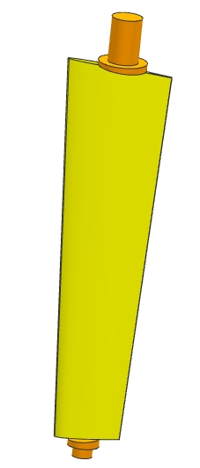
Background
VSV consist of blade and penny platforms.

Slide 7
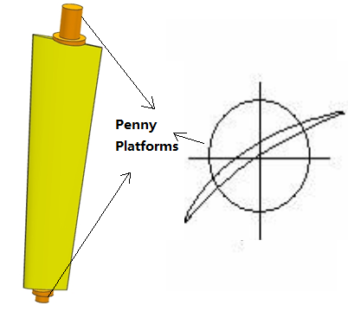
Backgroud
Previous Design
Advanced Design
Does the location and size of penny platforms impact on leakage loss only in VSV?

Slide 8
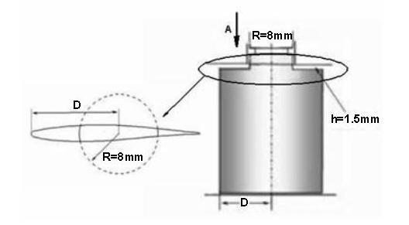
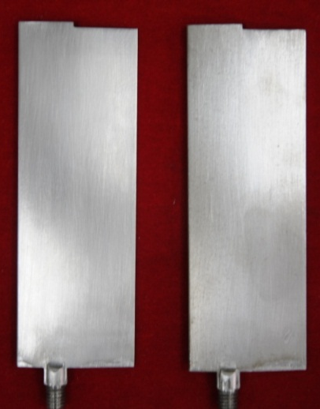
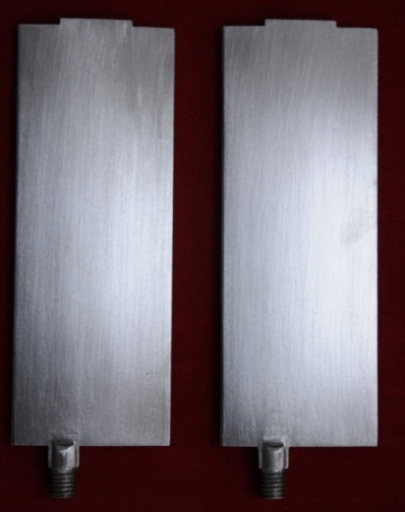
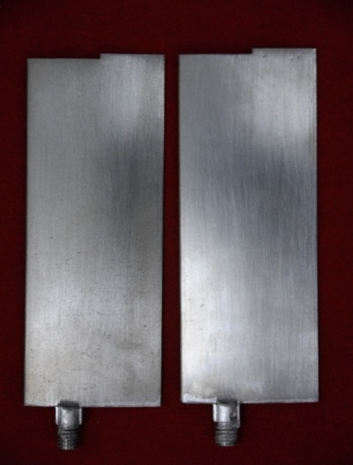
Experimental and numerical study on 2D cascade
Blade height | 100mm
gap | 1.5mm
pitch | 30mm
chord | 34.3mm
Blade number | 8
Blade A
Blade B
Blade C

Slide 9
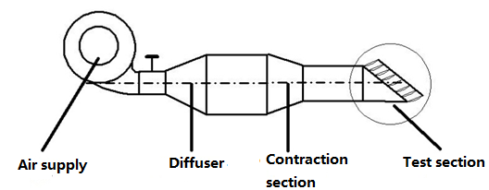
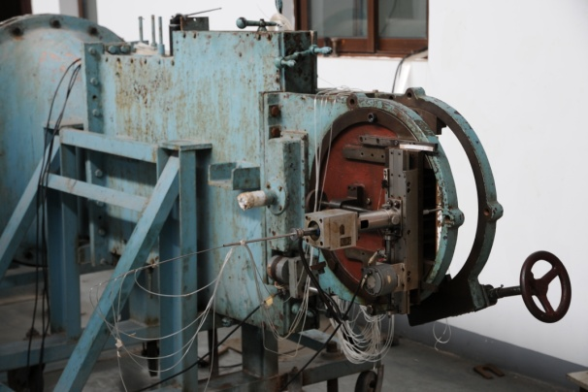
Plane cascade test rig at NUAA
Inflow condition:
Mach：0.5
Attack：0°，10°，20°
Outflow measure:
Total pressure is acquired at a blade passage section downstream of 0.5×blade chord

Slide 10
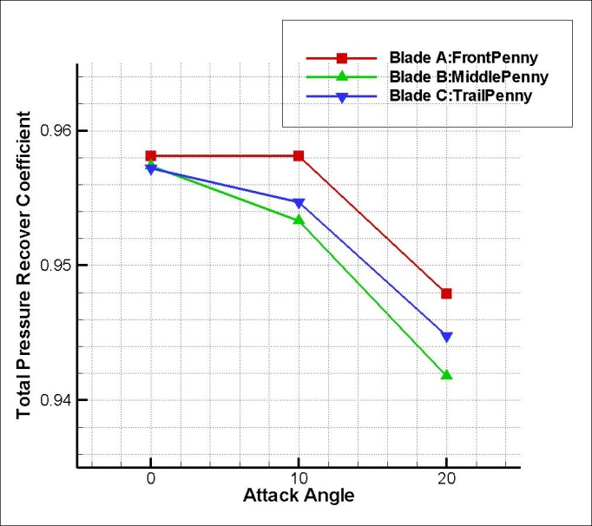
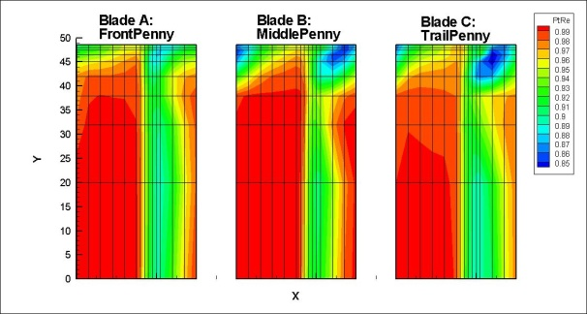
Expeimental result
Total pressure recovery coefficient:
Blade A > Blade C > Blade B
Attack of 10º
Trends of end-wall loss is consistent with blade loss

Slide 11
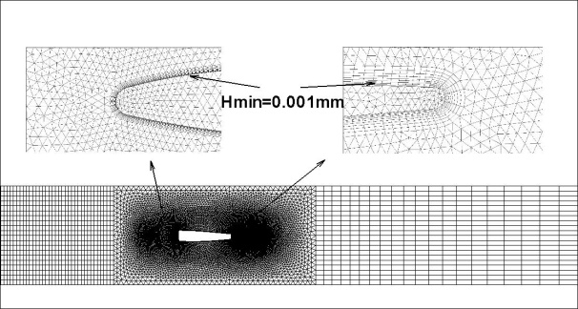
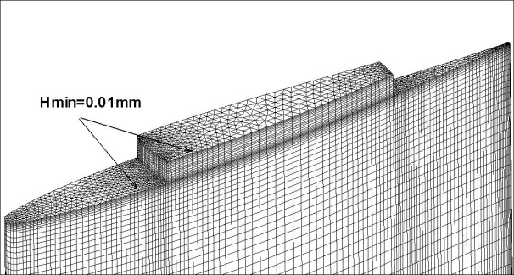
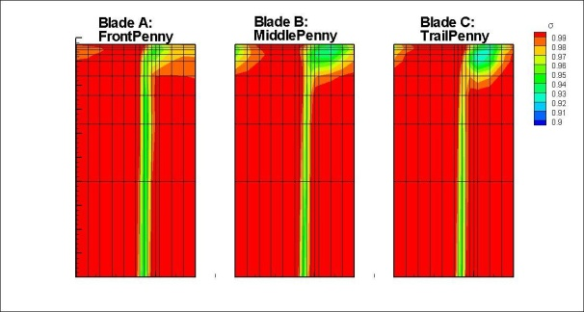
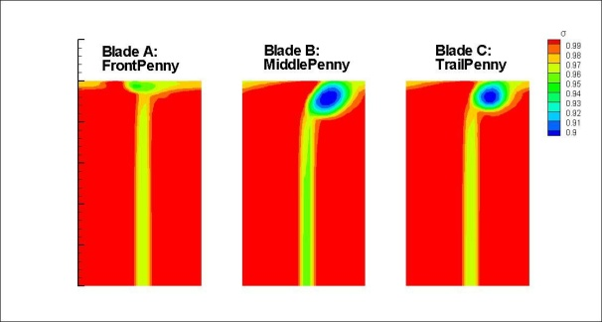
CFD method
Mesh: hybird grid,y+<5
Method: commerical CFD software CFX; k-ε turbulent model;
Experimental results
CFD results

Slide 12
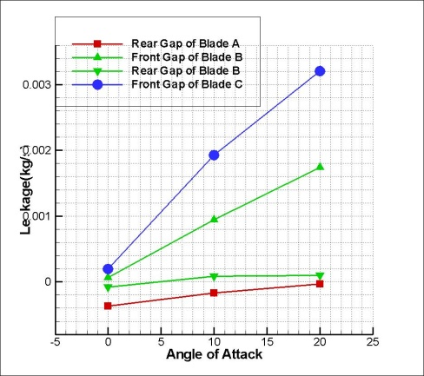
CFD result
Leakage flow:
Blade A < Blade B < Blade C
Total pressure recovery coefficient:
Blade A > Blade C > Blade B
Endwall loss ≠ leakage loss

Slide 13
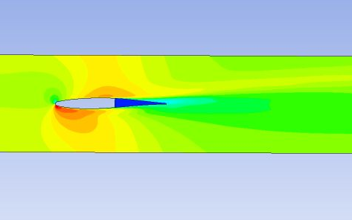
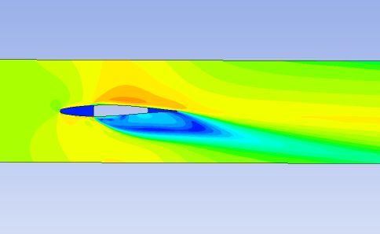
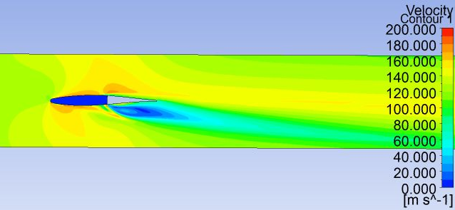
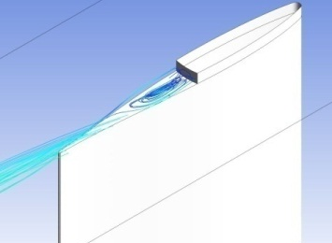
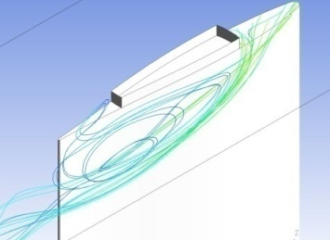
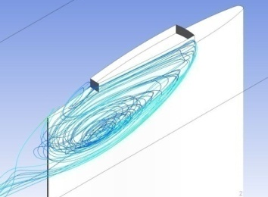
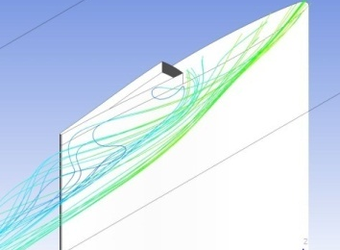
CFD result
Blade A
Blade B
Blade C
Endwall loss = leakage loss + leakage flow induced loss
Front penny platforms eliminate the induced loss.

Slide 14
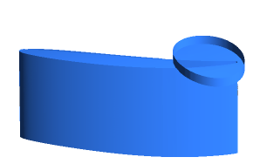
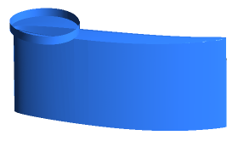
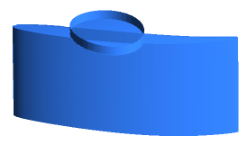
Numerical study on 3D cascade
Blade height | 56.25mm
Tip gap | 4.9mm
solidity | 2.24
chord | 125mm
Blade number | 19
Stagger angle | 51.12º
Tip gap is obtained by blade rotation angle 10º
Penny radius is 20mm.

Slide 15
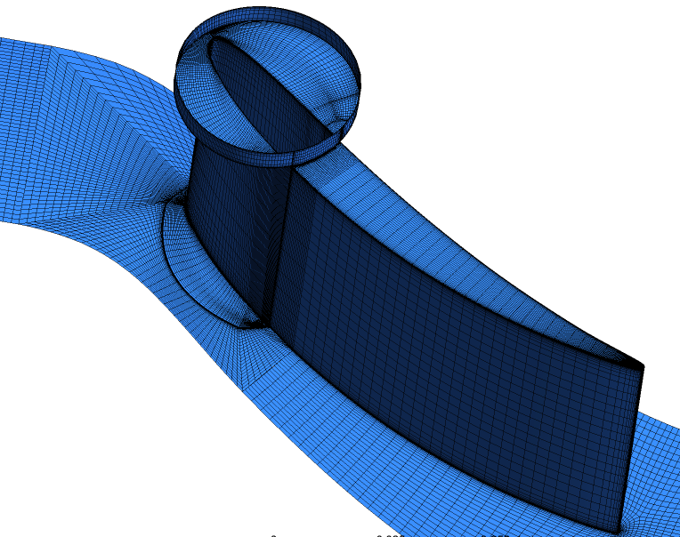
CFD method
Mesh: structured grid,y+<5
Method: CFX; k-e turbulent model;
Boundary condition: inflow attack is 5º;
mass flow is 1.9kg/s
Results of cascade without penny platfrom
Experimental
CFD

Slide 16
CFD results——cascade without tip gap
The end-wall loss become larger as it move downstream

Slide 17
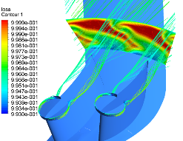
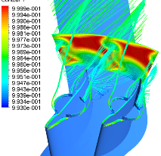
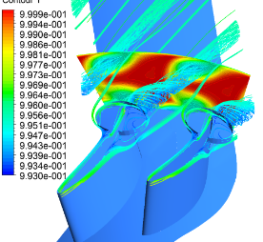
CFD results——cascade without tip gap
Penny platform wake loss is affected by the pressure difference through the blade passage

Slide 18
CFD results——cascade with tip gap
End-wall loss :
Mid penny> front penny> rear penny
End-wall loss of blade shaped penny platform:
Mid penny>rear penny>front penny

Slide 19
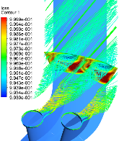
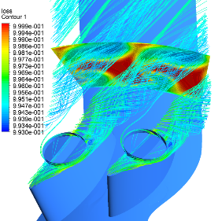
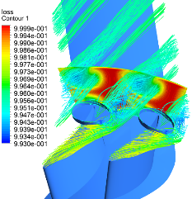
CFD results——cascade with tip gap
Leakage loss +
Penny platforms wake loss
Leakage loss +
Leakage flow induced loss

Slide 20
Conclusion
VSV end-wall loss includes leakage loss and leakage flow induced loss/penny platform wake loss.
Front penny platforms diminish the leakage flow induced loss and generate wake loss around it.
The location and size of penny platforms is determined by end-wall loss. Blades with middle penny has greatest loss.

Slide 21
3rd International Conference and Exhibition on Mechanical & Aerospace Engineering October 05-07, 2015 San Francisco, USA
Thanks for your attention!

