Slide 1


Methodology Issues in
Occupational Back Pain Research
Xiuwen Sue Dong, DrPH
CPWR, Silver Spring, MD, USA
August 24, 2015, Toronto

Slide 2
Overview
Challenges
Type of studies
Reserch practice/examples
Conclusion/discussion

Slide 3
Challenges
Definition
  How to define “back pain”?
  Who reported the problem? (e.g., self-reported, employer, doctor)
Work-relatedness
  What caused the back pain problem?
  Is back pain related to his/her job?
Measures
  Incidence (per month, per year, etc.)
  Prevalence
  Duration
Data sources
  Validity
  Reliability
  Representativeness
  Confidentiality
  Access
Cost

Slide 4
Type of studies
  Cross-sectional studies
  Longitudinal studies
  Clinical trials
  Reviews
  Meta-analyses
  Key words: back pain, work-related, musculoskeletal disorder (MSD)

Slide 5
Where did the data come from?

Slide 6
What are the limitations in the literature?
Samples not randomly selected
Small sample sizes
Limited occupational exposure data
Few longitudinal studies in the U.S.

Slide 7
Research practice

Slide 8
National Data Sources
Survey of Occupational Injuries and Illnesses (SOII)
National Health Interview Survey (NHIS)
Medical Expenditure Panel Survey (MEPS)
National Longitudinal Survey of Youth (NLSY, 1979 cohort)
Health and Retirement Study (HRS)
Occupational Information Network (O*NET)
Current Population Survey (CPS)
American Community Survey (ACS)

Slide 9
Examples

Slide 10
Example of an exposure estimate (O*NET)
Exposure to bending/twisting the body at work, by occupation
Source: The Construction Chart Book, fifth edition, http://www.cpwr.com/sites/default/files/publications/CB%20page%2034.pdf

Slide 11
Example of an exposure estimate (O*NET)
Exposure to kneeling/crouching/stooping/ crawling at work, by occupation
Source: The Construction Chart Book, fifth edition, http://www.cpwr.com/sites/default/files/publications/CB%20page%2034.pdf
Source:

Slide 12
Example of trend analysis (SOII)
Rate of back injuries resulting in days away from work, 1992-2013 (Wage-and-salary workers)
Source: U.S. Bureau of Labor Statistics, 1992-2013 Survey of Occupational Injuries and Illnesses.

Slide 13
Example of an incidence/new case analysis (SOII)
Number of back injuries resulting in days away from work, selected occupations, 2013
Source: U.S. Bureau of Labor Statistics, 2013 Survey of Occupational Injuries and Illnesses.
Notes:
Source: BLS Table R 10, 2013 http://www.bls.gov/iif/oshwc/osh/case/ostb3991.pdf

Slide 14
Example of an incidence rate analysis (SOII)
Rate of back injuries involving days away from work, selected industries, 2013
Source: U.S. Bureau of Labor Statistics, 2013 Survey of Occupational Injuries and Illnesses.

Slide 15
Example of a stratified analysis (NHIS)
Low back pain experienced in the last three months, by age group, 2014
Source: 2014 National Health Interview Survey. Calculations by the CPWR Data Center.

Slide 16
Example of a lifetime risk estimate (SOII)
Work-related MSDs in construction, Hispanic versus white, non-Hispanic workers (45y)

Slide 17
Example of cost estimate (HRS)
Out-of-pocket medical expenditures in past two years, back pain, 2012
Source: 2012 Health and Retirement Study. Calculations by The CPWR Data Center.

Slide 18
Example of a prevalence estimate (HRS)
Chronic conditions among construction workers over 50 years old, 2008
Source: 2008 Health and Retirement Study. Calculations by The CPWR Data Center.

Slide 19
Example of a prevalence estimate at baseline and follow-up (HRS)
Chronic conditions among older construction workers, a ten-year follow-up (1998 versus 2008)
Source: Dong X, Wang X, Daw C, & Ringen K. 2011. Chronic diseases and functional limitations among older construction workers in the United States: A 10-year follow-up study. Journal of Occupational & Environmental Medicine, 53(4), 372-380.

Slide 20
Example of an adjusted odds ratio estimate (HRS)
Selected chronic conditions for construction trades versus white-collar occupations
Source: Dong X, Wang X, Daw C, & Ringen K. 2011. Chronic diseases and functional limitations among older construction workers in the United States: A 10-year follow-up study. Journal of Occupational & Environmental Medicine, 53(4), 372-380.
Notes:
20

Slide 21
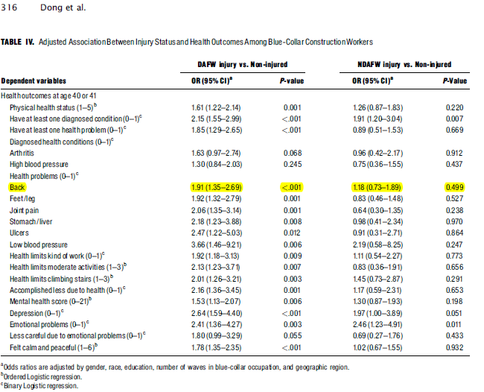
Example of a multiple logistic regression (NLSY79)
Am J Ind Med. 2015 Mar;58(3):308-18. doi: 10.1002/ajim.22415.
Long-term health outcomes of work-related injuries among construction workers--findings from the National Longitudinal Survey of Youth.
Dong XS1, Wang X, Largay JA, Sokas R.

Slide 22
Variables in a logistic regression model
Individual characteristics associated with back pain
Demographics
Gender
Race
Job Exposures
Longest occupation
Longest industry
Health Status
CES-D score (Mental health)
Health status (Physical health)
Ethnicity
Educational attainment
Geographic region
Employment status
Physical effort
Job stress
Employment type

Slide 23
Example of a fixed effects model (HRS)
Factors associated with back pain
/ ** represents significance levels at 5% and 1%, respectively.
Source: Dong XS, Wang X, Fujimoto A, Dobbin R. Int J Occup Environ Health. 2012 Apr-Jun;18(2):99-109.

Slide 24
Discussion (1)
Summary
Back pain or problems are common among American workers
The BLS annual injury and illness survey only captures a small number of work-related back injuries or MSDs
There are many advantages in utilizing large, nationally representative health surveys as a complement to current occupational safety and health surveillance data collections

Slide 25
Discussion (2)
Advantages
Randomly selected
Standardized and validated survey instruments
Large sample sizes
Availability of workers’ socio-demographic information, employment status, medical conditions, and insurance coverage
Information on self-employed workers, retired workers, and other workers
Longitudinal surveys permit a long-term perspective on occupational exposures and health outcomes as well as consequences of health disorders
Medical costs are available in some surveys
Low cost

Slide 26
Discussion (3)
Limitations
Lacks some key information and measurements
Depends on the accuracy of the responses; recall bias may be present
Difficult to link exposures to outcomes in cross-sectional study designs
Respondents drop out over time in longitudinal study designs
Sample sizes may be limited for small worker groups

Slide 27
Discussion (4)
Tips
Be cognizant of study designs and limitations when using national survey data
Merge information together from a multitude of data sources
Pool multiple years of data for more reliable analyses
End goal is to enhance research and interventions on back pain and other occupational health outcomes

Slide 28

Thank You!
SDong@cpwr.com
8484 Georgia Avenue, Suite 1000
Silver Spring, MD 20910
Phone: (301) 578-8500
Fax: (301) 578-8572
http://www.cpwr.com

