Slide 1
Heterogeneity of Abnormal RUNX1 Leading to Clinicopathological Variations in Childhood B-Lymphoblastic Leukemia
Xiayuan Liang, MD
Department of Pathology University of Colorado School of Medicine Children’s Hospital Colorado

Slide 2
Background
RUNX1
Runt-related transcription factor 1
Also known as:
Acute myeloid leukemia 1 protein (AML1)
Core-binding factor subunit alpha-2 (CBFA2)
RUNX1 gene – chromosome 21q22
Function – participation in hematopoiesis

Slide 3
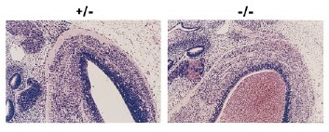
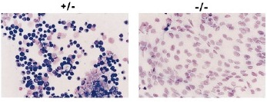
RUNX1 Function Participation in Hematopoiesis
+/- -/-
(control, E12.5) (mutant embryos, E12.5)
Hemorrhage within the ganglia of the cranial nerves with extension into the ventricles in mutant embryo.
Hemohrrage within the ventricles of the brain and
vertebral canal in the mutant embryo.
Liver TP. Control: numerous erythroid precursors. Mutant: primarily hepatocytes.
Okuda T1, van Deursen J, Hiebert SW, Grosveld G, Downing JR. AML1, the target of multiple chromosomal translocations in human leukemia, is essential for normal fetal liver hematopoiesis. Cell. 1996;84:321-330.

Slide 4
RUNX1 Abnormalities in Acute Leukemia
Translocations
ETV6-RUNX1/t(12;21)(p13;q22) → childhood B-ALL (25%) with good prognosis
RUNX1-RUNX1T1/t(8;21)(q22;q22) → AML with good prognosis
RUNX1-MECOM/t(3;21)(q26;q22) → MDS & blastic phase of CML
Amplifications (≥ 4 RUNX1copies on a single chromosome 21) → childhood B-ALL (2%) with unfavorable prognosis
Point Mutations → myeloid malignancies

Slide 5
Prognostic Significance of Chromosomal Abnormalities
UK ALL Trials

Slide 6
Study Objectives
Compare how abnormalities of RUNX1 affect the clinicopathological expression in childhood B-ALL.

Slide 7
MATERIALS AND METHODS
Case Selection
Newly diagnosed B-ALL with RUNX1 amplification or ETV6-RUNX1
< 20 years of age
1999-2013
Children’s Hospital Colorado (CHC)
Clinical Information – age, gender, WBC, CSF, relapse, mortality
Flow Cytometry – immunophenotype (≥20%) and S-phase (≥ 10%)
Cytogenetics
FISH Analysis - Vysis LSI ETV6(TEL)-RUNX1(AML1) extra signal dual-color probe set (Abbott Molecular)

Slide 8
Results
RUNX1 amplification – 10 cases
ETV6-RUNX1 – 67 cases

Slide 9
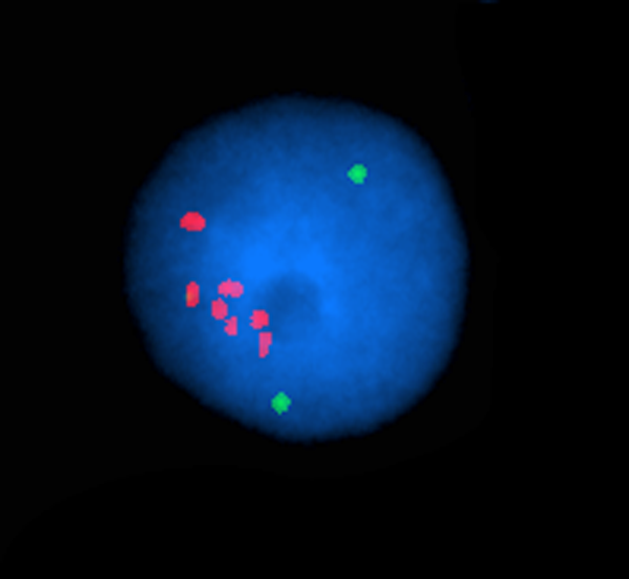
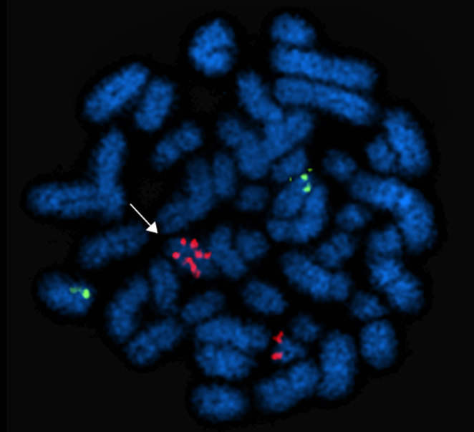
Results
RUNX1 amplification/iAMP
46,XX,add(21)(q22)(iAMP21)[14]

Slide 10
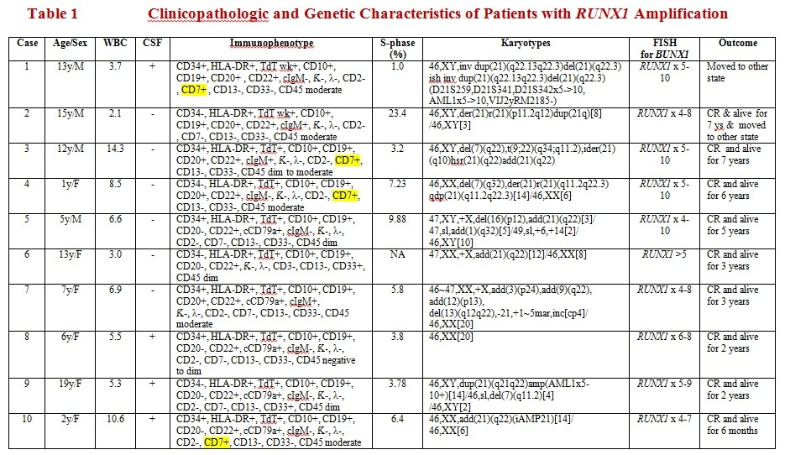

Slide 11
Aberrant Expression of CD7 Frequently Seen in B-ALL with RUNX1 Amplification Than B-ALL with ETV6-RUNX1

Slide 12
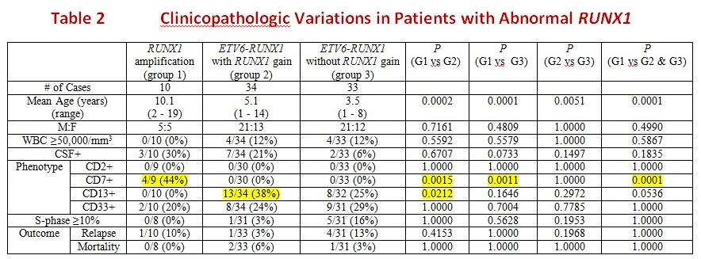
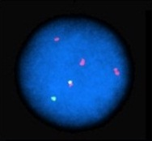
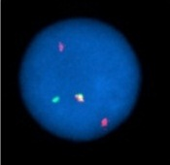
RUNX1 amplification
Group 1
ETV6-RUNX1 with RUNX1 gain
Group 2
ETV6-RUNX1 without RUNX1 gain
Group 3

Slide 13
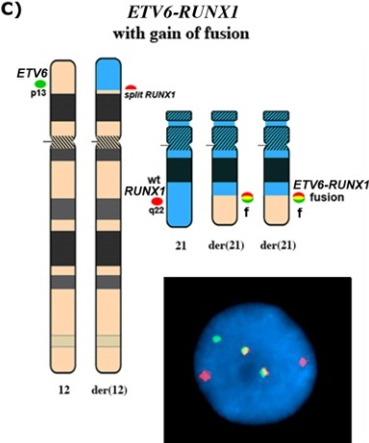
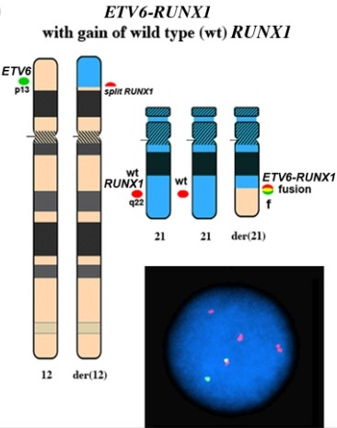
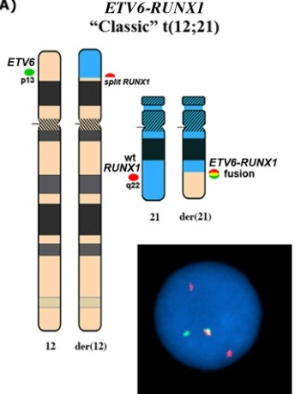
Group 2A
Group 2B
Group 3

Slide 14
Aberrant Expression of Myeloid Antigens Is More Common in Double ETV6-RUNX1 Fusion Group Than a Single ETV6-RUNX1 with a Wild Type RUNX1 Gain Group

Slide 15
Result Summary
Mean age
amplification group (10.1 y) older than translocation group (5.1 y)
Genders
equal distribution in amplification group (M:F = 5:5)
male predominant in translocation group (M:F = 21:13)
Hyperleukocytosis
translocation group (12%) > amplification group (0%)
CSF+
amplification group (30%) > translocation group (13%)
Phenotype
amplification group – CD7
translocation group – CD13 and CD33
double translocations > single translocation with RUNX1 gain
Outcomes
amplification group with high risk treatment = translocation group

Slide 16
Conclusions
Patients with RUNX1 amplification are older than patients with ETV6-RUNX1 suggesting that the factors driving amplification of RUNX1 may require longer time to develop or operate than those driving translocation of RUNX1.
B-ALLs with RUNX1 amplification more frequently show aberrant expression of CD7, suggesting amplification of RUNX1 may prevent silencing of T-cell phenotype in
B-lymphoblasts.
B-ALLs with ETV6-RUNX1 carry aberrant myeloid markers more often than those with RUNX1 amplification suggesting that RUNX1 at 21q22 likely is a myeloid associated breakpoint as seen in AML with t(8;21)(q22;q22)/RUNX1-RUNX1T1.
Increased number of ETV6-RUNX1 translocation, rather than gain of wild type RUNX1 promotes more frequent expression of myeloid-associated antigens in B-ALL.
More frequent CNS involvement may be partially responsible for more aggressive clinical behavior in patients with RUNX1 amplification, although the differences are not statistically significant.
Similar clinical outcome between RUNX1 amplification and ETV6-RUNX1 groups is attributed to different risk stratification treatments.

Slide 17
Contributors
Virginia Knez, MD: Unversity of Colorado Hospital
Billie Carstens : Colorado Cytogenetic Laboratory
Karen Swisshelm, PhD: Colorado Cytogenetic Laboratory
Amy McGranahan: Children’s Hospital Colorado

