Slide 1
Distinct priming effect of
live attenuated vs inactivated influenza vaccines
in repeated influenza vaccination
Xiao-Song He, PhD
Stanford University/VAPAHCS, USA

Slide 2
Background
Influenza epidemic and pandemic are serious public health problems
Average annual flu-related death- ~23,000 (USA)
Annual direct medical cost - $10 billion, lost earnings - $16 billion, total economic burden - $87 billion (USA)

Slide 3
Background
Influenza epidemic and pandemic are serious public health problems
Average annual flu-related death- ~23,000 (USA)
Annual direct medical cost - $10 billion, lost earnings - $16 billion, total economic burden - $87 billion (USA)
The best protection against influenza is provided by flu vaccines
B cell/Ab responses to influenza vaccination are associated with flu vaccine effectiveness

Slide 4
Limitations of current influenza vaccination
limited efficacy in the elderly
– lower Ab response after vaccination
limited efficacy for antigenically mismatched strains and need for annual re-vaccinating
– lower cross-reactive Ab activity to variant strains

Slide 5
Controversy in efficacy of repeated IIV immunization
Hoskins study (1979)
Annual vaccination of school children with inactivated influenza A vaccine conferred no long-term advantage – “Hoskins paradox”
Keitel study (1997)
Repeat influenza vaccination provided continual protection

Slide 6
CDC recommendation since 2010:
Annual flu vaccination starting at age of
6 months

Slide 7
Flu vaccine effectiveness could be affected by prior season vaccination
Skowronski 2012
Ohmit 2013
Sullivan 2013
Thompson 2014
Amer 2015
Skowronski 2014
Ohmit 2014a
Ohmit 2014b
McLean 2014
Ohmit 2015

Slide 8
Limitations of serum-based assays for Ab response
interference from pre-existing Abs in the circulation
no access to Ab-producing cells – plasma cells in BM

Slide 9
Plasmablast response to infection/vaccination
Ag exposure
plasma cells
skin
respiratory tract
GI tract
other mucosal sites
injection site
bone marrow
serum
IgG
IgA
naïve/memory
B cells
T follicular helper cells
0
7
14
21
day
respiratory tract
plasmablasts in blood
days 6-8
10-80% Ag-specific
secrete Ab
mucosal
IgA
IgG
B cell activation/ differentiation
germinal
center
homing
GI tract
mucosal
IgA
IgG
other sites
circulation

Slide 10
Plasmablast (Ab Secreting Cell, ASC)-based analyses for B cell responses
Phenotype – conventional flow cytometry/CyTOF
Number – ELISPOT (total and vaccine-specific ASCs)
Ig gene sequence – repertoire study, by next-G sequencing (deep sequencing)
Ab function – recombinant mAb
Ab function – Plasmablast-derived Polyclonal Ab (PPAb)
Notes:
10

Slide 11
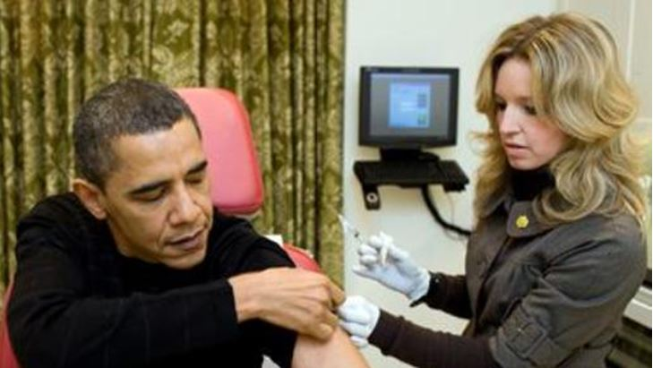
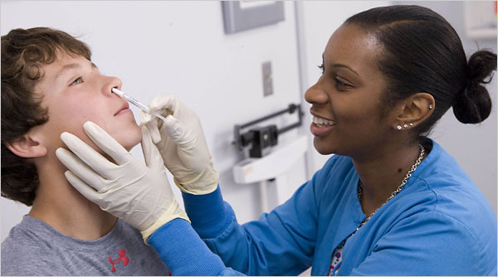
Two types of licensed influenza vaccines
IIV and LAIV
Inactivated Influenza Vaccine (IIV)
(>6 months)
Live Attenuated Influenza Vaccine (LAIV)
(2 – 49 years)
Similar or somewhat better efficacy than LAIV in adults
Better efficacy than IIV in children, especially for mismatched strains

Slide 12
B cell and Ab responses: LAIV vs IIV
Serum neutralization Ab response | LAIV < IIV
Frequency of vaccine specific IgA and IgG ASC | LAIV < IIV
IgG and IgA PPAb titer | LAIV < IIV
Yield of IgA or IgG per ASC | LAIV = IIV
IgG and IgA PPAb avidity | LAIV = IIV
IgA/IgG ratio | LAIV > IIV
Relative NP-specific plasmablast response | LAIV > IIV
Relative hererovariant ASC reactivity | LAIV > IIV
Sasaki et al. 2014 JID

Slide 13
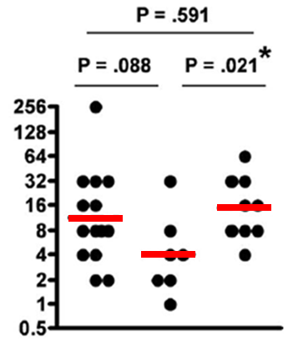
H3N2-specific serum Ab response after 2005 IIV immunization –
Distinct priming effect of LAIV vs IIV
Fold-increase of serum Ab titer
‘04 vaccine none IIV LAIV
Sasaki et al. 2008

Slide 14
Predominant circulating flu strains
2009 - 2014
A/H1N1pdm09 A/H3N2 A/H3N2 A/H3N2 A/California/7/09 A/H3N2
(A/California/7/09)

Slide 15
Seasonal flu vaccine composition and predominant circulating flu strains
2009 - 2014
Predominant
Circulating
strain
B/Brisbane/06/08
(in LAIV)
B/Brisbane/06/08
(in LAIV and IIV4)
A/H1N1pdm09 A/H3N2 A/H3N2 A/H3N2 A/H1N1pdm09 A/H3N2
(A/California/7/09)

Slide 16
Seasonal flu vaccine composition and predominant circulating flu strains
2009 - 2014
Predominant
Circulating
strain
B/Brisbane/06/08
(in LAIV)
B/Brisbane/06/08
(in LAIV and IIV4)
A/H1N1pdm09 A/H3N2 A/H3N2 A/H3N2 A/H1N1pdm09 A/H3N2
(A/California/7/09)
2010/2011
Baseline serum titer
1st immunization
IIV
2012
2nd immunization
IIV
Repeated vaccination study

Slide 17
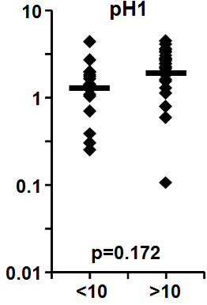
Distinct priming effect of natural flu infection vs IIV
PPAb reactivity
baseline serum neutralizing titer

Slide 18
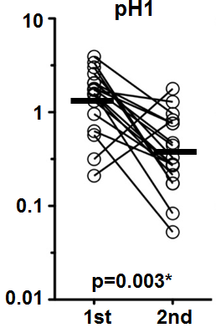
Distinct priming effect of natural flu infection vs IIV
PPAb reactivity
PPAb reactivity
baseline serum neutralizing titer
IIV immunization

Slide 19
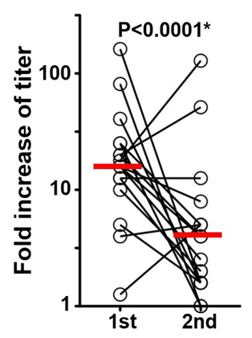
Distinct priming effect of natural flu infection vs IIV
Serum Neut titer
PPAb reactivity
PPAb reactivity
baseline serum neutralizing titer
IIV immunization

Slide 20
Distinct priming effect of natural flu infection vs IIV
Natural infection did not affect the Ab response to subsequent IIV immunization
Repeated IIV immunization resulted in reduced Ab response
Serum Neut titer
PPAb reactivity
PPAb reactivity
baseline serum neutralizing titer
IIV immunization
He et al. JID 2015

Slide 21
Priming effect of LAIV vs IIV in identical twin children
identical twins
2011
LAIV
IIV
Plasmablast response
PPAb
re-mAb
2013
IIV
IIV

Slide 22
PB response in repeated flu vaccination: MZ twins 8-17 years
10
PPAb reactivity
AUC
1
0.1
1st 2nd
1st 2nd
1st 2nd
1st 2nd
IIV-IIV
LAIV-IIV

Slide 23
PB response in repeated flu vaccination: MZ twins 8-17 years
10
PPAb reactivity
AUC
1
0.1
1st 2nd
1st 2nd
1st 2nd
1st 2nd
IIV-IIV
LAIV-IIV

Slide 24
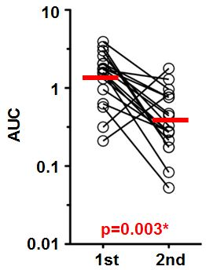
PB response in repeated flu vaccination: MZ twins 8-17 years
18 – 30 yo
10
PPAb reactivity
AUC
1
0.1
1st 2nd
1st 2nd
1st 2nd
1st 2nd
IIV-IIV
LAIV-IIV
1st 2nd

Slide 25
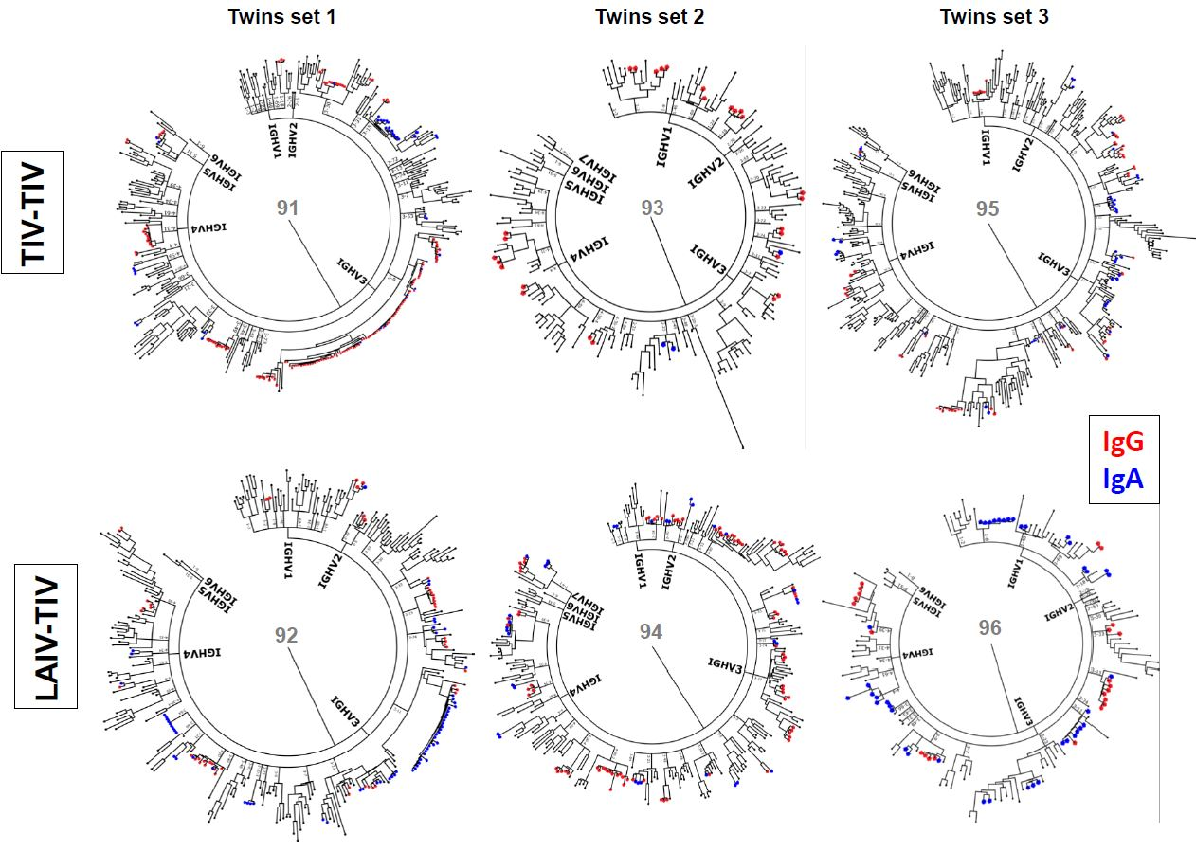
Clonal structure of plasmablast repertoire in LAIV/IIV-immunized twins
IIV-IIV
LAIV-IIV

Slide 26
Conclusion
First IIV immunization resulted in reduced B cell response to subsequent IIV immunization
Natural infection by wild type flu virus and LAIV immunization did not result in reduced B cell response to subsequent IIV immunization

Slide 27
Current CDC recommendation:
Annual flu vaccination starting at age of 6 months
= ~80 doses of flu vaccines per lifetime

Slide 28
Limitations of the current influenza vaccines
Limited efficacy in the elderly
Needs for annual re-vaccination

Slide 29
Limitations of the current influenza vaccines
Limited efficacy in the elderly
Needs for annual re-vaccination
?

Slide 30
Acknowledgements
Harry Greenberg
Sanai Sasaki
Mrinmoy Sanyal
Caiqiu Zhang
Tyson Holmes
Bill Robinson
Chia-Hsin Ju
Lisa Kay Scalfone
Mark Davis
Corry Dekker and the Clinical Core

