Slide 1



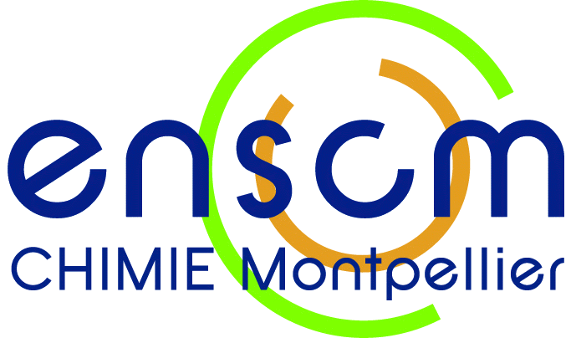
Torquoselective Nazarov Cyclization
Mediated by a Chiral Sulfoxide
Dr. Xavier J. Salom-Roig
2nd European Organic Chemistry Congress
March 02-03, 2017 Amsterdam, Netherlands

Slide 2
The Nazarov Reaction
Reactivity and Regioselectivity problems

Slide 3
« Polarized » Nazarov Cyclization
He, W.; Sun, X. F.; Frontier, A. J. J. Am. Chem. Soc. 2003, 125, 14278-14279.

Slide 4

Polarized divinylketones
EDG
EWG
4

Slide 5
The torquoselectivity
Torquoselectivity
Asymmetric Nazarov reaction… Torquoselectivity control
Houk, K. N.; et al. J. Am. Chem. Soc. 1989, 111, 5356-5367.

Slide 6
Asymmetric Nazarov Cyclization
Chiral Auxiliaries
Chiral Acids
Lewis
Brønsted
Cu-pybox : Aggarwal, V. K.; Belfield, A. J. Org. Lett. 2003, 5, 5075-5078.
¹Pridgen, L. N.; et al. Synlett 1999, 9, 1612-1614.
²Kerr, D. J.; Flynn, B. L. J. Org. Chem. 2010, 75, 7073.
³Kerr, D. J.; Flynn, B. L. Org. Lett. 2012, 14, 1732-1735.
⁴Tius, M. A.; et al. J. Am. Chem. Soc. 2007, 129, 5328-5329.
Cr-Salen : Rawal, V. H.; et al. J. Am. Chem. Soc. 2013, 135, 4988-4991.
Phosphoramide : Rueping, M.; et al. Angew. Chem. Int. Ed. 2007, 46, 2097-2100.

Slide 7
A DIASTEREODIVERGENT STRATEGY

Slide 8
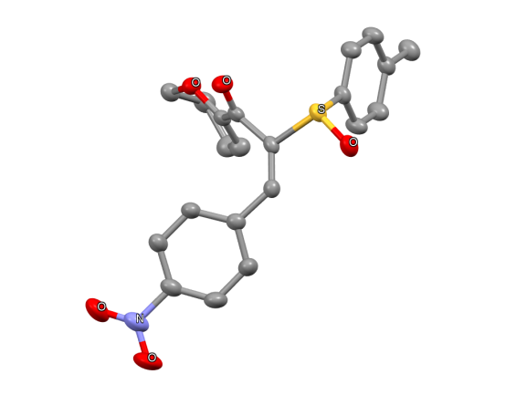
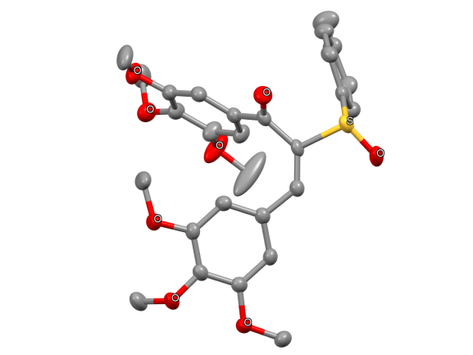
E configuration

Slide 9
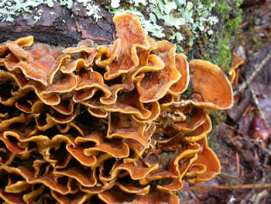
Cyclopenta[b]pyranones
Stereum Hirsutum
(Tibet fungus)

Slide 10
Lewis Acid | R. time | trans 1 | trans 2 | cis 1 | cis 2
ZrCl₄ | - | - | - | - | -
MgCl₂ | - | - | - | - | -
ZnI₂ | 24h | 83 | 17 | 0 | 0
ZnCl₂ | 24h | 75 | 25 | 0 | 0
Cu(OTf)₂ | 2h | 66 | 34 | 0 | 0
Al(OTf)₃ | 24h | 60 | 40 | 0 | 0
Sc(OTf)₃ | 48h | 50 | 50 | 0 | 0
InCl₃ | 6h | 50 | 50 | 0 | 0
FeCl₃ | 30min | 45 | 55 | 0 | 0
AlCl₃ | 20min | 34 | 66 | 0 | 0
TiCl₄ (excès) | 2h | 18 | 82 | 0 | 0
Lewis Acid | R.time | trans 1 | trans 2 | cis 1 | cis 2
ZrCl₄ | - | - | - | - | -
MgCl₂ | - | - | - | - | -
ZnI₂ | 24h | 83 | 17 | 0 | 0
ZnCl₂ | 24h | 75 | 25 | 0 | 0
Cu(OTf)₂ | 2h | 66 | 34 | 0 | 0
Al(OTf)₃ | 24h | 60 | 40 | 0 | 0
Sc(OTf)₃ | 48h | 50 | 50 | 0 | 0
InCl₃ | 6h | 50 | 50 | 0 | 0
FeCl₃ | 30min | 45 | 55 | 0 | 0
AlCl₃ | 20min | 34 | 66 | 0 | 0
TiCl₄ (excess) | 2h | 18 | 82 | 0 | 0
Lewis Acid | R.Time | trans 1 | trans 2 | cis 1 | cis 2
ZrCl₄ | - | - | - | - | -
MgCl₂ | - | - | - | - | -
ZnI₂ | 24h | 83 | 17 | 0 | 0
ZnCl₂ | 24h | 75 | 25 | 0 | 0
Cu(OTf)₂ | 2h | 66 | 34 | 0 | 0
Al(OTf)₃ | 24h | 60 | 40 | 0 | 0
Sc(OTf)₃ | 48h | 50 | 50 | 0 | 0
InCl₃ | 6h | 50 | 50 | 0 | 0
FeCl₃ | 30min | 45 | 55 | 0 | 0
AlCl₃ | 20min | 34 | 66 | 0 | 0
TiCl₄ (excès) | 2h | 18 | 82 | 0 | 0

Slide 11
DHP-Substrates

Slide 12
Further synthetic elaboration
γ-secretases inhibitors
Notes:
Nécessité d’enlever le sulfoxyde et de pouvoir fonctionnaliser

Slide 13
Stereoselective Carbonyl Reduction
H⁻ | trans : cis Ratio | Yield in major diastereomer (%)
L-selectride | - | -
ZnI₂/DIBAL-H | 30:70 | 62
NaBH₄ | 7:93 | 92
DIBAL-H | > 95:5 | 86
Grenet, E.; Martínez, J.; Salom-Roig, X. J. Chem. Eur. J. 2016, 22, 16770-16773.

Slide 14
Sulfoxide Group Removal

Slide 15
Conclusion
TWO DIASTEREODIVERGENT STEPS
4 STEREOISOMERS FROM A COMMON PRECURSOR

Slide 16
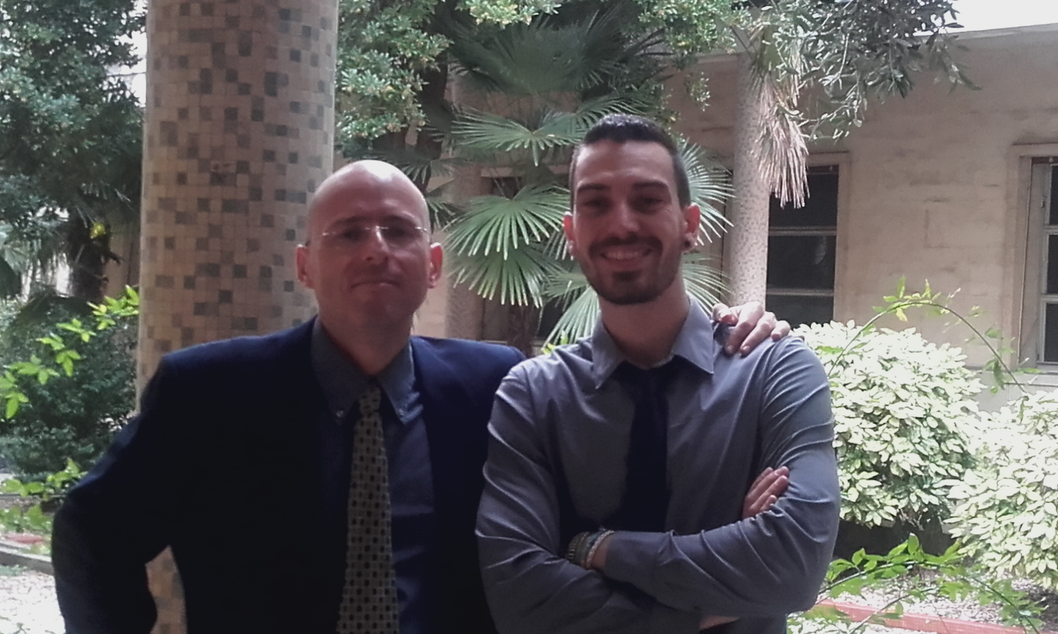
Acknowledgements
Pr. Jean Martinez Dr. Erwann Grenet | Dr. Arie Van der Lee (RX) Aurélien Lebrun (NMR) Guillaume Cazals (SM) Pierre Sanchez (LC-MS)

Slide 17
Reaction Mechanism

Slide 18
Aromatic Substrates
Grenet, E.; Martínez, J.; Salom-Roig, X. J. Asian. J. Org. Chem. 2017, 6, 189-198.

Slide 19
AlCl₃ and ZnI₂ give the same stereoisomer with aromatic substrates
19

Slide 20
20

Slide 21

Failed!!!
TfOH ,TFA, MsOH,
FeCl₃, Sc(OTf)₃, TiCl₄
21

Slide 22
Grenet, E.; Martínez, J.; Salom-Roig, X. J. Asian. J. Org. Chem. 2017, 6, 189-198.
22

Slide 23
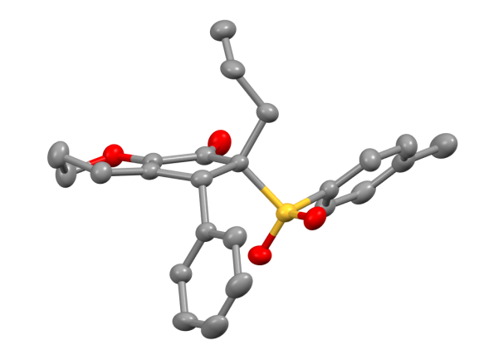
Alkylated Products
23

Slide 24
Sulfone Group Removal
24

Slide 25
Conclusion
25

Slide 26
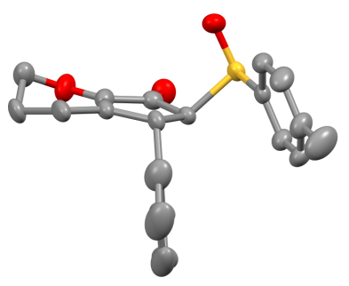
Determination of the absolute Stereochemistry
enantiomers
Diastereodivergent Methodology
Grenet, E.; Martínez, J.; Salom-Roig, X. J. Chem. Eur. J. 2016, 22, 16770-16773.
26

