Slide 1
About OMICS Group
OMICS Group International is an amalgamation of Open Access publications and worldwide international science conferences and events. Established in the year 2007 with the sole aim of making the information on Sciences and technology ‘Open Access’, OMICS Group publishes 400 online open access scholarly journals in all aspects of Science, Engineering, Management and Technology journals. OMICS Group has been instrumental in taking the knowledge on Science & technology to the doorsteps of ordinary men and women. Research Scholars, Students, Libraries, Educational Institutions, Research centers and the industry are main stakeholders that benefitted greatly from this knowledge dissemination. OMICS Group also organizes 300 International conferences annually across the globe, where knowledge transfer takes place through debates, round table discussions, poster presentations, workshops, symposia and exhibitions.

Slide 2
About OMICS Group Conferences
OMICS Group International is a pioneer and leading science event organizer, which publishes around 400 open access journals and conducts over 300 Medical, Clinical, Engineering, Life Sciences, Pharma scientific conferences all over the globe annually with the support of more than 1000 scientific associations and 30,000 editorial board members and 3.5 million followers to its credit.
OMICS Group has organized 500 conferences, workshops and national symposiums across the major cities including San Francisco, Las Vegas, San Antonio, Omaha, Orlando, Raleigh, Santa Clara, Chicago, Philadelphia, Baltimore, United Kingdom, Valencia, Dubai, Beijing, Hyderabad, Bengaluru and Mumbai.

Slide 3
Numerical Study on Active Flow Control using Synthetic Jet Actuators over a NACA 4421 Airfoil
AUTHOR
Xavier Guerrero Pich
Notes:
Good morning ladies and gentlemen. My name is Xavi Guerrero, from Polytechnic University of Catalonia, and I have performed a Numerical Study on Active Flow Control using Synthetic Jet Actuators over a NACA 4421 Airfoil.

Slide 4
Summary
Active Flow Control
Definition
Applications
The Zero-Net-Mass-Flux
Setting simulations
Results
Conclusions
Notes:
Definition of AGC and applications
Introduction of what a ZNMF is
Parameters mesh + simulations
Respective results
Obtain conclusions
During the presentation, the definition of what is Active Flow control is presented, together with some of the possible applications. After that, an AFC device (particularly, the ZNMF) is introduced as it has been used for the study. Then, the parameters of both the mesh and the simulations will be presented, together with their respective results. These results will be discussed in order to get final conclusions about if the initial hypothesis have been accomplished, and a practical application on the automobile sector is presented.

Slide 5
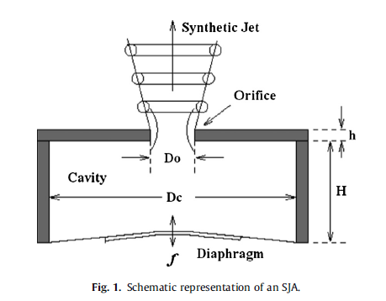
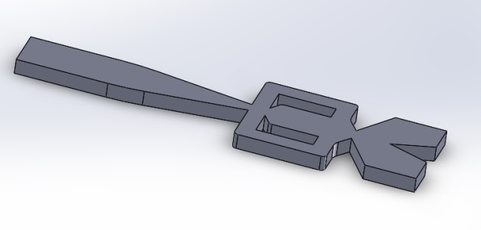
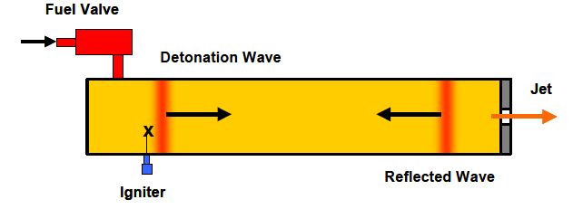
Active flow control (AFC)
Fluid dynamics technology which is used to improve the performance of aerodynamic surfaces under varying conditions.
Active: Implies that the technology is applied only when needed, to avoid the drawdown of the natural performance.
Zero-Net-Mass-Flux
Fluidic oscillator
Combustion driven jet actuator
Notes:
Flow control can be described as a technology which is used to improve the performance of aerodynamic surfaces. The word active which is added implies the fact that this technology is only used when necessary, avoiding the possible negative consequences in the natural performance of the surface.
Here they are presented some AFC devices. Firstly, the ZNMF, which will be described further in this presentation. Moreover, the fluidic oscillator is similar to the first one, but with the difference of having a mass addition. Finally, and more present in the nowadays technology, the combustion driven jet actuator uses the detonation wave to modify the fluid behaviour (which is in the end the purpose of these devices).

Slide 6
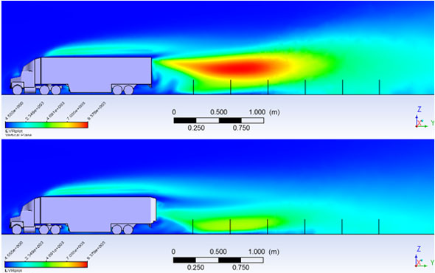
Active flow control (AFC)
Wide application in different fields of research
Aerospace sector
Automobile industry
Vorticity in the back of the truck when using AFC
Tomoscopy flow visualization of the boundary layer without AFC (top) and using AFC (bottom)
Notes:
AIM Project: Improve performance
Using ANSYS ICEM CFD → Mesh
Using ANSYS Fluent → ZNMF simulated + Results
The aim of the project is to study how a ZNMF can improve the performance of a NACA 4421 airfoil.
Using ANSYS ICEM CFD the mesh has been created and evaluated, while using ANSYS Fluent the whole simulation including ZNMF has been performed, and results have been obtained and evaluated as well.

Slide 7
The Zero-Net-Mass-Flux
Aim: Study how a Zero-Net-Mass-Flux (ZNMF) can improve the performance of a NACA 4421 airfoil
Development
Fluid field mesh
Define parameters
Evaluate results
ZNMF set on a NACA 4421
Notes:
AIM Project: Improve performance
Using ANSYS ICEM CFD → Mesh
Using ANSYS Fluent → ZNMF simulated + Results
The aim of the project is to study how a ZNMF can improve the performance of a NACA 4421 airfoil.
Using ANSYS ICEM CFD the mesh has been created and evaluated, while using ANSYS Fluent the whole simulation including ZNMF has been performed, and results have been obtained and evaluated as well.

Slide 8
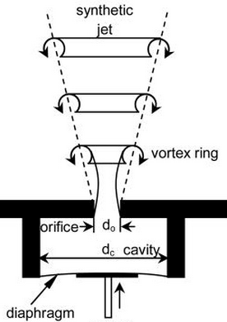
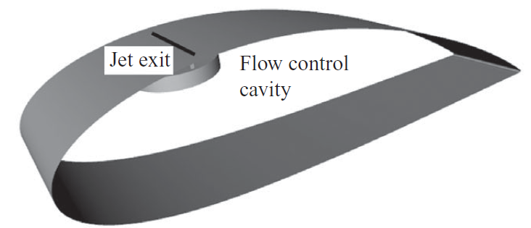
The Zero-Net-Mass-Flux
No mass addition, only momentum to the embedding flow.
Blowing stroke and suction stroke through an oscillating membrane.
Cross flow
ZNMF scheme (Zhang, 2007)
Cavity set in the airfoil (Sahni, 2011)
Notes:
ZNMF:
Type of SJA without mass addition, it only adds momentum to the embedding cross flow
The jet is created by an oscillating membrane which is inside a cavity, and is connected to the outer environment through an orifice
Membrane consists of 2 strokes
In the blowing stroke, the fluid is pulled outside the cavity in order to create the perturbation in the cross flow.
In the suction stroke, the fluid coalesces itself to create the jet. At the same time, a vortex pair appears at the edges of the orifice
Better see it with an animation.

Slide 9
The Zero-Net-Mass-Flux
Synthetic jet behaviour (quiescent flow)
Notes:
Here it is presented a synthetic jet behaviour in quiescent flow.
During the blowing stroke, the fluid is pulled out of the cavity.
When the suction stroke begins, the vortex pair is created and the fluid coalesces to create the synthetic jet.

Slide 10
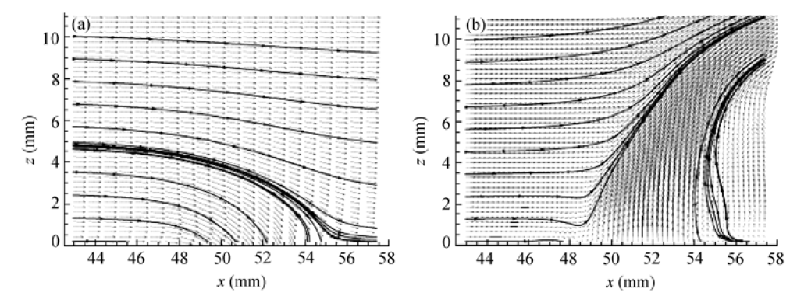
State of the art
Experimental studies to appreciate the jet behaviour (Ugrina 2007)
Synthetic jet has to enter inside the boundary layer
Too strong
Out of the boundary layer
Too weak
No effects on the boundary layer
ZNMF jet streamlines (cross flow). (a)Suction stroke; (b) Blowing stroke (Ugrina, 2007)
Notes:
Here we can see the streamlines behaviour during the suction stroke and the blowing stroke (when the jet is created).

Slide 11
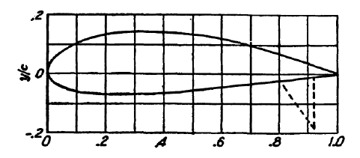
Meshing the NACA 4421 Airfoil
Stall process in thick airfoils (Meseguer, 2004)
Relative thickness: $\frac{δ}{c}=0.21$
$$δ/c>0.15$$
Thick airfoil
NACA 4421 Airfoil (Abbott, 1959)
Notes:
This is a NACA 4421, which has been used in the study. As its relative thickness is 21%, according to the established criteria
CLIC
The airfoil is classified as a thick airfoil. Moreover, these airfoils suffer a
CLIC
Progressive stall, beginning in the trailing edge and moving backwards to the leading edge, until the boundary layer is completely separated.
CLIC
Once the airfoil is presented,

Slide 12
Meshing the NACA 4421 Airfoil
Stall process in thick airfoils (Meseguer, 2004)
Relative thickness: $\frac{δ}{c}=0.21$
$$δ/c>0.15$$
Thick airfoil
NACA 4421 Airfoil (Abbott, 1959)

Slide 13
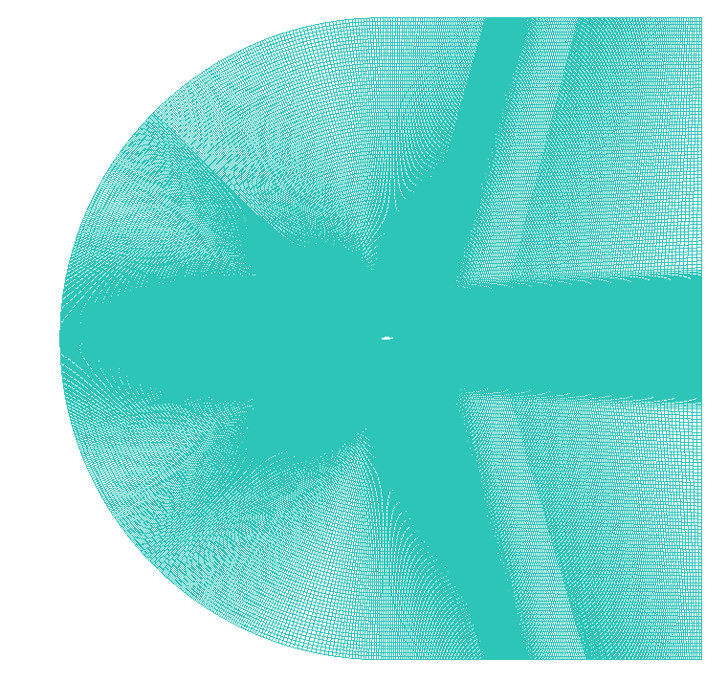
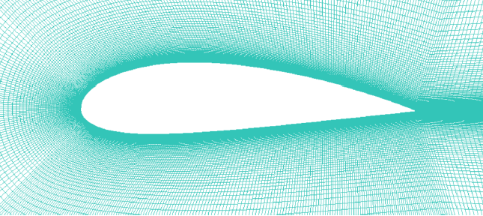
Meshing the NACA 4421 Airfoil
First cell height: $y^{+}≈2.2$
Mesh in the fluid field
Mesh around the airfoil
Notes:
It is time to present the mesh around it. It must be underlined that it is more coarse far away from the extrados, and it becomes more refined as you come closer to the airfoil surface.
Let’s take a zoom
CLIC
We can see that the mesh is even more refined very close to the extrados. One of the parameters which evaluate the mesh is the y+ value, also known as the height of the first cell from the airfoil surface.
It depends on the Re number and the airfoil chord, and the perfect value would be 1, although in our case a value under 5 is also accepted.
CLIC
Furthermore, here it is the mesh in the whole fluid field (with the airfoil in the centre of it) , and whose range is 20 times the chord.

Slide 14
Setting simulations parameters
Dimensionless parameters
Mach Number
Reynolds Number
$$M_{∞}=0.13$$
𝑀_∞=0.13
$$Re=3·{10}^{6}$$
𝑅𝑒=3·〖10〗^6
Incompressible flow
Turbulent flow
Characteristic parameters of the simulations
Solver
RANS
$$k−ω SST$$
𝒌−𝝎 𝑺𝑺𝑻
Solver used in the simulations
Notes:
Parameters which define the simulation background:
Mach number, define upstream velocity and uncompressible flow (under 0.2)
Re number, define the chord and density (ideal gas law has been used). We can affirm that the flow is turbulent.
CLIC
Among all turbulence models, the only one which was reachable in terms of time and resources was RANS.

Slide 15
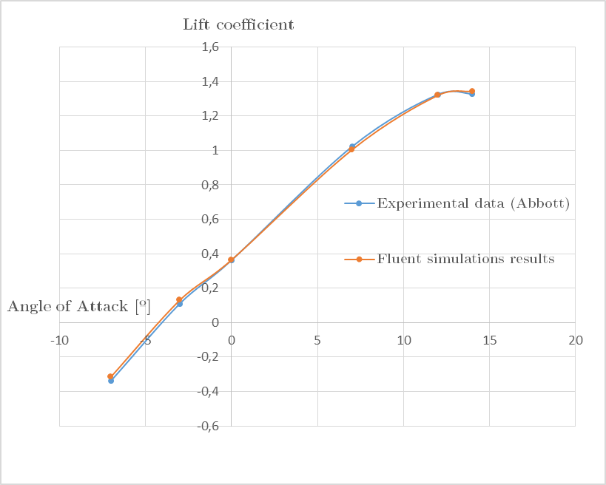
Evaluating mesh and parameters
$C_{l}−α$ curve of NACA 4421 airfoil
Notes:
To evaluate the mesh, the cl-alpha graphic was obtained through simulations and compared to experimental data.
In order to quantify the similarity,
CLIC
Max RE is 15%.
However, at positive values of alpha, the max RE is 2% verifying then the mesh quality.

Slide 16
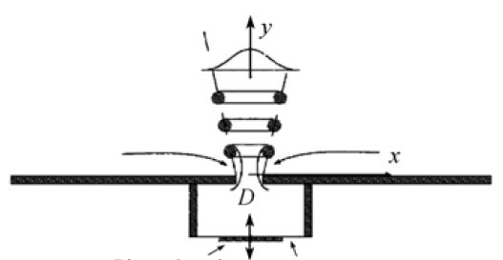
Setting the ZNMF
ZNMF can be simulated using boundary conditions
Sinusoidal function, without offset (no mass addition)
Velocity perpendicular to the surface, with a characteristic frequency
Sinusoidal function
Amplitude (A) $[m/s]$
Amplitude (A) [𝑚/𝑠]
Frequency (f) $[Hz]$
Frequency (f) [𝐻𝑧]
Momentum coefficient $c_{μ}$
Momentum coefficient 𝑐_𝜇
Lift coefficient (transient)
Notes:
Since the whole design of the cavity and the ZNMF was beyond the scope of the study, the actuator has been simulated using a boundary condition, particularly a sinusoidal function for the velocity.
No offset because of the absence of mass addition
Velocity perpendicular to the orifice.
CLIC
Variables to calculate:
Amplitude of the velocity oscillation → Momentum coef.
Frequency → Lift coefficient in transient simulations without ZNMF
CLIC
As there wasn’t enough time to evaluate every parameter, the amplitude was settled using calculations of similar performed experiments. Using Durrani’s expression, the amplitude was found to be about 31 m/s.
CLIC
About the frequency, a period of the lift convergence was used to find what is called the shedding frequency , which was about 45 Hz.

Slide 17
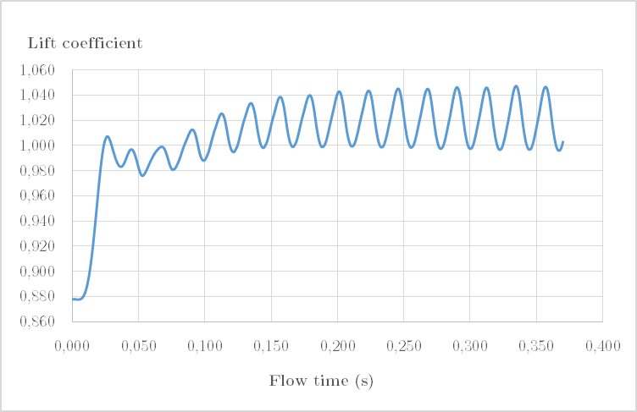
Setting the ZNMF
STATIC Simulations
DYNAMIC Simulations
$C_{l}−α$ curve of NACA 4421 airfoil
Lift coefficient value in dynamic simulations
Notes:
To evaluate the mesh, the cl-alpha graphic was obtained through simulations and compared to experimental data.
In order to quantify the similarity,
CLIC
Max RE is 15%.
However, at positive values of alpha, the max RE is 2% verifying then the mesh quality.

Slide 18
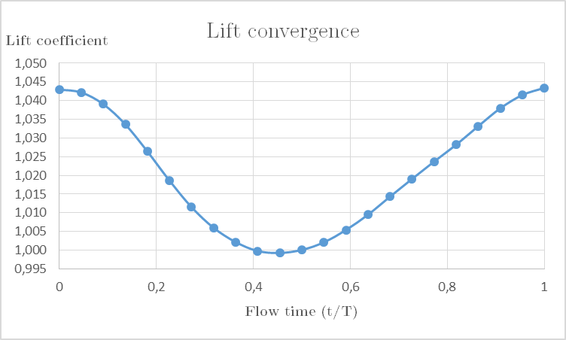
Setting the ZNMF
Frequency (f) $[Hz]$
Amplitude (A) $[m/s]$
Momentum coefficient
$$c_{μ}=\frac{Momentum near orifice}{Momentum upstream}$$
$$c_{μ}=\frac{h·A^{2}·ρ_{x}}{c·U_{∞}^{2}·ρ_{∞}}$$
$$f≈45 Hz$$
$$A≈90 m/s$$
Notes:
Since the whole design of the cavity and the ZNMF was beyond the scope of the study, the actuator has been simulated using a boundary condition, particularly a sinusoidal function for the velocity.
No offset because of the absence of mass addition
Velocity perpendicular to the orifice.
CLIC
Variables to calculate:
Amplitude of the velocity oscillation → Momentum coef.
Frequency → Lift coefficient in transient simulations without ZNMF
CLIC
As there wasn’t enough time to evaluate every parameter, the amplitude was settled using calculations of similar performed experiments. Using Durrani’s expression, the amplitude was found to be about 31 m/s.
CLIC
About the frequency, a period of the lift convergence was used to find what is called the shedding frequency , which was about 45 Hz.

Slide 19
Setting the ZNMF
Different frequencies have to be studied
Same order of magnitude (Durrani, 2011)
One order of magnitude larger (Zhang, 2008)
SCENARIOS (Frequencies & Angles of attack)
Angle of attack | 7º |  |  | 12º |  |  | 14º
Frequency (Hz) | 45 | 250 | 500 | 45 | 250 | 500 | 45 | 250 | 500
Other parameters settled following experimental bibliography
Orifice length $(h=2 mm)$
Orifice position $\left(\frac{x}{c}=0,17\right)$
Notes:
However, studies differ from the frequency which has to be used for the actuator. Some claim that the frequency must be the same order of magnitude than the shedding frequency, while others assure that the actuator frequency must be an order of magnitude larger.
CLIC
For this reason, three different frequencies have been studied at each angle of attack.
CLIC
As there hasn’t been enough time to evaluate every parameter, the other ones like the orifice length and position have been settled using bibliography.

Slide 20
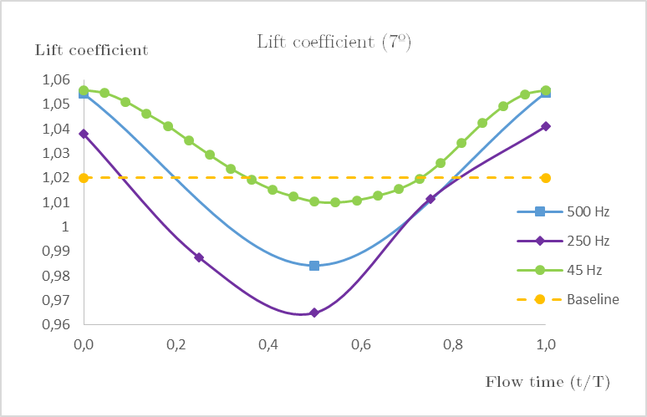
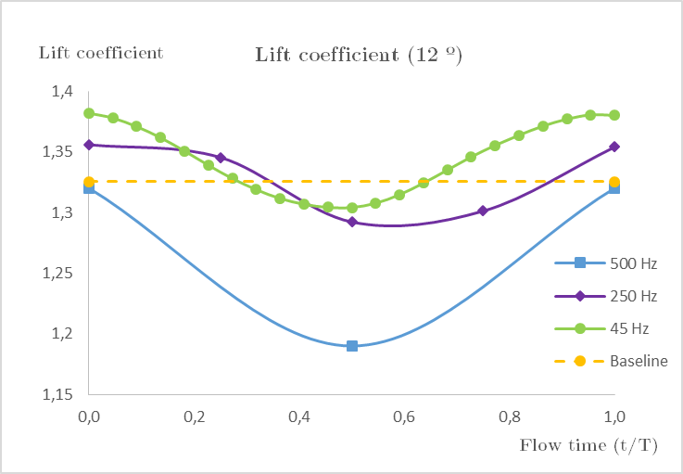
Results: Lift coefficient
The ZNMF should decrease the amplitude of the oscillation
7º
Frequency | 45 Hz | 250 Hz | 500 Hz
Amplitude | 0,046 | 0,076 | 0,071
12º
Frequency | 45 Hz | 250 Hz | 500 Hz
Amplitude | 0,078 | 0,104 | 0,130
Notes:
The lift coefficient is an important result because the ZNMF is expected to reduce the amplitude of the oscillation. As shown in the graphics and charts, in both cases the frequency of 45 Hz is the one that supresses the most the amplitude.

Slide 21
Results: Lift coefficient
The ZNMF should decrease the amplitude of the oscillation
7º
Frequency | 45 Hz | 250 Hz | 500 Hz
Amplitude | 0,046 | 0,076 | 0,071
12º
Frequency | 45 Hz | 250 Hz | 500 Hz
Amplitude | 0,078 | 0,104 | 0,130
Notes:
The lift coefficient is an important result because the ZNMF is expected to reduce the amplitude of the oscillation. As shown in the graphics and charts, in both cases the frequency of 45 Hz is the one that supresses the most the amplitude.

Slide 22
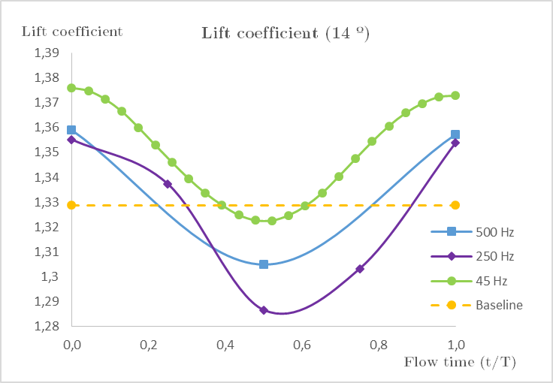
Results: Lift coefficient
The ZNMF should decrease the amplitude of the oscillation
14º
Frequency | 45 Hz | 250 Hz | 500 Hz
Amplitude | 0,078 | 0,104 | 0,130
Notes:
At an angle of attack of 14º, the behaviour is the sae, although the lift coefficient is lower than at 500 Hz.

Slide 23
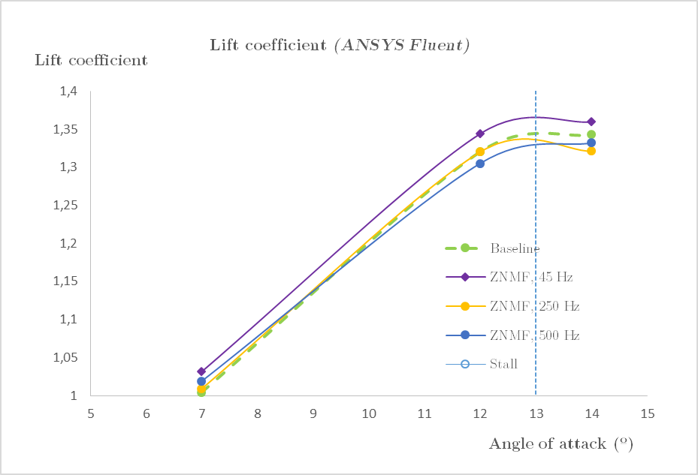
Results: Lift coefficient
Notes:
This is the graphic which shows the boundary layer separation point at each angle of attack and frequency. According to theory, the ZNMF should move backwards this point.
However, it can be easily noticed that only at 12º the ZNMF sets back this point, and again the most optimum frequency is 45 Hz.
Again, the conclusion that ZNMF has to be precisely calibrated gains strength, because at 14º the separation point using the ZNMF is by far closer to the leading edge than when not using the actuator.

Slide 24
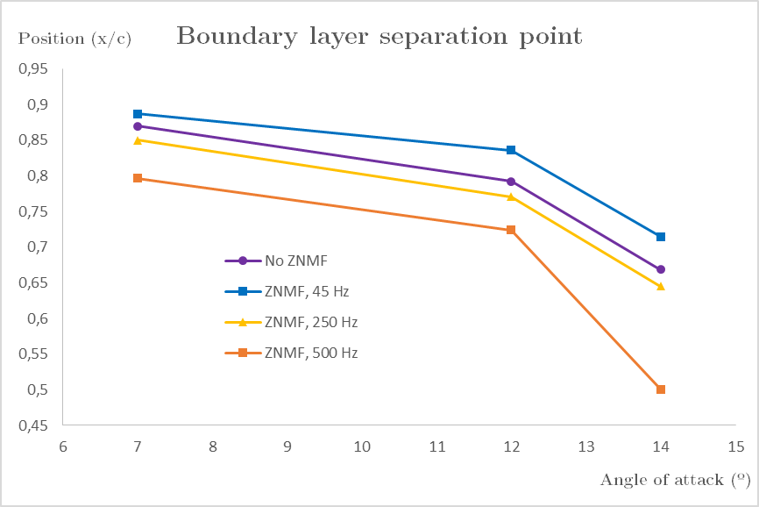
Results: Boundary layer separation
Notes:
This is the graphic which shows the boundary layer separation point at each angle of attack and frequency. According to theory, the ZNMF should move backwards this point.
However, it can be easily noticed that only at 12º the ZNMF sets back this point, and again the most optimum frequency is 45 Hz.
Again, the conclusion that ZNMF has to be precisely calibrated gains strength, because at 14º the separation point using the ZNMF is by far closer to the leading edge than when not using the actuator.

Slide 25
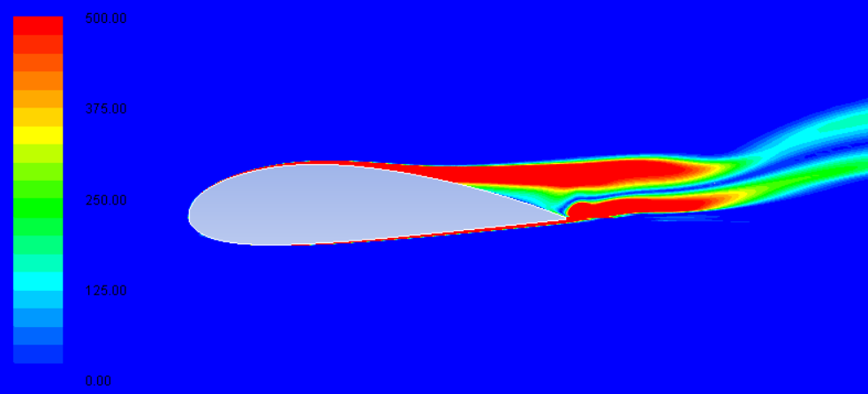
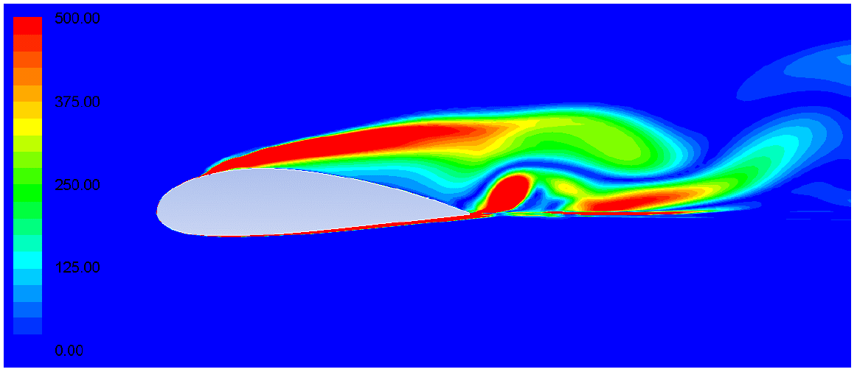
Results: Vorticity magnitude
Vorticity [1/s] of a NACA 4421 without ZNMF.
$α=12º$(ANSYS Fluent)
Vorticity [1/s] of a NACA 4421 using ZNMF.
$α=12º$(ANSYS Fluent)
Notes:
Finally, the vorticity is presented. It can be seen the vorticity added by the actuator, which is similar to the bibliography behaviour (although scales are not equal). This vorticity helps to compensate the vorticity created in the separated region, decreasing its dimensions and therefore moving backwards to the trailing edge the separation point.

Slide 26
Conclusions
The ZNMF improves NACA 4421 performance, best results at 45 Hz
Lift coefficient oscillation amplitude supressed
Boundary layer separation point moved upstream
Separated region diminished
The actuator has to be precisely calibrated
Future work needed to get study the effect of each parameter
Change $C_{μ}$ value
Change orifice parameters (length, position)
Compare ZNMF performance with other AFC devices
Notes:
After discussing the results, it can be concluded that:
ZNMF improves NACA 4421 performance, and the best results are obtained at 45 Hz, because
Lift coefficient oscillation amplitude more supressed
Boundary layer sep point more delayed
Vorticity addition diminishes the separated region
2. However, actuator has to be precisely calibrated in order to get reliable and useful results
3. In order to improve this results, quality of the mesh has to be improved (the y+ value) and the simulations settings have to be readjusted (use better turbulence models)

Slide 27
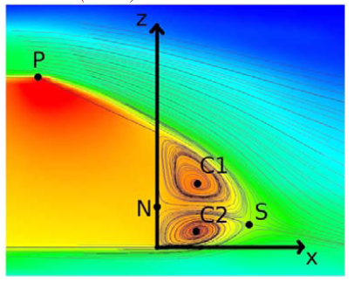
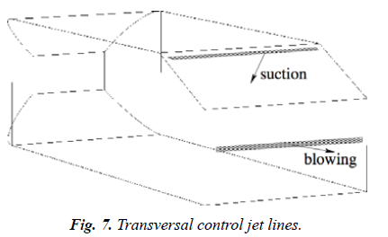
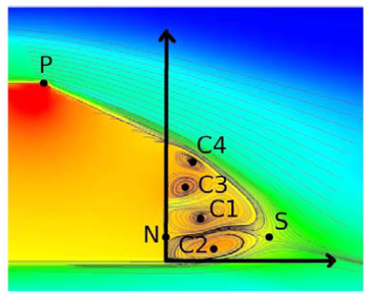
Applying AFC in automobiles
Streamlines in the back of the car without AFC (top) or using it (bottom)
Notes:
After discussing the results, it can be concluded that:
ZNMF improves NACA 4421 performance, and the best results are obtained at 45 Hz, because
Lift coefficient oscillation amplitude more supressed
Boundary layer sep point more delayed
Vorticity addition diminishes the separated region
2. However, actuator has to be precisely calibrated in order to get reliable and useful results
3. In order to improve this results, quality of the mesh has to be improved (the y+ value) and the simulations settings have to be readjusted (use better turbulence models)

Slide 28
Numerical Study on Active Flow Control using Synthetic Jet Actuators over a NACA 4421 Airfoil
AUTHOR
Xavier Guerrero Pich
Notes:
This is the end of the presentation. I hope you have enjoyed it and if you have any questions , I will be pleased to answer them.

Slide 29
Sustainability study
High lift device
Fuel savings
CO₂ emissions decreased
ZNMF actuator saves up to 3% of a common commercial aircraft fuel consumption (Agarwal, 2012)
CO₂ emissions saved
$$240 kg CO_{2}$$
CO₂ emissions saved
240 𝑘𝑔 𝐶𝑂_2
Hourly flight
A320 consumption
$$2500 kg_{kerosene}/h$$
A320 consumption
2500 𝑘𝑔_𝑘𝑒𝑟𝑜𝑠𝑒𝑛𝑒/ℎ
A320 emissions
$$3,23 kg_{CO_{2}}/kg_{kerosene}$$
A320 emissions
3,23 𝑘𝑔_(𝐶𝑂_2 )/𝑘𝑔_𝑘𝑒𝑟𝑜𝑠𝑒𝑛𝑒
Notes:
Furthermore, it is important to know how this actuator affects to the environment. As it facilitates the avoidance of the stall, it could eliminate the necessity of a thrust increment, which brings about fuel savings. This in turn, decreases the CO2 emissions.
According to bibliography, a ZNMF can save up to 3% of an A320 fuel consumption.
CLIC
Therefore, if we assume an hourly flight and we use the aircraft consumption and the fuel emission per kg, wit has been found that it is possible to save up to 240 kg CO2.

Slide 30
Setting simulations parameters
Dimensionless parameters
Mach Number
Reynolds Number
$$M_{∞}=0,13$$
𝑀_∞=0,13
$$Re=3·{10}^{6}$$
𝑅𝑒=3·〖10〗^6
Incompressible flow
Turbulent flow
Solver
RANS
LES
DNS
Notes:
Parameters which define the simulation background:
Mach number, define upstream velocity and uncompressible flow (under 0.2)
Re number, define the chord and density (ideal gas law has been used). We can affirm that the flow is turbulent.
CLIC
Among all turbulence models, the only one which was reachable in terms of time and resources was RANS.

Slide 31
Setting simulations parameters
Dimensionless parameters
Mach Number
Reynolds Number
$$M_{∞}=0,13$$
𝑀_∞=0,13
$$Re=3·{10}^{6}$$
𝑅𝑒=3·〖10〗^6
Incompressible flow
Turbulent flow
Solver
RANS
LES
$$k−ε$$
𝑘−𝜖
DNS
$$k−ω$$
𝑘−𝜔
$$k−ω SST$$
𝑘−𝜔 𝑆𝑆𝑇
Notes:
About the solver, k-E was not good enough near the airfoil surface, and k-W required too much computational power, for that reason, the k-W Shear Stress Transport SST, which is a combination of both,
CLIC

Slide 32
Setting simulations parameters
Dimensionless parameters
Mach Number
Reynolds Number
$$M_{∞}=0,13$$
𝑀_∞=0,13
$$Re=3·{10}^{6}$$
𝑅𝑒=3·〖10〗^6
Incompressible flow
Turbulent flow
Solver
RANS
LES
$$k−ε$$
𝑘−𝜖
DNS
$$k−ω$$
𝑘−𝜔
$$k−ω SST$$
𝒌−𝝎 𝑺𝑺𝑻
Notes:
was the most optimum one to be chosen.

