Slide 1

Adsorption Equilibrium and Kinetic Study for the Removal of Nitrate from Drinking Water Supplies By Chitosan Composite
Wondalem Misganaw Golie
Dr. Sreedevi Upadhyayula
Department of Chemical Engineering,
Indian Institute of Technology Delhi, India

Slide 2
Outline
      Introduction
      Objectives
      Experimental
      Results and discussion
      Conclusions

Slide 3
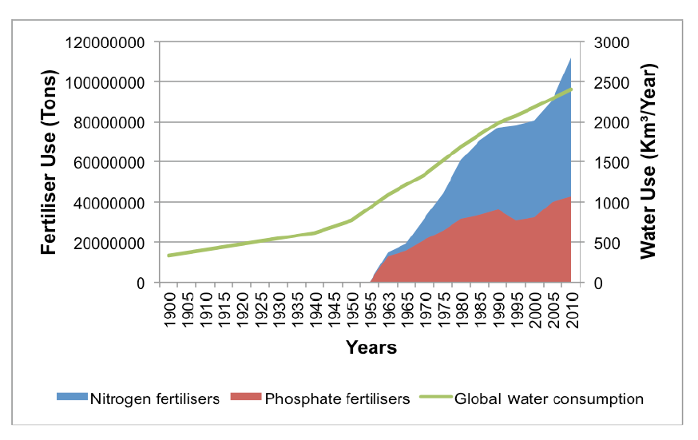
Introduction
  Nitrate is a naturally occurring form of nitrogen and it is part of the nitrogen cycle
  Anthropologic activities cause the imbalances in the nitrogen cycle.
Nitrate contaminated water
Chemical fertilizers
Agricultural processes runoff
Municipal wastewater
Landfill Leachates
Septic systems and urban runoff
Livestock and poultry farming
Automobile and industrial emissions
Worldwide fertilizer use and water consumption
Source: https://freshwaterwatch.thewaterhub.org/content/waterpollution

Slide 4
Risks associated with nitrate
Health effects
  High concentration of nitrate in drinking water leads to:
  Methemoglobinemia
  Spontaneous abortions
  Cancer
2. Eutrophication
  Affects biodiversity
Regulatory limits for nitrate in drinking water
Country/Organization | Max. Acceptable Concentration(MAC) | References
WHO | 50 mg/l as NO₃⁻ | (WHO, 2011)
The USEPA | 10 mg NO₃⁻-N/l | (USEPA, 2009)
European Union | 50 mg/l as NO₃⁻ | European Union (Drinking Water) Regulations, 2014)
Canada | 45 mg/l as NO₃⁻ | (Health Canada, 2012)
Ontario Ministry of the Environment | 10 mg NO₃⁻-N/l | (Ontario Ministry of the Environment, 2006)
Australia | 50 mg/l as NO₃⁻ | (Health Australia, 2004)
Malaysia | 50 mg/l as NO₃⁻ | (Health Malaysia, 2004)
India | 45 mg/l as NO₃⁻ | (Bureau of Indian Stabdards, 2012)

Slide 5
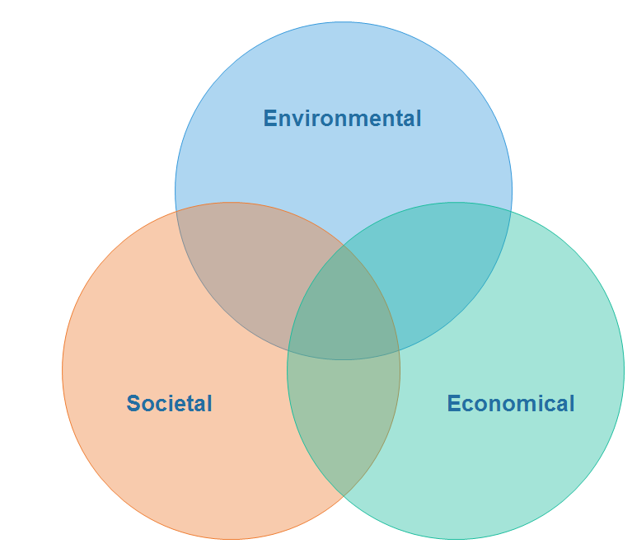
Technologies for Nitrate Removal from Water
Treatment options
Removal
(Physico-chemical)
Reduction
Ion exchange
Reverse osmosis
Electrodialysis
Adsorption
Catalytic
Chemical
Biological

Slide 6
Objectives
Preparation and characterization of of chitosan/alumina composite for the removal of nitrate from drinking water
Examine the effect of different parameters on the adsorption of nitrate
Determine kinetic and equilibrium parameters using batch adsorption experimental data
Investigate the re-usability of adsorbent by cyclic adsorption-regeneration study

Slide 7

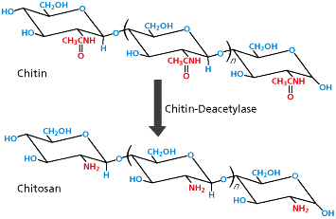
Features of chitosan
Why Chitosan?
Biocompatible
Biodegradable
Non-toxic
Abundant and Low cost
Renewable
Chitosan is the N-deacetylated derivative of chitin (the 2nd abundant natural polysaccharide next to cellulose)
Limitations
Sensitive to pH and temperature
Poor mechanical stability
    Modifications
    Grafting, Crosslinking, Organic-inorganic hybrid composite formation
Ref. (M. N. Ravi Kumar, 2000); (Kyzas & Bikiaris, 2015)

Slide 8
Experimental (Batch adsorption study)
Approach
Adsorbent preparation and characterization
Adsorption (investigation of the effects of operating parameters)
Regeneration study
Adsorption equilibrium isotherm study
Kinetic study
Thermodynamic parameters

Slide 9
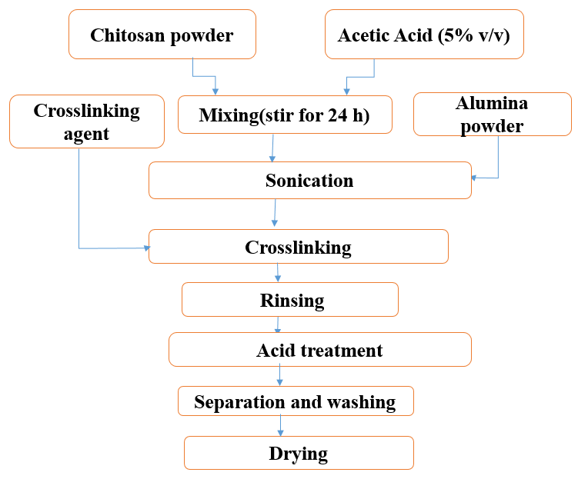
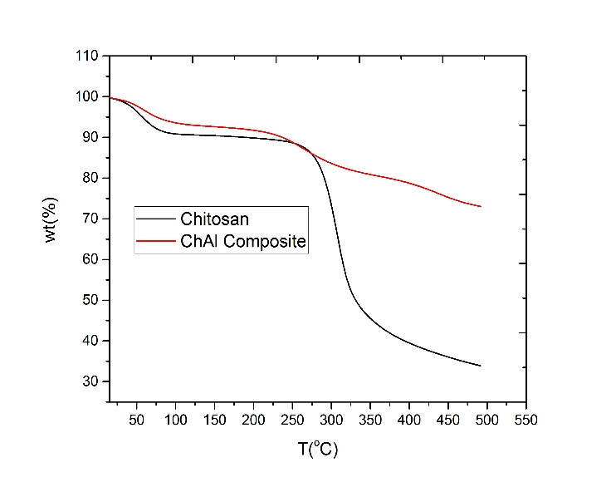
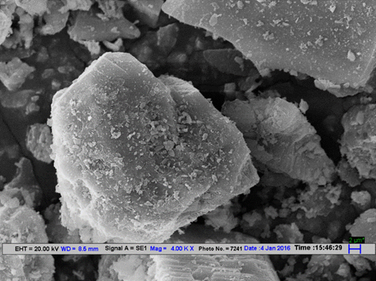
Preparation and Characterization
Preparation
Characteristics of ChAl Composite
BET Surface area(m²/g) | 59.37
Pore Volume (m³/g) | 0.144
Pore Size(A) | 97.23
Average Particle size(mm) | 0.25
pH_{pzc} | 7.6
SEM image of ChAl composite
TGA curve of chitosan and ChAl composite

Slide 10
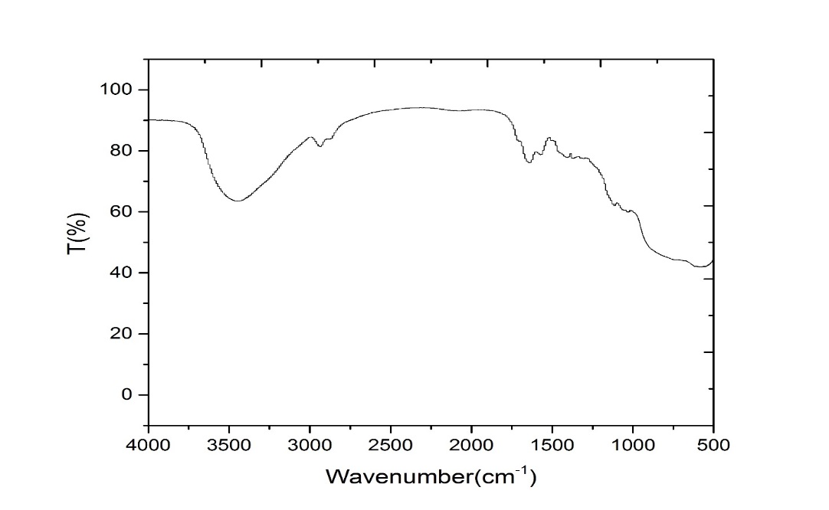
FT-IR spectra of ChAl composite
EDX
El AN Series unn. C norm. C Atom. C Error
[wt.%] [wt.%] [at.%] [%]
-------------------------------------------
O 8 K-series 49.08 49.08 49.12 16.9
C 6 K-series 20.46 20.46 27.27 7.7
Al 13 K-series 20.40 20.40 12.10 1.0
N 7 K-series 10.07 10.07 11.51 4.9
------------------------------------------ Total: 100.00 100.00 100.00
Wave No.(cm⁻¹ )
3500 | -OH and -NH₂
2900 | Stretching of C-H in -CH and -CH₂.
1630 | bending and vibration of -NH in -NH₂
1250 | Stretching vibration of -CO in -COH
630 | Al-O stretching

Slide 11

Adsorption study
Batch adsorption was conducted in an orbital shaker
Effects of significant parameters were investigated
Exhausted adsorbent was regenerated
$Removal efficiency (\%)=$ $\frac{(C0− Ct)}{C0} x 100$
Adsorption capacity(mg/g):${ q}_{t}=$ $\frac{(C0− Ct)V}{M}$

Slide 12
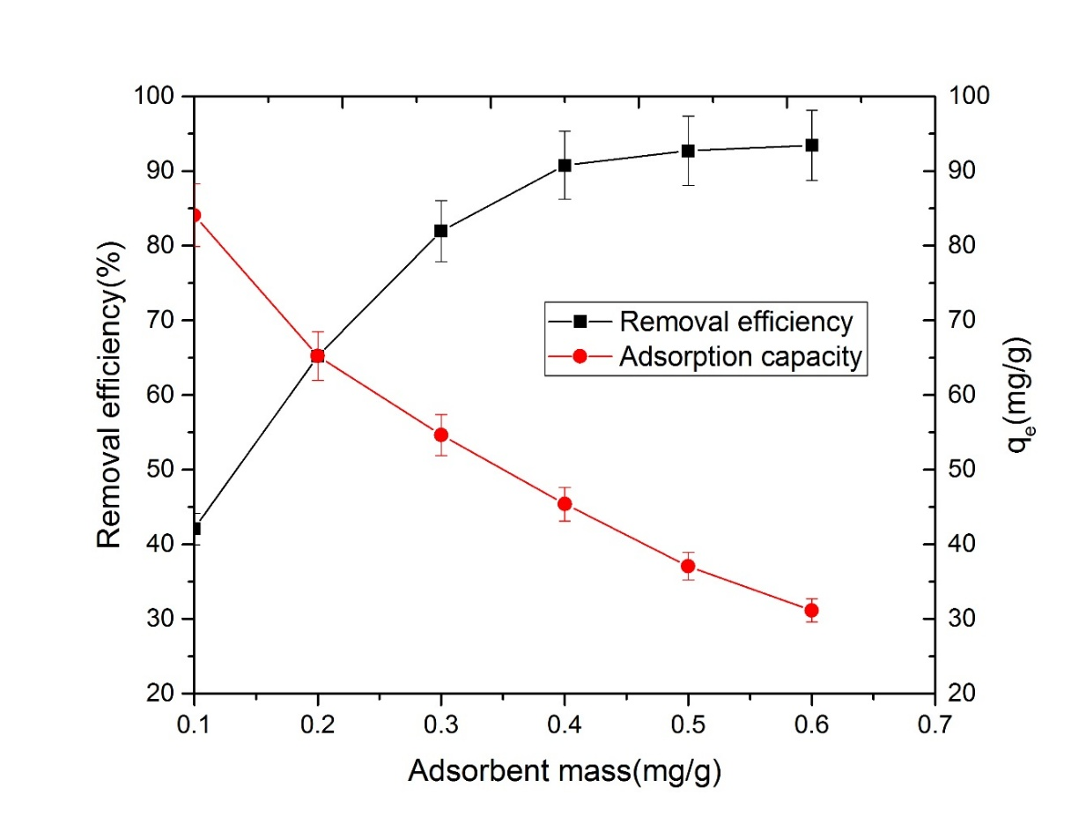
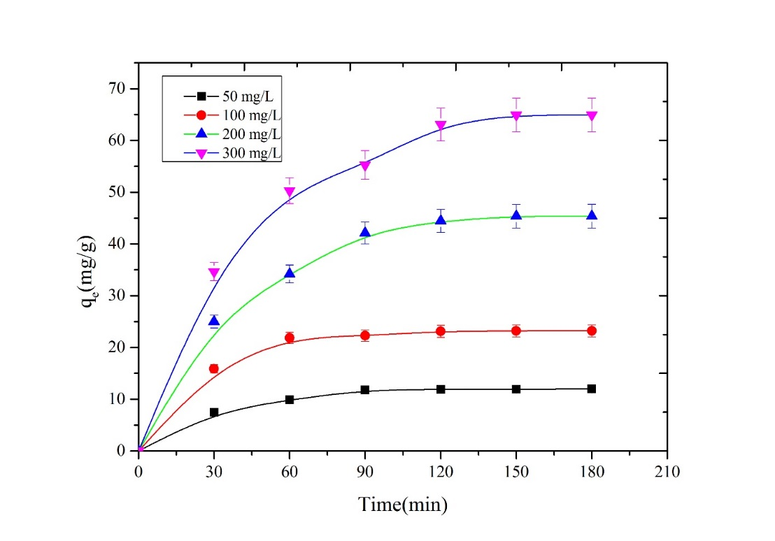
Results
Effect of adsorbent dose
Effects of contact time and initial nitrate concentration

Slide 13
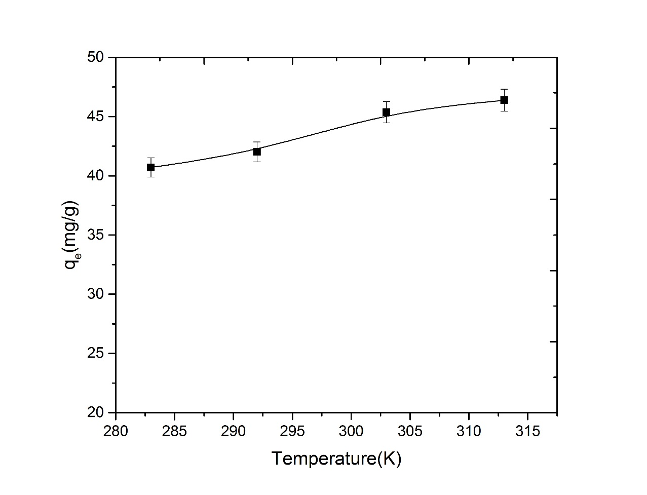
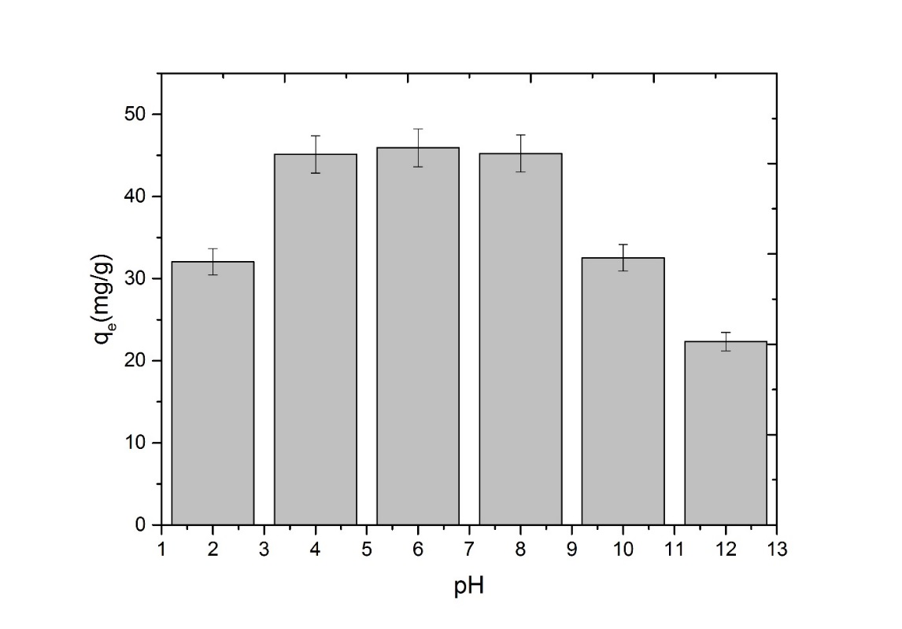
Effect of temperature on adsorption capacity
Effect of pH

Slide 14
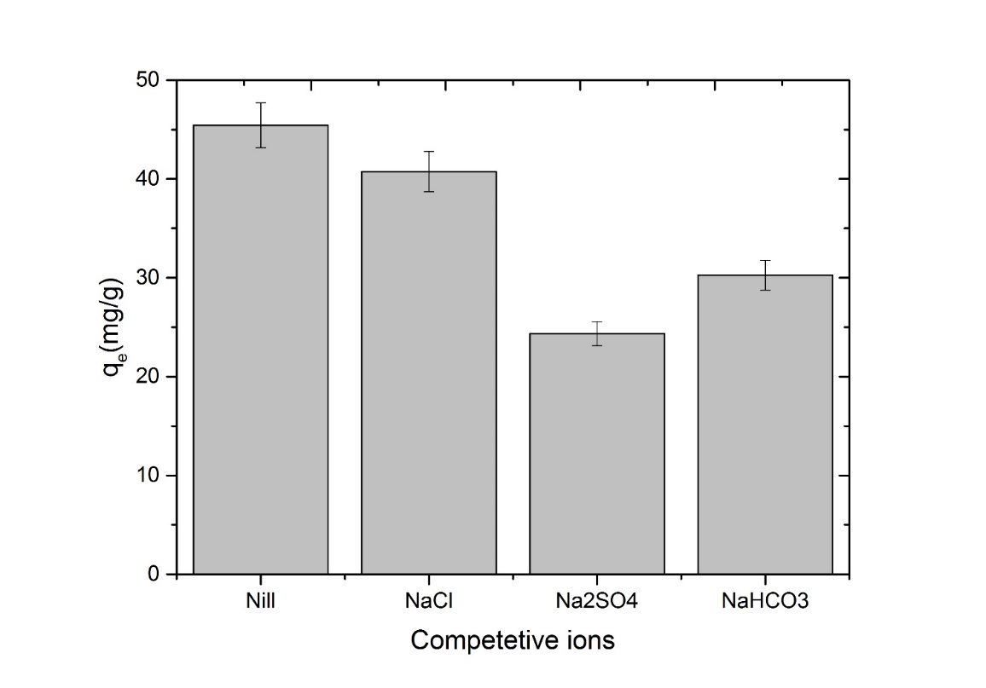
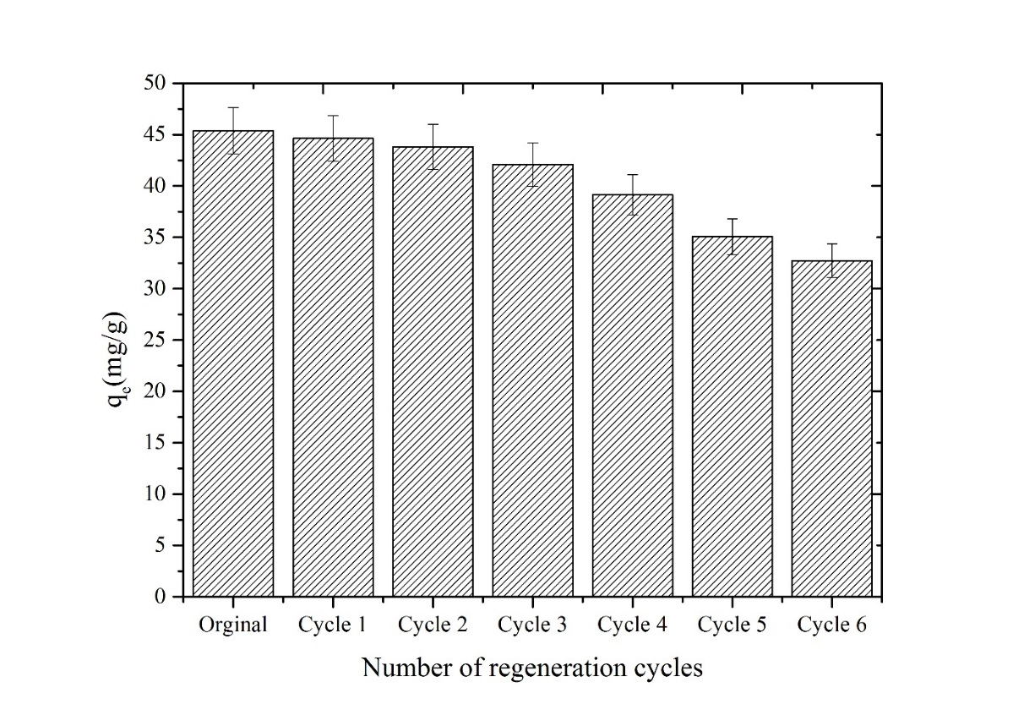
Relationship between regeneration cycles and adsorption capacity
Effect of presence of other ions

Slide 15

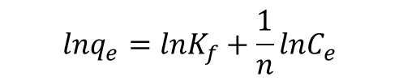

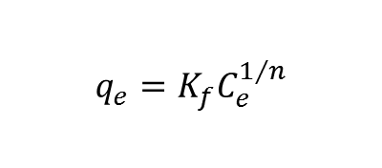

Adsorption Equilibrium Isotherms
Langmuir Isotherm
Freundlich Isotherm
The Langmuir adsorption model is given by
The Freundlich equation is expressed as
$$q_{e}=\frac{q_{m}bC_{e}}{1+bC_{e}}$$
$$q_{e}=K_{f}C_{e}^{1/n}$$
$$\frac{C_{e}}{q_{e}}=\frac{1}{bq_{m}}+\frac{C_{e}}{q_{m}}$$
The linearized form is,
A linear form of this expression is
$R_{L}=\frac{1}{1+bC_{O}}$
$$lnq_{e}=lnK_{f}+\frac{1}{n}lnC_{e}$$
Dimensionless separation factor,
The value of R_{L} indicates the type of the isotherm to be either:
unfavorable (R_{L} >1),
linear (R_{L}=1),
favorable (0 < R_{L} < 1)
irreversible (R_{L}= 0).

Slide 16
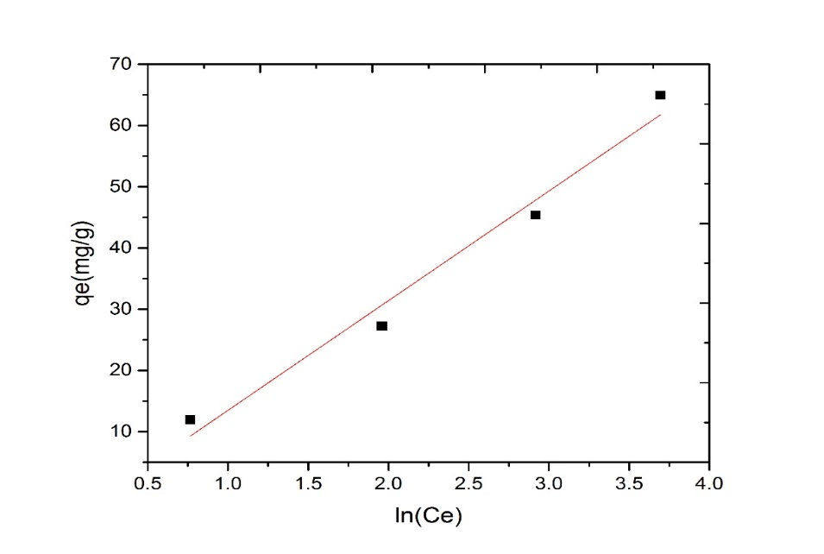
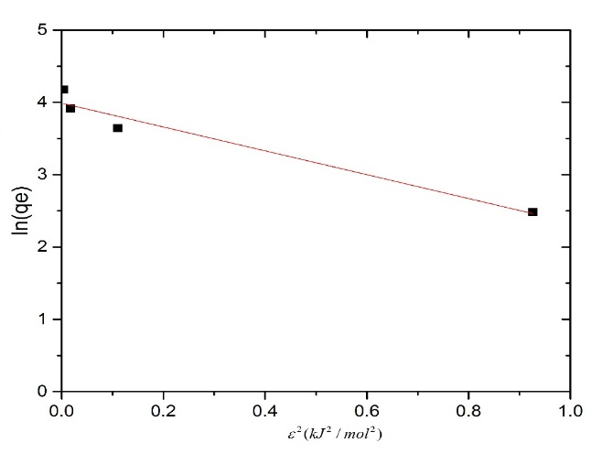

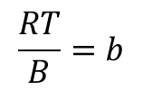

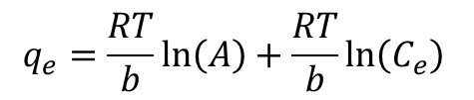
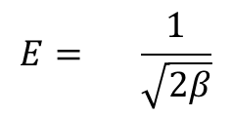
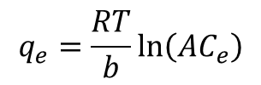
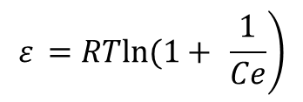
Temkin isotherm
Dubinin–Radushkevich (D-R) Isotherm
$$\ln{q_{e}}= \ln{q_{o}−β}ε^{2}$$
$$q_{e}=\frac{RT}{b}\ln\left(AC_{e}\right)$$
$$\left.ε =\text{​}RTln(1+ \frac{1}{Ce}\right)$$
$$q_{e}=\frac{RT}{b}\ln\left(A\right)+\frac{RT}{b}\ln\left(C_{e}\right)$$
$$\frac{RT}{B}=b$$
The mean adsorption energy (E)
$$E= \frac{1}{\sqrt{2β}}$$
$$q_{e}=B\ln\left(A\right)+B\ln\left(C_{e}\right)$$

Slide 17
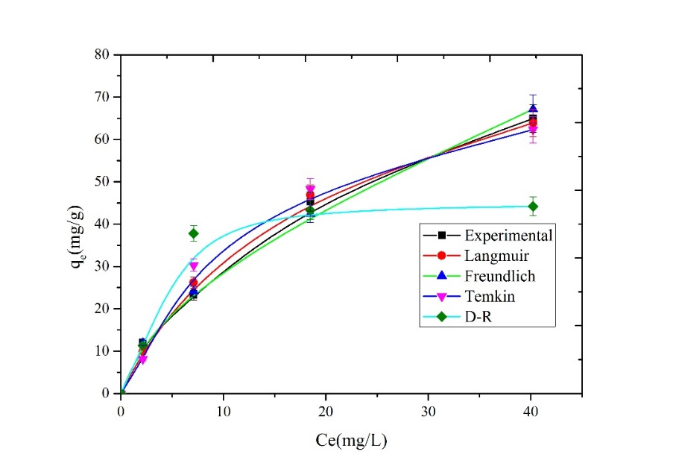
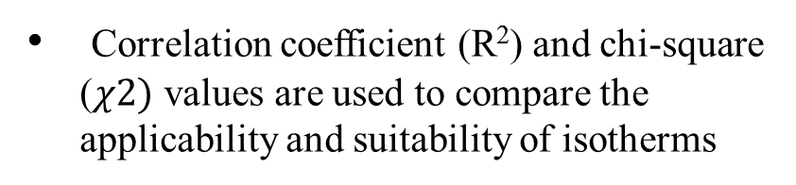
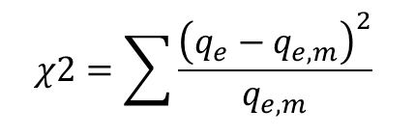
Adsorption isotherm parameters
Chi-square analysis (A. Sowmya & Meenakshi, 2013)
$$χ2=\sum{\frac{{\left(q_{e}−q_{e,m}\right)}^{2}}{q_{e,m}}}$$
Isotherm | Parameters
Langmuir | q_{m}(mg/g) | 92.59
 | b(L/g) | 0.056
 | R² | 0.97
 | R_{L} | 0.264
 | χ2 | 0.84
Freundlich | 1/n | 0.59
 | n | 1.69
 | K_{f}(mg/g)(L/mg)^{1/n} | 7.58
 | R² | 0.99
 | χ2 | 0.31
D-R | β(mol²/kJ²) | 1.48
 | q_{o}(mg/g) | 44.46
 | E(kJ/mol) | 0.58
 | R² | 0.77
 | χ2 | 1.47
Temkin | B(J/mol) | 18.23
 | R² | 0.96
 | χ2 | 0.89
Correlation coefficient (R²) and chi-square ($χ2)$ values are used to compare the applicability and suitability of isotherms

Slide 18
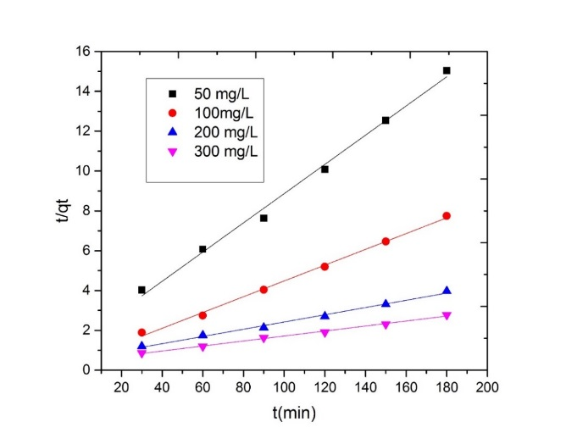
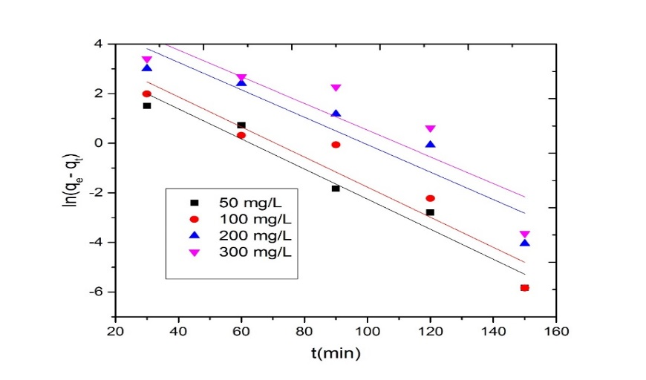
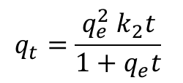
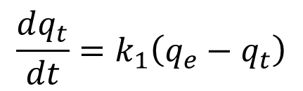
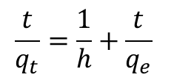
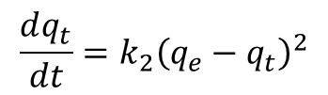


Adsorption Kinetics
Pseudo-first-order model
Pseudo-second-order model
$$\frac{dq_{t}}{dt}=k_{1}\left(q_{e}−q_{t}\right)$$
$$\frac{dq_{t}}{dt}=k_{2}{\left(q_{e}−q_{t}\right)}^{2}$$
$h=k_{2}q_{e}^{2}$
$$\frac{t}{q_{t}}=\frac{1}{h}+\frac{t}{q_{e}}$$
$$q_{t}=\frac{q_{e}^{2} k_{2}t}{1+q_{e}t}$$
$ln(q_{e}−q_{t})=ln q_{e}−k_{1}t$
k₁ is rate constant of pseudo-first-order adsorption (1/min).
k₂ is the pseudo-second-order rate constant (g/mg min)

Slide 19
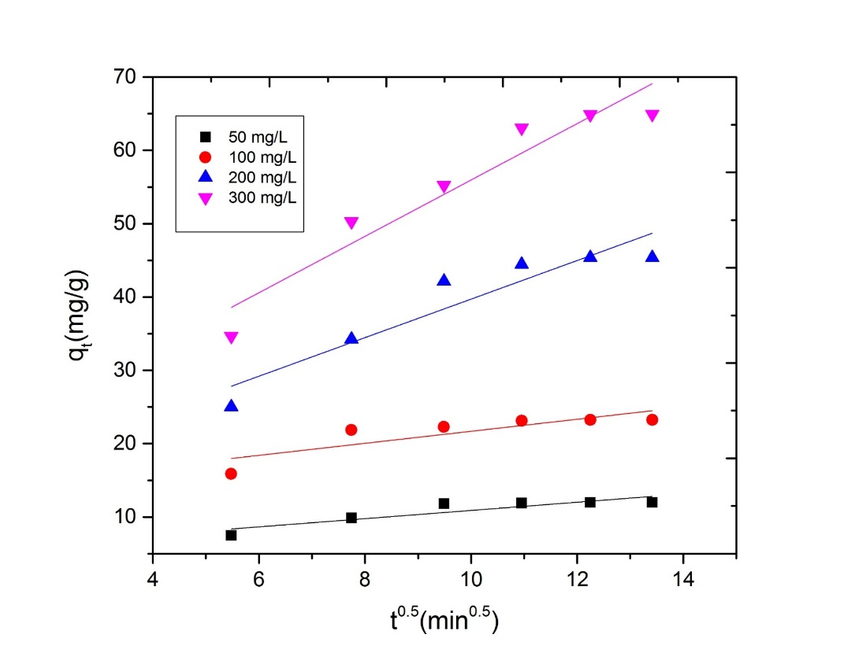
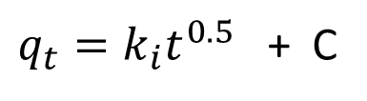
Intraparticle diffusion model
Kinetic parameters
Model | Parameter
 | Initial concentration(mg/g) | 50 | 100 | 200 | 300
Pseudo-first-order | k₁(min⁻¹) | 0.06 | 0.061 | 0.06 | 0.05
 | q_{e}(experimental)(mg/g) | 11.96 | 23.22 | 45.38 | 64.94
 | q_{e}(calculated)(mg/g) | 45.41 | 73.65 | 239.31 | 371.44
 | R² | 0.95 | 0.88 | 0.83 | 0.76
Pseudo-second-order | k₂(g/mg min) | 0.004 | 0.003 | 0.001 | 0.001
 | q_{e}(experimental)(mg/g) | 11.96 | 23.22 | 45.38 | 64.94
 | q_{e}(calculated)(mg/g) | 13.64 | 25.25 | 54.95 | 80.00
 | h | 0.65 | 1.93 | 1.65 | 2.16
 | R² | 0.99 | 0.99 | 0.97 | 0.97
Intraparticle diffusion | k_{i}(mg /g.min^{0.5}) | 0.56 | 0.82 | 2.63 | 3.84
 | R² | 0.76 | 0.64 | 0.86 | 0.91
$q_{t}=k_{i}t^{0.5}$ + C

Slide 20
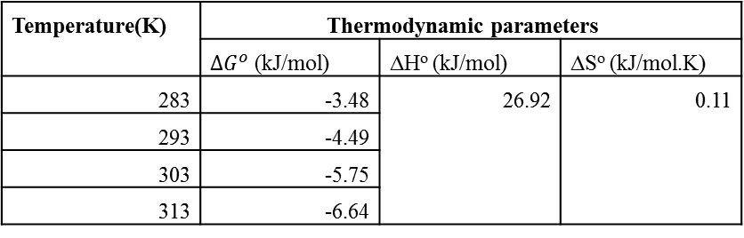

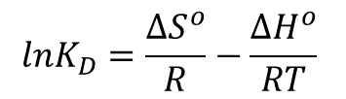
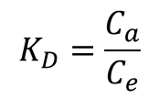
Thermodynamic parameters for the adsorption of nitrate on ChAl composite
$${∆G}^{o}=−RTlnK_{D}$$
(P. S. and S. Chowdhury, 2003)
$$K_{D}=\frac{C_{a}}{C_{e}}$$
$$lnK_{D}=\frac{{∆S}^{o}}{R}−\frac{{∆H}^{o}}{RT}$$
Temperature(K) | Thermodynamic parameters
 | ${∆G}^{o}$ (kJ/mol) | ∆Hº (kJ/mol) | ∆Sº (kJ/mol.K)
283 | -3.48 | 26.92 | 0.11
293 | -4.49
303 | -5.75
313 | -6.64

Slide 21
Conclusions
The adsorption data were well fitted with the Freundlich adsorption isotherm which indicates the heterogeneous nature of adsorption.
The kinetic data indicates that the pseudo-second-order model better describes the adsorption process of nitrate onto the ChAl composite.
Physical binding force involved in the adsorption of nitrate on ChAl composite was confirmed from E value calculated from the D-R isotherm.
Thermodynamic parameters revealed that adsorption of nitrate was endothermic and spontaneous.
Electrostatic interaction between the anion and the positive functional groups in the adsorbent was the main driving force for the adsorption of nitrate.
Chitosan biopolymer can be used as an inexpensive, sustainable, reusable, and environment-friendly treatment option for nitrate contaminated drinking water..

Slide 22
Thank You

