Slide 1
The Unique Role of TLR3 Agonists and the Induced Products of Innate Immunity as Pharmaceuticals
William M. Mitchell, MD, PhD
Pathology, Microbiology & Immunology
Vanderbilt University

Slide 2
Competing Interests: WMM is a member of the Board of Directors for Hemispherx Biopharma (a Public traded biotech company) and Chronix Biomedical (a privately held biotech company)

Slide 3
The Master Innate Immune Molecule: State of the Art
(IFN circa 1970s)

Slide 4
Major Pathways of Antiviral Innate Immunity
Initial cellular induction
  Viral pattern recognition
    TLRs
    Helicases
Cell response
  IFN
    Antiviral mediators

Slide 5
The Toll/Toll-Like Receptors
Structure and Function

Slide 6
Drosophila Toll Receptors
Originally studied in Drosophila melanogaster for their function in embryonic development
Human genome sequencing demonstrated sequence homologies to Toll Receptors (i.e.-Toll-Like Receptors)
No known embryological function of TLRs in vertebrates
Toll and Toll-Like Receptors are widely distributed in nature

Slide 7
PAMPs and Function
Toll and Toll-Like Receptors (TLRs) are specific germ-line pattern recognition proteins (PRPs) that detect common structural motifs of microorganisms bearing distinctive pathogen-associated molecular patterns (PAMPs) that initiate cellular innate and adaptive immune responses.
All Toll and Toll-Like Receptors are Type 1 membrane proteins with an ectodomain (extra-cytoplasmic) containing binding sites for PAMP ligands and a cytoplasmic signaling domain.

Slide 8
Wide Distribution of Toll/TLRs
CLASS | NAME | #TLRs
Mammal | Human | 10;TLR1-10
Mammal | Mouse | 12;TLR1-13(TLR10)
Mammal | Rat | 10;TLR1-7,9,10,13
Mammal | Dog | 10;TLR1-10
Mammal | Cat | 9;TLR1-9
Mammal | Cow | 10;TLR1-10
Mammal | Opossum | 11;TLR1-12
Aves | Chicken | 13;TLR1a-c,2a,b,3,4,7a,b,8,15,21
CLASS | NAME | #TLRs
Actinoptergli | Green Puffer Fish | 10;TLR1,b,2,3,5,8,9,21-23
Ascidiacea | Tunica | 7-19
Echinoida | Sea Urchin | 222
Insecta | Honey Bee | 5;Toll1,2,6, 8,10
Insecta | Flour Bettle | 9;Toll1-4, 6-10
Secernentea | Round worm | 1; Toll1
Anthozoa | Anemone | 1
Leulier F and Lemaitre, Nat Rev Genetics 9:165-178, 2010

Slide 9
Pathogen Structural Patterns Detected by TLRs
Bacteria
Fungus
Component | Species | TLR Usage
LPS | Gm Negatives | TLR4
Diacyl lipopep- | Mycoplasma | TLR6,2
Triacyl lipopep- | Bact/Mycoplas | TLR1,2
Lipoteichoic acid | Gm Positives | TLR6,2
PG | Gm Positives | TLR2
Porins | Neisseria | TLR2
Lipoarabinoma- | Mycobacteria | TLR2
Flagelin | Flagelated Bac | TLR5
CpG DNA | Bact/Mycobac | TLR9
ND | Uropathogens
Component | Species | TLR Usage
Zymosan | Saccharomyc | TLR6,2
Phospholipo-mannan | Candida | TLR2
Mannan | Candida | TLR4
Glucuronoxylo-mannan | Cryptococcus | TLR2,4

Slide 10
Pathogen Structural Patterns Detected by TLRs
Parasites
Viruses
Parasites | Species | TLR Usage
tGPI-mutin | Trypanosome | TLR2
Glycoinositol- phosphatide | Trypanosome | TLR4
Hemozoin | Trypanosome | TLR6
Profilin-like | Toxoplasma | TLR11
Viruses | Species | TLR Usage
DNA | Viruses | TLR9
dsRNA | Viruses | TLR3
ssRNA | RNA | TLR7,8
Env Proteins | RSV,MMTV | TLR4
Hemagglut- | Measles agents | TLR2
ND | HCMV, HSV1 | TLR2

Slide 11
Leucine-Rich Repeats (LRR) of the TLRs
19-25 tandem LRRs in the ten human LTRs
The consensus sequence of the LRRs:
  xLxxLxLxxNxLxxLxxxxFxxLx
Leucine residues may be replaced by other hydrophobic residues
Forms a flat horseshoe shaped structure
Capped by specialized N- and C-terminal structures known as LRR-NT and LRR-CT domains

Slide 12
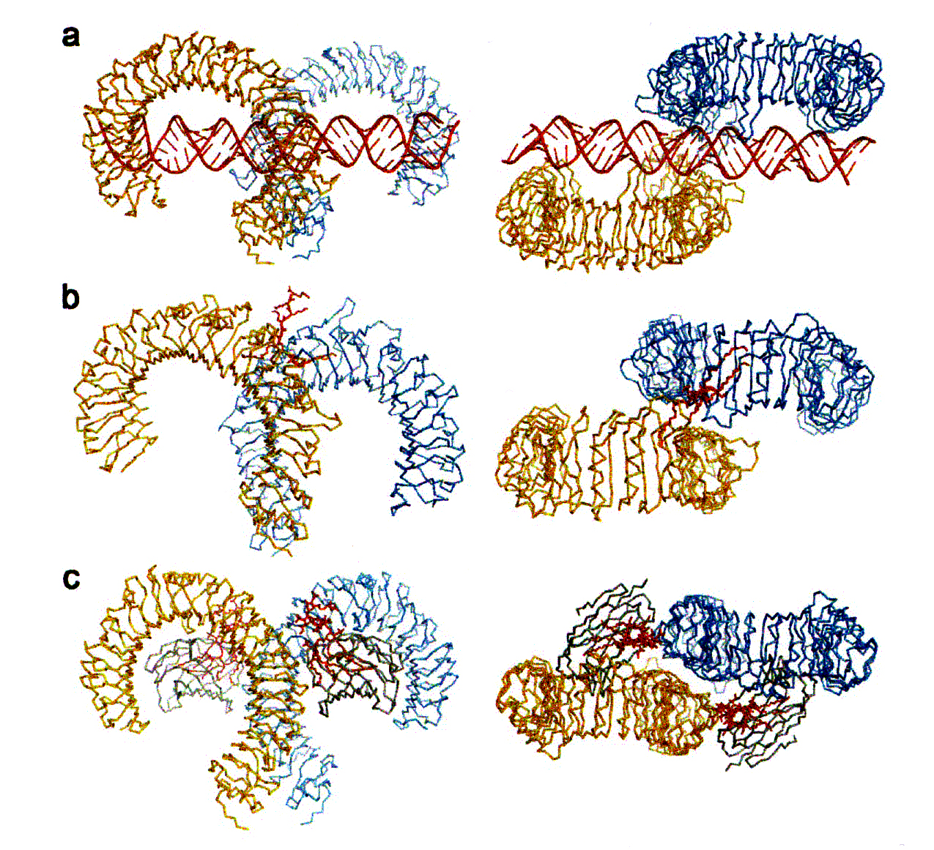
Leucine Rich Repeats (LRR) Provide the Structural Basis for PAMP Detection
Residues of the LRR provide the specific PAMP ligand affinity site to form a dimer that activates the TIR cytoplasmic domain to recruit adapter signaling proteins
  A. TLR3 (dsRNA) homodimer
  B. TLR1/TLR2:Pam₃CSK₄ heterodimer (functional residues of the lipopeptide provides non-covalent bond association of TLR1 and TLR2
  C. TLR4/MD2: LPS homodimer requires the accessory protein, MD2 for dimerization

Slide 13
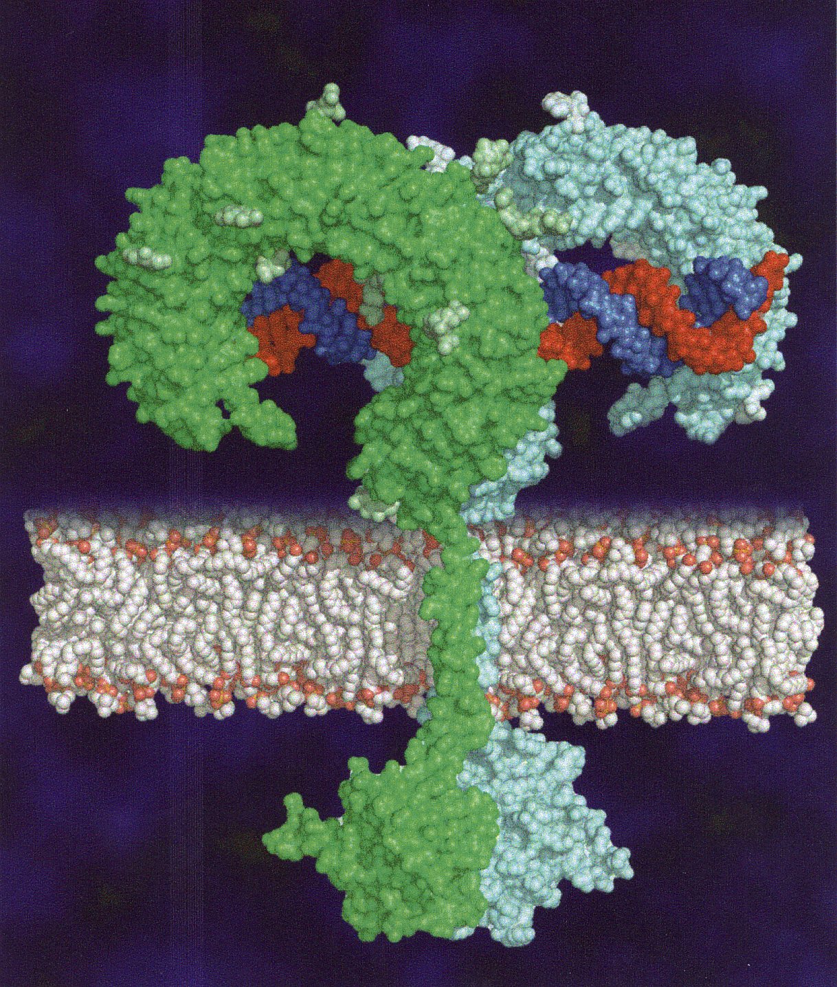
Model Activated TLR Structure
Mouse TLR3
Agonist (dsRNA) activated dimer
Ectodomain with PAMP reconnition sites bind agonist
Dimer formation brings globular cytoplasmic TIR domains of monomers to drive adapter protein(s) association with the cytosolic TIR domain and induction of intracellular signaling
Botos et al.BBA; 1789:667-674(2009)

Slide 14
Intracytoplasmic Signaling Pathways
Association of TLR monomers into either a homodimer or heterodimer structure is dependent on the PAMP ligand
Dimer formation activates the intracytoplasmic signaling complex commonly referred to as “adapter” proteins or factors
There are two signaling pathways dependent on the specific TLR
  MyD88 dependent (TLRs 1, 2, 5-10
  MyD88 independent (TLR 3)
  Mixed (TLR 4)

Slide 15
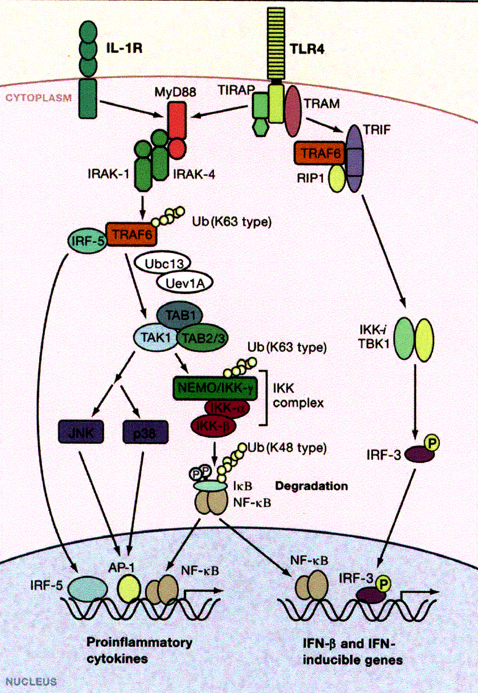
MyD88 Dependent Intracytoplasmic Signaling Pathway
All TLRs except TLR3 utilize the IL-1R MyD88 path
Dimer activated MyD88 recruits IRAK-4, and MyD88:IRAK-4 recruits IRAK-2(1) into a MyDDosome complex that initiates a phosphorylation event and downstream activation of NF-κB, Ap-1 and IRF-5 induction of inflammatory cytokines
Lin S-C et al. Nature 465: 885-890 (2010)

Slide 16
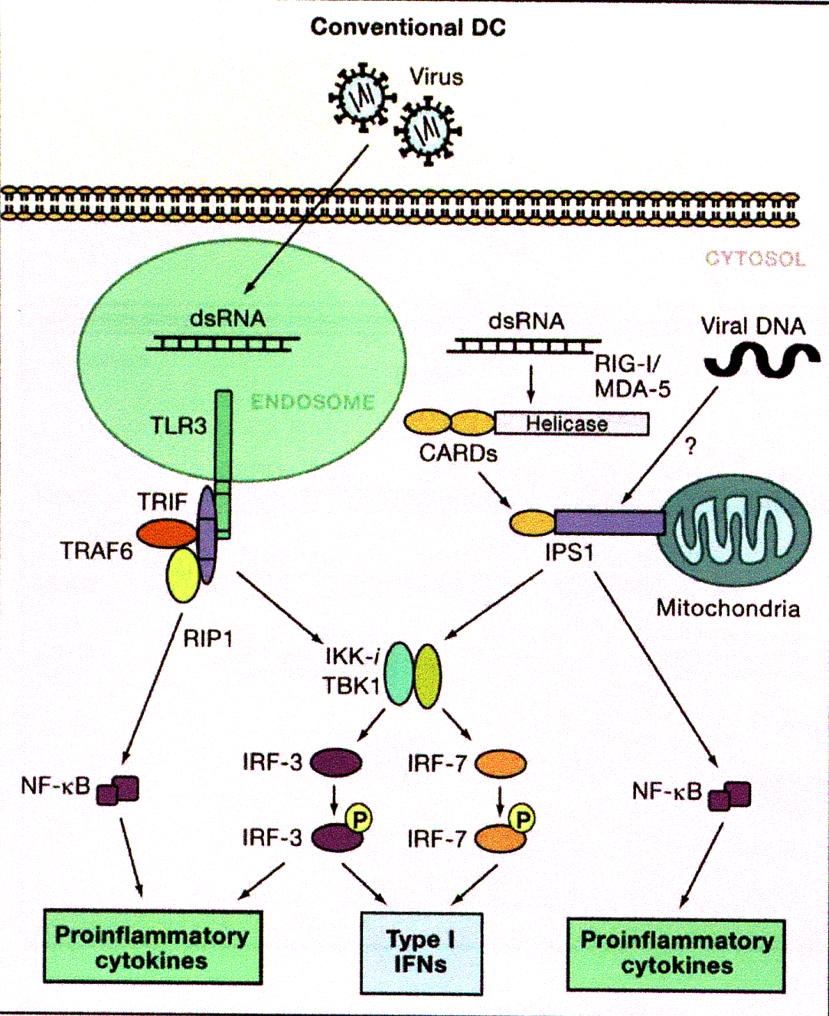
TLR3 MyD88 Independent, TRIF Dependent TLR3 Intracellular Signaling Pathway
TRIF/TRAF6/RIP1 complex initiates an IKK/TBK1 mediated dimer formation of IRF3 and IRF7 that translocate to nucleus that activate ISREs for Type 1 IFN transcription
The TLR3 activates NF-κB and proinflammatory responses although IFN transcription appears to be dominant
Poly I:Poly C activates mda5 with resultant proinflammatory responses that is not shared by Poly I:PolyC₁₂U
Akira S et al. Cell 124:783-801 (2006)

Slide 17
TLR Activation/Response Summary
Toll and Toll-Like Receptors share structural features
Humans have 10 TLRs with differential responses to PAMPs that initiate innate and adaptive immune responses
TLR dimer formation results from PAMP ligand binding to specific TLRs.
Intracellular signaling induces transient gene responses
All human TLRs except TLR3 utilize a proinflammatory MyD88 pathway
TLR3 exclusively uses a TRIF pathway following dsRNA dependent dimerization
Not all synthetic dsRNAs are equivalent
  Poly I:Poly C activates both a TLR3 and a mda5 mediated pathway
  Poly I:Poly C12U is restricted to TLR3 as an agonist
IFN-α/β are major TLR resonse elements with induction of shared and non-shared TLR induced transient gene reponses

Slide 18
Highly Pathogenic Emerging Viral Pathogens
Pathogenicity directly related to subversion of one or more of the components of innate immune response
  Highly pathogenic avian influenza viruses (HPAIV)
  Human coronoviruses (SARS-CoV, MERS-CoV)
  Filoviruses (Ebola, Marburg, Cueravir)
    Ebolaviruses (Zaire, Sudan, Tai forest, Bundibugyo, Reston)
    Marburgvirus (Marburg)
    Cueravirus (Lloviu)

Slide 19
HPAIV
Segmented negative strand ssRNA virus
NS1 derived from the NS segment is multifunctional
  N-terminal 73 amino acids forms a dsRNA binding domain through R35, K41, R46 electrostatic bonding to dsRNA phosphodiester backbone
  N-terminal (E96,E97) binds TRIM essential for RIG-1 activation
  Prevents activation of PKR and 2’-5’OAS

Slide 20
HPAIV Pathogenesis
Mortality in humans is independent of morbidity and mortality in fowl
  H5N1 has high mortality rate in both fowl and humans
  H7N9 has low mortality rate in fowl but high in humans
Human mortality is always associated with Acute Respiratory Distress Syndrome (ARDS)
  ARDS is not dependent on pulmonary viral titer
  Low dose oral IFN can protect against ARDS in cynomolgus primates

Slide 21
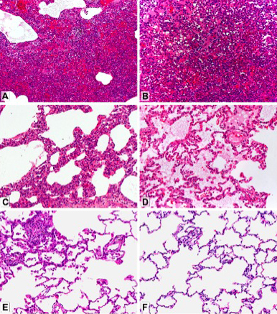
Pulmonary Protection in Primates from H5N! With Low Dose Oral IFN
Prophylactic protection with buccal administration of a low dose natural IFN- α (Alferon)
No effect on H5N1 pulmonary titers
Dose dependent protective response with minimal pulmonary damage (Panel F) at highest dose administered (62.5 IU/Kg)
-
Antiviral Research 2014; 110: 175–180

Slide 22
Human Highly Pathogenic Coronaviridae
Enveloped positive strand non-segmented RNA viruses
Both highly pathogenic and mildly pathogenic human coronaviruses
Highly Pathogenic
  Severe Acute Respiratory Syndrome Coronavirus (SARS-CoV)
  Middle Eastern Respiratory Syndrome Coronavirus (MERS-CoV)

Slide 23
SARS-CoV and MERS-CoV are Infectious Innate Immunity Deficiency Diseases
Infection with MERS-CoV inhibits cellular IFN response
MERS-CoV ORF 4a binds dsRNA
Predicted dsRNA is at N-terminus
Both IFN and a dsRNA in advanced clinical trials provide protection against SARS-CoV infection

Slide 24
SARS-CoV Inhibition in Cell Culture by Commercial Pharmaceuticals
 | Antiviral Agent | Source | Highest Concentration | Complete Inhibition of Cytopathic Effect
Natural Interferon | Interferon α‑n3 (Alferon N) | Hemispherx | 10,000 IU/mL | Yes
Recombinant Interferons | Interferon α‑n1 (Wellferon) | GlaxoSmithKline (withdrawn) | 500,000 IU/mL | Yes
 | Interferon α‑2a (Roferon) | Roche | 100,000IU/mL | No
 | Interferon α‑2b (Intron A) | Schering-Plough | 500,000 IU/mL | No
 | Interferon β‑1a (Rebif) | Serono | 500,000 IU/mL | No
 | Interferon β‑1b (Betaseron) | Schering AG | 100,000IU/mL | Yes
Nucleoside Analogs | Acyclovir | Faulding | 1,000 µg/mL | No
 | Ganciclovir (Cymevene) | Roche | 50,000 µg/mL | No
 | Ribavirin | ICN Pharma | 10,000 µg/mL | Yes (toxic to cells)
Protease Inhibitors | Indinavir (Crixivan) | Merck | 100 µmol/mL | No
 | Nelfinavir (Viracept) | Roche | 10,000 nmol/L | No
 | Saquinavir (Fortovase) | Roche | 10,000 nmol/L | No
Reverse Transcriptase Inhibitors | Lamivudine (Epivir) | GlaxoSmithKline | 1,000 µmol/L | No
 | Zidovudine (Retrovir) | GlaxoSmithKline | 10,000 µg/mL | No
Neuraminidase Inhibitors | Oseltamivir (Tamiflu) | Roche | 10,000 µmol/L | No
 | Zanamivir (Relenza) | GlaxoSmithKline | 1,000 µmol/L | No
 | Amantadine (Symmetrel) | Novartis | 1,000 µg/mL | No
Tan et al. Emerging Infect Dis 2004;10:581-586

Slide 25
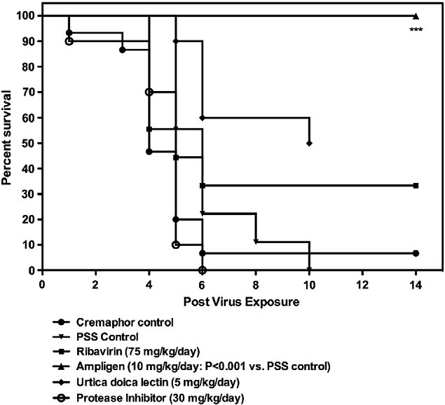
In vivo protection in mice from mouse adapted SARS-CoV with rintatolimod (dsRNA)
In vivo activity closely corresponded with activity in culture, viral titers , and absence of lung lesions
Day et al.2009 Virology 2009;210-222

Slide 26
Filoviridae: Marburg and Ebola Viruses
Non-segmented negative ss RNA viruses
Up tp 90% mortality with EBOV-Z
  Impaired coagulation and innate immunity cascades
  Cytokine storm
  Profound immune suppression with T-cell apoptosis
  Lack of adaptive immunity
Transmitted through body fluids
Current international crisis level epidemic (WHO) in West Africa
Survivors have neutralizing antibodies

Slide 27
Rx
Supportive only
Drugs (Zmapp mAb cocktail) in developmental pipeline but safety unproven/currently no supply available
Pipeline drugs are dependent on stable viral genome. Current pipeline drugs at risk due to high current mutation rate in West Africa crisis epidemic (Science 2014; 345:1369-1372)

Slide 28
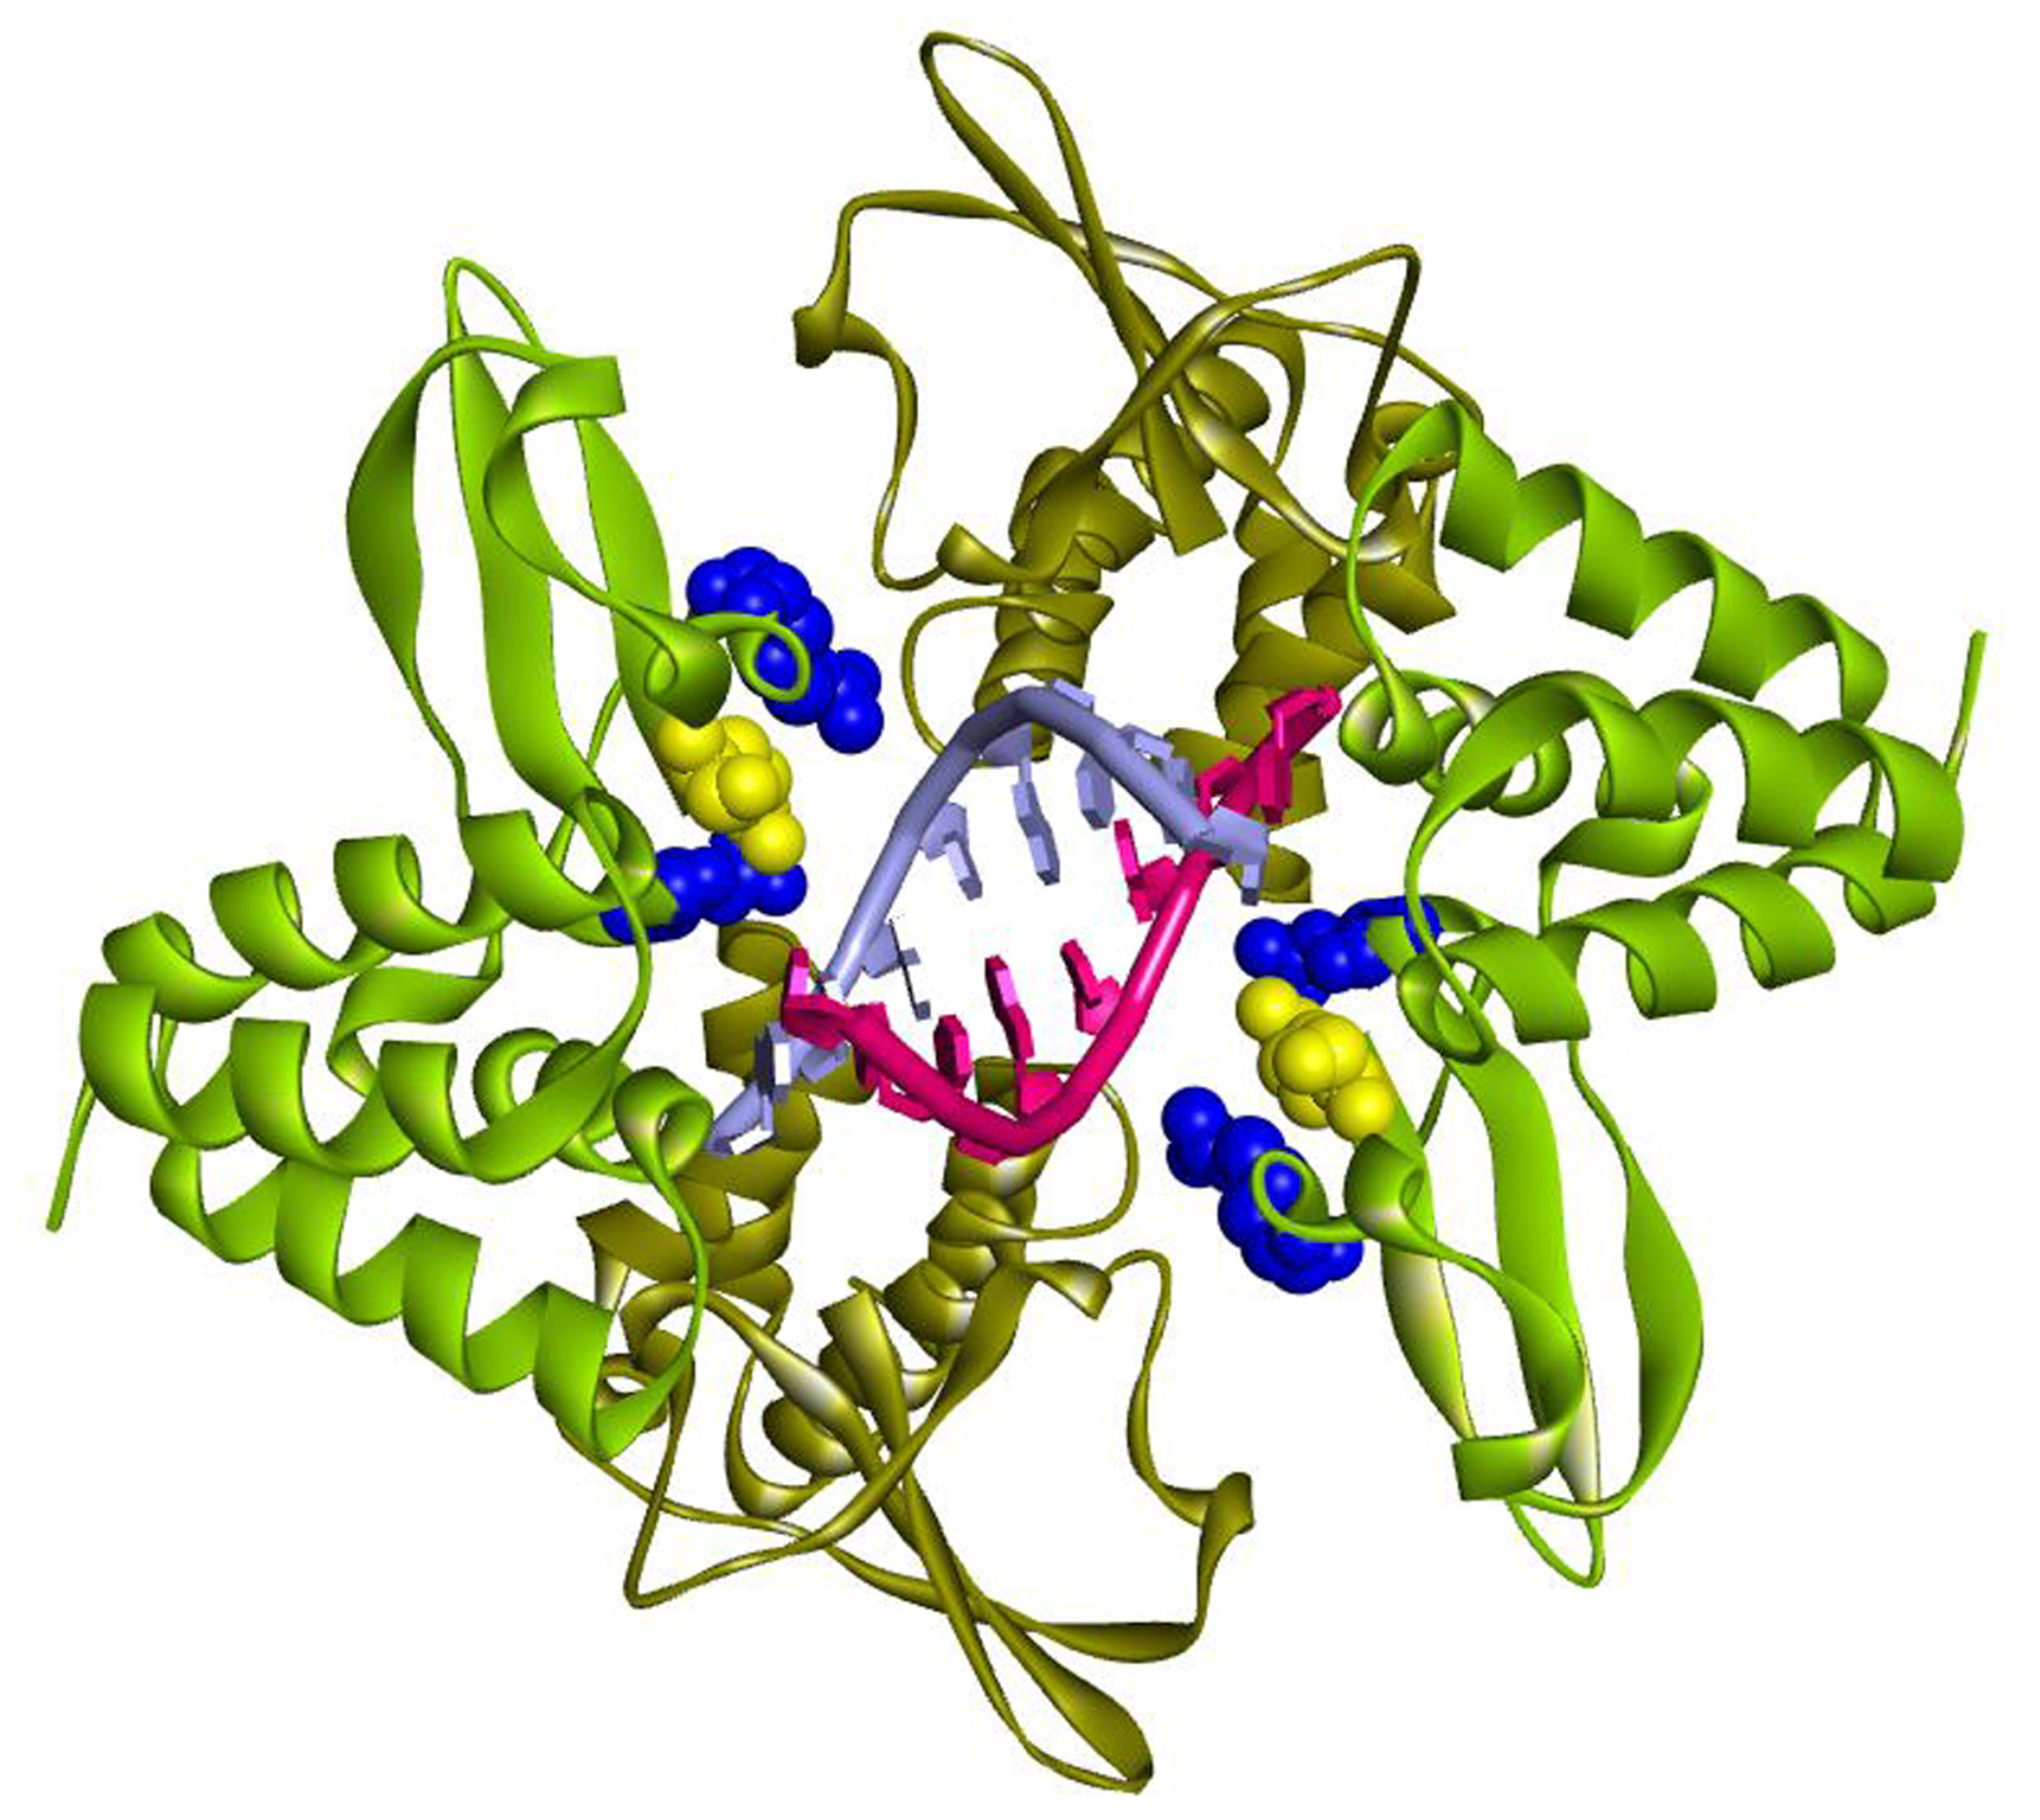
Alternative Rx Approach
Utilize approved drugs (IFNs) or drugs in advanced clinical development (dsRNAs/safety demonstrated)
VP35 demonstrated principal lethal factor
VP35 binds dsRNA (illustration)
Immediately available
Synergistic with IFN
Mitchell WM and Carter WA.
The Quest for Effective Ebola Treatment: Ebola VP35 Is An Evidence Based Target for dsRNA Drugs. Emerg Microbes & Infect. 2014; in press

Slide 29

Questions?

