Slide 1
Epigenetic regulation of the IGF2 /H19 gene cluster. Prospects for novel therapeutic traits
Wilhelm Engström
Professor of General Pathology
Uppsala

Slide 2
Presentation 28 October 2014

Slide 3
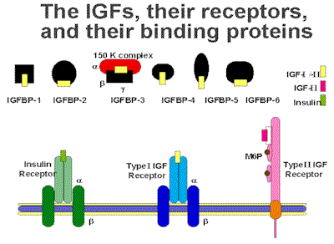
The IGF system

Slide 4
IGF2/H19 domain

Slide 5
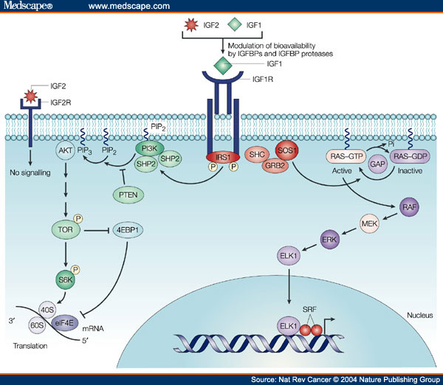

Slide 6
IGF2 is parentally imprinted
Classic knockout experiments demonstrated that the IGF2 gene is expressed exclusively from the paternally inherited allele
The gene is imprinted in a variety of mammals including humans

Slide 7
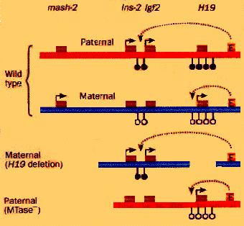
Epigenetic mechanisms

Slide 8
Methylation of ICR

Slide 9
Three different concepts to explain the imprinting mechanism

Slide 10
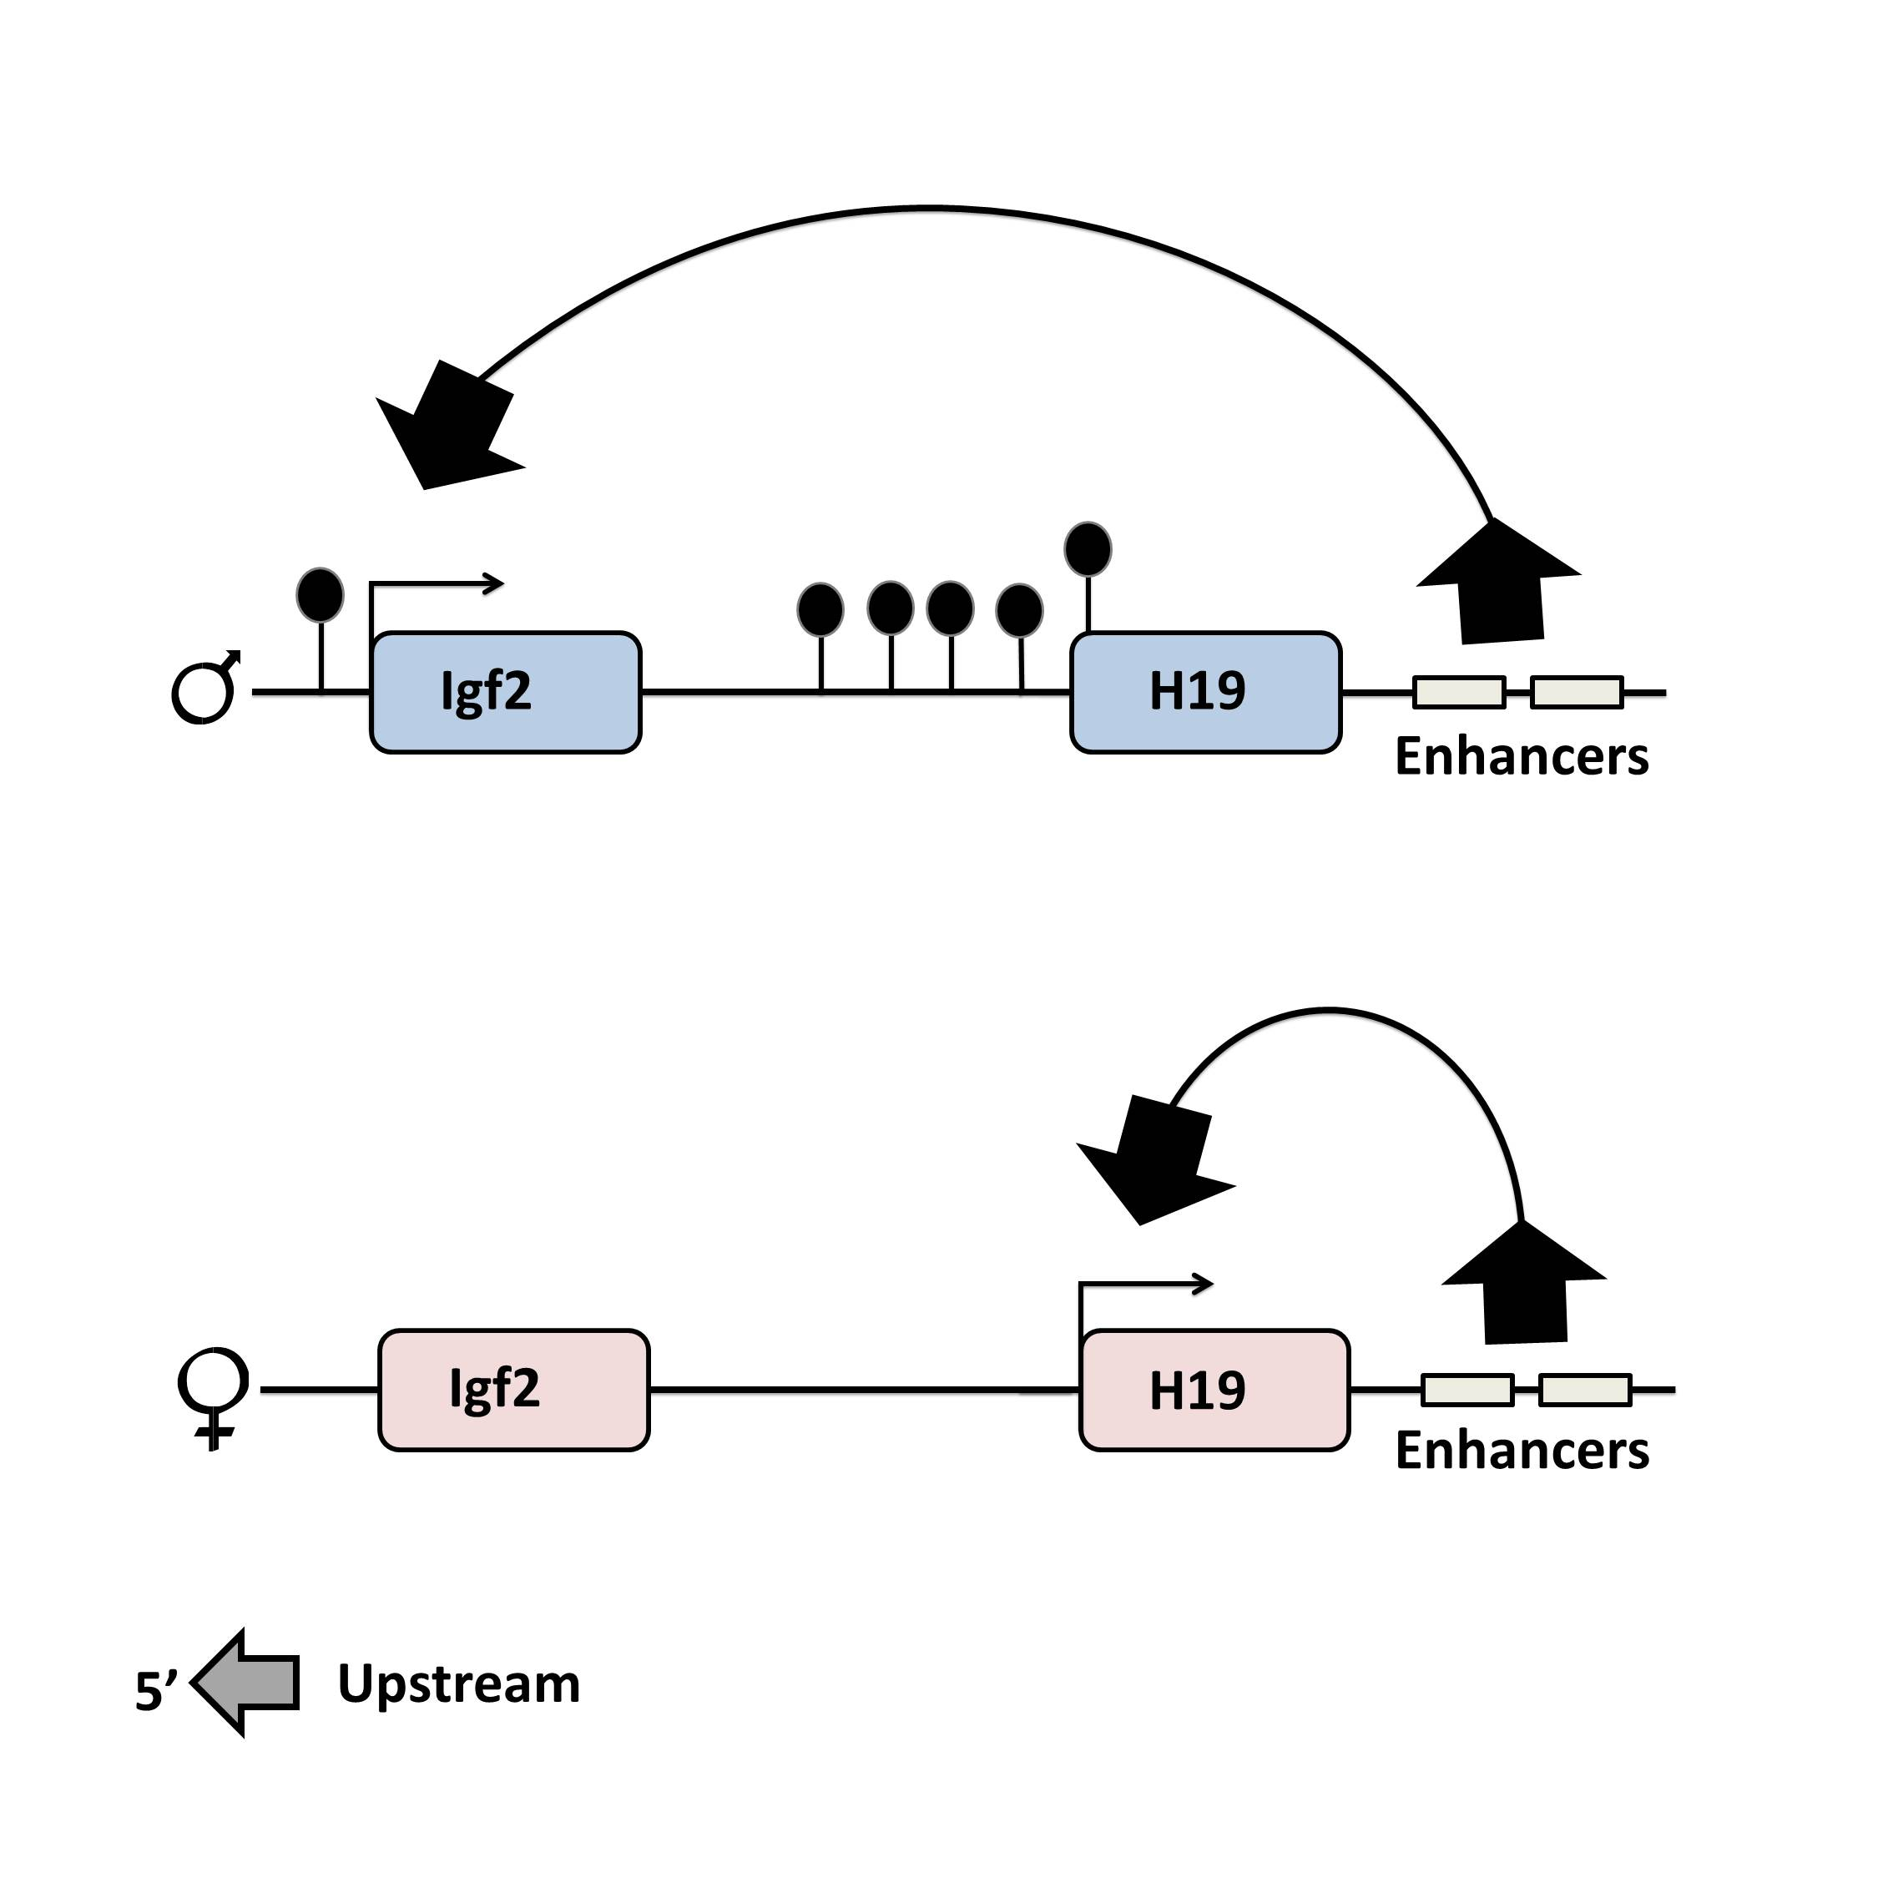
1. Enhancer competition

Slide 11
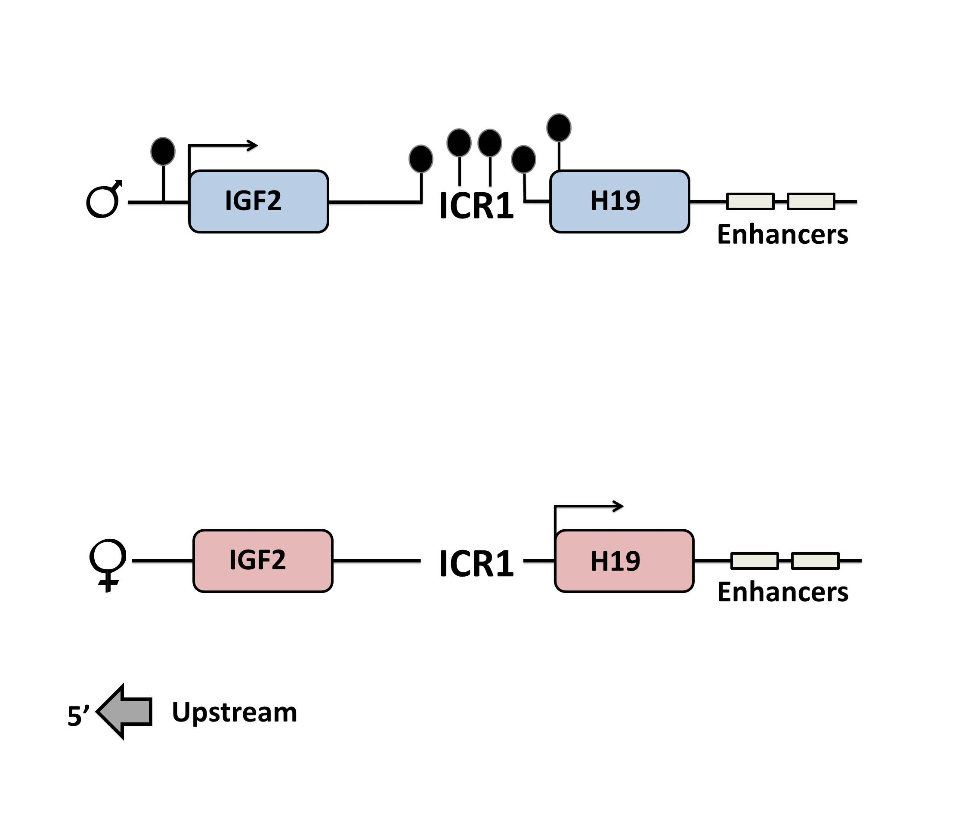
The enhancer competition model and parental specific methylation of ICR

Slide 12
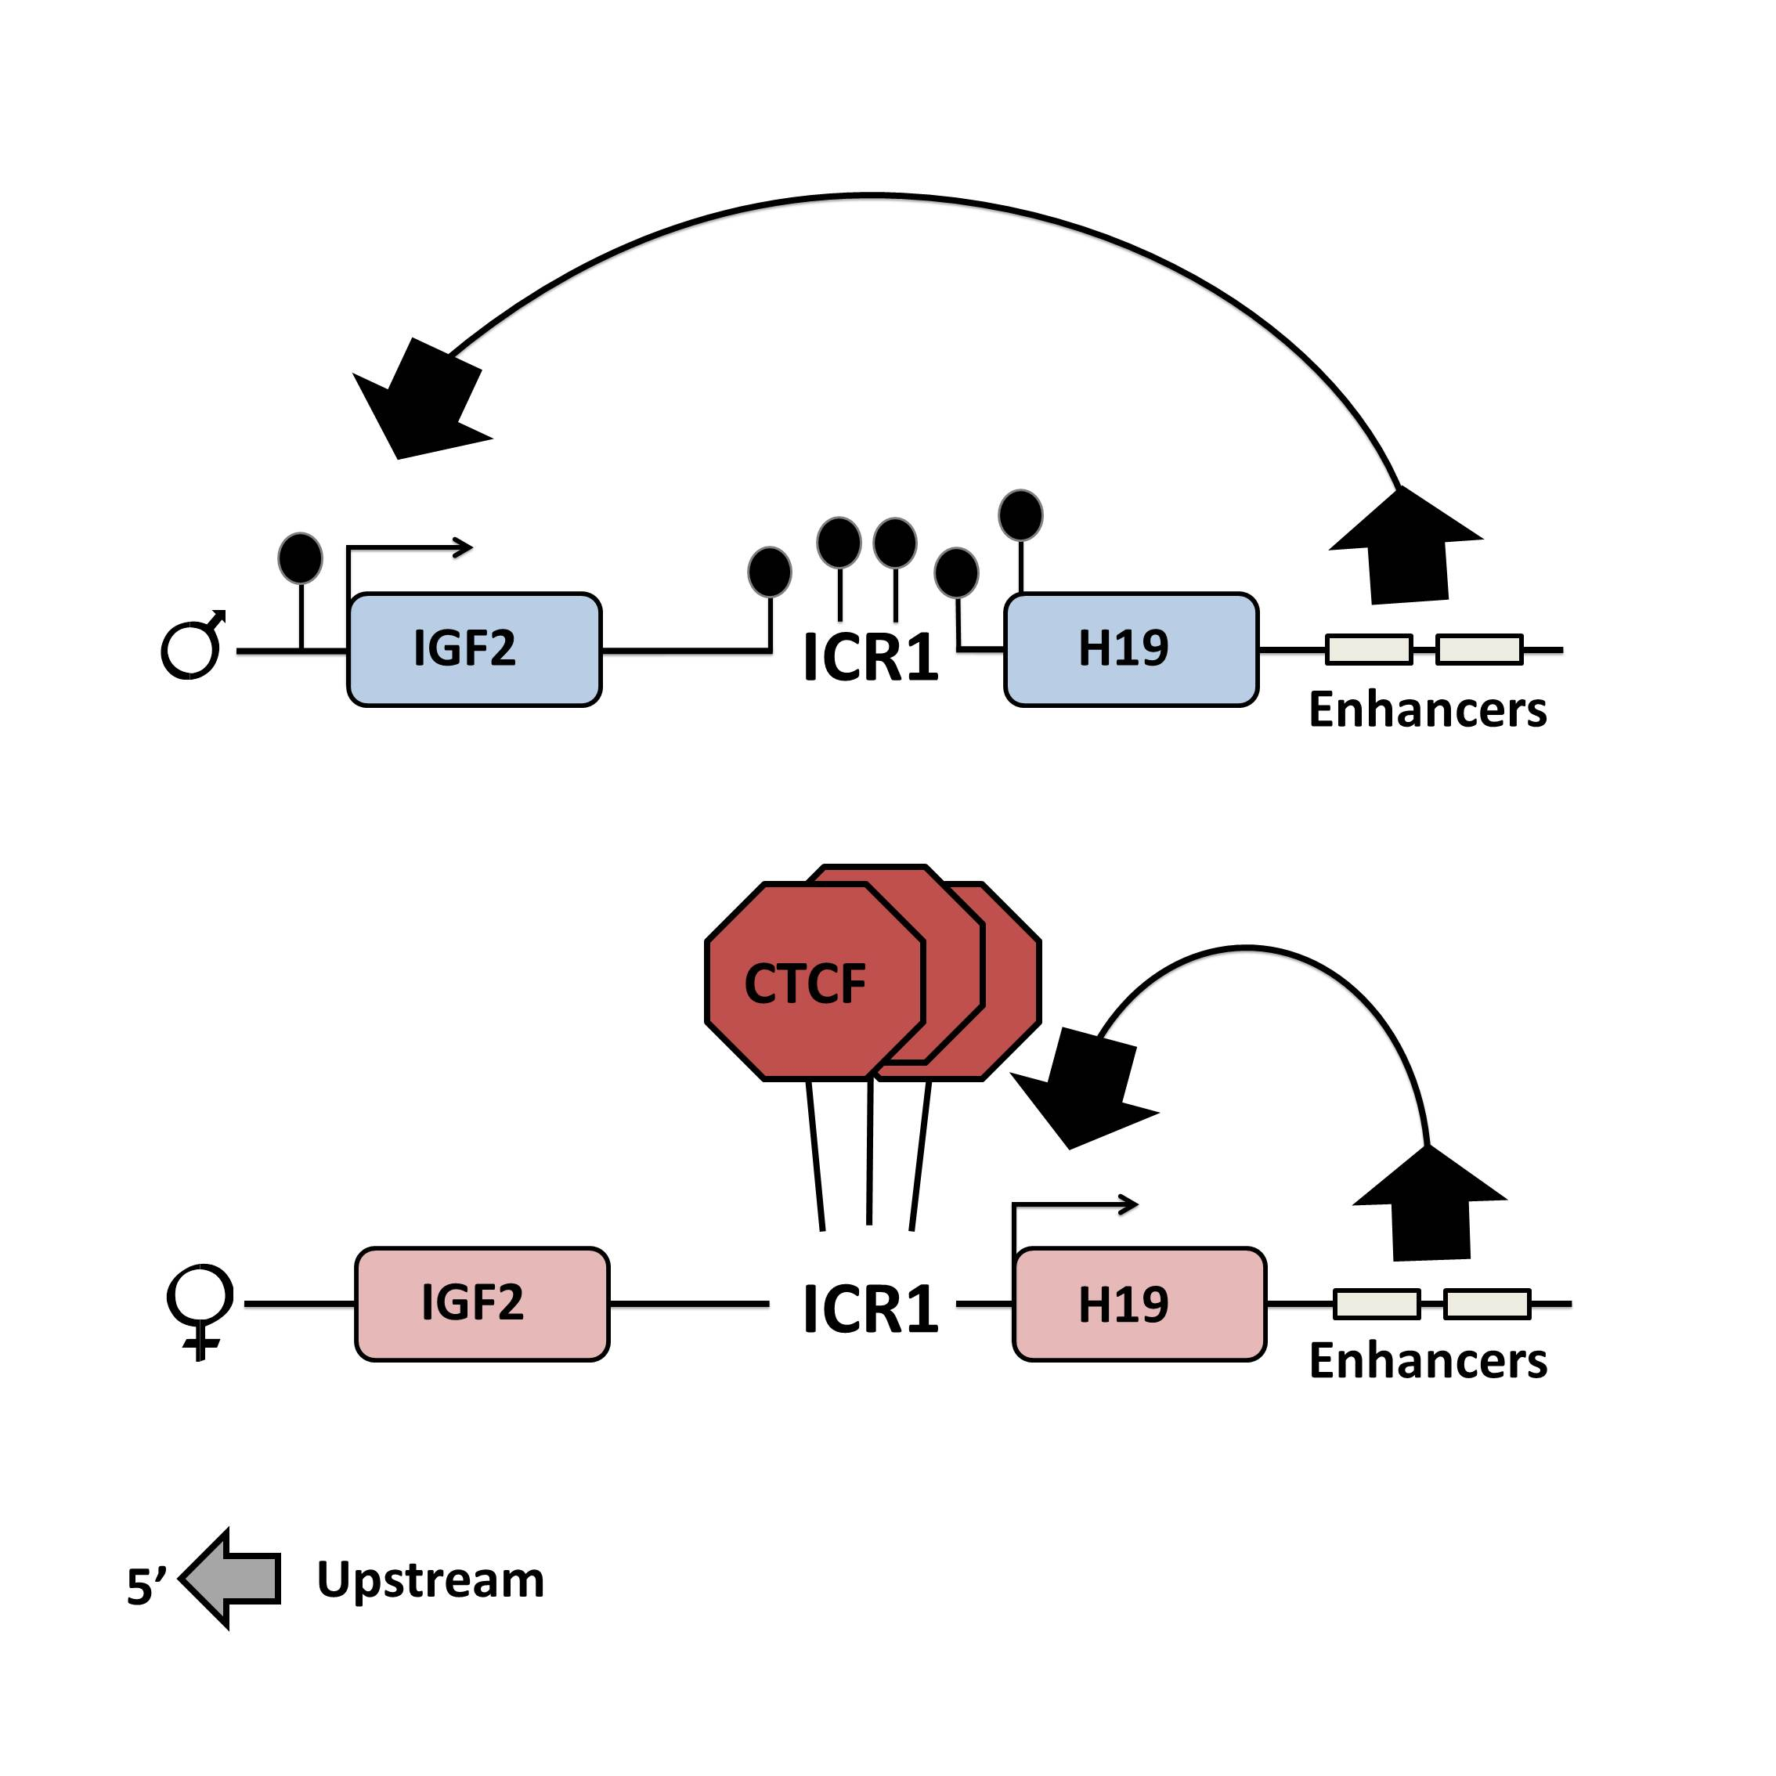
2. Boundary model

Slide 13
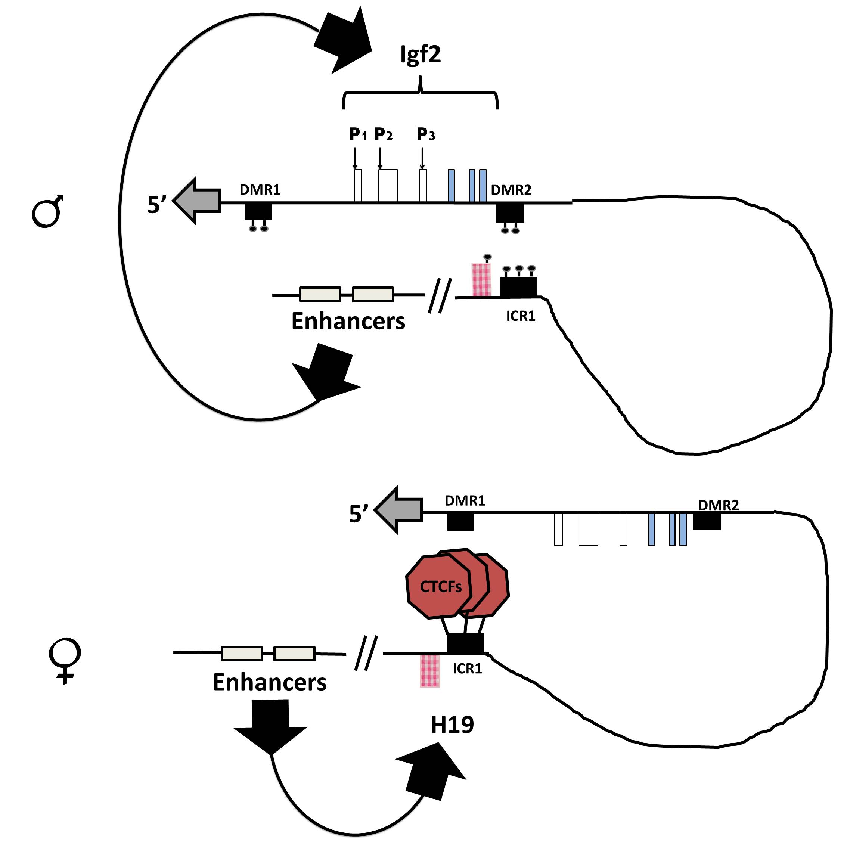
3. Chromatin looping

Slide 14
The role of imprinting in tumourigenesis
Wilms tumour common denominator for this concept.

Slide 15
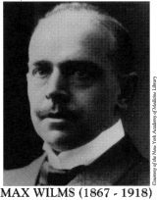
Wilms tumour – a puzzling story

Slide 16
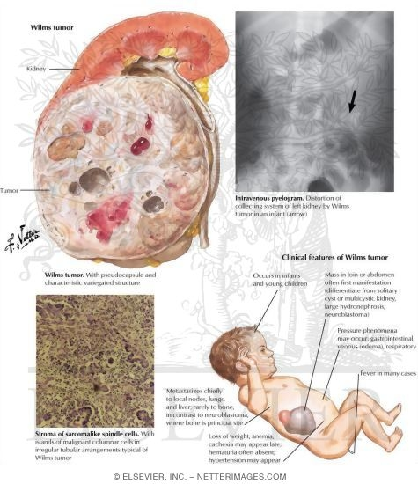
Wilms tumour

Slide 17
Wilms tumour and IGF2
The IGF2 gene is overexpressed in Wilms tumour and a wide spectrum of other neoplasms
Early data suggested that imprinting is relaxed even in non-neoplastic BWS tissues

Slide 18
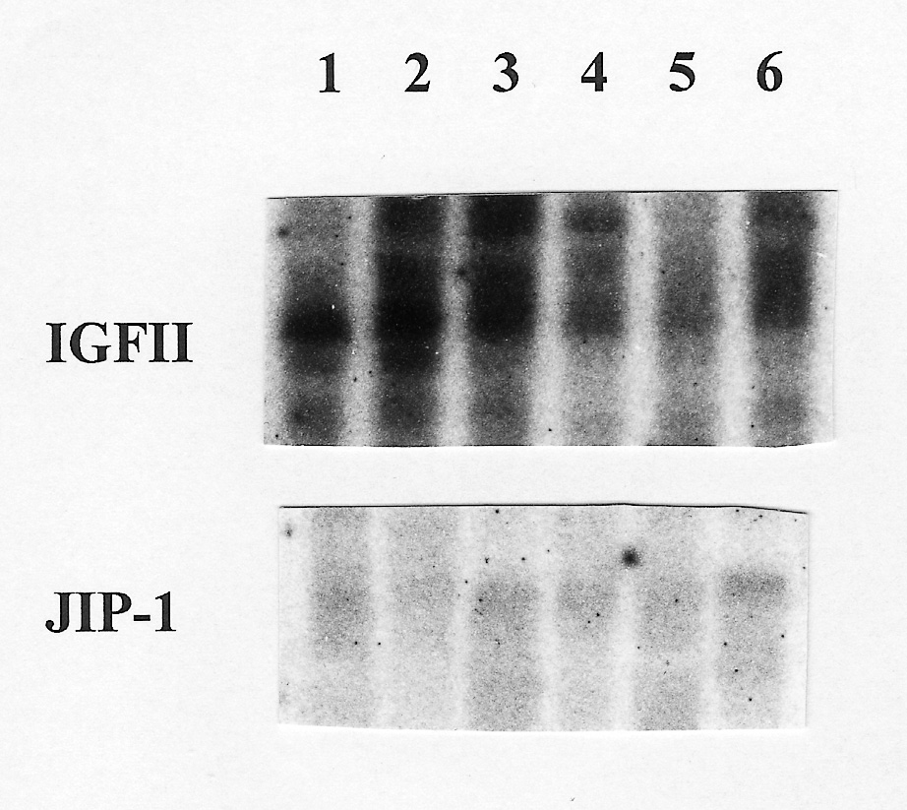
JIP-1 and IGF2 are coexpressed in Wilms tumour

Slide 19
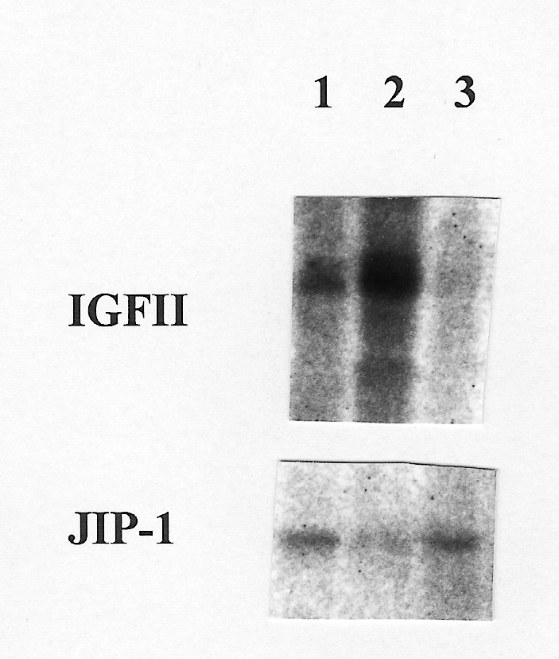
The co-regulation of IGF2 and JIP-1 expression is relaxed in Wilms tumour cell lines

Slide 20
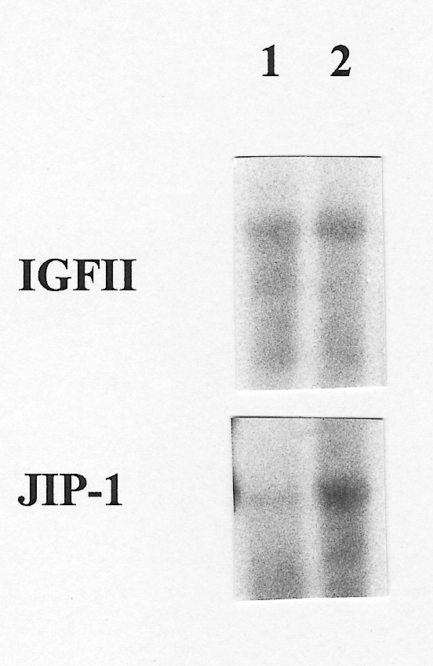
Exogenous IGF2 upregulates JIP-1 expression in one Wilms tumour cell line (WCCS-1)

Slide 21
Abrogation of IGF2 effects in human Wilms tumour cell lines
WCCS-1
Gawa
GOS-4

Slide 22
Effects of antibodies and binding proteins on JIP-1 expression in WCCS-1
Alpha IR-3
IGF-BP-2
Will restore JIP-1 expression to normal levels

Slide 23
Imprinting effects – 2 model diseases
Silver Russell Syndrome
Beckwith Wiedemann Syndrome

Slide 24
1. Silver Russell syndrome
S
Chromosomes 7 and 11
Growth retardation before and after birth
Large head compared to rest of the body
Prominent head, narrow chin
5th finger clinodactyly
hemihypoplasia

Slide 25
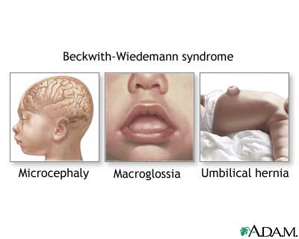
2. Beckwith Wiedemann Syndrome
Overgrowth syndrome
hemihypertrophy
Increased risk of acquiring Wilms tumour

Slide 26
SRS vs BWS
SRS – ICR1 hypomethylation
BWS – a variety of mechanisms to relax IGF2 imprinting.

Slide 27
Complicating the picture….. Introducing ICR2
Deletion of H19 sequence without effect
ICR2 regulates reciprocal expression of CDKN1C and KCNQ1
Mutations i paternally suppressed CDKN1C accounts for 40% of BWS

Slide 28
SRS, BWS and imprinting control

Slide 29
CONCLUSIONS
IGF2 expression is one of the most puzzling parentally imprinted genes
Relaxation of imprinting will alter the growth factor concentration
Imprinting control within a locus rather than in individual genes.
Interference with imprinting an interesting basis for the development of novel treatment

Slide 30
Acknowledgements
SLU; Marika Granerus, Matilda Halje, Matilda Nordin; Caroline Laestander, Tove Hultman
University of Bath; Andrew Ward, Kim Moorwood; Daniel Bergman
University of Oxford; Christopher F Graham FRS
University of Cambridge; Paul F Schofield

