Slide 1
Syringomatous tumour of the nipple and low-grade adenosquamous carcinoma:
World Congress on Breast Cancer
evidence for a common origin
Werner Boecker and Igor Buchwalow
University of Münster, and Hamburg, Germany
boecker@me.com

Slide 2
Low-grade adenosquamous carcinoma
Metaplastic carcinoma with well developed glandular formation and nest of squamous cells in spindle cell background.
Largely indolent, locally aggressive tumor
Association with sclerosing lesions and adenomyoepithelioma
Pathogenesis: Myoepithelial origin.
Syringomatous tumor
Nipple tumor with sweat duct differentiation.
Branching cords of cells, glandular structures and keratinous cysts.
Recurrences after incomplete resection
Pathogenesis: Sweat duct origin
WHO-Classification of Tumors of the Breast, Eusebi et al, 1012; 2012 Carter and Dyess, 2004; Doctor and Sirat, 1971;Jones et al, 1989; Rosen,1984;
Suster et al, 1991; Raju, 1990; Reis-Filho et al, 2012; Drudis et al, 1994; Rosen and Emsberger, 1987, Van Hoeven et al, 1993

Slide 3
Material and Methods
Material:
12 Syringomatous tumors
9 nipple adenomas
Methods
Multicolor Immunofluorescence experiments (Double- or Triple Immunofluorescence) for
p63 (p53 homologue)
Basal keratins K5 and K14
Luminal keratins K7, K8/18, (K19)
Gel electrophoresis and immunoblotting
qRT PCR
Nagle et al, 1986; Boecker et al, 1992, 1993, 2012, 2014: Buchwalow and Boecker, 2006, Reis-Filho et al,2002, 2006; Moll, 2008,

Slide 4
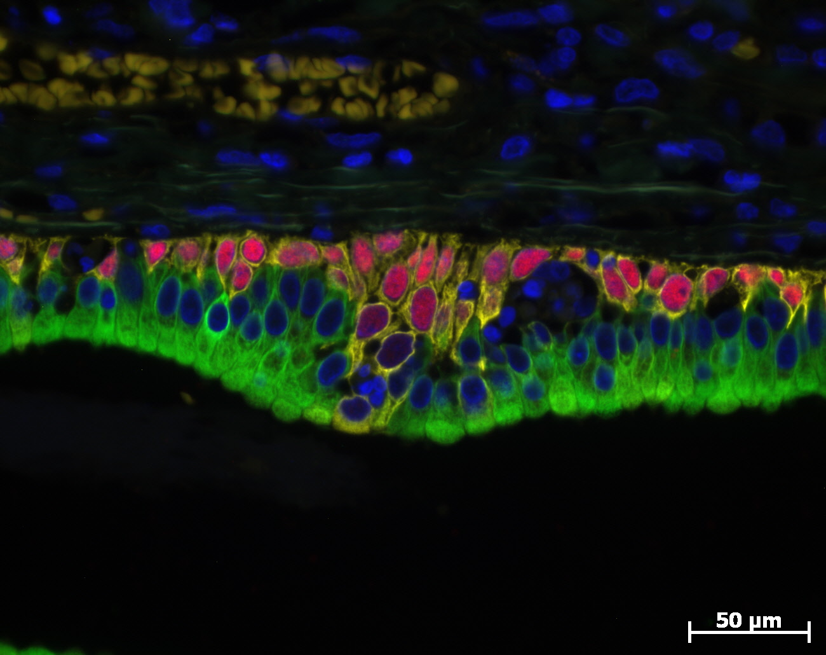
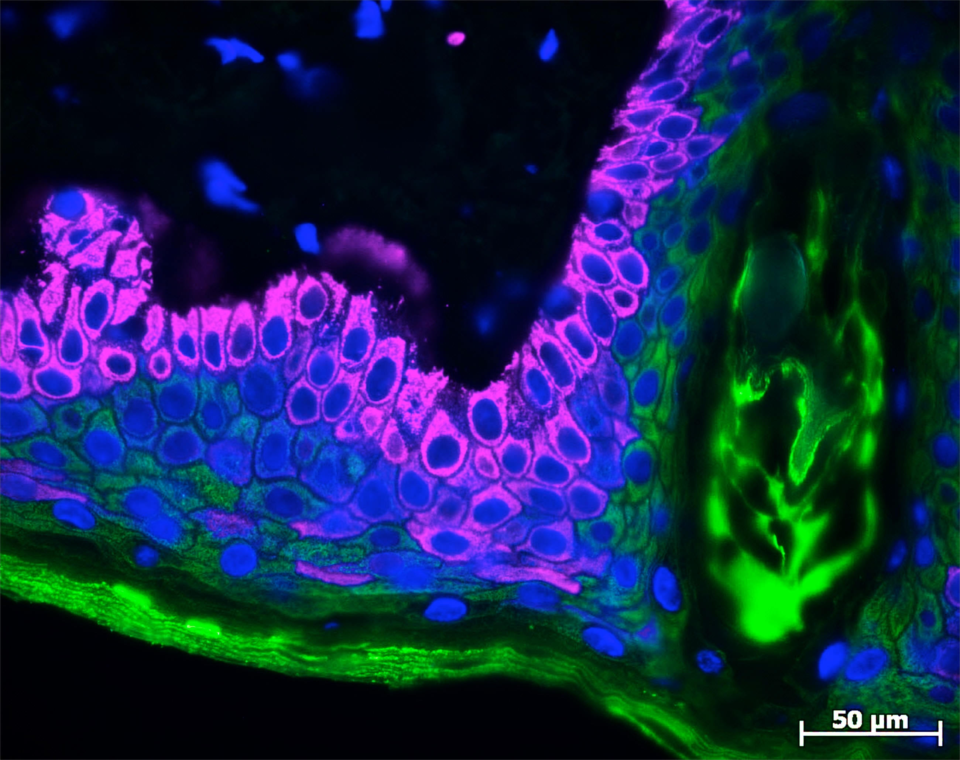
Basal and luminal keratins
Salivary gland; Excr. Duct
Basal keratins K5, K14, (K17) expressed in cells sitting an a basal position
Luminal (glandular) keratins K7, K8/18 expressed in glandular cells
P63
K5
K8/18
Squamous epithelium
Basal keratins K5, K14, (K17) expressed in cells sitting in a basal position
Squamous keratins K10 expressed in more differentiated squamous cells
K5
K10

Slide 5
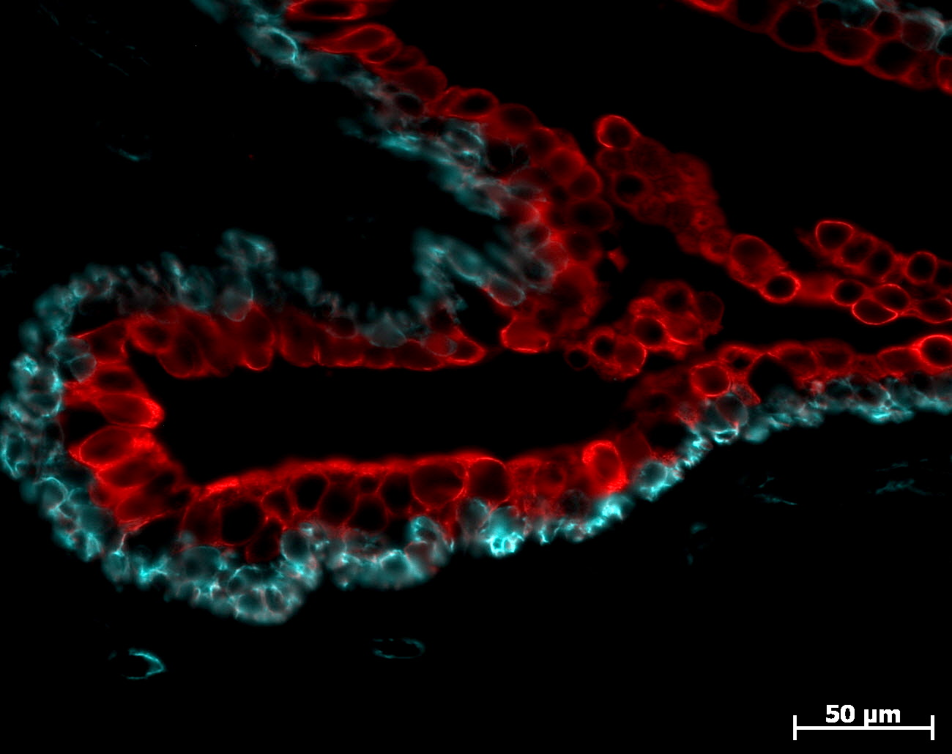
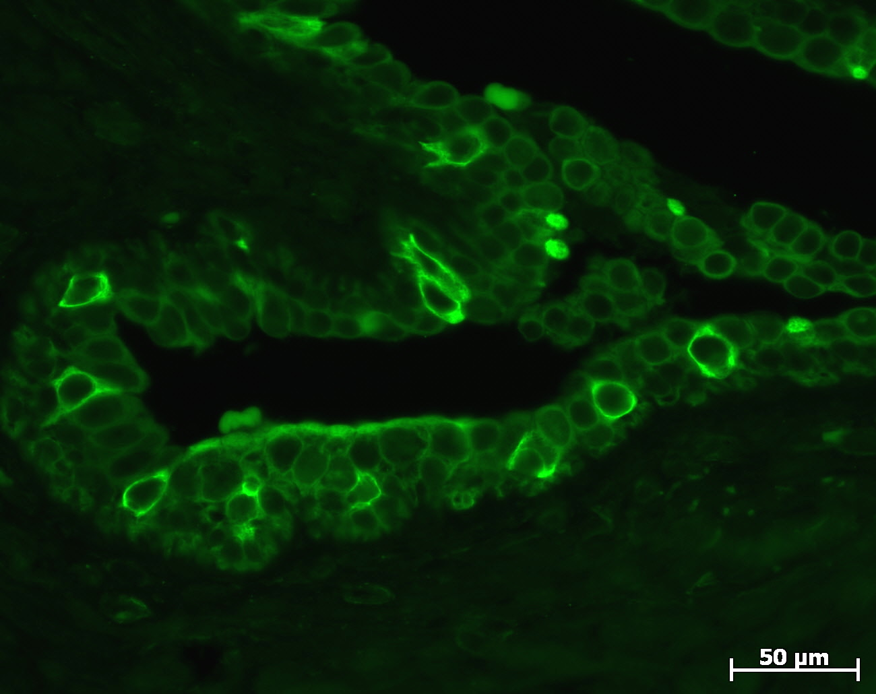
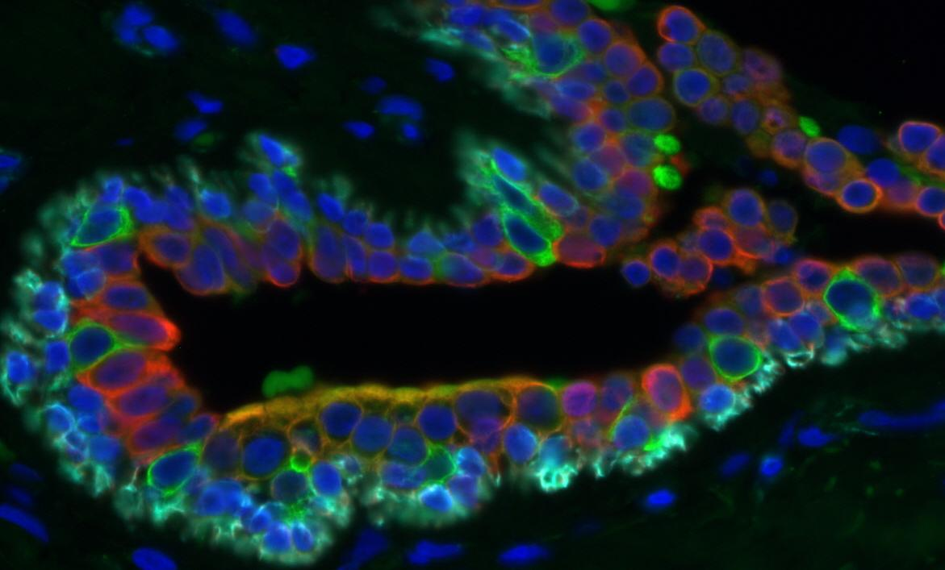
Breast duct
Triple Immunofluorescence for K5, K8/18, and SMA
K5
SMA
K 5
K 5/14
K 8/18
K 8/18
K5
K8/18
SMA
K8/18

Slide 6
Syringomatous tumor
12 cases: 3 core biopsies, 9 excision biopsies
Macroscopy: 0,4- 3,0 cm size (Literature: 1-3,5 cm, mean 1,7)
Microscopy: tubular to solid nests or colums with comma or tail-like extension and small squamous cysts. Infiltration into smooth muscle bundles of nipple.
Low-grade adeno-squamous carcinoma
9 cases: All 9 tumors located deep in the parenchyme outside the nipple.
Macroscopy: 1,0- >3,0 cm size (Literature: 0,5-3,4cm, average about 2.0cm)
Microscopy: tubular to solid nests or columns and occasional small squamous cysts in a spindle cell stroma. Infiltration between and around ducts and lobules.

Slide 7
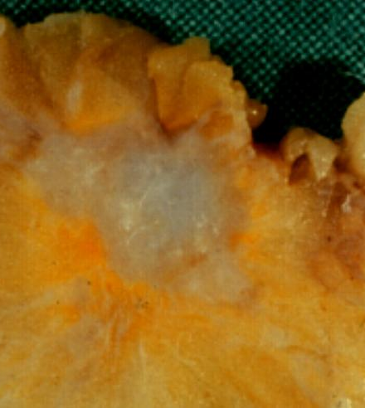
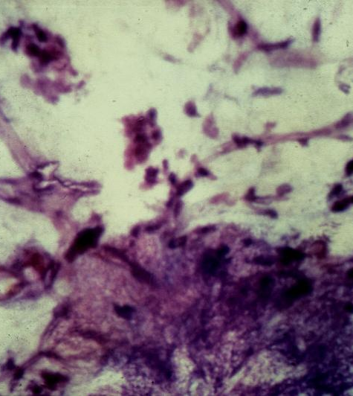
Low grade adeno-squamous carcinoma (n=9)
All 9 tumors located deep in the parenchyme outside the nipple.
Macroscopy: 1,0- >3,0 cm size (Literature: 0,5-3,4cm, average about 2.0cm)
1 cm

Slide 8
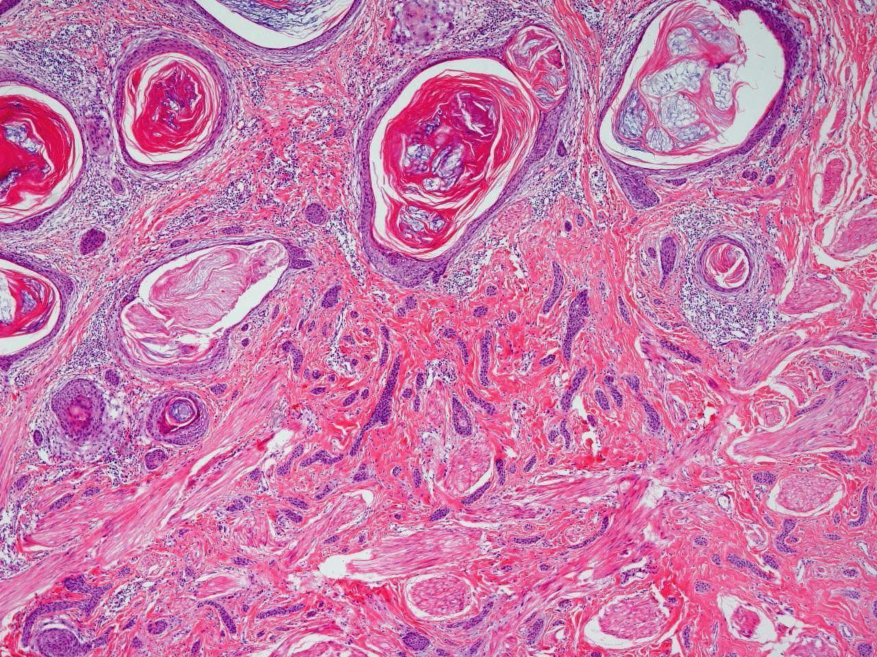
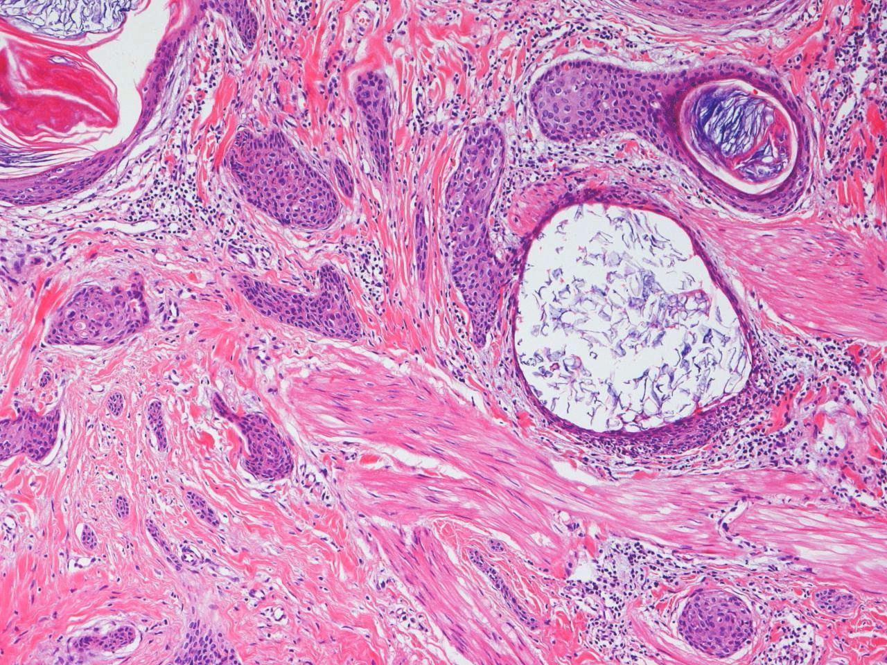
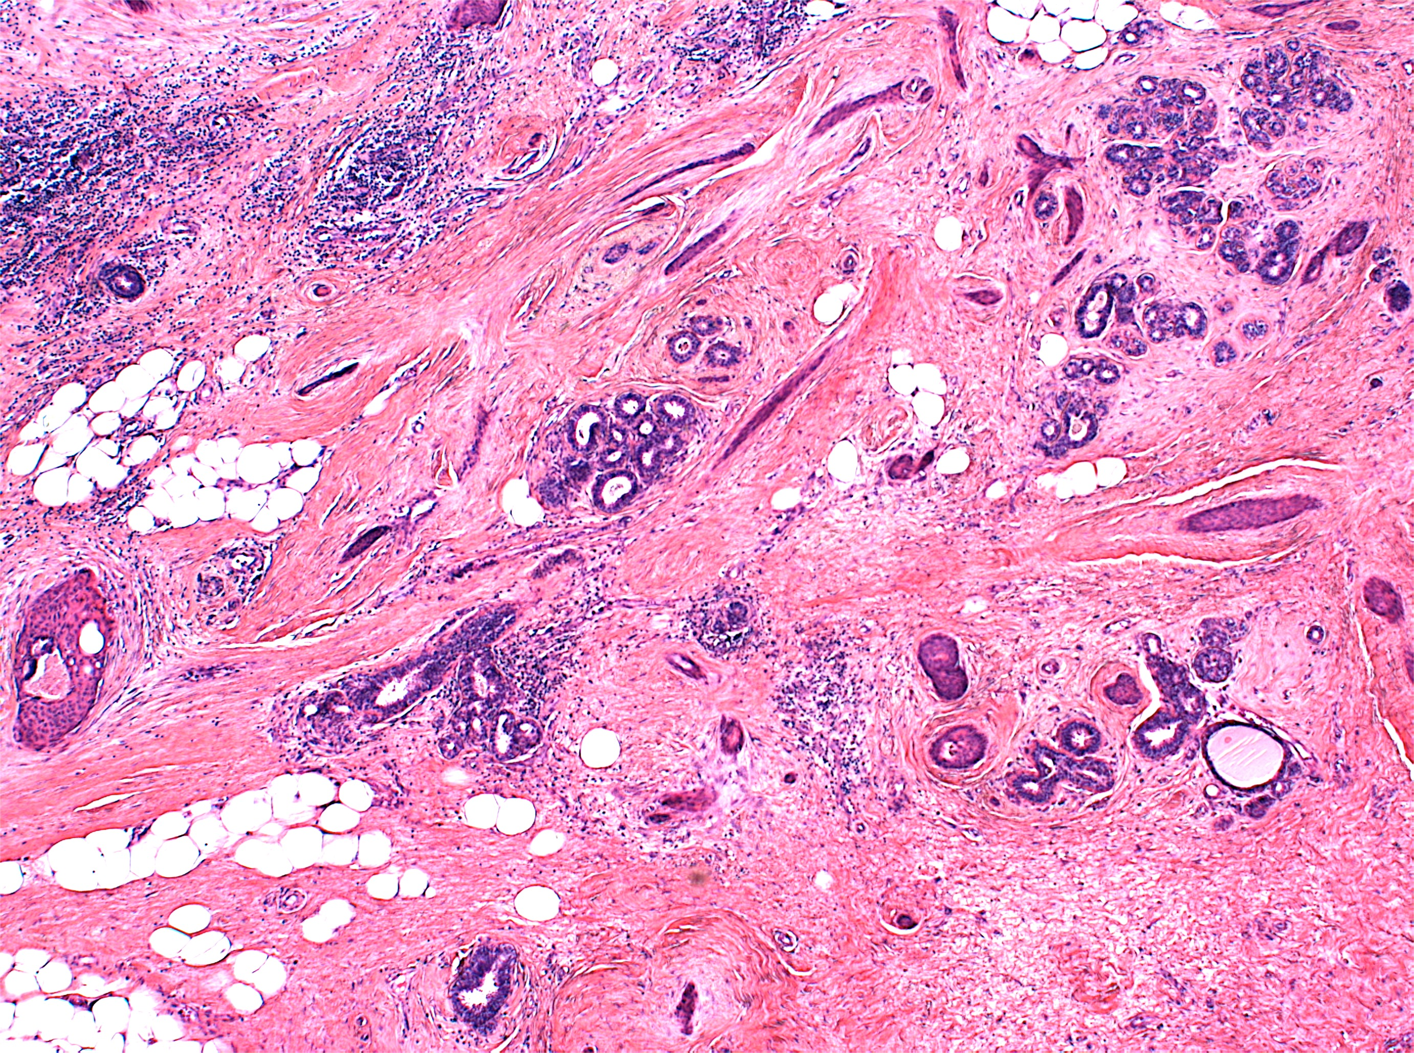
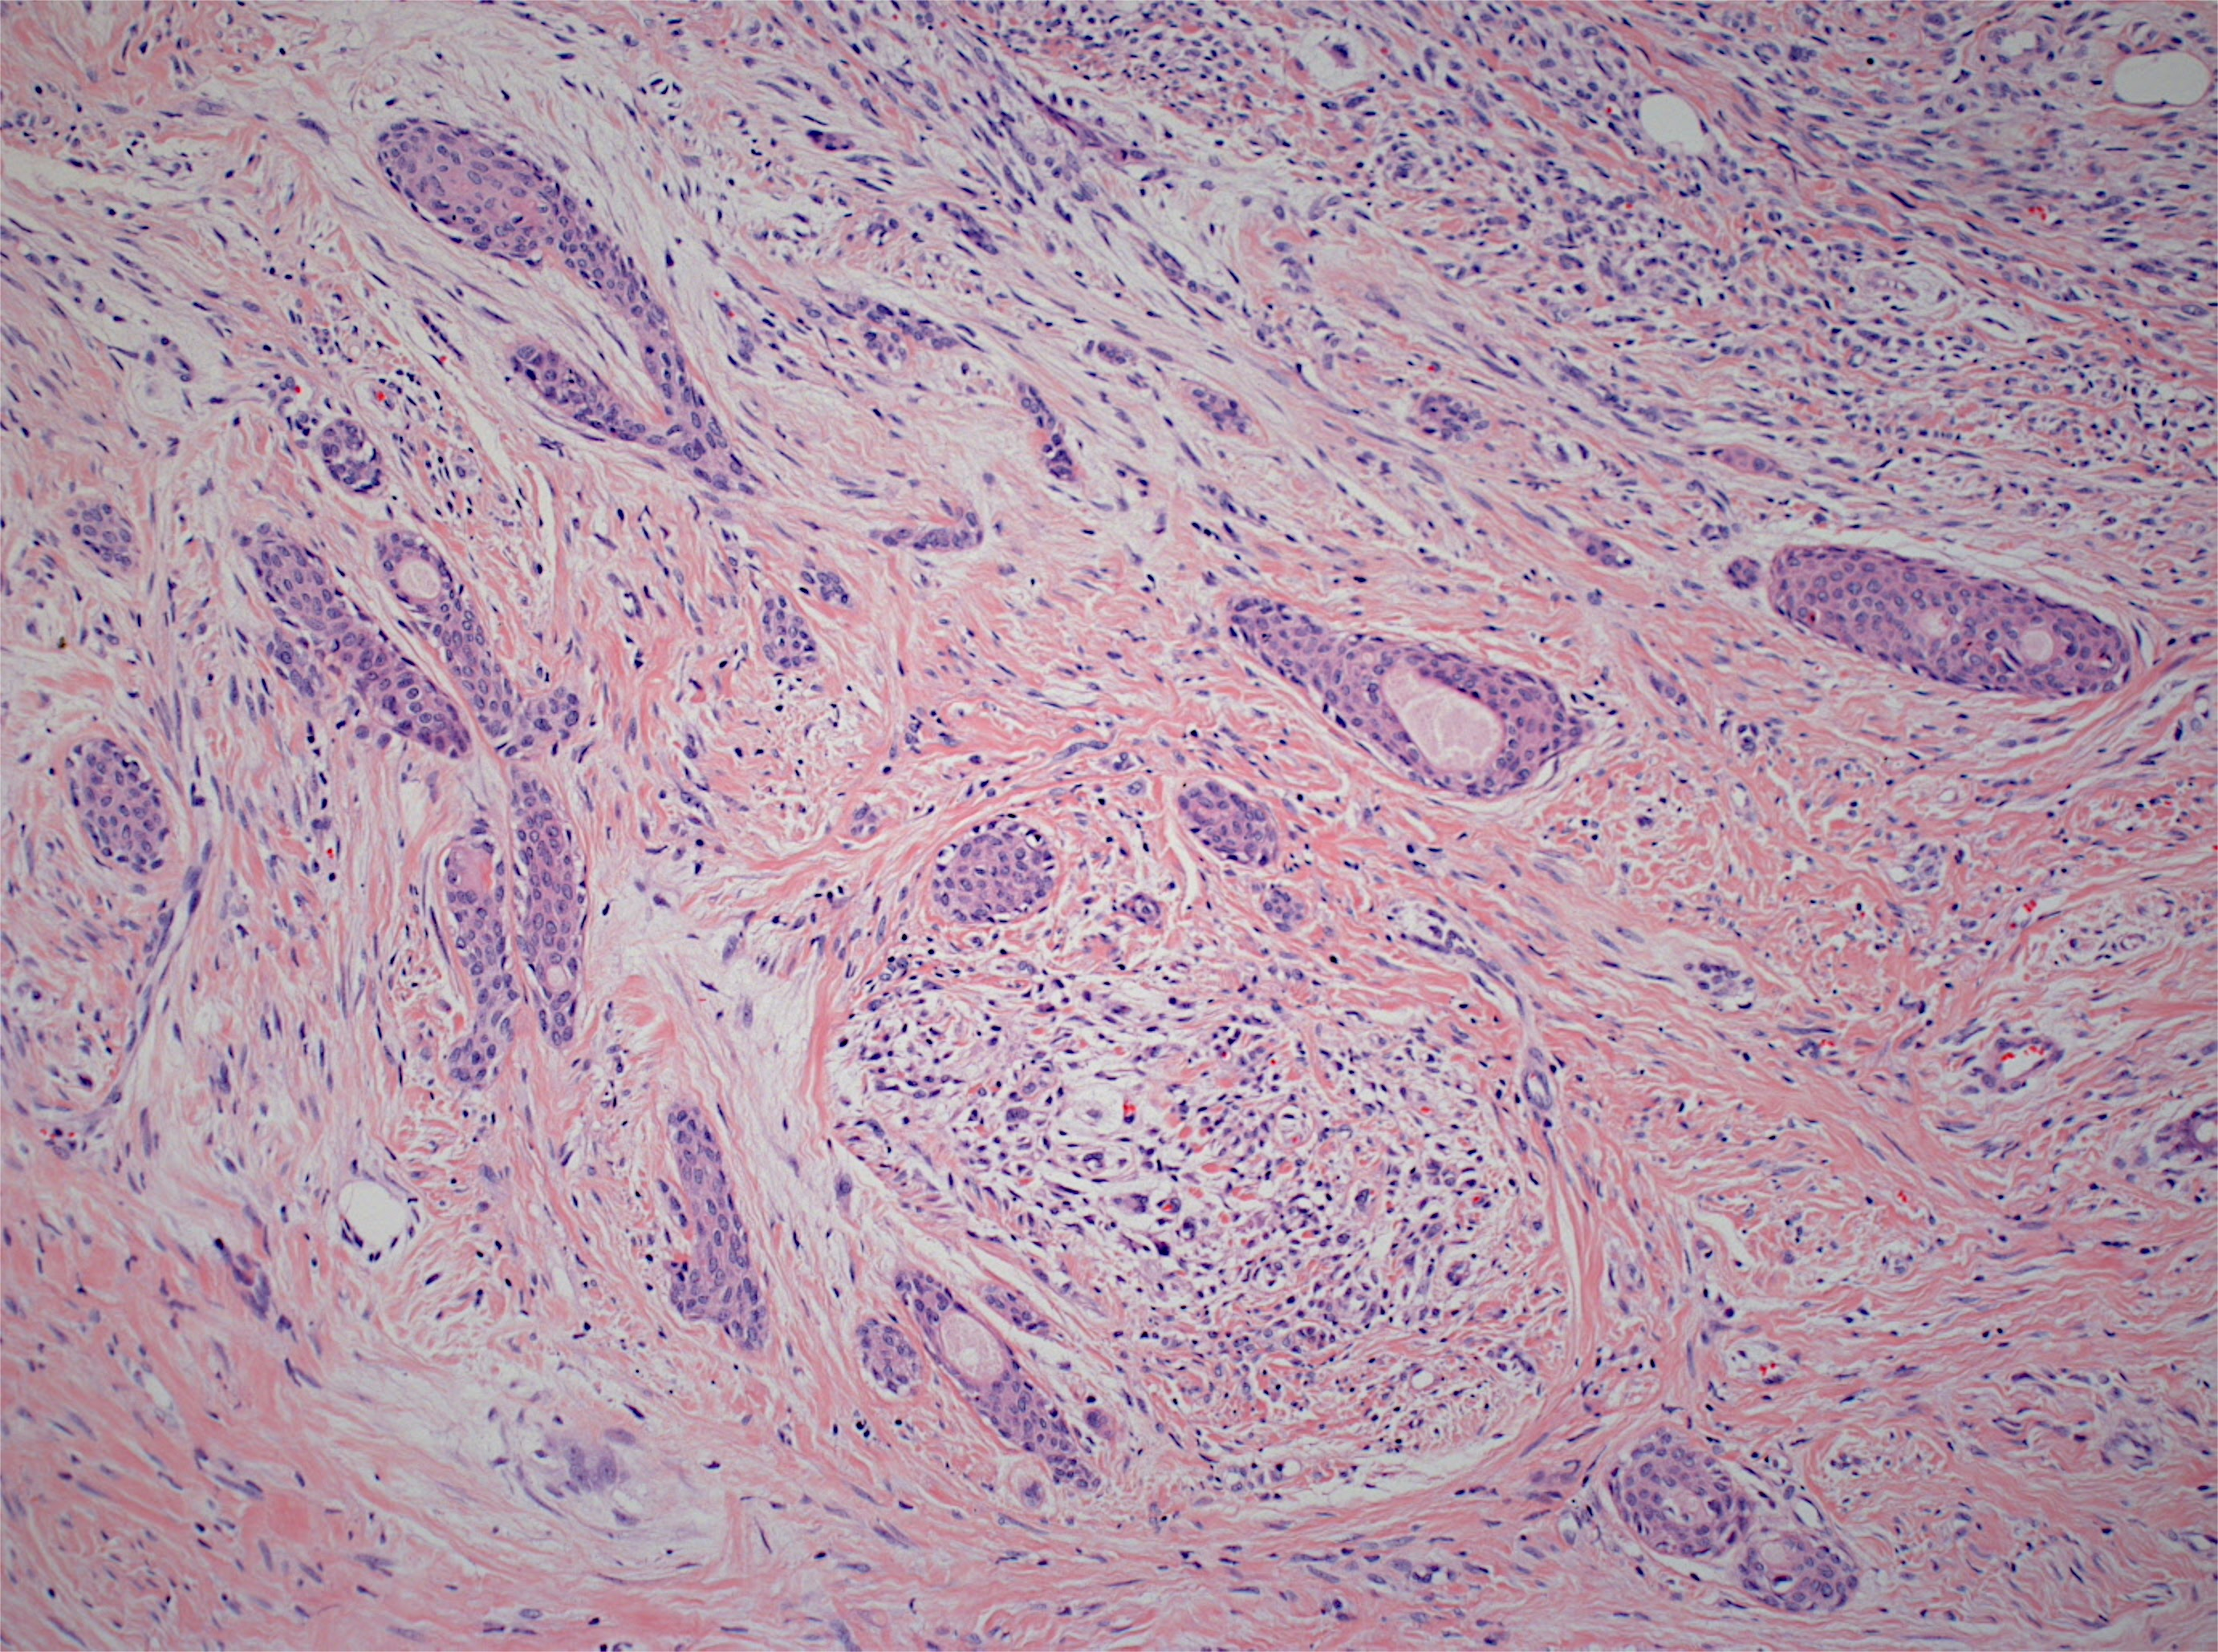
Microscopy

Slide 9
Microscopy
Syringomatous tumor
Low-grade adeno-squamous carcinoma

Slide 10
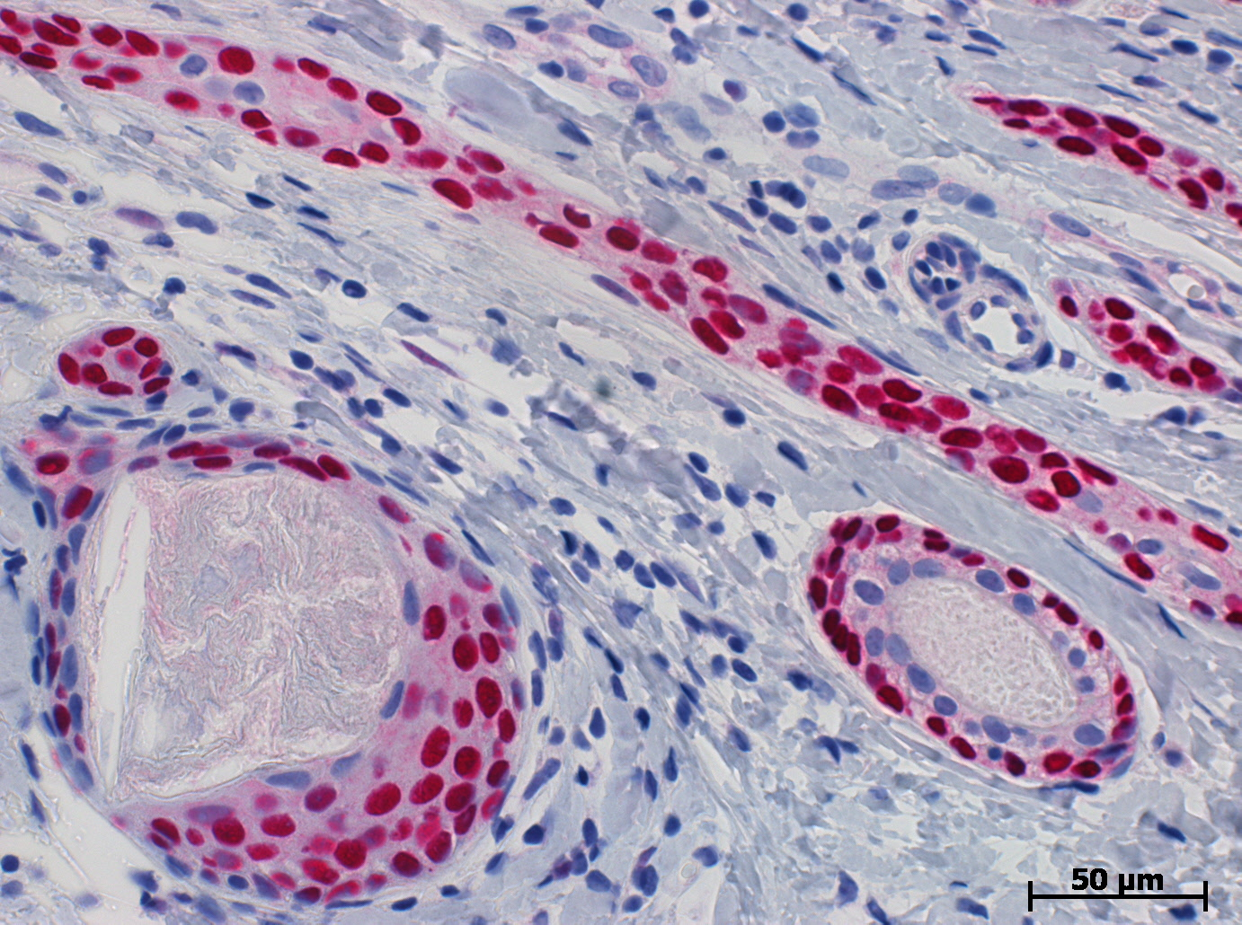
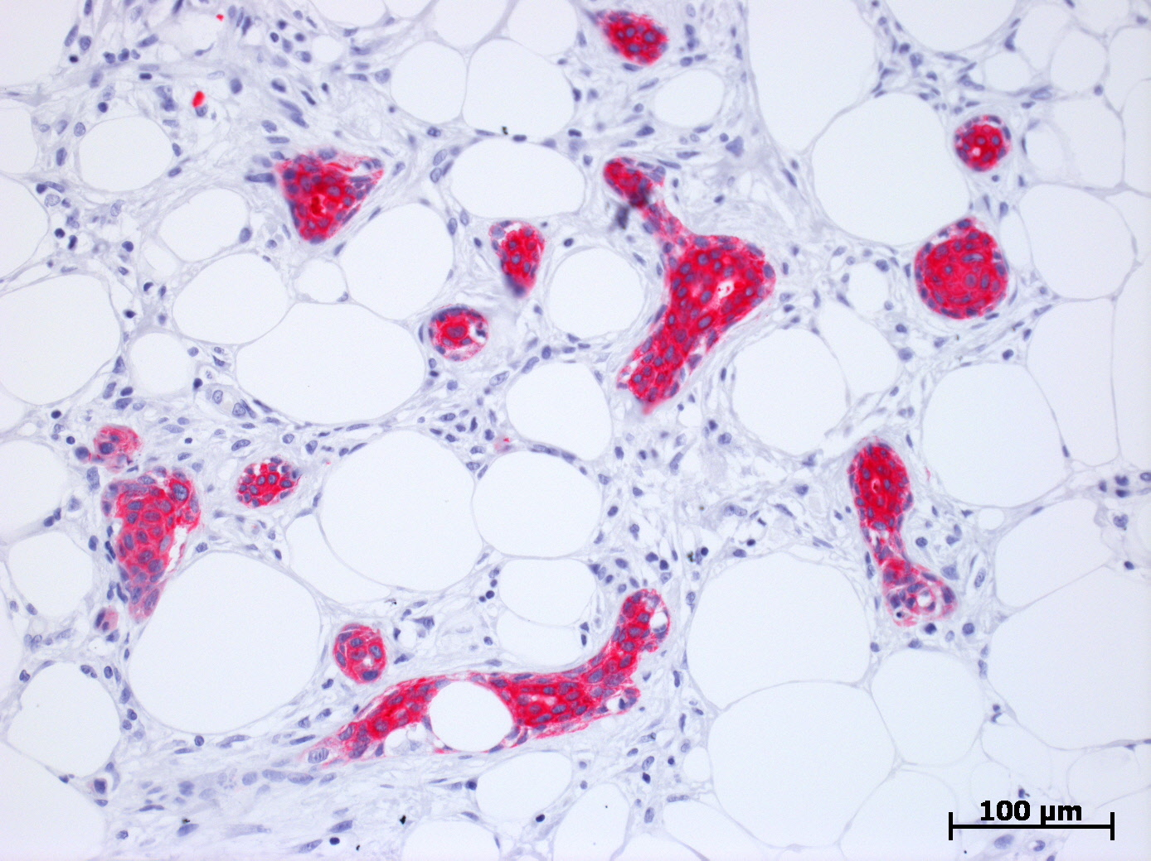
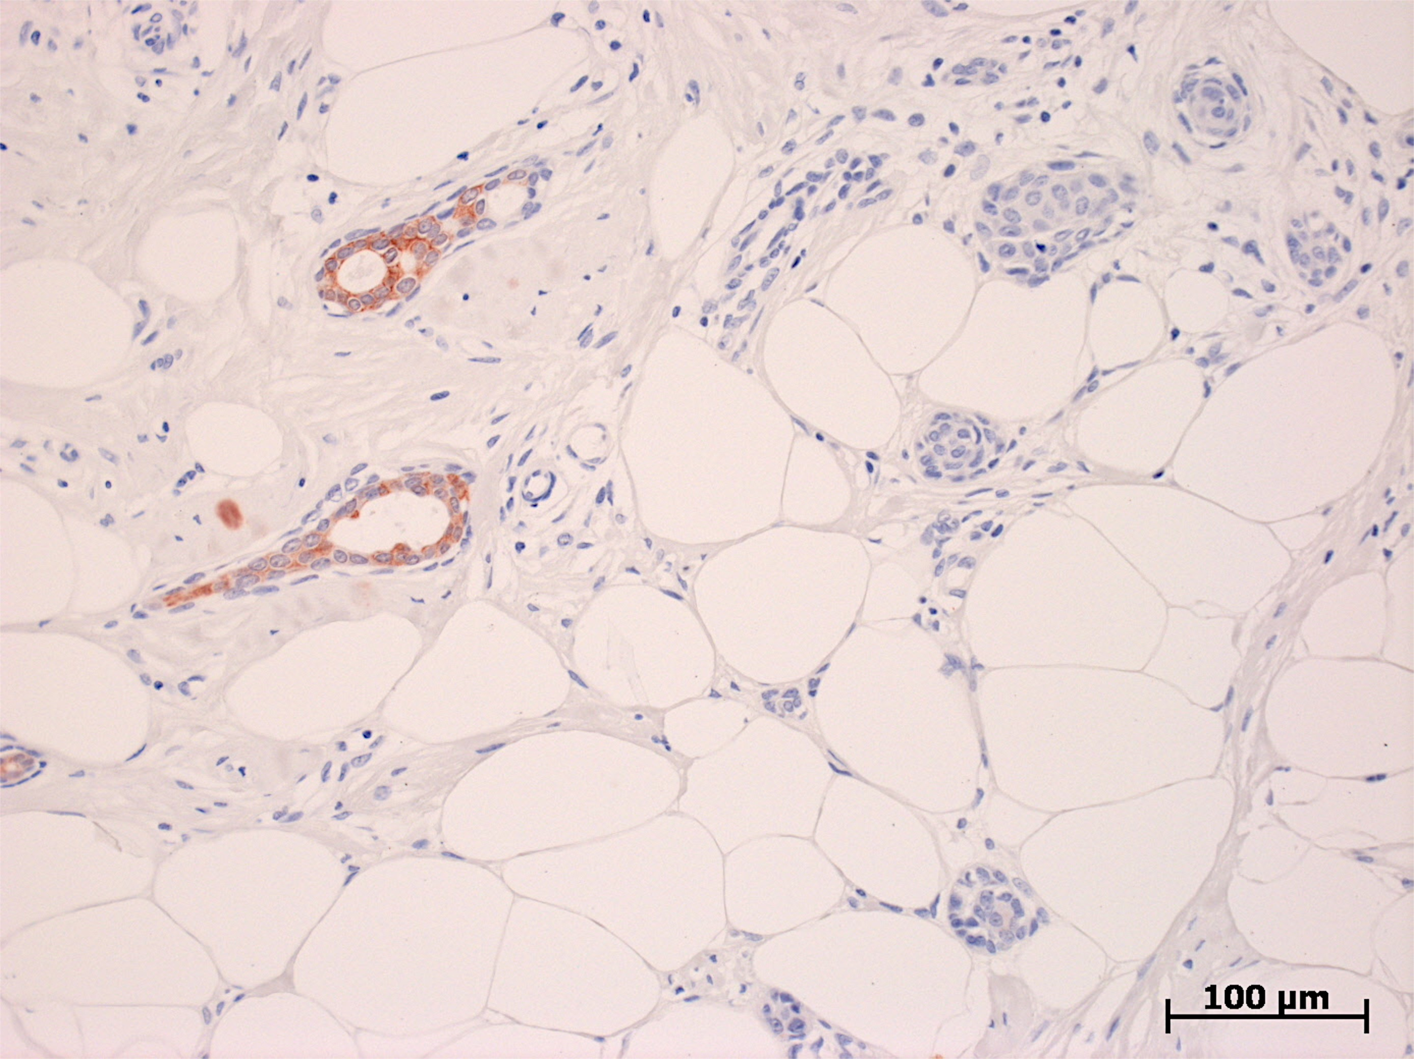
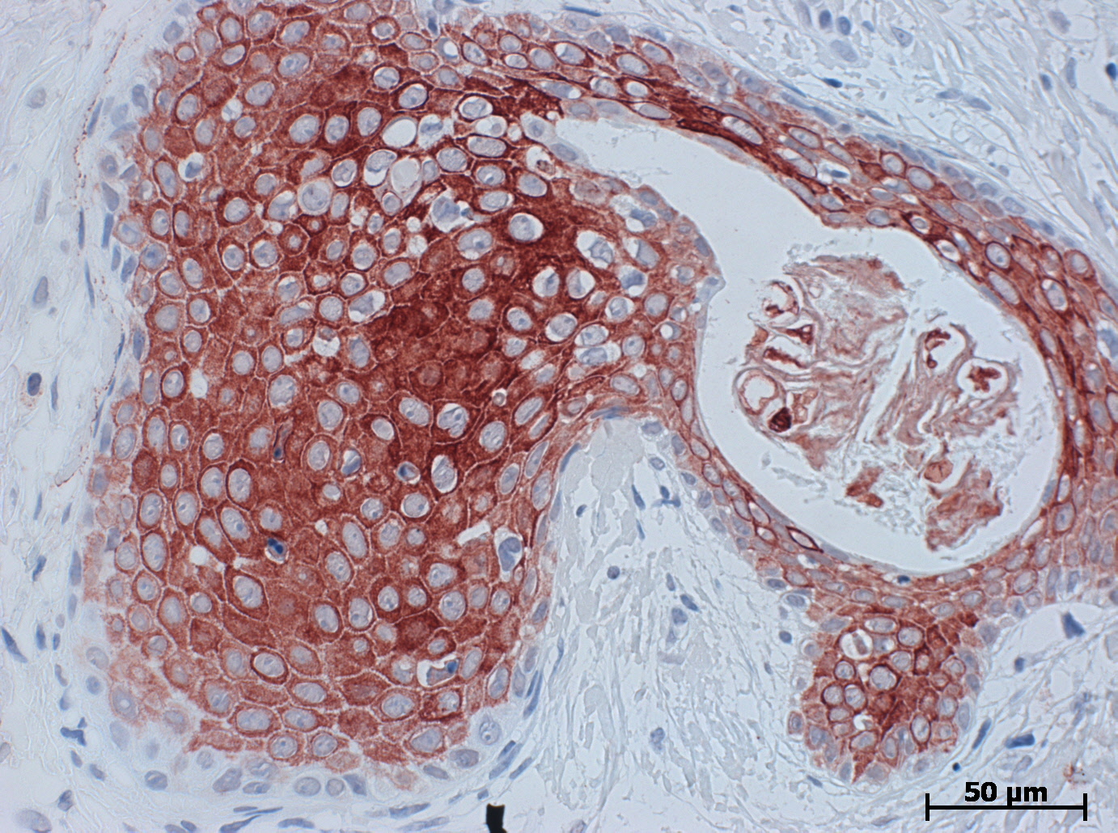
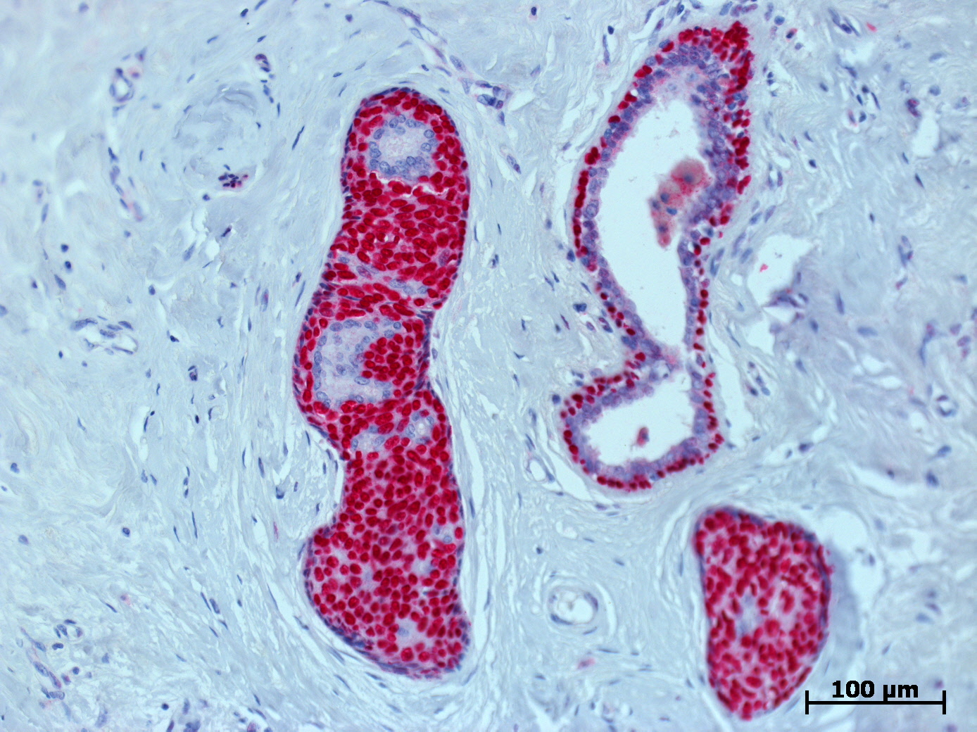
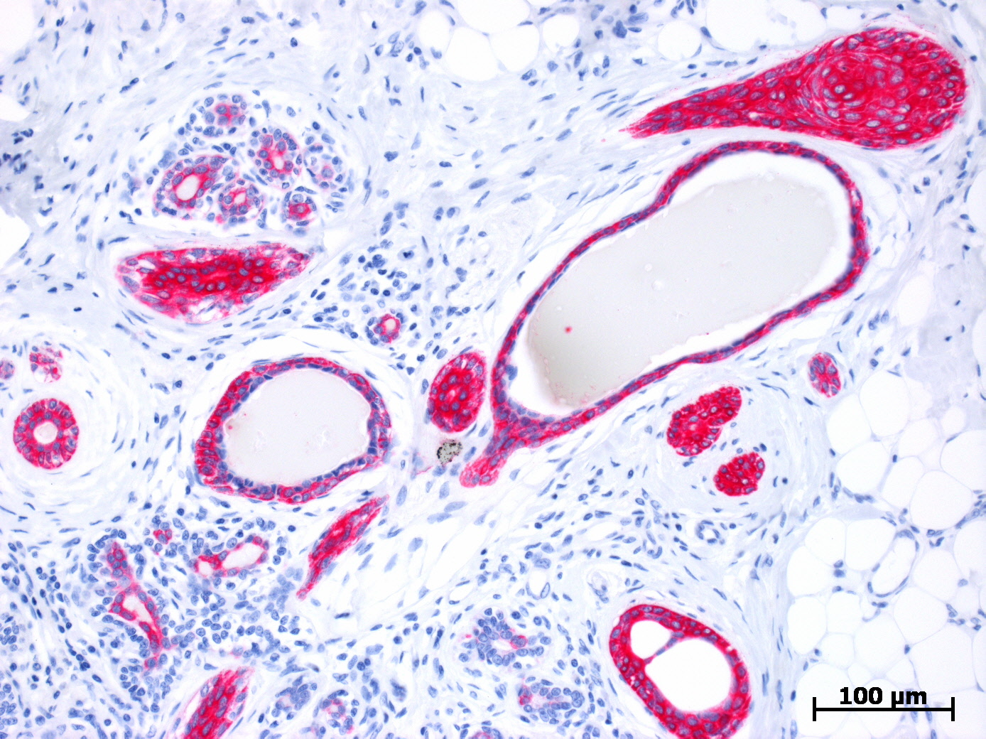
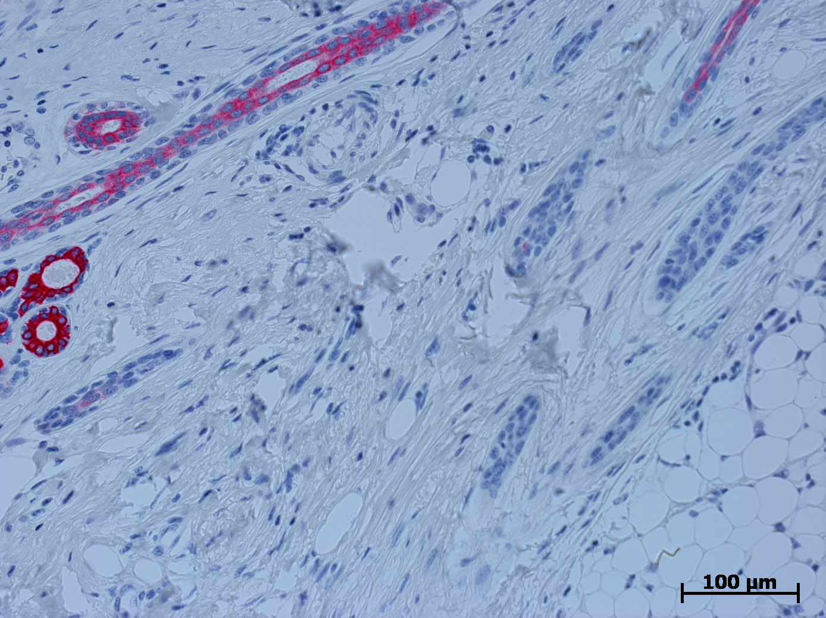
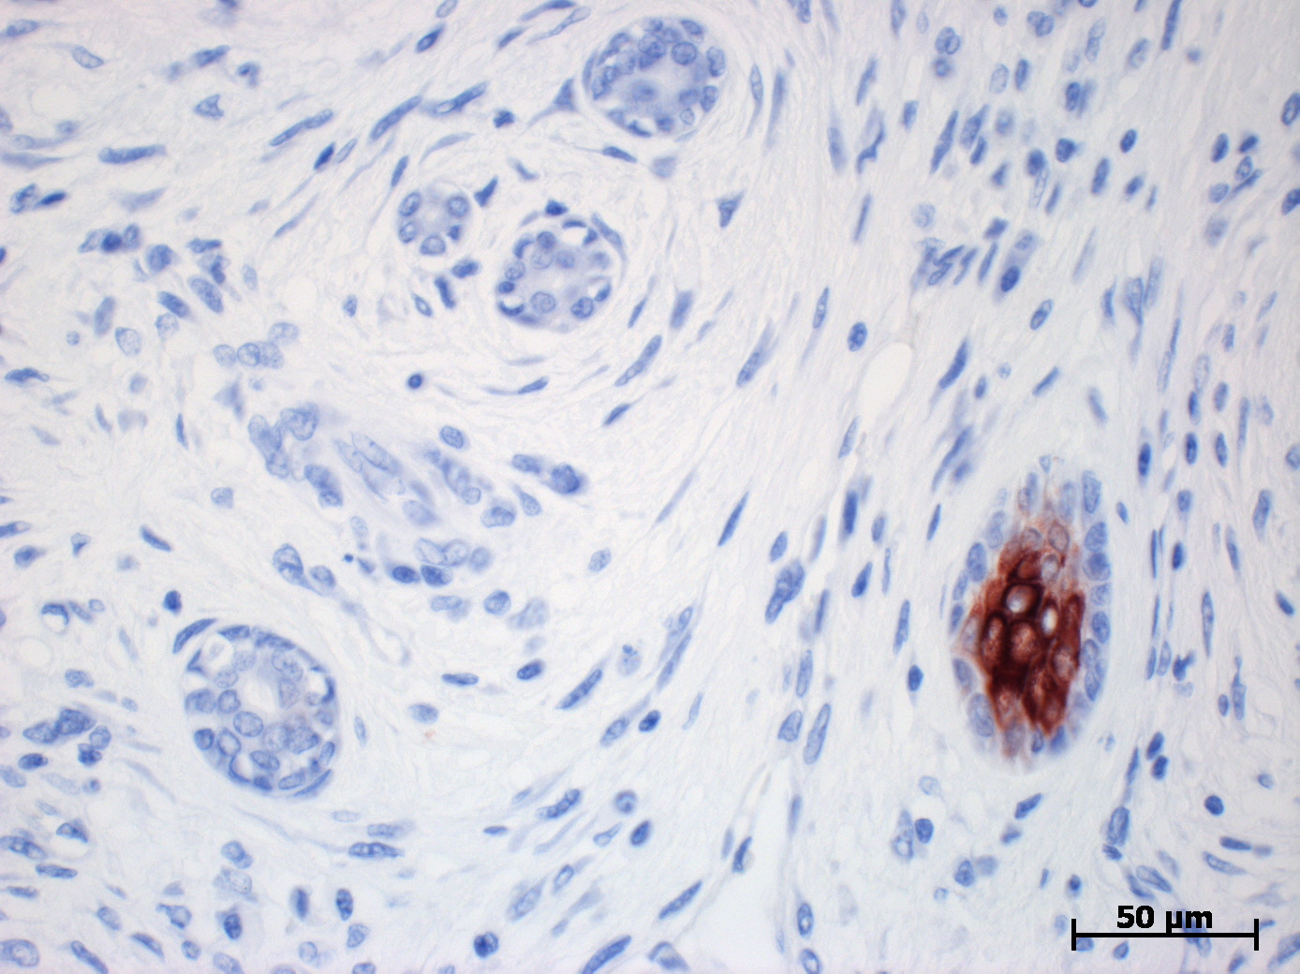
Immunohistochemistry
Syringomatous tumor
p63
K5
K8/18
K10
Low-grade adeno-squamous carcinoma
p63
K5
K8/18
K10

Slide 11
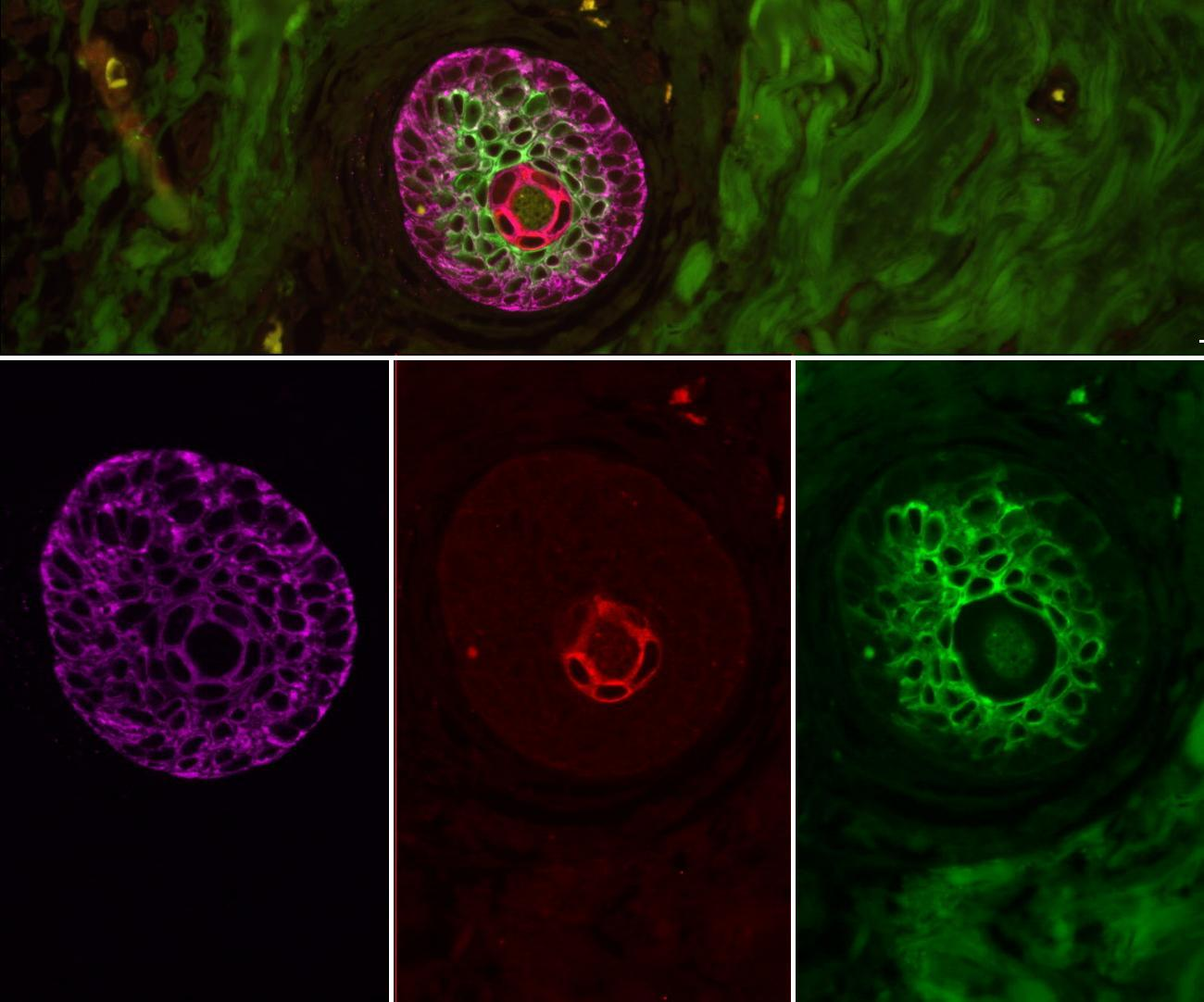
Syringomatous adenoma
In-situ Triple Immunofluorescence for K5, K8/18 and K10
Merge
K5+ cells give rise to squamous and glandular cells
K 5
K5
K8/18
K10
K 8/18
K 10

Slide 12
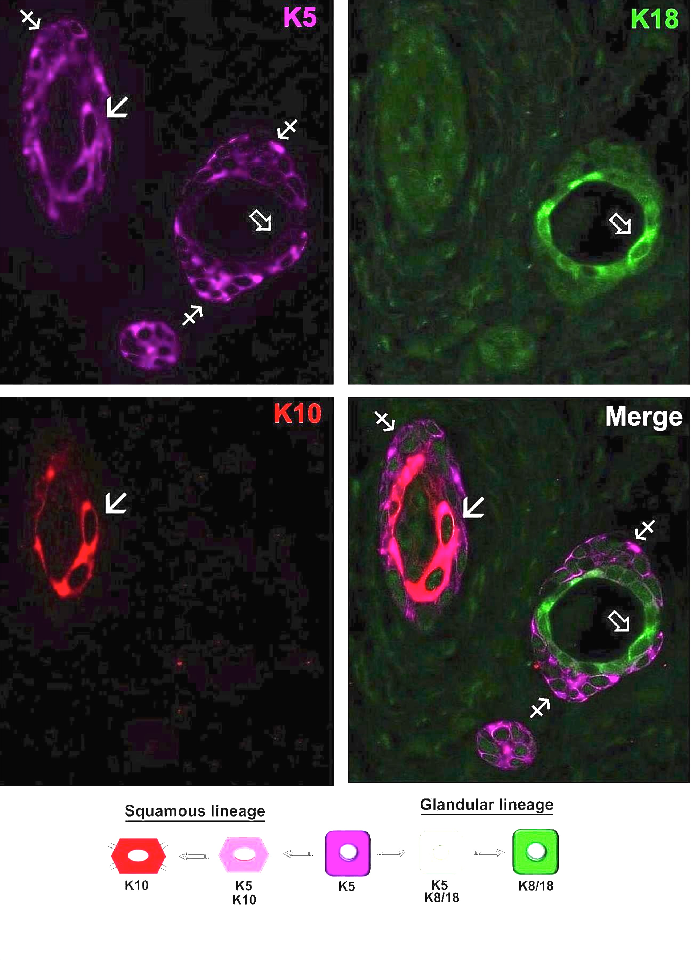
LG AdSC

Slide 13
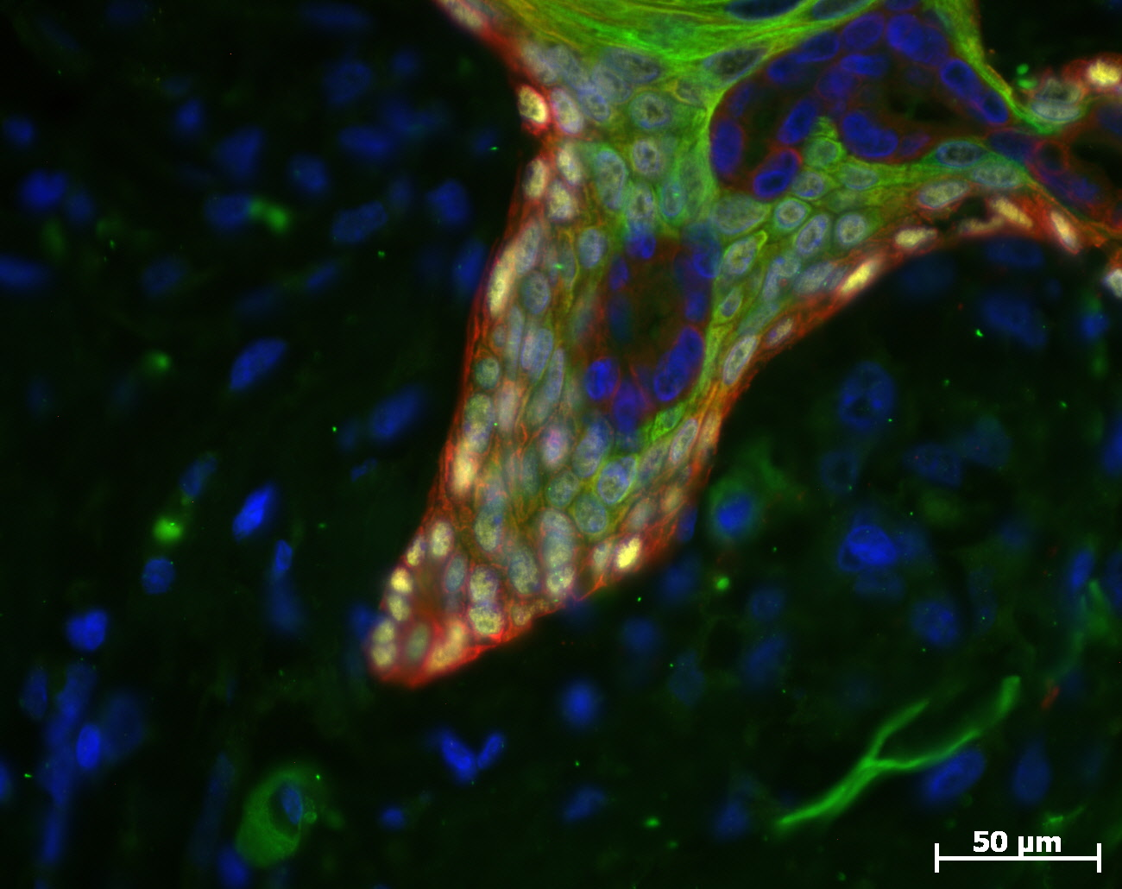
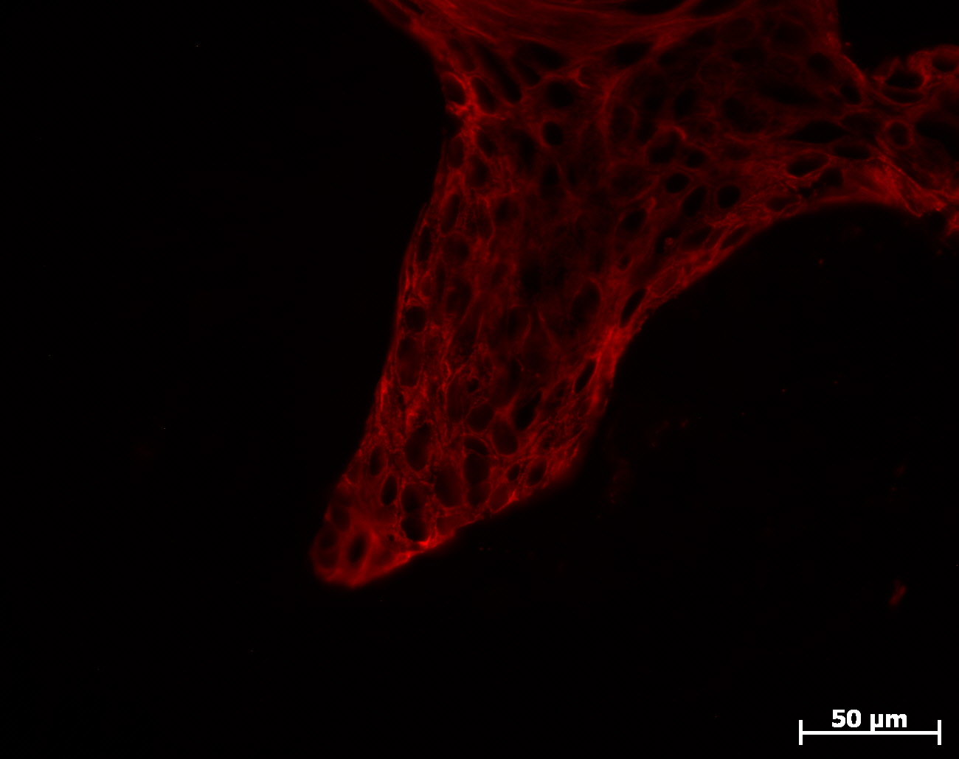
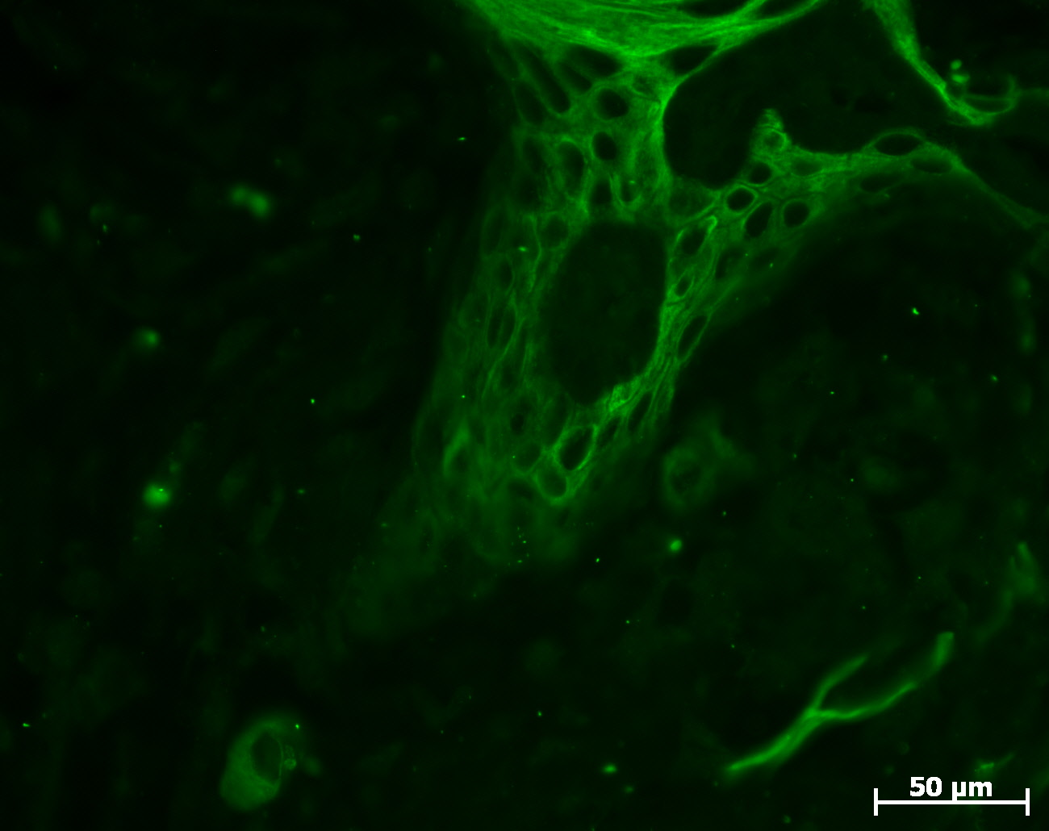
Syringomatous adenoma
In-situ Triple Immunofluorescence for p63,K5, and K10
P63
K5
K10
P63+K5+ progenitor cells give rise to squamous cells
K5
K10

Slide 14
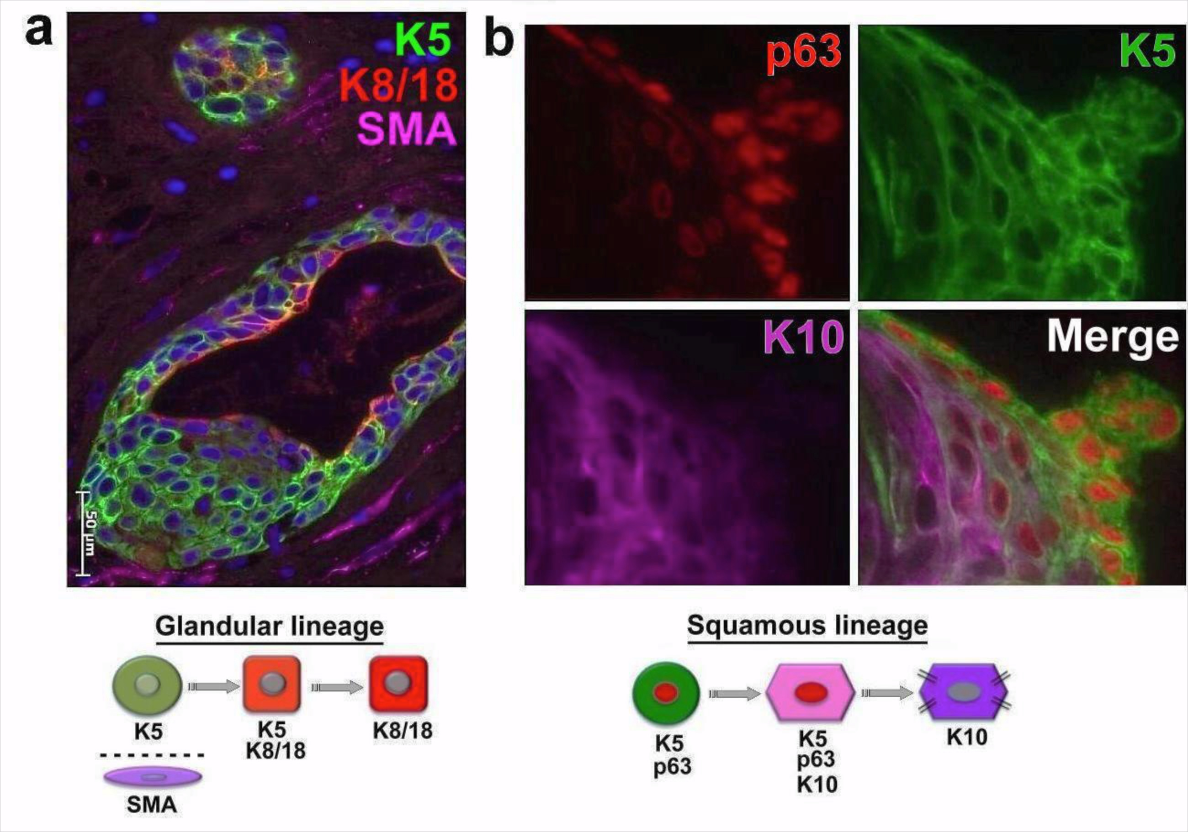
LG AdSC

Slide 15
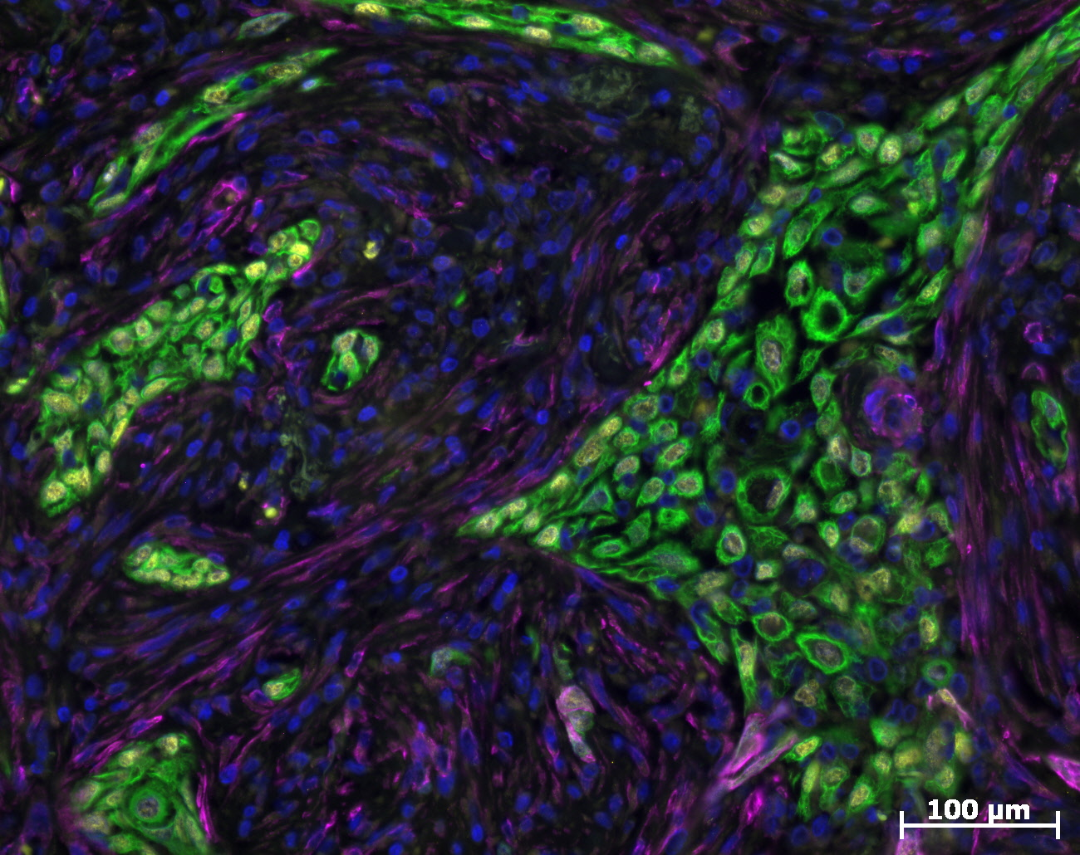
LG AdSC: Triple Immunofluorescence for p63, K5 and SMA
P63
K5
SMA
SMA+ myoepithelial cells are not observed in these tumors!

Slide 16
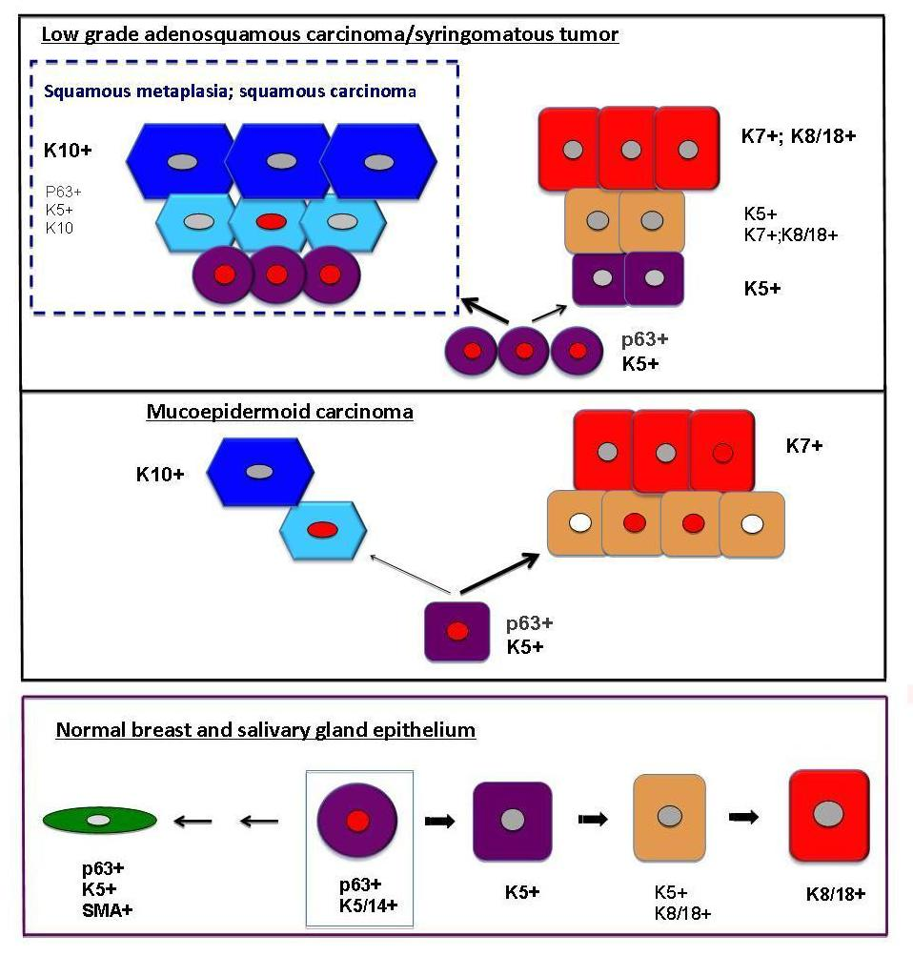
Syringomatous tumor/ Low-grade adenosquamous carcinoma
Conclusion:
Syringomatous tumors and low-grade adeno-squamous carcinoma contain p63+K5+ progenitor cells that give rise to either K10+squamous or K8/18+glandular cells

Slide 17
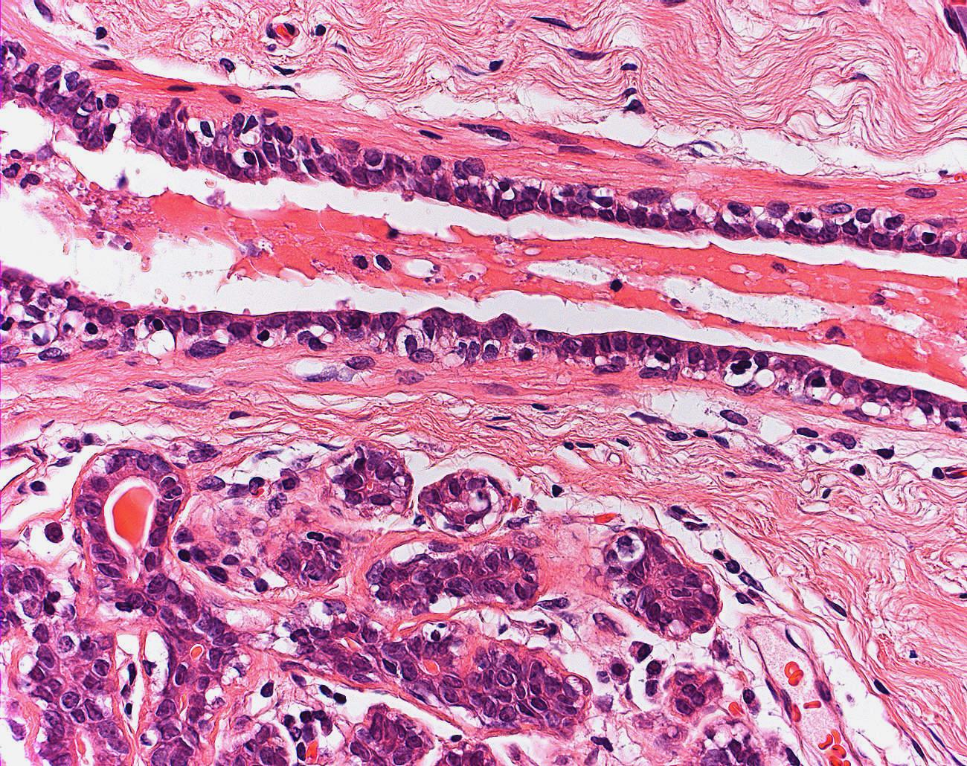
Ontogeny and breast tumors
Normal breast epithelium
Two cells concept
Basal/myoepithelial
(K5/14+; SMA+, p63+ etc)
Luminal
(K7;K8/18;K19)
ER
HE
IH
Molecular
Perou, Sorlie et al, 2000; Sorlie et al, 2001
The two-cell concept does not provide an explanation for the histogenesis of these non-classical basal type tumors!
Stem cells in breast epithelium
(Eirew et al., 2008) (L) [5] [4].Lui et al (Dontu) 2005, (Kordon and Smith, 1998) (Novelli et al., 2003; Tsai et al., 1996) [4]. (SP) (Goodell et al., 1997; Welm et al., 2002, Smith and Chepko, 2001) (Chepko and Smith, 1997),(Smalley and Clarke, 2005) (Sleeman et al., 2007).
Smith (1996); Chepko and Smith (1997); Clarke et al. (2003); Dontu et al. (2003); Smalley and Clarke (2005); Villadsen (2005); Sleeman et al. (2006); Stingl et al. (2006); Asselin-Labat et al. (2008); Eirew et al. (2008); Van Keymeulen et al. (2011); Tosoni et al. (2012); Fu et al. (2014); Visvader and Stingl (2014) (Boecker et al., 2002); Lim et al, 2009

Slide 18
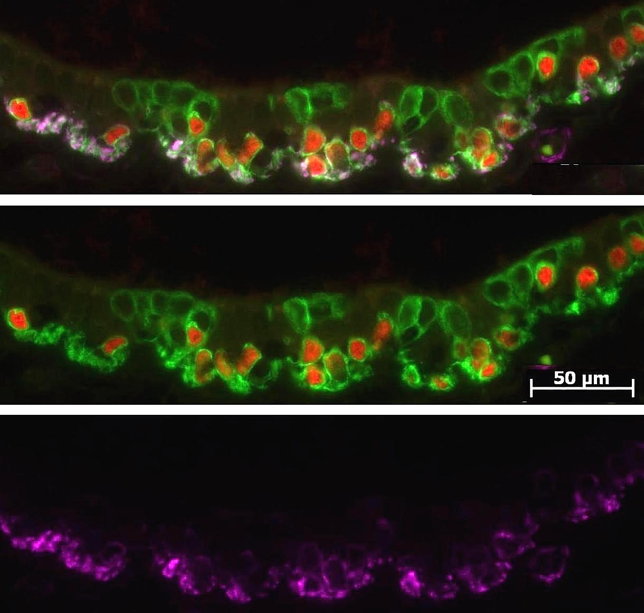
P63+K5+ progenitor cells in brrast ducts give rise to glandular and myoepithelial cells
Breast duct
K5
P63
SMA
P63
K5
K8/18
Salivary excretory duct
K5
K8/18
SMA

Slide 19
Breast
Duct Epithelium
glandular
K5+
K 5+
K 8/18+
K8/18+
P63+
K 5/14+
m y o e p i t h e l i a l
p63+
K 5+
P63+
K 5+
SMA+
SMA+
P63+K5+ bipotent cells give rise to K8/18+ glandular and SMA+ myoepithelial cells
p63
Estrogen receptor

Slide 20
Conclusions
Syringomatous tumors and low-grade adeno-squamous carcinomas contain p63+K5+ progenitors, K8/18+ glandular and K10+ squamous cells.
In both tumors the p63+K5+ progenitors differentiate through intermediary cells towards the glandular or squamous lineage.
A transdifferentiation from myoepithelial to squamous or glandular cells can be excluded.
Thus syringomatous tumor and Low-Grade adeno-squamous carcinoma seem to be immunophenotypically identical lesions.
Normal breast ducts contain p63+K5+ physiological progenitors which through intermediary cells differentiate towards the K8/18+ glandular and SMA+ myoepithelial lineage.
We conclude that the p63+K5+ physiological progenitors might be the cells of origin for both tumors.

Slide 21
Thank you for your attention

Slide 22
Lim et al, 2009: Aberrant luminal progenitors as the candidate target population for basal tumor development in BRCA1 mutation carriers:
Putative common
Progenitor
Restricted
Progenitors
Differentiated Lineage Cells
Lim et al, 2009
Eirew et al, 2008
Flow cytometry
Cell culture
Transplantation assays
Immunohistochemistry
L u m i n a l
EpCAM+
CD49+
K5+
K8/18+
MUC1+
EpCAM+
CD49f⁻
K8/18+
K19+
MUC1+
ER+, ER-
EpCAM^{neg}
CD49f^{high}
P63+
K5+
K14+
Vimentin+
M y o e p i t h e l i a l
K14+
SMA+
Fluorescence activated cell sorting for surface markers CD49f and EpCAM of normal human mammary epithelium revealed:
CD49f+EpCAM- subpopulation of cells enriched in cells positive for p63, K5/6 and K14 which were shown to have “stemness” features in regard to their bipotent differentiation potency in transplantation studies, albeit without showing which exact cell type was responsible for the formation of the structures

Slide 23
Associated lesions
Syringomatous tumors
1/9 hybrid lesion of syringomatous tumor and adenosis.
2/9 lesions lesions of syringomatous and adenomatous adenoma
Low-grade adeno-squamous carcinoma*
6/9 hybrid lesions of low-grade adenosquamous carcinoma and slerosing lesions.
3 cases showed transitions to squamous or metaplastic carcinoma.
*It is nor unusual to find ... a(n associated) papilloma or sclerosing adenosis. ...rarely transition to..... squamous carcinoma) Rosen, 2009

Slide 24
Basal-like tumors of the breast unlike classical basal-like tumors
SMA
Pleomorphic adenoma (n=4)
Adeno-myoepithelial tumors (n=7)
Adenoid-cystic carcinoma (n=6)
Squamous carcinoma breast (n=8)
Syringoma (n=12)
Adeno-squamous carcinoma (n=8)
P63;K5;K14
K10
K 5/14
K 8/18
K8/18
Chang et al, 2003; Foschini and Eusebi, 1989; Loose et al,1992; Marchio et al, 2010;Shin and Rosen, 2002;Slaughter et al, 1992; Suster et al, 1991; Pia Foschini and Reis-Filho, 2003; Rosen, 1989; Trendell-Smith et al, 1999; Wetterskog et al, 2012
Reis-Filho and Schmitt, 2002 (p63..reliable stem cell marker)
Boecker et al, 2012,2013,2014a,b

Slide 25
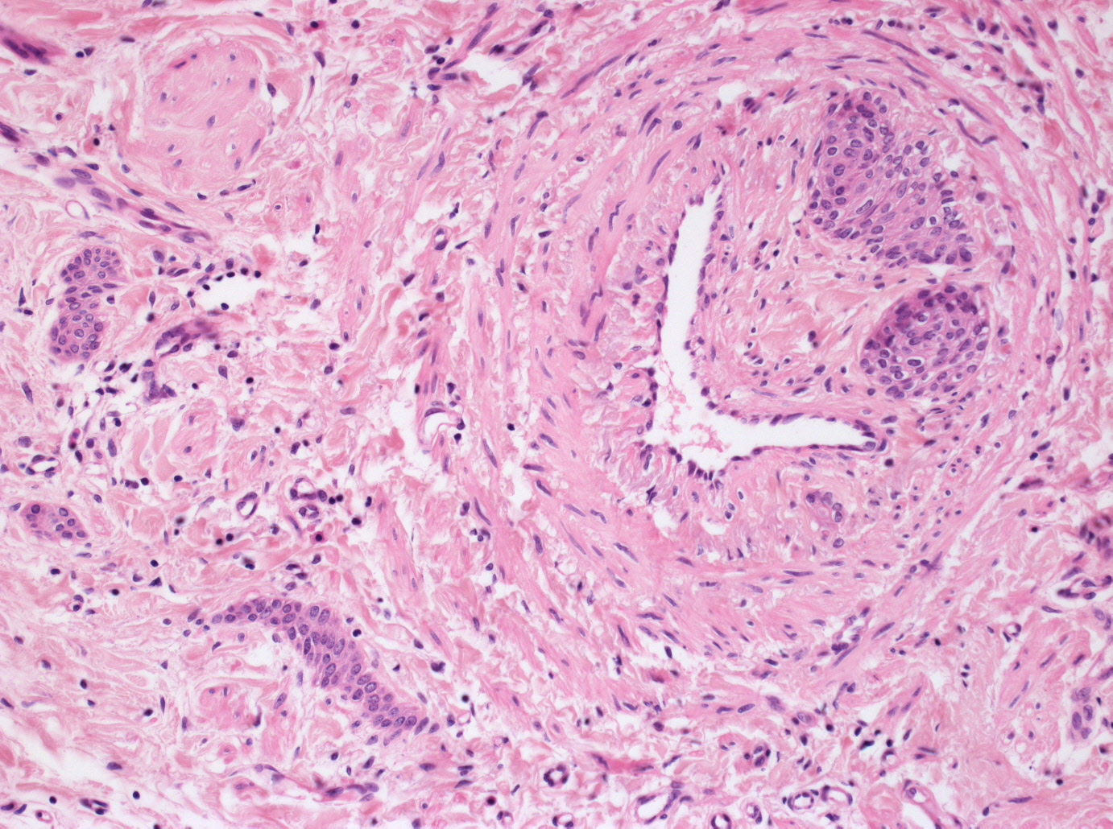
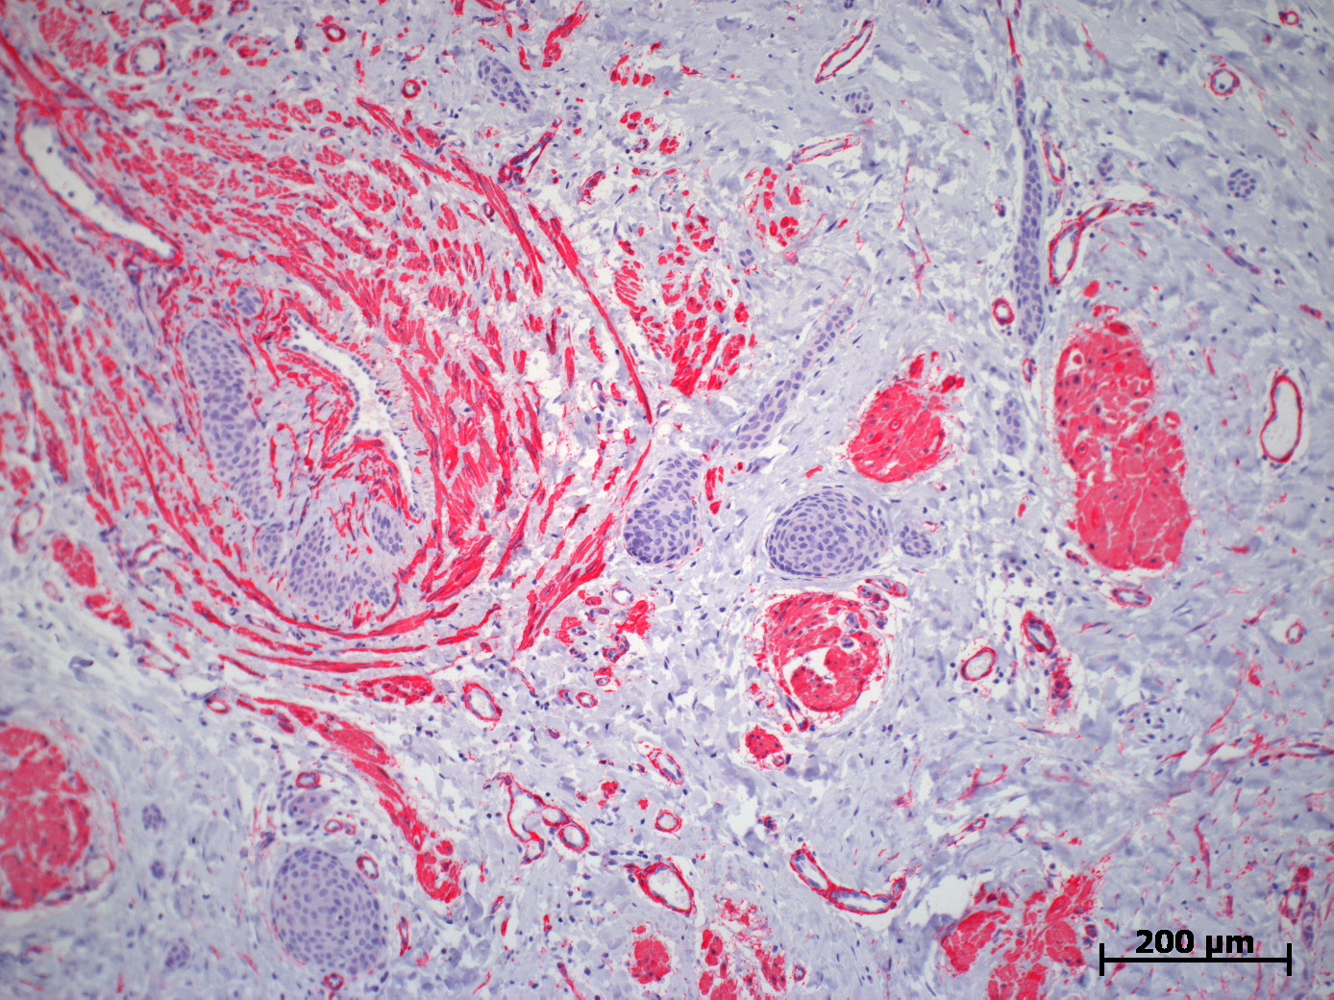
Syringomatous adenoma
9 excision biopsies
Eusebi and Azzopardi, 1976

Slide 26
K5/14+
P63+
progenitor cell
glandular lineage
K 5/14
K 5/14
K 8/18
K 8/18
myoepithelial lineage
K 5/14
SMA
SMA
squamous lineage
K 5/14
K10
K10

Slide 27
K5/14+
P63+
progenitor cell
glandular lineage
K 5/14
K 5/14
K 8/18
K 8/18
myoepithelial lineage
K 5/14
SMA
SMA
squamous lineage
K 5/14
K10
K10

Slide 28
Ontogeny
Knowledge of the human adult mammary gland epithelium is a requirement for understanding physiologic regeneration and for developing concepts of abnormal proliferative disease.
Recent cell culture studies and transplantation assays have provided profound evidence for the existence of stem cells, pointing to the existence of an epithelial differentiation hierarchy in both human and mouse mammary gland epithelium

Slide 29
Ontogeny
However, different definitions and partly opposing concepts on the nature of mammary progenitor cells have evolved based on type of experimental study and on tools used to identify the cells such as FACS with cell surface markers, molecular stem cell-and lineage markers, Hoechst 33342 dye efflux, and multicolor immunofluorescence experiments

Slide 30
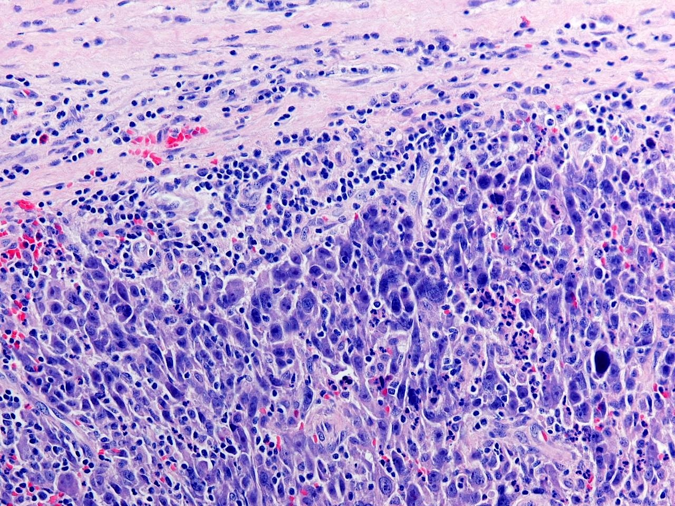
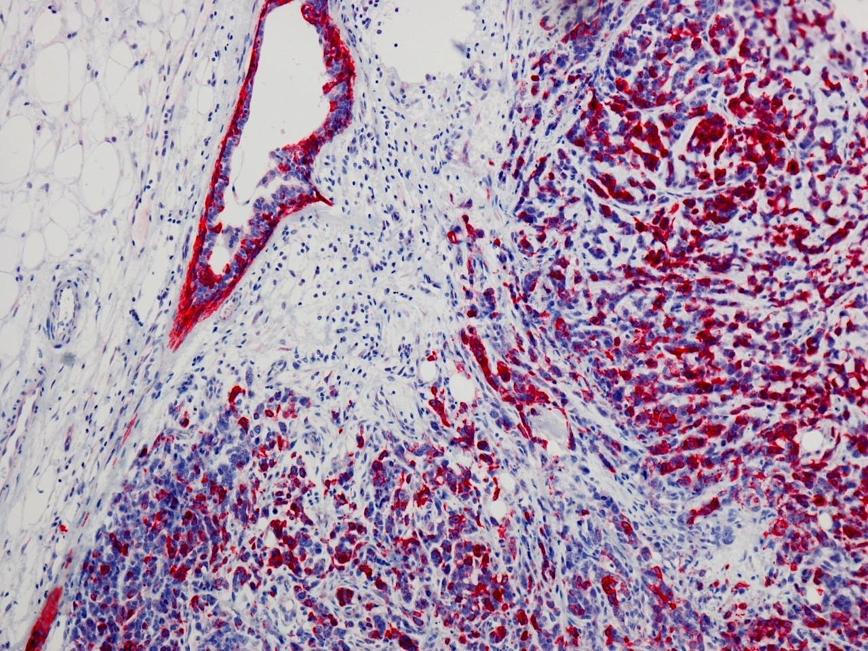
Current classification:
Two cells concept
basal/myoepithelial (K5/14+ and/or EGFR+; triple negative)
luminal (K7+; K8/18+; K19+)
ER+/-
Her2+
Invasive carcinoma, basal-like
HE: high grade
IH: K5+ a/o EGFR+
Molecular signature
bad prognosis
K5
Perou, Sorlie et al, 2000; Sorlie et al, 2001, Abd El Rehim , Pinder et al,2004; Banerjee, Reis-Filho et al, 2006, Fulford, Reis-Filho et al, 2007; Haupt et al, 2010, Jumppanen et al, 2007, Kim et al, 2006; Korsching et al, 2008; Laakso et al, 2006,Lavasani, Moinfar, 2012, Lerma et al, 2009, Linnn, Van `t Veer, 2009; Livasi et al, 2007, Moinfar, 2008, Nassar et al, 2012; Natrajan et al, 2010, Nielsen et al, 2004; Polidoro et al, 2009; Rakha et al, 2008; Reis-Filho et al, 2006, Reis-Filho and Tutt, 2008; Tan et al,2008; Tuner and Reis-Filho, 2006; Yamashita et al, 2013

Slide 31
Ontogeny and breast tumors
Normal breast epithelium
Two cells concept
Basal/myoepithelial
(K5/14+; SMA+, p63+ etc)
Luminal
(K7;K8/18;K19)
ER
HE
IH
Molecular
Invasive carcinoma
Two cells concept
Basal/myoepithelial
(K5/14; SMA, p63 etc)
Luminal
(K7;K8/18;K19)
ER
Her2
HE
IH
Molecular
K5
Perou, Sorlie et al, 2000; Sorlie et al, 2001

Slide 32
Ontogeny: Hypothetical Models of the Cellular Hierarchy of Human Breast Epithelium I
Putative common
Progenitor
Intermediary cells
Differentiated Cells
Boecker et al, 2002
In situ Double Immunofluorescence
Luminal
Dontu et al, 2003
Cell culture
Immunohistochemistry
Rios et al, 2014
clonal cell-fate mapping studies
K5/6+
K8/18+
K 8/18+
K5/6+
K14+
K5/6+
SMA+
K5/6+
SMA+
Myoepithelial
Luminal
Stingl et al, 2003
Gudjonsson et al, 2002
Villadsen et al,2007
Flow cytometry
Immunofluorescence
Cell culture
Transplantation assays
EpCAM+
CD49+
MUC1+
K 8/18+
K19+
MUC1+
ER+, ER-
EpCAM+
CD49+
MUC-
K19+
K14+
K14+
BGA2+
Myoepithelial

Slide 33
Hypothetical Models of the Cellular Hierarchy of Human Breast Epithelium II
Putative common
Progenitor
Restricted
Progenitors
Differentiated Lineage Cells
Lim et al, 2009
Eirew et al, 2008
Flow cytometry
Cell culture
Transplantation assays
Immunohistochemistry
L u m i n a l
EpCAM+
CD49+
K5+
K8/18+
MUC1+
EpCAM+
CD49f⁻
K8/18+
K19+
MUC1+
ER+, ER-
EpCAM^{neg}
CD49f^{high}
P63+
K5+
K14+
Vimentin+
M y o e p i t h e l i a l
K14+
SMA+
Clarke et al, 2005
Immunomagnetic sorting
Immunofluorescence
Cell culture
Transplantation assays
EpCAM+
MUC1+
ER+ o ER-
ER+
Musashi+
or p21+
K19-
-
Shehata et al, 2012
Liu et al, 2014
Deng et al, 2014
K14+
CD10+

Slide 34
Basal-like tumors of the breast unlike classical basal-like carcinomas
Pleomorphic adenoma breast (n=4)
Adeno-myoepithelial tumors breast (n=7)
Adenoid-cystic carcinoma breast (n=6)
Squamous carcinoma breast (n=8)
Syringoma breast (n=12)
Adeno-squamous carcinoma (n=8)
ERneg, PRneg, Her2neg, K5+
Low-grade o benign
p63-pos
Chang et al, 2003; Foschini and Eusebi, 1989; Loose et al,1992; Marchio et al, 2010;Shin and Rosen, 2002;Slaughter et al, 1992; Suster et al, 1991; Pia Foschini and Reis-Filho, 2003; Rosen, 1989; Trendell-Smith et al, 1999; Wetterskog et al, 2012
Boecker et al, 2012,2013,2014a,b

