Slide 1
Probabilistic seismic hazard assessment for the pseudo-negative stiffness control of a steel base-isolated building: A comparative study with bilinear isolation scheme
Huazhong University of Science and Technology
School of Civil Engineering and Mechanics
Wei Gong，龚微，PhD Candidate,
Huazhong University of Science and Technology
Email: ivykung@foxmail.com
1037, LuoYu Road, Wuhan, China,430074
Earthquake Epicenter Distribution of China

Slide 2
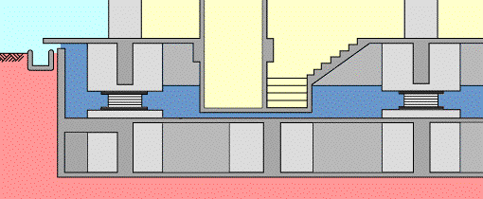
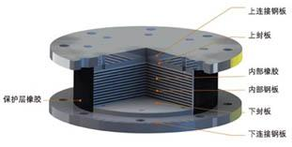
Huazhong University of Science and Technology
School of Civil Engineering and Mechanics
Background
Objective
Method
Conclusion
Flexibility
Superstructure demands
Base movement
Upper connection plate
Near-fault ground motion
Extensive earthquake
Upper cover plate
Internal rubber
Internal steel plate
New device brings new problem!
Lower cover plate
Lower connection plate

Slide 3
Huazhong University of Science and Technology
School of Civil Engineering and Mechanics
Background
Objective
Method
Conclusion
Structure control
Isolation
safety
Isolation
effective
passive
Reduce isolation effectiveness
in superstructure response control
active
Require large power supply and doubtable reliability
Semi-active
Effectiveness + reliability + adaptability

Slide 4
Huazhong University of Science and Technology
School of Civil Engineering and Mechanics
Background
Objective
Method
Conclusion
earthquake
structure
response
Is there a semi-active control algorithm simple?
feedforward sensor
control device
feedback sensor
control
algorithm
Conventional semi-active control algorithm：
clipped-optimal control
maximum energy dissipation
modulated homogeneous friction
fuzzy logic-based control
Lyapunov control algorithm
complicated computational process
Complex
massive sensing networks

Slide 5
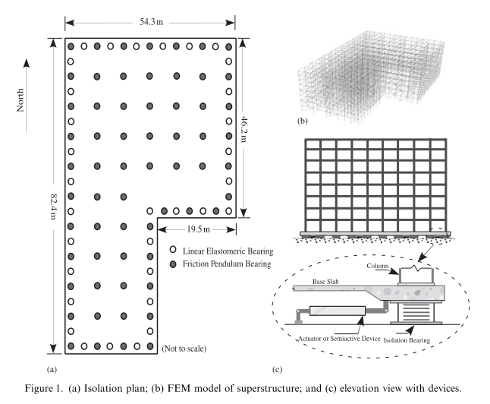
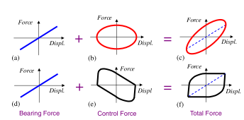
Huazhong University of Science and Technology
School of Civil Engineering and Mechanics
Background
Objective
Method
Conclusion
pseudo-negative stiffness (PNS) control
Force
Force
Force
Displ.
Displ.
Displ.
Force
Force
Force
Displ.
Displ.
Displ.
Bearing Force
Control Force
Total Force
Input voltage
reduced force transmission to the superstructure
high damping ratio
53.4%
Displ.
1、Low energy source requirement
2、high control force
Effectiveness; Safety; Simplicity
base shear
base displ.
func. of displ

Slide 6
Huazhong University of Science and Technology
School of Civil Engineering and Mechanics
Background
Objective
Method
Conclusion
PNS control
Less base shear
Large damping
Force to super.
?
Base displ.
real effective
A low base shear is not a guarantee of an real effective isolation system because the high modes, which carry both the floor acceleration and inter-storey drift, are almost orthogonal to the base shear.
Less acc. & drift
in super.
(Kelly, 1999)
Can we get both?
acc. & drift
in super
base shear
base displ.

Slide 7
Huazhong University of Science and Technology
School of Civil Engineering and Mechanics
Background
Objective
Method
Conclusion
socio-economic
variability in seismic intensity
Ideal isolation control principle
Response quantities can't be always reduced simultaneously for a specific control strategy.
Basic concept :
different seismic intensity different control objective
frequent earthquake
→
improve the structural functionality
acc. and drift in super.
extreme earthquake
→
improve the structural safety
isolator displacement
reduce the overall economic loss
Ideal isolation control principle solves the conflict between iso. effectiveness and iso. safety.

Slide 8
Huazhong University of Science and Technology
School of Civil Engineering and Mechanics
Background
Objective
Method
Conclusion
Modified PNS control
MPNS
Propose
evaluate
Deterministic
Probabilistic
Ideal isolation control principle
difficulty
Probabilistic seismic risk assessment
Benchmark base-isolated building
MPNS, PNS and passive damping control

Slide 9
Huazhong University of Science and Technology
School of Civil Engineering and Mechanics
Background
Objective
Method
Conclusion
Part 1: Modified pseudo-negative stiffness (MPNS) control
Control object:
energy dissipation capacity
loosen the restriction on isolator displacement for low-to-moderate seismic intensity
V₀=1
prevent the relative movement of isolators for high seismic intensity
k_{pns}=5
passive energy dissipation fashion
increasing the control force
U_{T}=0.2
V₀
Force-displacement sketch of MPNS
Implemented by MRD

Slide 10
Huazhong University of Science and Technology
School of Civil Engineering and Mechanics
Background
Objective
Method
Conclusion
Part 2: Deterministic assessment of MPNS control
PGA = 0.139 g
PGA = 0.8 g
Seismic input : El Centro
Acceleration (m/s²)
Displacement(m)
x-direction
MPNS
PNS
Larger iso. displ. for MPNS
Larger contr. force for MPNS

Slide 11
Huazhong University of Science and Technology
School of Civil Engineering and Mechanics
Background
Objective
Method
Conclusion
Part 3: Probabilistic seismic hazard/risk assessment (PSHA) of MPNS control
Definition :
estimate probabilities of exceeding various damage states for a certain damage measure
Merit :
consider various ground motions with different frequency contents and intensities
explicit
descript structural performances in probabilistic format
scientifically complete
Damage Measure (DM) :
EDP
Damage State | Slight (LS1) | Moderate (LS2) | Extensive (LS3) | Collapse (LS4)
Inter-storey drift ratio | 0.1% | 0.2% | 0.7% | 1.5%
Story acceleration(g) | 0.05 | 0.1 | 0.2 | 0.4
Bearing displacement (m) | 0.1D (0.06) | 0.2D (0.12) | 0.45D (0.27) | min(0.55D,3Tr) (0.33)

Slide 12
Huazhong University of Science and Technology
School of Civil Engineering and Mechanics
Background
Objective
Method
Conclusion
Part 3: Probabilistic seismic hazard/risk assessment (PSHA) of MPNS control
Site Hazard
Nonlinear IDA
Probabilistic Seismic Fragility
Structure Hazard
Scale up with IM
Sa(T₁)
IM

Slide 13
Huazhong University of Science and Technology
School of Civil Engineering and Mechanics
Background
Objective
Method
Conclusion
Part 3: Probabilistic seismic hazard/risk assessment (PSHA) of MPNS control
Site Hazard

Slide 14
Huazhong University of Science and Technology
School of Civil Engineering and Mechanics
Background
Objective
Method
Conclusion
Part 3: Probabilistic seismic hazard/risk assessment (PSHA) of MPNS control
Nonlinear IDA
 | 63.2%50r | 10%50r | 2%50r | 2%100r
 | 47% | 11% | / | /
 | 64% | 20% | / | /
 | / | / | 9% | 9%
PNS-MPNS
PNS

Slide 15
Huazhong University of Science and Technology
School of Civil Engineering and Mechanics
Background
Objective
Method
Conclusion
Part 3: Probabilistic seismic hazard/risk assessment (PSHA) of MPNS control
Probabilistic Seismic Fragility

Slide 16
Huazhong University of Science and Technology
School of Civil Engineering and Mechanics
Background
Objective
Method
Conclusion
Part 3: Probabilistic seismic hazard/risk assessment (PSHA) of MPNS control
Structure Hazard
probabilities of exceeding DMs per 50 years
EDP | Control scheme | PE in 50 years (10⁻²)
 |  | >LS1 | >LS2 | >LS3 | >LS4
 | MPNS | 21.0 | 2.0 | 0.0 | 0.0
 | PNS | 48.1 | 2.3 | 0.0 | 0.0
 | BIS | 63.2 | 5.4 | 0.1 | 0.0
 | MPNS | 76.1 | 36.7 | 8.0 | 0.2
 | PNS | 99.7 | 96.3 | 35.0 | 0.4
 | BIS | 95.9 | 72.6 | 13.9 | 0.5
 | MPNS | 66.1 | 27.9 | 3.1 | 1.4
 | PNS | 52.1 | 21.3 | 3.3 | 1.8
 | BIS | 60.4 | 23.5 | 3.1 | 1.8

Slide 17
Huazhong University of Science and Technology
School of Civil Engineering and Mechanics
Background
Objective
Method
Conclusion
A MPNS control scheme is proposed based on the ‘ideal isolation control
principle.’
The effect of the MPNS control is investigated within a probabilistic
performance-based seismic engineering framework in terms of structural
functionality and safety.
MPNS control exhibits an enhanced ideal isolation control capacity for
improving structural functionality to a substantial extent for low seismic
intensities and for enhancing structural safety from collapse.

Slide 18
Huazhong University of Science and Technology
School of Civil Engineering and Mechanics
Thank you ~
Wei Gong，龚微，PhD Candidate,
Huazhong University of Science and Technology
Email: ivykung@foxmail.com
1037, LuoYu Road, Wuhan, China,430074

