Slide 1

About OMICS Group
OMICS Group International is an amalgamation of Open Access publications and worldwide international science conferences and events. Established in the year 2007 with the sole aim of making the information on Sciences and technology ‘Open Access’, OMICS Group publishes 400 online open access scholarly journals in all aspects of Science, Engineering, Management and Technology journals. OMICS Group has been instrumental in taking the knowledge on Science & technology to the doorsteps of ordinary men and women. Research Scholars, Students, Libraries, Educational Institutions, Research centers and the industry are main stakeholders that benefitted greatly from this knowledge dissemination. OMICS Group also organizes 300 International conferences annually across the globe, where knowledge transfer takes place through debates, round table discussions, poster presentations, workshops, symposia and exhibitions.

Slide 2
About OMICS Group Conferences
OMICS Group International is a pioneer and leading science event organizer, which publishes around 400 open access journals and conducts over 300 Medical, Clinical, Engineering, Life Sciences, Pharma scientific conferences all over the globe annually with the support of more than 1000 scientific associations and 30,000 editorial board members and 3.5 million followers to its credit.
OMICS Group has organized 500 conferences, workshops and national symposiums across the major cities including San Francisco, Las Vegas, San Antonio, Omaha, Orlando, Raleigh, Santa Clara, Chicago, Philadelphia, Baltimore, United Kingdom, Valencia, Dubai, Beijing, Hyderabad, Bengaluru and Mumbai.

Slide 3

Simulation Research of Driving Schemes for a Dynamic Calibration System of Fuel Turbine Flowmeters
3rd International Conference and Exhibition on Mechanical & Aerospace Engineering October 05-07, 2015 San Francisco, USA
Bin Wang
Nanjing University of Aeronautics and Astronautics, China
October 7, 2015

Slide 4
Contents
1. Introduction
2. Modeling and Simulation
3. Results and Discussions
4. Conclusions and Ongoing Work
1/24

Slide 5
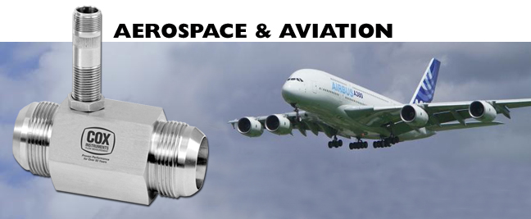
Introduction
2/24

Slide 6
Introduction
3/24

Slide 7
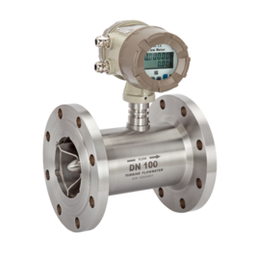
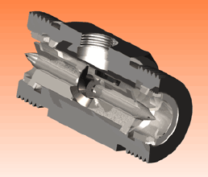
Introduction
long-term usage performance degradation
fluctuation of meter coefficient calibration needed
4/24

Slide 8
Introduction
Theoretical basis
Review of research
Static
Dynamic
1、mass method
2、volume method
1、thimble method
2、……
5/24
Notes:
.

Slide 9
Introduction
Principle and method presented by our research
6/24

Slide 10
Modeling and Simulation
Alternative actuating solutions:
orifice hole
orifice hole
flapper
Torque motor driving NFV.
Piezoelectric actuator driving NFV.
7/24

Slide 11
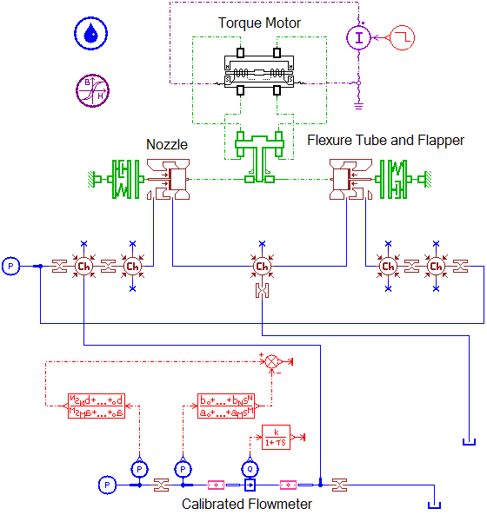
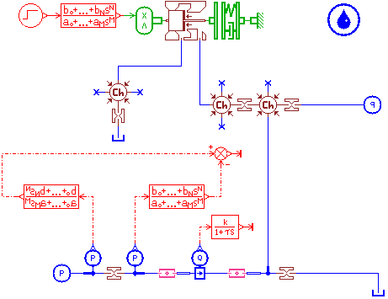
Modeling and Simulation
Model of piezoelectric stack driving scheme
Model of torque motor driving scheme
8/24

Slide 12
Modeling and Simulation
Structure of nozzle-flapper stimulating system
9/24

Slide 13
Modeling and Simulation
Piezoelectric stack actuator
Control cavity
Flowmeter and pressure difference transducer
10/24
Equations of nozzle-flapper stimulating system

Slide 14
Modeling and Simulation
Parameters
Elements | Parameters | Value | Units | Origin
Piezoelectric stack actuator | excitation voltage U_{e} electrostatic capacity Ce stiffness Kp number of stack n piezoelectric constant d₃₃ | 0~150 1.6e-6 1.2e7 420 4.4e-10 | V F N/m - pC/N | datasheet datasheet datasheet datasheet datasheet
Flapper | amplification factor n_{a} length of flapper L moment of inertia J elasticity modulus E stiffness K_{f} | 10 0.12 1.63e-4 2e11 5e6 | - m kg·m² Pa N/m | designed designed calculated datasheet calculated
Nozzle | inner diameter d_{i} external diameter d_{e} | 2.5 5 | mm mm | designed designed
Flowmeter | time constant τ fuel density ρ | 0.02 800 | s kg/m³ | estimate datasheet
Control cavity | reference orifice D₀ draining orifice D_{d} | 1.1 2 | mm mm | designed designed
11/24

Slide 15
Modeling and Simulation
Load analysis of the flapper
12/24

Slide 16
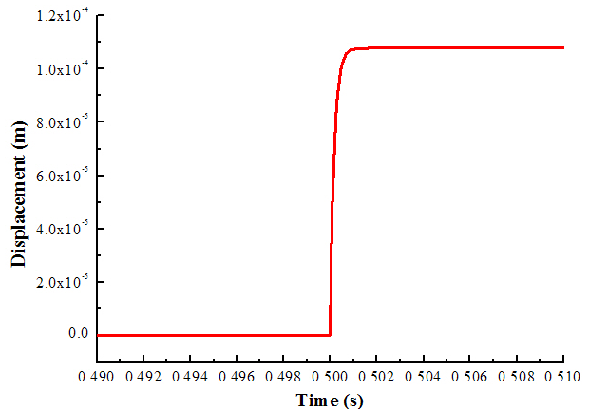
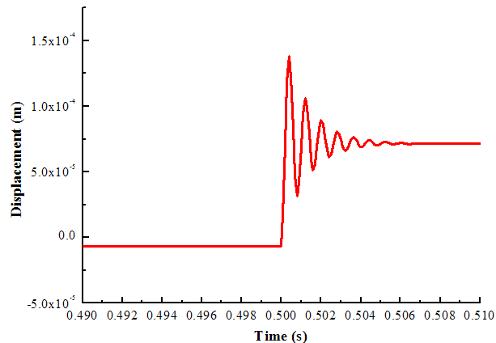
Results and Discussion
Disp. of piezoelectric stack system
Disp. of torque motor system
Comparison between these two solutions
13/24

Slide 17
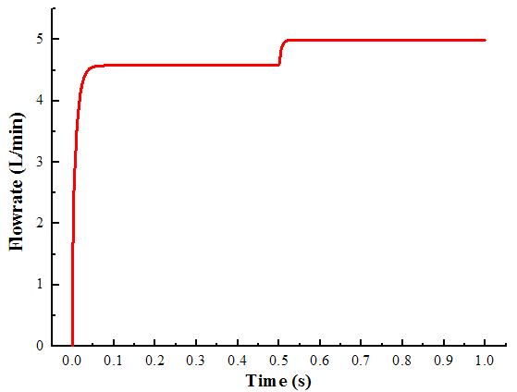
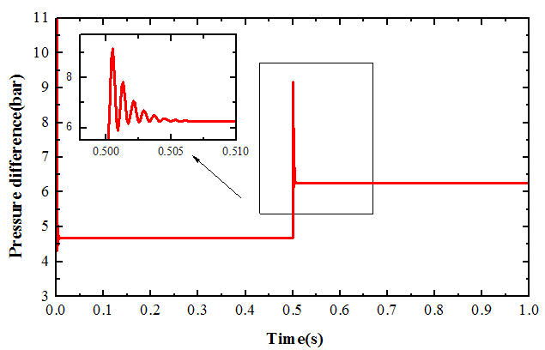
Results and Discussion
a. Pressure difference
b. Flowrate
Performance of torque motor stimulating system
14/24

Slide 18
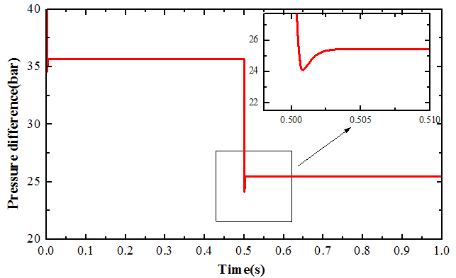
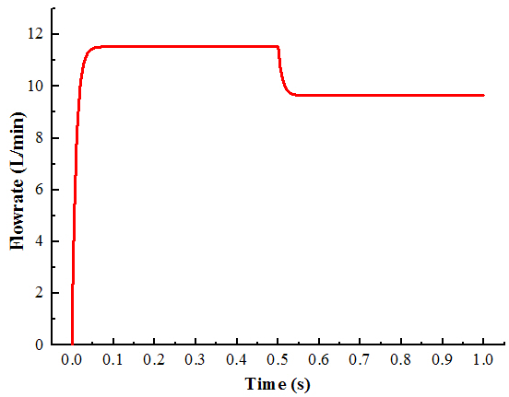
a. Pressure difference
b. Flowrate
Performance of piezoelectric stack stimulating system
15/24

Slide 19
Modeling and Simulation
Simulink Model
16/24

Slide 20
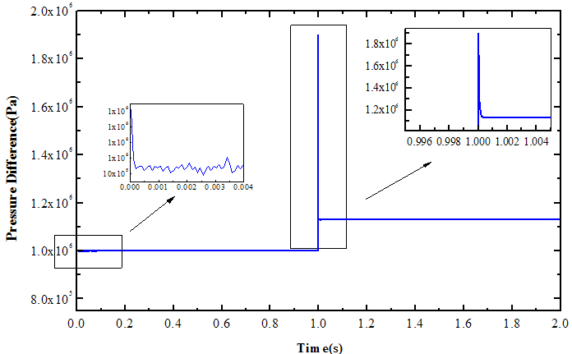
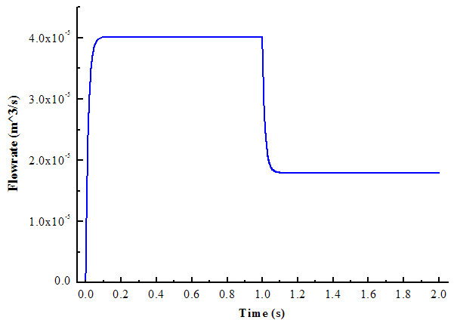
Results and Discussion
a. Pressure difference
b. Flowrate
Response of the adopted system to 80V excitation voltage
17/24

Slide 21
Results and Discussion
Calibrated flow rate with different excitation voltage
18/24

Slide 22
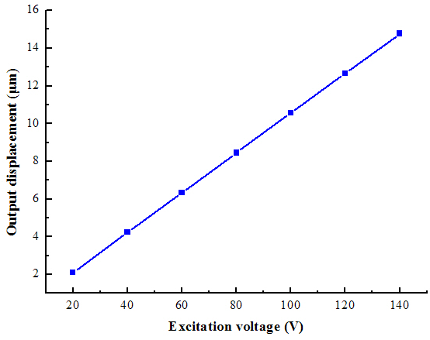
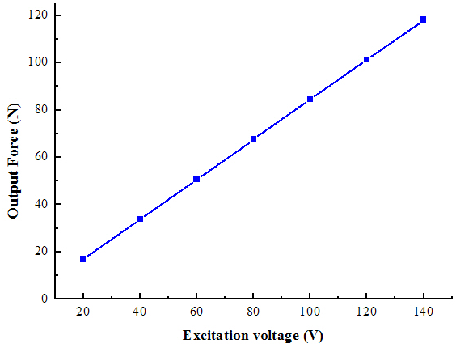
Results and Discussion
Calibrated flow rate vs excitation voltage
Driving force vs excitation voltage
19/24

Slide 23
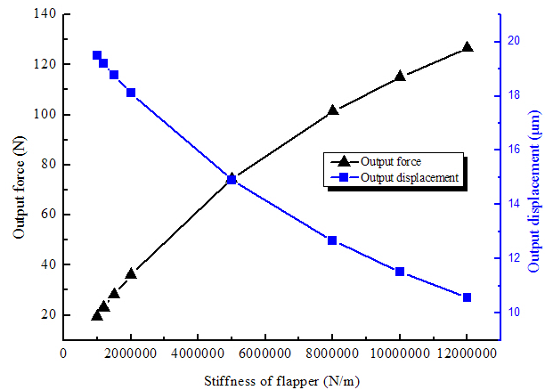
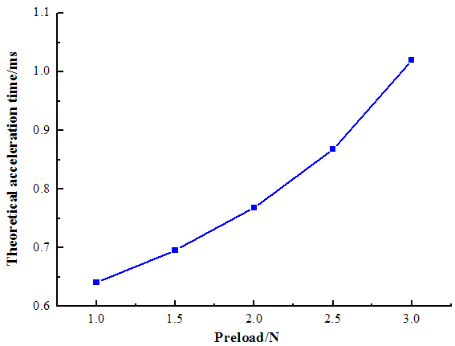
Results and Discussion
Output force and disp. vs flapper stiffness
Acceleration time vs spring preload
20/24

Slide 24
Conclusions and Ongoing work
1. As the relatively small output torque the torque motor can provide, diameter of the nozzle can’t be set to a large enough value. Oscillation of the flapper can’t be neglected.
2. The piezoelectric stack actuator (PSA) can produce much greater force to balance the flow force acting on the flapper. Larger size nozzles are feasible. Piezoelectric structure effectively controls the high-frequency oscillation of the flapper.
3. Dynamic calibration system driven by piezoelectric-stack provides a faster and larger excitation flow than by the torque motor. In the mean time, the PSA can control the flapper flutter more effectively.
4. Structural parameters of the flapper needs to be carefully designed on the basis of a thorough understanding of the characteristics of PSA. As the preload spring is essential for stabilization of output displacement, its magnitude should be considered carefully.
21/24

Slide 25
Conclusions and Ongoing work
Virtual prototype of experimental setup
22/24
Notes:
This is the virtual prototype of the experimental setup. All parts in this system were designed and manufactured or bought for their using here.

Slide 26
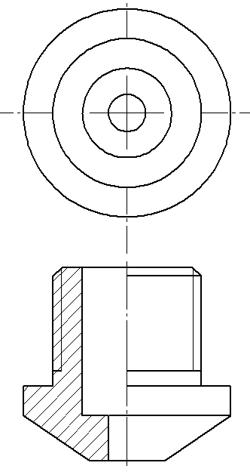
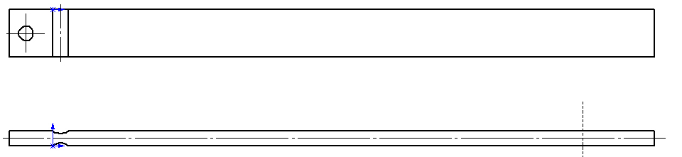
Conclusions and Ongoing work
Nozzle-flapper valve under in machining
23/24

Slide 27
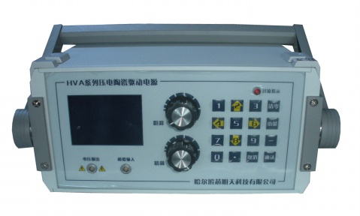
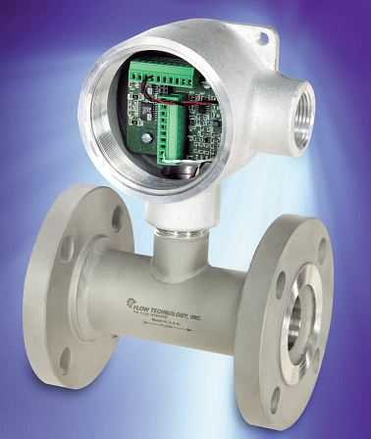
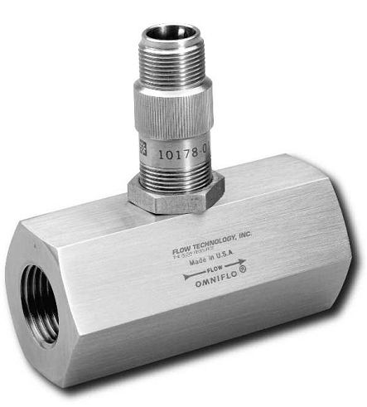
Conclusions and Ongoing work
Piezoelectric-stack and its power supply
FT Series flowmeters to be calibrated
Primary equipments prepared
24/24

Slide 28
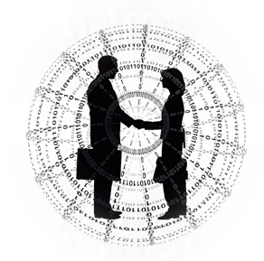
3rd International Conference and Exhibition on Mechanical & Aerospace Engineering October 05-07, 2015 San Francisco, USA
Thank you for your attention!

