Slide 1
About OMICS Group
OMICS Group International is an amalgamation of Open Access publications and worldwide international science conferences and events. Established in the year 2007 with the sole aim of making the information on Sciences and technology ‘Open Access’, OMICS Group publishes 400 online open access scholarly journals in all aspects of Science, Engineering, Management and Technology journals. OMICS Group has been instrumental in taking the knowledge on Science & technology to the doorsteps of ordinary men and women. Research Scholars, Students, Libraries, Educational Institutions, Research centers and the industry are main stakeholders that benefitted greatly from this knowledge dissemination. OMICS Group also organizes 300 International conferences annually across the globe, where knowledge transfer takes place through debates, round table discussions, poster presentations, workshops, symposia and exhibitions.

Slide 2
About OMICS Group Conferences
OMICS Group International is a pioneer and leading science event organizer, which publishes around 400 open access journals and conducts over 300 Medical, Clinical, Engineering, Life Sciences, Phrama scientific conferences all over the globe annually with the support of more than 1000 scientific associations and 30,000 editorial board members and 3.5 million followers to its credit.
OMICS Group has organized 500 conferences, workshops and national symposiums across the major cities including San Francisco, Las Vegas, San Antonio, Omaha, Orlando, Raleigh, Santa Clara, Chicago, Philadelphia, Baltimore, United Kingdom, Valencia, Dubai, Beijing, Hyderabad, Bengaluru and Mumbai.

Slide 3
Distinct classes of selenium-containing
proteins in carcinogenesis and prevention
Wancai Yang, MD
Department of Pathology
Xinxiang Medical University, China
Department of Pathology
University of Illinois at Chicago, USA
University of Oxford
Oxford, UK
April 15, 2014

Slide 4
Introduction
There are three classes of selenium-containing proteins:
A protein that contains selenomethionine in which selenium incorporates non-specifically into the sulfur-containing amino acid (due to its structural similarity to sulfur);
Selenoproteins: these proteins contain the amino acid selenocysteine (Sec), e.g. glutathione peroxidases (GPx-1, GPx-2, GPx-3 and GPx-4), selenoprotein P, selenoprotein W, etc;
Selenium-binding protein: human, hSBP1, SELEBP; mouse, SBP1, SBP2.

Slide 5

Identification of selenium-binding protein:
SBP1 was discovered in rat liver and intestinal tract (Banerjee et al, BBRC, 1982; Sani, et al. Carcinogenesis. 1988; Morrison, et al, In vivo. 1989) The selenium-binding proteins were different from selenoproteins (glutathione peroxidase, etc)
SBP1 was found to have anti-cancer function via binding selenium in mice (Bansal, et al, Carcinogenesis, 1990)
Human SBP1 was cloned and characterized in 1997 (J. Cell. Biolochem, 1997, 64: 217)
Genomic location: Chromosome 1 at location 149,603,402-149,611,833
Transcription: Exons: 12; Transcript length: 1,752 bps;
Translation length: 472 residues

Slide 6
SBP1 and Cancers:
SBP1 expression is reduced in human cancer tissues and the reduction of SBP1 in cancer is associated with poor survival:
Prostate cancer (Yang, Cancer Res, 1998, 58: 3150-3)
Lung cancer (Chen et al, J Pathol, 2004, 202: 321-9)
Pleural Mesothelioma (Pass et al,Clin. Can.Res., 2004, 10:849-859)
Ovarian cancer (Huang et al, Int J Cancer, 2006, 118: 2433-40; Zhang et al, Hum Pathol, 2010, 41: 255-61)
Colorectal cancer (Li et al, Proc.AACR, 2005; Kim et al, Proteomics, 2006, 6: 3466-76; Li et al, Mol Nutr Food Res, 2008);
Thyroid cancer (Brown et a, Mol. Carcinogenesis, 2006, 45: 613-626)
Esophageal cancer (Silvers et al, Clin Can. Res, 2010, 16: 2009-21)
Gastric cancer (Zhang et al, Med. Oncol, 2010, Jun;28(2):481-7)

Slide 7
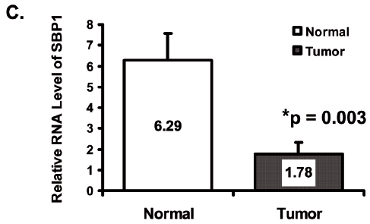
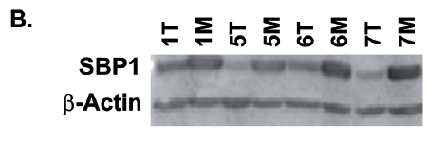
SBP1 expression was reduced
in colonic carcinomas v.s. normal mucosa

Slide 8
Decreased expression of SBP1 in colorectal cancer
was associated with poor survival

Slide 9
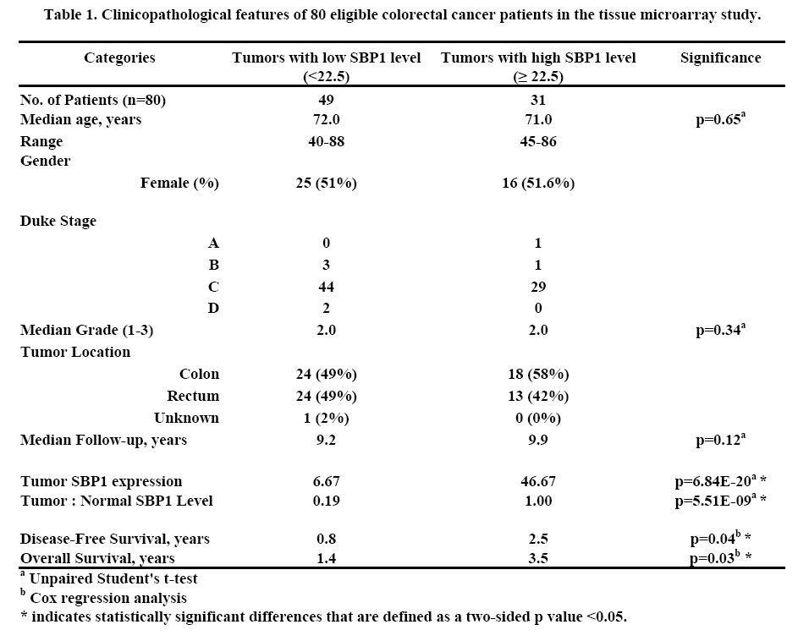

Slide 10
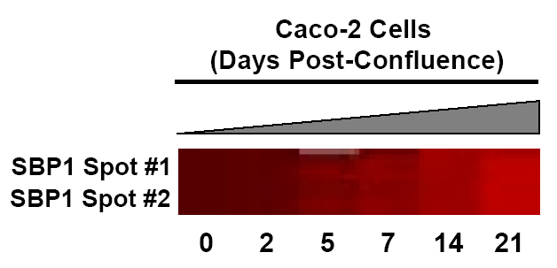
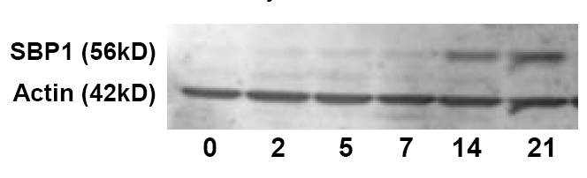
SBP1 expression was upregulated
during cell differentiation

Slide 11
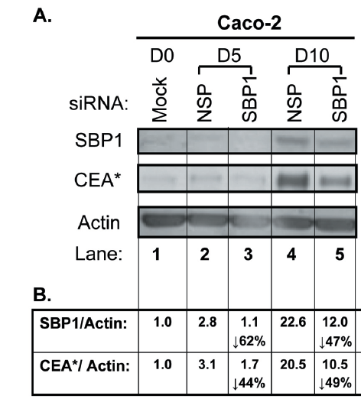
Knockdown SBP1 by siRNA delayed cell differentiation in colon cancer cells
Li et al, Mol Nutr Food Res, 2008

Slide 12
Functional interaction between SBP1 and GPX1

Slide 13



SBP1 inhibited GPX1 activity , but did not affect GPX1 protein and mRNA levels
HCT116
Parental pIRES2 SBP1
SBP1
GPX1
β-actin
Fang et al, Carcinogenesis, 2010

Slide 14
SBP1 inhibited GPX1 activity in breast cancer cells

Slide 15
SBP1 overexpression inhibited selenium-induced
GPX1 activity in colon cancer cells

Slide 16
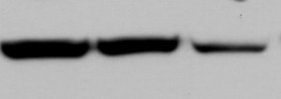

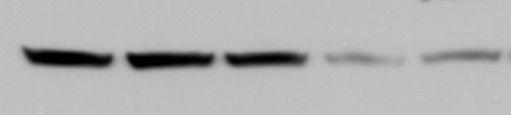


GPX1 inhibited SBP1 expression in translational and
transcriptional levels.
A
B
C
MCF-7
Parental Vector GPX1
SBP1
GPX1
β-actin
D
MCF-7-GPX1 stable cell line
E
HCT116-SBP1 stable cell line
Sodium selenite
0 25 50 100 250 nM
Sodium selenite
0 25 50 100 250 nM
SBP1
GPX1
β-actin
SBP1
GPX1
β-actin

Slide 17

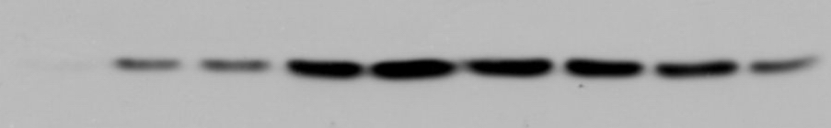
SBP1 affects selenium-mediated alterations of GPX1
HCT116-pIRES2 stable cell line
Sodium selenite
0 25 50 100 250 500 1,000 2,500 5,000 nM
SBP1
GPX1
β-actin
HCT116-SBP1 stable cell line
Sodium selenite
0 25 50 100 250 500 1,000 2,500 5,000 nM
SBP1
GPX1
β-actin

Slide 18


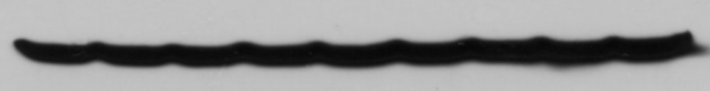
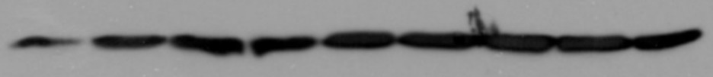

Selenium-mediated alterations of GPX1 affects SBP1
MCF7-Vector stable cell line
Sodium selenite
0 25 50 100 250 500 1,000 2,500 5,000 nM
GPx1
SBP1
β-actin
MCF7-GPX1 stable cell line
Sodium selenite
0 25 50 100 250 500 1,000 2,500 5,000 nM
GPx1
SBP1
β-actin

Slide 19


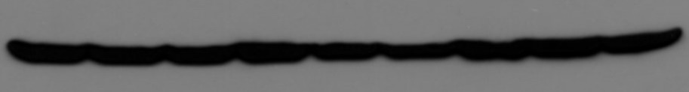
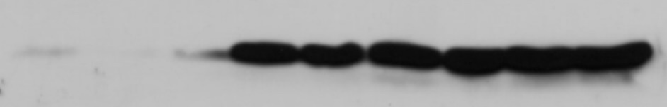


GPX1 and SBP1 expression in mouse intestinal epithelial cells (3 mice/group)
Se-deficiency Normal diet Se-supplemental
GPX1
SBP1
β-actin
Duodenum
Se-deficiency Normal diet Se-supplemental
GPX1
SBP1
β-actin
Colon

Slide 20
Physical interaction between SBP1 and GPX1
Whole cell lysate
1.HA-SBP1+pECFP
2.HA-SBP1+pECFP-Sec-GPX1
1.HA-SBP1+pECFP
2.HA-SBP1+pECFP-Sec-GPX1
3.HA-SBP1+pECFP-Cys-GPX1

Slide 21
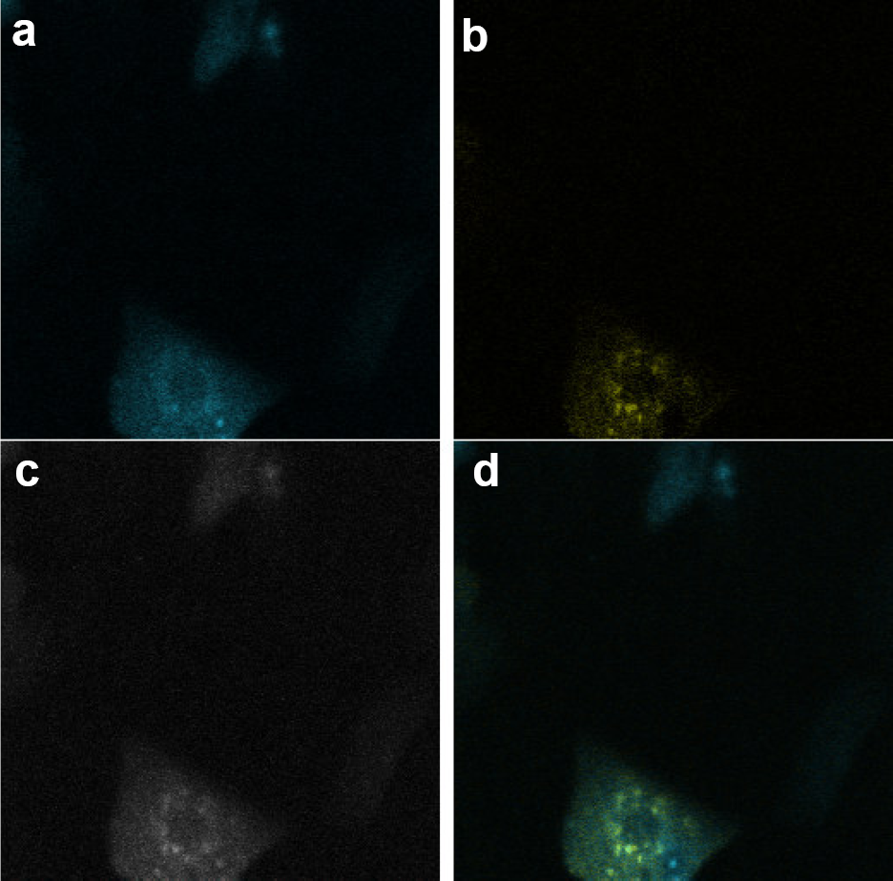
Co-localization of SBP1 and GPX1 in cytoplasm
detected by FRET (confocal microscope)
a. Before photobleaching
b. After photobleaching detect YFP-SBP1
c. After photobleaching detect CFP-GPx1
d. After photobleaching detect merge image

Slide 22
Anti-oxidant and Tumor Suppression

Slide 23
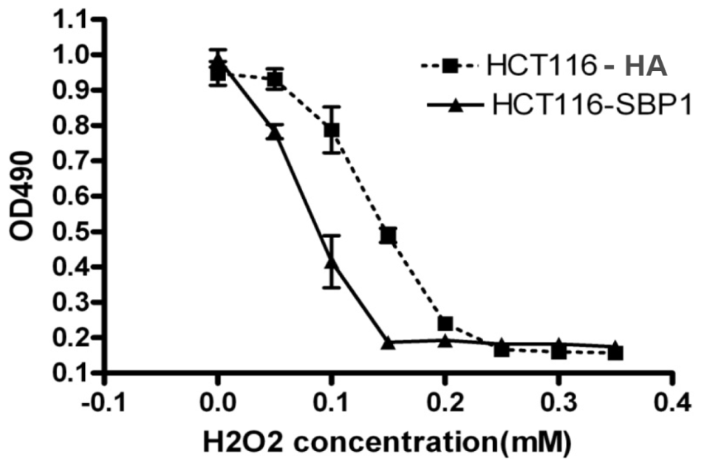
SBP1 accelerates H2O2-induced cell death

Slide 24

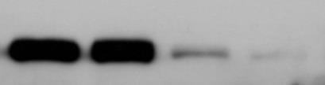


Selenium-supplementation prevented intestinal tumor formation in Muc2/P21 mice through JNK1 phosphorylation and inhibition of beta-catenin and COX2
A
Mice on diets for 12 weeks
B
*p=0.005
p=0.17
Western Diet WD + Selenite
p-JNK
JNK1
β-catenin
COX2
β-actin
1.0 0.7 1.5 1.7
1.0 1.1 1.1 1.1
Mice on diets for 24 weeks
1.0 1.0 0.4 0.3
*p=0.003
** p=0.008
1.0 0.6 0.3 0.3

Slide 25





Sodium selenite promoted apoptosis in colon cancer cells
A
B
HCT116
HCT116
48h-C 48h-T 72h-C 72h-T
**
Cleaved
Caspase3
Total
Caspase3
β-actin
**
1.0 1.7 1.2 2.0
*
1.0 0.9 1.2 0.7
C
D
SW620
SW620
**
48h-C 48h-T 72h-C 72h-T
Cleaved
Caspase3
Total
Caspase3
β-actin
**
1.0 1.5 1.2 1.8
*
1.0 0.9 1.0 0.7

Slide 26

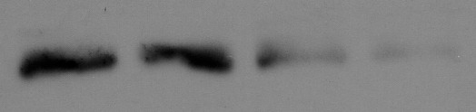
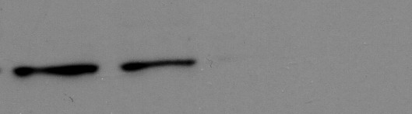
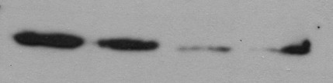
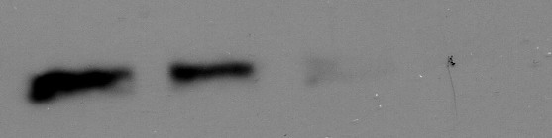
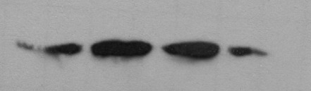




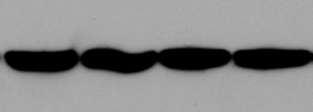
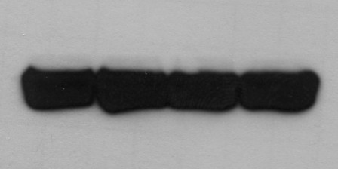
Sodium selenite suppressed beta-catenin signaling and increased JNK1 phosphorylation in vitro
HCT116
SW620
0 1 2.5 5 µmol/L
0 1 2.5 5 µmol/L
β-catenin
C-myc
Cyclin D1
Cdk4
p-JNK
JNK1
β-actin

Slide 27
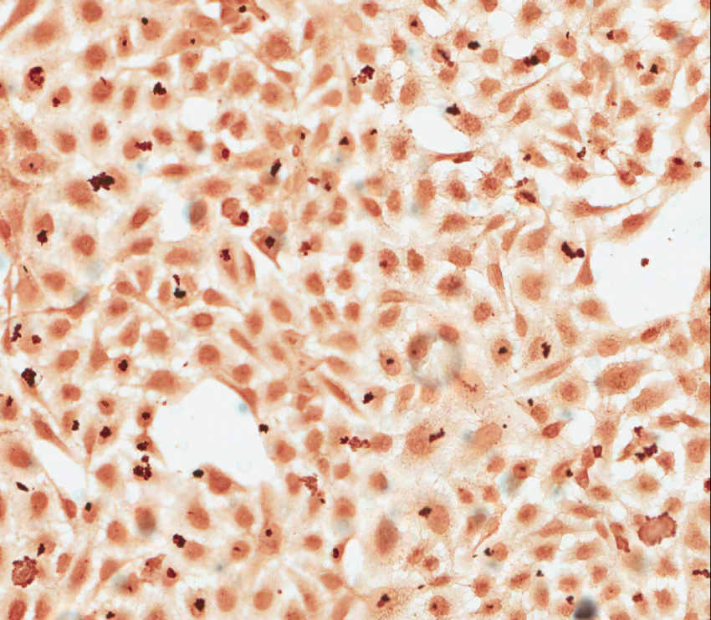
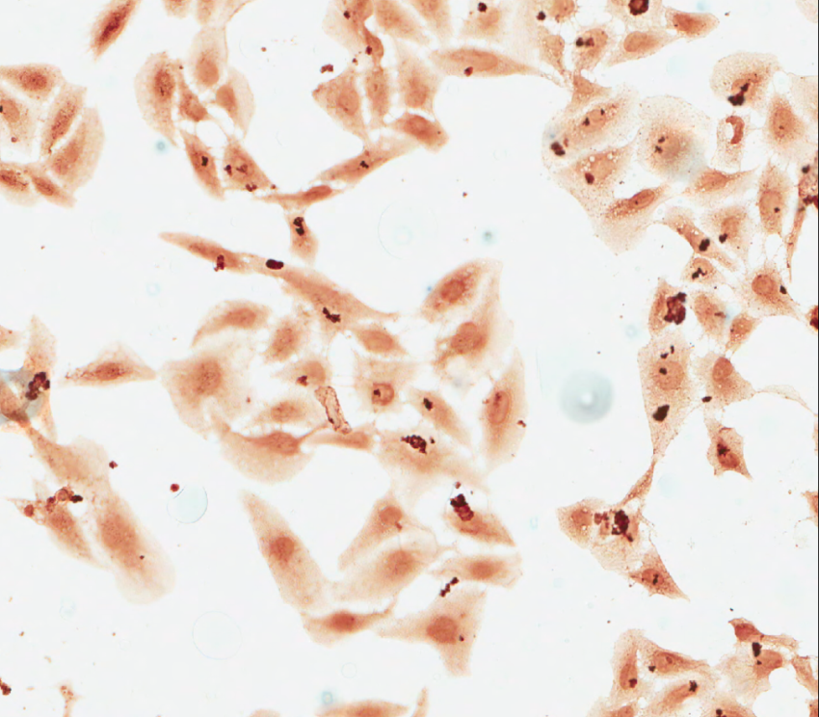
Sodium selenite degraded beta-catenin in osteosarcarmo cells U2OS
Control
5 µM sodium selenite

Slide 28





Reduced JNK1 expression attenuated selenium-mediated inhibition of cell proliferation
HCT116
si-GFP
si-JNK1
0 5 0 5 µmol/L
p-JNK1
JNK1
β-catenin
Cyclin D1
Cdk4
β-actin

Slide 29
Summary
SBP1 expression is reduced in colon cancer, reduced expression of SBP1 in cancer predicts poor outcome;
There is a direct interaction and negative regulation between SBP1 and GPX1;
Decreased SBP1 transcription and translation by TGF-beta was linked to reduced p21 expression and JNK1 phosphorylation, to increased GPx1 and beta-catenin in vitro;
Selenium-mediated cancer prevention is associated with JNK1 phosphorylation and inhibition of beta-catenin in vitro and in mouse model of colon cancer.
Li , et al. Mol Nutr Food Res, 2008; Pohl, et al. PloS ONE, 2009
Fang, et al. Int. J. Cancer, 2010; Fang et al, Carcinogenesis, 2010
Huang, et al. Int J Mol Med. 2012 Yang et al, Biomarker Res. 2013
Ansong et al, Mol Nutr Food Res, 2014

Slide 30
Acknowledgements
Collaborators:
University of Illinois at Chicago
Alan Diamond, PhD
Marci Goldberg, MS
Timothy Koh, PhD
Grace Guzman, MD
Andrew Mesecar, PhD
Albert Einstein Cancer Center
Leonard Augenlicht, PhD
John Mariadason, PhD
University of California
Davis Cancer Center
Tina Li, PhD, MD
Yang’s Lab
Wenfeng Fang, MD
Nicole Pohl, PhD
Xiuli Bi, PhD
Emily Terry
Emmanuel Ansong
Mengtao Xing
Chang Tong, PhD
Dong Hu, PhD
Anjia Han, PhD
Lindsay Gallagher
Ashley Dockendorff
Support: Grants from NCI, AICR and UIC Faculty Startup fund, USA, and from the National Nature Science Foundation of China （Grant # 91229115, 81272251), and the grants from the Department of Sciences and Technology, and Education, Henan, and USCACA-TIGM, USA

Slide 31
Let Us Meet Again
We welcome you all to our future conferences of OMICS Group International
Please Visit:
www.omicsgroup.com
www.conferenceseries.com
http://biomarkers.conferenceseries.com/

