Slide 1
PCOS and Infertility Treatment
WANAKAN SINGHASENA,MD.
BANGKOK, THAILAND

Slide 2
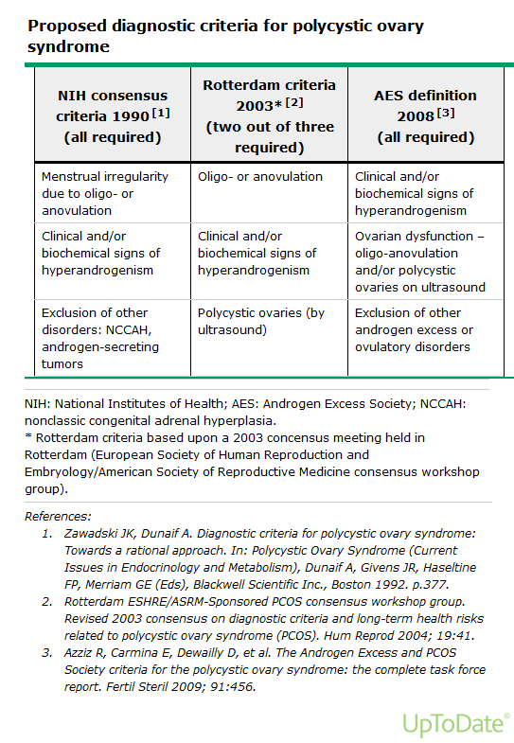

Slide 3
PCOS
Increased risk of
Insulin resistance (IR)
Impaired glucose tolerance (IGT)
type 2 diabetes mellitus (DM2)
Obesity
Dyslipidemia

Slide 4
Goals of therapy
Ameolioration of hyperandrogenic symptoms
Management of metabolic abnormalities
Prevention of endometrial hyperplasia/ CA
Contraception for those not pursuing pregnancy
Ovulation induction for those pursuing pregnancy

Slide 5
Infertility treatment
Lifestyle modification
Ovulation induction
Medications
Clomiphene citrate
Letrozole
Metformin
Gonadotropin therapy
Laparoscopic surgery
In vitro fertilization

Slide 6
Goals of ovulation induction
Induce monofollicular development
Start with least invasive and simplest treatment option
Maximize rate of singleton pregnancies
Minimize risk of OHSS

Slide 7
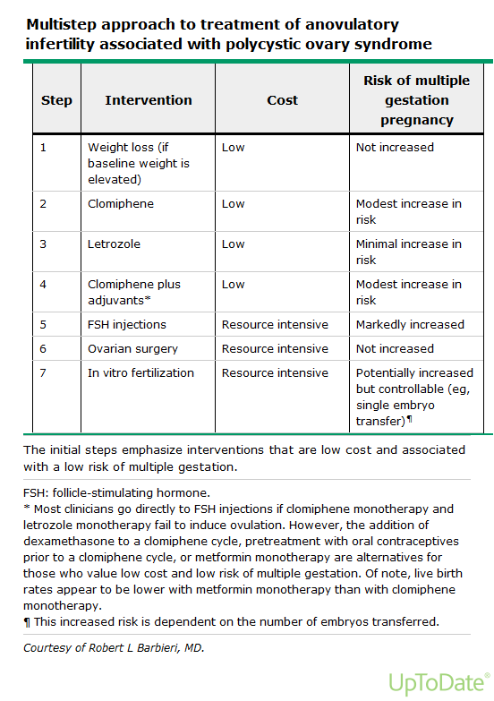

Slide 8
Lifestyle modifications
Preconception counselling
Obesity associated with anovulation (Pasquali et al., 2003), pregnancy loss (Froen et al., 2001), late pregnancy complication (Boomsma et al., 2006)
Weight loss is recommended as first-line therapy in obese women with PCOS
Pregnancy after losing as little as 5% of initial bodyweight (Kiddy et al., 1992)
Improve spontaneous ovulation rate (Pasquali et al., 2003; Moran et al., 2006)
Improve live birth rate (Moran et al., 2006)

Slide 9
Clomiphene citrate
SERM, block negative feedback of endogenous estradiol
Dose
50 mg/day x 5 days, start day 2-5 (Wu et al., 1989; Denbashi et al., 2006)
Max 150 mg/day
ASRM suggest that >100 mg add little to clinical pregnancy rate (Practice Committee of ASRM, 2013)
Monitoring
LH kits ,LH surge 5-12 days after completed CC, ovulation 14-26hr (Miller et al., 1996)
Ultrasound to monitor first cycle (Legro et al., 2007)
Efficacy
70-80% will ovulate (Homburg, 2005; Messinis 2005)
Conception rate 22% per cycle (Hammond et al., 1983; Kousta et al., 1997; Eijkemans et al., 2003)

Slide 10
Clomiphene citrate
OUTCOMES
Ovulatory and pregnancy rates
80% ovulate and cumulative pregnancy rate 30-40% (Dickey, et al., 1996; Gorlitsky et at., 1978; Gysler et al.,1982)
Miscarriage and birth defect similar to spontaneous pregnancy (Dickey et al., 1989; Gysler et al.,1982; Kurachi et al., 1983; Sorenson et al.,2005)
Multiple gestation 7% (Legro et al., 2014 N Engl J Med) , triplets 0.3-0.5
OHSS <1% (Eijkemans et al., 2003)
Notes:
NEJM cohort 3837 case infertility in Seattle 1974-1985, 9/11 found invasive or boarderline took CC with RR 2.3, and 5/9 took 12 or more cycle, but < 1 yr not increase risk
Case report and case controll study

Slide 11
Clomiphene citrate
Duration of treatment
Cumulative live birth rates 50-60% for up to six cycles
Pregnancy rates low after six cycles and 12 or more cycles may increase risk ovarian neoplasm (Rossing et al., 1994 N Eng J med)
ACOG limited fewer than 12 cycles
Generally should be limited to six cycles (Eijkeman et al., 2003; Homburg, 2005)
Notes:
NEJM cohort 3837 case infertility in Seattle 1974-1985, 9/11 found invasive or boarderline took CC with RR 2.3, and 5/9 took 12 or more cycle, but < 1 yr not increase risk
Case report and case controll study

Slide 12
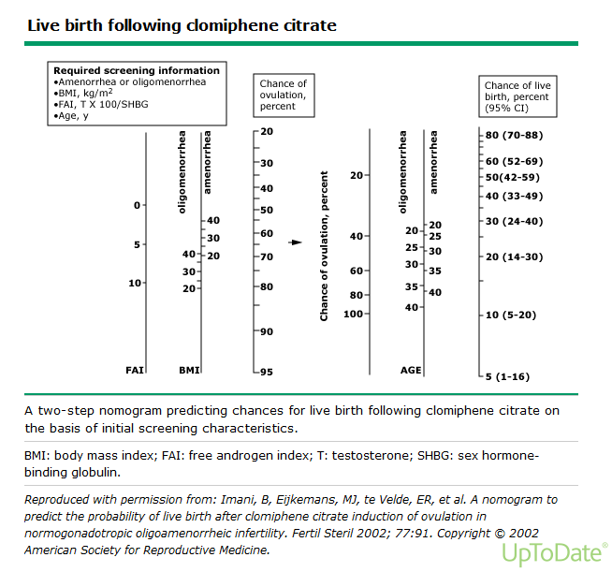

Slide 13
Clomiphene citrate
Adverse effects
Common side effects (ACOG committee 2002; Jones et al., 1965)
Hot flash 10-20%, Abdominal distention and pain 5.5%, Nuasea and vomiting 2.2%
Visual disturbances 1-2%, usually reversible
Endometrial effects: antiestrogenic effect and luteal phase defect (Keenan et al., 1989)
Cancer risks
Notes:
NEJM cohort 3837 case infertility in Seattle 1974-1985, 9/11 found invasive or boarderline took CC with RR 2.3, and 5/9 took 12 or more cycle, but < 1 yr not increase risk
Case report and case controll study

Slide 14
Clomiphene citrate
Combination therapy
Addition of metformin (Moll el at., 2006; Legro et al., 2007) or dexamethasone (Daly et al., 1984) to CC as primary therapy has no benefital effect
Alternative therapy
Anti-estrogen: Tamoxifen (Messinis 1982; Steiner et al., 2005)
Aromatase inhibitors : Letrozole “off-label”
Notes:
NEJM cohort 3837 case infertility in Seattle 1974-1985, 9/11 found invasive or boarderline took CC with RR 2.3, and 5/9 took 12 or more cycle, but < 1 yr not increase risk
Case report and case controll study

Slide 15
Cochrane Database of Systematic Reviews 2009, Issue 4. Art. No.: CD002249

Slide 17
Cochrane Database of Systematic Reviews 2009, Issue 4. Art. No.: CD002249

Slide 18
Cochrane Database of Systematic Reviews 2009, Issue 4. Art. No.: CD002249

Slide 19
Cochrane Database of Systematic Reviews 2009, Issue 4. Art. No.: CD002249

Slide 20
Cochrane Database of Systematic Reviews 2009, Issue 4. Art. No.: CD002249

Slide 21
Cochrane Database of Systematic Reviews 2009, Issue 4. Art. No.: CD002249

Slide 22
15 RCTs were included
Clomiphene was effective in increasing pregnancy rate compared to placebo (OR 5.8, 95% CI 1.6 to 21.5) as was clomiphene plus dexamethasone treatment (OR 9.46, 95% CI 5.1 to 17.7) compared to clomiphene alone
No evidence of a difference in effect was found between clomiphene versus tamoxifen or clomiphene in conjunction with human chorionic gonadotrophin (hCG) versus clomiphene alone
Cochrane Database of Systematic Reviews 2009, Issue 4. Art. No.: CD002249

Slide 23
Aromatase inhibitors
Off-label in treatment anovulatory infertility (Malloch et al.,2013) and for increasing number of follicles in COH (Casper et al.,2012; Bedaiwy et al.,2007)
Suppression ovarian E2, rise in FSH, follicular development, monofollicular ovulation due to not deplete ER in brain (Kamat et al., 2002; Naftolin 1994)
Notes:
OV E2 suppress, rise FSH, E2 increase, dominat follicle growth, E2 production, normal negative feedback occur in brain, FSH then suppress small follicle atresia

Slide 24
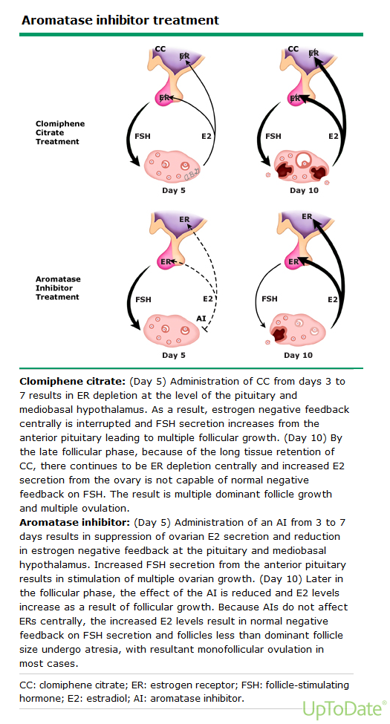

Slide 25
Aromatase inhibitors
Dose
2.5 mg/day start cycle day 3-7, max 7.5 mg/day (AL-Fadhli et al., 2006; Legro et al., 2014 N Engl J Med)
Higher dose associated with thin endometrium (Al-Fozan et al., 2004)
Comparison with CC (Casper et al., 2006)
High rate of monofolliculr
No direct antiestrogenic adverse effect on endometrium
Shorter half-life (48hr and 2 wks)
Lower serum E2
Outcomes
Notes:
Legro compare CC and Letrozole RCT multicenter double blind 75o women

Slide 26
Aromatase inhibitors
Outcomes RCT (Legro et al., 2014)
Cumulative live birth rate higher in Letrozole (27.5 and 19.1 %, RR 1.44, 95% CI 1.10-1.87)
Cumulative ovulation rate higher in Letrozole (62 and 48%, RR 1.28, 95% CI 1.19-1.37)
BMI had significant impact on live birth rates
BMI ≤30.3 kg/m², cumulative live birth rate 30%
BMI >30.3 kg/m², higher in Letrozole (20 and 10 %)
44% higher life birth rate in high BMI (Berger et al., 2014)
Notes:
Legro compare CC and Letrozole RCT multicenter double blind 75o women

Slide 27
Aromatase inhibitors
Outcomes RCT (Legro et al., 2014)
Miscarriage rate similar in two group (31.8 and 29.1%)
Twin pregnancy rate lower in Letrozole (3.4 and 7.4%)
2014 meta-analysis (Franik, Cochrane 2014;CD010287)
Live birth rate higher in Letrozole (OR 1.79, 95% CI 1.38-2.31)
Side effects
Hot flash 33%, fatigue 22%, dizziness 12%
Notes:
Legro compare CC and Letrozole RCT multicenter double blind 75o women

Slide 28
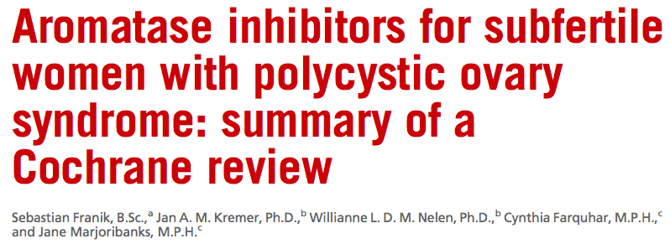
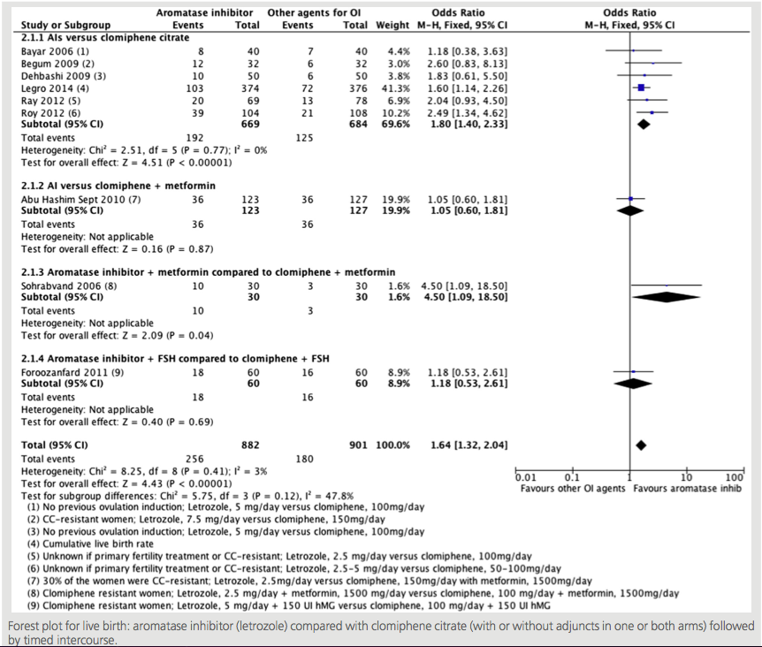

Slide 30
Insulin sensitizing agents
Metformin, category B
Lower fasting insulin but not change in BMI
RCTs; metformin not increase live birth rate above CC alone (obese or normal weight PCOS) (Moll et al., 2006; Legro et al., 2007)
Except in BMI >35 kg/m² and in CC resistance
Metformin alone is less effective than CC, should be restricted to glucose intolerance

Slide 31
Metformin
Effective for restoring ovulation, but less effective for live birth rate, compare to CC (Legro et al., 2007; Moll et al.,2006; Polomba et al., 2005; Zain et al., 2009; Johnson et al., 2010; Siebert et al., 2012; Misso et al., 2013)
A 2012 meta-analysis (Cochrane Database of Systematic Reviews 2010, Issue 1. Art. No.: CD003053)

Slide 32
No evidence that metformin improves live birth rates whether it is used alone (Pooled OR = 1.00, 95% CI 0.16 to 6.39) or in combination with clomiphene (Pooled OR = 1.05, 95% C.I. 0.75 to 1.47)
Clinical pregnancy rates are improved for metformin versus placebo (Pooled OR = OR 3.86, 95% C.I. 2.18 to 6.84) and for metformin and clomiphene versus clomiphene alone (Pooled OR =1.48, 95% C.I. 1.12 to 1.95) )
Compared metformin and clomiphene alone
no evidence of an improved live birth rate (OR= 0.67, 95% CI 0.44 to 1.02) but the pooled OR resulted in improved clinical pregnancy rate in the clomiphene group (OR = 0.63 , 95% 0.43 to 0.92), although there was significant heterogeneity
Cochrane Database of Systematic Reviews 2010, Issue 1. Art. No.: CD003053

Slide 33
Ovulation rates are improved with metformin in women with PCOS for metformin versus placebo (Pooled OR 2.12, 95% CI 1.50 to 3.0) and for metformin and clomiphene versus clomiphene alone (Pooled OR = 3.46, 95% CI 1.97 to 6.07)
Metformin was also associated with a significantly higher incidence of gastrointestinal disturbance, but no serious adverse effects
Cochrane Database of Systematic Reviews 2010, Issue 1. Art. No.: CD003053

Slide 34
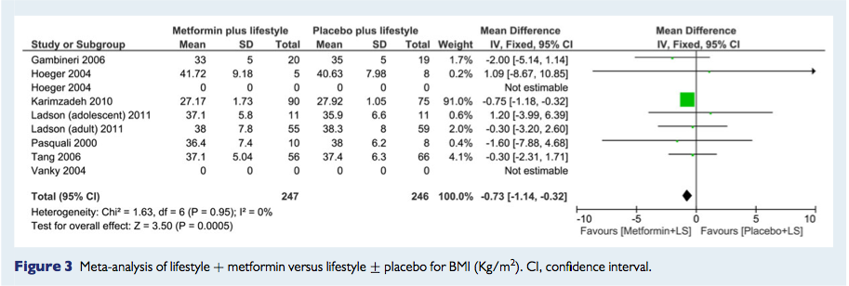
Metformin and life style modification
Notes:
Metaanalysis and systematic review 2015
12 RCT from 2000-2013

Slide 35
Laparoscopic ovarian drilling
Main indication is CC resistance
Second-line treatment in selected population (PCOS consensus group ESHRE/ARSM 2007; Berger et al., 2014)
When there are other indications for laparoscopy, if contraindiation of multuple pregnancies (Rockville et al., 2013; French CPG 2010)
Methods and dose
Monopolar electrocautery and laser dose not difference outcomes (Farquhar et al., 2007)
No evidence that any surgery technique is superior but few as 4 punctures shown to be effective, more puncture associated with POF (Amer et al.,2002, 2003; Malkawi et al., 2003)
Efficacy

Slide 36
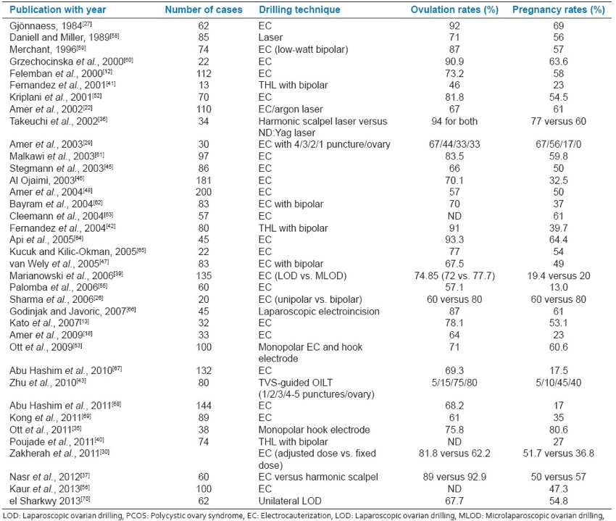
Subarna mitra et al., 2015

Slide 37
Laparoscopic ovarian drilling
Safety
Immediate complications are rare
Long-term complication include adhesion, and premature menopause
LOD should not be offered for non-infertility indications
Notes:
The most plausible mechanisms of action are the destruction of ovarian follicles and a part of the ovarian stroma, inducing a reduction of serum androgens and inhibin levels, which results in an increase of FSH and restores the ovulation function (1). LOD may also increase ovarian blood flow, allowing a high deliv- ery of gonadotrophins and post-surgical local growth factors. An improvement of insulin sensitivity after LOD has also been suggested

Slide 38
No evidence of a difference in live birth or clinical pregnancy rate between LOD and Gn and OR 1.04 (95% CI 0.59 to 1.85) and 1.08 (95% CI 0.69 to 1.71)
Multiple pregnancy rates were lower with LOD than with Gn (1% versus 16%; OR 0.13, 95% CI 0.03 to 0.52)
No evidence of a difference in miscarriage rates between the two groups (OR 0.81, 95% 0.36 to 1.86)
Cochrane Database of Systematic Reviews 2007, Issue 3. Art. No.: CD001122
Notes:
25 RCT

Slide 39
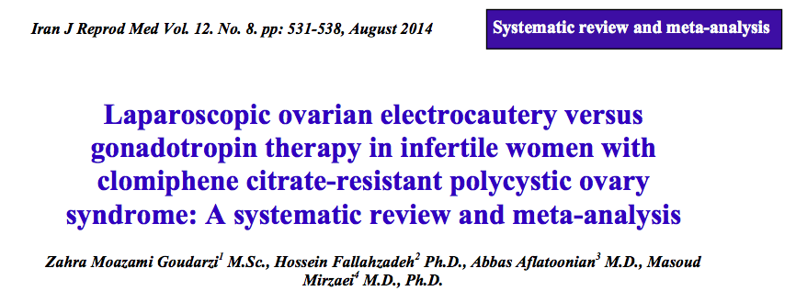

Slide 40
Gonadotropin and GnRH analoques
Second-line treatment in case of CC resistance or CC failure (Rockville et al.,2013; French CPG 2010; ESHRE/ASRM)
Step-up or step-down regimen to get single follicle resulting in single life birth
Low-dose step-up protocol recommended starting dose 37.5-50 IU/day (Thessaloniki ESHRE/ASRM sponsored PCOS workshop 2008; Christin-Maitre et al., 2003)
Ovarian response monitoring is required to reduce complication and secure efficiency
Strict cycle cancellation criteria be agreed with patient (>2 of 16 mm or 1 of 16mm and 2 of 14mm)
Higher OHSS and risk of multiple pregnancies

Slide 41
Ovulation induction and IUI
No RCTs compare pregnancy rate of IUI and timed intercourse during ovulation induction in PCOS women
IUI may be considered in PCOS women who failed to conceived despite successful ovulation (Cohlen et al., 2000)
Careful monitoring to reduce risk OHSS (ESHRE Capri Workgroup, 2003)
Double IUI did not show any significant benefit in pregnancy(Cantineau et al., 2003)
Clinical pregnancy rate per cycle 11-20%, multiple pregnancy rate 11-36% (Gerli et al., 2004; Mitwally and Casper, 2004; Palomba etv al., 2005)

Slide 42
IVF
Anovulation is not primary indication for IVF and multiple pregnancy rate 10% after Gn therapy (van Santbrink and Fauser, 2003)
PCOS women who do have associated pathology, IVF is indicated
Induction ovulation with Gn should be replaced by COS and IVF (Eijkemans et al.,2005)
IVF and SET, the risk of multiple pergnancies is markedly reduced(Papanikolaou et al., 2006; Heijnen et al., 2007)
Clinial pregnancy rate similar between PCOS and non-PCOS women (35%)
adjuvant use of metformin may enhance ongoing pregnancy rate and reduce incidence OHSS (Tang et al., 2006)

Slide 43
IVF
Recent Cochrane review comparing the GnRH antagonist protocol with the long GnRH agonist protocol (Cochrane Database Syst Rev. 2011;11(5):CD001750)
no significant difference was found in ongoing pregnancy rate or clinical pregnancy rate
rate of OHSS was 10% lower with the antagonist protocol
RCT metformin 1500 mg per day significantly reduced the risk of OHSS (RR 0.28, 95% CI 0.11–0.67) in women with PCOS undergoing IVF/ICSI who were at high risk for OHSS (Palomba et al., 2011)

Slide 44
Cochrane Database of Systematic Reviews 2014, Issue 11. Art. No.: CD006105

Slide 45
Cochrane Database of Systematic Reviews 2014, Issue 11. Art. No.: CD006105

Slide 46
Cochrane Database of Systematic Reviews 2014, Issue 11. Art. No.: CD006105

Slide 47
Cochrane Database of Systematic Reviews 2014, Issue 11. Art. No.: CD006105

Slide 48
No conclusive evidence that metformin treatment before or during ART cycles improved live birth rates in women with PCOS,
The use of this insulin-sensitising agent increased clinical pregnancy rates and decreased the risk of OHSS
Cochrane Database of Systematic Reviews 2014, Issue 11. Art. No.: CD006105

Slide 49
Overall conclusions
PCOS women desire pregnancy should exclude any other health issues or infertility problem in couple
Preconcetional counseling, weight reduction
Recommended 1st-line treatment for ovulation induction remains CC
Recommended 2nd-line intervention Gn or LOD
Recommended 3rd-line treatment is IVF
Pateint-tailored approach
Metfomin restrict to women with glucose intolerance
Even singleton pregnancies are associated with increased health risk

Slide 50
Thank you

