Slide 1
Oral Health Status among children suffering from juvenile rheumatoid arthritis
Vlorë Hysenaj Cakolli DDS^{1*}, Valë Hysenaj Hoxha DDS², Merita Berisha Koqinaj MD PhD³ , Fatmir Dragidella DDS PhD¹ , Valmira Maxhuni DDS¹, Arben Murtezani DDS⁴

Slide 2
Objective
To investigate the oral health status and related concomitant disease in children with juvenile rheumatoid arthritis (JRA).

Slide 3
Setting
The study was conducted at the Pediatric Department of the University Clinical Center of Kosovo in Prishtina, in order to improve the oral health care awareness among patients suffering from JRA and their parents.

Slide 4
Study Design and Methods
A group of 29 children suffering from JRA age 7 to 15 are included in this prospective study.
Healthy control group is consisted of 29 schoolchildren.
Assessment of oral health awareness questionnaire was distributed to the parents/guardians.

Slide 5
Study Design and Methods
Oral examination was performed to determine scores for gingival index (GI), plaque index (PI) and dmft/DMFT index.
Conventional orthopantomographic (OPT) images are done to examine the condition of the temporomandibular joint (TMJ) and to identify potential dental/oral focuses.

Slide 6
Study Design and Methods
In older children, age 8 and above the overall health status was measured using Stanford Health Assessment Questionnaire (HAQ).

Slide 7
RADIOLOGIC FINDINGS
At the study group, characteristic radiologic findings were identified in seven children (24%).

Slide 8
RADIOLOGIC FINDINGS

Slide 9
RADIOLOGIC FINDINGS

Slide 10
RADIOLOGIC FINDINGS

Slide 11
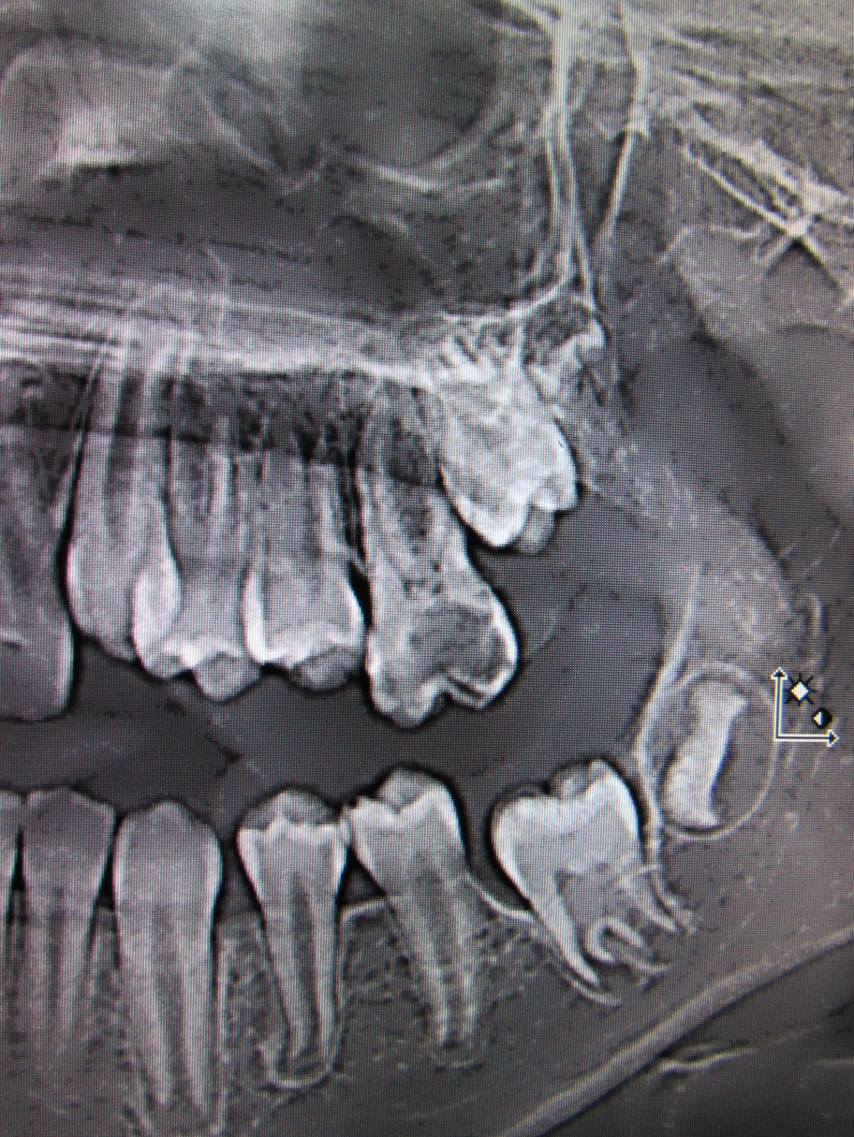
RADIOLOGIC FINDINGS

Slide 12
RADIOLOGIC FINDINGS

Slide 13
RADIOLOGIC FINDINGS

Slide 14
RESULTS
There was no significant difference in dmft scores of study and control group (2.27±2.58 and 1.94±2.12 respectively) and DMFT scores of study and control group (1.55±1.69 and 1.89±2.19 respectievely).

Slide 15
RESULTS
The average +/- SD gingivitis score was significantly greater in the children suffering from JRA 33.8+/-20.8, compared with control group, 22.12+/-11.2, p<0.0001.
A significantly greater mean plaque score related to permanent teeth was observed in children with JRA 88.3 SD +/- 38.6, compared with the control group 121.6 SD +/- 49.5, p<0.000

Slide 16
RESULTS
In 11 % of children suffering from JRA, TMJ disorders were identified.
The most frequent concomitant disease in the study group was chronic tonsillitis (23%); whereas in the control group acute bronchiolitis was predominant (11%).

Slide 17
RESULTS
Disability Index scores from questionnaires distributed to older children (>8 years) and their parents/guardians was 0.79 (n=23; P<0.001), demonstrating that parents can precisely report for their children.
Reliability, of Child HAQ evaluated by test-retest and internal reliability was excellent, and demonstrated strong correlations of disability index, pain and morning stiffness.

Slide 18
CONCLUSION
Our data suggested that there is an ongoing necessity for improving the oral hygiene of patients suffering from JRA, and to concentrate the efforts of dental professionals on a preventive methods and to provide proper dental care and education of patients and their parents/guardians.

Slide 19
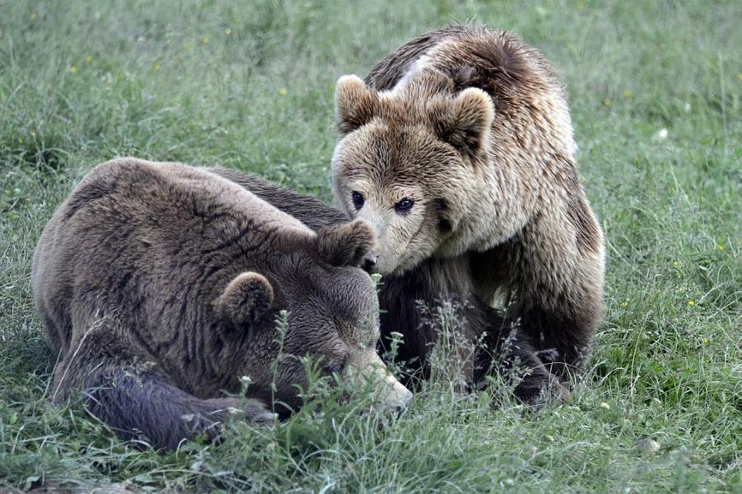
THANK YOU FOR YOUR ATTENTION !

