Slide 1
Field evaluation of entomopathogenic fungi against white grub, Holotrichia consanguinea Blanch in sugarcane.
Theme : Crop Protection and Management
M.Visalakshi
Regional Agricultural Research Station, Anakapalle
Acharya N. G. Ranga Agricultual University ,
Andhra Pradesh, INDIA.

Slide 2
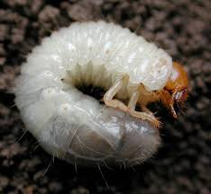
INTRODUCTION
White grub, Holotrichia consanguinea (Melolonthinae: Scarabaeidae: Coleoptera) –
Important soil pest of sugarcane in tropical India.
White grub become increasingly difficult pest in Andhra Pradesh during the last few years.
Endemic to sugarcane tract in high altitude or assured rainfall areas earlier but extending its spatial range in the recent years due to monoculture of sugarcane and minimal varietal diversity.

Slide 3
White grub beetles emerge from soil after early summer showers
(May- June).
White grub adults feed on folage of host trees like neem, acasia .
Average of 20 eggs are laid by females inside the soil.
Incubation period-
7 to 13 days.
The newly hatched grubs feed on organic matter till they come in contact with living roots.
Duration of first instar grub – 16 days
second instar grub - 32 days and
third instar - 49 days.
Total grub duration ranges from
82 to 113 days.
white grub average duration of one life cycle is 122 days.

Slide 4
Grubs active feeding period: July to mid October. Grubs pupate during November.

Slide 5
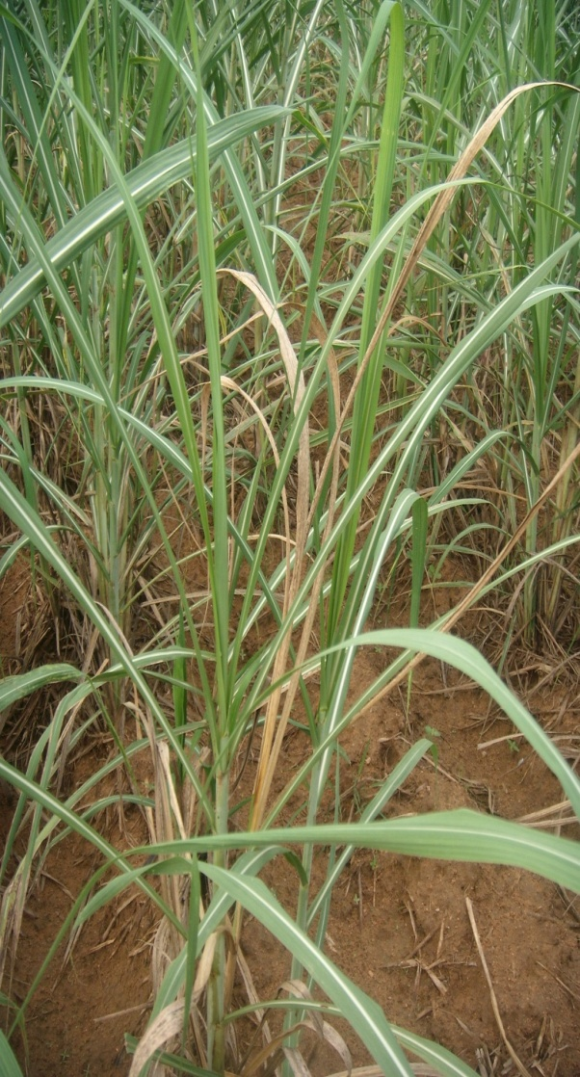
Symptoms of Damage
Late larval stages feed on roots of sugarcane and damage the underground portions of stalks
Following injury, spindle wilts and leaves turn yellow; clumps gradually dry up and can be easily pulled out.

Slide 6
Damage and Loss
Severe cases of attack the entire field devastation.
Affected canes lose weight, dry up, collapse and become unfit for crushing and planting.
Damage occurs in patches leaving gaps .

Slide 7
Damage and Loss
Infested clumps harbor 7-10 grown up grubs around the root region.
Severe symptoms of damage by older grubs manifest only late in the season resulting in complete crop loss .
Yield loss was as high as 100 per cent.

Slide 8
Management of White grub
Several tactis have been adopted for the management of white grub .
In a majority of the farming situations, control of white grub become difficult because of the lack of control over the damage.
Chemical control is practically uneconomical, difficult and associated with high cost, environmental pollution and pesticide residues.
Hence, there is need for development of alternate ecofriendly and economically feasible strategy for the control of white grub.

Slide 9
Importance
Studies on use of entomopathogenic fungi in pest control is limited.
Among these, Beauveria bassiana and Metarhizium anisopliae have great importance in the management of white grub.
Both the fungi are eco-friendly, cost effective, highly persistent and also self-perpetuating in nature and the microclimate of sugarcane eco-system is ideal for their multiplication.
Keeping in view , experiments were conducted to study the efficacy of entomopathogenic fungi for the management of white grub in sugarcane.

Slide 10
Methodology
Field experiments conducted in endemic areas of farmer’s fields i.e., at Pakki village (Bobbilli mandal), Vizianagaram district, Andhra Pradesh .
Sugarcane variety 87 A 298 was planted in July to study the efficacy of treatments imposed at the time of planting .
Efficacy of treatments at one month after planting was studied in June planted crop .
Treatments: 7
T1 : Beauveria bassiana @ 5x10 ¹³ spores ha⁻¹
T2 : B. bassiana in FYM enriched field.
T3 : Metarhizium anisopliae @ 5x10 ¹³ spores ha⁻¹
T4 : M.anisopliae in FYM enriched field
T5 : Neem cake @ 500 kg/ha
T6 : Phorate 10G @ 15kg/ha
T7 : Untreated check

Slide 11
Data recorded
Observations were recorded on plant damage due to white grubs , number of white grubs per 10 meter row in the root zone recorded at 60 days after treatment (DAT) i.e.,in Sep-Oct.
Millable cane, cane yield and sucrose (%) was recorded at harvest.

Slide 12
RESULTS
Soil Application of Entomopathogenic fungi (Beauveria bassiana / Metarhizium anisopliae @ 5x10 ¹³ spores ha⁻¹ ( 5g/lt ) were proved effective in reducing the sugarcane plant damage due to white grubs and also in reducing grub population in both the experiments conducted i.e., Imposing treatments at the time of planting / Imposing treatments at one month after planting compared with phorate and neem cake.

Slide 13
Treatments imposed at planting
M. anisopliae applied in FYM enriched field proved significantly superior to neem cake , phorate and untreated check.
M. anisopliae reduced the plant damage by grub to the extent of 93.6% followed by
B. bassiana (88.09%) compared to untreated check .
M. anisopliae recorded high grubmortality (77.22%) followed by B. bassiana ( 74.08%).
Phorate (45.43%) and neem (40.93%) recorded low grub mortality compared to untreated check.

Slide 14
Similar trend was observed in the experiment conducted by imposing treatments at one month after planting i.e., after the onset of monsoon in the month of July.
Treatments imposed at one month after planting
M. anisopliae reduced the plant damage by grub to the extent of 87.89% followed by
B. bassiana (86.2%) compared to untreated check .
M. anisopliae recorded 76.93% mortality in grubs followed by B. bassiana (69.2%) compared to untreated check.

Slide 15
Highest per cent increase in yield over untreated check was noticed in M. anisopliae applied in FYM enriched field in both the experiments i.e., Treatment imposed at the time of planting / at one month after planting.
Soil application of M.anisopliae in FYM enriched field gave higher cane yield in both the experiments.

Slide 16
Treatments imposed at planting
Highest cane yield was recorded in M. anisopliae (81.44 t ha⁻¹) in FYM enriched field followed by B.bassiana (76.6 t ha⁻¹) .
Cane yields recorded less in neem cake, phorate and lowest in untreated check.
Treatments imposed at one month after planting
M. anisopliae (79.73 t ha⁻¹) in FYM enriched
field recorded higher cane yield followed by
B. bassiana (76.45 t ha⁻¹) in FYM enriched field.

Slide 17
Table 1: Efficacy of entomopathogenic fungi against sugarcane white grub, Holotrichia consanguinea.
Treatment | Applied at the time of Planting |  |  |  | Applied at one month after planting
 | White grub damage |  | White grub population |  | White grub damage |  | White grub population
 | Damage (% ) | Per cent decrease over untreated check | No. of grubs per 10 m row | Per cent decrease over untreated check | Damage (% ) | Per cent decrease over untreated check | No. of grubs per 10 m row | Per cent decrease over untreated check
Beauveria bassiana | 4.53 | 83.13 | 2.33 | 68.21 | 5.15 | 76.55 | 2.67 | 69.2
Beauveria bassiana applied in FYM enriched field | 3.2 | 88.09 | 1.9 | 74.08 | 3.03 | 86.2 | 2.67 | 69.2
Metarhizium anisopliae | 3.67 | 86.34 | 2.33 | 68.21 | 4.52 | 79.42 | 2.0 | 79.93
Metarhizium anisopliae applied in FYM enriched field | 1.72 | 93.6 | 1.67 | 77.22 | 2.66 | 87.89 | 2.0 | 79.93
Neem cake @ 500 kg/ha | 9.28 | 65.45 | 4.33 | 40.93 | 17.19 | 21.72 | 6.33 | 26.99
Phorate 10G @ 15kg/ha | 8.41 | 68.69 | 4.0 | 45.43 | 11.37 | 48.22 | 5.67 | 34.6
Untreated check | 26.86 |  | 7.33 |  | 21.96 |  | 8.67
CD( P=0.05) | 4.36 |  | 2.09 |  | 5.61 |  | 2.01
CV % | 9.34 |  | 13.9 |  | 13.49 |  | 16.38

Slide 18
Table 2 : Efficacy of entomopathogenic fungi on yield parameters of sugarcane.
Treatment | Applied at the time of Planting |  |  |  | Applied at one month after planting
 | Millable canes at harvest ( 000’ha) | Yield t ha⁻¹ | Per cent yield increase over untreated check | Sucrose % | Millable canes at harvest ( 000’ha) | Yield t ha⁻¹ | Per cent yield increase over untreated check | Sucrose %
Beauveria bassiana | 83.33 | 73.77 | 55.4 | 19.95 | 90.33 | 73.35 | 15.53 | 19.5
Beauveria bassiana applied in FYM enriched field | 87.3 | 76.6 | 61.37 | 20.04 | 81.67 | 76.45 | 20.43 | 19.76
Metarhizium anisopliae | 94.0 | 76.55 | 61.26 | 18.86 | 90.33 | 74.16 | 16.82 | 21.15
Metarhizium anisopliae applied in FYM enriched field | 92.33 | 81.44 | 71.56 | 19.16 | 94.67 | 79.73 | 25.6 | 21.89
Neem cake @ 500 kg/ha | 94.67 | 56.95 | 19.97 | 16.63 | 85.33 | 59.38 | -6.46 | 18.1
Phorate 10G @ 15kg/ha | 82.67 | 65.14 | 37.22 | 18.79 | 80.67 | 66.77 | 5.18 | 17.95
Untreated check | 83.67 | 47.47 |  | 16.59 | 83.0 | 63.48 |  | 17.07
CD( P=0.05) | 4.92 | 5.21 |  | 1.24 | 6.88 | 14.68 |  | 1.73
CV % | 3.12 | 4.48 |  | 3.72 | 4.47 | 11.25 |  | 4.91

Slide 19
Conclusion
Soil application of Metarhizium anisopliae @ 5x10¹³spores/ha / Beauveria bassiana @ 5x10 ¹³ spores ha⁻¹ in FYM enriched field was effective in reducing the plant damage due to white grub and grub population imposing treatment at the time of planting / at one month after planting.
As entomopathogenic fungi persist in the soil for a longer period than chemicals, Metarhizium anisopliae and Beauveria bassiana are better alternatives for the management of white grubs in endemic areas.

Slide 20
THANK YOU

