Slide 1
Spatial and Temporal Changes in Salinity of Arable Lands in Shah Bandar Tehsil, Thatta District, Sindh.
*Viqar Husain¹, Shella Bano¹ and Ghulam Murtaza²
1. Department of Geology, University of Karachi, Pakistan.
2. Pakistan Council of Research in Water Resources (PCRWR) Karachi, Pakistan

Slide 2
Aims and Objectives
Present study is aimed to evaluate spatial and temporal variation in soil salinity and sodicity in Shah Bandar Tehsil during Post and Pre-monsoon seasons of 2011-2013.
To understand and quantify extent and pattern of soil salinity (ECe) and sodicity (SAR), samples of top and sub soil layers of Shah Bandar Tehsil were collected.
Another objective was to assess the effects of 2010 and 2011 floods and sea water intrusion on soil salinity and soil fertility in the study area.

Slide 3
Study Area
The study area lies between latitude 24º 12´ to 24º 24´ N and longitude 67º 35´ to 67º 59´ E, covering the coastal parts of Shah Bandar tehsil, Thatta district Sindh (Fig. 1).
It is surrounded by Hyderabad and Dadu districts in north, Arabian Sea in south, Indus River in the east and Karachi district in the west.
River and coastal plains are two main landform types in the area.

Slide 4
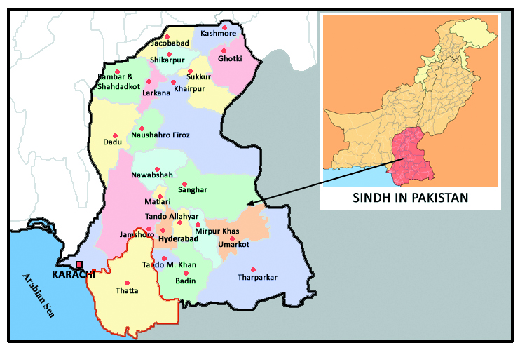
Study Area

Slide 5
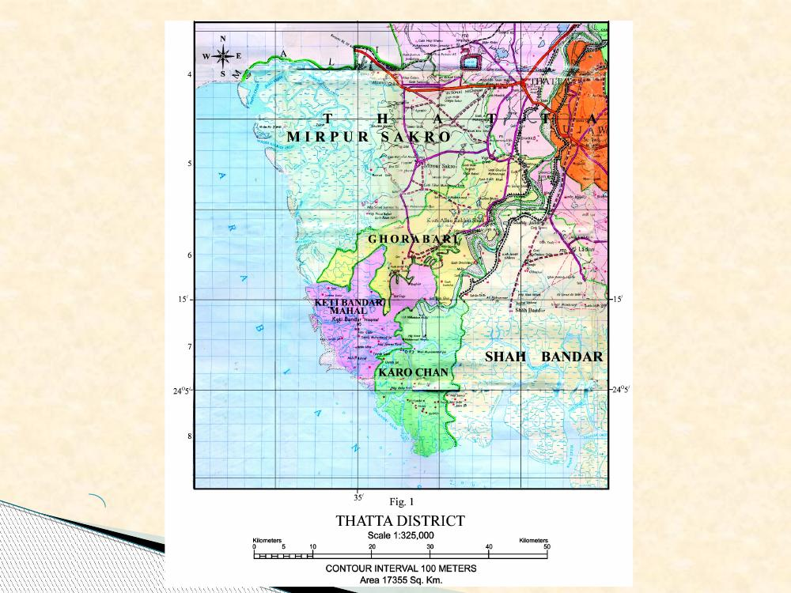
Study Area
(Fig. 1)
(Fig. 1)

Slide 6
Climate
The climate of the area is arid and tropical marine. Temperature ranges from about 25 ºC to 40 ºC and average rainfall does not exceed 200 mm (8 inches) per annum
Canals are passing through the study area, which receives water for few months during a year.

Slide 7
Problems Faced by Agriculture Sector
Groundwater is highly saline and water table depth ranges from 2-25 (ft) from general ground surface depending upon topography.
Cultivation is based on monsoon rains and water from perennial/non perennial canals.
The flooding with monsoon rains and water logging is also common.

Slide 8
Problems Faced by Agriculture Sector
Flood water keeps standing for 3-4 months in depressions due to uneven topography, making the cultivation not possible in the area.
The coastal belt is under regular salt water flooding and sea water intrusion, causing increased soil salinity and sodicity, which is badly affecting the soil fertility and crop productivity in the area (Fig. 2).

Slide 9
Problems Faced by Agriculture Sector
The construction of dams along Indus River caused reduction of fresh water flow and sediments resulting in
Increased soil and groundwater salinity
Encroachment of Arabian Sea into the Indus Delta.
Deteriorating the soil fertility to the extent that cultivable land is fast changing into barren areas.
As a result, locals are migrating for their livelihood instead of continuing farming.

Slide 10
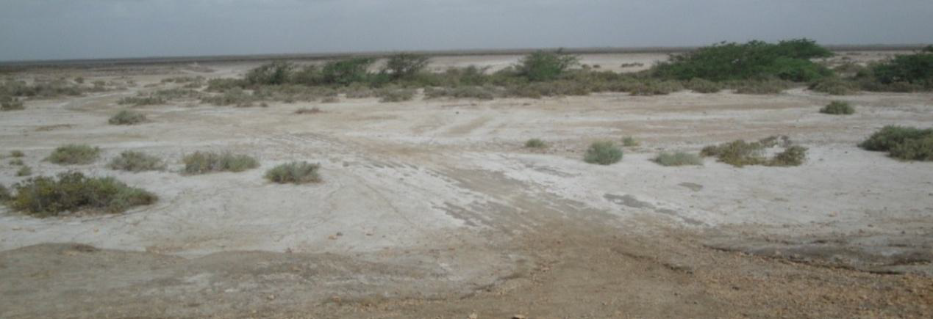
Fig. 2: Barren land near Siddique Punlano site, Daulatpur union council, Shah Bandar.

Slide 11
Materials and Methods
Forty eight soil samples were collected from six sites in Shah Bandar at depths of 0-12" and 12-24" during Post and Pre-monsoon seasons of 2011-2013.
Extracts of soil samples were analyzed for determining pHe, ECe, cations and anions.
Sodium adsorption ratios (SAR) of these samples were also calculated.
Spatial maps along with sample locations were plotted to indicate temporal variation in soil salinity (ECe) and sodicity (SAR) during Post/Pre-monsoon seasons of 2011-2013.

Slide 12
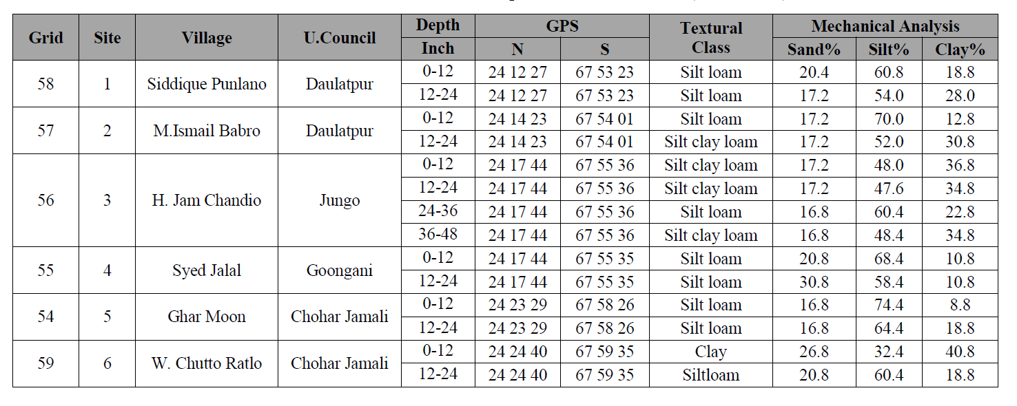
Soil Texture
Table 1. Location and texture of soil samples from Shah Bandar (2011- 2013).

Slide 13
Spatial Maps of Soil Salinity (ECe)
Post monsoon, 2011
Pre monsoon, 2012
Pre monsoon, 2013
Post monsoon, 2013
Kilometer

Slide 14
Spatial Maps of Sodicity (SAR)
Post monsoon, 2011
Pre monsoon, 2012
Pre monsoon, 2013
Post monsoon, 2013

Slide 15
Isotope Analysis of Ground Water
Tehsils | Grid # | Depth (Ft) | δ 18O (‰) | δ 2H (‰) | Contribution Of Arabian Seawater ¹⁸O (%) | Contribution Of Arabian Seawater ²H (%)
Shah Bandar | 55 | 25 | -8.81 | -58.39 | 7.89 | 12.15
 | 54 | 20 | -8.86 | -60.63 | 7.50 | 9.37
K. T.Bandar | 49 | 20 | -7.73 | -52.36 | 16.51 | 19.64
 | 50 | 20-25 | -8.07 | -52.41 | 13.80 | 19.58
 | 51 | 20-25 | -6.23 | -43.20 | 28.47 | 31.01
Ghora Bari | 37 | 40 | -8.09 | -55.98 | 13.64 | 15.14
 | 43 | 25 | -8.24 | -55.59 | 12.44 | 15.63
 | 46 | 25 | -6.65 | -45.54 | 25.12 | 28.10
 | 47 | 25 | -7.48 | -53.06 | 18.50 | 18.77
MirPur Sakero | 3 | 25 | -6.83 | -47.38 | 23.68 | 25.82
 | 4 | 22 | -7.91 | -56.22 | 15.07 | 14.85
 | 11 | 35 | -6.55 | -45.61 | 25.92 | 28.02
 | 13 | 25 | -7.18 | -50.73 | 20.89 | 21.66
 | 17 | 20 | -8.26 | -54.42 | 12.28 | 17.08
 | 19 | 50 | -8.33 | -57.90 | 11.72 | 12.76
 | 20 | 25 | -6.84 | -48.34 | 23.60 | 24.63
 | 24 | 25 | -7.89 | -53.07 | 15.23 | 18.76
 | 25 | 25 | -7.76 | -55.17 | 16.27 | 16.15
 | 27 | 45 | -8.10 | -54.00 | 13.56 | 17.60
 | 33 | 22 | -7.36 | -50.59 | 19.46 | 21.83
 | 34 | 32 | -6.93 | -48.21 | 22.89 | 24.79
 | 35 | 25 | -7.90 | -53.51 | 15.15 | 18.21
 | 39 | 30 | -7.43 | -50.69 | 18.90 | 21.71
 | 40 | 25 | -8.06 | -55.55 | 13.88 | 15.68

Slide 16
Conclusion
Soil salinity in Shah Bandar Tehsil varies from area to area and season to season.
Soil sodicity and salinity were high during pre monsoon than post monsoon season due to severe arid climate, shortage of canal water, capillarity of saline ground water, salt water /tidal flooding and sea water intrusion.
It is concluded that soil quality improved and the area under cultivation also increased due to significant decrease in soil salinity after the floods of 2010 and 2011.

Slide 17
Acknowledgement
Authors are thankful to Pakistan Science Foundation for providing financial support under the Project PSF/NSLP/S-KU (140) to carry out the present study.
This study is also the part of Ph.D of Shella Bano¹ under my supervision.
Authors are thankful to Mr. Muhammad Shumail and Ammad Ahmed, Lecturers, Department of Geology, Federal Urdu University of Arts, Science and Technology for their technical support.

Slide 18
Call For Paper
International Conference on
Mining and Fuel Industries (CMFI-2017)
October 19-21, 2017, Sheikh Zayed Islamic Research Center, Karachi, Pakistan
Organized by
Department of Geology, Federal Urdu University of Arts, Science and Technology, Karachi
Society of Economic Geologists and Mineral Technologists (SEGMITE)
Inspectorate of Mines, Department of Mines and Mineral Development, Sindh, Pakistan
Department of Mining Engineering, Dumlupinar University, Kutahya, Turkey
Contact Persons for Information
Conference Secretary: Assoc. Prof. SuhailAnjum
(Treasurer SEGMITE) Department of Geology,
E-mail: cmfi2017@gmail.com (Abstract Submission)
Engr. Syed Irshad A. Jilanee
Chief Inspector of Mines, Sindh,
E-mail: siajilanee@hotmail.com
Chief Organizer: Prof. Dr. Viqar Husain
(Convener SEGMITE & Vice President AGID)
E-mail:cmfi2017@gmail.com
Prof. Dr. Cem ŞENSÖĞÜT
Department of Mining Engineering,\
E-mail:cem.sensogut@dpu.edu.tr

