Slide 1
Integrated Cancer Treatment and Research Centre Wagholi, Pune, INDIA Recognized as “Center of Excellence” by Department of AYUSH, Govt. of India Supported by Department of Atomic Energy (DAE), Government of India
Integrated Cancer Treatment and Research Center

Slide 2
Effectiveness of Ayurvedic treatment in alleviating side-effects of radiotherapy in oropharyngeal cancer patients and its relationship with improvement in immune status of the host
Vineeta Deshmukh, Sudha Gangal,
Arvind Kulkarni, Shubha Chiplunkar*, Shweta Gujar, Trupti Pradhan*, Shriram Agashe, Rupali Gaikwad, Sampat Navale and Sadanand Sardeshmukh
Integrated Cancer Treatment and Research Center,
Pune, and
* Advanced Center for Treatment Research and Education in Cancer (ACTREC), Tata Memorial Center, Navi Mumbai

Slide 3
Introduction
Ayurveda, an ancient Indian system of medicine is practised even today for various illnesses especially those which are caused by reduced immune responses
Recently combinations of Ayurvedic drugs are recommended for cancer as an adjunct therapy
Non-toxicity of Ayurvedic drug combinations makes the drugs acceptable by patients
Oral cancer ranks in the top three of all cancers in India with an alarming increase in younger age. High incidence is associated with use of smokeless tobacco
The preference of treatment for oropharyngeal cancers is surgery followed by radiotherapy and / or chemotherapy depending upon grade and stage of disease

Slide 4
Introduction
Side effects of Radiotherapy often affect immune system and compromise quality of life of cancer patient
Side effects are also reflected in Quality of life as the treatment hampers intake of food
This major concern is being addressed worldwide
We have used selected Ayurvedic medicines, known to act on pathological conditions similar to side-effects of radiotherapy, as per Ayurvedic texts
In the first part of this study we have clinically assessed the efficacy of Ayurvedic drugs in alleviating side effects of radiotherapy
In the second part, we have assessed the possible improvement in immune status of these patients

Slide 5
Patient population
Inclusion criteria: Patients with cancers of all sites in oropharynx,
patients of all stages and grades eligible for radiation therapy
All patients had undergone surgery before radiation
Exclusion criteria: Oral cavity cancer patients who have received palliative radiotherapy, curative chemotherapy along with radiotherapy and those who have undergone Radiotherapy in the past
Treatment: Patients received radiation dose up to 6600 cGy in 30-35 fractions in 5-6 weeks
First part of the study:
Group 1: 35 patients treated with radiotherapy alone
Group 2: 35 patients who received combinations of Ayurvedic drugs from the beginning of radiotherapy and continued for 3 months after radiotherapy

Slide 6
Ayurvedic medication for group 2
Ayurvedic medication –
Mauktikyukta Kamadudha - 250 mg with milk twice a day
Mauktikyukta Praval Panchamrut - 250 mg with milk twice a day
Ananta Vati - 1 gm with water after both meals
Yashtimadhu Ghruta - 5 gm before both meals
Yashtimadhu Ghrut - local application in the mouth

Slide 7
Assessment criteria for group 1 and 2
1) Common Toxicity Criteria (CTC, Designed by NIH/NCI) related to symptoms associated with oral cancers : Stomatitis , Trismus, Dysphagia, Xerostomia, Nausea, Excessive salivation and Weight loss
These symptoms were assessed at the end of radiotherapy and 3 months after radiotherapy
Symptoms are grades as 0 (No symptom) to 4 (Severe symptom) as per CTC
2) Karnofsky score
3) QLQ C30 (EORTC – European Oraganization of Research and Treatment in Cancer) – Quality of Life Questionnaire - Functional, symptom and global score [the later indicating general well-being]
Criteria 2 and 3 were assessed before and after radiation All the criteria are internationally accepted outcome measures to assess side-effects and Quality of Life of cancer patients under treatment

Slide 8
Results - symptoms
Graphical representation of mean values depicting side effects of radiotherapy

Slide 9
Graphical representation of mean values (35 samples) depicting Karnofsky score
A – Before Radiotherapy , B – After Radiotherapy

Slide 10
Graphical representation of mean values depicting functional, symptom and global score of QLQ
A – Before Radiotherapy , B – After Radiotherapy

Slide 11
Conclusion
1. Ayurvedic treatment is effective in management of Radiotherapy side-effects in oral cavity cancer patients such as stomatitis, trismus, dysphagia, xerostomia and nausea
2. Karnofsky score representing ability to conduct daily activities, as judged by clinician, improved significantly with adjunct Ayurvedic treatment
3. Global score of QLQ indicative of general feeling of wellbeing, as assessed by patient was significantly reduced in group 1 patients while in group 2 patients the feeling of well being did nor worsen as reported by the patients themselves

Slide 12
Part 2 Effect of Ayurvedic medicines on immune response of Oral Squamous cell carcinoma (OSCC) patients: preliminary studies.
Relationship of oral Ayurvedic medicines (OAM) used in this study with immune response -
a) Rasayana: 4 drugs categorised as Rasayana are used in this study. They are known to boost up immunity as per Ayurvedic texts
b) Two drugs used in this study are known to reduce inflammatory responses
c) Selective Panchakarma procedures used for side-effects in OSCC include medicated oil treatments, local applications in mouth region and massage meant for systemic and local detoxification.
This treatment was given to a group of patients treated with RT and OAM, who continued to show side effects 1 to 6 months post RT

Slide 13
Immunological criteria assessed
1) Immunophenotyping - Total T & B cells and T cells subsets in PBMC and mitogen induced proliferation of T and B cells
2) Markers of tumor load: CD105 and Ki67
3) Assessment of cytokines carried out in saliva and serum, local responses were indicated by salivary samples, therefore data presented will be on salivary samples
Type 1 cytokines: IFN-γ and TNF-α
Type 2 cytokines: IL-1 β, IL-6, IL-8 and IL-10, indicative of inflammatory status
4) Immune complexes and IgA in saliva indicative of local immune response.

Slide 14
Grouping of patients
Major limitation of the study:
1. small sample size.
Group 1a – controls: 1 normal healthy donor,
1 chewer with mild leukoplakia
1 chewer with severe leukoplakia
Group 1b – OSCC patients treated with RT alone – 2
Group 2a – OSCC patients treated with RT and OAM – 5
Group 2b – OSCC patients treated with RT + OAM + Panchakarma -6
2. Large variation in test results in individual samples in 2a and 2b, statistical analysis was therefore not conclusive although pattern of response was same
Time point of assessment 2a: A - beginning of RT + OAM, B – at the end of RT + OAM, C – 1 month post RT + OAM
2b: A – beginning of Panchakarma (OAM continued), B – at the end of Panchakarma (OAM continued), C – 1 month post Panchakarma (OAM continued)

Slide 17
Tumor markers

Slide 18
Local immune response

Slide 19
Type 1 cytokines in saliva

Slide 20
Type 2 cytokines in saliva

Slide 21
Tentative conclusion
Based on the preliminary data, the trends indicate-
1) Local immune response in saliva shows better association with treatment outcome
2) Immune recovery in the form of a) phenotypes in peripheral blood b) proliferative responses in T and B cells c) oral mucosal immunity d) type 1 cytokines e) reduction in circulating tumour markers is seen in patients treated with oral administration of Ayurvedic drugs along with RT.
3) The pro inflammatory cytokines showed decrease after radiation. In both 2a and 2b patients this response appears to be related to Ayurvedic treatment
4) Type 1 cytokines IFN-Ƴ and TNF-α show low levels initially which are increased in both 2a and 2b after 1 month of radiotherapy, which is perhaps indicative of polarization towards TH₁ response
Further research leads require inclusion of larger cohort and extended follow-up with OAM to confirm the findings

Slide 22
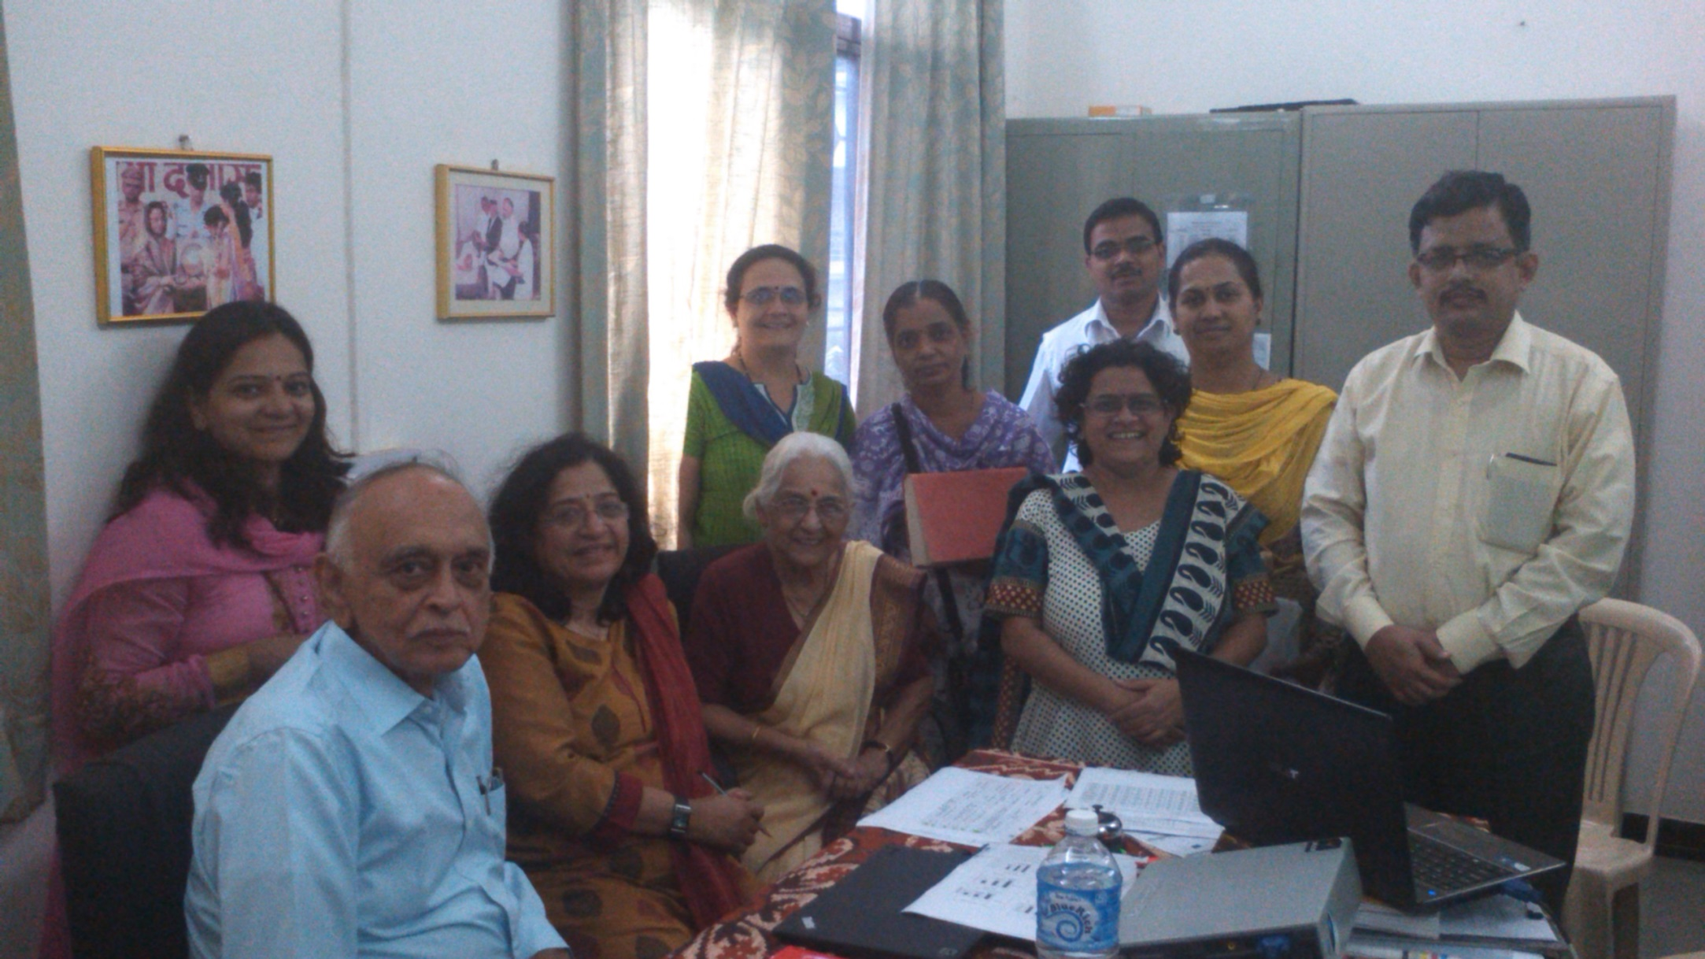

Slide 23
Controls and TNM classification
1) 4 parameters compared in 3 normal donors
Name of Group | Proliferation T cell | CD3 | IL 10 in Saliva | CD 105 in Saliva
Healthy | 65187 | 35 | 4.3 | 1.8
Tobacco chewer with mild leukoplakia | 33506 | 29 | 0.9 | 3.2
Tobacco chewer with severe leukoplakia | 73356 | 27 | 1.4 | 2.1
Mean - Healthy | 57350 | 33 | 2.2 | 2.4
2) Responses of T1/T2 Vs T3/T4 patients
Stage | Mean values
Stage I + II | 65437 | 41 | 2.6 | 2.5
Stage III + IV | 54132 | 53.8 | 5.1 | 2.62

