Slide 1
A Novel and Simple Technique for Separation of Liposomes from Unloaded Drug Molecules
Naagarajan Narayanan
Vignesh Muthuvijayan*
Department of Biotechnology
Bhupat and Jyoti Mehta School of Biosciences
Indian Institute of Technology Madras
Chennai 600 036, India
5th International Conference and Exhibition on Pharmaceutics & Novel Drug Delivery Systems

Slide 2
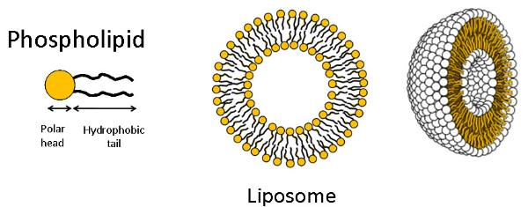
Liposomes
Lipid vessicles
Can self assemble to spheres at T > T_{g}
Amphiphilic nature of the lipids
Phospholipids: Polar group and hydrophobic chain
Self assemble with hydrophobic core
Image from http://www.reemazeineldin.com/Liposome.html
Notes:
1. Above glass transition temperature, lipids are in the fluid state. Therefore, they can move around and self assemble.

Slide 3
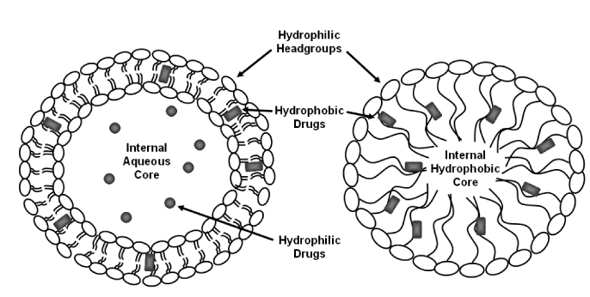
Liposomes for Drug Delivery
Biocompatible
Amphiphilic → Both hydrophobic and hydrophilic drugs can be loaded
Image from Journal of Cancer Science & Therapy

Slide 4
Separation of Liposomes
Important to separate liposomes from unloaded drug molecules
Separation – Size and molecular weight
Ultra centrifugation
Liposomes > 100 nm
Pellet down due to higher sedimentation coefficient
Lipid-lipid fusion is possible
Breakage of liposomes
Loss of loaded drug molecule

Slide 5
Separation of Liposomes
Dialysis
Cut-off range of dialysis bag
Density gradient centrifugation
Sucrose or Ficoll gradient
Combined with ultracentrifugation
Density of liposomes
Column chromatography
Most effective method
Liposome morphology is maintained
Expensive and large scale can be a problem

Slide 6
Problem Statement
Develop a novel and simple technique for separation of liposomes from unloaded drug molecules
Rapid
Cost effective
Potential for large-scale application

Slide 7
Protocols
Isolation of phospholipids from egg yolk
Preparation of liposomes
Separation of liposomes

Slide 8
Isolation of Phospholipids
Protocol described by Merkle and Ball (2001), US Patent 6,217,926
10 mL egg yolk with 37 mL distilled water
Centrifuge for 15 min at 10,000 rpm
Add 0.15% carboxymethyl cellulose to supernatant (1:2 ratio)
Extract creamy layer with 25 mL of chloroform
Centrifuge at 7,000 rpm for 10 min
Dry chloroform to obtain phospholipids

Slide 9
Preparation of Liposomes
Protocol described by Chen et al. (2012), Molecules, 17, 5972–87
2 mL of 50 mg/mL phospholipids in 100 mL
10 mL of phosphate buffed
Stirring at 400 rpm for 30 min (50°C)
Sonication for 6 min (10 s on & 5 s off cycles at 30%)
Milky white colloidal liposomes solution homogenized by sonication
Samples were cooled

Slide 10
Separation of Liposomes
Using precipitating agents to separate liposomes
Analogy to precipitation of DNA
Precipitating agents
Ethanol
Acetone
Isopropanol
Treated samples were centrifuged 7000 rpm for 10 min to obtain pellet
Pellet was air dried and resuspended in PBS
Notes:
Different volumes of precipitating agents were added and incubated for different time periods

Slide 11
Optimization
2-factorial design
4-corner points with a central point
Evaluate the interaction effects
Liposome volume (μL) | Ppt agent volume (μL) | Time (min) | Particle size | % recovery
500 | 100 | 60
500 | 100 | 10
500 | 300 | 35
500 | 500 | 10
500 | 500 | 60

Slide 12
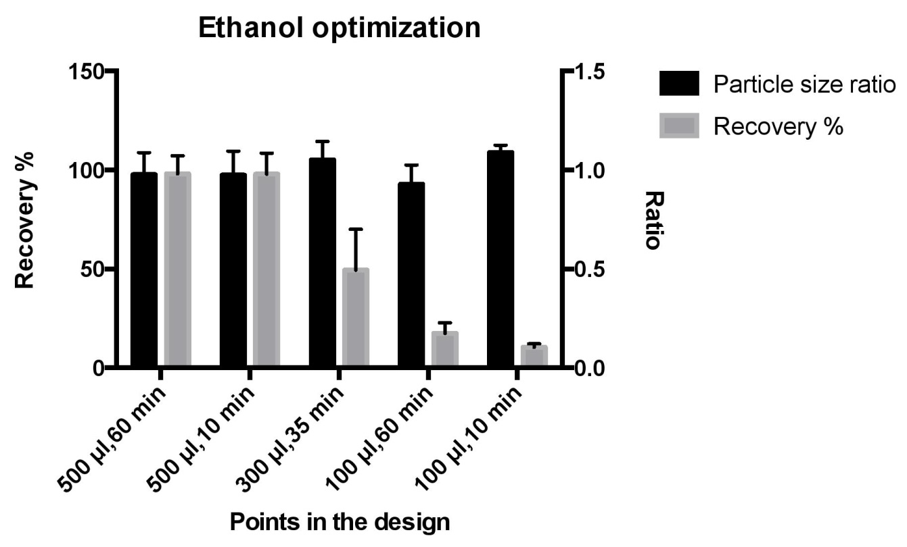
Ethanol
Optimum volume of ppt agent – 500 μL
Optimum time – 10 min (faster)

Slide 13
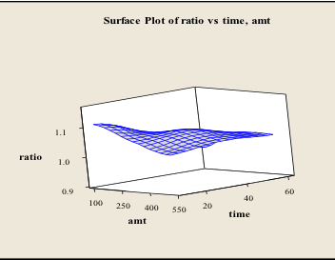
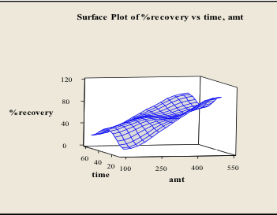
Ethanol – Minitab Optimization
Volume of precipitating agent plays a significant role
Incubation time doesn’t have much effect

Slide 14
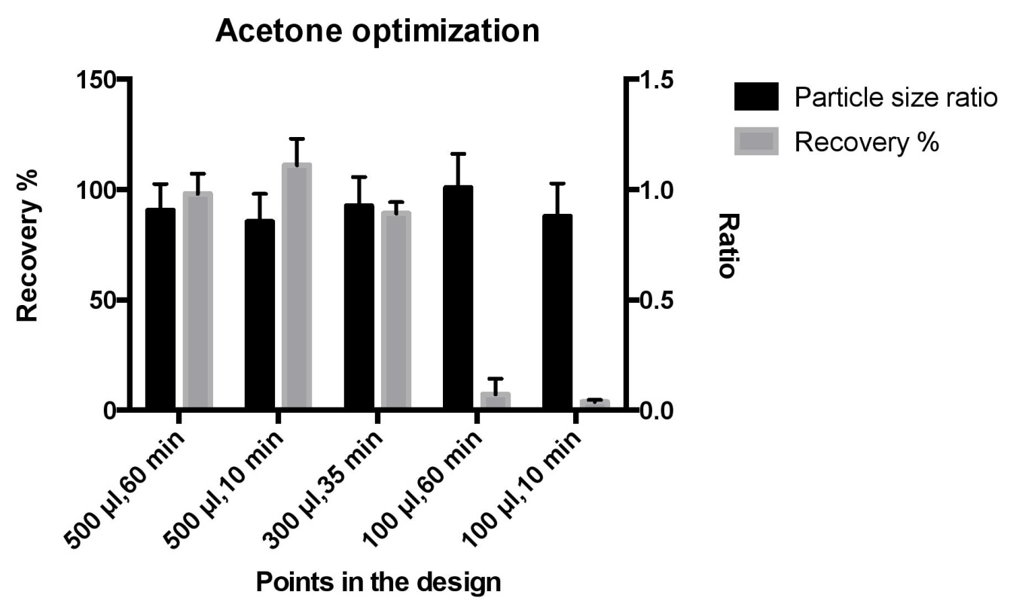
Acetone
Optimum volume of ppt agent – 500 μL
Optimum time – 10 min (faster)
Particle size ratio might be slightly lower

Slide 15
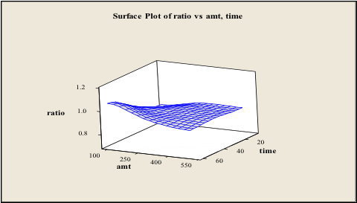
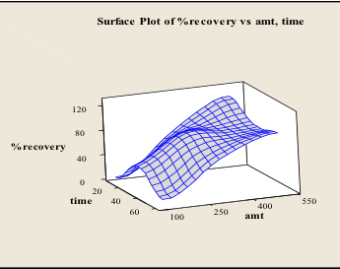
Acetone – Minitab Optimization
Volume of precipitating agent plays a significant role
Incubation time doesn’t have much effect

Slide 16
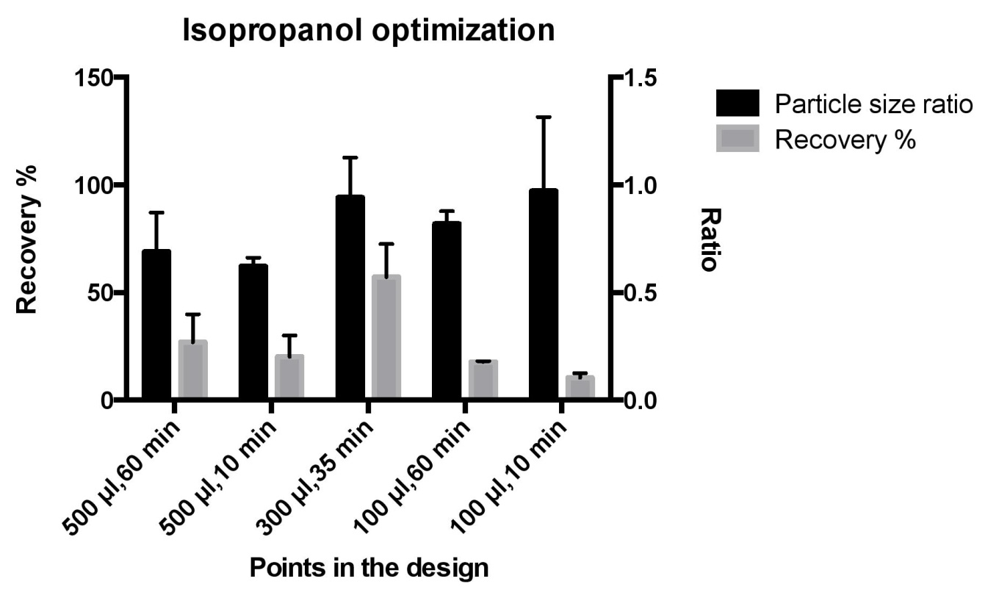
Isopropanol
Low recovery of liposomes
Particle size ratio was also varying from one

Slide 17
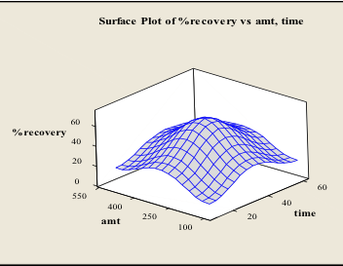
Isopropanol – Minitab Optimization
Minitab analysis showed no significant factor

Slide 18
Summary
A simple technique based on precipitation
Ethanol
500 μL ethanol for 10 min incubation
100% recovery without any effect on particle size
Acetone
500 μL ethanol for 10 min incubation
100% recovery
Particle size ratio may be slightly lower than 1
Isopropanol
Low recovery
SEM / TEM images to confirm the findings

Slide 19
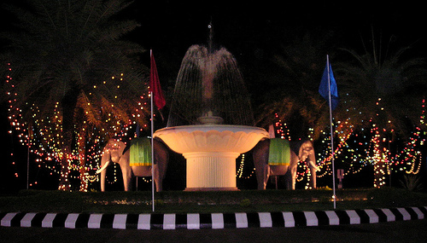
Acknowledgment
Indian Institute of Technology Madras
Prof. Mukesh Doble
Dr. R Nandakumar
Balaji Ramachandran

Slide 20
?

Slide 21
Particle Size Analysis
Zetatrac Particle Size Analyzer at room temperature at a back scattering angle of 180◦, and wavelength of 780 nm

Slide 22
Phospholipid Estimation
Protocol described by Stewart (1980), Analytical Biochemistry, 104, 10–14
Ammonium ferrothiocyanate reagent (2.703 g of FeCl₃.6H₂O and 3.04g of NH₄SCN in 100 mL of distilled water)
4 mL sample + 3 mL chloroform (rotamixer for 1 h)
Chloroform layer was extracted
1 mL chloroform was added to the extract, followed by 2 mL ammonium ferrothiocyanate reagent
Vortexed for 1 min and allowed to separate
Lower phase was extracted and analyzed at 488 nm
3 mL chloroform + 2 mL reagent was used as blank

