Slide 1
Changes in Breast Cancer Reports After Second Opinion
Dr. Vicente Marco
Department of Pathology
Hospital Quiron Barcelona. Spain

Slide 2
Second Opinion in Breast Pathology
Usually requested when a patient is referred from another institution for treatment
An opportunity to detect diagnostic errors that impact on patient management.

Slide 3
Who’s requesting a second opinion in Breast Cancer ?
Medical Oncologists
Breast Surgeons
Patients
Pathologists

Slide 4
Prognostic Factors in Breast Cancer
Tumor size
Tumor grade
Histological type
Margins of resection
Lymphovascular invasion
Proliferative Index
Lymph node stage
Predictive markers
Estrogen & progesterone receptors
HER2

Slide 5
Breast cancer management team effort
Oncologists
Surgeons
Pathologists
“Castellers in Catalunya, Spain”

Slide 6
Questions for the pathologist when providing a second opinion in breast biopsies
Is it cancer?
Is it breast cancer?
Is it invasive breast cancer?
Are the margins of resection free of disease?
Are the predictive markers of response accurate (Hormone Receptors, HER2)?

Slide 7
Special situations
Patient with previous history of breast cancer presenting with disease in other organs.
Patient with history of non-breast cancer presenting a breast lesion.
Tumor presenting in the axilla without a clinically evident breast lesion.

Slide 8
Tumors of the axillary region
Metastatic tumors to axillary lymph nodes.
Metastases from occult breast cancer
Primary tumors of the axilla
Breast cancer arising in ectopic breast tissue
Primary tumors of skin appendages

Slide 10
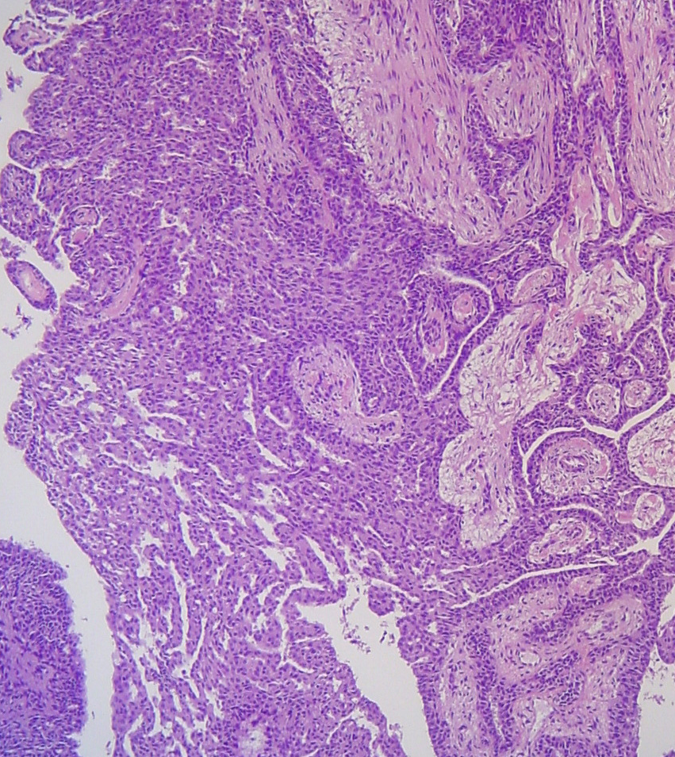
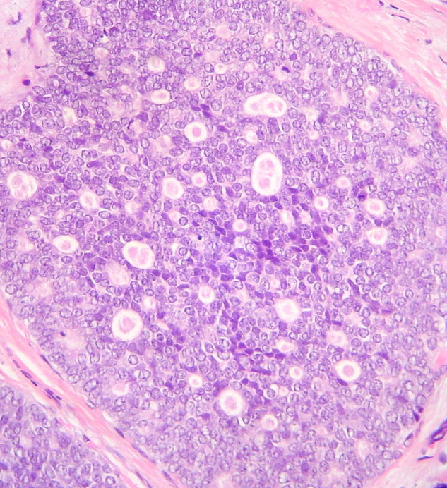
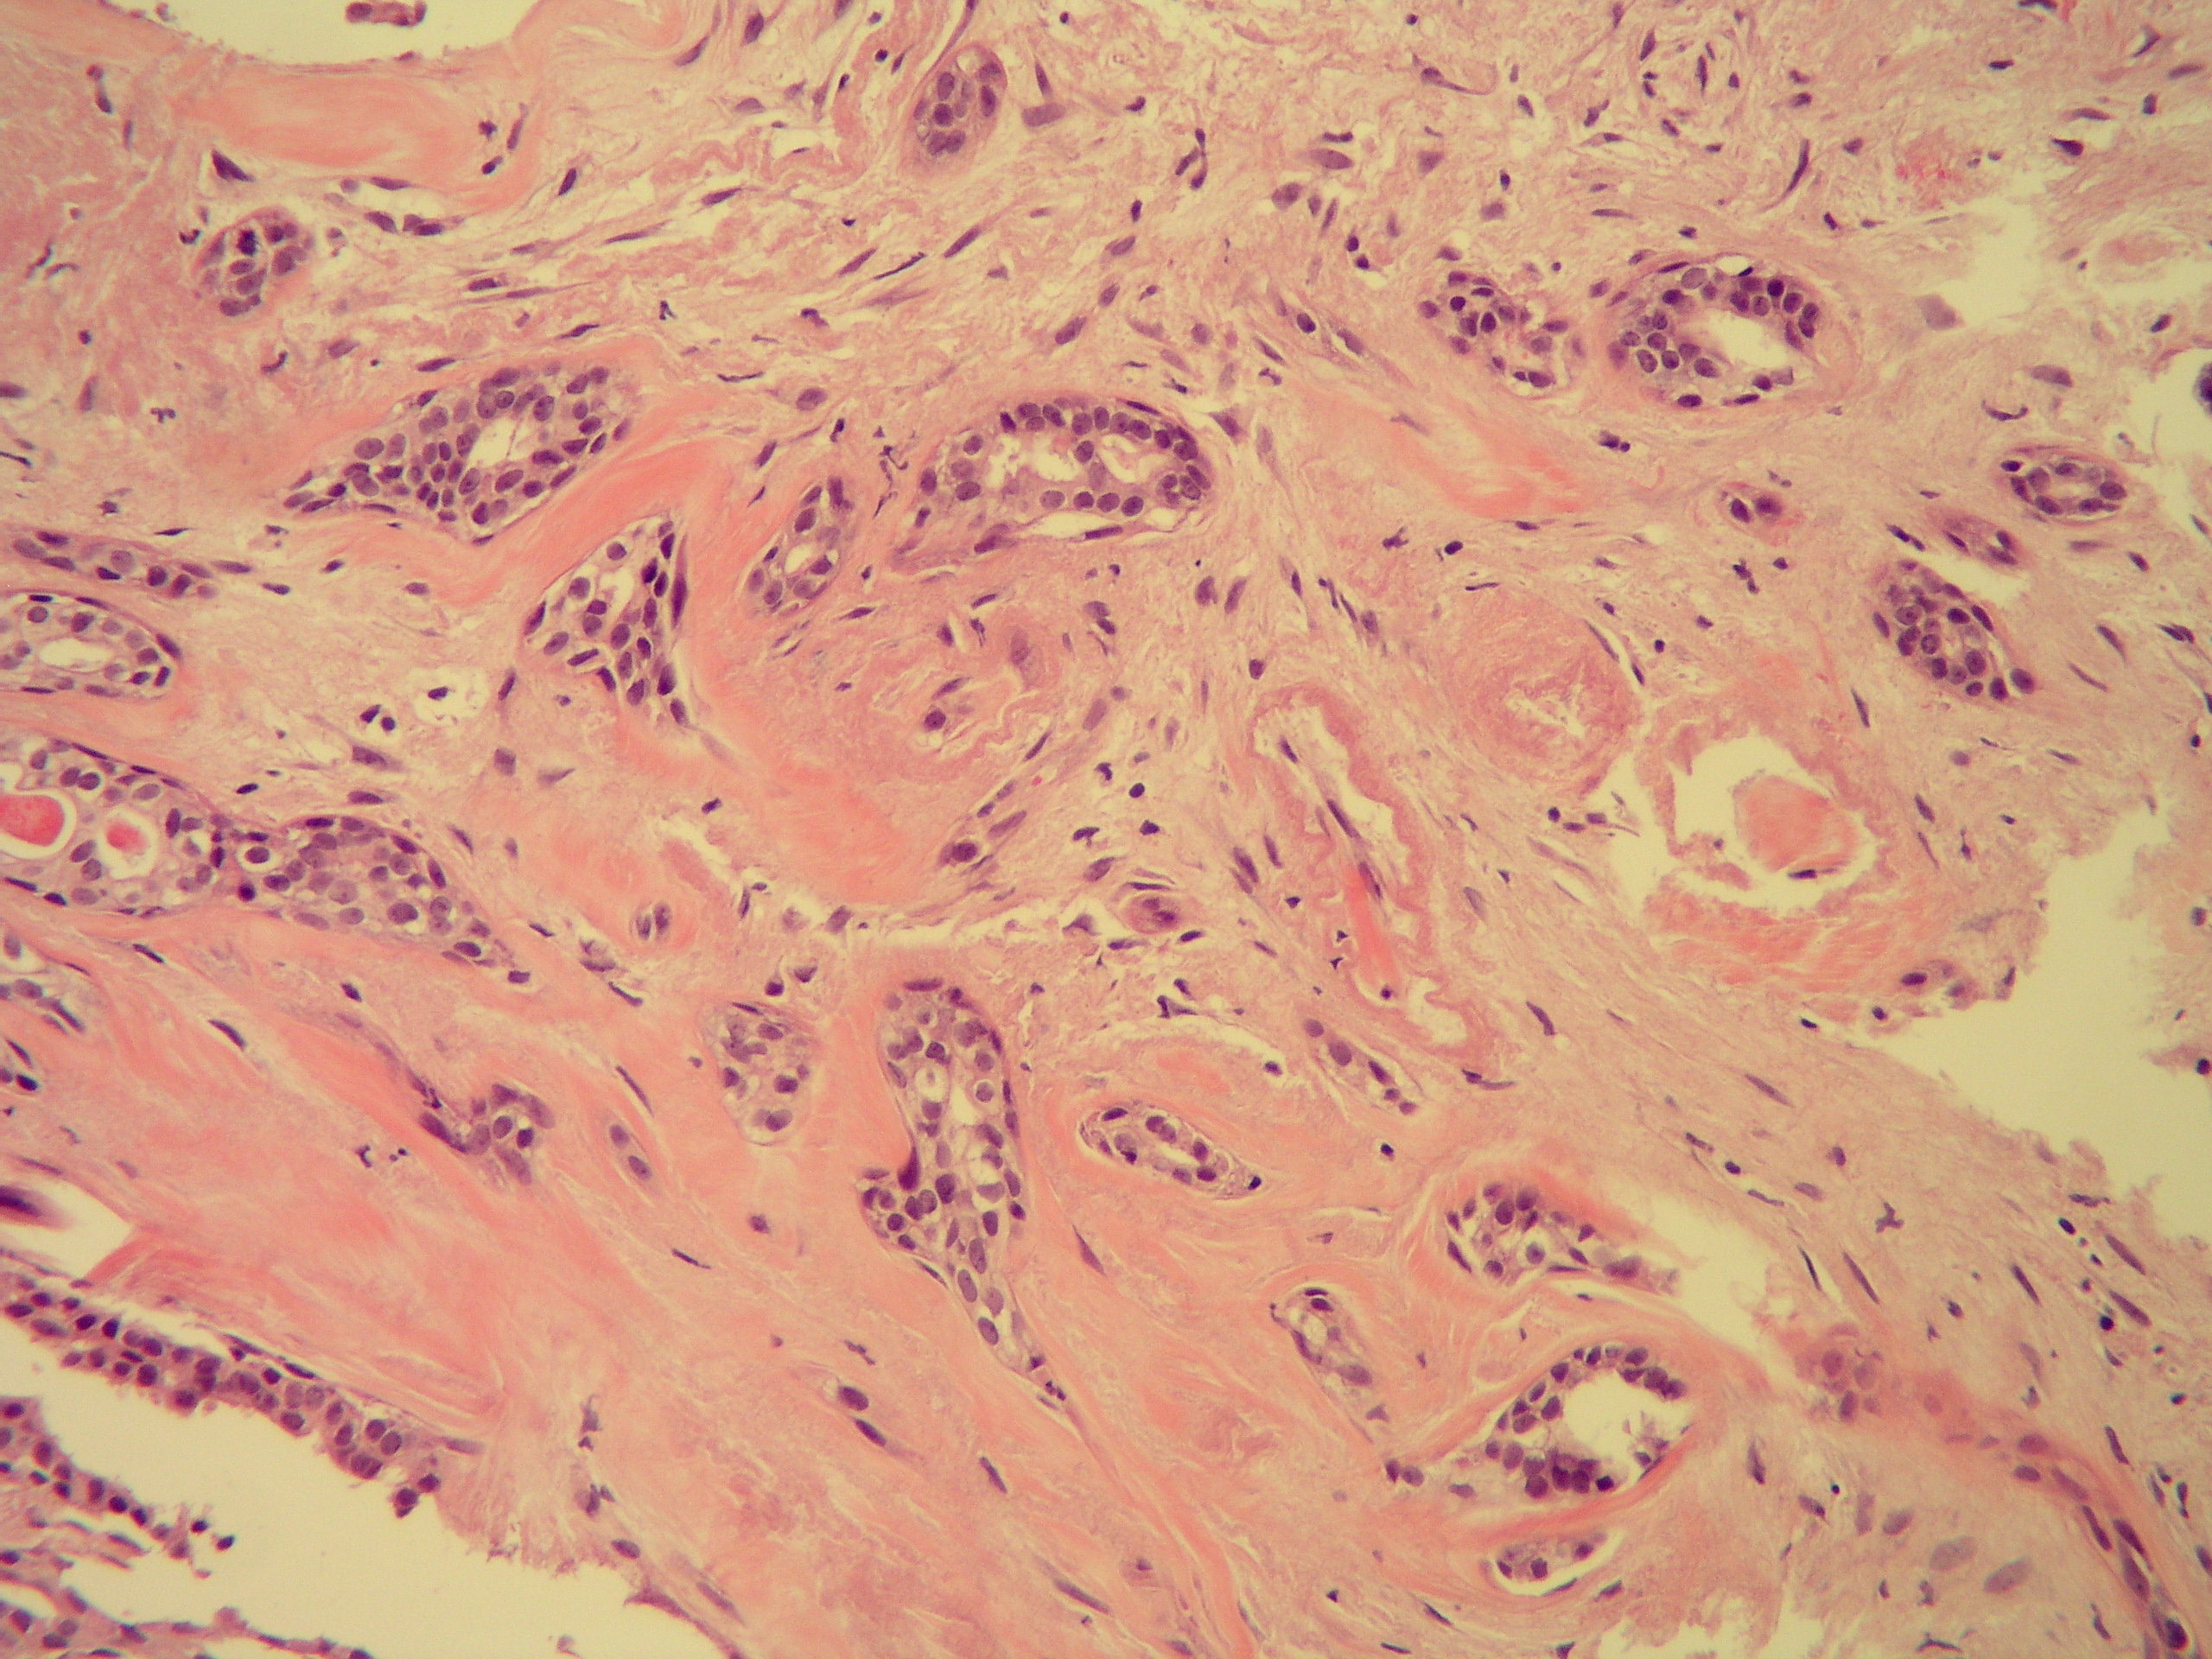
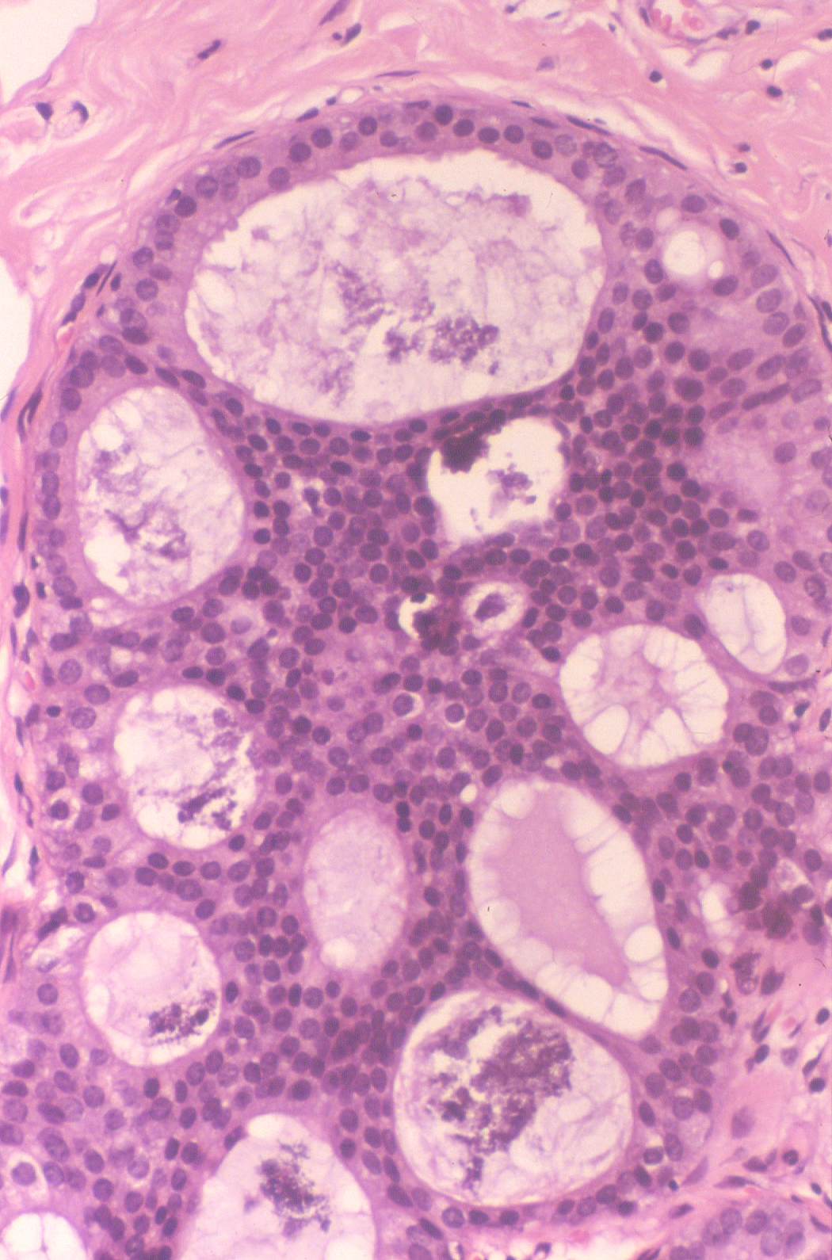
Concordance among pathologists in the diagnosis of breast lesions
Benign lesions without atypia
Atypical Hyperplasia
Ductal Carcinoma in situ
Invasive cancer

Slide 11
Diagnostic concordance among pathologists interpreting breast biopsy specimens
Diagnosis | Concordance rate | Overinterpretation rate | Underinterpretation rate
Benign without atypia | 87% (85-89) | 13% (11-15)
Atypia | 48% (44-52) | 17% (15-21) | 35% (31-39)
DCIS | 84% (82-86) | 3% (2-4) | 13% (12-15)
Invasive carcinoma | 96% (94-97) |  | 4% (3-6)
Modified after Elmore JG et al. JAMA 2015;313 (11):1122-1132.

Slide 12
Why do pathologists disagree in the diagnosis of breast lesions?
Different levels of training and experience
Different levels of interest in breast pathology
Interpretation of borderline or grey zone cases
Diagnosis of rare cases
Special clinical situations
Technical issues

Slide 13
Classification of second opinion results in breast pathology
Concordant
Major discrepancies
Potential for significant change in prognosis and/or treatment.
Minor discrepancies
Don’t impact significantly in prognosis and/or treatment.

Slide 14
Rate of major discrepancies in breast cancer pathology after review
Author/ year | Number of cases reviewed | Major discrepancies %
Staradub et al. 2002 | 340 | 7.8
Newman et al. 2006 | 149 | 9
Price et al. 2010 | 93 | 11
Kennecke et al. 2012 | 405 | 6
Middleton et al. 2014 | 2718 | 6.20
Marco et al. 2014 | 205 | 16
Romanoff et al. 2014 | 430 | 10
Khazai et al. 2015 | 1970 | 11.47

Slide 15
Second Opinion in Breast Pathology Major Discrepancies
Changes in Histologic Diagnoses (37.7%)
Invasive Carcinoma vs DCIS (32 %)
Invasive Ca DCIS
DCIS Invasive Ca
Hormone Receptors Results (9.4%)
ER- ER+
HER2 Results (20.7%)
HER2+ HER2 -

Slide 16
Second Opinion in Breast Pathology Major Discrepancies in 46 Patients
First Diagnosis | Second Opinion | N
Invasive breast cancer Lung cancer metastasis to lymph node Lung cancer metastasis to breast Fibroadenoma/DCIS/ Lobular neoplasia Atypical ductal hyperplasia Atypical papilloma/DCIS Changes in histologic type of primary breast tumor (phyllodes tumor, adenoid cystic ca, atypical vascular lesion, fibromatosis) Invasive carcinoma NST DCIS with microinvasion DCIS Estrogen receptor negative Estrogen receptor positive HER2 positive HER2 negative | Benign Lung cancer in breast, brain and lymph nodes Cutaneous axillary adnexal carcinoma Axillary metastasis of melanoma Breast cancer metastasis to lymph node Primary breast cancer, small cell type Fibroadenoma/Lobular neoplasia DCIS high grade Papilloma with ductal hyperplasia Spindle cell ca, cribriform ca, angiosarcoma, myofibroblastic sarcoma DCIS DCIS with microinvasion DCIS DCIS with invasive carcinoma Estrogen receptor positive Estrogen receptor negative HER2 negative HER2 positive | 4 4 2 1 1 1 1 1 1 4 9 2 2 4 4 1 10 1

Slide 17
30 y-o woman with axillary mass.
First diagnosis:
Consistent with breast cancer metastasis.

Slide 18
Second opinion: Metastatic adenocarcinoma of lung
TTF-1
NAPSIN A

Slide 19
Immunohistochemistry in the differential diagnosis of lung and breast cancer
 | Lung Cancer | Breast Cancer
TTF-1 | + | -
Mammaglobin | - | +
p63 | + | -
ER | - | +
GATA-3 | - | +

Slide 20
Assessment of predictive factors of response in Breast Cancer
Hormone Receptors:
Estrogen Receptors
Progesterone Receptors
HER2
Immunohistochemistry
In situ hybridization

Slide 21
Assessment of predictive factors of response in Breast Cancer
Technical Issues
Fixation
Methodology
Interpretative Issues

Slide 22
Estrogen Receptors Assessment by Immunohistochemistry
NIH Consensus 2001
“….patients with any extent of hormone receptors in their tumor cells may still benefit from hormonal therapy”
Dichotomous results
99% of tumors are negative (0%) or positive in 70% or more of cells.
1% cutoff for ER positivity
False negative ER is more problematic

Slide 23
Estrogen Receptor IHC
NEGATIVE POSITIVE LOW POSITIVE HIGH

Slide 24
HER2 Assessment ASCO-CAP Guidelines

Slide 25
HER2 SCORE IHC

Slide 26
HER2 IHC SCORE
2+
3+

Slide 27
HER2 ISH Assay

Slide 28
HER2 ISH
Negative. Ratio<2
Positive. Ratio >2

Slide 29
CONCLUSIONS
Major discrepancies in the evaluation of breast cancer reports are often related to the assessment of the degree of invasion of breast carcinoma and the immunohistochemical results of predictive markers, in particular HER2.
The assessment of axillary lesions and distant metastasis in patients suspected of having breast cancer or with a history of treated breast cancer may reveal non-mammary tumors.

Slide 30
Conclusions
Significant improvement in the concordance among pathologists in the assessment of breast lesions can be achieved by careful histological study, following standardized criteria, and having complete clinical information.
Using high quality IHC techniques will improve the evaluation of markers of prognosis and therapeutic response.

Slide 31
Thank you

