Slide 1



A Comparison of Samplers for Inhalable Welding Fumes and Laboratory Analysis for Manganese
VERPAELE Steven*, JOURET Jonathan*, VANOIRBEEK Jeroen**, POELS Katrien**, GODDERIS Lode**, HAEGEMAN Martine†, MARTENS Frank‡, LEPLA Bart‡
* Adhesia vzw, non-profit association licensed by the Belgian Law as external company for occupational prevention and protection, Oude Graanmarkt 10, 1000 Brussels, Belgium
**Occupational and Environmental Hygiene, Katholieke Universiteit Leuven, Kapucijnenvoer 35 blok D box 7001, 3000 Leuven, Belgium
†Central Laboratory of The Fund for Occupational Diseases, Sterrenkundelaan 1, 1210 Brussels, Belgium
‡Laboratory for Industrial Toxicology, AZ Groeninge Kortrijk, Reepkaai 4, 8500 Kortrijk, Belgium

Slide 2
Introduction
Welding fumes and manganese exposure is a major domain of interest for Occupational Hygienists
Important to decide which material should be used for sampling
International methodology is not consistent according to the use of:
  Samplers
  Sampling filters
  Sampling time
  Laboratory analysis
Dose-response recalculations out of historical data
  ! Conditions have to be comparable

Slide 3
Laboratory vs WP
Laboratory
  Controllable atmosphere
  Controllable homogeneous aerosol
  Equal exposure for each sampler
Workplace
  Stationary ⬄ personally
  Work routine not controllable
  No equal exposure
Hard job to execute comparisons in WP

Slide 4
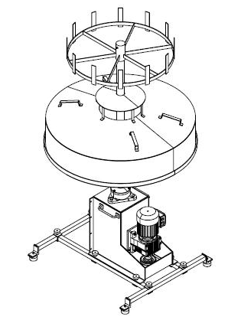
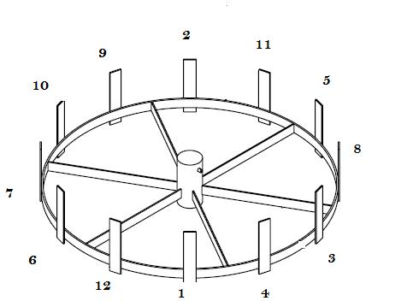
Workplace Atmosphere Multisampler: WAM

Slide 5
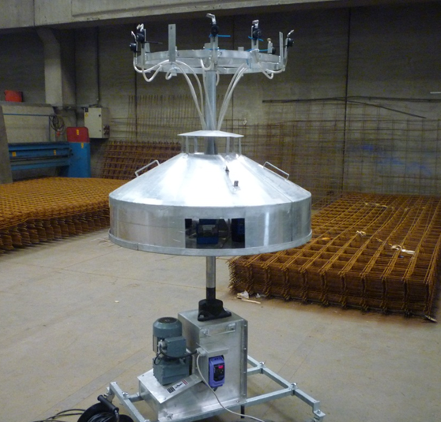
Workplace Atmosphere Multisampler: WAM

Slide 6
WAM
WAM makes it possible to
  Provide a homogeneous aerosol for all 12 samplers → 2,8 rpm
  No interferences from pump flows → shielded with decks
  Mobile & light → comparisons possible at different places
  Adjustable for explosive atmospheres (mines, ATEX,…)
  Good hight → respiration zone
  Stable
  Can it be used to compare inhalable samplers according to Witschger, O., Willeke, K., Grinshpun, S.A., Aizenberg, V., Smith, J. and Baron, P. “Simplified Method for Testing Personal Inhalable Aerosol Samplers”, J. of Aerosol Science, 29:855-874 (1998)?
Needs validation

Slide 7
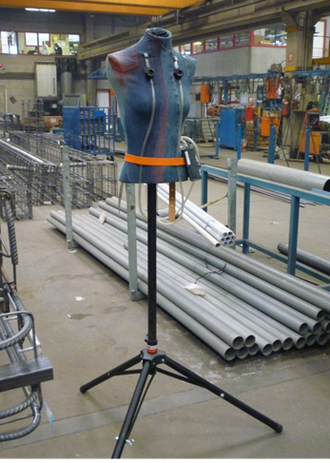
WAM: Validation part 1 – is the use of a torso required?
According to Witschger et al. “Simplified Method for Testing Personal Inhalable Aerosol Samplers”, J. of Aerosol Science, 29:855-874 (1998) a torso is needed when inhalable samplers are compared
A torso was used next to the WAM runs

Slide 8
WAM: Validation part 2 – equal sampling
Gravimetric analysis
3 runs with 6 identical combinations of plastic IOM samplers filled with MCE filters
Average concentration and range
SD
RSD (%)

Slide 9
WAM: Validation
Goal: Average RSD < 10% for each type of sampler
  Pump fault
  Gravimetric analysis
  Samples with pump errors are not included in these figures
EN 482 – Expanded uncertainty requirements for measurements for comparison with limit values and periodic measurements
  Long term sampling (> 2 hours)
    Exposure index (Concentration measured/Limit value) 0,1 - < 0,5 → 50%
    Exposure index (Concentration measured/Limit value) 0,5 - 2 → 30%
EN 689 – Assesment of exposure by inhalation to chemical agents for comparison with limit value and measurement strategy
  Exposure index < 0,1 → exposure negligible
  Exposure index 0,1 - < 0,25 → exposure under control
  Exposure index 0,25 - < 0,5 → exposure not under control – follow up needed identify exposure
  Exposure index > 1 →over exposure– immediate measures needed to reduce exposure

Slide 10

WAM: Validation - results
Is a torso required in a workplace – calm air conditions?
  The variation between the WAM and the Simplified Torso was not more than 4,9% → OK
Does the WAM equally sample?
  The average variation of the 3 runs was 5,5% → OK
WAM can be used for a comparison study of inhalable samplers

Slide 11
Results - Comparison inhalable samplers
2 types of samplers where compared with different filters
  MCE filter was used as a reference filter
  Plastic IOM and cassette vs Stainless steel IOM and cassette
No significant difference between the two samplers

Slide 12
Results - Comparison filters used

Slide 13
Results - Comparison filters used

Slide 14
Results - Comparison filters used

Slide 15
Results - Comparison Manganese analysis
Three different laboratories performed the analysis of manganese on the different filters:
  Using there in house method
  2 laboratories used Inductive Coupled Plasma (ICP)
    One laboratory used ICP-AES
    One laboratory used ICP-MS
  1 laboratory used Atomic Absorption Spectroscopy AAS

Slide 16
Results - Comparison Manganese analysis

Slide 17
Conclusion
Gravimetric analysis found that the MCE filters were under sampling
  compared to the PVC (y=0.88x)
  compared to the PC (y = 0.82x)
  compared to the GF (y = 0.91x)
No significant differences were found in between the types of filters
No significant differences were found between the IOM plastic sampler and cassette and the IOM stainless steel sampler and cassette
No significant differences where found between the methods. Although it seems that lower concentrations are more accurately measured by ICP techniques
Manganese analysis showed that MCE filters retain more manganese compared to PC and GF

Slide 18
Conclusion
Manganese analysis showed that MCE filters retain more manganese compared to the other filters
  2% more than PVC filters
  6% more compared to GF filters
  13% more compared to PC filters
WAM can be easily used for evaluation and comparisons of samplers in the workplace
This is necessary to better understand the behaviour and sampling in the workplace
  New PTS
  WASP
  ALASCA
  How do laboratories perform in analyzing real workplace samples (proficiency)

Slide 19
Discussion
Further research is necessary to determine the retention of metals and metalloids on different filters
More comparisons of analysing techniques for metals and metalloids are necessary to have a better understanding of the differences (low concentration range)
Could those differences explain the differences in metabolite results? Especially for welding fumes.

Slide 20
Thank you for your attention
Please take a look at:
A Comparison of the Performance of Samplers for Respirable Dust in Workplaces and Laboratory Analysis for Respirable Quartz
- http://annhyg.oxfordjournals.org/content/early/2012/07/17/annhyg.mes038.full
Differences between samplers for respirable dust and the analysis of quartz - An international study http://www.astm.org/DIGITAL_LIBRARY/STP/PAGES/STP156520120188.htm

Slide 21
Q&A
Steven Verpaele, MSc
Occupational Hygienist – Adhesia-Mensura Belgium
President Belgian Centre for Occupational Hygiene (BeCOH)
+32496289688 steven.verpaele@adhesia.be www.adhesia.be steven@becoh.be www.becoh.be

