Slide 1
About OMICS Group
OMICS Group International is an amalgamation of Open Access publications and worldwide international science conferences and events. Established in the year 2007 with the sole aim of making the information on Sciences and technology ‘Open Access’, OMICS Group publishes 400 online open access scholarly journals in all aspects of Science, Engineering, Management and Technology journals. OMICS Group has been instrumental in taking the knowledge on Science & technology to the doorsteps of ordinary men and women. Research Scholars, Students, Libraries, Educational Institutions, Research centers and the industry are main stakeholders that benefitted greatly from this knowledge dissemination. OMICS Group also organizes 300 International conferences annually across the globe, where knowledge transfer takes place through debates, round table discussions, poster presentations, workshops, symposia and exhibitions.

Slide 2
About OMICS Group Conferences
OMICS Group International is a pioneer and leading science event organizer, which publishes around 400 open access journals and conducts over 300 Medical, Clinical, Engineering, Life Sciences, Pharma scientific conferences all over the globe annually with the support of more than 1000 scientific associations and 30,000 editorial board members and 3.5 million followers to its credit.
OMICS Group has organized 500 conferences, workshops and national symposiums across the major cities including San Francisco, Las Vegas, San Antonio, Omaha, Orlando, Raleigh, Santa Clara, Chicago, Philadelphia, Baltimore, United Kingdom, Valencia, Dubai, Beijing, Hyderabad, Bengaluru and Mumbai.

Slide 3
Systems Engineering approach and Space Technology Transfer: the role of International Relations and Public Policy
San Francisco, 6 October 2015
Veronica La Regina – Walter O. Piperno

Slide 4
Concepts’ Outline
Space Technology Transfer
without SE and
with SE
Roles of
Market
Public policy and
International Relations
Conclusions and Recommendations

Slide 5
Space Technology Transfer & SE
Technology Transfer has manifold dimensions: it has often been used to describe the process through which:
ideas and concepts are moved from laboratory to marketplace (Phillips, 2002; Williams & Gibson, 1990),
the transfer of knowledge and concept from developed to less technologically developed countries (Derakhshani, 1983; Putranto et al., 2003) and
the transfer of inventive activities to secondary users, the adaptation of innovative technology to a new use (Van Gigch, 1978)

Slide 6
Space Technology Transfer
Technology
Transferor
Knowledge
Know-how
Expertise
Transferee
Mechanism of Transfer
Source: N. Khabiri, 2012 – Elaboration by author

Slide 7
Space Technology Transfer
Technology: set of knowledge, know-how and expertise employed for provision of goods/services/systems
Mechanism of transfer: set of channels in order to give technology from one to another one
Transferor: owner of the knowledge
Transferee: receiver of knowledge
The grater environment: policy conditions

Slide 8
Space Technology Transfer
Space
Non-Space
Technology
Transferor
Knowledge
Know-how
Expertise
Transferee
Mechanism of Transfer
Source: N. Khabiri, 2012 – Elaboration by author

Slide 9
Space Technology Transfer & SE
Space
Non-Space
Reliability in O-Space
Redundancy
Trade-off: mass/power
Complexity
Stand-alone production
Re-usability
Redundancy
Interoperability
Simplification
Replication
B2B Market
Bilateral Relations
B2C Market
International Trade & Law
Image Credits: ISU, SSP 1997
~150 B€
~150 x n market B€

Slide 10
SE & Space Technology Transfer
Systems Engineering is an interdisciplinary field of knowledge that focuses on how to design and manage complex systems over their life cycles
If
Space
shall work even for
Non-Space
then…
Reliability in Outer Space shall be mitigatable to redundancy
Redundancy shall be managed through re-usability
Trade-off between mass/power shall pass the floor to interoperability
Complexity shall be flexible adapt to simplification’s context
Stand-alone production shall be simplified into a replication procedure
B2B Market shall be a catalyzing leverage to B2C Market
Bilateral Relations shall be supportive of multi-lateral relations

Slide 11
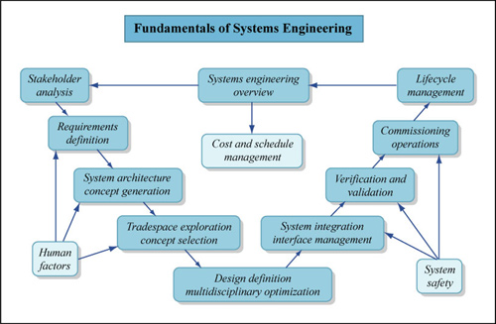
SE & Space Technology Transfer
International Relations
Market
Public Policy

Slide 12
Space Technology Transfer
Automotive
Nano Technology
Biomedical applications
Mobile Telecommunications
Optical Communication
Photonics
Biomedical
Energy
Space
Energy
Advanced Materials
Biomedical
Transport
Source: C. Giannopapa, 2010
Elaboration by author
Bio Technology
Energy
Biomedical
ITC
Wireless
It is not an exhaustive outlook
Intelligent Transport

Slide 13
Space Technology Transfer
Institutional Case | Description
NASA (USA) | Commercial Technology Network Small Business Innovation Research Small Business Technology Transfer
ESA (~ Europe) | Technology Transfer Programme Office: Tech Brokers & BICs ESA – Integrated Application Programme (AIP): user-drivers
European National Agencies (e. g. ASI, CNES, …) | Past-time: Shareholders’ corporations Today: incubator approach, support for IP, innovation development
DLR (Germany) | Technology push: risk sharing between private player and DLR through a company as special vehicle in order to reduce systemic financial risk
CSA (Canada) | Space Policy Framework: marketing approach from space sector to other industrial sector
Examples of policy initiatives

Slide 14
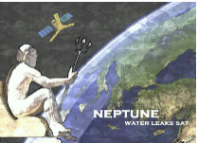
Space Technology Transfer: ASI achievements
Start-up | Technology | Website
 | Monitoring Evolution with Soccer -Satnav Innovation High Precision | www.spaceexe.com
 | Monitoring urban areas by means of long term DInSAR time series | www.surveylab.info
 | Innovative Smart multi-sensor for indoor detection | www.airgloss.com
 | User friendly lab performing the microbiological analyses on bathing marine area | www.biosensingtechnologies.com
 | Smart Base Transceiver Stations | www.smartstru.com
 | Self-powered piezoelectric temperature and humidity sensor | www.stronger2012.com
 | Hyperspectral/multispectral satellite data based system to detect water leaks | www.neptunewaterleaks.com
 | An integrated motion capture system with inertial sensors, GPS and 2 way wireless communication | www.captiks.com
 | Sharing Economy models for scooter’s ride through apps | www.scooterino.it

Slide 15
Conclusions and Recommendations
Space technology transfer is a complex ecosystem and an holistic approach (e. g. SE) shall be adopted for achieving a more comprehensive outcome
Space and no-Space ecosystems present different and peculiar business approaches (marketing policies and strategies, governance and international trades)
If Space investments shall be exploited as much as possible for humankind then Space technology transfer is the right channel
no-Space requirements shall be included earlier
B2C market approach and international trade shall be encompassed into the initial design

Slide 16
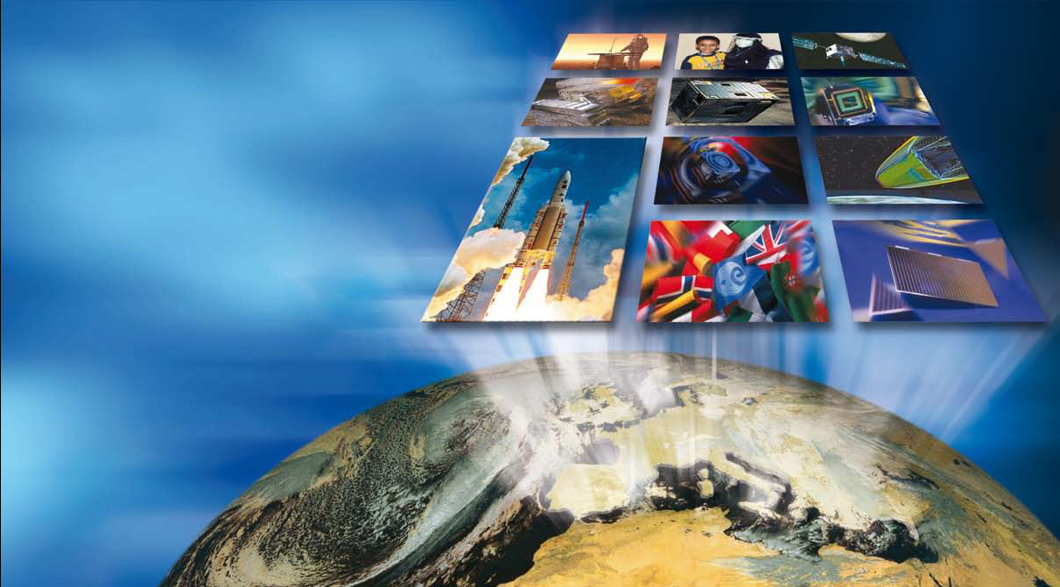
There is always space for Space!

