Slide 1

About OMICS Group
OMICS Group International is an amalgamation of Open Access publications and worldwide international science conferences and events. Established in the year 2007 with the sole aim of making the information on Sciences and technology ‘Open Access’, OMICS Group publishes 400 online open access scholarly journals in all aspects of Science, Engineering, Management and Technology journals. OMICS Group has been instrumental in taking the knowledge on Science & technology to the doorsteps of ordinary men and women. Research Scholars, Students, Libraries, Educational Institutions, Research centers and the industry are main stakeholders that benefitted greatly from this knowledge dissemination. OMICS Group also organizes 300 International conferences annually across the globe, where knowledge transfer takes place through debates, round table discussions, poster presentations, workshops, symposia and exhibitions.

Slide 2
About OMICS Group Conferences
OMICS Group International is a pioneer and leading science event organizer, which publishes around 400 open access journals and conducts over 300 Medical, Clinical, Engineering, Life Sciences, Pharma scientific conferences all over the globe annually with the support of more than 1000 scientific associations and 30,000 editorial board members and 3.5 million followers to its credit.
OMICS Group has organized 500 conferences, workshops and national symposiums across the major cities including San Francisco, Las Vegas, San Antonio, Omaha, Orlando, Raleigh, Santa Clara, Chicago, Philadelphia, Baltimore, United Kingdom, Valencia, Dubai, Beijing, Hyderabad, Bengaluru and Mumbai.

Slide 3
Ph.D. Student: Veronel-George JACOTA
EVALUATION OF DISSIPATED ENERGY BY THE CAR DAMPERS
Scientific coordinator :
Prof. univ. dr. eng. Eugen Mihai NEGRUS
Valencia, 2015

Slide 4
1. ACTUAL SITUATION OF FUEL CONSUMPTION REDUCTION
2. SIMULATION PARAMETERS
2.1 The road profile
2.2 The car parameters
2.3 The simulation conditions
3. MATHEMATICAL MODEL
4. SIMULINK MODEL
5. RESULTS
6. VEHICLE VIBRATION EFFECTS ON THE HUMAN BODY
7. CONCLUSIONS
SUMMARY
Veronel-George JACOTA ︳ 01.09.2015

Slide 5
Achievements in the field of energy recovery
1. Actual situation of fuel consumption reduction
II. Optimisation the aerodynamics
fuel consumption economy : 5%
modiffication the habitacle
modification the car design
I. Thermal engines modifications
direct injection: 8% - 20%
variable compression ratio & downsizing : 8% - 30%
multi valve engine: 5% - 10%
variable valve timing : 5% - 8%
cylinder suspending: 5% - 15%
III. Automated transmissions and
hybrid traction
Reconception the combustion chamber,
limiting the compression ratio, injectors control,
the mixture formation and combustion
fuel consumption economy (NEDC cycle): 15%
price
internal management of available energy
optimisation the recovery of braking energy
V. Car weight reduced
IV. Reduce rolling resistance tyres
fuel consumption economy (NEDC cycle): 2% - 9%
fuel consumption economy : 6%
subcomponents car price: 50% - 130%
modification the conduit car
Veronel-George JACOTA ︳ 01.09.2015

Slide 6

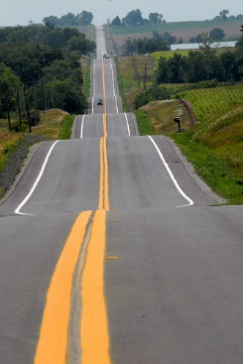
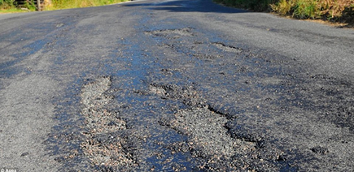

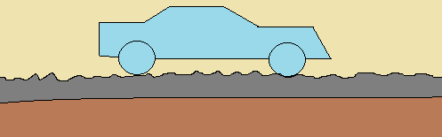
2.1 Road profile
Road macrostructure
Road microstructure
27 road profiles
120 Km/h | X
100 Km/h | X | X
80 Km/h | X | X | X | X
60 Km/h | X | X | X | X
50 Km/h | X | X | X | X
40 Km/h | X | X | X | X
30 Km/h | X | X | X | X
25 Km/h | X | X | X | X
 | ISO A-B | ISO B-C | ISO C-D | ISO D-E
8 macrostructural road profiles with maximum speed between 25Km/h – 120Km/h
4 microstructural road profiles
ISO A-B (Δh = ± 15 mm)
ISO B-C (Δh = ± 25 mm)
ISO C-D (Δh = ± 50 mm)
ISO D-E (Δh = ± 100 mm)
Veronel-George JACOTA ︳ 01.09.2015

Slide 7
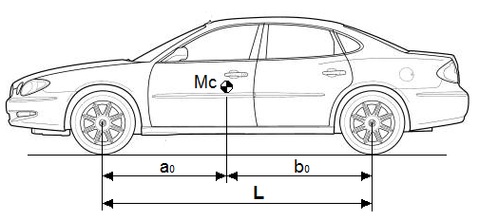
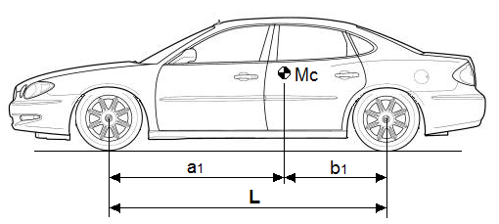
2.2 Car parameters
Parameters used in the car simulation have been chosen as the average values of middle-class cars, in two situations:
unladed weight: m₀ = 1100 kg
wheelbase: L = 2600 mm
the ratio: a₀ / L = 0.45
the ratio: b₀ / L = 0.55
total weight m1 = 1600 kg
wheelbase L = 2600 mm
the ratio a1 / L = 0.55
the ratio b1 / L = 0.45
Veronel-George JACOTA ︳ 01.09.2015

Slide 8

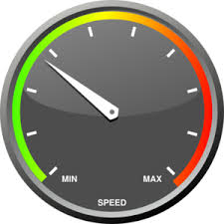
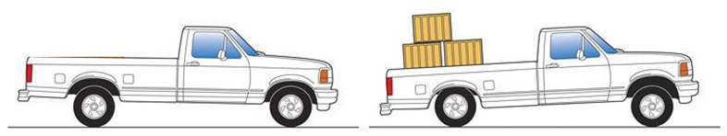
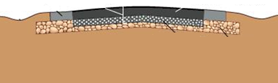
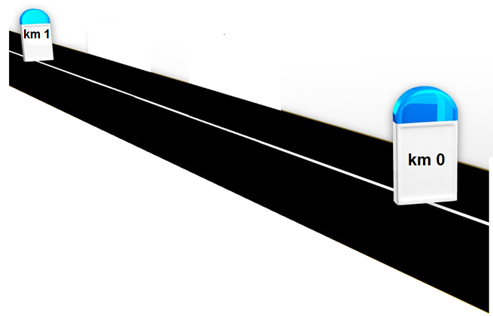
2.3 The simulation conditions
simulation performed in two conditions,
the car's unladed weight and with total weight
straight displacement at a constant speed
CONSTANT
the cross profile of the lane road is symmetrical
all the road profiles used in simulation
have a length of 1 km
Veronel-George JACOTA ︳ 01.09.2015

Slide 9
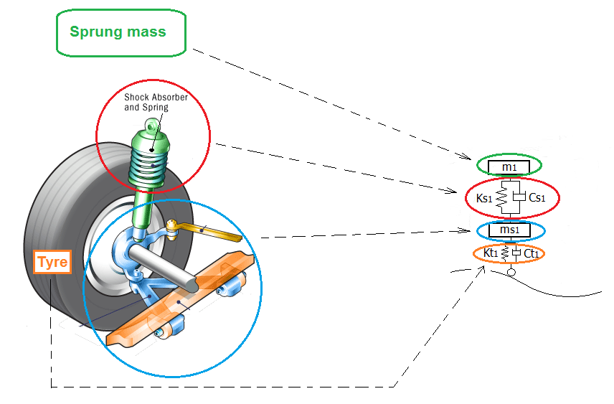
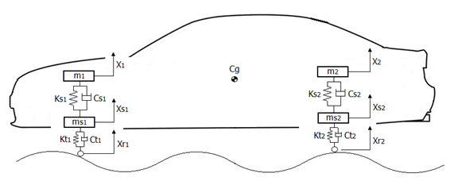
3. Mathematical model
The suspension itself includes:
- the spring (ks)
the damper (cs)
the sprung mass (m)
The tire was defined as an independent suspension with the same elements - the spring (kt)
the damper (ct)
the unsprung mass (m)
Veronel-George JACOTA ︳ 01.09.2015

Slide 10
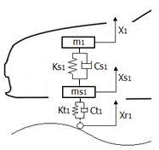
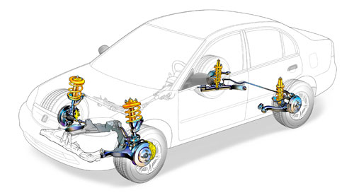
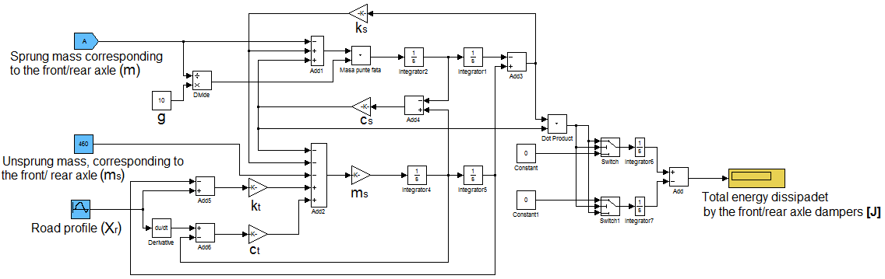
The Simulink model is made in two parts, for the front axle and for the rear axle.
4. Simulink model
Veronel-George JACOTA ︳ 01.09.2015

Slide 11
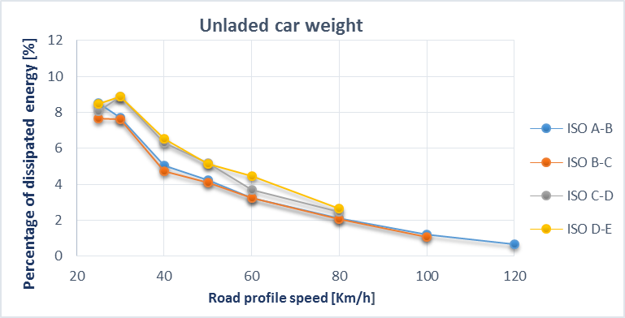
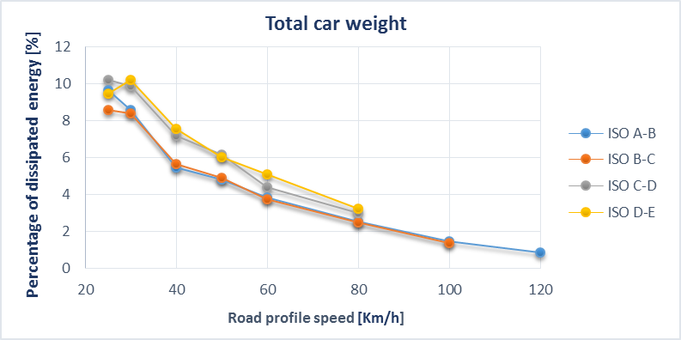
5. Results
Percentage of energy dissipated by the dampers, in relation to the energy consumed by the engine car with unladed/ total weight, to cover the distance of 1 km
(the car has tires rolling resistance coefficient f = 0.008, the drag coefficient c_{x} = 0.28 and the frontal area A_{x} = 2 m² )
Veronel-George JACOTA ︳ 01.09.2015

Slide 12
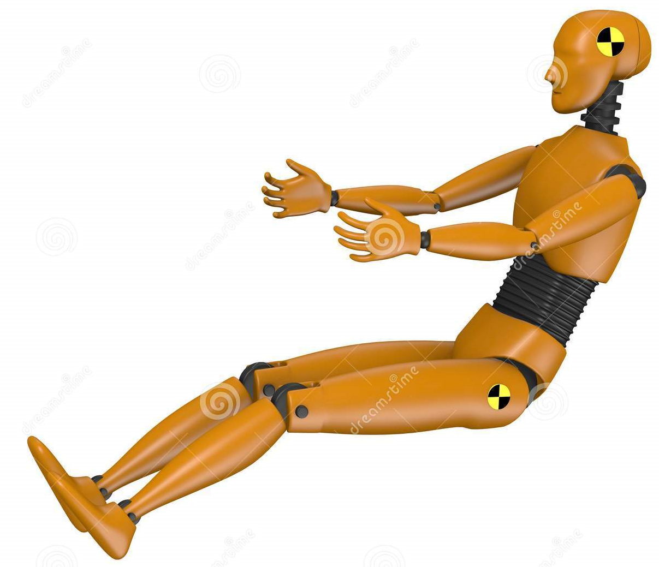

6. Vehicle vibration effects on the human body
60Hz (eyeball resonance)
m₀ = 1100 kg
m₁ = 1600 kg
3 - 4Hz (cervical vertebrae resonance)
Frequency [Hz]
Frequency [Hz]
5Hz (shoulder resonance)
4Hz (lumbar vertebrae resonance)
Speed [km/h]
Speed [km/h]
Average acceleration [m/s²]
Average acceleration [m/s²]
Fluctuation of acceleration effects on human body
Speed [km/h]
Speed [km/h]
Oscillation frequency [Hz] | Human sense that depends on oscillation acceleration [m/s²]
 | unpleasant | painful
60 | 2.3 | 2.7
90 | 2.1 | 2.5
120 | 1.9 | 2.3
180 | 1.7 | 2.0
Peak acceleration [m/s²]
Peak acceleration [m/s²]
Speed [km/h]
Speed [km/h]
Veronel-George JACOTA ︳ 01.09.2015

Slide 13
7. Conclusions
the simulation of system suspension shows a relation between the energy dissipated by the damping car and vehicle and road profile properties.
among the properties of the car, it results that the mass of the car (m), the suspension spring (k_{s}) and the suspension damping (c_{s}) contribute most to the percentage of energy dissipation. An increase of mass vehicle and damping coefficient, corroborated with a decrease of spring rate, will produce a higher energy dissipation for the dampers.
the road profile subcomponent who have the biggest influence on the suspension excitation is the microstructure. The macrostructure has an important role only if the road profile speeds is below 60 km/h.
the macrostructure profiles of road categories with maximum speeds between 25 km/h - 60 km/h and microstructures profiles of road categories ISO C-D and ISO D-E contributes to increased suspension load.
Veronel-George JACOTA ︳ 01.09.2015

Slide 14
Thank you for your attention !
The work has been funded by the Sectorial Operational Programme Human Resources Development 2007-2013 of the Ministry of European Funds through the Financial Agreement POSDRU 187/1.5/S/155420.
Veronel-George JACOTA ︳ 01.09.2015

Slide 15
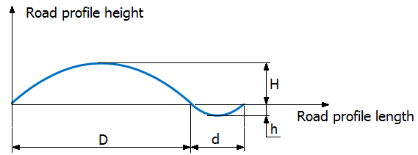
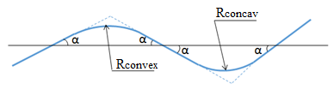
Annex 1 : Macrostructure road profile
Road profile speed [Km/h] | α [ ° ] | Rconvex [m] | Rconcav [m]
25 | 8 | 500 | 300
30 | 7,5 | 800 | 500
40 | 7 | 1000 | 1000
50 | 7 | 1300 | 1000
60 | 6,5 | 1600 | 1500
80 | 6 | 4500 | 2200
100 | 5 | 10000 | 3000
120 | 5 | 18000 | 6500
Road profile speed [Km/h] | H [m] | h [m] | D [m] | d [m]
25 | 1.6 | 0.9 | 80 | 48
30 | 2.2 | 1.4 | 120 | 75
40 | 2.4 | 2.4 | 140 | 140
50 | 3.1 | 2.4 | 181 | 140
60 | 3.3 | 3.2 | 207 | 196
80 | 8.1 | 3.9 | 538 | 224
100 | 7.1 | 2.1 | 748 | 263
120 | 12.2 | 4.5 | 1330 | 480
Veronel-George JACOTA ︳ 01.09.2015

Slide 16
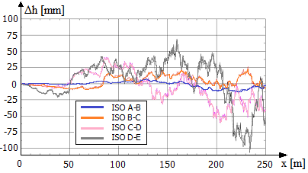
Annex 2 : Microstructure road profile
Veronel-George JACOTA ︳ 01.09.2015

Slide 17
Annex 3 : the car parameters
Veronel-George JACOTA ︳ 01.09.2015

Slide 18
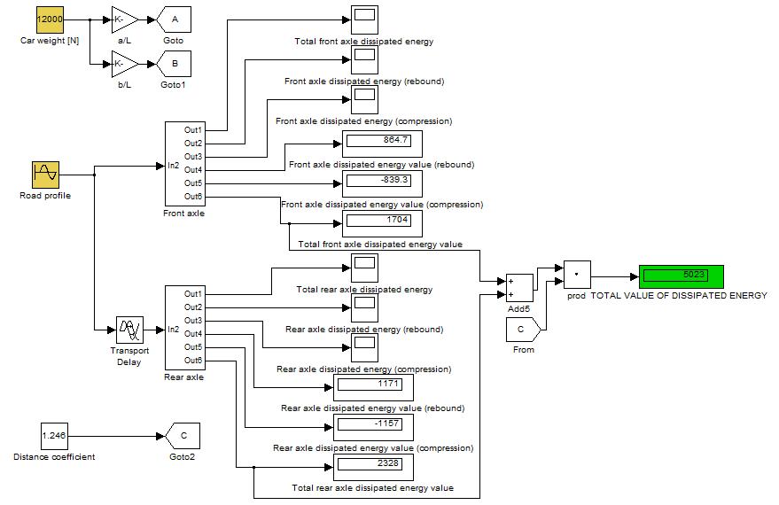
Annex 4 : Simulink model
Veronel-George JACOTA ︳ 01.09.2015

Slide 19
Annex 5 : the dissipated energy value [J]
 | ISO A-B | ISO B-C | ISO C-D | ISO D-E
25 Km/h | 8877 | 8011 | 8444 | 8852
30 Km/h | 8610 | 8491 | 9920 | 9905
40 Km/h | 6567 | 6151 | 8198 | 8519
50 Km/h | 6525 | 6322 | 7956 | 7905
60 Km/h | 5914 | 5954 | 6755 | 8125
80 Km/h | 5351 | 5341 | 6290 | 6771
100 Km/h | 4222 | 3792 | - | -
120 Km/h | 3062 | - | - | -
 | ISO A-B | ISO B-C | ISO C-D | ISO D-E
25 Km/h | 13930 | 12380 | 14760 | 13650
30 Km/h | 13000 | 12730 | 15000 | 15490
40 Km/h | 9328 | 9577 | 12240 | 12880
50 Km/h | 9363 | 9482 | 11960 | 11670
60 Km/h | 8502 | 8339 | 9830 | 11300
80 Km/h | 7592 | 7323 | 8855 | 9553
100 Km/h | 5735 | 5449 | - | -
120 Km/h | 4297 | - | - | -
The dampers dissipated energy, corresponding to unladed car weight
The dampers dissipated energy, corresponding to total car weight
Veronel-George JACOTA ︳ 01.09.2015

