Slide 1


Overview of emerging and detection of arboviral disease in South Africa.
Msimang V.¹, Jansen van Vuren P. ¹, Weyer J. ¹, Le Roux C. ¹, Kemp, A. ¹, Paweska J.T. ¹
¹Centre for Emerging and Zoonotic Diseases,
National Institute for Communicable Diseases/NICD, Republic of South Africa (RSA)
3rd International Conference on Epidemiology & Public Health, 4-6 August 2015, Valencia

Slide 2
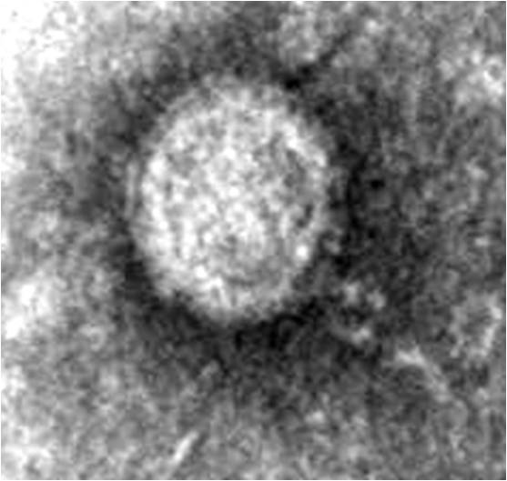
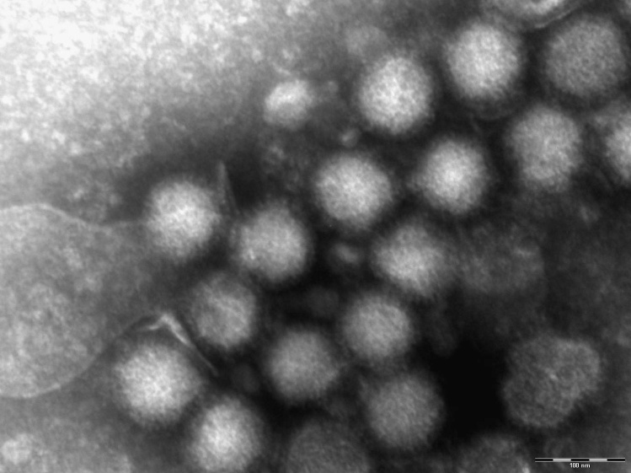
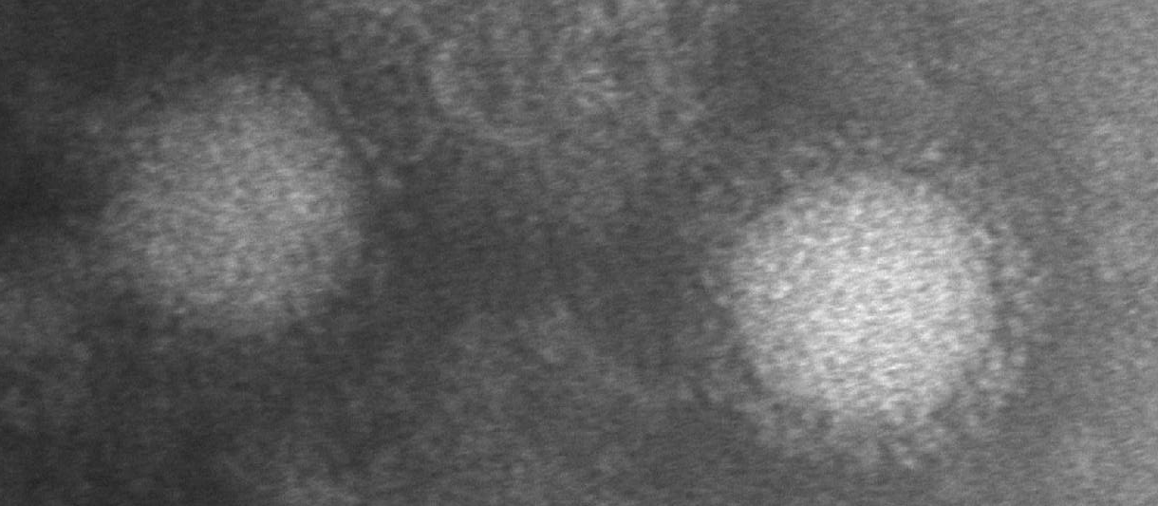
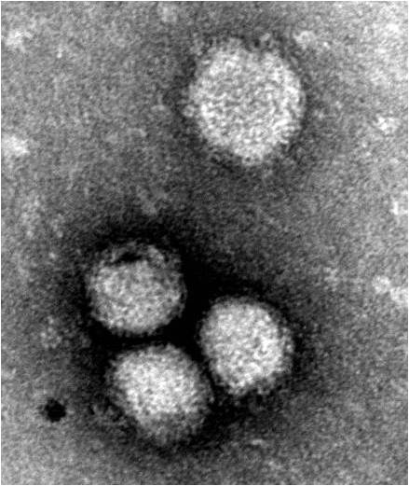
Arbovirus infections endemic to South Africa
Rift Valley fever (Phlebovirus)
West Nile fever (Flavivirus)
Chikungunya fever (Alphavirus)
Sindbis fever (Alphavirus)
Wesselbron disease (Flavivirus)
(Courtesy: Dr Monica Birkhead, NICD)
Notes:
534 arboviruses

Slide 3
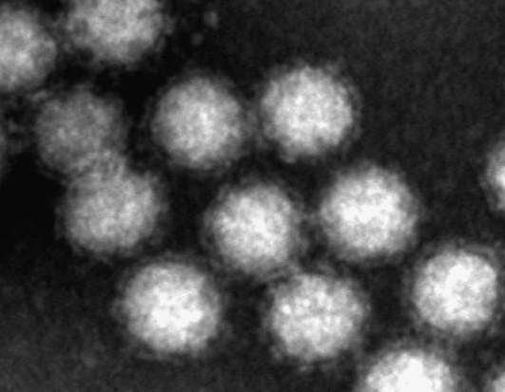
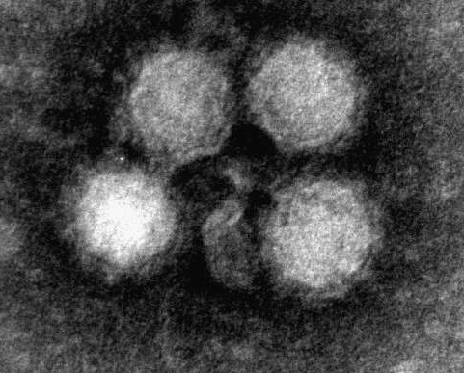
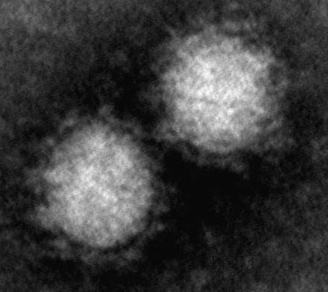
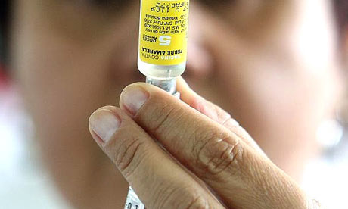
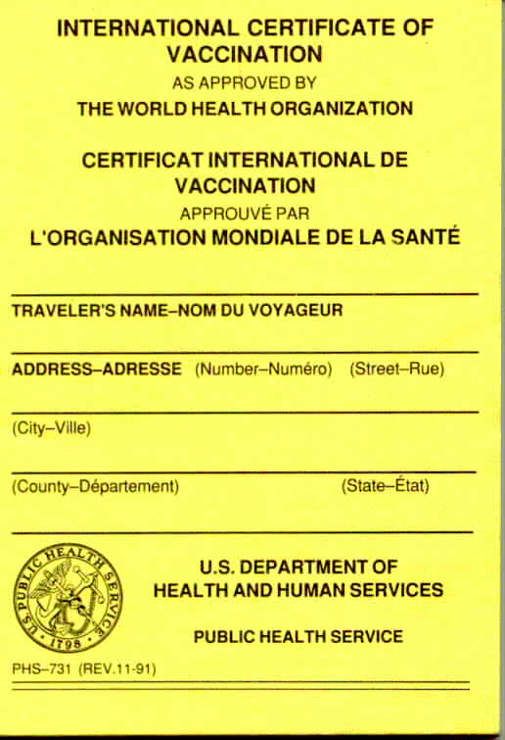
Imported arboviral infectious diseases to South Africa
Dengue (Flavivirus)
Chikungunya (Alphavirus)
No human yellow fever cases have ever been recorded in South Africa
Yellow fever (Flavivirus)
(Courtesy: Dr Monica Birkhead, NICD)
Notes:
Japanese encephalitis

Slide 4
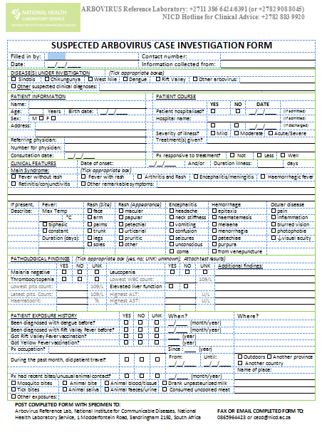
Diagnosis of arboviral disease
Integrated approach for diagnosis
Arbovirus infections are most often mild, febrile illness not unlike enterovirus, influenza and herpes infection
Encephalitis, Haemorrhagic fever, polyarthritis
Case histories: travel and exposure histories, dates
Travel, exposure
to arthropods
(mosquitoes, ticks,
biting flies, midges, tabanids, ...
Clinical manifestation,
pathology testing
Diagnostic testing
Flavivirus crossreaction

Slide 5
Laboratory Investigations
Routine blood screens / scans not very informative
Specialized laboratory testing only provided in selected reference laboratories
Specimens
Blood, serum for acute and sero-converted cases
CSF for acute neurological cases
Liver, CSF, brain for post mortem cases
Arbovirus case
Confirmed
Case found positive for acute infection by polymerase chain reaction (PCR)
Fourfold IgG titre increase of long-lived antibodies (IgG) between convalescent specimens (10-14 d apart) by Enzyme-linked immunosorbant assay (ELISA)
Highly suggestive
Case found positive for short-lived antibodies (IgM) (90% recent infection)
Persistence of arbovirus virus-specific IgM responses
Flaviviruses: variable up to 3 years
Alphaviruses: variable up to 2.5 years
Rift Valley virus (Bunyavirus): 4-6 weeks
Notes:
Genus wide antigen cross reactions
Extend of cross reaction dependant on reagents used for the serological testing; specific
5

Slide 6
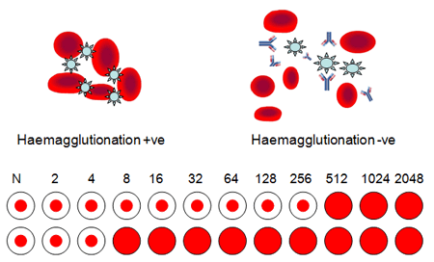
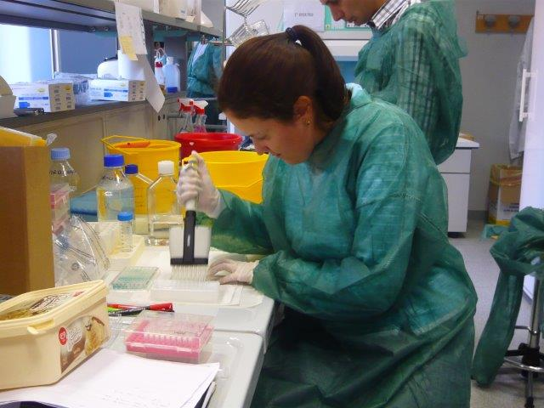
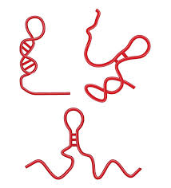
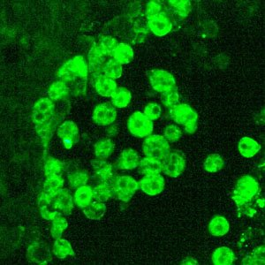
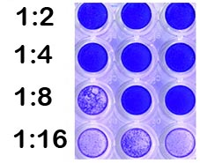
Laboratory Investigations
Routine blood screens / scans not very informative
Specialized laboratory testing only provided in selected reference laboratories
HAI Haemagglutination Inhibition assay
Chantel le Roux performing ELISA (24-48h)
PCR Polymerase chain reaction
Virus isolation
Virus Neutralizing Antibody Assays
Indirect immunofluorescence tests
Notes:
Genus wide antigen cross reactions
Extend of cross reaction dependant on reagents used for the serological testing; specific
6

Slide 7
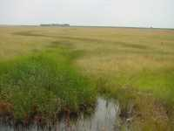
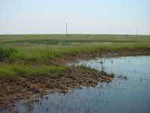
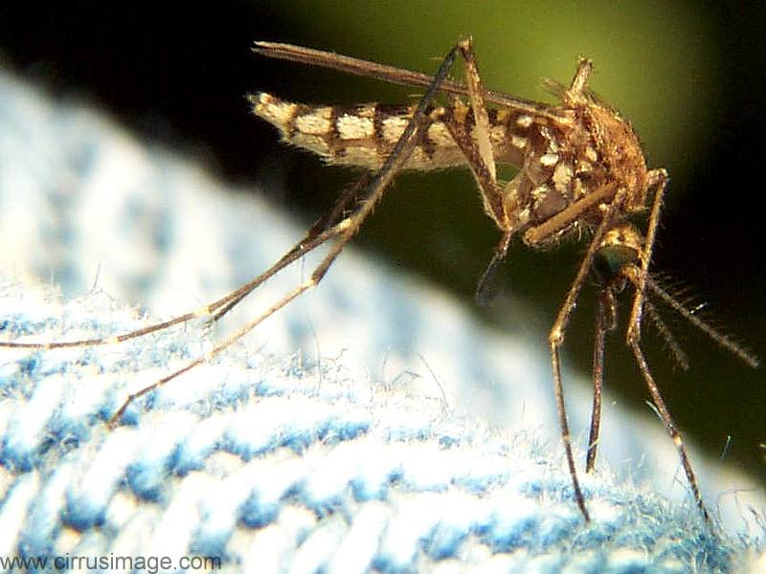
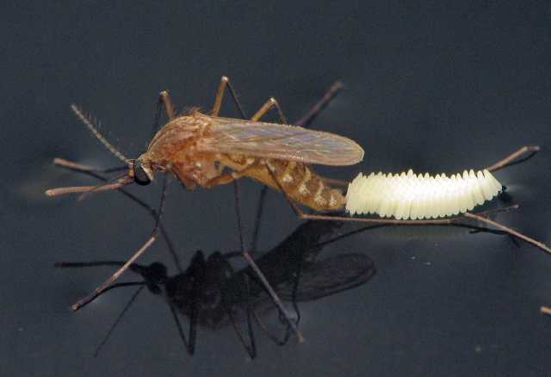
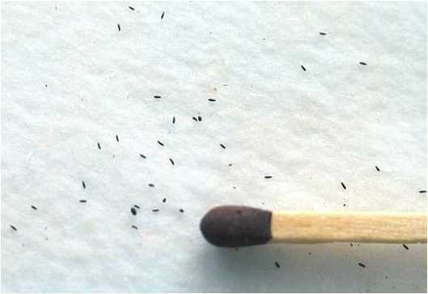
Proliferation of mosquitoes near water
Rift Valley fever virus mosquitoes
Flood water - Aedes
Culex
Notes:
Many of you are probably aware of Rift Valley fever virus, which is present in buffalo and other wildlife, as well as mosquitoes in the Park. It is carried by mosquitoes that lay their eggs on the wet ground rather than the surface of the water after rains. We refer to these mosquitoes as “floodwater” Aedes. Eggs hatch when dried out (4 days, 1 year). Culex eggs do not need to dry out for hatching (development is few weeks, within season) They also occur in vleis and floodplain pools when rivers subside and leave behind catchments of water. What makes them special is that they can carry the Rift Valley fever arbovirus in the eggs, the larvae and the pupae, so that when the pupa becomes an adult mosquito, it can transmit the arbovirus to an animal.
If the pools are big and the water stands for a few weeks or months, like in a dam, certain Culex mosquitoes will lay their egg rafts. Any sick animals will infect more mosquitoes with Rift Valley fever virus, causing the virus to spread to other animals.

Slide 8
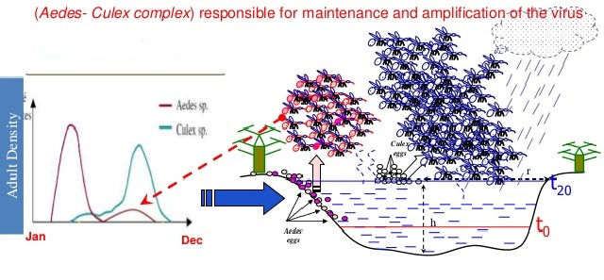
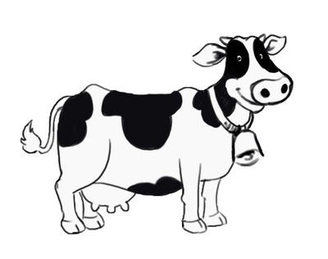
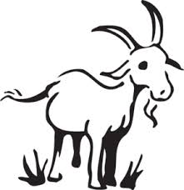
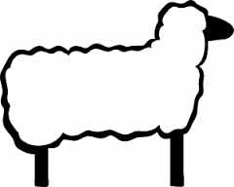
Amplification of virus in animals via Culex mosquitoes
Infection of animals via feeding mosquitoes
Risk of infection
for people
increases

Slide 9
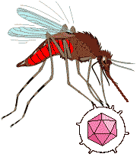

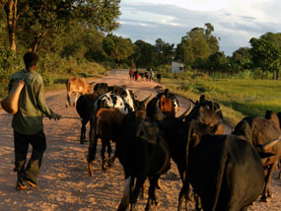
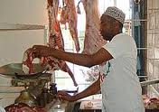
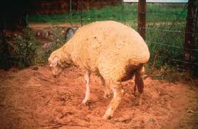
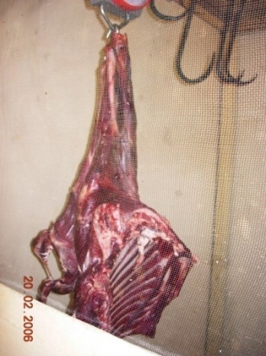
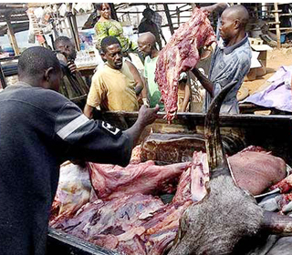
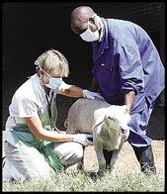
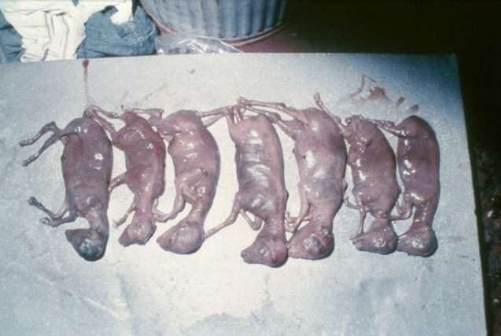
Rift Valley Fever Virus at risk populations
and clinical manifestation
Humans
Animals
Sudden onset of abortion storms
Mortality in young animals
Haemorrhages
Credit: PROF. COETZER, UP
Credit: Tilahun Yilma/UC Davis
Fever, often accompanied by headaches, muscle pains and nausea
Light sensitivity, watery eyes, early signs of retinal detachment,
which could lead to partial blindness
Haemorrhagic fever, encephalitis and necrotic hepatitis
Notes:
The vast majority of human infections result from direct or indirect contact with the blood or organs of infected animals. Such contact may occur during the care or slaughtering of infected animals or possibly from the ingestion of raw milk. Human infection can also result from the bites of infected mosquitoes.
· Sudden onset of abortion storms
Up to 100 percent mortality in lambs under five to six days old
· High fever, lymphadenitis, nasal and ocular discharges in mature animals
· Profuse fetid diarrhoea (often haemorrhagic)
· Vomiting, abdominal colic
· Severe prostration, dysgalactia, jaundice
Abortion storms and mortality in young animals are considered to be the most common symptoms of RVF. Haemorrhages can sometimes be seen under the skin and in the mucous membranes of the eyes, mouth and vulva and, in the latest cases in South Africa, calves showed a bloody diarrhoea. Blood clotting also appeared to be impaired in dairy cows.
· Epizootic period of 8-16 weeks
Within three to seven days after contact with an infected animal, patients showed fever, often accompanied by headaches, muscle pains and nausea. Light sensitivity and watery eyes were described as an early sign of retinal detachment, which could lead to partial blindness. Severe cases showed blood in the stool, vomit or sputum or unexplained bleeding from the gums, nose or eyes (haemorrhagic fever). In Egypt and South Africa, hemorrhagic fever, encephalitis and necrotic hepatitis .
9

Slide 10
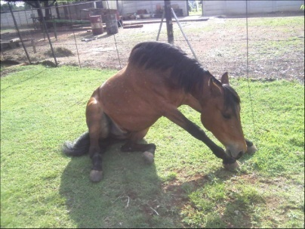
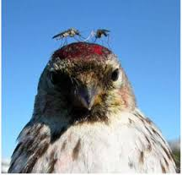
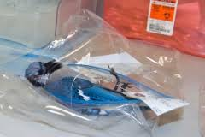

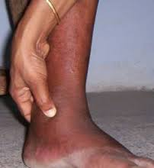
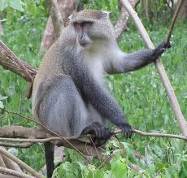
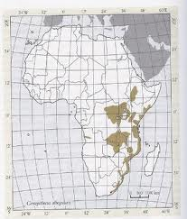
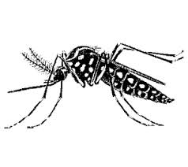
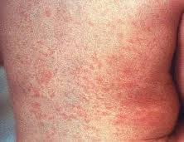
Endemic West Nile, Sindbis and chikungunya
West Nile
Sindbis
Widespread in South Africa
Horse ill
with West Nile virus
Culex mosquitoes
severe arthritis
chikungunya
North-Eastern South Africa
Aedes mosquitoes
rash
Notes:
Humans are usually incidental hosts for infection but there are exceptions for certain arboviruses i.e chikungunya and dengue

Slide 11
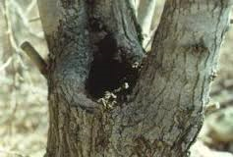
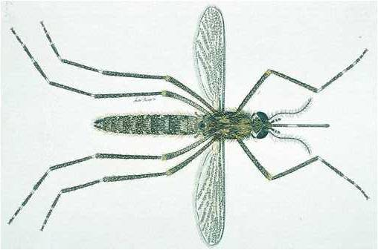
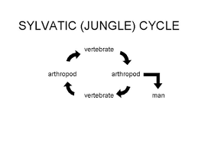
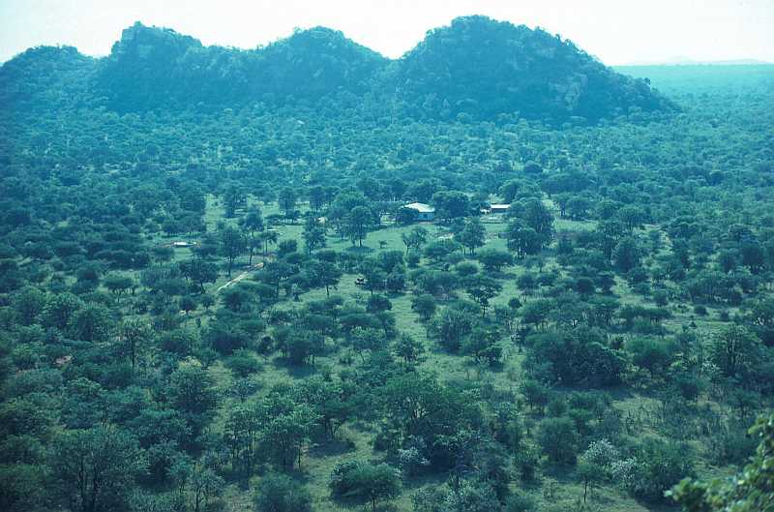
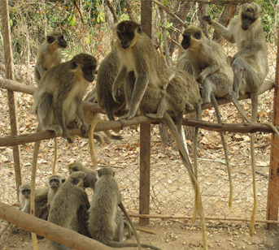
Sylvatic environment and vectors of
Dengue and chikungunya virus
Tree hole breeding spot
Aedes furcifer
Tropical forest
SSenegal-green monkeys

Slide 12
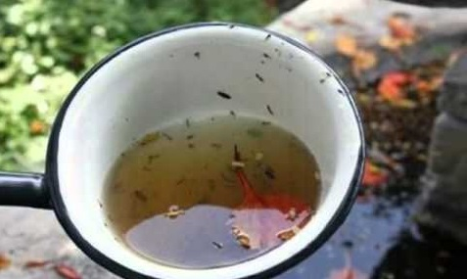
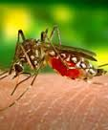
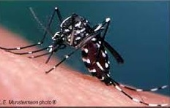
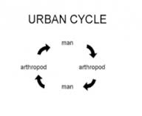
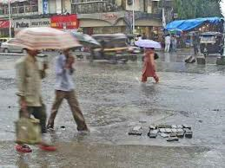


Urban environment and vectors of
Dengue and chikungunya virus
Aedes (stegomyia) Aegypti
Aedes (stegomyia) Albopictus
Monsoon season
Tyres breeding spot

Slide 13

Rift Valley Fever Virus
Alicia I Rolin et Al. , http://www.nature.com/emi/journal/v2/n12/pdf/emi201381a.pdf
Occurs in periodic outbreaks with long intervals of 7-15 years
1950
1955
1969
1974
1981
1996
1999
2007
2010
2014-2019
8 years
4 years
14 years
7 years
RVF
1953
1959
1971
1976
2008
2011

Slide 14


RVF Outbreaks followed period of above normal rainfall

Slide 15





Large pan in the Northern Cape
Notes:
15
Q: Why RVF-re-emerged?
The re-emergence of RVF in South Africa may be explained by climate factors during the period. Outbreaks are often recorded after an extended period of draught followed by heavy rainfall.
The infected eggs of the mosquito can survive for many years of draught and desiccation.
During periods of increased rainfall, low lying areas are flooded – allowing for the re-emergence of the vectors carrying the virus.
These go onto to infect livestock within the area.

Slide 16






RVF epidemic 2010-2011: human cases
2008
2009
2010
2011
Maps created by V. Msimang
Notes:
Cases are those reported in domestic livestock only

Slide 17

RVF epidemic 2010-2011
In 2010 all deaths were among 244 persons infected with lineage H virus,
while no deaths were recorded in areas where lineage C virus was active, only 22 cases were diagnosed
(NICD, unpub. Data, .
Grobbelaar, A.A., et al., Molecular epidemiology of Rift Valley fever virus. Emerg Infect Dis, 2011. 17(12): p. 2270-6.
Map created by V. Msimang

Slide 18








Kruger National park survey of Arboviral exposure
1. Information sessions
3. Blood sampling
2. Data collection

Slide 19
Arbovirus results considerations
TOTAL N=200 | Past exposure Long-term antibodies | Recent exposure Short-term antibodies | Symptoms | RICK | Q F
SINDBIS VIRUS | 8 | 5 | Fever headache tiredness | X | Y
 |  |  | Sore eyes | X | X
 |  |  | Unknown | Y | -
 |  |  | Tick bite fever malaria | Y | X
 |  |  | Rash | Y | Y
CHIKUNGUNYA VIRUS | 1 | 0
WEST NILE VIRUS | 11 | 2** | Fever sore joints, sore eyes neck stiffness blurred vision | X | X
 |  |  | Unknown | X | Y
RIFT VALLEY FEVER | 1 | 0
TOTAL | 21 | 7
* High titre ≥ 1:320
Serological cross reaction
Persistence of virus-specific IgM responses:
Alphas: variable up to 2.5 years
Flavis: variable up to 3 years
RVF (Bunyavirus): 4-6 weeks
Males between 27-62 years old
2 southern, 5 central region
5 general workers, 1 rangers, 1 scientist

Slide 20






Rift Valley Fever Virus IEP Project
People
Climate
Mosquitoes
Testing for RVF virus
and antibodies
Wild antelope
Game farms
Free-ranging
Domestic ruminants

Slide 21




Rift Valley Fever Virus IEP Project
Pilot farmers surveillance 10-17 May 2015
Notes:
Tablets instead of paper-based questionnaires (advantages): faster, easier, in English, in Afrikaans, in Sesotho (in making), when worker illiterate can still complete with assistance; first time introduction of electronic questionnaire (tablets)
Interviewing of farmers both commercial or subsistence

Slide 22
Arboviral infectious outbreaks in South Africa
 | Year/s | Area | Animal cases* | Human cases
RVF | 1950-51, 1952-53, 1955-59 | Western FS, sthn Gauteng, NW, Limpopo; Zimbabwe; Namibia | 600 000+ | numerous
 | 1968-69 | Southeastern Zimbabwe; KZN coastal plain, Mozambique | widespread, large numbers | unknown
 | 1969-71**, 1973-76, 1978** | RSA; Namibia; Zimbabwe; Zambia | 140 000+**; widespread, catastrophic | Numerous, some deaths
 | 1981 | Mtubatuba | Localised, many cattle | unknown
 | 1990-91, 1999 | Madagascar; KNP | Extensive; localised*** | Some, 1 death; suspected***
CHIK | 1962; 1956, 1964 | Southeastern Zimbabwe; Phalaborwa, Ndumo | Widespread, large nos.; | 38+; some
 |  |  | localised, small nos.
 | 1975-76 | Mica/Phalaborwa region | Localised, 76+ | 57+
SIN/WN | 1962-63 | Sthn Gauteng, nthn Free State | widespread | 14/2+5?
WN/SIN | 1974 | Karoo | widespread | 18 000+/4000+****
SIN | 1983-84 | Witwatersrand/Pretoria/Bela Bela | widespread | 100s
DEN | 1926/1927 | Coastal KZN (Stanger to Durban) | unknown | 40 000+
Data compiled by Alan Kemp

Slide 23


Sindbis and West Nile virus prevalence
Storm N, Weyer J, Markotter W, Kemp A, Leman P A, Dermaux-Msimang V, Nel L H, Paweska J T (2014). Human cases of sindbis fever in south Africa, 2006-2010.
Epidemiol Infect. 2014 Feb; 142(2):234-8.

Slide 24

Severe West Nile CNS case
West Nile clinical manifestation
Fatal case 2014
A 38-year-old man from Nelspuit, Mpumalanga presented late July 2014 with fever and neurological disturbances.
Rabies was considered as a potential diagnosis for this patient given the exposure history and his encephalitic presentation.
Ultimately a history of travel to Escourt, KwaZulu Natal came to light were the patient had contact with horses.
Based on the history and the clinical presentation of encephalitis, arboviral disease was suggested as a diagnosis.
Blood specimens collected over the course of the patient’s illness were tested for anti-West Nile fever antibodies and
Seroconversion was indicated in testing of the serial specimens. RT-PCR analysis on the earliest collected blood and
Cerebrospinal fluid specimens were however negative for West Nile.
The patient progressively deteriorated and required intubation and ventilation. The patient died about three weeks after onset of illness.

Slide 25


Dengue is on the rise globally
Expansion
Increase
Source: WHO. Emergencies preparedness, response Pandemic and Epidemic Diseases Dengue/dengue haemorrhagic fever

Slide 26
South Africa is connected to the world.....
DENV-endemic countries interconnectivity with South Africa
Important airport in Africa
Recent research estimates the burden of dengue infection in Africa to be similar to that of the America’s
Bhatt S, Gething P, Brady O et al. The global distribution and burden of dengue, Nature; 2013; 25 April; 496(7446):504-507

Slide 27
Testing and confirmation of imported dengue cases in South Africa increases

Slide 28
DENV-cases in returned to non-endemic SA travellers per DENV-endemic country of travel
*Returning travellers from Angola to SA; total estimated cases linked to Angola outbreak confirmed in NICD n=19
2013: Viraemia confirmed by PCR after return to SA in travellers n=5 (out of 13 tested)

Slide 29




CCHF virus transmission
Tick life and enzootic cycle
Transmission to humans
Hyalomma rufipes marginatum = 2 hosts-tick cycle
(larva molts to nymph while attached to first host (bird or small mammal)
Example of 3 hosts-tick cycle
Hyalomma rufipes marginatum
Notes:
Transmission to humans is zoonotic through bite or crushing of infected ticks or direct contact with the blood or tissues of livestock
with short-period high-level viraemia. The virus can also be transmitted from one human to another resulting from close contact with
infectious blood or bodily fluids.

Slide 30

Human exposure routes in South Africa
60 to 75% tick-related
V. Msimang
Notes:
Two foci of nosocomial spread were reported , recorded in the Orange Free State in 1984 (5 cases, 1 fatal) and at a hospital near Cape Town, Western Cape (8 cases, two fatal), and only one recorded outbreak occurred in 1996 (17 cases, 1 fatal) at an ostrich abattoir in Oudtshoorn, Western Cape[8, 9, 27] and sporadic cases thereafter at an average of 7 cases almost every year.

Slide 31




Differential diagnosis: What is Malaria
Serious, sometimes fatal disease caused by a parasite spread by mosquitoes
.
Anopheles
Parasite in blood as seen under microscope
Malaria test for ill patient
Plasmodium Falciparum
Notes:
500 million cases of malaria per year, plasmodium falciparum(most malaria cases in Africa)
At least 2 million malaria deaths per year
> 90% of deaths in Africa
South Africa
Malaria, no.1 factor of death amongst the children under the age of 5

Slide 32
Acknowledgements
NICD-Centre for Emerging and Zoonotic Diseases, Arbovirus reference laboratory personnel
NICD medical and epidemiology staff ensuring preparedness and follow up of suspected cases in South Africa
National Department of Health of South Africa, Defence and Threat Reduction Agency, Polio Research Foundation

