Slide 1
Quantification of conditional differentiation by Life Table Response Experiments: a study case with Kelp temperature regimes.
Vasco M. N. C. S. Vieira¹, Luz Valeria Oppliger and Aschwin H. Engelen
¹MARETEC, Instituto Superior Técnico, Universidade Técnica de Lisboa,
Av. Rovisco Pais, 1049-001, Lisboa, Portugal.

Slide 2
LTRE with Kelp temperature regime
x₁
coexistence
extinction
A
C
D
B
x₂
Species cannot overlap their resource exploitation beyond a limit where one is eliminated
Coexistence requires the partition of ecological niches (how?)

Slide 3
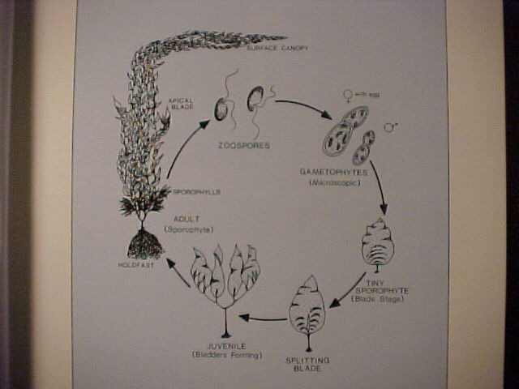
LTRE with Kelp temperature regime
Heteromorphic biphasic life cycles of Kelp:
stages:
macroscopic diploids
microscopic haploid males
microscopic haploid females
vital rates:
survival
growth
Breakage
fertility
Overall fitness results from the holistic integration of the fitness specific to each life-cycle component.
conditional differentiation = species differentiate their vital rates response to the environment => differentiate their fitness => partition of ecological niches.

Slide 4
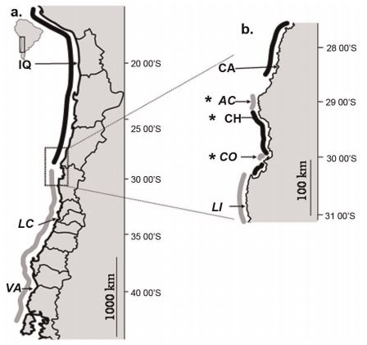
LTRE with Kelp temperature regime
The geographic distribution of Lessonia nigrescens:
Former L. nigrescens with 2 cryptic species:
northern
southern
Now :
northern L. berteroana
southern L. spicata
the species partition their niches by conditionally differentiating their haploid microstages response to temperature
Hypothesis:

Slide 5
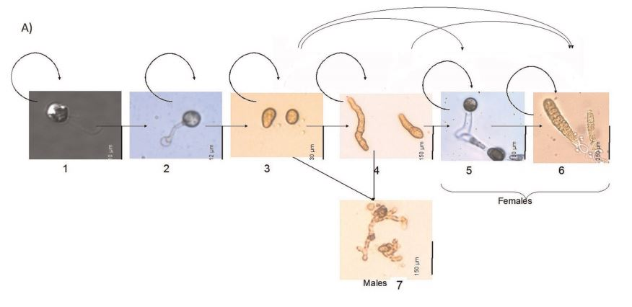
LTRE with Kelp temperature regime
The haploid microstages of Lessonia nigrescens:
Spores
(2) Germinated spores
(3) Gametophytes 1-2 cells
(4) Gametophytes >2 cells
(5) Mature females
(6) Fertilized females
(7) Males

Slide 6
LTRE with Kelp temperature regime
The haploid microstages of Lessonia nigrescens:
Spores
(2) Germinated spores
(3) Gametophytes 1-2 cells
(4) Gametophytes >2 cells
(5) Mature females
(6) Fertilized females
(7) Males
Micro-stages
S6
S6
S6
S5
S5
S5
S4
S4
S4
S3
S3
S3
S2
S2
S1
S1
day
2
5
13
17
24

Slide 7
LTRE with Kelp temperature regime
Evolutionists and ecologists wish to know:
Why in a given environment
- species A outcompetes species B
Why a given species
thrives in environment A
fails in environment B
Preliminary analysis tested vital rates, population growth rates and elasticities of growth rates to changes in the vital rates
Posterior analysis with LTRE

Slide 8
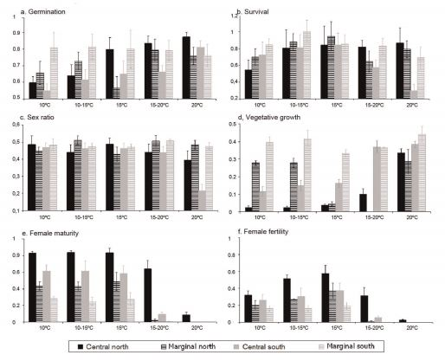
LTRE with Kelp temperature regime
The mean vital rates:
8 vital rates
8 sites
5 temperature regimes
= 320 values

Slide 9
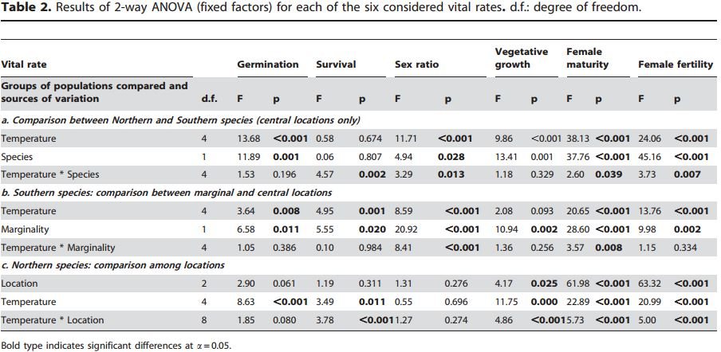
LTRE with Kelp temperature regime
The ANOVAs portraying the significant difference:
6 vital rates × 3 Comparisons = 18 ANOVAs

Slide 10
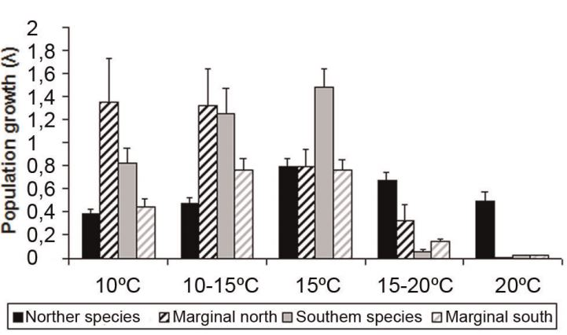
LTRE with Kelp temperature regime
The population growth rate (λ):
8 populations × 5 temperature regimes = 40 λ

Slide 11
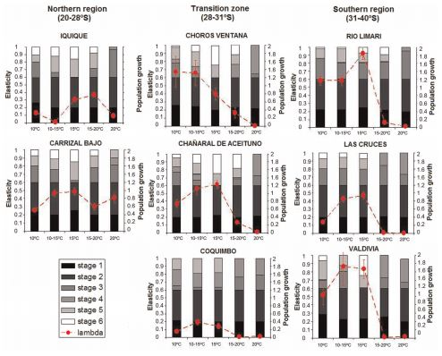
LTRE with Kelp temperature regime
The elasticities of λ to the vital rates:
8 populations
×
5 temperature regimes
×
8 vital rates
=
320 elasticities
Information overdose
False conclusions:
The 2 cryptic kelp species conditionally differentiate everything with a significant impact on fitness

Slide 12
LTRE with Kelp temperature regime
Evolutionists and ecologists wish to know:
Why in a given environment
- species A outcompetes species B
Why a given species
thrives in environment A
fails in environment B
Requires 2 demographic/life-cycle models with common structure (stages and vital rates, as presented earlier), diverging only in the values these assume.
Tested by decomposing the demographic model in a Taylor Expansion

Slide 13
LTRE with Kelp temperature regime
The demographic model common to A and B:
- The vital rates (x₁, x₂, …, x_{i}) interact to yield the population growth rate λ=f(x₁, x₂, … x_{i})
- Vital rates, interactions and λ different between A and B
Species (environment) A
Species (environment) B
Difference B - A

Slide 14
LTRE with Kelp temperature regime
The Taylor Expansion (series) of the demographic model :
Model sensitivity to changes
Model sensitivity to covariances
Refference state
Observed changes
Observed covariances
General expression:
n = until all interactions are accounted for

Slide 15
LTRE with Kelp temperature regime
The Life Table Response Experiment:
Model sensitivity to changes
Model sensitivity to covariances
Refference state
Observed changes
Observed covariances
General expression:

Slide 16
LTRE with Kelp temperature regime
Lessonia berteroana @ Valdivia
(southern most)
–
Lessonia spicata
@ Iquique
(northern most)
Incubated 10ºC

Slide 17
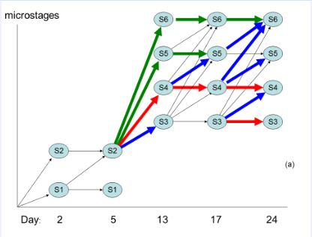
LTRE with Kelp temperature regime
p^{th} population
(demography)
–
Average population
(demography)
@ 10ºC
@ 15ºC
@ 20ºC

Slide 18
LTRE with Kelp temperature regime
p^{th} population
(demography)
–
Average population
(demography)

Slide 19
LTRE with Kelp temperature regime
True conclusions:
L. Berteroana and L. spicata conditionally differentiate the maturation and fertilization of females relatively to temperature
Everything else is irrelevant

Slide 20
LTRE with Kelp temperature regime
The end
This work was funded by
ERDF Funds of the Competitiveness Factors Operational Programme – COMPETE
and
national funds of the FCT - Foundation for Science and Technology
under the project UID/EEA/50009/2013

