Slide 1
New Developments in Neuraxial Anesthesia
Vanny Le, MD
Assistant Professor
Anesthesiology and Pain Management
Department of Anesthesiology
Rutgers – New Jersey Medical School

Slide 2
Disclosures
No conflicts of interest or financial disclosures

Slide 3
New Developments in Neuraxial Anesthesia
Benefits of neuraxial anesthesia in surgical procedures
Sedation techniques
New anticoagulation guidelines
Multiport vs. single port catheters

Slide 4
Systematic review of 141 trials, 9559 patients
Overall mortality after 30 days was 1/3 less in neuraxial group
Decreased pulmonary embolisms, cardiac events, strokes, deaths from infection, and deaths from other causes

Slide 5
Neuraxial blockade reduced risk of PE/DVT by almost half
1/3 fewer cardiac events
Decreased bleeding with decreased transfusions in NB

Slide 6
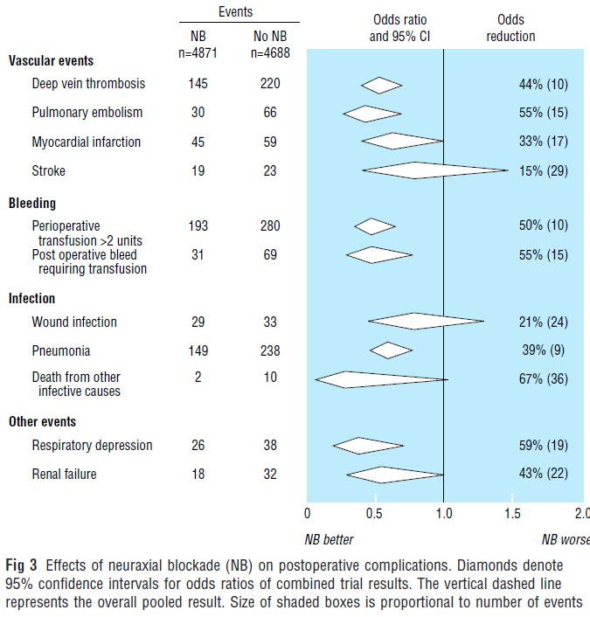
Notes:
Highlight decreased pneumonia and respiratory depression.
Major surgery induces a stress response that is altered by neuraxial blockade and not by general anesthesia.
These benefits are due to the use of neuraxial blockade rather than avoidance of GA.
The mechanisms may be due to altered coagulation, increased blood flow, improved ability to breathe without pain, and reduction in surgical stress responses.

Slide 7
↓ DVT 44%/↓ PE 55%
↓ Transfusion requirements 50%
↓ Pneumonia 39%/↓ Respiratory depression 59%
Reduced incidence of postop ileus
Reduced time to extubation and ICU stay
Decreased perioperative coagulability
Attenuation of stress response in CAGB surgery
Notes:
Decreased coagulability leads to lower incidences of vascular graft occlusion, reoperation for inadequate tissue perfusion, and few thromboembolic complications
Link between inflammation and coagulation

Slide 8
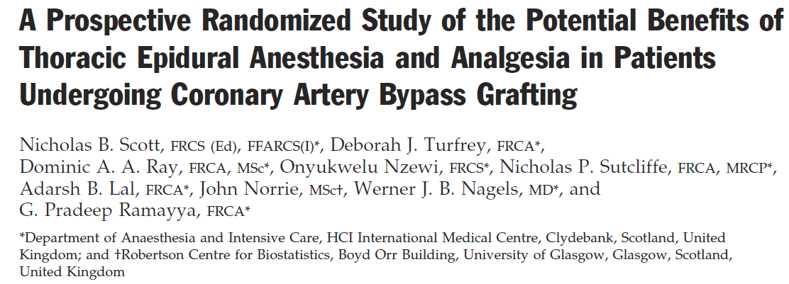
420 patients undergoing routine CABG
TEA 0.125% bupivacaine/0.6 µg/mL clonidine vs. alfentanil infusion/morphine PCA
Postop complications data collected for 5 days
Pulmonary complications, arrhythmias, MI, renal failure, CVA, acute confusion, bleeding

Slide 9
Notes:
Decreased incidence of lower respiratory tract infections 15.3% vs. 29.2%
Less incidences of supraventricular arrhythmias requiring treatment. No difference in bradycardia, ventricular arrhythmias, conduction defects or MIs.
Significant reduction in ARF and acute postoperative confusion.

Slide 10
50% reduction in lower respiratory tract infections
30% increase in lung volumes
Faster extubation within first 4 hours
Quicker transfer from ICU to step down unit

Slide 11
Stress Response to Surgery
Modulation by CNS
Release of cytokines
Oxygen free radical production
Influx of neutrophils
Release of prostanoids
Pain
Anxiety
Hypothermia
Hyperthermia
Normal Wound Healing
Fatigue
SIRS
Sepsis
Multi-Organ Failure
Catecholamines
Glucagon
Cortisol
ACTH
Local Wound
Endocrine Response
Systemic Inflammation
Increased Metabolic Rate
Increased Oxygen Consumption
Systemic Response
Increased Temperature
Protein Catabolism, Loss Lean Body Mass
Blood Flow Maldistribution Leading to Ischemia

Slide 12
Hysterectomy patients receiving lumbar epidurals
Preemptive analgesia (PA) epidural doses with continuation of PCEA vs. postop PCEA alone
Decreased pain scores in PA + PCEA group
Decreased postop cytokine production in PA + PCEA group

Slide 13
Intraoperative use of thoracic epidural (TEA-I) vs. postop thoracic epidural (TEA-P) alone
Stress response and immune response
Decreased epinephrine and cortisol in TEA-I
Decreased cytokine production, circulating NK cells

Slide 14
Analyzed data from 9 systemic reviews
Decreased 30 day mortality in intermediate-to-high risk surgery
Decreased risk of pneumonia
No difference in risk of MI
No difference when neuraxial anesthesia was combined with GA
Anesth Analg 2014; 119: 716-25

Slide 15
Conflicting evidence with inconclusive or flawed data
No definite reduction in cardiovascular complications in general or cardiac surgery
No reduction in postop pulmonary complications in general surgery
Statistical but not clinical significance decrease in pain scores with epidural analgesia
Anesth Analg 2014; 119: 740-44
Notes:
Effects on cardiac complications are minimal and limited to a subpopulation of high risk patients and procedures
Again, benefits of epidural anesthesia for reduction in pulmonary complications is seen in high-risk intra-thoracic procedures and patients
Regional anesthesia with peripheral blocks was found to be comparable to neuraxial anesthesia
Argued against epidural anesthesia as being a necessary part of ERAS (Enhanced Recovery After Surgery) programs
Debatable whether epidural anesthesia reduces cancer recurrence

Slide 16
Is Neuraxial Anesthesia Better or Not?
Anesth Analg 2014; 119: 501-2
Notes:
Identical data is open to interpretation, i.e. difference in definitions
Results depend on neuraxial techniques used for anesthesia or analgesia
Small sample sizes produces low incidences of complications
Trends toward better outcome even without statistical significance
Neuraxial anesthesia rarely is worse than GA

Slide 17
Sedation Techniques
Reassurance
Midazolam
Fentanyl
Propofol
Ketamine
Remifentanil
Dexmedetomidine

Slide 18
Dexmedetomidine
Potent, highly-selective α-2 agonist
Sedative, anxiolytic and analgesic effects
Does not cause respiratory depression
T ½ α = 6 minutes (distribution half life)
T ½ β = 2 hours (elimination half life)
Side effects: hypotension and bradycardia
Curr Opin Anaesthesiol 2008, 21:457-461
Notes:
T ½ α = 6 minutes (distribution half life)
T ½ β = 2 hours (elimination half life)

Slide 19
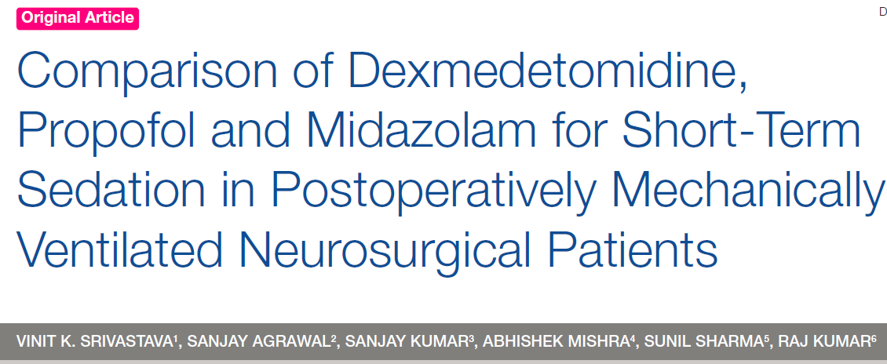
Dex group had lower HR
Extubation time was slightly lower in Propofol (26.13 ± 5 min) vs. Dex (35.28 ± 5.92 min)
Less fentanyl requirement with Dex
Dex pts were easily arousable and cooperative

Slide 20
K. Candiotti, S. Bergese, P. Bokesch, M. Feldman, W. Wisemandle, A. Bekker
Dex (1 µg/kg or 0.5 µg/kg load then 0.6 µg/kg/h) vs. placebo with midazolam/fentanyl rescue
Wide range of MAC cases – orthopedic, ophthalmic, plastic, vascular stents, breast biopsies, hernias, AV fistulas, excision of lesions
All patients in placebo group required rescue except for cataract surgery
Significantly more respiratory depression in placebo group
Increased patient satisfaction in dex group

Slide 21
Neuraxial Anesthesia and Anticoagulation
Changes from ASRA 2010 Guidelines

Slide 22
ASRA 2010 Guidelines Review
 | Needle/Catheter Insertion |  | Catheter Removal/Restart Med
 | Prophylaxis | Therapeutic | Prophylaxis | Therapeutic
Heparin (UFH) | No contraindication (5,000U BID) Indeterminate for TID | Delay heparin 1 hour after insertion | Restart heparin 1 hour later | Remove catheter 2-4 hours after last dose Restart heparin 1 hour later
LMWH | Wait 12 hours after last dose | Wait 24 hours after last dose | Single daily dosing 1st dose 6-8 hours postop 2nd dose 24 hours Wait 4 hours to restart* | Twice daily dosing Wait 24 hours postop Remove catheter before 1st dose Wait 4 hours to restart *
*FDA Drug Safety Communication 11/6/2013

Slide 23
ASRA 2010 Guidelines Review
 | Needle /Catheter Insertion | Catheter Removal
Warfarin | Stop Warfarin 4-5 days prior Check INR | INR <1.5, remove catheter with neuro checks for 24 hours INR 1.5 – 3, remove catheter with caution and neuro checks before and after until INR is normal INR > 3, no recommendation
Ticlopidine (Ticlid®) | Stop 14 days prior
Clopidogrel (Plavix®) | Stop 7 days prior If only stopped 5-7 days, check platelets
Abciximab (Reopro®) | Stop 24-48 hours prior Check platelets
Eptifibatide (Integrilin®) Tirofiban (Aggrostat®) | Stop 4-8 hours prior Check platelets

Slide 24
ASRA 2010 Guidelines Review
 | Needle/Catheter Insertion | Catheter removal
Fondaparinux (Arixtra®) | No specific recommendations Follow clinical trial info Stop 48 hours prior | Wait 36 hours from last dose Restart medication 12 hours after removal
Plasugrel (Effient®) | Stop 7 days prior | Restart 7 hours after removal
NSAIDS | No contraindication
Herbal medications | No contraindication

Slide 25
New Anticoagulants
 | Dabigatran (Pradaxa®) | Rivaroxaban (Xarelto®) | Apixaban (Eliquis®)
Target | Factor II | Factor Xa | Factor Xa
Half-life | 14-17 hours | 5- 9 hours 9-13 hours (elderly | 10-14 hours
Peak effect | 2 hours | 2-4 hours | 2-4 hours
Regional anesthesia recommendations | Stop 48 hours Stop longer for renal impairment, age, low body weight Restart 2 hours from catheter removal | No specific recommendations for placement or wait 24 hours Do not remove catheter until 18-24 hours from last dose Restart 6 hours from catheter removal | Stop 48 hours Stop longer for renal impairment, age, low body weight

Slide 26
Current recommendations use 1-2 half-lives before neuraxial injection
Studies based on healthy subjects
Use current guidelines for high-risk patients
Consider waiting 5 half-lives for healthier low-risk patients
Restart medication 8 hours minus time to peak effect

Slide 27
Epidural Catheters
Soft-tip vs. stiff? Multiport vs. single?

Slide 28
Hogan, Quinn. Epidural Catheter Tip Position and Distribution of Injectate Evaluated by Computed Tomography. Anesthesiology 1999; 90:964-70.

Slide 30
Multiport vs. Single port Catheters
Multiport catheter
Single port catheter
3 lateral holes
Most fluid flows through proximal port
More even distribution of solution
Higher analgesia rates with low flows
Less requirement for catheter manipulation
Single-holed, open end
Less theoretical risk of multi-compartmental block
More prone to obstruction
Less likely to aspirate blood
Efficacy is equivalent with high flows
D’Angelo, R. et al. A comparison of multiport and uniport epidural catheters in laboring patients. Anesth Analg 1997; 84: 1276-9.

Slide 31
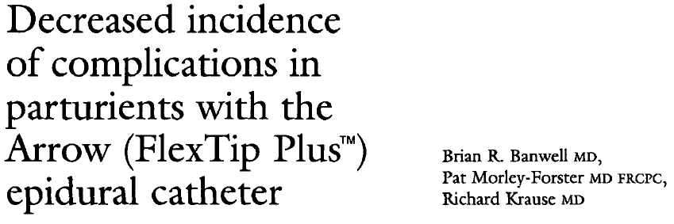
Notes:
Less intravascular cannulation
Lower incidence of paresthesias
Increased ability to advance catheter into epidural space

Slide 32
Conclusion
Neuraxial anesthesia decreases risk of
Venous thromboembolisms
Pulmonary complications
Arrhythmias
Postoperative ileus
Transfusion requirements
Pain
Stress/immune response
Dexmedetomidine is a useful alternative sedation technique
Anticoagulation updates for LMWH and new anticoagulants Pradaxa®, Xarelto®, and Eliquis®
Consider using 5 half-lives for anticoagulants
Soft-tipped multiport catheters offer advantages to stiff single port catheters

