Slide 1
Genotypic variability in colour, pungency and antioxidant activity among chilli genotypes
Dr. V. K. Rao
Indian Institute of Horticultural Research,
Bangalore, India

Slide 2
Introduction
It is a major spice crop in India and some other countries
It is used for its pungency, flavour and colour.
India – worlds largest producer, consumer and exporter of chillies
Apart from India, other major countries producing chillies are South Africa, China, Pakistan and Mexico.
It is grown in almost all parts of India under various climatic conditions.
Different types of chillies are grown to be used for different purposes.
High pungent, low pungent, high colour value ones etc.
7. India exports chillies in the form of dry chillies, dry powder, pickled chillies and chilli oleoresins.
Notes:
India is the world’s largest producer, consumer and exporter of chillies in the world. India also has
the largest area under chillies in the world. Chillies are the most common spice cultivated in India.
It is grown nearly in all parts of the country, hills and plains. Chilli production is spread throughout
the length and breadth of the country, with almost all the states producing this crop.

Slide 3
Usage
1. It is used in fresh green state, fermented state, dry red powder.
2. Other products include pickles, sauce and paste
3. Paprika color – natural red colour - colouring substance in food
industry
4. Oleoresin – For flavour and colour in food industry

Slide 5
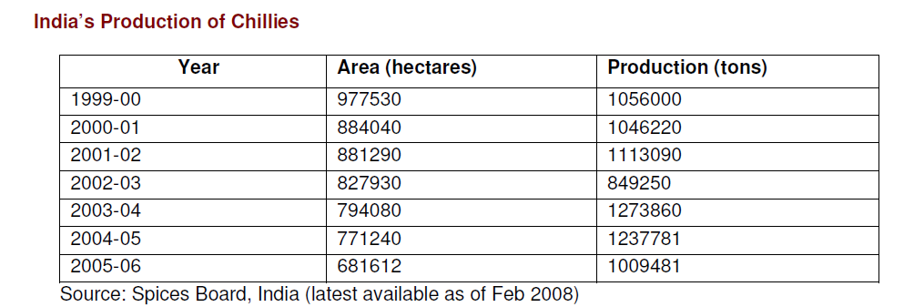

Slide 6
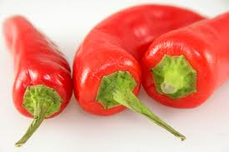
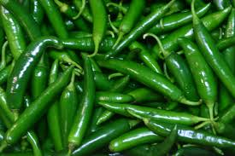
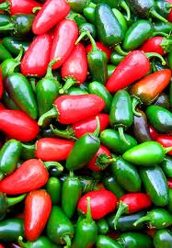
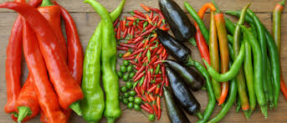
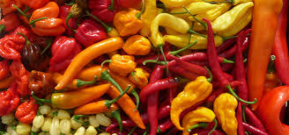
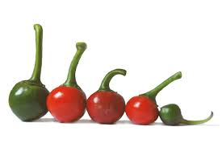
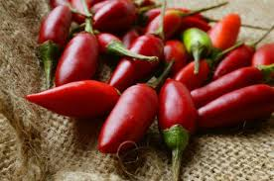
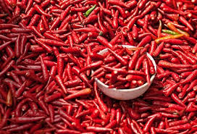
Variability in Chillies
Size, colour, shape, pungency, flavour, texture etc.
Notes:
Chili is grown in

Slide 7
Objectives
To study the extent of variability in pungency, colour, antioxidant activity, vitamin C and total phenols among hybrids / varieties developed at IIHR as well as in different varieties collected from other places.
To know the relation between pungency and other parameters in chilli hybrids / varieties.
To know the extent of contribution of each parameter towards variability through principal component analysis.
To know the extent of variability among the samples analyzed through hierarchical clustering.

Slide 8
Plant Material
1 | Arka Khyati | Hybrid
2 | Arka Meghana | Hybrid
3 | Arka Swetha | Hybrid
4 | Arka Haritha | Hybrid
5 | Arka Abhir | OP variety
6 | Arka Suphal | OP variety
7 | Arka Lohit | OP variety
8 | Andaman collection | Natural cross of chinense vs frutescence
9 | Bhut Jalokia | ----do----
10 | Local Toom | wastern ghats collection
11 | Kerala Collection | chinence
12 | Naga Chilli | grown in Nagaland
13 | Habanero | exotic variety

Slide 9
Parameters studied
Pungency – by estimating capsaicinoids by HPLC
(SHU units obtained by multiplication with 16.1 million)
ASTA colour value – Spectrophometric method
Vitamin C – Titrimetric method by using 2,6-dichlorophenol indophenol
Total phenols - spectrophotometric assay
DPPH radical scavenging assay – spectrophotometric assay
FRAP antioxidant capacity assay - spectrophotometric assay

Slide 10
HPLC method for capsaicinoids analysis
1. Column : Onyx monolithic C18, 100 x 4.6 mm
2. Method: Gradient
3. Mobile phase: Water :Acetonitrile
4. Detection: 205 nm
5. Flow: 1.8 ml/min
6.Injection: 20 µl
7. Std levels: 7
8. LOD: 0.01 µg
9. LOQ: 0.03 µg
S. No. | Time | Acetonitrile %
1 | 0 – 8 minutes | 30 % to 78 %
2 | 8.01 – 12 minutes | 78 %

Slide 11
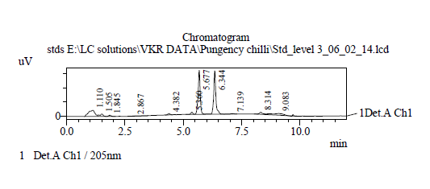
Chromatogram of capsaicinoid standards

Slide 12
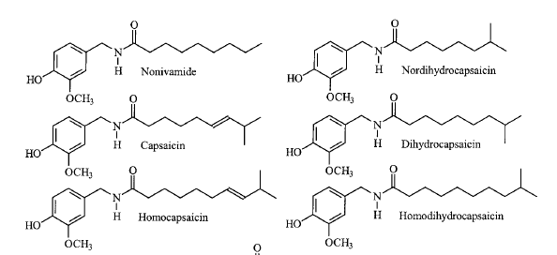
Capsaicinoids – pungency compounds
Capsaicin, Dihydrocapsaicin – account for 90-96 % of capsaicinoids
Notes:
Capsaicinoids are alkaloid compounds which are responsible for the hot flavour of chillies.

Slide 13
Total Capsaicinoids in Chilli Varieties
S. No. | Variety | Total capsaicinoids mg/g | SHU | Capsaicin % | Dihydro capsaicin % | CP/DC
1 | Arka Khyati | 0.1959 | 3295 | 66.6 | 34.4 | 1.9
2 | Arka Meghana | 2.111 | 33988 | 66 | 34 | 1.94
3 | Arka Swetha | 1.362 | 21928 | 65.8 | 34.2 | 1.92
4 | Arka Haritha | 4.1708 | 67151 | 61.1 | 38.9 | 1.57
5 | Arka Abhir | 0.1926 | 3101 | 60.4 | 39.6 | 1.52
6 | Arka Suphal | 0.4742 | 7636 | 66.5 | 33.5 | 1.98
7 | Arka Lohit | 1.9225 | 30954 | 62.4 | 37.6 | 1.66
8 | Andaman collection | 40.9646 | 941901 | 73.9 | 26.1 | 2.83
9 | Bhut Jalokia | 27.7312 | 493330 | 84.1 | 15.9 | 5.29
10 | Local Toom | 6.4686 | 104145 | 76.9 | 23.1 | 3.32
11 | Kerala Collection | 8.5754 | 141821 | 73.1 | 26.9 | 2.72
12 | Naga Chilli | 29.0245 | 623269 | 77.8 | 22.4 | 3.51
13 | Habanero | 11.6403 | 243932 | 74.9 | 25.1 | 2.98
Large variation in pungency levels (3101 to 9.4 million SHU) was observed. CP/DC ratio also varied from 1.52 to 5.29.

Slide 14
Variation in CP/DC ratio with pungency level

Slide 15
Total phenols and pungency
S. No | Variety | Pungency (SHU) | Total phenols (mg/g)
1 | Arka Khyati | 3295 | 8.4
2 | Arka Meghana | 33988 | 9
3 | Arka Swetha | 21928 | 8.7
4 | Arka Haritha | 67151 | 9
5 | Arka Abhir | 3101 | 8.7
6 | Arka Suphal | 7636 | 7.2
7 | Arka Lohit | 30954 | 9.3
8 | Andaman collection | 941901 | 33
9 | Bhut Jalokia | 493330 | 23
10 | Local Toom | 104145 | 14
11 | Kerala Collection | 141821 | 11
12 | Naga Chilli | 623269 | 22
13 | Habanero | 243932 | 19

Slide 16
Total phenols and pungency

Slide 17
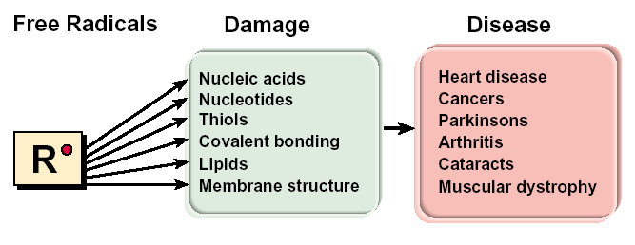
Free radicals in human body

Slide 18
Function of dietary antioxidants
Phytochemicals / antioxidants in diet
Neutralize free radicals
Prevent metabolic disorders /
delay the onset of symptoms

Slide 19
Antioxidant capacity
S. No | Variety | DPPH scavenging activity (mg/g AEAC units) | FRAP antioxidant capacity (mg/g AEAC units)
1 | Arka Khyati | 3.74 | 4.26
2 | Arka Meghana | 4.30 | 5.86
3 | Arka Swetha | 4.93 | 5.88
4 | Arka Haritha | 4.93 | 6.69
5 | Arka Abhir | 3.39 | 3.90
6 | Arka Suphal | 2.76 | 3.39
7 | Arka Lohit | 4.09 | 5.12
8 | Andaman collection | 35.15 | 51.26
9 | Bhut Jalokia | 19.92 | 26.75
10 | Local Toom | 8.88 | 11.93
11 | Kerala Collection | 6.79 | 9.24
12 | Naga Chilli | 24.39 | 32.71
13 | Habanero | 13.35 | 31.86

Slide 20
Comparison of antioxidant levels among varieties

Slide 21
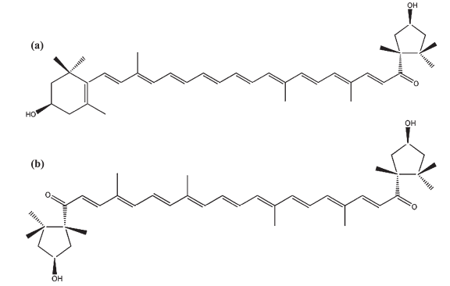
Carotenoid pigments in chillies
A. Red carotenoids
capsanthin
capsorubin

Slide 22
B. Yellow carotenoids
zeaxanthin
antheraxanthin
mutatoxanthin
Β-cryptoxanthin

Slide 23
Distribution of red and yellow carotenoids
S. No. | Variety | Red carotenoids (mg/100 g) | yellow carotenoids (mg/100 g) | Total corotenoids mg/100 g | Ratio (Red/Yellow)
1 | Arka Khyati | 147.0 | 109.7 | 256.7 | 1.3
2 | Arka Meghana | 119.6 | 94.9 | 214.5 | 1.3
3 | Arka Swetha | 130.8 | 145.7 | 276.4 | 0.9
4 | Arka Haritha | 80.7 | 65.5 | 146.1 | 1.2
5 | Arka Abhir | 154.8 | 113.1 | 267.9 | 1.4
6 | Arka Suphal | 125.7 | 98.7 | 227.8 | 1.3
7 | Arka Lohit | 87.3 | 38.8 | 126.2 | 2.2
8 | Andaman collection | 45.9 | 28.8 | 74.7 | 1.6
9 | Bhut Jalokia | 45.9 | 30.0 | 75.9 | 1.5
10 | Local Toom | 40.8 | 94.7 | 135.5 | 0.4
11 | Kerala Collection | 46.2 | 36.2 | 82.4 | 1.3
12 | Naga Chilli | 56.4 | 33.3 | 89.8 | 1.7
13 | Habanero | 4.1 | 2.7 | 6.9 | 1.5

Slide 24
Comparative levels of red and yellow carotenoids

Slide 25
Total carotenoids and pungency
S.No. | Variety | Total corotenoids mg/100 g | ASTA colour value | Pungency (SHU)
1 | Arka Khyati | 256.74 | 98 | 3295
2 | Arka Meghana | 214.48 | 82 | 33988
3 | Arka Swetha | 276.43 | 106 | 21928
4 | Arka Haritha | 146.12 | 56 | 67151
5 | Arka Abhir | 267.88 | 103 | 3101
6 | Arka Suphal | 227.77 | 87 | 7636
7 | Arka Lohit | 126.16 | 48 | 30954
8 | Andaman collection | 74.72 | 30 | 941901
9 | Bhut Jalokia | 75.88 | 30 | 493330
10 | Local Toom | 135.49 | 53 | 104145
11 | Kerala Collection | 82.37 | 32 | 141821
12 | Naga Chilli | 89.77 | 35 | 623269
13 | Habanero | 6.87 | 3 | 243932

Slide 26
Relation between total carotenoids and pungency

Slide 27
Vitamin C in Chilli varieties
S. No. | Variety | Vitamin C mg/100 g FW | Pungency SHU
1 | Arka Khyati | 77 | 3295
2 | Arka Meghana | 89.5 | 33988
3 | Arka Swetha | 113 | 21928
4 | Arka Haritha | 100 | 67151
5 | Arka Abhir | 172 | 3101
6 | Arka Suphal | 94 | 7636
7 | Arka Lohit | 179.5 | 30954
Pungency VS vitamin C

Slide 28
Principal component Analysis

Slide 29
Hierarchical Clustering
Hierarchical Clustering
Distance/Similarity Measure = Squared Euclidean Distance
Cluster Method = Nearest Neighbour

Slide 30
CONCLUSIONS
Large variation in pungency levels (3101 to 9.4 million SHU) was observed. CP/DC ratio also varied from 1.52 to 5.29
Total phenols correlated well with pungency levels.
Some of the varieties showed high antioxidant capacities as well as radical scavenging activities. Highly pungent varieties showed more antioxidant capacity.
Red capsaicinoids were more (up to 2.2 times) when compared to yellow ones except in one variety (local toom).
ASTA colour values varied widely from 3 to 106 among the varieties. It appears that there is a negative correlation between colour values and pungency.
Some of the varieties possessed high vitamin C content (179 mg/100 g FW)
Three distinct groups have appeared in PCA analysis indicating their similarity. PCA biplot indicates that values of all the parameters are positively correlated to each other except colour value.
Heirarchical clustering indicated that andaman collection is chemically different from all other varieties.

Slide 31
THANK YOU

