Slide 1
Exploratory Comparison of Credentialed Clinical Instructors’ and non-Credentialed Clinical Instructors’ Report of Frequency and Importance of Professional Behaviors in Clinical Education Affiliations.
Trent Jackman, PT, DPT, ACCE
Deanna Dye, PT, PhD
Idaho State University

Slide 2
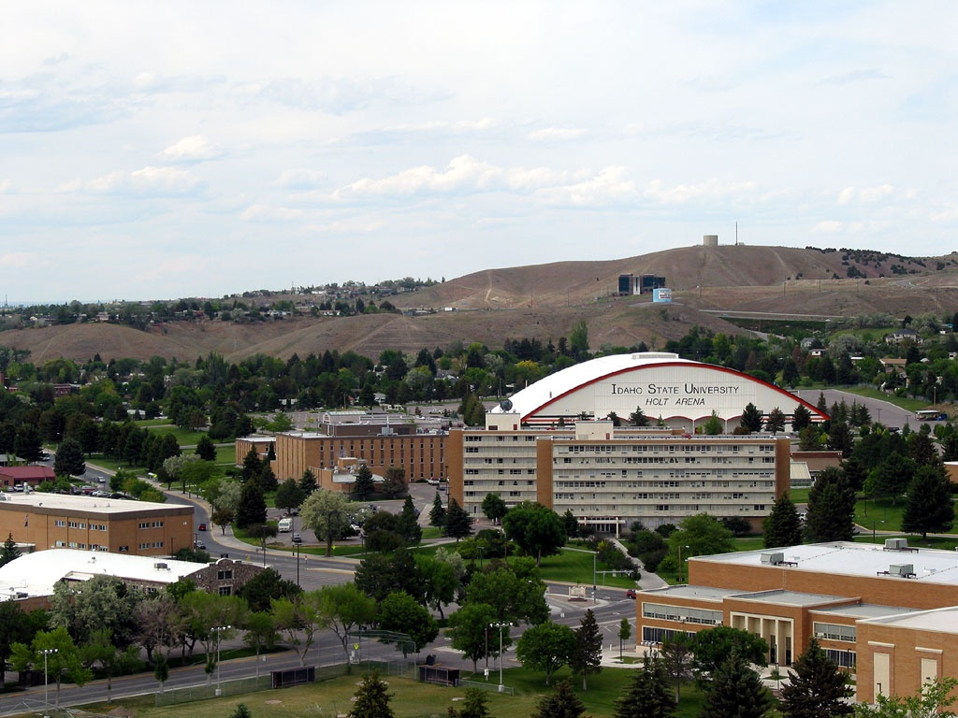

Slide 3
Disclosure
No conflict of interest

Slide 4
Overview
Purpose
Background
Methods
Results
Discussion
Conclusion

Slide 5
Purpose
Professional behavior characteristics are important to maximize student learning during clinical education affiliations. The purpose of this study was to explore the comparison of credentialed and non-credentialed clinical instructors’ report of importance and frequency of professional behaviors during clinical education affiliations.

Slide 6
Background
History of professional behavior in rehabilitation
Clinical experience is most important component of education. (Gaberson)
Emery studied importance and frequency of clinical teaching behaviors
Nursing Clinical Teacher Effectiveness Inventory (Morgan and Knox)
Ongoing development of professional behavior in teaching in clinical settings.

Slide 7
Background continued
Credentialed Clinical Instructor Program
American Physical Therapy Association
Credentialing program for health care providers to improve teaching skills
Plans and preparation to teach students
Develop skills of performance evaluation
Addresses legal implications for clinical educators

Slide 8
Subjects
Students
Clinical Instructors
Center Coordinators of Clinical Education

Slide 9
Methods
Used Emery’s statements.
Developed survey on Survey Monkey.
43 statements about professional behaviors
Electronically sent to 142 CIs/CCCEs and to 118 students
All levels of students and instructors

Slide 10
Methods
CI asked to self-report importance and frequency of each behavior
Student asked to report the importance of each statement and how frequently the CI demonstrated the behavior
5 point Likkert scale

Slide 11
Likkert Scale
Frequency
Always
Usually
Sometimes
Rarely
Never

Slide 12
Likkert Scale
Importance
Extremely Important
Very Important
Important
Somewhat Important
Not Important

Slide 13
Statements
4 categories
Communication behaviors
I am an active listener.
Interpersonal Relations behaviors
I am empathetic.
Professional Skills behaviors
I serve as an appropriate role model.
Teaching behaviors
I plan effective learning experiences.

Slide 14
Methods
Statistics
Descriptive
Means
Frequencies
Percentages

Slide 15
Results
60 CIs (42%) and 76 students (64%)
CIs most important characteristics:
Point out student performance discrepancies
Plans effective learning experiences
Perceives self as an extension of the academic program
Defines specific objectives for the experience

Slide 16
Results
Students most important characteristics:
CI points out performance discrepancies
CI is an extension of the academic program
CI demonstrates professional behavior
CI provides unique learning experiences
CI schedules regular meetings

Slide 17
Results
CIs highest frequency characteristics:
Questioning in a way to facilitate student learning
Providing a variety of patients
Pointing out discrepancies in student performance
Explaining the physiological basis of PT evaluation
Making yourself understood

Slide 18
Results
Students report of highest frequency CI behaviors:
Pointing out discrepancies in student performance
Questioning in a way that facilitates student learning
Explaining the physiological basis of PT evaluation
Providing unique learning experiences
Observing performance in a discreet manner

Slide 19
Discussion Importance
Both groups:
Greatest importance to:
Point out student performance discrepancies
Extension of academic program

Slide 20
Discussion Frequency
Both groups:
Pointing out discrepancies
Questioning that facilitates learning
Explaining the physiological basis of PT evaluation.

Slide 21
Discussion Differences
Differences:
Planning effective versus unique learning experiences
Providing a variety of patients
Observing in a discreet manner
CI manages time well

Slide 22
Discussion
Some areas that are considered important and have been frequently demonstrated per CI/student reports.
Some areas need change
Planning effective versus unique learning experiences.
Student wants CI to plan meetings
CIs need to recognize importance of observing in a discreet manner
CIs need to define specific objectives
CIs need to recognize demonstration of professional behavior.

Slide 23
Limitations
Due to the small sample size, and therefore low power, corrections for multiple comparisons were not applied.
No comparison of student to corresponding CI.

Slide 24
Future Research
Compare each student to respective CI using Mann Whitney U tests to evaluate specific details of comparison.

Slide 25
Conclusion
Need to better understand perceptions of CIs and students about professional behaviors in clinical education settings in order to improve student preparation for professional practice.

Slide 26
Acknowledgments
Deanna Dye
Students
Clinical Instructors
Center Coordinators
Teri Peterson
Conference Organizers

Slide 27
Questions?

Slide 28
Resources
Gaberson KB, Oermann MH. Clinical teaching strategies in nursing. 2nd ed. 2007; New York: Spriner Publishing.
American Physical Therapy Association. http://www.apta.org/CCIP/. Accessed July 7, 2016.
Emery M, Wilkinson CP. Perceived importance and frequency of clinical teaching behaviors: surveys of students, clinical instructors, and center coordinators of clinical education. J Phys Ther Educ. 1987;1:29-32.
Emery M. Effectiveness of the Clinical Instructor: Students’ Perspective. Phys Ther. 1984;64;7:1079-1083.
Moran J, Knox JE. Characteristics of ‘best’ and ‘worst’ clinical teachers as perceived by university nursing faculty and students. J of Adv Nursing. 1987;12:331-337.

