Slide 1
Efficacy of a novel bactericide for elimination of biofilm in food processing facilities
Tong Zhao
Center for Food Safety
University of Georgia
For 3rd International Conference and Exhibition on Food Processing & technology

Slide 2
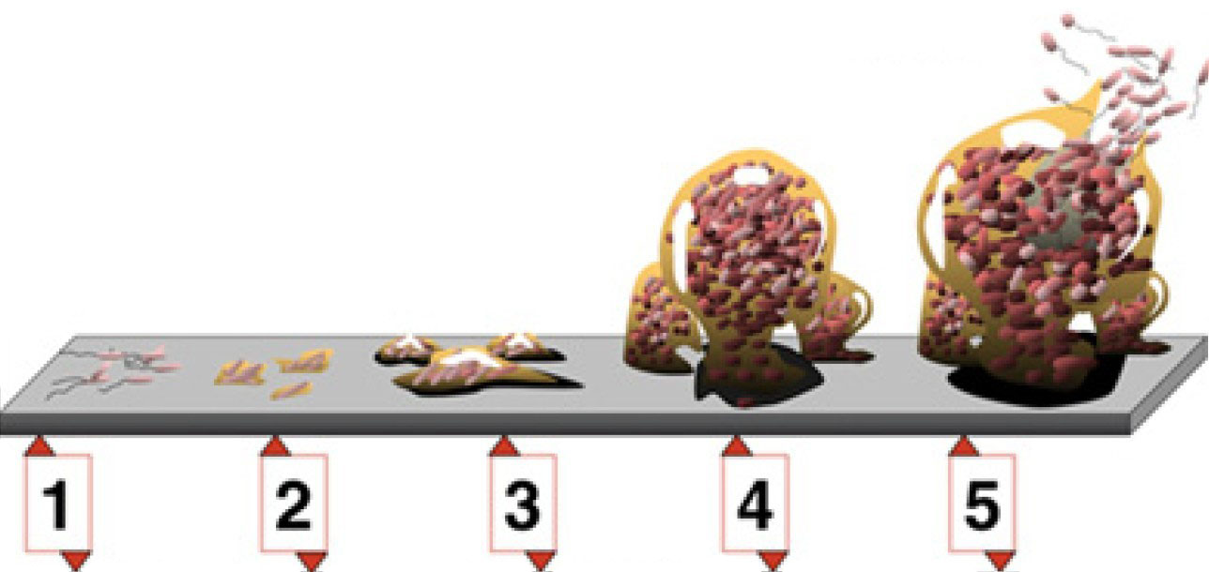
Biofilm
Biofilms are single or multi layers of microorganisms embedded in their own extracellular polymeric substances (EPS) which associate with a solid surface
1. Initial attachment
2. Irreversible attachment
3. Microcolony
4. Maturation
5. Dispersion

Slide 3
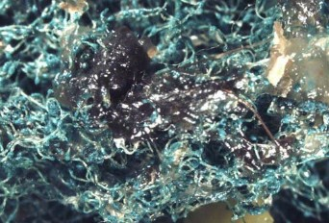
Biofilm
Predominant matrix for bacterial growth
~ 80% of all bacterial infections are biofilm-associated

Slide 4
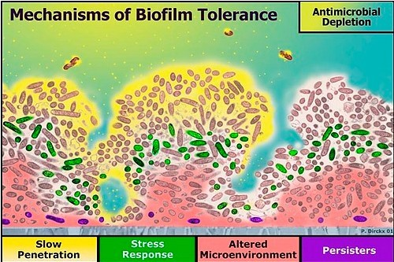
Problem
Cells in biofilms are more resistant to cleaning and disinfection processes than their planktonic counterparts
EPS
Slow growth
Gene expression

Slide 5
Development of a novel bactericide
Effective, easy-to-use, cost-efficient, and environmentally friendly.
Levulinic acid and sodium dodecyl sulfate (SDS) were tested in combination at different concentrations and temperatures (8 or 82°C) either as liquid or foam for their killing effects on human pathogens formed as biofilms.

Slide 6
Development of a novel bactericide
Effective, easy-to-use, cost-efficient, and environmentally friendly.
Levulinic acid and sodium dodecyl sulfate (SDS) were tested in combination at different concentrations and temperatures (8 or 82°C) either as liquid or foam for their killing effects on human pathogens formed as biofilms.

Slide 7
Development of a novel bactericide
U. S. Patent and Trademark Office. U.S. patent number 8,722,123. Issue date: May 13, 2014. Antimicrobial Composition and Use as Food Treatment.
More than 10 papers regarding its application on dental, produce, poultry, and meat have been published.
Marked by HealthPro Brands.

Slide 8
Results

Slide 9
Chemical Inactivation of S. Enteritidis on biofilm as a liquid at 21°C
Coupon material | Chemical solution | Salmonella Enteritidis counts (log CFU/cm2) at minutes
 |  | 0 | 1 | 2 | 5 | 10 | 20
Stainless steel | PBS, pH 7.2 | 8.0 | 8.4 | 8.5 | 8.6 | 8.2 | 8.1
 | Acidified sodium chlorite (500 ppm), pH 2.8 | 7.5 | 5.9 | 5.7 | 5.4 | 6.2 | 6.0
 | 3% levulinic acid plus 2% SDS, pH 3.0 | <0.7 | <0.7 | <0.7 | <0.7 | <0.7 | <0.7
Polyvinyl chloride | PBS, pH 7.2 | 8.8 | 9.0 | 8.1 | 8.8 | 8.0 | 8.3
 | Acidified sodium chlorite (500 ppm), pH 2.8 | 6.9 | 5.5 | 5.8 | 5.3 | 4.2 | 2.9
 | 3% levulinic acid plus 2% SDS, pH 3.0 | 2.3 | 1.7 | 2.0 | 2.2 | <0.7 | <0.7
Nitrile rubber | PBS, pH 7.2 | 7.8 | 8.0 | 8.5 | 7.7 | 7.9 | 7.7
 | Acidified sodium chlorite (500 ppm), pH 2.8 | 7.2 | 5.2 | 2.7 | 2.6 | 1.3 | <0.7
 | 3% levulinic acid plus 2% SDS, pH 3.0 | 4.1 | 1.7 | 1.7 | <0.7 | <0.7 | <0.7
Glass | PBS, pH 7.2 | 8.2 | 8.7 | 8.4 | 8.4 | 8.4 | 8.4
 | Acidified sodium chlorite (500 ppm), pH 2.8 | 6.8 | 3.3 | 0.7 | 0.7 | <0.7 | <0.7
 | 3% levulinic acid plus 2% SDS, pH 3.0 | <0.7 | <0.7 | <0.7 | <0.7 | <0.7 | <0.7
Ultra-high molecular weight polyethylene | PBS, pH 7.2 | 8.4 | 8.4 | 8.6 | 8.4 | 8.4 | 8.4
 | Acidified sodium chlorite (500 ppm), pH 2.8 | 6.8 | 6.1 | 2.1 | 0.7 | <0.7 | <0.7
 | 3% levulinic acid plus 2% SDS, pH 3.0 | <0.7 | <0.7 | <0.7 | <0.7 | <0.7 | <0.7

Slide 10
Inactivation of S. Enteritidis on biofilm by 3% levulinic acid plus 2% SDS as a foam at 21°C
Coupon material | Chemical solution | Salmonella Enteritidis counts (log CFU/cm²) at minutes
 |  | 0 | 1 | 2 | 5 | 10 | 20
Stainless steel | PBS, pH 7.2 | 7.3 | 7.7 | 8.0 | 7.2 | 8.0 | 7.3
 | 3% levulinic acid plus 2% SDS, pH 2.8 | 8.3 | 6.7 | 6.8 | 4.0 | 2.3 | 2.0
Polyvinyl chloride | PBS, pH 7.2 | 8.0 | 8.3 | 8.2 | 8.6 | 8.2 | 8.6
 | 3% levulinic acid plus 2% SDS, pH 2.8 | 5.8 | 4.9 | 3.1 | 3.0 | 3.2 | 1.0
Nitrile rubber | PBS, pH 7.2 | 7.4 | 7.6 | 7.6 | 7.5 | 7.4 | 7.2
 | 3% levulinic acid plus 2% SDS, pH 2.8 | 7.1 | 4.1 | 3.5 | 3.3 | 2.4 | 1.7
Glass | PBS, pH 7.2 | 8.0 | 8.5 | 7.7 | 7.9 | 7.8 | 7.9
 | 3% levulinic acid plus 2% SDS, pH 2.8 | 4.9 | 4.4 | 3.3 | 3.5 | 1.7 | 1.7
Ultra-high molecular weight polyethylene | PBS, pH 7.2 | 6.9 | 6.9 | 6.7 | 6.4 | 6.7 | 6.3
 | 3% levulinic acid plus 2% SDS, pH 2.8 | 5.4 | 4.6 | 2.9 | 2.3 | 1.7 | 1.7

Slide 11
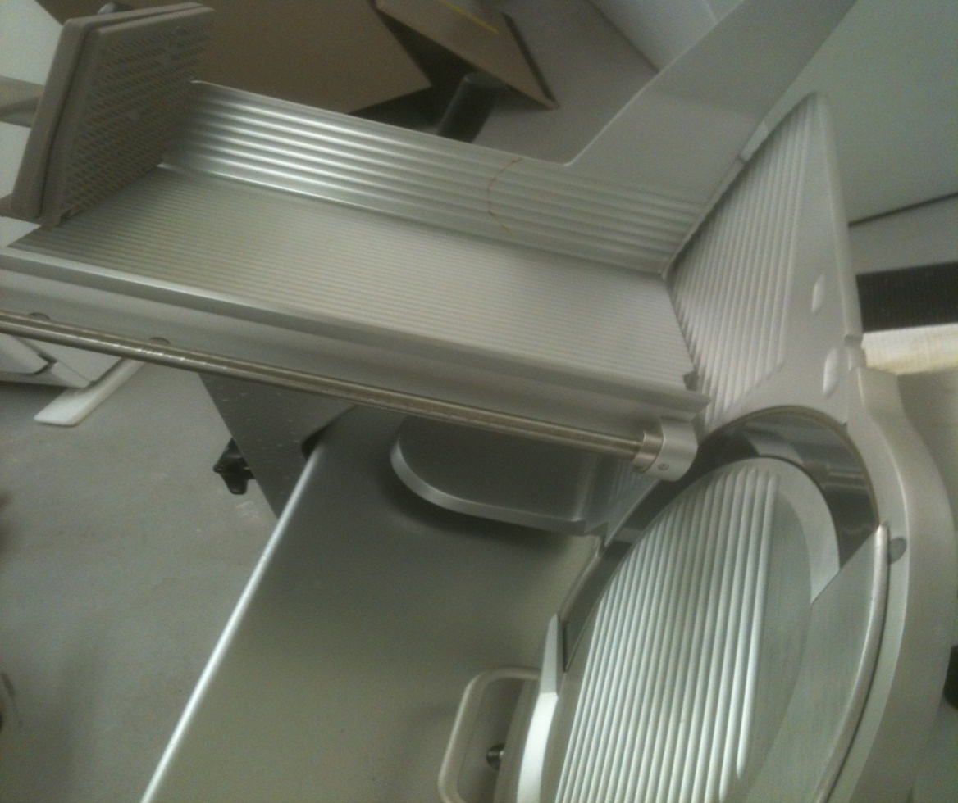

Slide 14
Before chemical treatment
The Salmonella isolation rate was 19% (19/100).
The fecal coliform population averaged 6.8 CFU/25 cm² log (ranged from 3 to 9.3 log CFU/25 cm²).
The total aerobic bacteria count averaged 7.9 log CFU/25 cm² (ranged from 5.7 to 9.9 log CFU/25 cm²).
After treatment with 3% levulinic acid plus 2% SDS as a foam
The Salmonella isolation rate was 1% (1/100).
The fecal coliform population averaged 1.15 log CFU/25 cm² (ranged from 0.6 to 3.1 log CFU/25 cm²), a 5.6 log CFU/25 cm² reduction.
The aerobic bacteria count averaged 4.8 log CFU/cm² (ranged from 1.6 to 7.5 log CFU/25 cm²), a 3.2 log reduction.

Slide 15
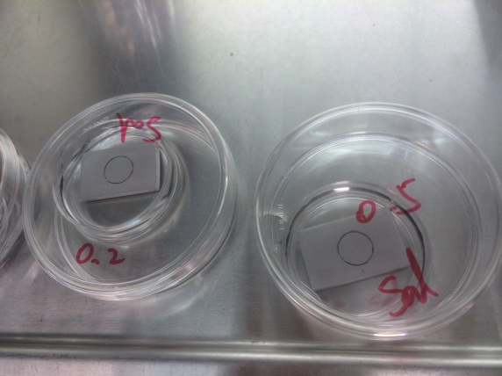
10-min Heat Treatment
60, 80, and 100°C
and / or
10-min Sanitizer Treatment
72 h
100% RH
21°C
QAC, 150 ppm quaternary ammonium-based sanitizer;
LA, 3% lactic acid;
SHC, 100 ppm sodium hypochlorite;
HP, 2% hydrogen peroxide;
LVA, 3% levulinic acid;
SDS, 2% sodium dodecyl sulfate
0.5% LVA + 0.05% SDS
1% LVA + 0.1% SDS
3% LVA + 2% SDS
Biofilm Growth

Slide 16
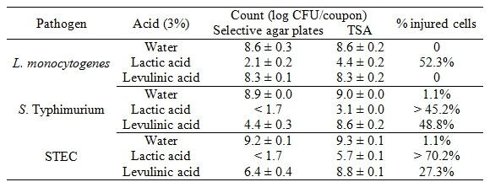
Acid Shock
Bacteria counts of selective agar plates and TSA of 72-h biofilms of L. monocytogenes, S. Typhimurium, and STEC formed on stainless steel after a 10-min treatment with 3% lactic acid (pH 2.2) or 3% levulinic acid (pH 2.7).

Slide 17
10-min Heat Treatment
*
*
*
*
*
*
*
*
Inactivation of 72-h biofilms of L. monocytogenes, S. Typhimurium, and STEC formed on stainless steel after receiving 10-min heat treatment at 21, 60, 80 or 100ºC.

Slide 18
80°C + Sanitizer Treatment
*
*
*
*
*
* * *
Inactivation of 72-h biofilms of L. monocytogenes, S. Typhimurium, and STEC formed on stainless steel after receiving a 10-min 80°C treatment and a subsequent 10-min sanitizer treatment.

Slide 19
10-min Sanitizer Treatment
*
*
*
*
*
*
*
*
*
*
*
*
*
*
*
*
* *
*
* * *
Inactivation of 72-h biofilms of L. monocytogenes, S. Typhimurium, and STEC formed on stainless steel after receiving a 10-min sanitizer treatment.

Slide 20
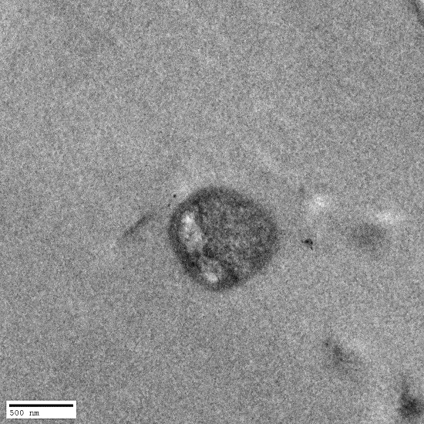
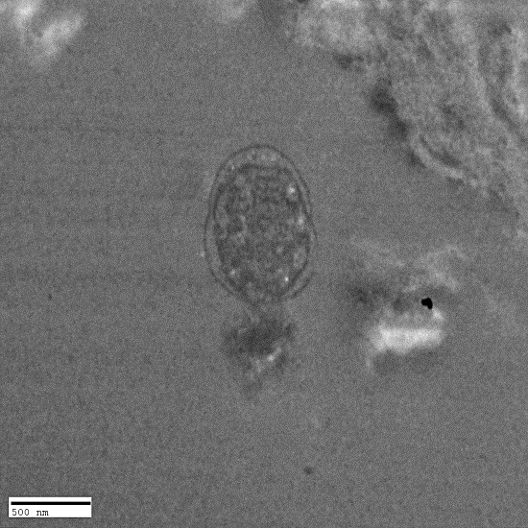
Representative images made by TEM of biofilms formed by Listeria monocytogenes (A, B), Salmonella (C, D), and STEC (E, F) after a 10-min treatment with water (control, A, C, E), and 0.5% levulinic acid + 0.05% SDS (B, D, F).

Slide 21
Representative images made by SEM of biofilms formed by Salmonella after a 10-min treatment with water (control, A), 0.5% levulinic acid + 0.05% SDS (B), 1% levulinic acid + 0.5% SDS (C), and 3% levulinic acid + 2% SDS (D).

Slide 22
Conclusions
All foodborne pathogens as tested, including E. coli O157:H7, Salmonella, L. monocytogenes have the potential to form the biofilms on the surface of materials that commonly used in the processing facilities.
Levulinic acid-based sanitizer either in liquid or in foam has strong ability to remove or eliminate the biofilms.

Slide 23
Acknowledgements
Michael P. Doyle, Dong Chen, Yen-con Hung, Ping Zhao, University of Georgia; and Juan F. DeVillena, Wayne Farms LLC, for his technical assistance.
This study was supported by grants from the Center for Food Safety, University of Georgia; the National Institute of Food and Agriculture, U. S. Department of Agriculture; and the State of Georgia’s Traditional Industries Program for Food Processing.

