Slide 1
Pediatric Oncology and Clinical Pediatrics
Toronto, Canada Aug 11, 2016
Improvement of
Karyomegalic Interstitial Nephritis
Three Years After Ifosfamide and
Cisplatin Therapy by Corticosteroid.
Tomokazu Matsuura
National Hospital Organization Tokyo Medical Center, Tokyo, Japan

Slide 2
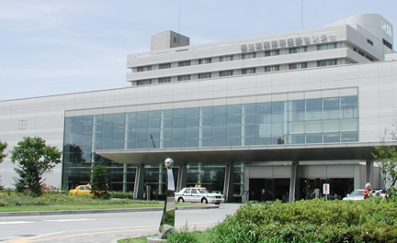
National Hospital Organization
Tokyo Medical Center

Slide 3
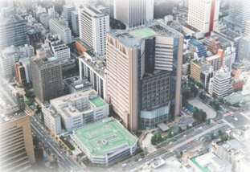
National Cancer Center Hospital, Tokyo, Japan

Slide 4
In recent years, survival outcomes for children cancers have significantly improved.
Childhood cancer survival rates have improved substantially over the last decades, leading to a 5-year survival of 80%.
（Siegel R et al. CA Cancer J Clin. 2012; 62: 220-241）
Knowledge of the long-term effects of childhood cancer treatments has become the focus of research.
In this presentation, I want to focus on late effects of chemotherapeutic agents on renal function in childhood cancer.

Slide 5
Dekkers IA et al. Long-term Nephrotoxicity in Adult Survivors Of Childhood Cancer. Clin J Am Nephrol. 2013; 8: 922-929.
Median follow-up time: 18.3 years
（range = 5.0 – 58.2）
Independent Variables | eGFR (ml/min per 1.73 m²) Adjusted Mean 95% CI p
No cisplatin | 101 | 89.00; 113.00
Cisplatin ≦ 450 | 104 | 88.00; 120.00 | 0.54
Cisplatin > 450 | 83 | 66.00; 100.00 | 0.004
No ifosfamide | 98 | 85.00; 112.00
Ifosfamide ≦16,000 | 102 | 86.00; 117.00 | 0.42
Ifosfamide > 16,000 | 88 | 73.00; 103.00 | 0.02
No carboplatin | 94 | 81.00; 106.00
Carboplatin treatment | 98 | 81.00; 115.00 | 0.50
No cyclophosphamide | 96 | 82.00; 110.00
Cyclophosphamide≦3500 | 96 | 83.00; 110.00 | 0.98
Cyclophosphamide>3500 | 95 | 81.00; 109.00 | 0.74
No methotrexate | 97 | 84.00; 110.00
Methotrexate treatment | 95 | 81.00; 109.00 | 0.36

Slide 6
Review article
Jones DP et al. Renal late effect in patients treated for cancer in childhood : a report from the Children’s Oncology Group. Pediatr Blood Cancer. 2008; 51: 724-731.
Ifosfamide may cause permanent and potentially
progressive kidney damage.
- The outlook for long-term recovery or stability of renal function
caused by cisplatin is generally favorable.
Methotrexate-induced nephrotoxicity appears to be entirely
reversible.

Slide 7
Late renal adverse effect induced by ifosfamide has been reported in several articles.
- Skinners et al. reported that 13% of patients suffered glomerular
toxicity (GFR < 60 mL/min/1.73m2) ten years after ifosfamide
treatment in childhood.
(Skinner R et al. Pediatr Blood Cancer. 2010; 54: 983-989.)
- Prasad et al. reported that 17.1% of children underwent glomerular
dysfunction appeared to be causally linked to ifosfamide within
a median follow-up of 29 months (range 9-135).
(Prasad VK et al. Med Pediatr Oncol. 1996; 27: 149-155.)
- A follow-up study in 75 patients who had completed ifosfamide
treatment found that subclinical damages developed in the first 2 years
after completion of treatment.
(Rossi et al. Med Pediatr Oncol. 1999; 32: 177-182.)

Slide 8
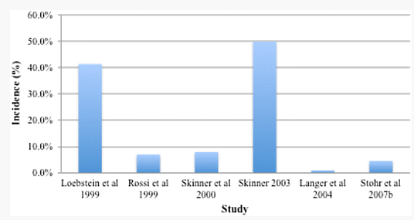
O’Sullivan D et al. Late effects of chemotherapeutic agents on renal function in childhood cancer survivors: a review of the literature.
Ir J Med Sci. 2016
Comparison of variations in reported incidence of
Ifosfamide induced nephrotoxicity by study

Slide 9
References | Screening parameters for ifosfamide induced nephropathy
Loebstein et al.(1) | glomerular filtration rate (GFR), serum phosphate, urine protein and glucose concentrations
Rossi et al.(2) | creatine clearance, fractional phosphate reabsorption, percent amino acid and glucose reabsorption, fractional sodium excretion
Skinner et al.(3) | GFR, serum bicarbonate, phosphate, renal tubular threshold for phosphate
Skinner et al.(4) | GFR, serum bicarbonate, renal tubular reabsorption of phosphorus
Langer et al.(5) | creatinine clearance, fractional phosphate reabsorption, proteinuria, glucosuria
Stohr et al.(6) | serum phosphate, bicarbonate, magnesium, creatinine concentrations, urine protein, glucose, creatinine and phosphate concentrations, hematuria
(1) Loebstein R et al. Risk factors for long-term outcome of ifosfamide-induced nephrotoxicity in children. J Clin Pharmacol. 1999; 39(5): 454-461.
(2) Rossi R et al. Development of ifosfamide-induced nephrotoxicity: prospective follow-up in 75 patients. Med Pediatr Oncol. 1999; 32(3): 177-182.
(3) Skinner R et al. Risk factors for nephrotoxicity after ifosfamide treatment in children: a UKCCSG Late Effects Group study.
United Kingdom Children’s Cancer Study Group. Br J Cancer. 2000; 82(10): 1636-1645.
(4) Skinner R. Chronic ifosfamide nephrotoxicity in children. Med Pediatr Oncol. 2003; 41(3): 190-197.
(5) Langer T et al. Late effects surveillance system for sarcoma patients. Pediatr Blood Cancer. 2004; 42(4): 373-379.
(6) Stohr W et al. Ifosfamide-induced nephrotoxicity in 593 sarcoma patients: a report from the Late Effects Surveillance System.
Pediatr Blood Cancer. 2007; 48(4): 447-452.

Slide 10
Potential risk factors for persistent nephrotoxicity
Induced by ifosfamide.
References | Reported risk factors
Loebstein et al. (1) | Children < 3 years of age at time of treatment Cumulative ifosfamide doses (> 45 g/m²)
Skinner et al. (2) | High cumulative ifosfamide doses (> 119 g/m²)
Skinner (3) | Children <3 years of age at time of treatment Cumulative ifosfamide doses (>80 g/m²) Previous or concurrent cisplatin Previous unilateral nephrectomy Pre-existing renal impairment or tumor invasion
Stohr et al. (4) | High cumulative dose of ifosfamide Children <4 years of age at time of diagnosis
Loebstein R et al. Risk factors for long-term outcome of ifosfamide-induced nephrotoxicity in children.
J Clin Pharmacol. 1999; 39(5): 454-461.
(2) Skinner R et al. Risk factors for nephrotoxicity after ifosfamide treatment in children: a UKCCSG Late Effects Group study.
United Kingdom Children’s Cancer Study Group. Br J Cancer. 2000; 82(10): 1636-1645.
(3) Skinner R. Chronic ifosfamide nephrotoxicity in children. Med Pediatr Oncol. 2003; 41(3): 190-197.
(4) Stohr W et al. Ifosfamide-induced nephrotoxicity in 593 sarcoma patients: a report from the Late Effects Surveillance System.
Pediatr Blood Cancer. 2007; 48(4): 447-452.

Slide 11
Clinical manifestation of ifosfamide-induced nephrotoxicity
Proximal tubular toxicity
Fanconi’s syndrome including:
Urinary loss of glucose, amino acids and low molecular mass proteins
Phosphaturia, Hypophosphatemic rickets, Kaluria, Hypokalemia
Bicarbonaturia, Proximal renal tubular acidosis
Glomerular toxicity
Reduced GFR, Increased serum urea and creatinine concentration
Chronic renal failure
Distal tubular toxicity
Nephrogenic diabetes insipidus
Distal renal tubular acidosis
Nephrotoxicity most commonly manifests as proximal tubule damage.
Glomerular toxicity is normally secondary to that of tubular.
(Prasad VK et al. Med Pediatr Oncol. 1996; 27: 149-155)

Slide 12
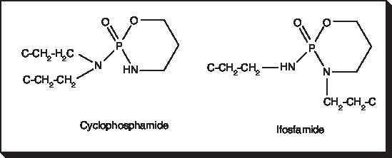
Ifosfamide is almost identical in structure to Cyclophosphamide, varying only in the position of one chloroethyl group.
Nephrotoxicity: ifosfamide > cyclophosphamide

Slide 13
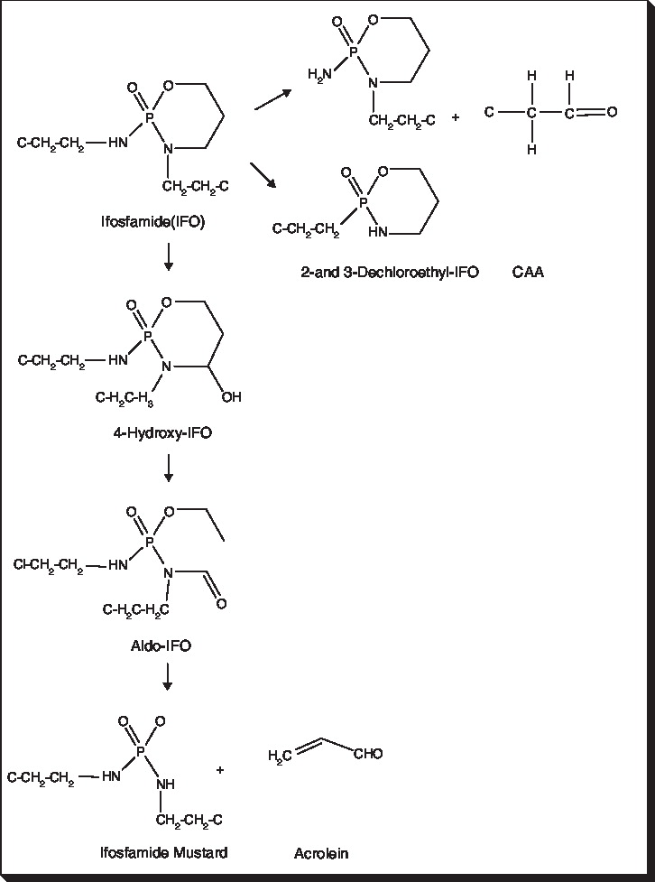
50%
Nephrotoxic agent
(cyclophosphamide: 10% )
Ifosfamide metabolism
Active cytotoxic agent
Urotoxic agent

Slide 14
Nephrotoxicity: ifosfamide(IFO) > cyclophosphamide(CF)
(The metabolite of both of them, chloroacetaldehyde (CAA),
is responsible for nephrotoxicity.)
Reason: (Hanly L et al. Expert Opin Drug Saf. 2009; 8(2): 155-168)
Up to 50% of IFO metabolism occurs through the side chain
pathway producing CAA,
although it only accounts for 10% of metabolism in CF.
(2) IFO requires a greater therapeutic dose to produce
the same amount of alkylating agent
when compared to CF.
→ This leads to CAA quantities that are as much as 100-fold higher with IFO than the amounts being produced from CF.

Slide 15
CAA (chloroacetaldehyde)
- Local renal production of CAA can be responsible for
IFO-induced nephrotoxicity.
- Tubular epithelial CYP2B6 can inactivate IFO to release CAA.
(Goren MP et al. Lancet. 1986; 2(8517): 1219-1220)
- High concentrations of CAA lead to
depletion of intracellular glutathione and ATP levels,
resulting in impaired tubular epithelial cell function
and acute injury.
(Lind MJ et al. Biochem Pharmacol 1989; 38(11): 1835-1840)
(Yassen Z et al. Arch Toxicol. 2008; 82(9): 607-614)

Slide 16
In most patients, ifosfamide-induced decreased
kidney function is temporary, and kidney function
appears to normalize upon cessation of therapy.
Rarely, the ifosfamide-related kidney injury is
progressive, leading to end-stage kidney disease.
(Akilesh S et al. Am J Kidney Dis. 2014; 63(5): 843-850)
Long –term nephrotoxicity of ifosfamide is notorious.

Slide 17
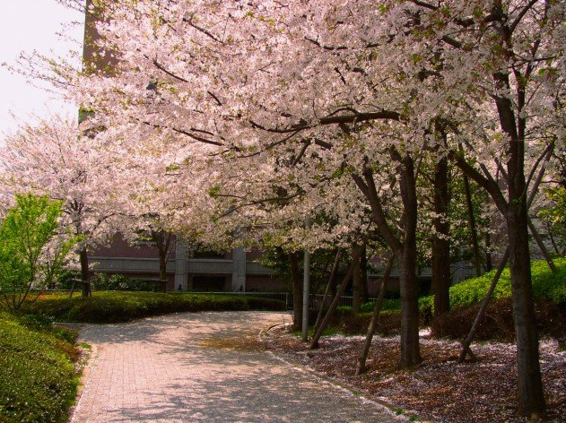

Slide 18
【Case Report】
A 15-year-old boy was referred to our hospital
because of the gradual deterioration of renal function.
He used to be diagnosed with osteosarcoma of the left femur treated with systemic chemotherapy.
（cisplatin, doxorubicin, high dose-methotrexate, ifosfamide）
along with surgical excision in May, 2009.
Treatment was complete in November, 2009,
at that time his serum creatinine level was 0.8 – 1.0 mg/dL.
His serum creatinine level had gradually increased to
3.23 mg/dL until July, 2012.
( 3 years after completion of chemotherapy)

Slide 19
- He had no history of hypertension and diabetes mellitus.
- CT scan showed normal-sized kidneys with no hydronephrosis.
No metastases were found on subsequent radiological stating
Cumulative dose of ifosfamide was 69.7 g/m².
(High cumulative dose)
Reported risk factor of cumulative dose of ifosfamide
> 45 g/m² (Loebstein R et al. J Clin Pharmacol. 1999; 39(5): 454-461)
> 60 g/m² (Hanly L et al. Expert Opin Drug Saf. 2009; 8: 155-168)
> 80 g/m² (Skinner R. Med Pediatr Oncol. 2003; 41(3): 190-197)
> 119 g/m² (Skinner R et al. Br J Cancer. 2000; 82(10): 1636-1645)

Slide 20
《 Laboratory findings at renal biopsy 》
Urinalysis
S.G. 1.005
pH 5.5
Protein (2+)
1.10 g/day
Glucose (2+)
Occult blood (+)
Urinary sediment
RBC 1-4/HPF
WBC 1-4/HPF
Peripheral blood
WBC 5,400/μL
Neutro 55.2 %
Lymph 28.9 %
Mono 14.8 %
Baso 0.4 %
Eosino 0.7 %
RBC 464 x 10⁴/μL
Hgb 13.4 g/dL
PLT 16.0 x 10⁴/μL
Blood chemistry
TP 7.6 g/dL
ALB 4.9 g/dL
TB 0.6 mg/dL
LDL-C 57 mg/dL
BS 90 mg/dL
BUN 25.3 mg/dL
Cr 3.51 mg/dL
UA 4.3 mg/dL
Na 136.9mEq/L
K 2.9 mEq/L
Cl 99 mEq/L
Ca 9.8 mg/dL
IP 3.3 mg/dL
GOT 20 IU/L
GPT 8 IU/L
LDH 191 IU/L
CRP 0.18 mg/dL
HgbA1c 5.3 %
Coagulation system
PT-INR 1.04
IgG 1173 mg/dL
IgA 246 mg/dL
IgM 90 mg/dL
C3 95 mg/dL
C4 31 mg/dL
CH-50 50.4 U/mL
RPR (-)
TPHA (-)
HCV-Ab (-)
HBs-Ag (-)
HBs-Ab (-)
RF (-)
ANA < 40 x
Anti-dsDNA-Ab (-)
PR3-ANCA (-)
MPO-ANCA (-)
Anti-GBM-Ab (-)
Cryoglobulin (-)

Slide 21
《 Clinical course 》
1 / Creatinine
His renal function
continued to deteriorate
3 years after completion
of chemotherapy.
What kind of therapy
was appropriate?
year/month/day

Slide 22
His clinical findings:
• Progressive renal dysfunction
• Fanconi syndrome
(glucosuria with normal serum glucose,
aminoaciduria, phosphaturia,
metabolic acidosis)

Slide 23
《 Renal biopsy 》
• Of 34 glomeruli,
18 were global sclerotic, 1 was segmental sclerotic, and 2 were collapsed.
Thirteen other glomeruli were almost normal.
•There was severe tubular degeneration
and interstitial inflammation. (A)
• Interstitial fibrosis was observed in about 50% of cortical area.
• Among infiltrate lymphocytes, CD3+(T lymphocytes) were dominant. (B)
• The foci of Ki-67-positive epithelia were scattered,
and this implied the regenerative changes in renal tubular epithelium.

Slide 24
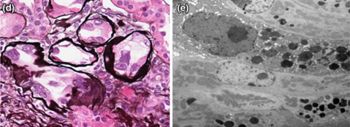
• Marked nuclear cytomorphological change was apparent. (d)
(The form of variably sized nuclei, some of which were massively
enlarged, vesicular, irregular shaped and bizarre-appearing)
→ Karyomegalic interstitial nephritis
• No viral inclusion was identified. (e)

Slide 25
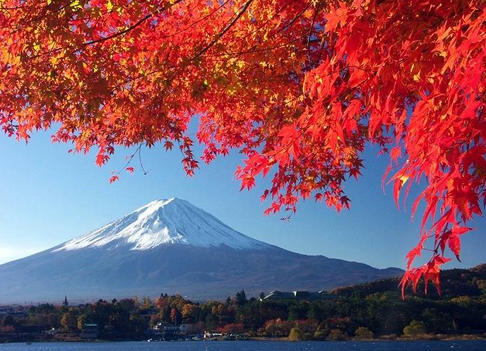

Slide 26
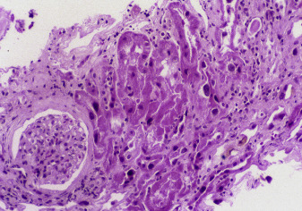
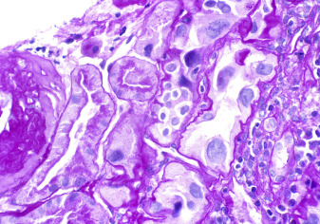
Karyomegalic interstitial nephritis
Karyomegalic nephropathy is characterized by focal marked enlargement of tubular epithelial cells with prominent nuclei and nucleoli. There is associated chronic interstitial nephritis.
(Fogo AB et al. Am J Kidney Dis. 2016; 68(1): e7)

Slide 27
Karyomegalic interstitial nephritis
Karyomegalic interstitial nephritis is sometimes regarded as the heredity disease.
(Spoendlin M et al. Am J Kidney Dis. 1995; 25: 242-252)
In this case, there were no sign of renal dysfunction and
Fanconi’s syndrome at least before the initiation of the
chemotherapy.
Thus, we speculated that karyomegalic interstitial nephritis
was induced by the chemotherapy.

Slide 28
Histology of ifosfamide-induced late nephropathy
Author | Age/Sex | Malignancy | Histology
Morland BJ | 5/M | Rhabdomyosarcoma | Interstitial inflammation, Hyperplastic epithelial cells
Morland BJ | 5/F | Rhabdomyosarcoma | Focal inflammation at corticomedullary junction
McCulloch T | 15/M | Ewing sarcoma | Karyomegalic-like features with large atypical tubular epithelial cell nuclei, flattering, severe interstitial fibrosis, tubular atrophy, mild inflammatory infiltrate
McCulloch T | 13/F | Ewing sarcoma
McCulloch T | 14/F | Ewing sarcoma
Friedlaender MM | 33/M | Rhabdomyosarcoma | Severe interstitial fibrosis and tubular atrophy
Berns JS | 60/M | Malignant fibrous histiocytoma | Diffuse tubulointerstitial damage with degenerative/regenerative changes
Berns JS | 56/M | Osteogenic sarcoma | Moderate tubulointerstitial fibrosis, Mild interstitial inflammation
Willemse PH | 62/F | Ovarian carcinoma | Focal tubular atrophy, diffuse Interstitial fibrosis

Slide 29
Treatment of ifosfamide-induced nephrotoxicity
• McCulloch et al. prescribed corticosteroids to ifosfamide-induced chronic
interstitial nephritis, without noticeable effect.
(McCulloch T et al. Pediatr Nephrol. 2011; 26: 1163-1166)
• Morland et al. speculated on the possible effect of steroid in ifosfamide
-induced nephrotoxicity.
They, however, did not use steroid because the renal function was stable
after renal biopsy.
(Morland BJ et al. Med Pediatr Oncol. 1996; 27: 57-61)
→ In spite of the global sclerosis in 60% of glomeruli
and the interstitial fibrosis in 50% of the cortical area,
we decided to prescribe corticosteroid to treat
the active interstitial nephritis.

Slide 30
Prednisolone apparently improved
the course of renal function.
1 / Creatinine
prednisolone
10mg
20mg
This is the first case that corticosteroid was possibly effective for the long-term nephrotoxicity after the completion of the ifosfamide therapy.
year/month/day

Slide 31
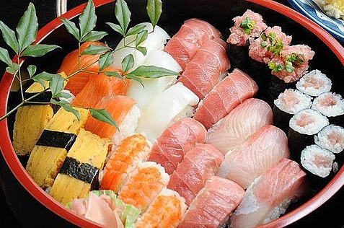

Slide 32
【Conclusion】
• Long-term nephrotoxicity of ifosfamide is notorious.
• We reported a case of a 15-year-old boy presented with
progressive nephrotoxicity 3 years after systemic
chemotherapy with ifosfamide and cisplatin.
• Karyomegalic chronic interstitial nephritis must be induced
by the treatment of ifosfamide.
There is a possibility that cisplatin may have a synergetic
effect with ifosfamide for producing karyomegalic
interstitial nephritis.
• Our case can provide a novel therapeutic choice,
corticosteroid, against the progressive nephrotoxicity
several years after the ifosfamide therapy.

